Slide 1
Module 9: Tree-Based Methods
Content based on ISLR Chapter 8

Slide 2
Module 8 Outline
Decision Trees
Forests
Gradient Boosting

Slide 3
Decision Trees

Slide 4
Introduction
Classic modeling technique that goes back to the 1980s
Fundamentally different from most other techniques which involve fitting some sort of function to the data
Instead, it involves successively partitioning the data according to some sort of “purity” criteria
Trying to break up the data space so that the components of the data are a similar as possible
Can be used for both continuous and categorical targets
Commonly referred to as Classification and Regression Trees (CART)
Approach is to partition the predictor space into several “regions”
For classification trees, final prediction is the mode of the training observations in the region
For regression trees, final prediction is the mean of the training observations in the region

Slide 5
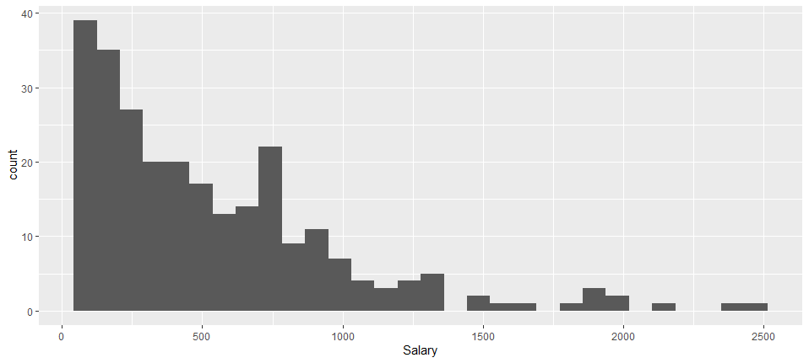
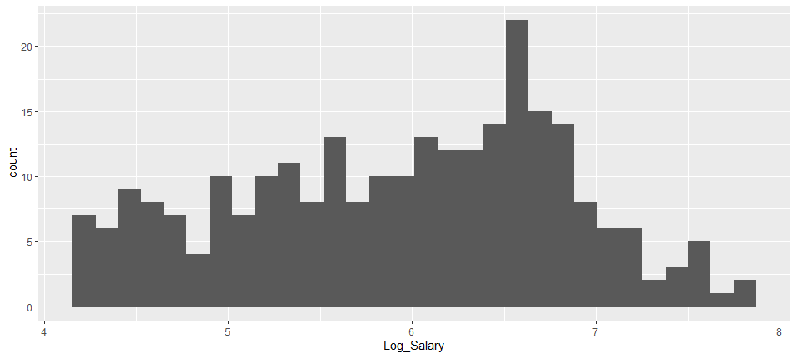
Regression Tree Example – Baseball Example
We wish to use a regression tree to model a baseball player’s salary based on the number of years played in the major league and the number of hits during the previous year.
Normality is an assumption for many statistical methods. Salary appears to be heavily right-skewed. Salary
Taking the log compresses the scale of a right-skewed distribution making it approximately normal so we use this in our model.

Slide 6
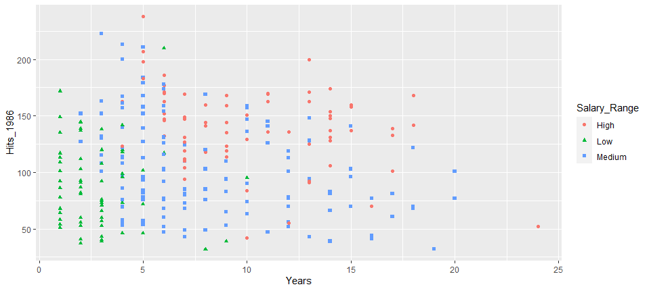



Partitioned Predictor Space
$$R_{3}$$
$$R_{1}$$
$$R_{2}$$

Slide 7
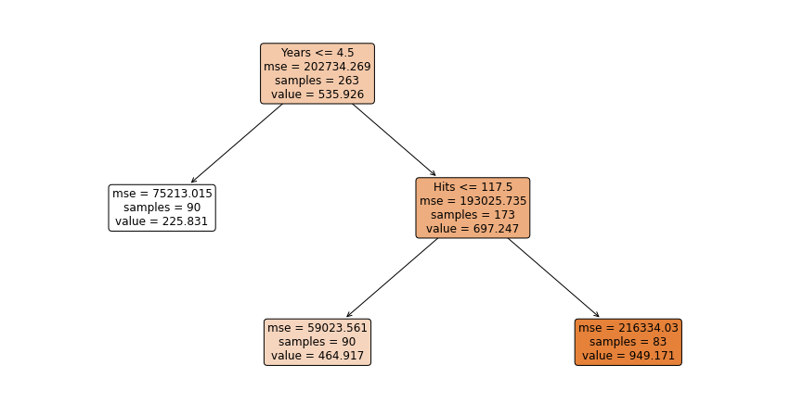
Interpretation
For less experienced players, the number of hits in the previous year does not have much effect on their salary.
For more experienced players, having more hits the previous year leads to higher salaries.
While regression trees are not the most powerful predictive model in terms of accuracy, they are easy to interpret and have a nice graphical representation.

Slide 8
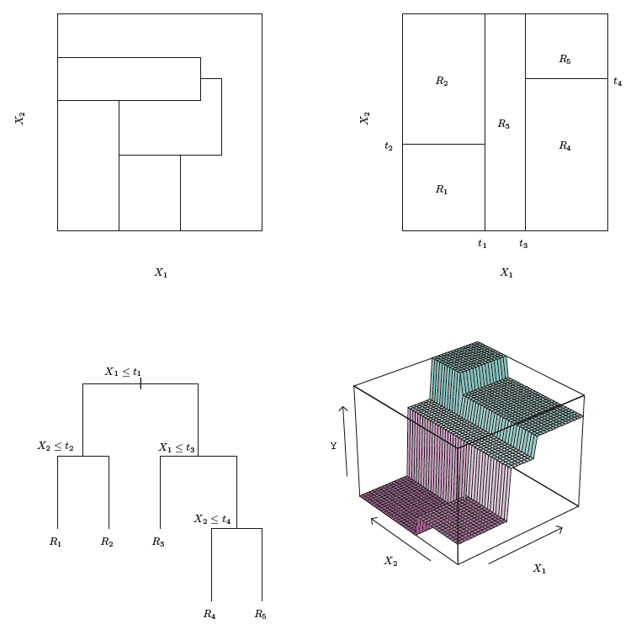
Making Predictions
For continuous targets, we predict the response for a given observation using the mean of the training observations in the region to which that test observation belongs.
Tree corresponding to this splitting
Perspective plot of prediction surface corresponding to this tree
Sample output of recursive binary splitting on a two-dimensional example.

Slide 9
Classification Trees
Very similar to a regression tree, except that it is used to predict a qualitative response rather than a quantitative one.
For a classification tree, we predict that each observation belongs to the most commonly occurring class, or the mode, of training observations in the region to which it belongs.

Slide 10
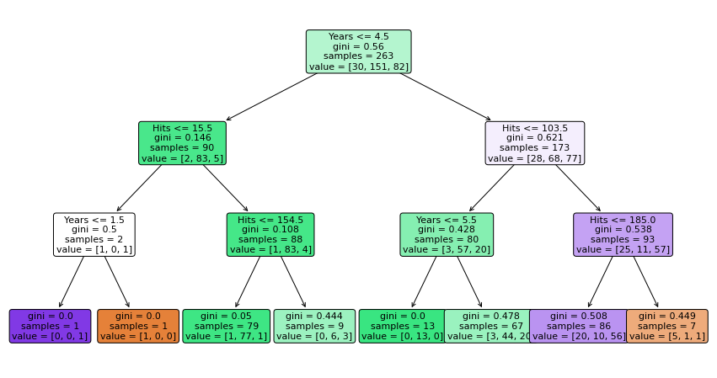
Classification Tree
Baseball Hitters Example

Slide 11
Terminology
Baseball Hitters Example
Internal Nodes
“Leaf Nodes” or “Terminal Nodes”

Slide 12
Constructing Trees

Slide 13
Constructing Trees
Objective
The objective in constructing trees is to divide the "predictor space" – the n-dimensional space of all possible values of all n predictors – into non-overlapping regions that are as "pure" as possible with regards to the target attribute.
Key questions:
How to define "purity"?
How and where to draw the boundaries?
How many regions should we split the predictor space into?

Slide 14
Constructing Trees
Variants of Trees
Details of algorithm depends on two factors
Attribute types
Binary
Nominal
Ordinal
Continuous
Split types
2-way split
Multi-way split

Slide 15




Constructing Trees
Defining Purity
Numerical target attribute
Residual sum of squared differences:
Categorical target attribute
Classification error rate:
Gini index:
Entropy:
Proportion of observations in region m from k^{th} class
$$E=1 −max⁡({\hat{p}}_{mk})$$
$$\sum_{j=1}^{J}{\sum_{i∈R_{j}}{{(y_{i} − {\hat{y}}_{R_{j}})}^{2}}}$$
$G=\sum_{k=1}^{K}{{\hat{p}}_{mk}}(1−{\hat{p}}_{mk}$)
Average target attribute for elements in the region
$$D=−\sum_{k=1}^{K}{{\hat{p}}_{mk}}\log{{\hat{p}}_{mk}}$$

Slide 16
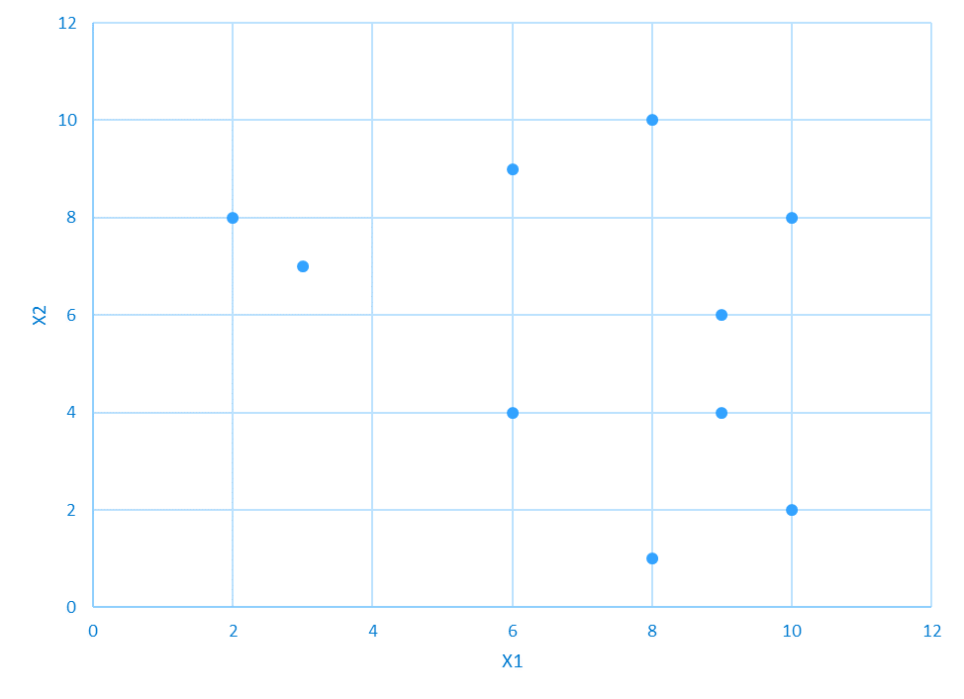
Calculating "Purity"
From visual inspection, where would you draw a line (horizontally or vertically) to achieve maximum purity?
123
160
138
114
188
118
166
110
102
120

Slide 17




Calculating "Purity"
$$\sum_{j=1}^{J}{\sum_{i∈R_{j}}{{(y_{i} − {\hat{y}}_{R_{j}})}^{2}}=}$$
123
160
138
114
188
$$R_{1}$$
$$4156.8+614.8=4771.6$$
118
$$R_{2}$$
166
110
102
120

Slide 18



Calculating "Purity"
$$R_{1}$$
$$R_{2}$$
$$\sum_{j=1}^{J}{\sum_{i∈R_{j}}{{(y_{i} − {\hat{y}}_{R_{j}})}^{2}}=}$$
123
160
138
114
188
118
$$1268+291.5=1559.5$$
166
110
102
120

Slide 19










Calculating "Purity"
$$Classification Error Rate$$
$$R_{1}$$
Max(${\hat{p}}_{1k})=1−$ 0.66 = 0.33
B
B
Max(${\hat{p}}_{2k})=1−$ 0.75 = 0.25
C
B
A
$$Gini Index$$
B
$$G_{1}=\left(\frac{1}{6}\right)\left(\frac{5}{6}\right)+\left(\frac{1}{6}\right)\left(\frac{5}{6}\right)+\left(\frac{4}{6}\right)\left(\frac{2}{6}\right)$$
A
A
$$R_{2}$$
$$G_{2}=\left(\frac{1}{4}\right)\left(\frac{3}{4}\right)+\left(\frac{3}{4}\right)\left(\frac{1}{4}\right)$$
B
A
$$Entropy$$
$$D_{1}=−(2∗\left(\frac{1}{6}\right)log\left(\frac{1}{6}\right)+$$ $\left(\frac{4}{6}\right)$ $log\left(\frac{4}{6}\right))$

Slide 20
How and Where to Draw Boundaries
For simplicity and ease of interpretation and computation, we limit our selection of regions to boxes (not circles or other non-linear boundaries.
123
160
138
114
188
118
166
110
102
120

Slide 21
Where and How to Draw Boundaries
Tree Building Algorithm
It is computationally infeasible to consider every possible partition of the feature space.
Standard algorithm is known as recursive binary splitting
Begin at the top of the tree and successively split the predictor space into two new branches resulting in the highest overall purity of the nodes
Repeat using one of the regions based on overall purity until a stopping condition is reached (see next section)
This algorithm is referred to as a "greedy" algorithm because it makes locally optimum choices instead of searching for a global optimum

Slide 22
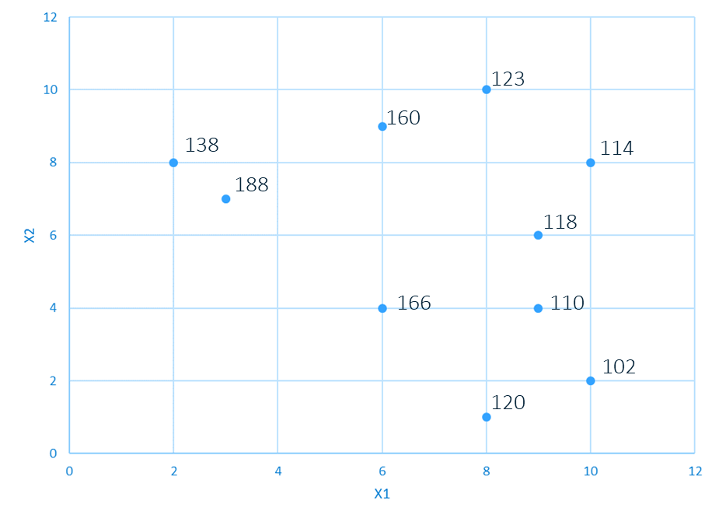
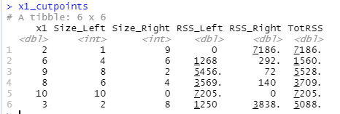
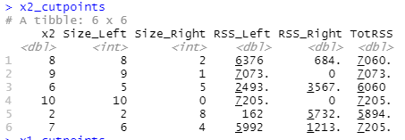


Example
Find First Cutpoint
$$R_{1}$$
$$R_{2}$$
Candidate Cutpoints
$$RSS= 1268$$
$$RSS=292$$
Total RSS before cut: 7205
Total RSS after cut: 1268 + 292 = 1560

Slide 23
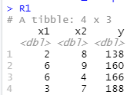
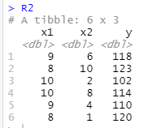
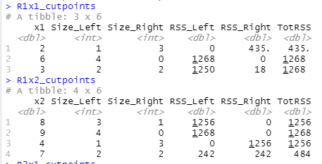
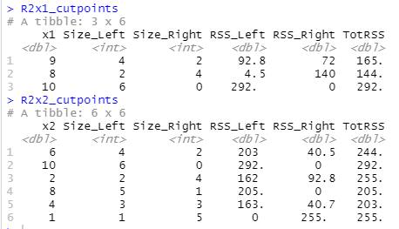


Example
Find Second Cutpoint
Candidate Cutpoints
$$R_{1}$$
$$R_{2}$$
$$RSS=242$$
$$RSS=292$$
$$RSS=242$$
Total RSS before cut: 1560
Total RSS after cut: 242 + 242 + 292 = 776
Note: if we had selected the R1X1 cutpoint of 2, the total RSS after cut would have been 435 + 242 + 292 = 969

Slide 24

Example
Find Third Cutpoint
Candidate Cutpoints
$$R_{1}$$
$$R_{2}$$
$$RSS=242$$
$$RSS=4.4$$
$$RSS=140$$
$$RSS=242$$
Total RSS before cut: 776
Total RSS after cut: 242 + 242 + 4.4 + 140 = 628

Slide 25
Example
Find Fourth Cutpoint
Candidate Cutpoints
$$R_{1}$$
$$R_{2}$$
$$RSS=242$$
$$RSS=4.4$$
$$RSS=8$$
$$RSS=242$$
$$RSS=32$$
Total RSS before cut: 628
Total RSS after cut: 242 + 242 + 4.4 + 8 + 32 = 528

Slide 27
Tree Size Decisions
It’s necessary to decide how deep to make the tree (when to “stop”) or we would end up with every observation in its own leaf node
Stopping conditions are generally set based on a maximum tree depth and/or a minimum node size
It is also frequently necessary to limit the tree size to avoid overfitting and to increase interpretability.
To understand this, we must first discuss variance and bias in predictive models

Slide 28
Pruning Trees
Objective: A smaller tree with fewer splits might lead to lower variance and better interpretation at the cost of a little bias.
One approach: stop growing the tree when the decrease in RSS is less than some threshold
May miss very good splits further down the tree
Alternate Approach: Grow a very large tree and then prune it back in order to obtain a subtree.
Overall objective is to reduce the tree size without reducing predictive accuracy as measured by a cross-validation set.

Slide 29

Pruning Trees
Cost Complexity Pruning ("Weakest Link Pruning")
Basic approach: modify the RSS algorithm that we are attempting to minimize by adding a "penalty" factor $α$ (where $|T|$ is the number of nodes in the tree:
$$\sum_{m=1}^{|T|}{\sum_{i∈R_{m}}{{(y_{i} − {\hat{y}}_{R_{m}})}^{2}+ α|T|},}$$
$α$ is selected by a technique known as cross-validation

Slide 30

Tree-Pruning Algorithm
Grow a large tree stopping only when each terminal node has fewer than some minimum number of observations
Perform tuning to obtain a collection of best subtrees as a function of $α$
Perform K-fold cross-validation to choose $α$. For each $k=1, …, K$:
Repeat seps 1 and 2 on the $\frac{k−1}{k}th$ fraction of the training data
Evaluate the RSS prediction error on the data in the left-out kth partition as a function of $α$
Return the subtree from Step 2 that corresponds to the chosen value of $α$

Slide 31
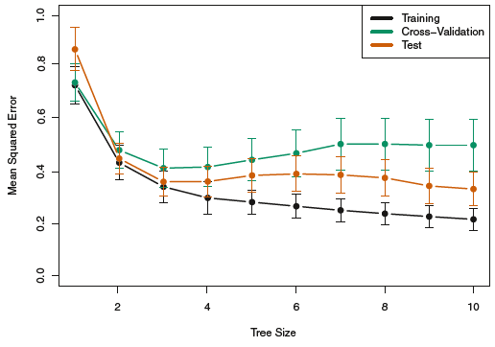
How Much to Prune?

Slide 32
Tree-Building Algorithms
ID3 (1986): Creates multi-way trees using categorical variables
C4.5: Successor to ID3 removes restriction that features must be categorical
CART (Classification and Regression Trees). Similar to C4.5 but supports numerical response variables
Scikit-learn uses CART but does not currently support categorical variables (we must convert them to numerics)

Slide 33
Advantages and Disadvantages of Trees
Easily explained
Mirrors human decision-making processes
Readily displayed graphically
Handles qualitative predictors without requiring dummy variables
Generally, not as accurate predictions as other techniques
Have a tendency to overfit
Data requires minimal pre-processing.
Automatically handles missing values, highly correlated predictors, and skewed variables

Slide 34
Scikit-Learn Decision Trees

Slide 35
Scikit-Learn Decision Trees
Similar to the sklearn linear models, there are two standard classes:
DecisionTreeClassifier
DecisionTreeRegressor
These classes have similar methods and attributes as the LinearRegression class:
.fit(x,y)
.predict(X)
.predict_proba(X)
.score(X,y)

Slide 36
Sklearn Decision Tree Classifier
Common parameters available when defining a decision tree classifier model:
criterion (gini, entropy, etc.)
max_depth: Maximum tree depth
min_samples Minimum number of samples required to split a node
max_leaf_node: Maximum number of leaf nodes
ccp_alpha: Cost complexity parameter (alpha)

Slide 37
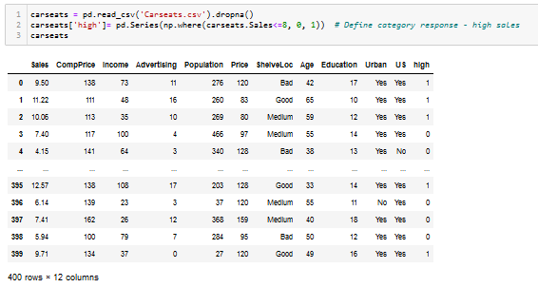
Fitting Classification Trees
Carseats Example

Slide 38
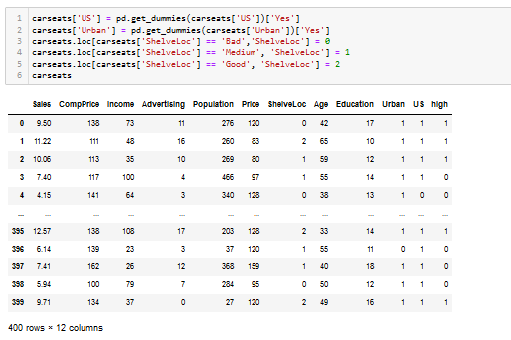
Fitting Classification Trees
Converting Categories to Numeric Variables

Slide 39
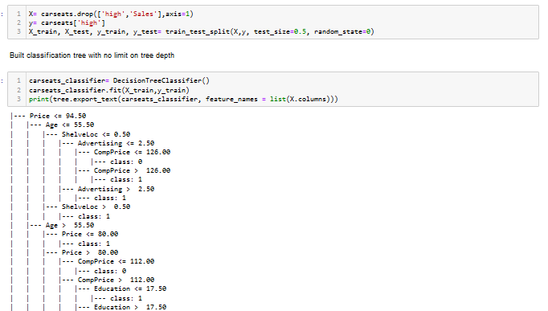
Fitting Classification Trees
No Limits on Depth and Alpha = 0 (no cost complexity pruning)

Slide 40
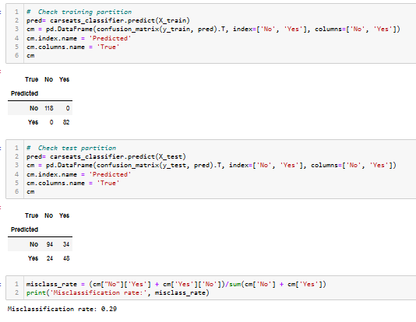
Fitting Classification Trees
Check Confusion Matrix and Misclassification Rates

Slide 41
Fitting Classification Trees
Perform Cost Complexity Pruning
To help specify an optimal alpha for cost complexity pruning, sklearn provides a method “cost_complexity_pruning_path” that returns the “effective alpha” and the corresponding total leaf impurities at each step of the pruning process
Effective alpha – the alpha that would generate the next change in the split decisions

Slide 42
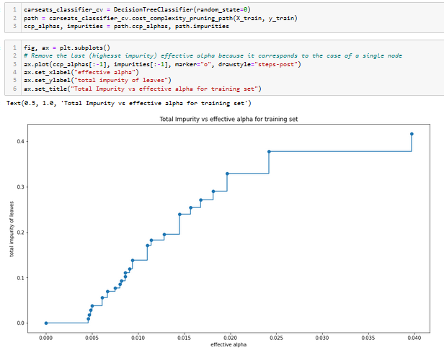
Perform Cost Complexity Pruning
Calculate and Plot Alphas and Corresponding Impurities

Slide 43
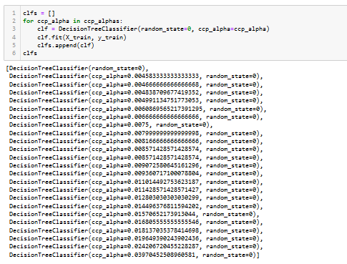
Perform Cost Complexity Pruning
Build a Classification Tree For Every Alpha

Slide 44
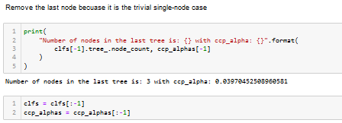
Perform Cost Complexity Pruning
Remove the Last Alpha Option Because it is the Single Node Tree

Slide 45
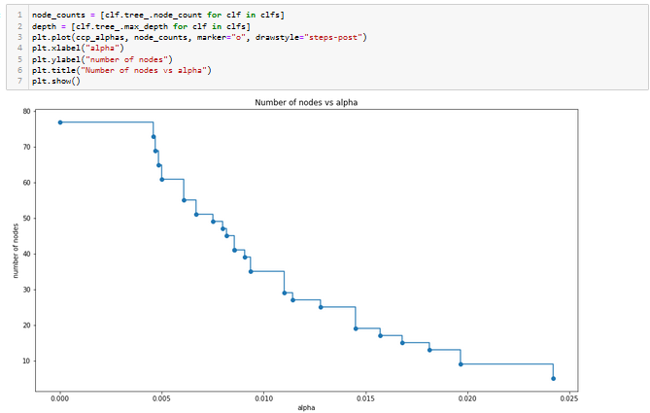
Perform Cost Complexity Pruning
Plot Number of Nodes vs Alpha

Slide 46
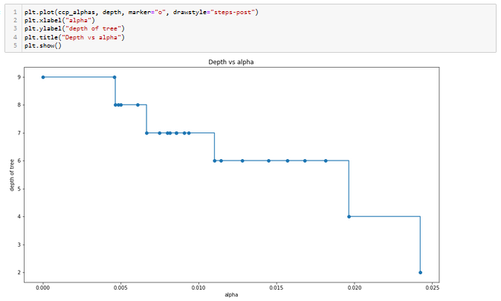
Fitting Classification Trees
Plot Number of Levels vs Alpha

Slide 47
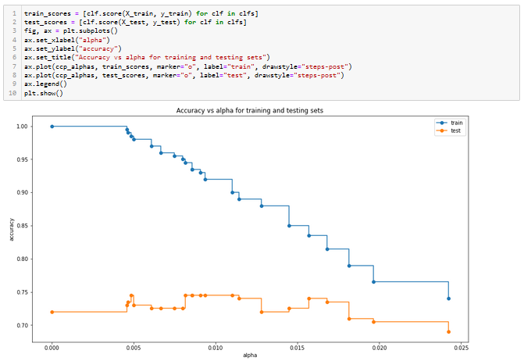
Fitting Classification Trees
Plot accuracy vs alpha for training and test partitions
Let’s try alpha = 0.01

Slide 48
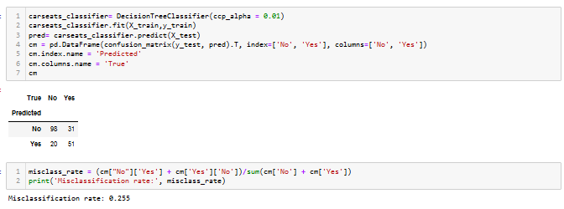
Fitting Classification Trees
Try Re-Running With Alpha = 0.01

Slide 49
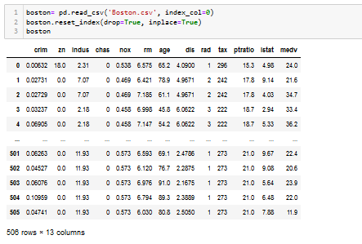
Regression Trees
Boston Dataset

Slide 50
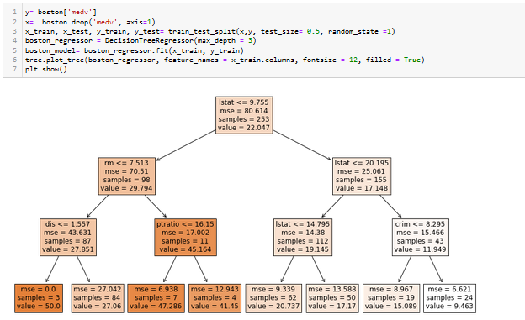
Regression Trees
Fit Regression Tree with max_depth = 3

Slide 51
Decision Trees
Guidelines for Fitting
Decision trees tend to overfit on data with a large number of features
Performing dimensionality reduction (e.g., PCA) tends to get better results
Understanding the decision tree structure is very valuable in performing inference
Start by limiting the depth (typically, max_depth = 3) to get a feel for the resulting logic
Gradually increase the depth while watching for overfitting
If your dataset is significantly unbalanced (much more observations with one class), it can be balanced by stratified sampling

Slide 52
Ensemble Models

Slide 53
Ensemble Models
An ensemble model is an aggregation of more than one model where the final prediction of the model is a combination of the predictions from the component models
An ensemble model creates a single consensus prediction
Robust Model
Improve Accuracy
Reduce Bias
Reduce Variance

Slide 54
Ensemble Models
Basic Types
Averaging methods
Build several estimators independently and average their predictions
Objective is to decrease model variance
Examples include bagging and forests of randomized trees
Boosting methods
Build estimators sequentially where the residuals from one model are used as inputs to the next model
Objective is to decrease bias of the combined estimator by combining several weak models to produce a powerful ensemble model
Examples include AdaBoost and Gradient Tree Boosting

Slide 55
Random Forests

Slide 56
Forest
A forest model is an ensemble of classification or regression trees.
The forest models were developed to overcome the instability that a single classification or regression tree exhibits with minor perturbations of the training data
Trees in the forest differ from each other in two ways:
Training data for a tree is a sample with replacement from all observations.
Input variables considered for splitting a node are randomly selected from available inputs at each point in the algorithm

Slide 57
Decision Trees
Reminder
Repetitive partitioning of the predictor space into internal and leaf nodes.
Leaf nodes yield Boolean prediction rules:
Leaf | X1 | X2 | Predicted Y
1 | <6.5 | <.51 | .22
2 | <6.5 | [.51, .63) | .19
3 | <6.5 | [.63, .67) | .27
4 | [6.5, 6.9) | <.67 | .27
5 | <6.9 | ≥.67 | .14
6 | [6.9, 7.4) | <.66 | .33
7 | ≥7.4 | <.66 | .46
8 | ≥6.9 | ≥.66 | .16

Slide 58
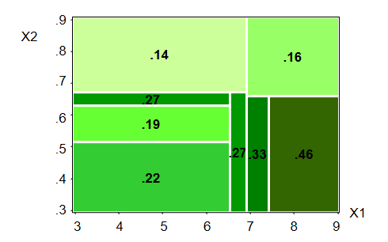
Decision Trees Reminder
Partitioned Input Space

Slide 59
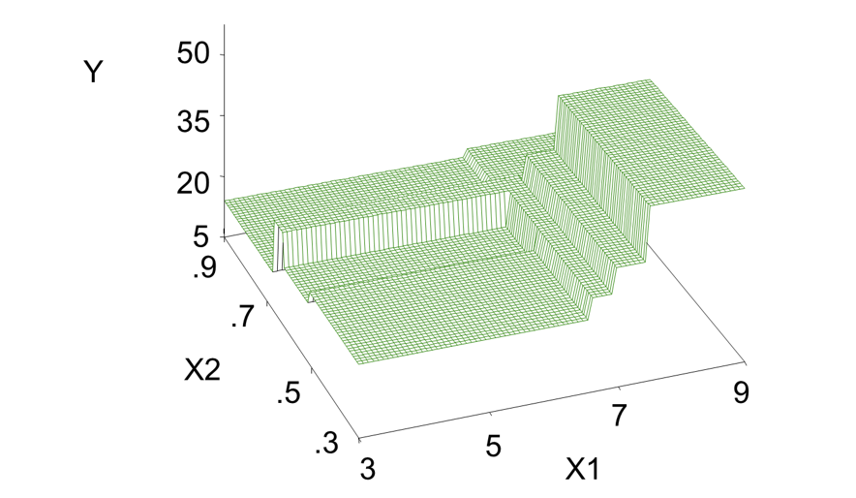
Multivariate Step Function

Slide 60
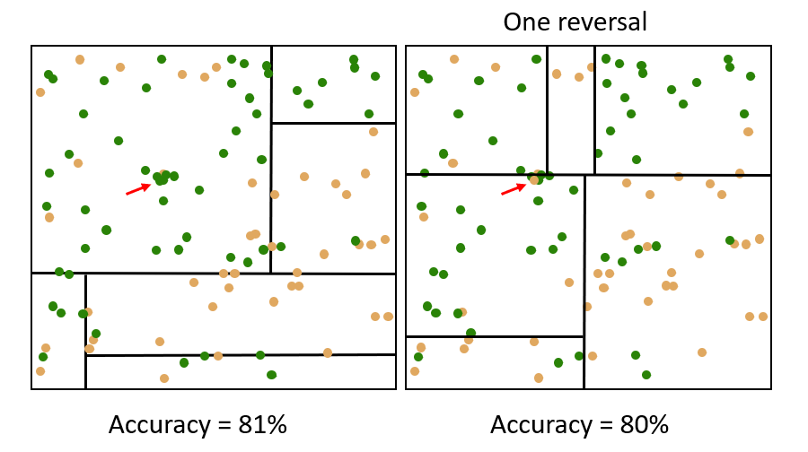
Classification Trees
Instability
...

Slide 61
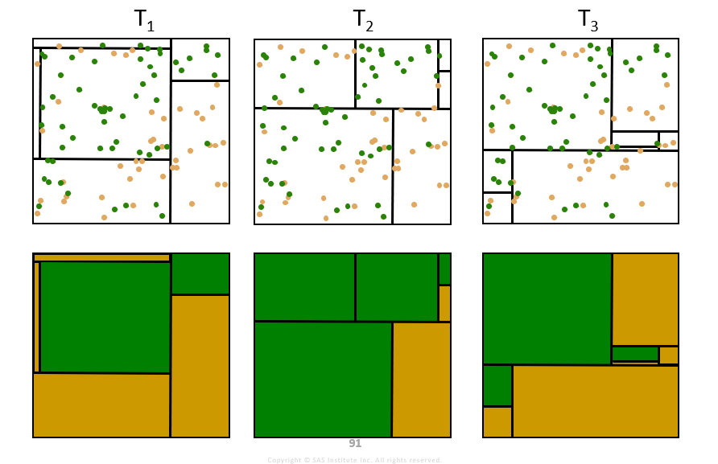
Perturb
...

Slide 62
Combine
T₁
T₂
T₃
Truth
avg(T₁, T₂, T₃) =
...

Slide 63
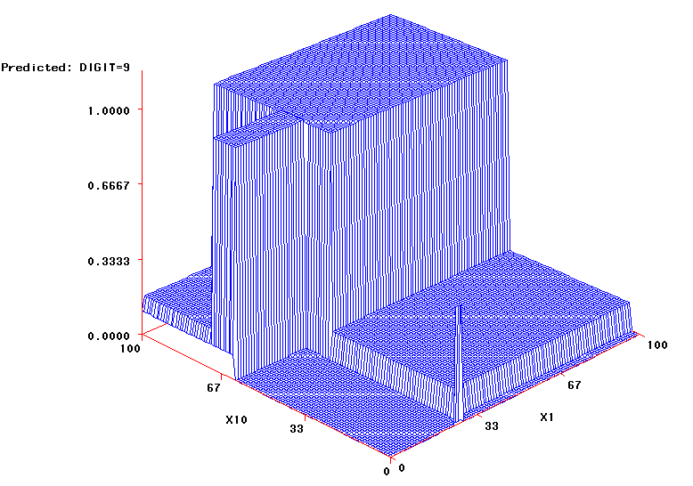
Single versus Bagged Trees

Slide 64

Ensemble Models - Review
Bootstrap Aggregation (Bagging)
A general-purpose technique for reducing the variance of a predictive model.
Used with many predictive modeling types to reduce variance
Recall from introductory statistics that if you take a set of $n$ independent observations, each with variance $σ^{2}$, the variance of the mean of the observations is given by ${σ^{2}}/n$
Bagging operates on the same principal by taking repeated samples with replacement from the training set

Slide 65

Ensemble Models - Review
Bagging Algorithm
Draw a random sample of size $N$ with replacements from the data consisting of $N$ observations, referred to as a bootstrap sample
Construct a classification tree from the bootstrap sample
Assign a class to each terminal node and store the predicted class of each observation
Repeat steps 1-3 a large number of times
Assign each observation to a final class by a majority vote over the set of trees

Slide 66

Ensemble Models - Review
Bootstrap Aggregation (Bagging)
Homogenous ensemble model: the base learning algorithm is the same for all models (classification tree)
Basic result: if $N$ observations are drawn with replacement from $N$ units, then 37% of the observations are left out on average

Slide 67

Forest Algorithm
Forest algorithms extend the bagging technique to perform sampling of the rows and sampling of the columns at each step.
Each time a split in a tree is considered a random selection of $m$ predictors is chosen as split candidates from the full set of $p$ predictors. The split is allowed to use only one of those $m$ predictors.
Typically, we choose $m≈\sqrt{p}$
The forest algorithm perturbs the training data more than the bagging algorithm, producing more variation among the trees in the ensemble.
Ensembles of a more diverse set of trees often lead to improved predictive accuracy.

Slide 68
Rationale Behind Forests
Suppose that we have a very strong predictor in the data set along with a number of other moderately strong predictors, then in the collection of bagged trees, most or all of them will use the very strong predictor for the first split
All bagged trees will look similar. Hence all the predictions from the bagged trees will be highly correlated
Averaging many highly correlated quantities does not lead to a large variance reduction, and thus random forests “de-correlates” the bagged trees leading to more reduction in variance

Slide 69

Forest Algorithm
These are the three main options.
Number of trees
Specifies the number of trees that make up the forest
Number of predictors to split nodes
Specifies the number of input variables to consider splitting for each decision tree (Default = $\sqrt{\# of inputs}$ )
Sampling strategy (Bootstrap)
Specifies the proportion of data to randomly sample for each tree (Default = 0.6)
Notes:
Many of these default values are chosen to increase the speed in which the forest is constructed. In practice, the user may want to change the defaults, such as increasing the number of trees in the forest, to improve the performance of the forest.

Slide 70
Variable Importance
Forests improve the performance of decision trees, but at a cost of easy visualization and interpretation
Tree-based algorithms are able to calculate a variable importance measure by recording the total amount that the RSS is decreased due to splits over a given predictor (averaged over all B trees)

Slide 71
Summary
Forests tend to give better prediction than any specific tree and often outperform other classes of models.
Forests are challenging to interpret, but they can be considered an “ideal” model for other models to be compared against.
Trees automatically handle missing values and variable reduction. Therefore, input data requires less preparation.
Trees are independent of each other so they can be built simultaneously, making training faster.
Forests are challenging to interpret
Forest algorithm requires a large number of trees, which might make the algorithm slow for real-time prediction

Slide 72
Scikit-Learn Forests

Slide 73
Scikit-Learn Bagging Methods
Bagging Meta-Estimator
Bagging methods come in several variations:
Random subsets of observations: Pasting
Observations drawn with replacement: Bagging
Random subsets of features: Random Subspaces
Both random samples and features: Random Patches

Slide 74
Scikit-Learn Bagging Methods
BaggingRegressor() Function
Parameters
base_estimator (default
n_estimators (default = 100)

Slide 75
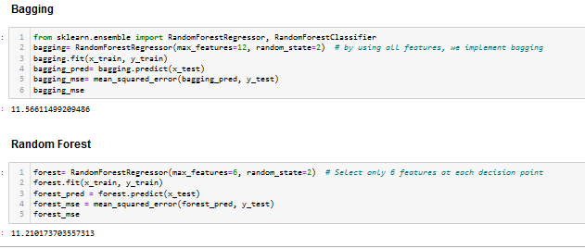
Scikit-Learn Bagging Methods
RandomForestRegressor Function

Slide 76
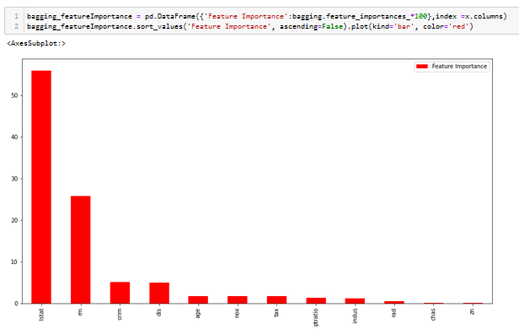
Variable Importance
Bagging

Slide 77
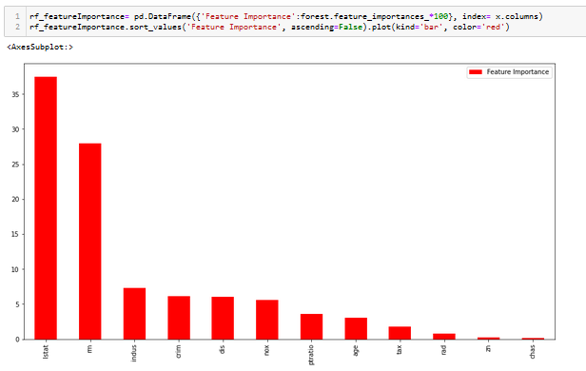
Variable Importance
Forest

Slide 78
Boosting

Slide 79
Boosting
Overview
A third type of ensemble modeling technique (after bagging and random forests) is boosting
Unlike the other techniques, this approach is a sequential ensemble method
The residual (or misclassified point) from the previous learner is incorporated in the next run of the algorithm

Slide 80
Boosting
Overview
Many boosting methods have been proposed, but the two most popular are:
AdaBoost (Adaptive Boosting)
Iteratively adjusts the weights on “hard” observations in the purity calculations for deciding on the next split
Gradient Boosting
Iteratively fits subsequent models to the residuals from the previous model and combines the models together

Slide 81
AdaBoost
Overview
“Pays more attention” to the training observations that the predecessor model missed
New predictors focus more on the “hard cases”
For example, for an AdaBoost classifier:
Trains a “base classifier” (e.g., decision tree) and uses it to make predictions on the training set
Increase the relative weights on the misclassified observations that are used to calculate the purities of the regions
Repeat

Slide 82
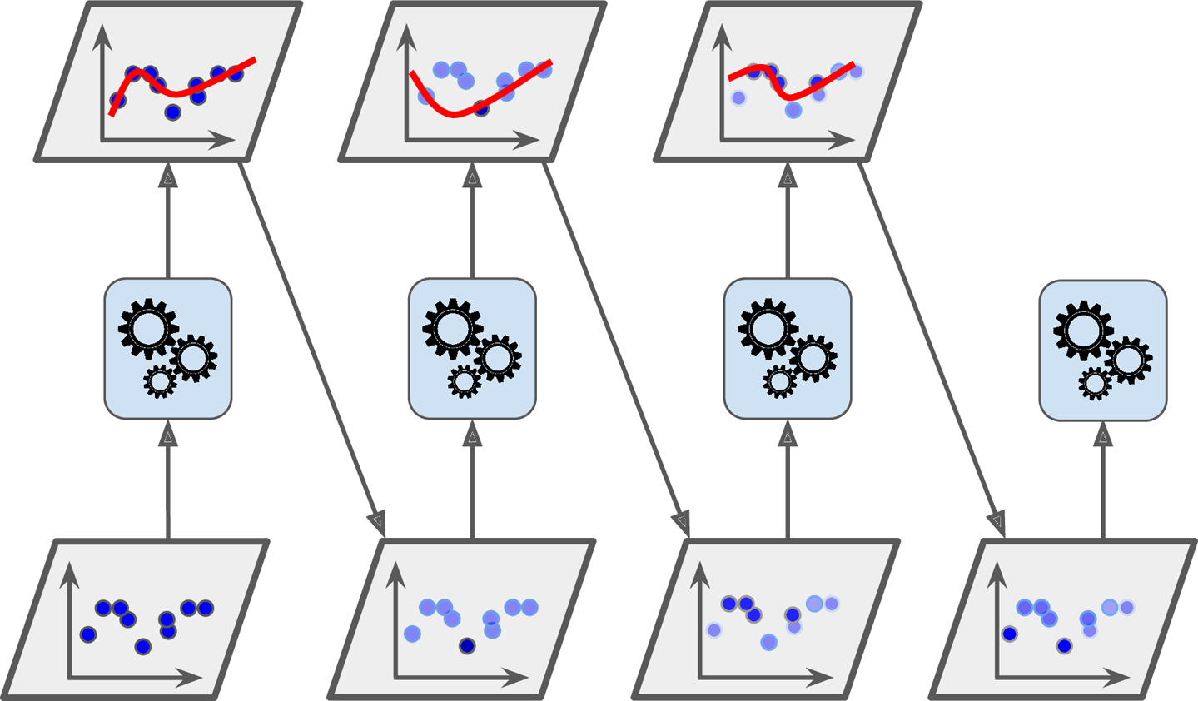
AdaBoost
Overview
Figure from Hands-On Machine Learning with Scikit-Learn, Keras, and TensorFlow, 2nd edition, Aurelien Geron, O’Reilly Media

Slide 83

Gradient Boosting
Basic Approach
Given a set of data $(x_{1},$ $y_{1}$), $(x_{2},$ $y_{2}$), … $(x_{n},$ $y_{n}$) and an initial decision tree model $F$, calculate the residuals $y_{n}−F\left(x_{n}\right)$
You want to add an additional model $h$ to $F$ so that the new prediction will be $F\left(x\right)+h(x)$ so that
$$F\left(x_{1}\right)+h\left(x_{1}\right)= y_{1} \\ F\left(x_{2}\right)+h\left(x_{2}\right)= y_{2} \\ ⋮ \\ F\left(x_{n}\right)+h\left(x_{n}\right)= y_{n}$$
Or, equivalently,
$$F\left(x_{1}\right)+h\left(x_{1}\right)= y_{1} \\ F\left(x_{2}\right)+h\left(x_{2}\right)= y_{2} \\ ⋮ \\ F\left(x_{n}\right)+h\left(x_{n}\right)= y_{n}$$
Residuals
Residual

Slide 84
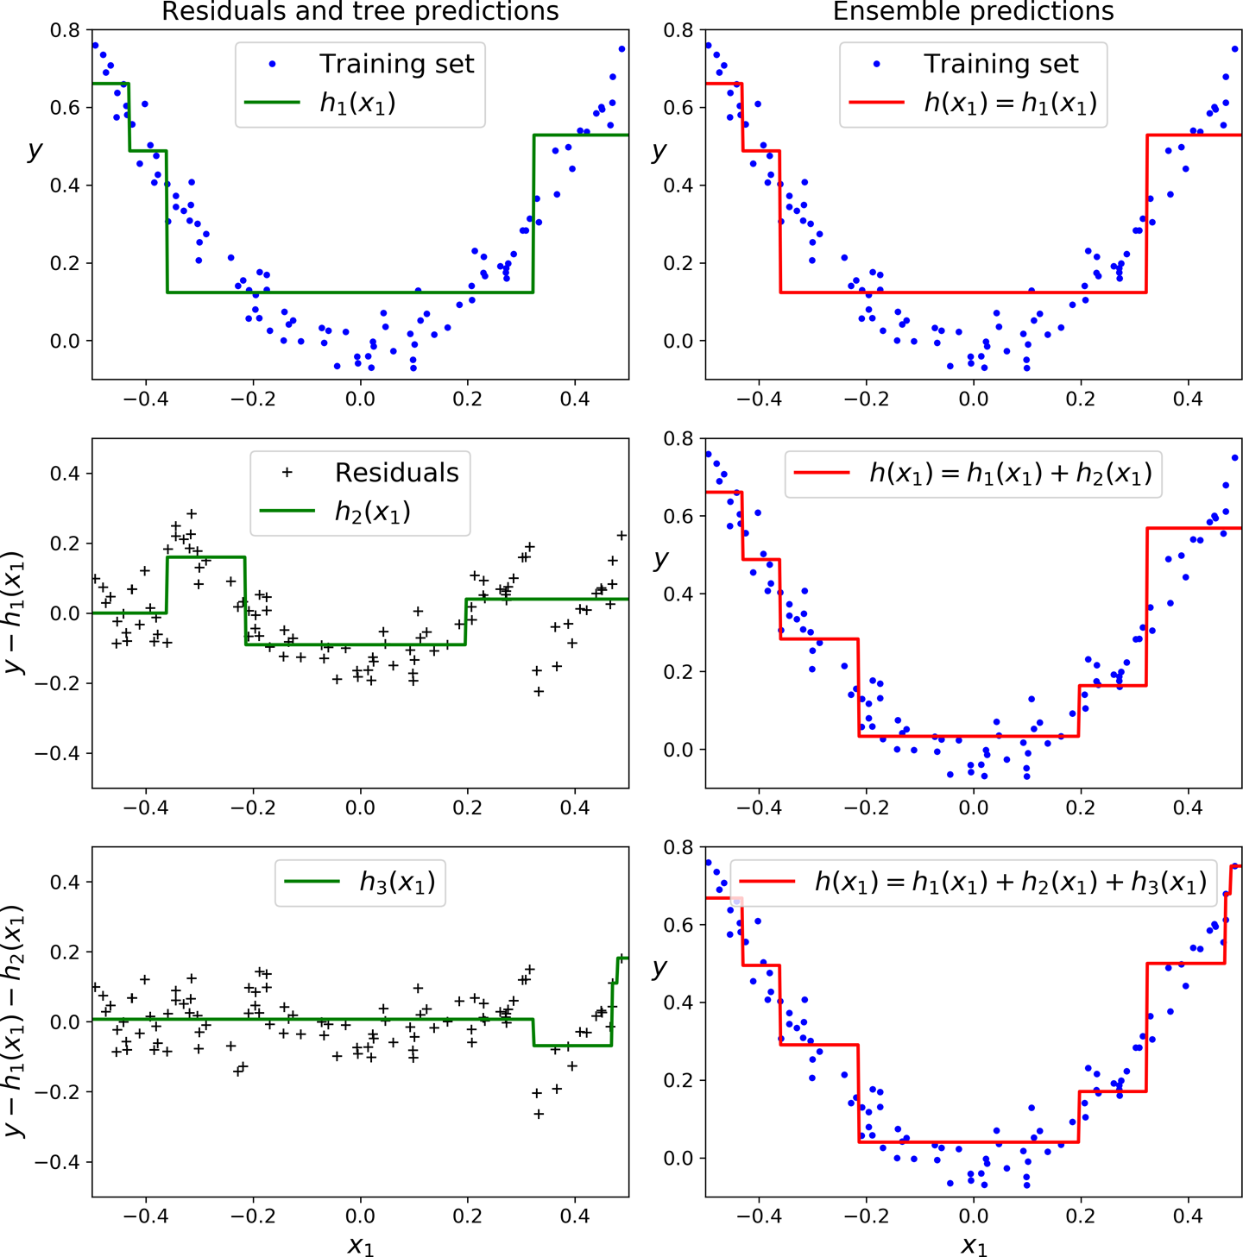
Gradient Boosting
First model fit
Fitting a model to the residuals from the first model
Combining the first two models to form the second
Fitting a model to the residuals from the second model
Combining the first three models to form the third
Figure from Hands-On Machine Learning with Scikit-Learn, Keras, and TensorFlow, 2nd edition, Aurelien Geron, O’Reilly Media

Slide 85

Gradient Boosting
Hyperparameters
Number of trees B. Unlike bagging and random forests, overfitting is a possibility
Shrinkage parameter $λ$ (also referred to as tuning parameter)
Number of splits $d$ in each tree.

Slide 86
Advantages of Gradient Boosting
Less data pre-processing (than neural networks, but same as forests) is required as trees automatically handle missing values and variable reduction.
Often outperforms other classes of models, as boosting reduces the correlation of the predictions of the trees, which in turn improves the predictions of the boosting model.

Slide 87
Disadvantages of Gradient Boosting
Training generally takes longer because trees are built sequentially.
Gradient boosting models are more sensitive to extreme values and anomalies in the data.
Can be slow for real-time scoring.

