Slide 1
Biodiversity in National Parks
A data analysis in the parks around us

Slide 2
Species Data:
category - The category of taxonomy for each species
scientific_name - The scientific name of each species
common_names - The common names of each species
conservation_status - The species conservation status
Stored in species_info.csv

Slide 3
Species in the Species Data
Total Number of Species
Species per Category
5541
Reptile: 79
Amphibian: 80
Fish: 127
Mammal: 214
Nonvascular Plant: 333
Bird: 521
Vascular Plant: 4470
As we can see Reptiles make up the least amount of observations with Vascular plants totalling an overwhelming amount.

Slide 4
Conservation Statuses of Species
Total
5541
Not Protected
Protected
5633
191
In Recovery
Endangered
Threatened
Species of Concern
4
16
10
161

Slide 5
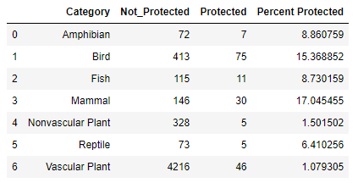
% of Protected Species per Category

Slide 6
Chi2 Contingency
Mammal and Bird
Reptile and Mammal
P-Val:
0.69
P-Val:
0.039
A p-val below 0.05 is statistically significant. Therefore, Mammals have a statistically significant higher rate of needed protection compared to Reptiles.

Slide 7
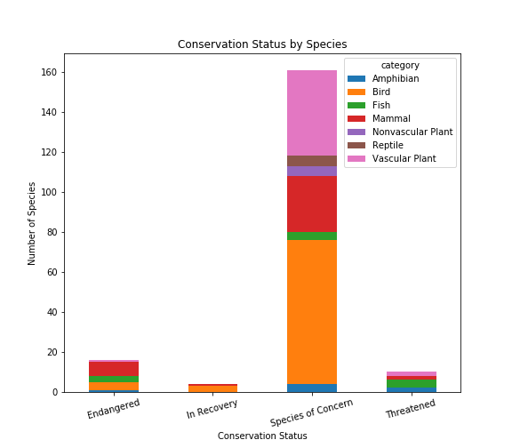
Conservation Status By Species

Slide 8
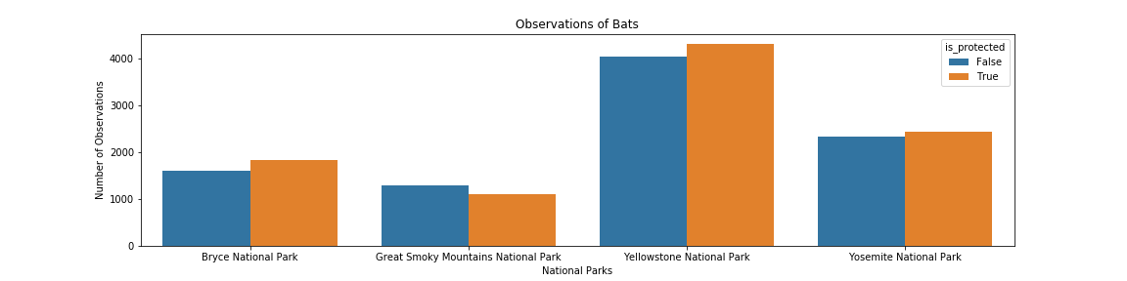
Protection Status of Bats Across the Parks (Bats)

Slide 9
Recommendations
Find more data on why Bats have such a high rate of conservation protections.
Maintain observations for multiple weeks, months, years to track the change over time for the various species’ conservation protections and population.
For those worried about endangered species.

