Slide 1
1
Eyeballs Tracking
Web stream
Proctor Engine
2
Capture Lips Tracking
3
Human Proctor Platform
Continuous prompt
No. of person Tracking
4
5
Mobile Phones Tracking
Agents

Slide 2

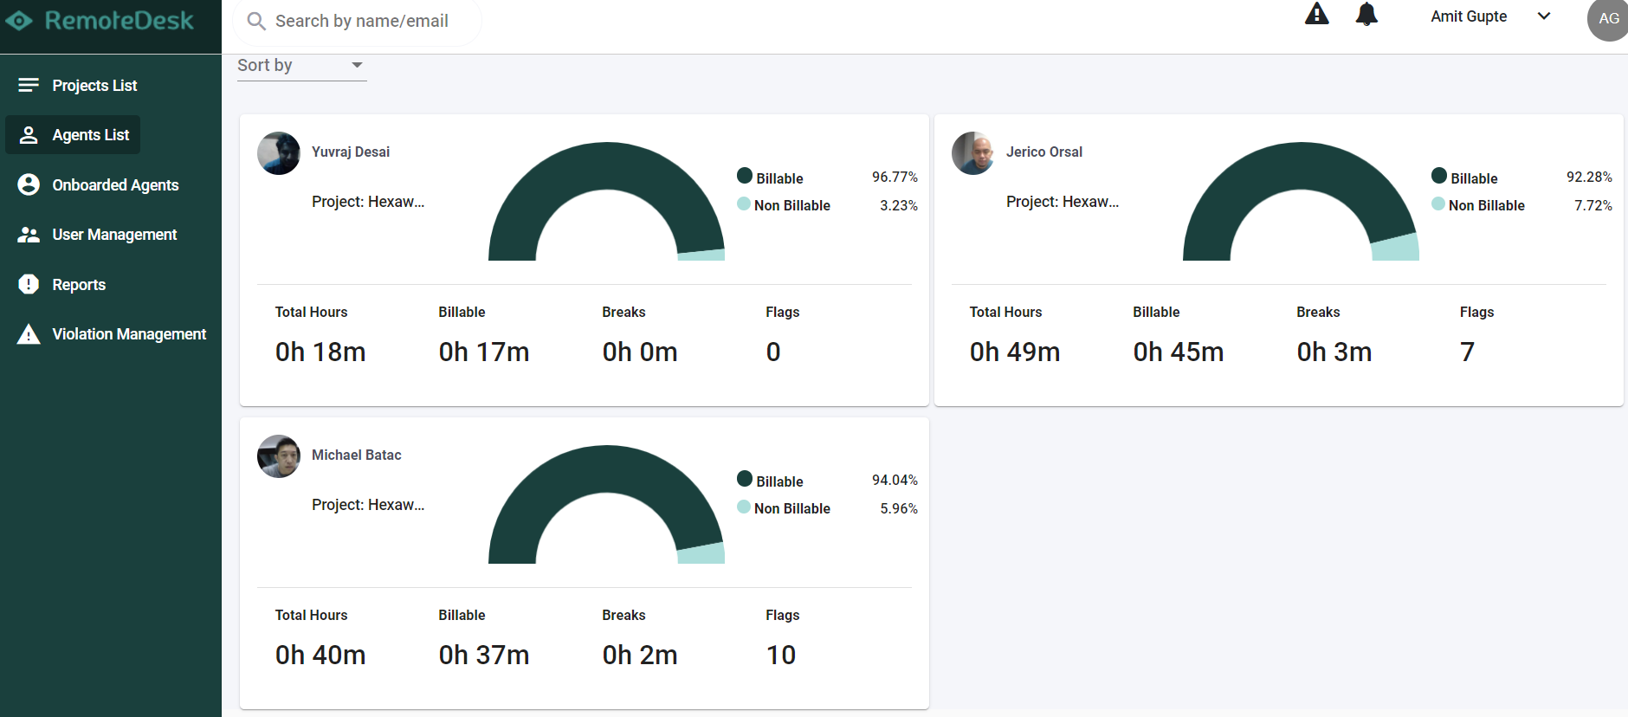


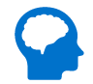
Agent Proctoring Solution
AI Proctor Model
Agent Monitoring Dashboard
Report if no agent is identified on screen
Face detection - Continuous face monitoring of the agent, prompt if any other face detected in the frame
Gadgets tracking - Detection of mobile phone or any other device in frame
EyeBall tracking - Capture face, eye movement away from screen
Agent Logged In
Agent Authentication using
Face detection
Web Application (.NET/JAVA etc.)
Agent Validation screen
Face Detector - Dlib’s facial keypoint detector and OpenCV for further image processing.
EyeBall tracking – Dlib’frontal face HOG detector OR OpenCV’s DNN module
Mobile Phones & person tracking – YOLOv3 in Tensorflow 2, Will use COCO dataset
Face Spoofing Detection - frontal face HOG detector
OpenCV - OpenCV's DNN module
Dlib - frontal face HOG detector
TensorFlow
Speech_recognition
PyAudio
NLTK
Admin to monitor multiple
agents simultaneously

Slide 3
Agent Proctoring Technical Solution
Unauthorized user
Face Spoofing Detector (Dlib’s facial keypoint detector and OpenCV for further image processing)
No
Authorize
Face detection & Authentication
Vision Model
Eyeball tracking (Dlib’frontal face HOG detector OR OpenCV’s DNN module)
Yes
Dlib’s frontal face
HOG detector
Dlib’s facial keypoint detector and OpenCV
Continuous Monitoring
Mobile Phones & person tracking (YOLOv3 in Tensorflow 2, Will use COCO dataset)
Major Library and Techniques
OpenCV - OpenCV's DNN module
Dlib - frontal face HOG detector
TensorFlow
Speech_recognition
PyAudio
NLTK
Admin to monitor multiple
agents simultaneously
Agent Monitoring Dashboard

Slide 4
Agent Proctoring Features details
Scope
Facial scanning for authorizing of using while login into system
Facial Landmark and Eyeball movement detection
Multiple face and people detection
Background motion detection – Detect if an person observe behind agent
Background motion detection – Detect if any object like books, mobile phone, pen, remote will be identified
Imposter and unauthorized person detection – Detects person apart from authorized agent
Background audio – Identifying background audio apart from Agent audio
Real-time notification of any policy violation – Notification will be send only for this product feature violation
Out of Scope
Enforce auto start boot – Not included in the product
Blacklisting apps – Not included in the product
VM and external storage detection – Not included in the product
Print Screen Violation – Will be done at application/system end
To Do
Legend :
In scope
Not in scope

Slide 5

Application Overview
Agent Proctoring System
Dashboard
Opened Cases
Case Number
Title
Assigned To
Date
Status
Comment
Cases
Escalations
NC1023 | Something to address in system | Ajay | 01-06-2021 | Open | XYZ
NC2344 | User wants to check balance | Umesh | 15-12-2021 | Open | ABC
NC3245 | Cheque got bounce | Dinesh | 16-09-2021 | Open | PQR
NC8765 | Facing monitor issue | Ahmad | 12-06-2021 | Closed | hjkkx
Profile
Summary
Documents
Settings
Help

Slide 6
Detailed Timelines and plan
# | Key Activities | Detailed activities | No of Weeks
1 | Process understanding and scoping problem statement in detailed | Current process flow understanding, defining user/agent and manager screens key fields, design complete workflow | 2
2 | Underlying system and existing application understanding for integration and feasibility study | Detailed study of the existing application, technical feasibility study and Integration | 1
3 | System prototype design, Facial landmark using OpenCv, Eyeball movement, Mobile phone detection and Multiple person detection | Leverage the different techniques to identify the best approach for identify face, eyeball tracking, Mobile phone detection and multiple person detection | 5
4 | Facial scanning for authorizing agent | Identify face of the agent to authorize and continuous monitoring while working | 4
5 | Background Audio Verification | Identify the background voice apart from Agent voice | 4
6 | API creation, model integration and Deployment | Building Flask API, hosting and deployment | 6

