Slide 1
Support Vector Machines With JRUBY
Matt Kirk
SocialVolt

Slide 2
Support Vector Machines Safari
Matt Kirk
SocialVolt

Slide 3
Problem
There is so much data out in the world.
What the hell should people do with it?
Ruby doesn’t have many machine learning or data mining packages out there.
Writing C-extensions to pull in existing open source work is a pain!
Notes:
You have all this data and you have no freaking clue what to do with it. Imagine a scenario where you have tons of meta data information about each of your products. Or perhaps say that you have a bunch of movies that have ratings. Overall you want to be able to judge what is useful for

Slide 4
Solution
Given a data set we can utilize a supervised learning model.
While many supervised learning models exist support vector machines are great for classification and are well supported in packages.
Since ruby’s svm gems are somewhat outdated the best option is to tie into the java package that is under active development.
Notes:
Although there is a plethora of solutions, one of the easiest to use is support vector machines

Slide 5
Why Jruby?!!
Ruby’s power along with Java’s tons of packages.
Don’t think I like Java :-P

Slide 6
Model
Three steps to support vector machines:
Collect data
Map data onto high dimensional planes
Use hyper planes to determine classification of new data
Rinse and repeat
Notes:
Support vector machines are a supervised learning model. This means that you give it the data you want it to learn from, instead of it going out to find some new data.
Hyperplanes are really just high dimensional plates

Slide 7
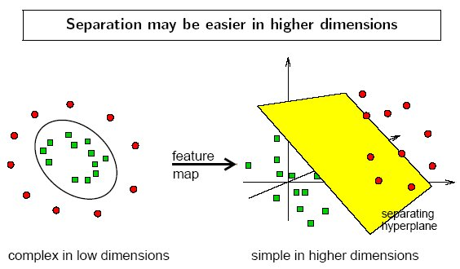
Linear: u’*v

Slide 8
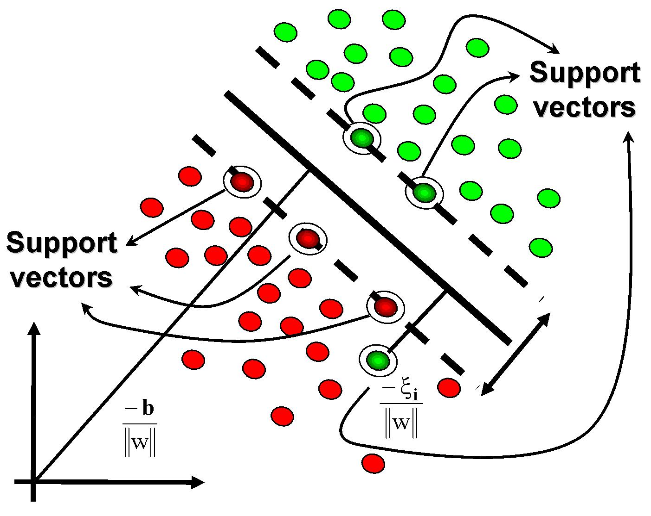
Support Margins

Slide 9

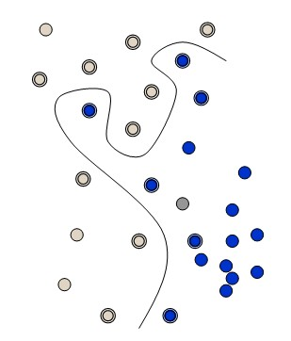
“Kernel Trick”

Slide 10
Underlying Technology
LibSVM is the post popular svm library out there written originally in C
But also simultaneously ported to Java.
To utilize it’s bindings it’s easier to load it all up in a Jar and mess around with it in IRB

Slide 11
BUT THERE IS A RUBy VERSION!!!
Unfortunately the ruby version isn’t very good and runs exceptionally slow.
One you can’t really find easily, and the other one using Swig has some interesting implementation problems such as overcomplicating svm_node creation.

Slide 12
Stop! Example Time

Slide 13
Some Data
Ghost Fever (Campy, 1987): 5 Stars
Attack of the Killer Tomatoes (“Man eating monster”, 1978): 3 Stars
The Blob (Teenagers, 1988): 2 stars
Turns into:
 |  | 1 | 2 | 3 | 4 | 5
Subtitle | Stars | Campy | MEM | Teens | Horror | Year
GF | 5 | 1 | nil | nil | nil | 1987
AKT | 3 | nil | 1 | nil | 1 | 1978
TB | 2 | nil | nil | 1 | nil | 1988

Slide 14
Source code All located on Github

Slide 15
Competition
For classifying generic attributes support vector machines shine but there are many other supervised and unsupervised learning algoritms
Linear regression
Logistic regression
Naïve Bayesian ranks
K-nearest neighbor algorithm
Etc etc

Slide 16
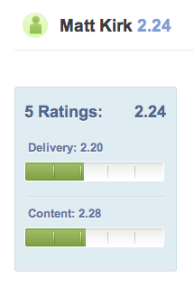
Please ☺
Notes:
My first speech was at reddirt rubyconf and I bombed. I have some ideas why, but at the end of the day I got a lot of ratings without explanation.
I love to learn so please

Slide 17
Give me Feedback
Twitter: @mjkirk
E-Mail: matt@matthewkirk.com
Github: http://github.com/hexgnu/rmw-svm
SpeakerRate: http://spkr8.com/t/8842
Notes:
Give me feedback ☺. I will <3 you forever

