Slide 1
Summer Report
Xi He
Golisano College of Computing and Information Sciences
Rochester Institute of Technology
Rochester, NY 14623
xi.he@mail.rit.edu
Notes:
Let’s start.
Good afternoon, everyone. My name is Xi He. Today I am going to talk about thermal-aware resource management framework.
1

Slide 2
Progress and Achievement
Review more than 20 related papers, and achieve a deeper understanding of the research problem and progress in my research field.
To further the research in Green Computing, learn thermodynamic and heat transfer theory. Develop a CFD model for Buffalo Data Center using CFD software COMSOL.
Rework on thermal aware scheduling algorithm and Improve the assessment paper
Notes:
I will first talk about the background and motivation of thermal aware resource management framework. Then I introduce the architecture of the thermal aware resource management framework. After that, I will present an example to illustrate my thermal aware task scheduling. I will also present my model, problem definition and solution. At last, I will conclude my research and propose my future work.

Slide 3
Progress and Achievement
Start to Implement Green IT infrastructure
Data Center Monitoring System
CFD based Data Center Simulation Environment
Web Portal http://greenit.cyberaide.org/
Notes:
I will first talk about the background and motivation of thermal aware resource management framework. Then I introduce the architecture of the thermal aware resource management framework. After that, I will present an example to illustrate my thermal aware task scheduling. I will also present my model, problem definition and solution. At last, I will conclude my research and propose my future work.

Slide 4
Paper Outline
Problem
Literature Review
Motivation
System Model
Artificial Neural Network
Thermal Aware Scheduling Algorithm
Simulation Result
Future work
Notes:
I will first talk about the background and motivation of thermal aware resource management framework. Then I introduce the architecture of the thermal aware resource management framework. After that, I will present an example to illustrate my thermal aware task scheduling. I will also present my model, problem definition and solution. At last, I will conclude my research and propose my future work.

Slide 5
Problem
Energy Crisis in Data Centers:
Energy consumption in data centers doubled between 2000 and 2006
In 2006, 61 billion kilowatt-hours of power was consumed, 1.5 percent of all US electricity use.
EPA estimates that the energy usage will double again by 2011.
Notes:
But in data centers, one of important cloud computing componenets, large energy consumption is becoming a challenging problem. According to U.S. Environment Protection Agency, 61 billion kilowatt-hours of power was consumed in data centers in 2006 that is 1.5 percent of all US electricity consumption costing around $4.5 billion. {In fact, the energy consumption in data centers doubled between 2000 and 2006. and U.S. Environment Protection Agency estimates the energy consumption in data centers will double again by 2011.}

Slide 6
Literature Review
Improve computation power efficiency
Scheduling VM in the DVFS cluster
Improve cooling power efficiency
Task scheduling in accordance with compute racks’ inlet temperature to minimize heat recirculation [1]
[1] Q. Tang, S. K. S. Gupta, and G. Varsamopoulos, “Thermal-aware task scheduling for data centers through minimizing heat recirculation,” in CLUSTER, 2007, pp. 129–138.
Notes:
Motivation for thermal aware resource management framework:
Resource management is very important and complex. A number of issues are to be addressed. For example,
1. How can end users easily get access to remote resources?
2. How can end users collaborate with each others and integrate resources into their research project?
3. How can make resources efficient?
How can the administrator monitor and manage different geographically distributed resources?
Temperature is considered as an important physical metrics in data centers. First, appropriate temperature management can increase hardware reliability. Some studies show that 15 Celsius\ centigrade increases hard disk drive failure rate by a factor of two.
Second, smart temperature management can decrease cooling energy costs in data centers. Some studies show that a data center can lower computer room air conditioning power consumption by 20%-40% by maintaining ambient room temperature 5 Celsius cooler by smart temperature management .

Slide 7
Literature Review
Task scheduling in accordance with compute racks’ outlet temperature [2]
Task Scheduling in accordance with compute nodes’ thermal distribution.
How to predict the future thermal distribution?
CFD model :too complex
A online scheduling is preferred.
[2] R. K. Sharma, C. Bash, C. D. Patel, R. J. Friedrich, and J. S. Chase, “Balance of power: Dynamic thermal management for internet data centers,” IEEE Internet Computing, vol. 9, no. 1, pp. 42–49, 2005.
[3] J. Moore, J. Chase, and P. Ranganathan, “Weatherman: Automated, Online and Predictive Thermal Mapping and Management for Data Centers,” in IEEE International Conference on Autonomic Computing, 2006. ICAC’06, 2006, pp. 155–164.
Notes:
Motivation for thermal aware resource management framework:
Resource management is very important and complex. A number of issues are to be addressed. For example,
1. How can end users easily get access to remote resources?
2. How can end users collaborate with each others and integrate resources into their research project?
3. How can make resources efficient?
How can the administrator monitor and manage different geographically distributed resources?
Temperature is considered as an important physical metrics in data centers. First, appropriate temperature management can increase hardware reliability. Some studies show that 15 Celsius\ centigrade increases hard disk drive failure rate by a factor of two.
Second, smart temperature management can decrease cooling energy costs in data centers. Some studies show that a data center can lower computer room air conditioning power consumption by 20%-40% by maintaining ambient room temperature 5 Celsius cooler by smart temperature management .

Slide 8
Motivation
Why use temperature as the metric for task scheduling?
Efficient thermal management can decrease the cooling costs in data centers
Efficient thermal management can increase hardware reliability.
Notes:
Ok. In the rest of the presentation, I will focus on thermal aware task scheduling, which is an important component in the thermal aware resource management framework.
This slide contains different the task-temperature profiles. A task-temperature profile shows the temperature increase along with the task execution. You can see this figure, x-axis is the task execution time. Y-axis is the core’s temperature increase. It has been observed that different types of computing tasks generate different amount of heat, and thus have different task-temperature profiles.

Slide 9
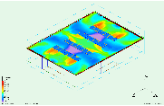
Motivation
Imbalance Thermal Distribution
Notes:
Ok. In the rest of the presentation, I will focus on thermal aware task scheduling, which is an important component in the thermal aware resource management framework.
This slide contains different the task-temperature profiles. A task-temperature profile shows the temperature increase along with the task execution. You can see this figure, x-axis is the task execution time. Y-axis is the core’s temperature increase. It has been observed that different types of computing tasks generate different amount of heat, and thus have different task-temperature profiles.

Slide 10
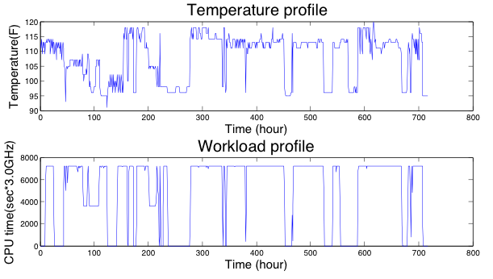
Motivation
Correlation between temperature and workload
Notes:
Ok. In the rest of the presentation, I will focus on thermal aware task scheduling, which is an important component in the thermal aware resource management framework.
This slide contains different the task-temperature profiles. A task-temperature profile shows the temperature increase along with the task execution. You can see this figure, x-axis is the task execution time. Y-axis is the core’s temperature increase. It has been observed that different types of computing tasks generate different amount of heat, and thus have different task-temperature profiles.

Slide 11
Motivation
Temperature after Scheduling
Temperature increase by tasks
Node1
Node2
Node3
Node4
Node5
Node6
Temperature before Scheduling
Notes:
Ok. In the rest of the presentation, I will focus on thermal aware task scheduling, which is an important component in the thermal aware resource management framework.
This slide contains different the task-temperature profiles. A task-temperature profile shows the temperature increase along with the task execution. You can see this figure, x-axis is the task execution time. Y-axis is the core’s temperature increase. It has been observed that different types of computing tasks generate different amount of heat, and thus have different task-temperature profiles.

Slide 12
System Model
Predict
Thermal topology
Job
Node
Node
Scheduler
Node
Node
queue
Node
Scheduling
algorithm
Compute Resource
Notes:
Ok. In the rest of the presentation, I will focus on thermal aware task scheduling, which is an important component in the thermal aware resource management framework.
This slide contains different the task-temperature profiles. A task-temperature profile shows the temperature increase along with the task execution. You can see this figure, x-axis is the task execution time. Y-axis is the core’s temperature increase. It has been observed that different types of computing tasks generate different amount of heat, and thus have different task-temperature profiles.

Slide 13
Artificial Neural Network
Temperature Distribution
Data Center Structure
?Relation
non-linear statistical data model
Neural Network
Workload Distribution
Cooling Configuration
Notes:
Ok. In the rest of the presentation, I will focus on thermal aware task scheduling, which is an important component in the thermal aware resource management framework.
This slide contains different the task-temperature profiles. A task-temperature profile shows the temperature increase along with the task execution. You can see this figure, x-axis is the task execution time. Y-axis is the core’s temperature increase. It has been observed that different types of computing tasks generate different amount of heat, and thus have different task-temperature profiles.

Slide 14
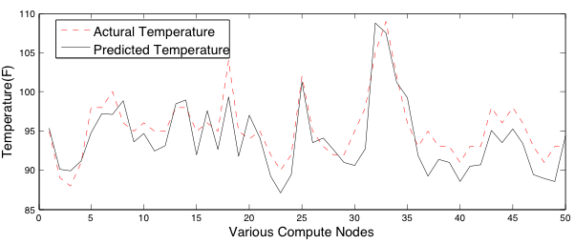
Artificial Neural Network
Notes:
Ok. In the rest of the presentation, I will focus on thermal aware task scheduling, which is an important component in the thermal aware resource management framework.
This slide contains different the task-temperature profiles. A task-temperature profile shows the temperature increase along with the task execution. You can see this figure, x-axis is the task execution time. Y-axis is the core’s temperature increase. It has been observed that different types of computing tasks generate different amount of heat, and thus have different task-temperature profiles.

Slide 15
Thermal Aware Scheduling Algorithm
Sort the jobs by their execute time
Sort the compute nodes by their temperature
Assign the hottest job to the coolest compute node
Predict compute node’s temperature using ANNs
Sort the compute nodes by their next available time’s temperature
Goto 3
Job
Hot
Job
Job
Job
Cool
Job
Node
Node
Node
Node
Node
Cool
Hot
15
Notes:
Ok. In the rest of the presentation, I will focus on thermal aware task scheduling, which is an important component in the thermal aware resource management framework.
This slide contains different the task-temperature profiles. A task-temperature profile shows the temperature increase along with the task execution. You can see this figure, x-axis is the task execution time. Y-axis is the core’s temperature increase. It has been observed that different types of computing tasks generate different amount of heat, and thus have different task-temperature profiles.

Slide 16
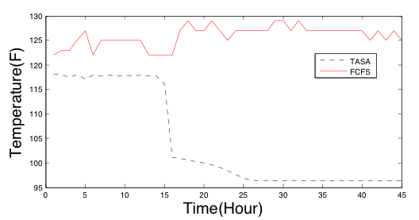
Simulation Result
Maximum Comparison
Notes:
Ok. In the rest of the presentation, I will focus on thermal aware task scheduling, which is an important component in the thermal aware resource management framework.
This slide contains different the task-temperature profiles. A task-temperature profile shows the temperature increase along with the task execution. You can see this figure, x-axis is the task execution time. Y-axis is the core’s temperature increase. It has been observed that different types of computing tasks generate different amount of heat, and thus have different task-temperature profiles.

Slide 17
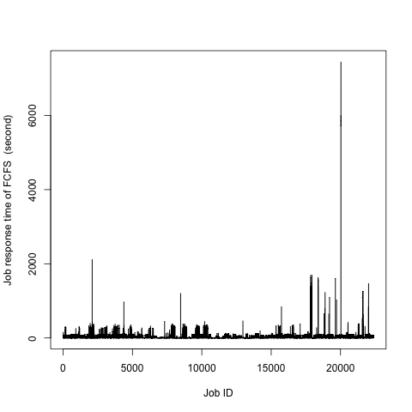
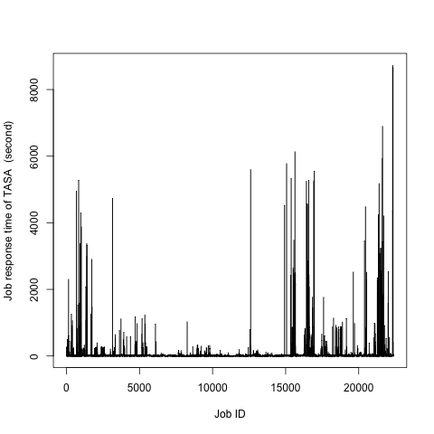
Simulation Result
Response time Comparison
FCFS
TASA
Notes:
Ok. In the rest of the presentation, I will focus on thermal aware task scheduling, which is an important component in the thermal aware resource management framework.
This slide contains different the task-temperature profiles. A task-temperature profile shows the temperature increase along with the task execution. You can see this figure, x-axis is the task execution time. Y-axis is the core’s temperature increase. It has been observed that different types of computing tasks generate different amount of heat, and thus have different task-temperature profiles.

Slide 18
Future Work
Refine and improve our neural network model. We are going to pay more attention to the effect of compute nodes’ spatial location on temperature distribution
Compare our neural network based prediction model with CFD based prediction model
Integrate back-filling algorithm into our thermal aware scheduling algorithm.
Notes:
Ok. In the rest of the presentation, I will focus on thermal aware task scheduling, which is an important component in the thermal aware resource management framework.
This slide contains different the task-temperature profiles. A task-temperature profile shows the temperature increase along with the task execution. You can see this figure, x-axis is the task execution time. Y-axis is the core’s temperature increase. It has been observed that different types of computing tasks generate different amount of heat, and thus have different task-temperature profiles.

Slide 19
Thank you
Notes:
Ok. In the rest of the presentation, I will focus on thermal aware task scheduling, which is an important component in the thermal aware resource management framework.
This slide contains different the task-temperature profiles. A task-temperature profile shows the temperature increase along with the task execution. You can see this figure, x-axis is the task execution time. Y-axis is the core’s temperature increase. It has been observed that different types of computing tasks generate different amount of heat, and thus have different task-temperature profiles.

