Slide 1
DHCP协议培训
网络基础之

Slide 2
目录
一、DHCP简介
二、DHCP的协议交互
三、DHCP的报文结构
四、DHCP Relay

Slide 3
一、简介
DHCP = Dynamic Host Configuration Protocol，
动态主机配置协议。
用于实现主机的网络参数的自动配置，如IP、掩码、网关、DNS等等。
DHCP是BOOTP协议的扩展，主要是改进了使用BOOTP时必须静态配置好客户端MAC地址和IP地址的对应关系的缺点，因此叫做“动态”主机配置协议。
DHCP主要协议标准：rfc2131 - DHCP。

Slide 4




典型组网
Non-DHCP Client
DHCP Client
IP Address1
IP Address2
IP Address1
IP Address2
IP Address3
.
.
.
IP AddressN
DHCP Client
DHCP Server
DHCP Database

Slide 5




二、DHCP的协议交互(首次申请)
DHCP
Server2
DHCP
Server1
DHCP
Client
1
DHCP client broadcasts a DHCP DISCOVER packet
2
DHCP servers broadcast a DHCP OFFER packet
3
DHCP client broadcasts a DHCP REQUEST packet
4
DHCP Server1 broadcasts a DHCP ACK packet
Notes:
问题：在第3步中，Client是广播的DHCP Request，为何第4步中只有Server1应答了DHCP ACK呢？

Slide 6



二、DHCP的协议交互(续租)
DHCP
Server2
DHCP
Server2
DHCP Client
DHCP Client
DHCP
Server1
DHCP
Server1
50% of lease duration has expired
87.5% of lease duration has expired
100% of lease duration has expired
50% of lease duration has expired
DHCP Client sends a DHCPREQUEST packet
1
DHCP client sends a DHCP REQUEST packet
1
2
DHCP Server1 sends a DHCP ACK packet

Slide 7
  当租期已过去50%， DHCP客户端尝试更新租约。
  如果DHCP服务器可用，那么将更新。
  如果DHCP服务器不可用，客户机将继续使用它的当前配置。
  当期限过去87.5%，DHCP客户端发出广播再次更新租约。在这一阶段，DHCP客户机接受任何DHCP服务器发出的租约。
  租约到期时(100%)，客户机停止使用当前的IP地址，然后开始新的DHCP租约过程。

Slide 8
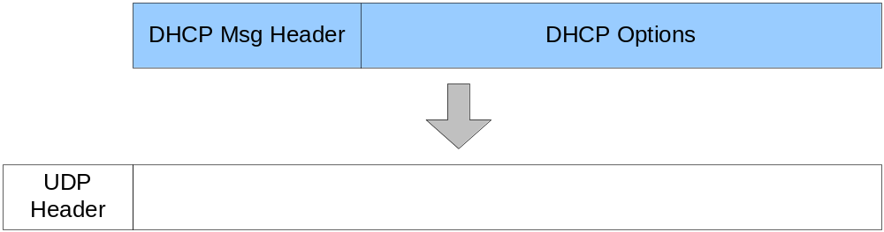
四、DHCP的报文结构
DHCP消息封装在UDP报文中。
DHCP Client使用UDP端口68，
DHCP Server使用UDP端口67；
DHCP消息由DHCP消息头和DHCP选项串构成；

Slide 9
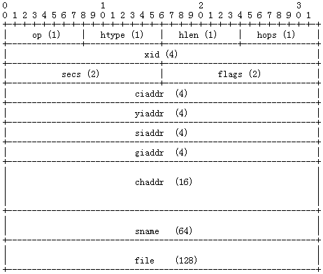
DHCP消息头结构

Slide 10
DHCP选项结构
DHCP选项采用TLV格式组织。
其中T、L字段各占一个字节，L是V的长度。
0xFF选项标志DHCP选项结束。

Slide 11
五、DHCP Relay
申请地址时客户端发出的DHCP Discovery广播包的目的IP是255.255.255.255，这是受限的广播地址，路由器在任何情况下都不会转发这样的报文。
这样就带来了一个问题：DHCP服务器必须跟客户端在同一子网。
为了解决这个问题，引入DHCP Relay，也叫做DHCP Proxy。

Slide 12



A DHCP relay agent is a computer or router configured to listen for DHCP/BOOTP broadcasts from DHCP clients and then relay those messages to DCHP servers on different subnets
DHCP Relay Agent
DHCP Server
Unicast
Broadcast
Broadcast
Subnet A
Subnet B
Routers
Non-RFC 1542 Compliant
Client
Client
Client
Client

Slide 13

DHCP Relay是如何工作的？
DHCP Relay Agent
DHCP Relay
DHCP Server
DHCP Server
Client2
Client2
Router
Non-RFC 1542 Compliant
Router
Non-RFC 1542 Compliant
Client3
Client1
Client3
Client1
1
Client1 broadcasts a DHCP DISCOVER packet
2
Relay agent forwards the DHCP DISCOVER message to the DHCP server
3
Server sends a DHCP OFFER message to the DHCP relay agent
4
Relay agent broadcasts the DHCP OFFER packet
5
Client1 broadcasts a DHCP REQUEST packet
6
Relay agent forwards the DHCP REQUEST message to the DHCP server
7
Server sends a DHCP ACK message to the DHCP relay agent
8
Relay agent broadcasts the DHCP ACK packet
Notes:
Graphic Artist:
You can try using the pulsing circles (instead of the two simultaneous arrows that go from the client 1 to client 2 and DHCP Relay Agent) that represent broadcasts. You can find the pulsing circles in Elise’s media piece titled, The Role of DHCP. The link to this media piece will be sent in an e-mail to you.
Also, for printing purposes, could you please set the slide build to print the frame with all eight bullets, but no arrows?

