Slide 1


Group-Pair Convolutional Neural Networks for Multi-View based 3D Object Retrieval
Zan Gao, Deyu Wang, Xiangnan He, Hua Zhang
Tianjin University of Technology
National University of Singapore
Notes:
Good afternoon everyone!
My name is Deyu Wang and I’m from Tianjin University of Technology. I’m honor to be here to make my presentation. The topic of my paper is “Group-Pair Convolutional Neural Networks for Multi-View based 3D Object Retrieval”,

Slide 2
Outline
Previous work
Proposed method
Experiments
Conclusion
Notes:
And my presentation will be divided into the following four parts.

Slide 3
Outline
Previous work
Proposed method
Experiments
Conclusion
Notes:
Now, I will introduce the previous work
In the previous, there are two ways to implement the 3D object retrieval which are view-based method and model-based method, Compared with model-based method, the view-based method usually has better performance ,and it doesn’t need more time and space to process 3D model, so we just introduce the view based method

Slide 4
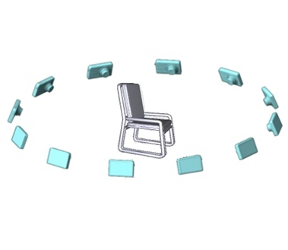
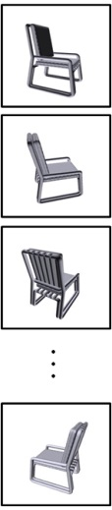




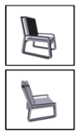





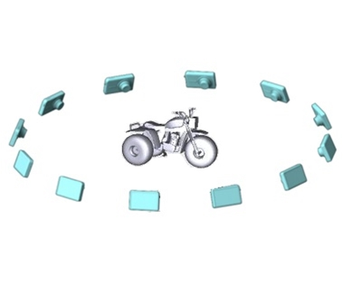
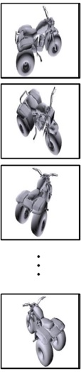
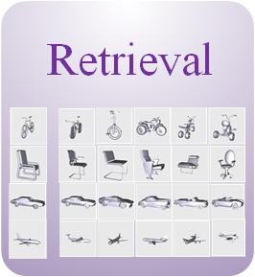
The view-based 3D object retrieval methods are based on the processes as follows:
View Distance
Graph Matching
Category Information
Chairs
Bikes
…
Feature Extraction
Object Retrieval
Zernike, HoG,
CNN features
Notes:
However, for the method based on the view distance, it needs to compare the view distance between two objects one by one, so it is time-consuming.
The graph matching method needs reweight the graph nodes iteratively to find a optimal matching, so it will take a lot of computing resource.
And for the method based on the category information, the retrieval performance depends on the classifier performance, so it can not optimize towards the retrieval task directly.

Slide 5
1. The existing 3D object retrieval methods:
separate the phase of feature extraction and object retrieval
use single view as matching unit
2. For the deep neural network, insufficient training samples in 3D datasets will lead to network over-fitting
Notes:
For the existing 3D object retrieval methods, there are two problems:
The first, they separate the phase of feature extraction and object retrieval which need extra space to store intermediate data and should spend more time to process data
Second, they all use single view as matching unit while ignoring complementary information among the views.
On the other hand, for the deep neural network, it often needs a large-scale training sample. But, the number of samples in current 3D datasets is not sufficient and may lead to network over-fitting

Slide 6
Outline
Previous work
Proposed method
Experiments
Conclusion

Slide 7
We propose the Group-Pair CNN (GPCNN) which:
has pair-wise learning scheme that can be trained end-to-end for improved performance
does multi-view fusion to keep complementary information among the views
need to generate group-pair samples so as to solve the problem of insufficient original samples
Notes:
So, to deal with these problems, we proposed our method GPCNN
The GPCNN has pair-wise learning scheme that can be trained end-to-end, and it can fuse the multiple views to mine the complementary information among the views. Since the GPCNN can receive group-pair samples, the problem of insufficient samples can be solved.

Slide 8


Given two input objects
Notes:
First of all, we have two input objects

Slide 9
Render with multiple cameras
Notes:
and render with multiple cameras.

Slide 10

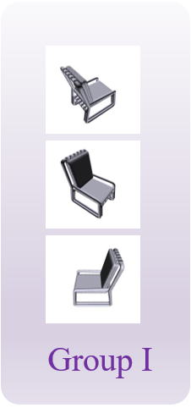
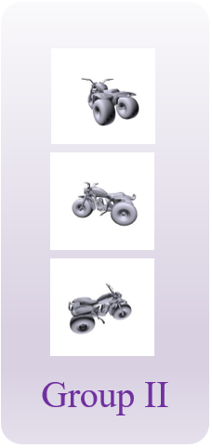
Extract some views to generate group pair samples
Group Pair
Notes:
then, extract some views by using a certain stride to generate group pair samples.

Slide 11

The group pair samples are passed through CNN₁ for image features
…
…
…
CNN₁
CNN₁: a ConvNet extracting image features
…
…
…
CNN₁
Group Pair
Notes:
after that, the group pair samples are passed through CNN₁ for image features

Slide 12
All image features are combined by view pooling …
…
…
View pooling
…
CNN₁
View pooling: element-wise max-pooling across all views
…
…
View pooling
…
CNN₁
Group Pair
Notes:
and there is view pooling layer to combine the multiple views
The view pooling is an element-wise max-pooling operation which can cross the multiple views

Slide 13
… and then passed through CNN₂ and computed loss value
CNN₂: a second ConvNet producing shape descriptors
…
…
View pooling
…
CNN₂
…
CNN₁
Contrastive loss
…
…
View pooling
…
…
CNN₂
CNN₁
Group Pair
Notes:
Next, all the image features are passed through CNN₂ and computed loss value by using contrastive loss

Slide 14
CNN₁ and CNN₂ are built based on VGG-M
…
View pooling
…
…
…
CNN₂
…
…
CNN₁
Contrastive loss
…
Build the structure based on VGG-M [Chatfield et al. 2014]
…
…
View pooling
…
…
…
CNN₂
CNN₁
Group Pair
[1] Return of the Devil in the Details: Delving Deep into Convolutional Nets [Chatfield et al. 2014]
Notes:
And here, the CNN1 and CNN2 are built based on VGG-M which is lightweight VGG model

Slide 15
CNN₁ and CNN₂ are built based on VGG-M
…
View pooling
…
…
…
CNN₂
…
…
CNN₁
Contrastive loss
…
…
…
View pooling
…
…
…
CNN₂
CNN₁
Group Pair

Slide 16
Retrieving: sorting by the distances between the retrieval object and the dataset objects …
…
Collect all the distances between the retrieval object and dataset objects
…
View pooling
…
CNN₂
…
CNN₁
Sorting
the distances
Distance
…
…
View pooling
…
…
CNN₂
CNN₁
Group Pair
Notes:
OK, in retrieval stage, we can use our network to compute distance between two objects directly and regard this distance as similarity of two objects. And then, collecting all the distances between the retrieval object and dataset objects.

Slide 17
… and then the retrieval result is obtained.
…
Collect all the distances between the retrieval object and dataset objects
…
View pooling
…
CNN₂
…
CNN₁
Sorting
the distances
Distance
…
…
View pooling
…
…
CNN₂
CNN₁
Group Pair
Notes:
Finally, we can get retrieval result by sorting these distances.
This is the overall process of GPCNN

Slide 18
Outline
Previous work
Proposed method
Experiments
Conclusion

Slide 19
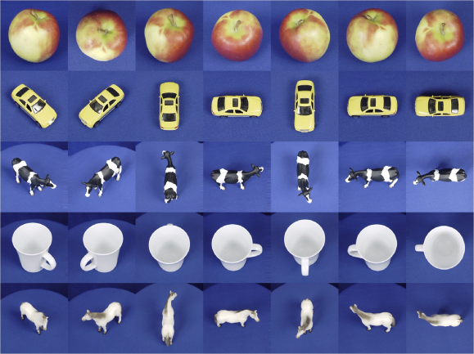
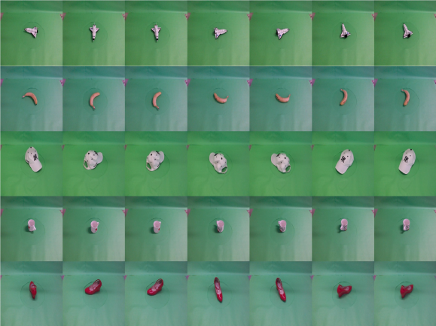
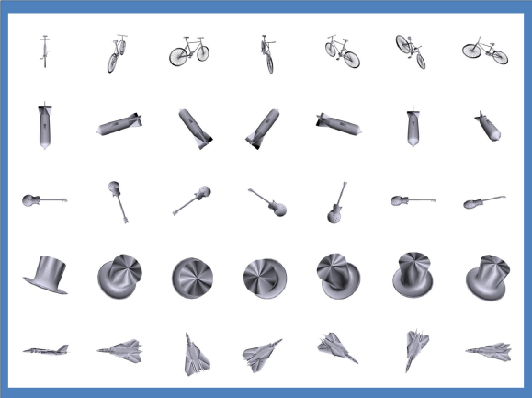
Datasets
ETH 3D object dataset (Ess et al. 2008), where it contains 80 objects belonging to 8 categories, and each object from ETH includes 41 different view s.
NTU-60 3D model dataset (Chen et al. 2003), where it contains 549 objects belonging to 47 categories, and each object from NTU-60 includes 60 views.
MVRED 3D object dataset (Liu et al. 2016), where it contains 505 objects belonging to 61 categories, and each object from MVRED includes 36 different views.
ETH
MVRED
NTU-60
Figure 1: Examples from ETH, MVRED, NTU-60 datasets respectively
[1] A mobile vision system for robust multi-person tracking [Ess et al. 2008]
[2] On visual similarity based 3-D model retrieval [Chen et al. 2003]
[3] Multimodal clique-graph matching for view-based 3d model retrieval[Liu et al. 2016]
Notes:
in our experiments, we use three public 3D datasets ETH, NTU-60 and MVRED. From the picture, we can see that the ETH and MVRED are the object datasets, and NTU-60 is the model dataset.

Slide 20
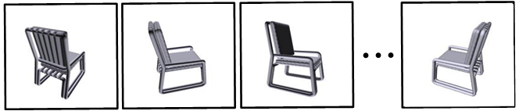
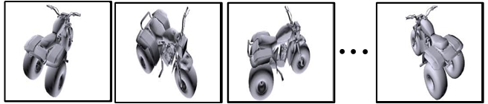
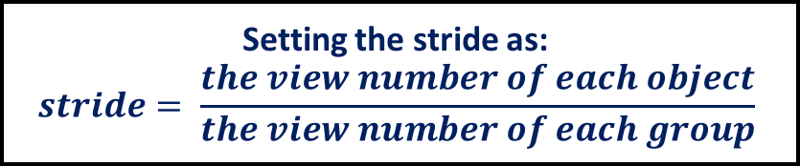
Generate group pair samples
Datasets | Original Samples |  |  |  | Group Pair Samples
 | Objects | Views (one object) | Views (all objects) | Views in Group | Groups (one object) | Group pairs (two objects) | All Group pairs
ETH | 80 | 41 | 3280 | 3 | 10660 | 10660² | 3160x10660²
NTU-60 | 549 | 60 | 32940 | 3 | 34220 | 34220² | 150426x34220²
MVRED | 505 | 36 | 18180 | 3 | 7140 | 7140² | 127260x7140²
Extract views
Setting the stride as:
$$stride= \frac{the view number of each object}{the view number of each group}$$
Group pairs
(two objects)
Group pairs
(all objects)
41 views
Extract views
41 views
Notes:
And before training, we should generate the group-pair samples, the details showed in table, In the ETH datasets, it only has 3280 samples, and then we generate group pair samples. There are 41 views in one object, and we extract views by setting the stride as the number of views divided by 3, so we can get the 10660 groups. Next, combine the groups from two objects; we can get 10660 square group pairs. For all objects, we can get 3160 time 10660 square samples

Slide 21
Evaluation Criteria
Nearest neighbor (NN)
First tier (FT)
Second tier (ST)
F-measure (F):
Discounted Cumulative Gain (DCG)[1]
Average Normalized Modified Retrieval Rank (ANMRR)[2]
Precision–recall Curve
[1] A Bayesian 3-D search engine using adaptive views clustering [Ansary et al. 2008]
[2] Description of Core Experiments for MPEG-7 Color/Texture Descriptors [MPEG video group. 1999]
Notes:
In the performance experiments, we use these Evaluation Criteria.
Nearest neighbor (NN): NN is the correct rate of the first retrieved result.
First tier (FT): It is defined as the recall of the top N results, where is the number of relevant samples in the whole dataset.
Second tier (ST): It is defined as the recall of the top 2N results, where is the number of relevant samples in the whole dataset.
F-measure (F): It is a composite measure of precision and recall for a fixed number of retrieved results Which defined as F=2 x P x R/(P+R).
Discounted cumulative gain (DCG)[1]: It is a statistic that assigns relevant results near the front of the list higher weights under the assumption that a user is less likely to consider elements near the end of the list.
Average Normalized Modified Retrieval Rank (ANMRR)[2]: ANMRR is another objective measure to evaluate the retrieval performances, where a low value of ANMRR indicates a high precision in the top results.
Precision–recall Curve: The performance of 3D object retrieval is assessed in terms of average recall and average precision

Slide 22
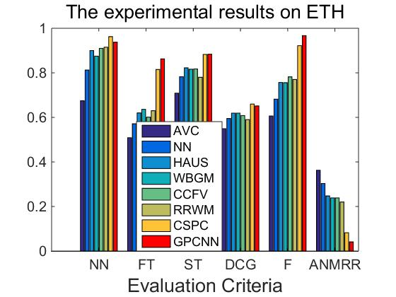
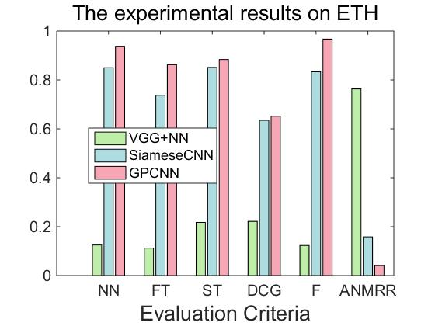
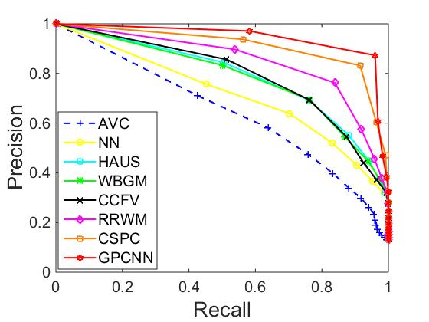
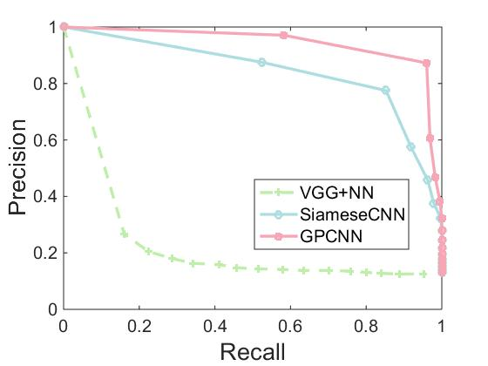
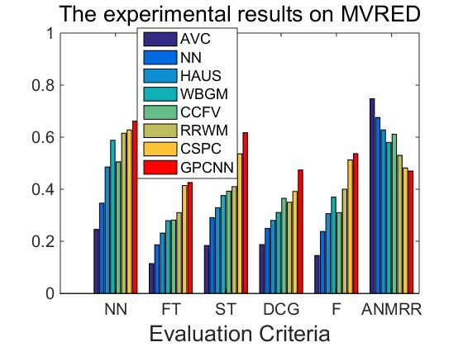
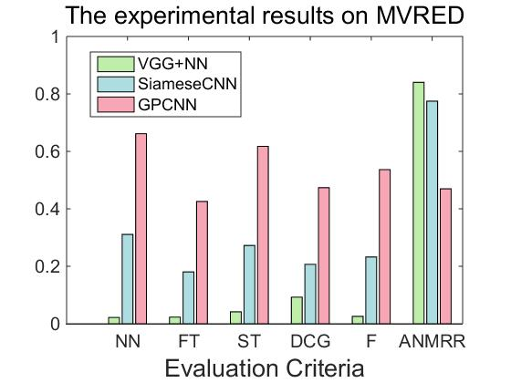
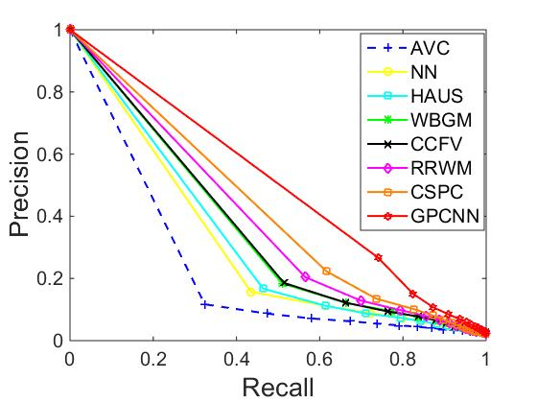
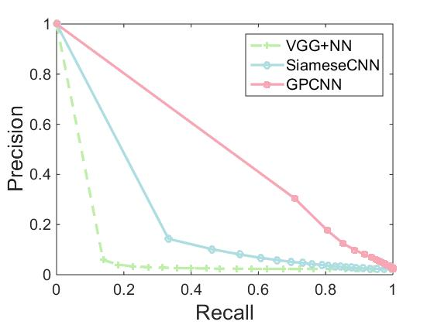
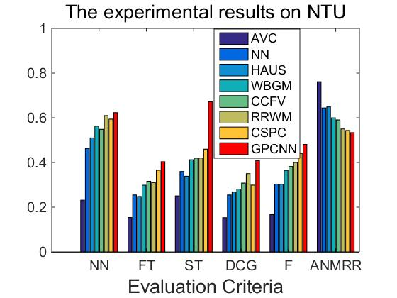
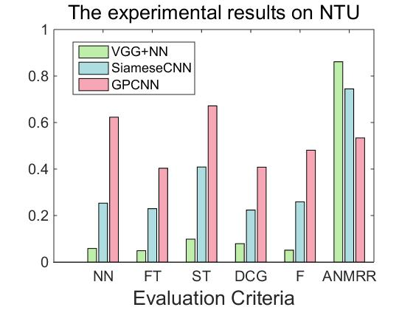
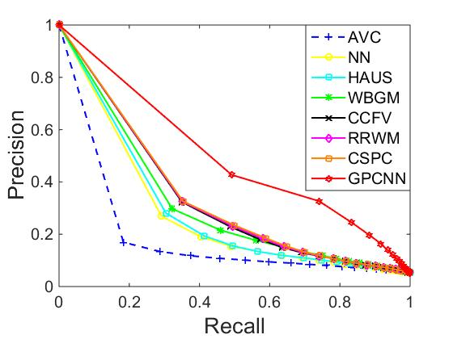
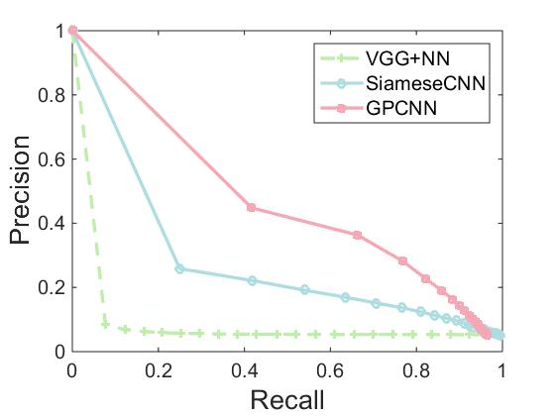
• Average performance is better than traditional machine learning methods for 3D object retrieval
• Average performance is better than traditional machine learning methods for 3D object retrieval
[AVC] A Bayesian 3-D search engine using adaptive views clustering (Ansary et al. 2008)
[NN and HAUS] A comparison of document clustering techniques (Steinbach et al. 2000)
[WBGM] 3d model retrieval using weighted bipartite graph matching (Gao et al. 2011)
[CCFV] Camera constraint-free view-based 3-d object retrieval (Gao et al. 2012)
[RRWM] Reweighted random walks for graph matching (Cho et al. 2010)
[CSPC] A fast 3d retrieval algorithm via class-statistic and pair-constraint model (Gao et al. 2016)
• Huge improvement than CNN-based methods for 3D object retrieval
[VGG] Very Deep Convolutional Networks for Large-Scale Image Recognition (Simonyan et al. 2015)
[Siamese CNN] Learning a similarity metric discriminatively, with application to face verification (Chopra et al. 2005)
Notes:
And these are the performance charts.
We can see that GPCNN has better performance than other traditional machine learning methods
And compared with some CNN-based methods, GPCNN also has good performance.

Slide 23
Conclusion
In this work, a novel end-to-end solution named Group Pair Convolutional Neural Network (GPCNN) is proposed which can jointly learn the visual features from multiple views of a 3D model and optimize towards the object retrieval task.
Experiment results demonstrate that GPCNN has a better performance than other methods, and increase the number of training samples by generating group pair samples.
In the future work, we will pay more attention to the view selection strategy for GPCNN including which views are the most informative and how to choose the optimal number of views for each group.
Notes:
And finally, let me make a brief conclusion
In this work, we propose GPCNN that can learn the features from multiple views and optimize towards the object retrieval task
And experiment results demonstrate GPCNN has a better performance than other methods.
In the future’s work, we will pay more attention to the view selection strategy including how to choose the most informative views and how to choose the optimal number of views

Slide 24
Thanks
Zan Gao, Deyu Wang, Xiangnan He, Hua Zhang
zangaonsh4522@gmail.com, xzero3547w@163.com, xiangnanhe@gmail.com, hzhang62@163.com
Notes:
Contrastive loss function is a simple way to implement pairwise training, and the goal of contrastive loss function is very clear, it’s to shorten the distance within cluster, and enlarge the distance between cluster, in this work ,we don’t pay more attention to the selection of loss function.
The end-to-end property is for training stage, the object retrieval is based on the distance between two objects, and we trained our network are also based on the distance between two objects, so they have the same target.
This structure can receive the group-pair samples to solve the problem insufficient samples, and we can use double-chain structure to train end-to-end, and this structure can map the object features from the same class into a same space.
The weights of two chains are the same after training, because of symmetrical training.

