Slide 1

Discrete Collaborative Filtering
Hanwang Zhang¹, Fumin Shen², Wei Liu³,
Xiangnan He¹, Huanbo Luan⁴, Tat-Seng Chua¹
Presented by Xiangnan He
National University of Singapore
University of Electronic Science and Technology of China
Tencent Research
Tsinghua University
19 July 2016

Slide 2
Highlights of Discrete Collaborative Filtering
Online Recommendation
An Efficient Recommender System
Latent Model: Binary Representation for Users and Items
Recommendation as Search with Binary Codes
Offline Training
End-to-end binary optimization
Balanced and Decorrelated Constraint
Small SVD + Discrete Coordinate Descent

Slide 3
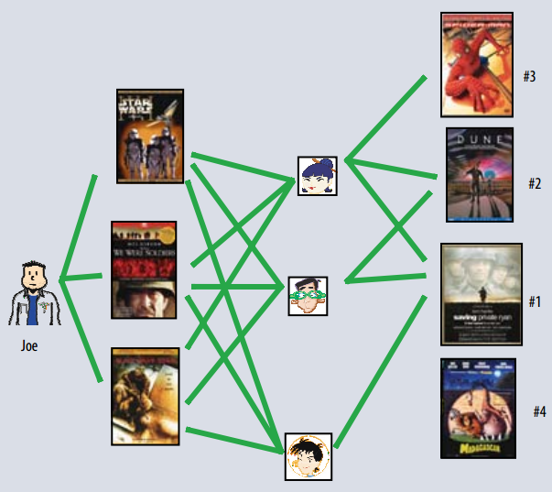
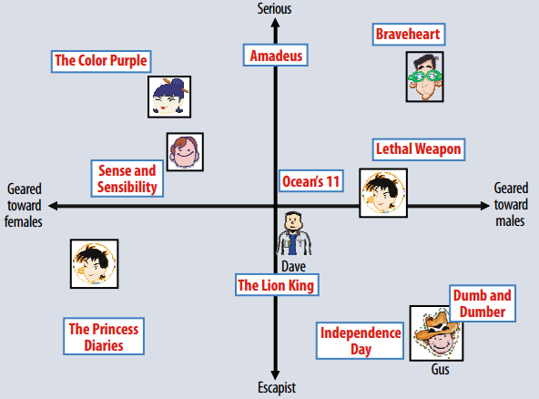
Collaborative Filtering
Latent Factor Approach [Koren et al. 2009]
User-Item Matrix
Latent Space

Slide 4
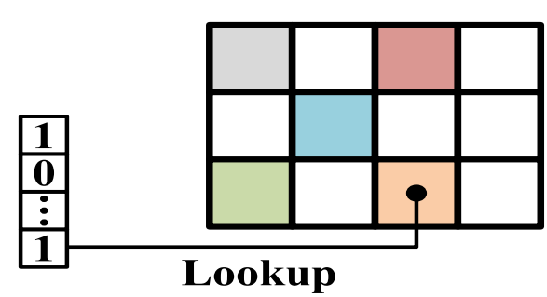
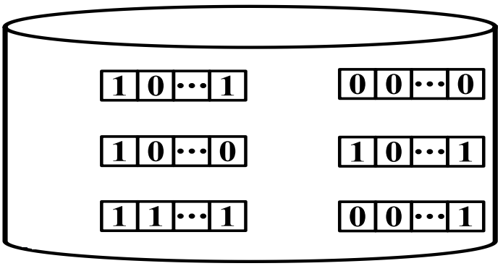


Efficient CF: Hashing Users & Items
Recommendation is Search
Search in Euclidean space is slow
Search in Hamming Space is fast.
Ranking by <user vector, item vector>
Requires float operations & linear scan of the data
Only requires XOR operation & constant-time lookup
Hash Table
User-Item Database
Query Code

Slide 5
Existing Hashing for CF: Two-Stage Approach
[Zhang et al, SIGIR’14; Zhou et al, KDD’12]
Stage 1: Relaxed Real-Valued Problem
{B, D} ← Continuous CF Methods
Stage 2: Binarization
B ← sgn (B), D ← sgn (D)
Code learning and CF are isolated
Quantization Loss

Slide 6
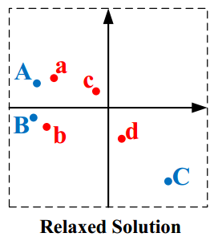
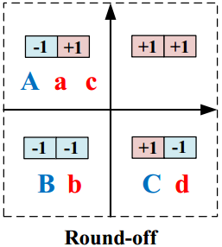
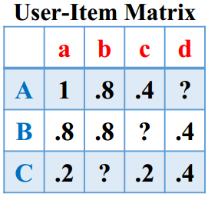
Quantization Loss
1. A,B,a,b are close but they are separated into different quadrants
2. C, d should be far but they are assigned to the same quadrant

Slide 7
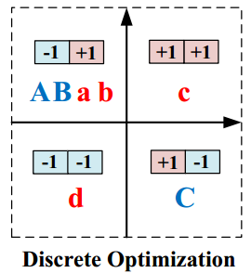
Tackling Quantization Loss

Slide 8
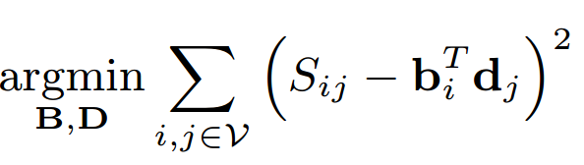

Intuitive Solution: Binary Constraints
Observed rating
User code
Item code
Binary Constraint
Rating Prediction
However, it may lead to non-informative codes, e.g.:
Unbalanced Codes → each bit should have split the dataset evenly
Correlated Codes → each bit should be as independent as possible

Slide 9
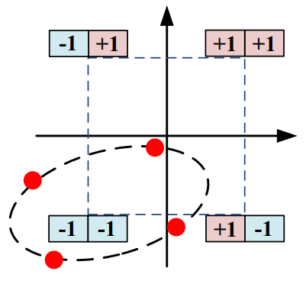
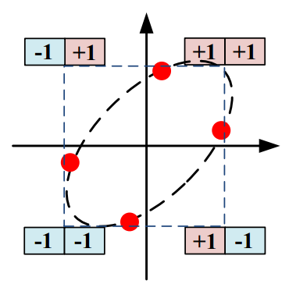
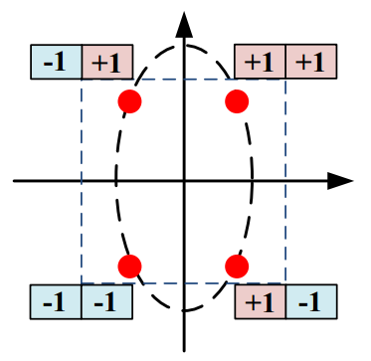
Balanced and Decorrelated Constraint
Illustration of the effectiveness of the two constraints in DCF
Without any constraints:
3 points are (-1, -1) and 1 point is (+1, -1), which is not discriminative.
Balanced:
Separated in the
1st & 3rd quadrant
Decorrelated:
Well separated

Slide 10
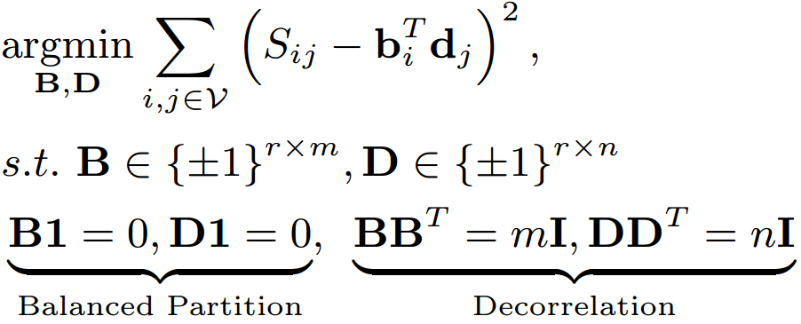
Solution with the Two Constraints
However, the hard constraints of zero-mean and orthogonality
may not be satisfied in Hamming space!

Slide 11
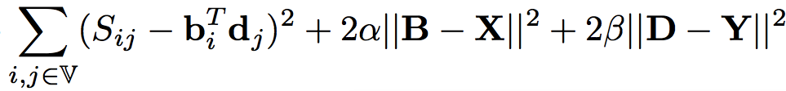
Our DCF Formulation
Objective function:
Rating Prediction
Constraint Trade-off
Binary Constraint
Balanced Constraint
Decorrelated Constraint
Delegate Code
Quality Constraint
Mixed-Integer Programming NP-Hard [Hastad 2001]

Slide 12
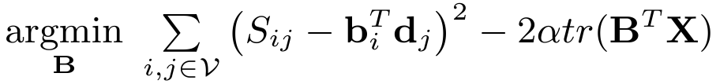

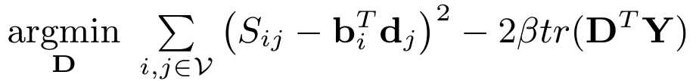




Our Solution: Alternating Optimization
Alternative Procedure
B-Subproblem
D-Subproblem
X-Subproblem
Y-Subproblem

Slide 13
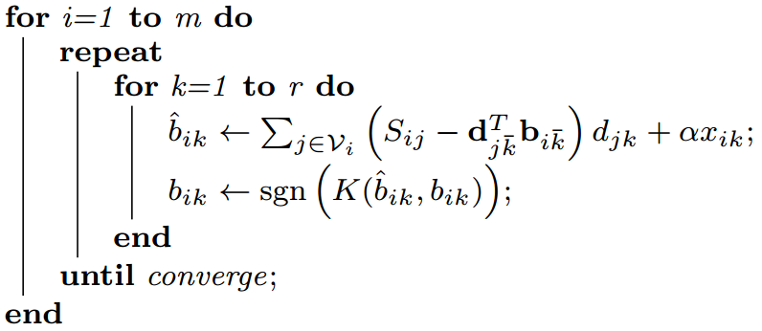
B-Subproblem for Binary Codes
Objective Function
For each user code b_{i}, optimize bit by bit
Parallel for loop over m users
Usually converges in 5 iterations
for loop over r bits
D-Subproblem can be solved in a similar way

Slide 14

B-Subproblem Complexity
#bits
#bit-by-bit iterations
#computing threads
#training ratings
Linear to data size!

Slide 15



X-Subproblem for Code Delegate
Objective Function
r x m row-centered
user code matrix
Small SVD r x m
Orthogonalization
Y-Subproblem can be solved in a similar way

Slide 16
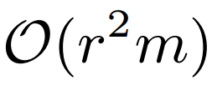
X-Subproblem Complexity
#bits
#users
Linear to data size!

Slide 17
Summary
Recommendation is search
We can accelerate search by hashing
Unlike previous erroneous two-stage hashing, DCF is an end-to-end hashing method
Fast O(n) discrete optimization for DCF

Slide 18
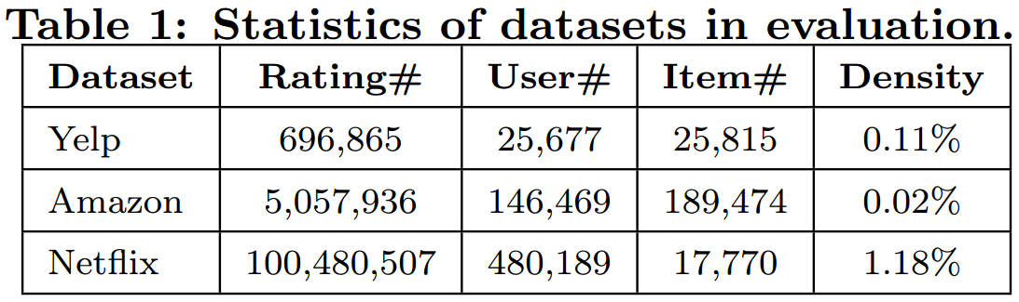
Evaluations
Dataset (filtering threshold at 10):
Random split: 50% training and 50% testing.
Metric: NDCG@K
Search Protocol:
Hamming ranking or hash table lookup

Slide 19
Evaluation 1: Compared to state-of-the-art
MF: Matrix Factorization [Koren et al 2009]
Classific MF, Euclidean space baseline
BCCF: Binary Code learning for Collaborative Filtering
[Zhou&Zha, KDD 2012]
MF+balance+binarization
PPH: Preference Preserving Hashing [Zhang et al. SIGIR 2014]
Cosine MF + norm&phase binarization
CH: Collaborative Hashing [Liu et al. CVPR 2014]
Full SVD MF + balance + binarization

Slide 20
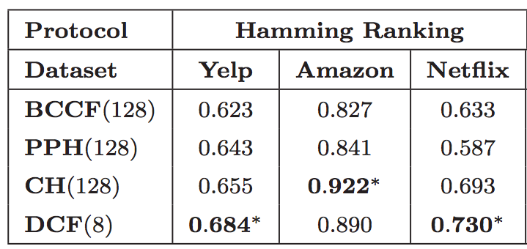
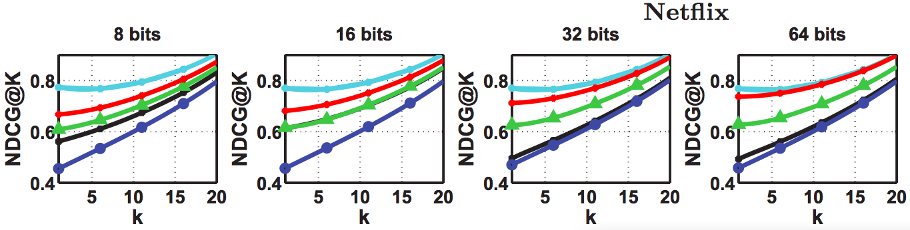
Evaluation 1 DCF is a new state-of-the-art
Performance of NDCG@10.
DCF learns compact and informative codes.
DCF’s performance is most close to the real-valued MF.
End-to-end > Two stage
￼
￼
￼￼
￼

Slide 21
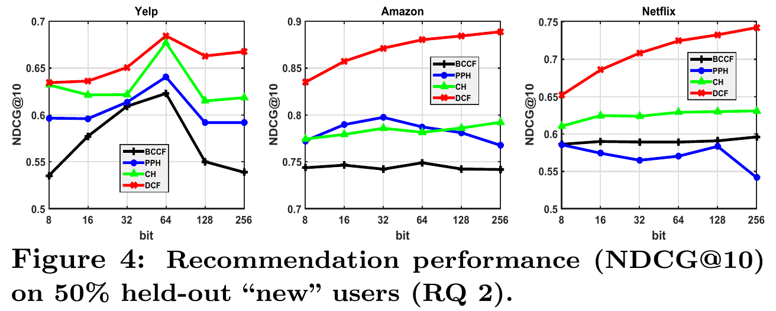
Evaluation 2 DCF generalizes well to unseen users
Training: full histories of 50% users
Testing: the other 50% users that have no histories in training
Evaluation: simulate online learning scenario.

Slide 22
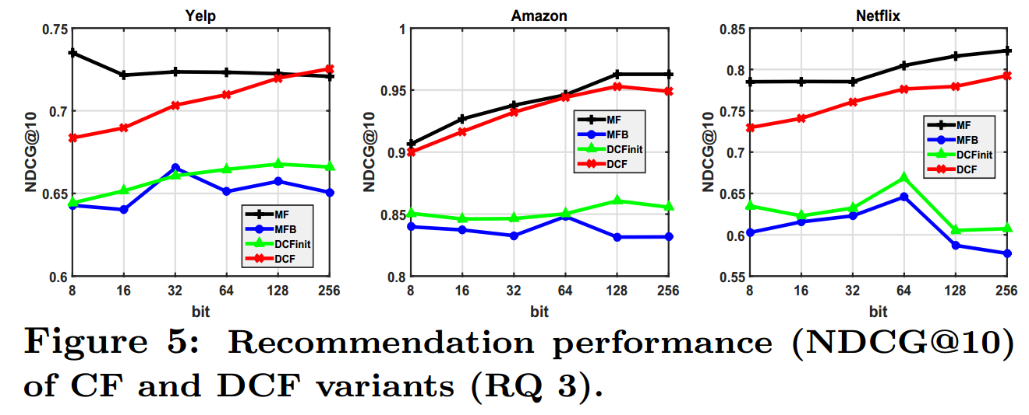
Evaluation 3 Balanced and Decorrelated Constraints are necessary
MF: original MF
MFB: MF+Binarization
DCFinit: the variant of DCF that discards the two constraints.

Slide 23
Conclusions
Discrete Collaborative Filtering: an end-to-end hashing method for efficient CF
A fast algorithm for DCF
DCF is a general framework. It can be extended to any popular CF variants, such as SVD++ and factorization machines.

Slide 24

Thank you
Code available: https://github.com/hanwangzhang/Discrete-Collaborative-Filtering

