Slide 1
Fast Matrix Factorization for Online Recommendation with Implicit Feedback
Xiangnan He, Hanwang Zhang, Min-Yen Kan, Tat-Seng Chua
National University of Singapore (NUS)
SIGIR 2016, July 20, Pisa, Italy

Slide 2
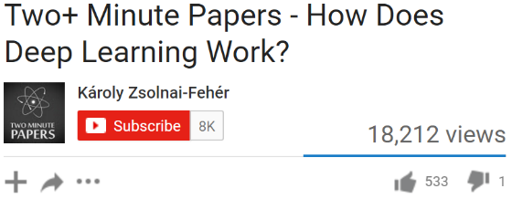



Value of Recommender System (RS)
Netflix: 60+% of the movies watched are recommended.
Google News: RS generates 38% more click-through
Amazon: 35% sales from recommendations
Statistics come from Xavier Amatriain

Slide 3
Collaborative Filtering (CF)
items
1 | ? | 5 | ?
? | 2 | ? | ?
4 | ? | 5 | ?
1 | ? | ? | ?
2 | ? | ? | 4
Explicit Feedback
Rating prediction problem
Popularized by the Netflix Challenge
Only observed ratings are considered.
But, it is sub-optimal (missing-at-random
assumption) for Top-K Recom. (Cremonesi and Koren, RecSys 2010
Implicit Feedback
Ranking/Classification problem
Aims at recommending (unconsumed)
items to users.
Unobserved missing data (0 entries) is important!
users
Real-valued Rating matrix
items
1 | 0 | 0 | 1
0 | 1 | 0 | 0
1 | 1 | 0 | 0
1 | 0 | 0 | 1
users
0/1 Interaction matrix

Slide 4
Outline
Introduction
Technical Background & Motivation
Popularity-aware Implicit Method
Experiments (offline setting)
Experiments (online setting)
Conclusion

Slide 5
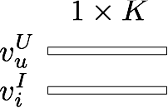

Matrix Factorization (MF)
MF is a linear latent factor model:
items
1 | 0 | 0 | 1
0 | 1 | 0 | 0
1 | 1 | 0 | 0
1 | 0 | 0 | 1
User 'u' interacted with item 'i'
users
Learn latent vector for each user, item:
0/1 Interaction matrix
Affinity between user ‘u’ and item ‘i’:

Slide 6
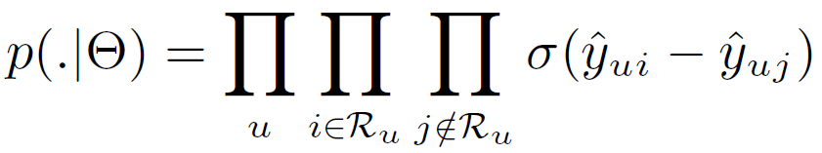
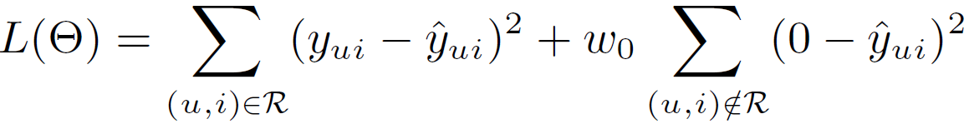
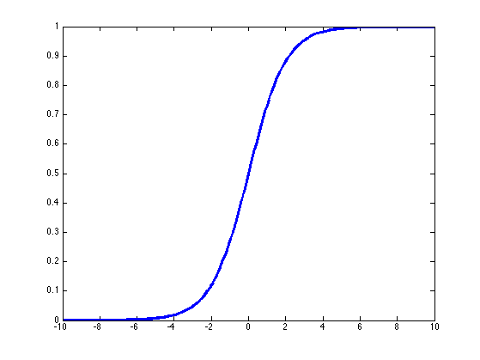
Previous Implicit MF Solutions
Pair-wise Ranking Method
(BPR, Rendle et al, UAI 2009)
Regression-based Method
(WALS, Hu et al, ICDM 2008)
Sampling negative instances:
Treating all missing data as negative:
LIKELIHOOD:
LOSS:
Weight for Missing data
Sigmoid:
Prediction on observed entries
Prediction for missing data
All Items
bought by u
Items not
bought by u
Address the effectiveness and efficiency issue of regression method.
Pros:
+ Efficient
+ Optimized for ranking (good precision)
Cons:
Only model partial data (low recall)
Pros:
+ Model the full data (good recall)
Cons:
Less efficient
Uniform weighting on missing data.

Slide 7
Drawbacks of Existing Methods
(whole-data based)

Slide 8
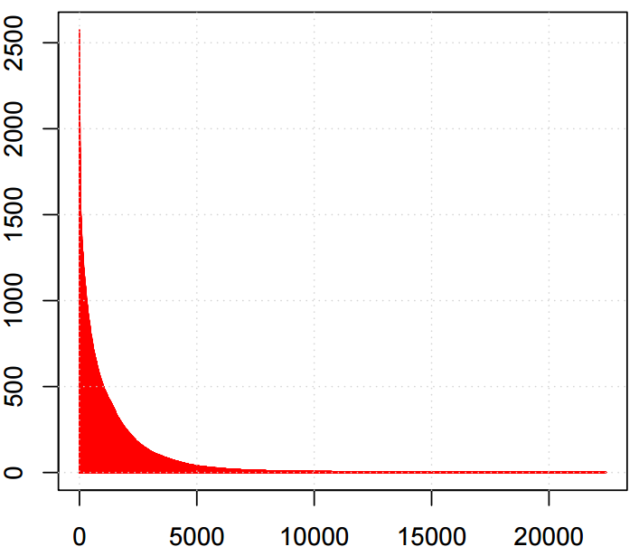
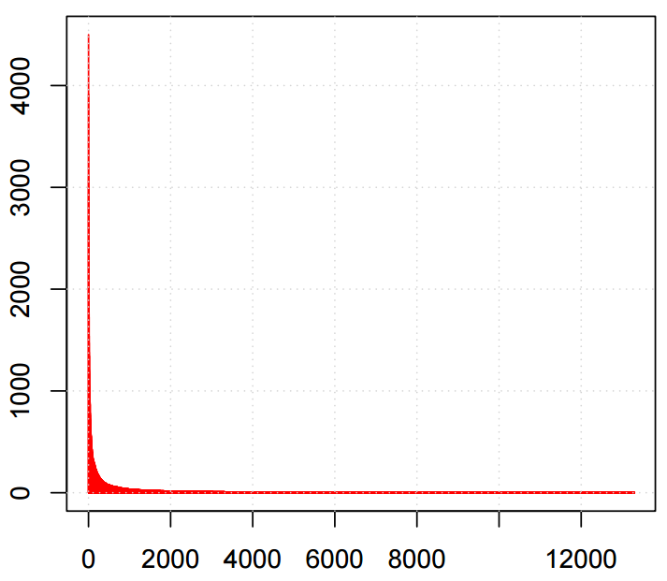
Uniform Weighting - Limits model’s fidelity and flexibility
Uniform weighting on missing data assumes that
“all missing entries are equally likely to be a negative assessment.”
The design choice is for the optimization efficiency --- an efficient ALS algorithm (Hu, ICDM 2008) can be derived with uniform weighting.
However, such an assumption is unrealistic.
Item popularity is typically non-uniformly distributed.
Popular items are more likely to be known by users.
BBC Video
Tag: ECML'09 Challenge
Selection Frequency
Selection Frequency
Video Rank
Tag Rank
Figures adopt from Rendle, WSDM 2014.

Slide 9
Low Efficiency - Difficult to support online learning
An analytical solution known as ridge regression
Vector-wise ALS
Time complexity: O((M+N)K³ + MNK²)
M: # of items, N: # of users, K: # of latent factors
With the uniform weighting, Hu can reduce the complexity to O((M+N)K³ + |R|K²)
|R| denotes the number of observed entries.
However, the complexity is too high for large dataset:
K can be thousands for sufficient model expressiveness
e.g. YouTube RS, which has over billions of users and videos.
Scary complexity and unrealistic for practical usage

Slide 10
Importance of Online Learning for RS
Scenario of Recommender System:
New data continuously streams in:
New users;
Old users have new interactions;
It is extremely useful to provide instant personalization for new users, and refresh recommendation for old users, but retraining the full model is expensive
=> Online Incremental Learning
Historical data
New data
Training
Recommendation
Time

Slide 11
Key Features
Our proposal
Non-uniform weighting on Missing data
An efficient learning algorithm (K times faster than Hu’s ALS, the same magnitude with BPR-SGD learner)
Seamlessly support online learning.

Slide 12
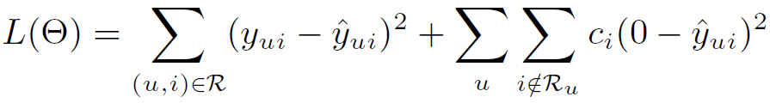
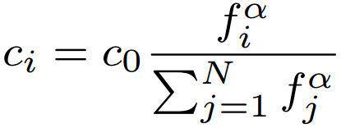
#1. Item-Oriented Weighting on Missing Data
Old Design:
Our Proposal:
The confidence that item i missed by users is a true negative assessment
Popularity-aware Weighting Scheme:
Intuition: a popular item is more likely to be known by users, thus a missing on it is more probably that the user is not interested with it.
Similar to frequency-aware negative sampling in word2vec.
Smoothness: 0.5 works well
Overall weight of missing data
Frequency of item

Slide 13
#2. Optimization (Coordinate Descent)
Existing algorithms do not work:
SGD: needs to scan all training instance O(MN).
ALS: requires a uniform weight on missing data.
We develop a Coordinate Descent learner to optimize the whole-data based MF:
Element-wise Alternating Least Squares Learner (eALS)
Optimize one latent factor with others fixed (greedy exact optimization)
Property | eALS (ours) | ALS (traditional)
Optimization Unit | Latent factor | Latent vector
Matrix Inversion | No | Yes (ridge regression)
Time Complexity | O(MNK) | O((M+N)K³ + MNK²)

Slide 14
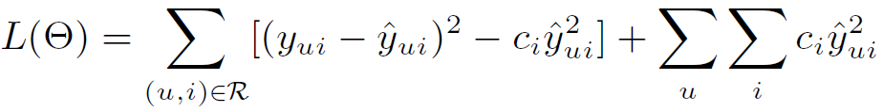
#2.1 Efficient eALS Learner
An efficient learner by using memoization.
Key idea: memoizing the computation for missing data part:
Reformulating the loss function:
Bottleneck: Missing data part
Sum over all user-item pairs, can be seen as a prior over all interactions!
This term can be computed efficiently in O(|R| + MK²), rather than O(MNK). Algorithm details see our paper.

Slide 15
#2.2 Time Complexity
# of latent factors
O((M+N)K² + |R|K)
# of users
# of items
# of observed ratings
Linear to data size!

Slide 16
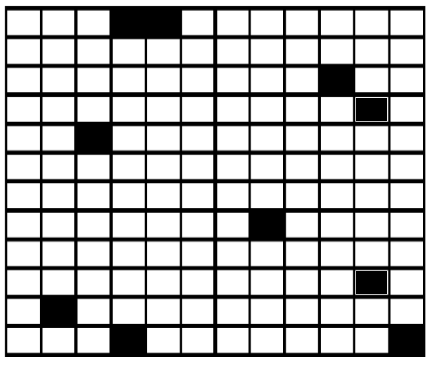
#3. Online Incremental Learning
Items
Given a new (u, i) interaction, how to refresh model parameters without retraining the full model?
Users
Our solution: only perform updates for v_{u} and v_{i}
- We think the new interaction should change the local features for u and i significantly, while the global picture remains largely unchanged.
Black: old training data
Blue: new incoming data
Pros:
+ Localized complexity: O(K² + (|R_{u}| + |R_{i}|)K)

Slide 17
Outline
Introduction
Technical Background & Motivation
Popularity-aware Implicit Method
Experiments (offline setting)
Experiments (online setting)
Conclusion

Slide 18
Dataset & Baselines
Two public datasets (filtered at threshold 10):
Yelp Challenge (Dec 2015, ~1.6 Million reviews)
Amazon Movies (SNAP.Stanford)
Baselines:
ALS (Hu et al, ICDM’08)
RCD (Devooght et al, KDD’15)
Randomized Coordinate Descent, state-of-the-art implicit MF solution.
BPR (Rendle et al, UAI’09)
SGD learner, Pair-wise ranking with sampled missing data.
Dataset | Interaction# | Item# | User# | Sparsity
Yelp | 731,671 | 25.8K | 25.7K | 99.89%
Amazon | 5,020,705 | 75.3K | 117.2K | 99.94%

Slide 19
Offline Protocol (Static data)
Leave-one-out evaluation (Rendle et al, UAI’09)
Hold out the latest interaction for each user as test (ground-truth).
Although it is widely used in literatures, it is an artificial split that does not reflect the real scenario.
Leak of collaborative information!
New users problem is averted.
Top-K Recommendation (K=100):
Rank all items for a user (very time consuming, longer than training!)
Measure: Hit Ratio and NDCG.
Parameters: #factors = 128 (others are also fairly tuned, see the paper)

Slide 20
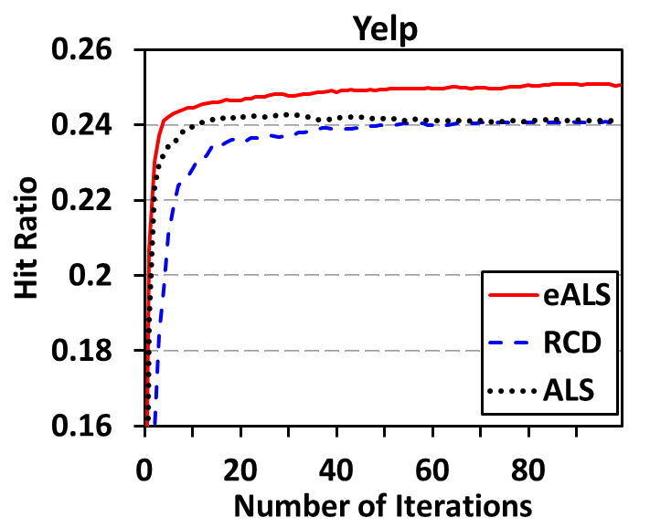
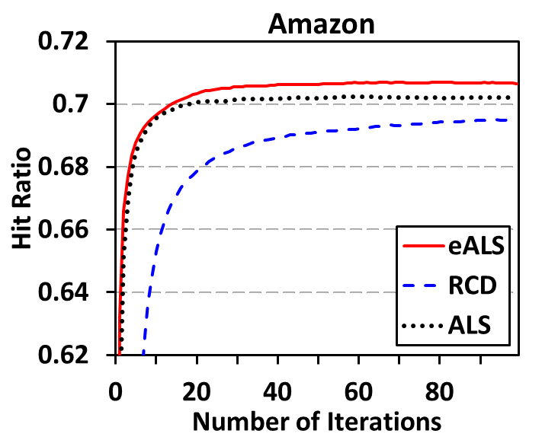
Compare whole-data based MF
Analysis:
1. eALS > ALS: popularity-aware weighting on missing data is useful.
2. ALS > RCD: alternating optimization is more effective than
gradient descent for linear MF model.

Slide 21
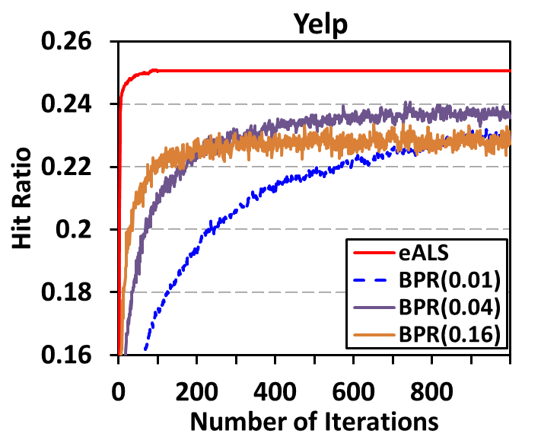
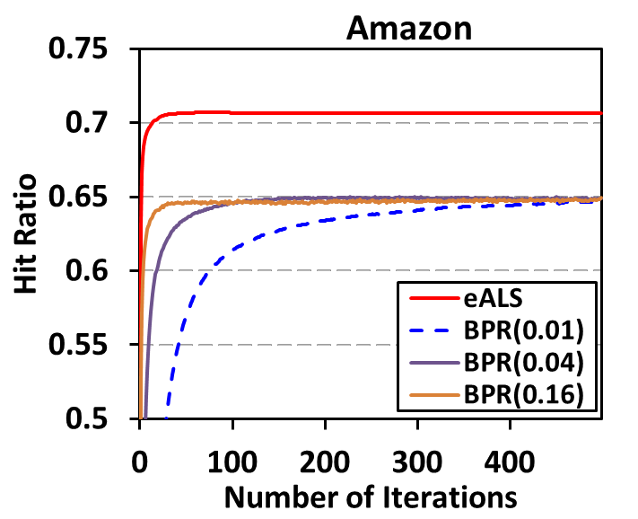
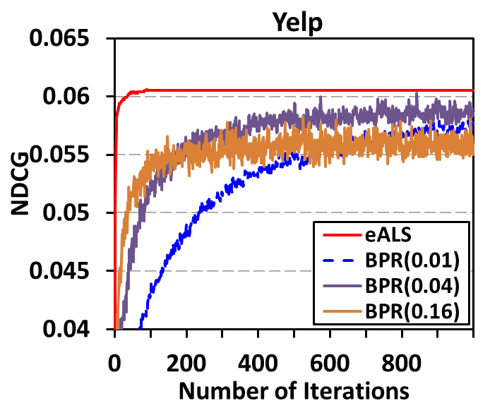
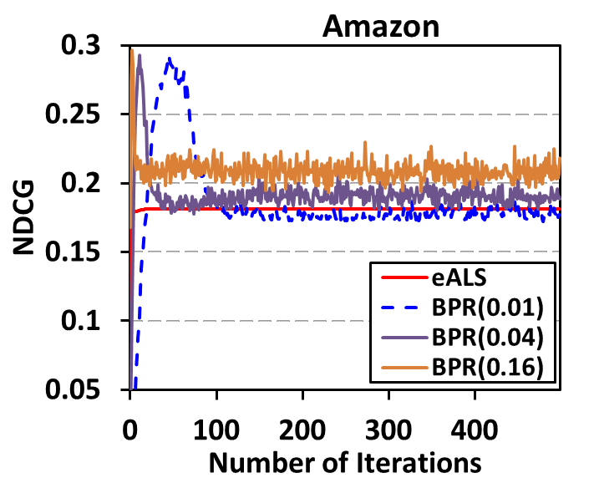
Compare with Sampled-based BPR
Observation:
1. BPR is a weak performer for Hit Ratio
(low recall, as it samples partial missing data only)
2. BPR is a strong performer for NDCG
(high precision, as it optimizes a ranking-aware function)
Hit Ratio
NDCG

Slide 22
Efficiency Comparison
Training time per iteration (Java, single-thread)
 | Yelp (0.73M) |  | Amazon (5M)
Factor# | eALS | ALS | eALS | ALS
32 | 1 s | 10 s | 9 s | 74 s
64 | 4 s | 46 s | 23 s | 4.8 m
128 | 13 s | 221 s | 72 s | 21 m
256 | 1 m | 23 m | 4 m | 2 h
512 | 2 m | 2.5 h | 12 m | 11.6 h
Analytically:
eALS: O((M+N)K² + |R|K)
ALS: O((M+N)K³ + |R|K²)
We used a fast matrix inversion algorithm: O(K^{2.376})
eALS has the similar running time with RCD (KDD’15), which only supports uniform weighting on missing data.

Slide 23
Online Protocol (dynamic data stream)
Sort all interactions by time
Global split at 90%, testing on the latest 10%.
In the testing phase:
Given a test interaction (i.e., u-i pair), the model recommends a Top-K list to evaluate the performance.
Then, the test interaction is fed into the model for an incremental update.
New users problem is obvious:
57% (Amazon) and 14% (Yelp) test interactions are from new users!
Historical data (offline)
New Interactions (online)
Training (90%)
Evaluate & Update
Time

Slide 24
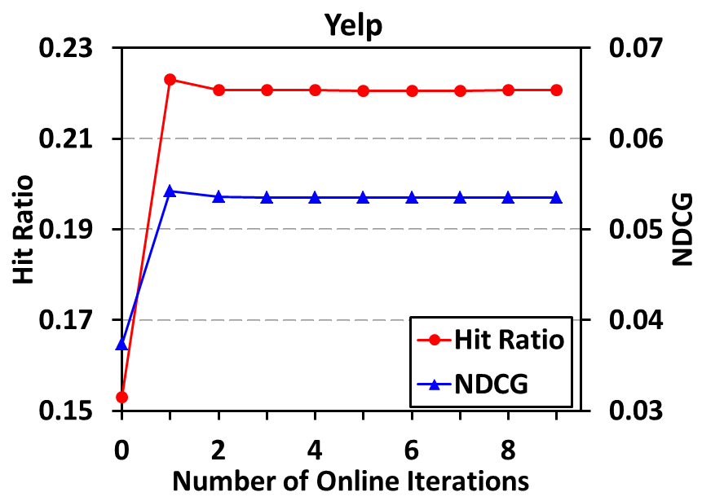
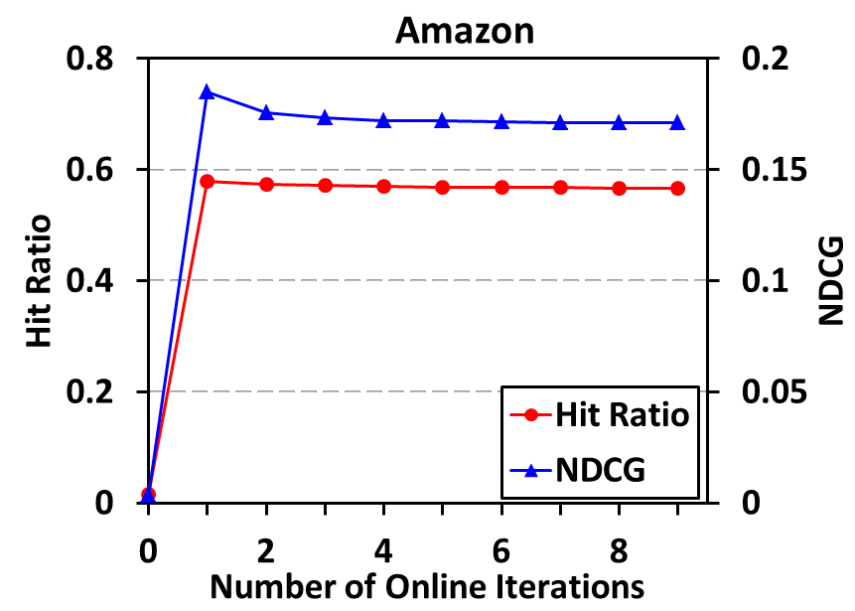
Number of Online Iterations
Impact of online iterations on eALS:
Offline training
Offline training
One iteration is enough for eALS to converge!
While BPR (SGD) needs 5-10 iterations.

Slide 25
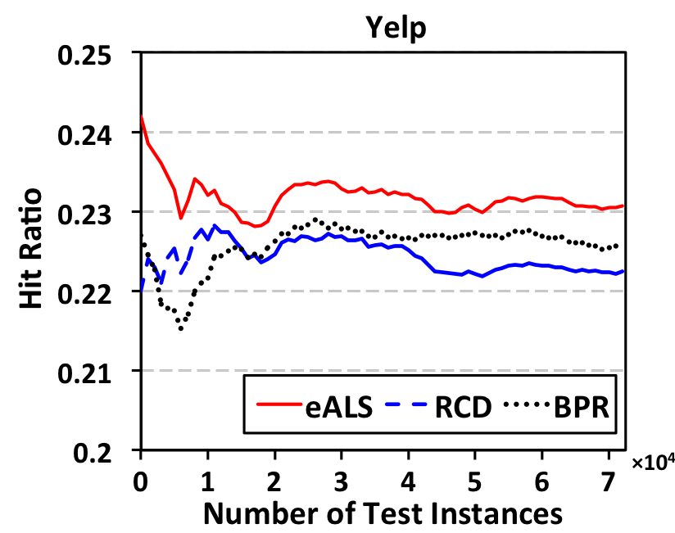
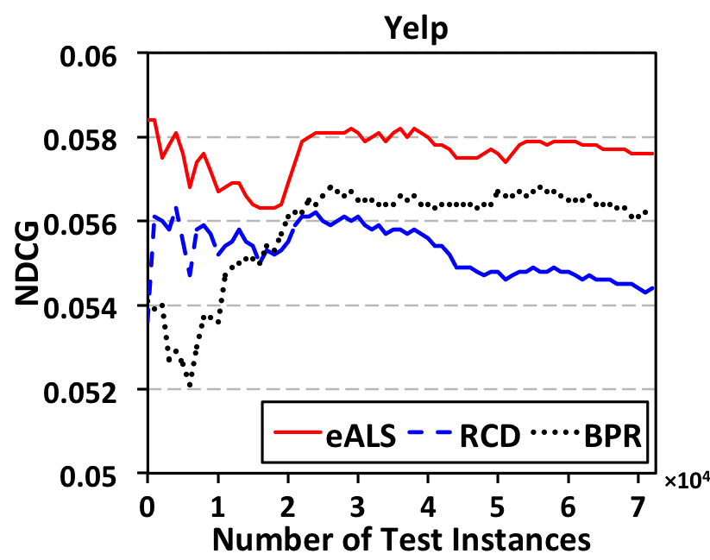
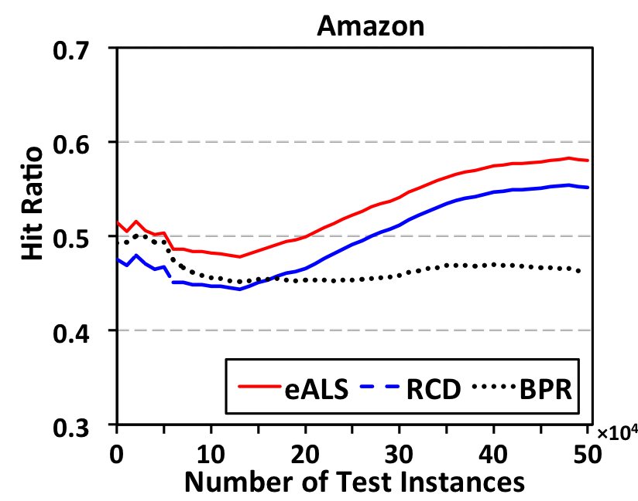
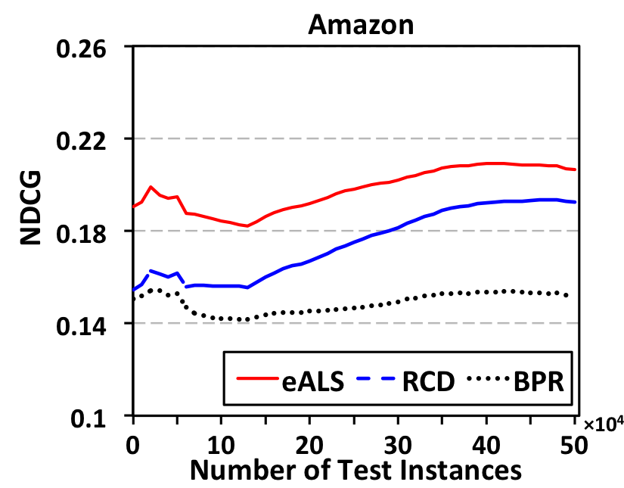
Compare dynamic MF methods
Performance evolution w.r.t. number of test interactions:
Observations:
1. Our eALS consistently outperforms RCD (Devooght et al, KDD’15) and BPR
2. Performance trend – first decreases (cold-start cases), then increases (usefulness of online learning).

Slide 26
Conclusion
Matrix Factorization for Implicit Feedback
Model the full missing data leads to better prediction recall.
Weight the missing data non-uniformly is more effective.
Develop an efficient algorithm that supports online incremental learning.
Explore a new way to evaluate recommendation in a more realistic, better manner.
Simulate the dynamic data stream.
Our efficient eALS technique is a generic solution, which can solve MF with any weighting scheme of missing data.
Item-oriented (this work) is just a special case.

Slide 27
Future Work
Online Recommendation:
Balance Short-term (online data) and Long-term preference (offline data).
Our technique is promising for other applications, e.g., in representation learning of words:
GloVe models observed entries only.
Word2vec samples negative entries.
Recently, Google develops Swivel that accounts for the full missing data, leading to better embedding but very high time complexity.

Slide 28

Thanks!
Codes available: https://github.com/hexiangnan/sigir16-eals

