Slide 1

Neural Collaborative Filtering
He Xiangnan¹, Liao Lizi¹, Zhang Hanwang¹, Nie Liqiang²,
Hu Xia³, Tat-Seng Chua¹
April 05, 2017 @ WWW 2017
Presented by Xiangnan He
1 National University of Singapore
2 Shandong University, China
3 Texas A&M University

Slide 2
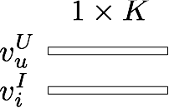

Matrix Factorization (MF)
MF is a linear latent factor model:
items
1 | 0 | 0 | 1
0 | 1 | 0 | 0
1 | 1 | 0 | 0
1 | 0 | 0 | 1
User 'u' interacted with item 'i'
users
Learn latent vector for each user, item:
0/1 Interaction matrix
Affinity between user ‘u’ and item ‘i’:
Notes:
Matrix factorization is known to be the most simple yet effective model for the collaborative filtering task. Basically, it models each user and item as a low-dimentional latent vector, and estimates an interaction between user and item as the inner product of their latent vectors.

Slide 3
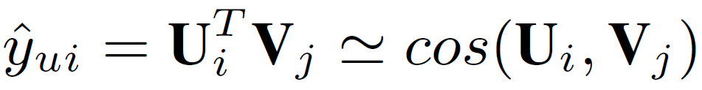
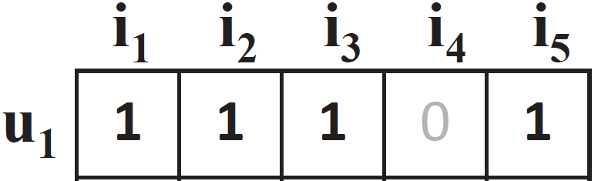


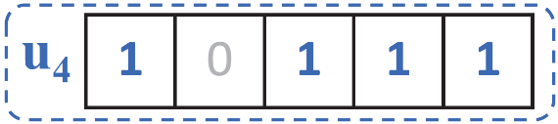
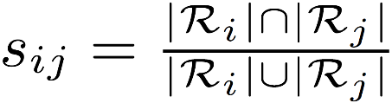
Limitation of Matrix Factorization
The simple choice of inner product function can limit the expressiveness of a MF model.
Example:
(E.g., assuming a unit length)
S₄₂ > S₄₃ (X)
u1
S₄₂ > S₄₃ (X)
sim(u1, u2) = 0.5
u2
sim(u3, u1) = 0.4
sim(u3, u2) = 0.66
u3
sim(u4, u1) = 0.6 *****
sim(u4, u2) = 0.2 *
sim(u4, u3) = 0.4 ***
Jaccard Similarity:

Slide 4
Limitation of Matrix Factorization
The simple choice of inner product function can limit the expressiveness of a MF model.
Example:
The inner product can incur a large ranking loss for MF
How to address?
- Using a large number of latent factors; however, it may hurt the generalization of the model (e.g. overfitting)
Our solution: Learning the interaction function from data!
Rather than the simple, fixed inner product.
(E.g., assuming a unit length)
S₄₂ > S₄₃ (X)
u1
S₄₂ > S₄₃ (X)
sim(u1, u2) = 0.5
u2
sim(u3, u1) = 0.4
sim(u3, u2) = 0.66
u3
sim(u4, u1) = 0.6 *****
sim(u4, u2) = 0.2 *
sim(u4, u3) = 0.4 ***
Jaccard Similarity:

Slide 5
Related Work
Our work
Recommender Systems
Deep Learning
Notes:
This work tackles the recommendation problem by utilizing the deep learning techniques. As such we position our work as the intersect of the two areas. In the next, we will review some recent work that use deep learning from recommender systems.

Slide 6
Related Work
Zhang et al. KDD 2016. Collaborative Knowledge Base Embedding for Recommender Systems
Y. Song et al. SIGIR 2016. Multi-Rate Deep Learning for Temporal Recommendation
Li et al. CIKM 2015. Deep Collaborative Filtering via Marginalized Denoising Auto-encoder
H. Wang et al. KDD 2015. Collaborative deep learning for recommender systems
A. Elkahky et al. WWW 2015. A Multi-View Deep Learning Approach for Cross Domain User Modeling in Recommendation Systems
X. Wang et al. MM 2014. Improving content-based and hybrid music recommendation using deep learning
Oord et al. NIPS 2013. Deep content-based music recommendation
Deep Learning (e.g., SDAE, CNN, SCAE) is only used for modelling SIDE INFORMATION of users and items.
For modelling the interaction between users and items, existing work still uses the simple inner product

Slide 7
Proposed Methods
Our Proposals:
A Neural Collaborative Filtering (NCF) framework that learns the interaction function with a deep neural network.
A NCF instance that generalizes the MF model (GMF).
A NCF instance that models nonlinearities with a multi-layer perceptron (MLP)
A NCF instance NeuMF that fuses GMF and MLP.

Slide 8
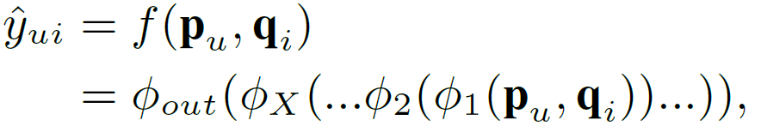
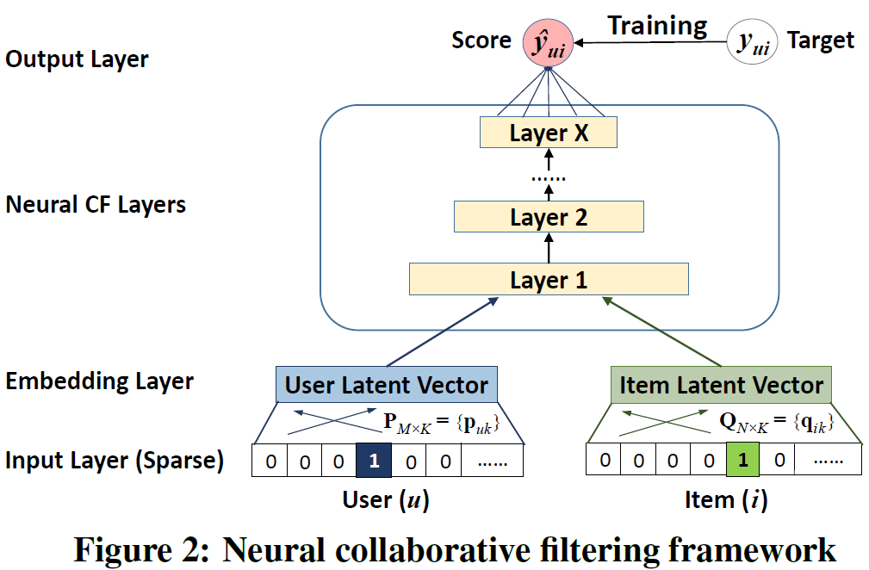
NCF Framework
Interaction function
NCF uses a multi-layer model to learn the user-item interaction function
Input: sparse feature vector for user u (v_{u}) and item i (v_{i})
Output: predicted score ŷ_{ui}
Note: Input feature vector can include any categorical variables other than user/item ID, such as attributes, contexts and content.
Notes:
NCF adopts two pathways to model users and items.

Slide 9
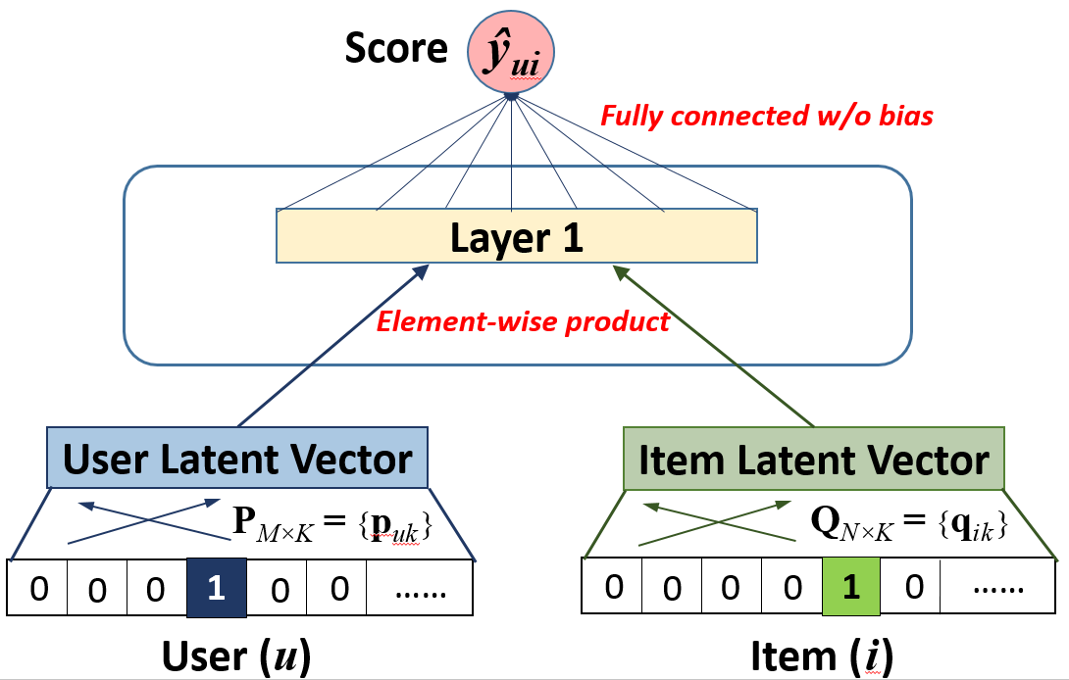
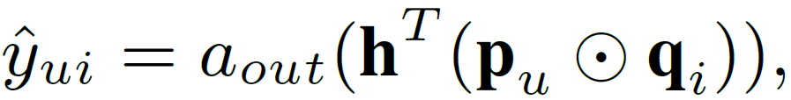
Generalized Matrix Factorization (GMF)
NCF can express and generalize MF:
Let we define Layer 1 as an element-wise product, and Output Layer as a fully connected layer without bias, we have:
Notes:
As MF is the most popular model for recommendation and has been investigated extensively in literature, being able to recover it allows NCF to simulate a large family of factorization models, such as SVD++, timeSVD and Factorization Machines.

Slide 10
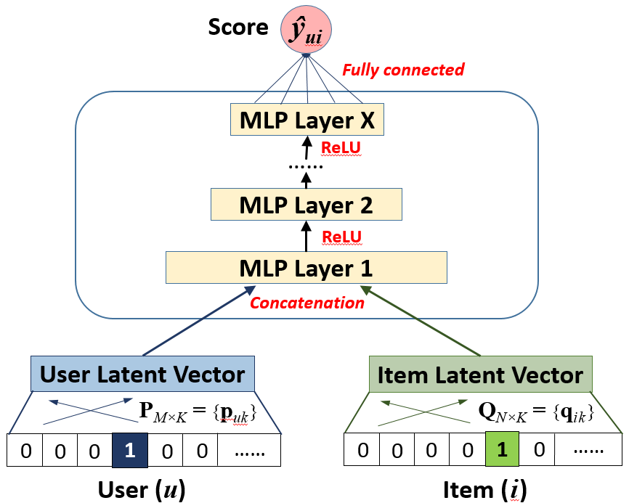
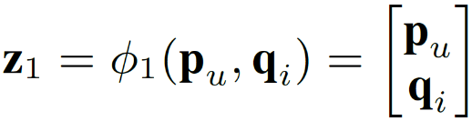
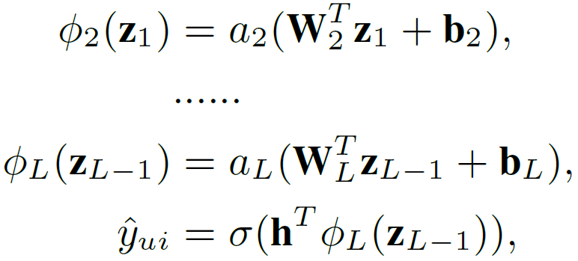
Multi-Layer Perceptron (MLP)
NCF can endow more nonlinearities to learn the interaction function:
Activation function: ReLU > tanh > sigmoid
Layer 1:
Remaining Layers:

Slide 11
MF vs. MLP
MF uses an inner product as the interaction function:
Latent factors are independent with each other;
It empirically has good generalization ability for CF modelling
MLP uses nonlinear functions to learn the interaction function:
Latent factors are not independent with each other;
The interaction function is learnt from data, which conceptually has a better representation ability.
However, its generalization ability is unknown as it is seldom explored in recommender literature/challenge.
Can we fuse two models to get
a more powerful model?
Notes:
By generalization ability, we mean a model’s prediction performance on the unknown, test data.
By representation ability, we mean a model’s ability to fit the training data.

Slide 13
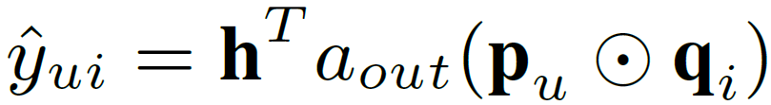
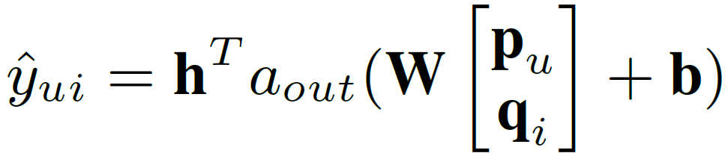
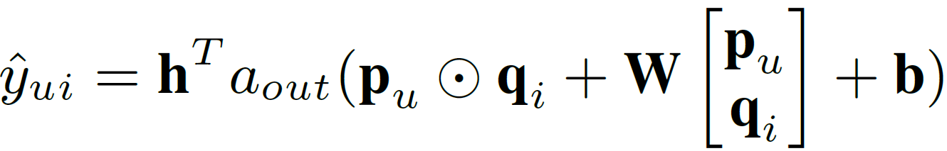
An Intuitive Solution – Neural Tensor Network
MF model:
MLP model (1 linear layer):
The Neural Tensor Network* naturally assumes MF and MLP share the same embeddings, and combines their latent space by an addition:
However, we find NTN does not significantly improve over MF:
A possible reason is due to the limitation of the shared embeddings.
* Socher Richard, et al. NIPS 2013 "Reasoning with neural tensor networks for knowledge base completion"

Slide 14
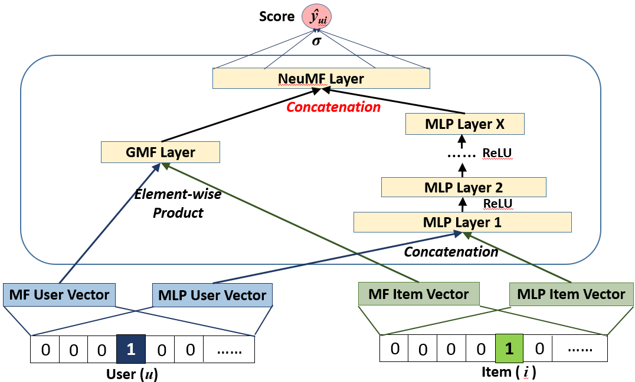
Our Fusion of GMF and MLP
We propose a new Neural Matrix Factorization (NeuMF) model, which fuses GMF and MLP by allowing them learn different sets of embeddings:

Slide 15
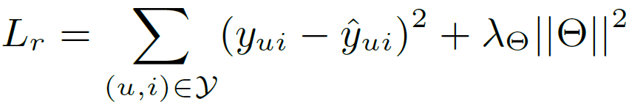
Learning NCF Models
For explicit feedback (e.g., ratings 1-5):
Regression loss:
For implicit feedback (e.g., watches, 0/1):
Classification loss:
Optimization is done by SGD (adaptive learning rate variants: Adagrad, Adam, RMSprop…)

Slide 16
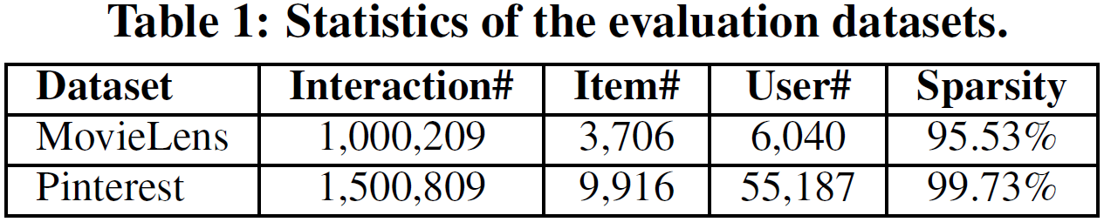
Experimental Setup
Two public datasets from MovieLens and Pinterest:
Transform MovieLens ratings to 0/1 implicit case
Evaluation protocols:
Leave-one-out: holdout the latest rating of each user as the test
Top-K evaluation
The ranked list are evaluated by Hit Ratio and NDCG (@10).

Slide 17
Baselines
ItemPop.
Items are ranked by their popularity.
ItemKNN [Sarwar et al, WWW’01]
The standard item-based CF method.
BPR [Rendle et al, UAI’09]
Bayesian Personalized Ranking optimizes MF model with a pairwise ranking loss, which is tailored for implicit feedback and item recommendation.
eALS [He et al, SIGIR’16]
The state-of-the-art CF method for implicit data. It optimizes MF model with a varying-weighted regression loss.

Slide 18
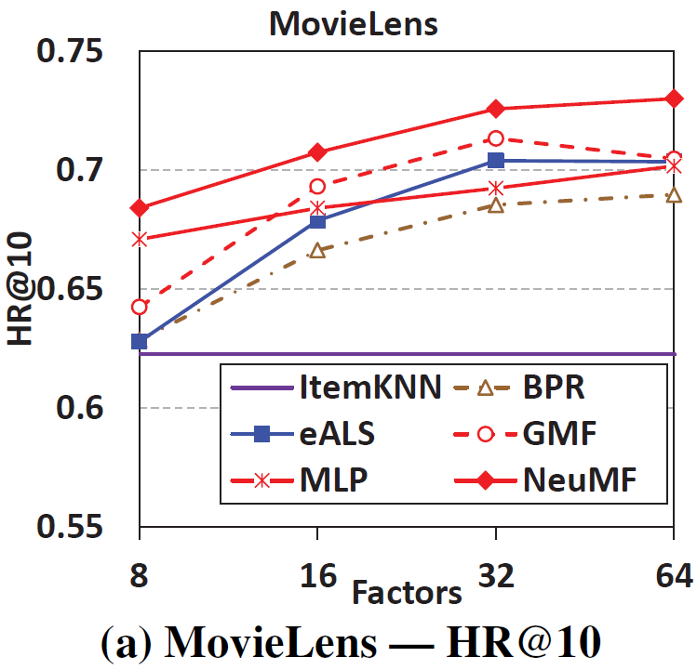
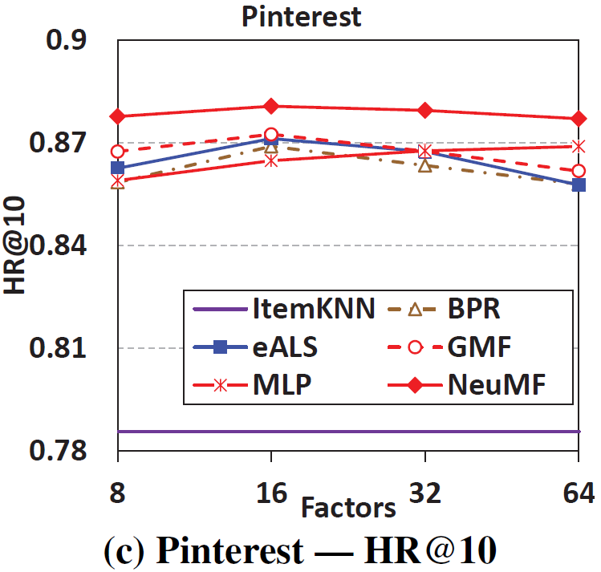
Performance vs. Embedding Size
1. NeuMF outperforms eALS and BPR with about 5% relative improvement.
2. Of the three NCF methods: NeuMF > GMF > MLP (lower training loss but higher test loss)
3. Three MF methods with different objective functions:
GMF (log loss) >= eALS (weighted regression loss) > BPR (pairwise ranking loss)
Notes:
Three-layer MLP and NeuMF.

Slide 19
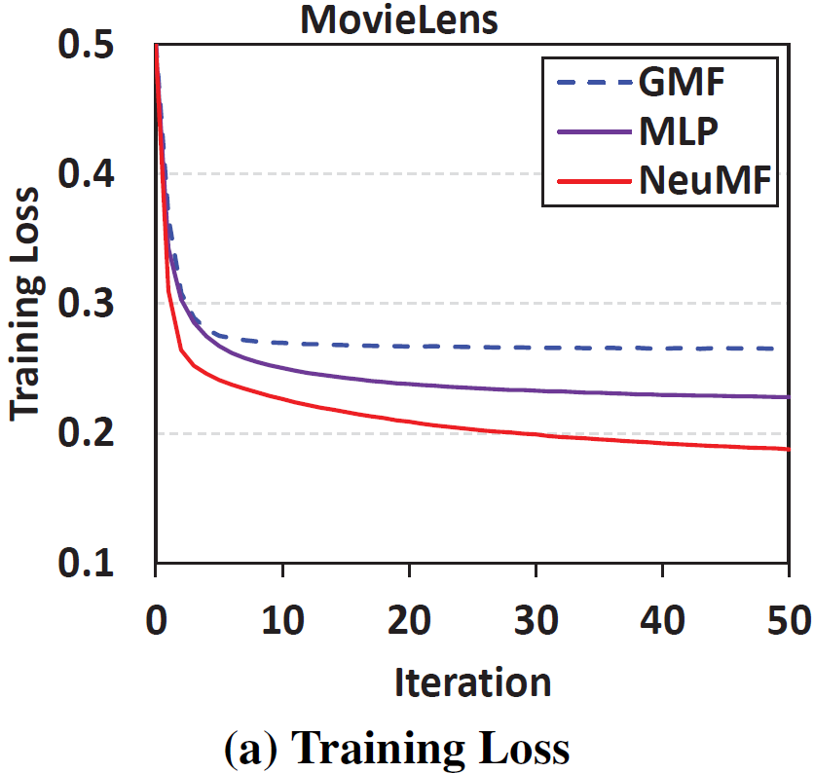
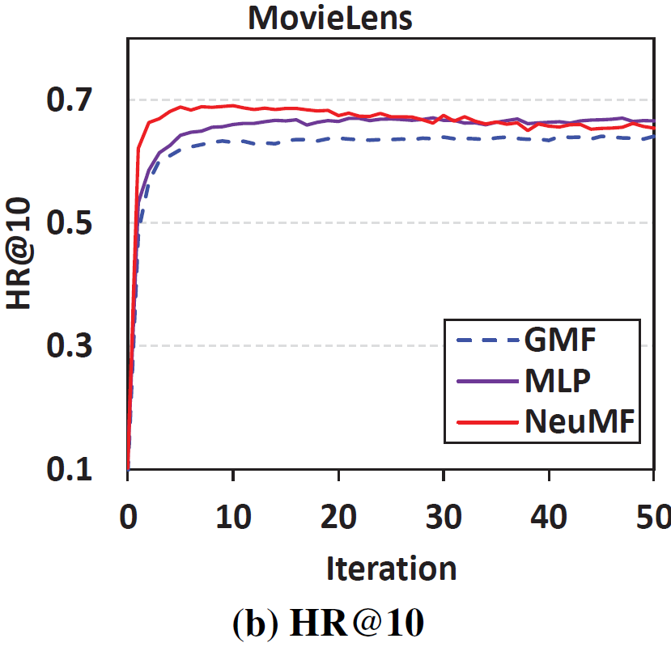
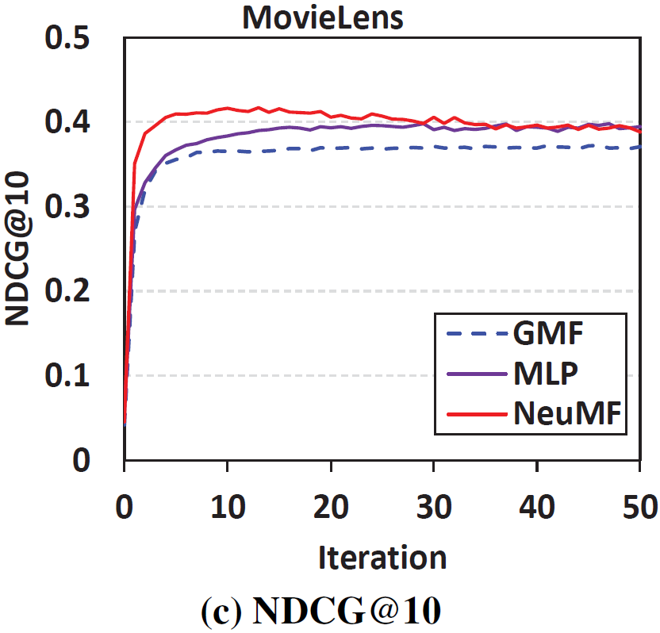
Convergence Behavior
Most effective updates are occurred in the first 10 iterations;
More iterations may make NeuMF overfit the data.
Trade-off between representation ability and generalization ability of a model.

Slide 20
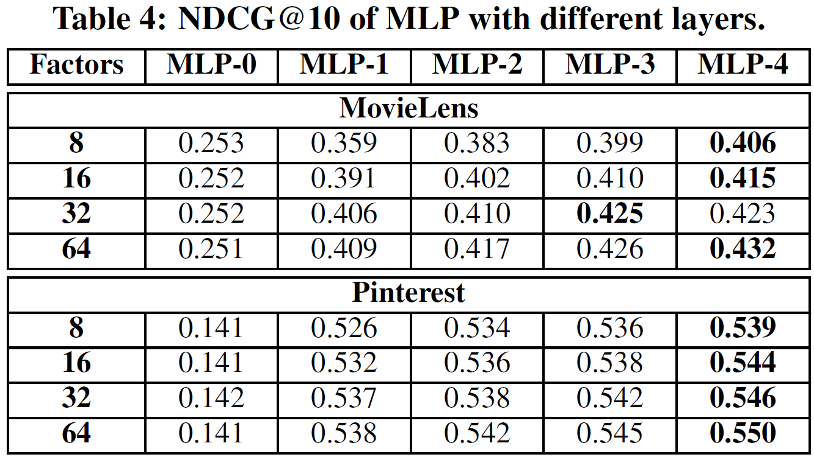
Is Deeper Helpful?
Even for models with the same capability (i.e., same number of predictive factors), stacking more nonlinear layers improves the performance.
- Note: stacking linear layers degrades the performance.
But the improvement gradually diminishes for more layers
- Optimization difficulties (same observation with K. He et al, CVPR 2016)
Kaiming He et al. CVPR 2016. “Deep residual learning for image recognition”

Slide 21
Conclusion
We explored neural architectures for collaborative filtering.
Devised a general framework NCF;
Presented three instantiations GMF, MLP and NeuMF.
Experiments show promising results:
Deeper models are helpful.
Combining deep models with MF in the latent space leads to better results.
Future work:
Tackle the optimization difficulties for deeper NCF models (e.g., by Residual learning and Highway networks).
Extend NCF to model more rich features, e.g., user attributes, contexts and multi-media items.
Notes:
Since most existing recommenders use shallow models, we believe this work opens up a new avenue of research possibilities for recommendation based on deep learning.

Slide 22

Thanks!
Codes: https://github.com/hexiangnan/neural_collaborative_filtering

