Slide 1

Reasoning over Linked Data for Explainable Recommendation
AAAI 2019
Xiang Wang¹, Dingxian Wang², Canran Xu², Xiangnan He³, Yixin Cao¹ & Tat-Seng Chua¹
¹National University of Singapore, ²eBay Inc
³University of Science and Technology of China

Slide 2
OUTLINE
Why Explainable Recommendation?
Recommendation + Knowledge Graph
Knowledge-aware Path Recurrent Network
Summarization

Slide 3


What is Recommendation Task?
Input: A user + her profile; An item + its Profile
Output: How likely she will adopt the target item? -> Relevance Score
The Recommendation Problem:
?
User Profile:
User ID
Rating history
Age, Gender
Clicks
Income level
…….
Item Profile:
Item ID
Description
Image
Category
Price
…….

Slide 4
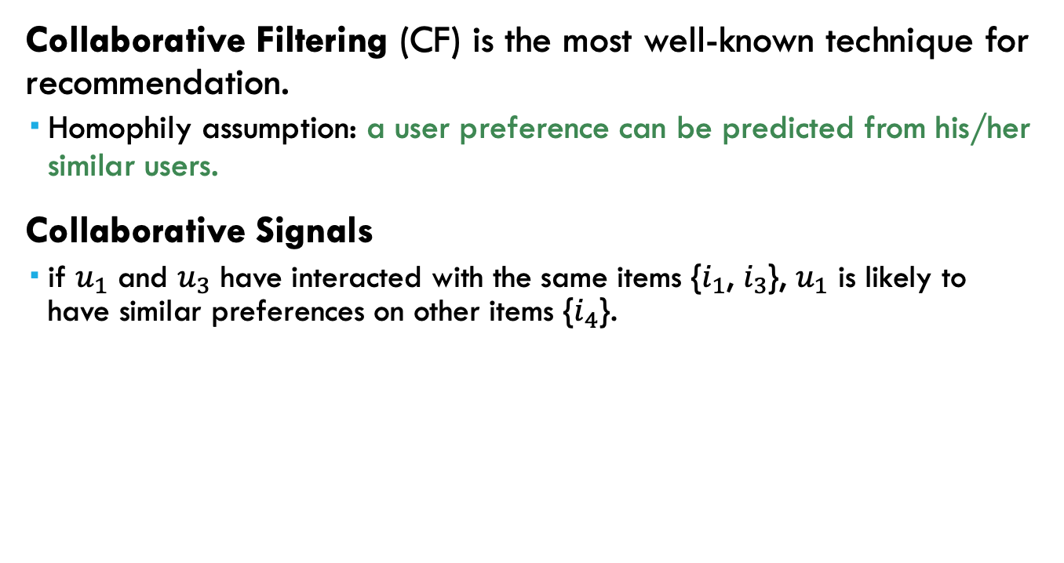








Back to Collaborative Filtering
Collaborative Filtering (CF) is the most well-known technique for recommendation.
Homophily assumption: a user preference can be predicted from his/her similar users.
Collaborative Signals
if $u_{1}$ and $u_{3}$ have interacted with the same items {$i_{1}$, $i_{3}$}, $u_{1}$ is likely to have similar preferences on other items {$i_{4}$}.
$i_{1}$ Shape of You
$u_{1}$ Alice
$i_{2}$ I See Fire
$u_{2}$ Annie
$i_{3}$ Castle on the Hill
$u_{3}$ Bob
$i_{4}$ Skin
$i_{5}$ Lose Yourself
Notes:
if $u_{1}$ and $u_{3}$ have interacted with the same items {$i_{1}$, $i_{3}$}, $u_{1}$ is likely to have similar preferences on other items {$u_{4}$}.

Slide 5


Explainable Recommendation
Explainable Recommendation is considered in more & more online services:
Why such items are recommended to you?

Slide 6
Benefits of Explanations
Win users’ trust in the recommender systems
Capture users’ fine-grained interest in specific aspect
Allow a user to correct the reasoning process, if she is unsatisfied with a recommendation due to improper reasons
…

Slide 7
OUTLINE
Why Explainable Recommendation?
Recommendation + Knowledge Graph
Knowledge-aware Path Recurrent Network
Summarization

Slide 8

What IS KG
KG works as a semantic web
Node represents for Entity or Concept
Edge represents for the relation between Entity/Concept
A KG consists of multiple triplets often denoted as (head, relation, tail) or (h, r, t)
Different from item attributes ( Offer deeper and longer connection and relationship between items and users other than only 1-hop connection)
Shape of you – Ed Sheeran – Pop music – Passenger - Heart's On Fire
likes
Alice
Shape of you
h = Alice r=likes t=shape of you
Notes:
Ranging from early matrix factorization to recently emerged deep learning methods

Slide 9
When RecSys Meets KG Cross-Domain Recommendation
Connecting different domains with overlapped entities
Achieve the transfer of information & knowledge across domains
Solve cold-start issues
Book Domain
TV Domain
Fashion Domain
Notes:
Ranging from early matrix factorization to recently emerged deep learning methods

Slide 10
Why Recommendation + Linked Data
Rich auxiliary information can be organized in the form of Graph
Predictability: Offer extra connections amongst users & items
User Profile:
Age
Gender
Income level
…….
Item Attribute:
Category
Price
…….
Social Network:
Friends
family
Following
Follower
…….
Multi-modal Info:
Description
Image
Video
…….
?
Behaviors:
Online
Offline
Knowledge Graph
Notes:
Ranging from early matrix factorization to recently emerged deep learning methods

Slide 11
Why Recommendation + Linked Data
Explainability:
1 Improve the user's satisfaction through connecting the user's history and recommendation history
2 Enhance the user's trust in the recommendation system.
likes
Shape of you
Alice
might like
1) Castle on the hill , belong to same album
2) I see fire, also sung by Ed Sheeran
3) Perfect, also a pop music
Notes:
Ranging from early matrix factorization to recently emerged deep learning methods

Slide 12

Why Recommendation + Linked Data
Precision: KG introduce more semantic relationships which leads to the discovery of user implicit interest
likes
Shape of you
Is Singer of
Might like
Is Singer of
I See Fire
Ed Sheeran
Notes:
Ranging from early matrix factorization to recently emerged deep learning methods

Slide 13


Why Recommendation + Linked Data
Diversity: 1. Different types of relationship are provided. 2. facilitates the divergence of recommendation results 3. avoids single type recommendation
Ed Sheeran
Is Singer of
Is Singer of
Castle on the Hill
likes
Is Song of
Contains Song
Shape of you
Genre
I See Fire
Pop
Genre
Notes:
Ranging from early matrix factorization to recently emerged deep learning methods

Slide 14
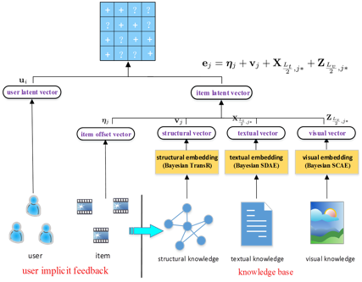
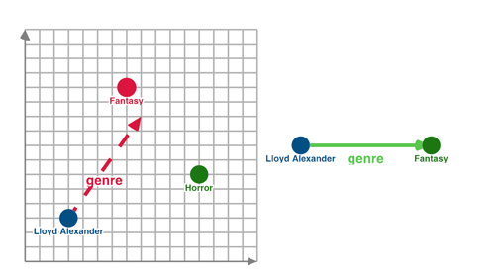
Existing KG BASEd Recommendation
Embedding-Based Methods:
TransE and TransR: leverage knowledge graph embedding techniques to regularize the representations of items.
Pros: items with similar connected entities have similar representations, which facilitate the collaborative learning of user interests.
Cons: Lacks the reasoning ability
Only considers direct relations between entities, rather than the multi-hop relation paths
Implicit characterization of user-item connectivity which can guide the representation learning, but not to infer a user's preference.
difficult to introduce the relationship information.
Notes:
As relations are usually excluded from meta-paths, they hardly specify the holistic semantics of paths, especially when similar entities but different relations are involved in a meta-path;
They fail to automatically uncover and reason on unseen connectivity patterns, since meta-paths requires domain knowledge to be predefined.

Slide 15
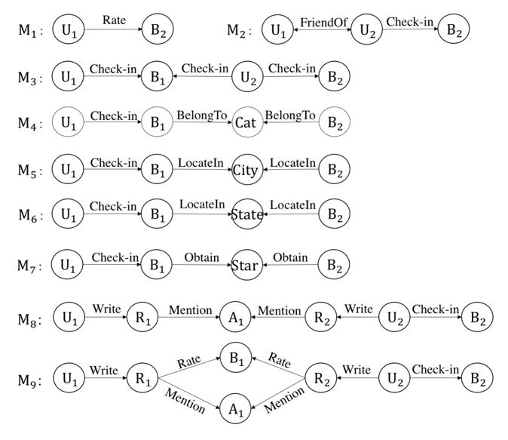
Existing KG BASEd Recommendation
Path-Based Methods:
Treat KG as a heterogeneous information network and construct meta-path or meta-graph based features between items.
Meta-path: a specific path connect two entities. E.g. singer-song-composer-song-singer
Pros: Can fully and intuitive use of the network structure of KG.
Fail to automatically uncover and reason on unseen connectivity patterns (Need to manually design meta-path or meta-graph )
Use the user-item connectivity to update user-item similarity, but not reason on paths
Performance rely heavily on the quality of meta-paths
Notes:
As relations are usually excluded from meta-paths, they hardly specify the holistic semantics of paths, especially when similar entities but different relations are involved in a meta-path;
They fail to automatically uncover and reason on unseen connectivity patterns, since meta-paths requires domain knowledge to be predefined.
User → Review → Word → Review → Business is used to capture users’ similarity since they both write reviews and mention the seafood it serves. However, if we want to capture the semantic that U1 and U2 rate the same type of business (such as Restaurant), and at the same time, they mention the same aspect (such as seafood), the meta-path fails
Here in the path (U, R,A, R,U, B), (R,A, R) means that if two reviews both mention the same A (Aspect), then they have some similarity. Similarly, in (U, R, B, R,U, B), R, B, R means that if two reviews both rate the same B (Business), then they have some similarity as well en by designing L meta-graphs, we can get L dierent user-item similarity matrices, denoted by Rˆ 1 , . . . , Rˆ L

Slide 16
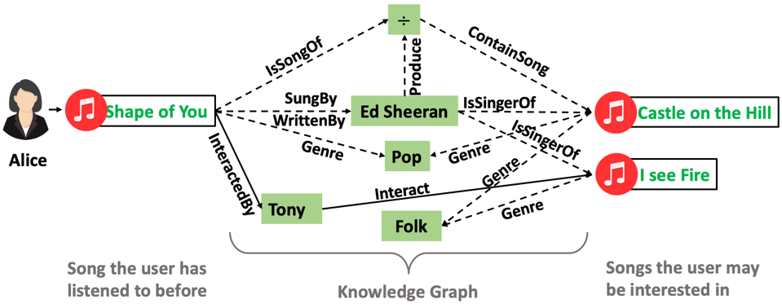
When RecSys Meets KG Explainable Recommendation
Reasoning on the paths to infer user preferences
Mimic the propagation process of user preference
model the sequential dependencies of entities & sophisticated relations of a path connecting a user-item pair
Wang et al, 2019, “Reasoning over Knowledge Graph for Recommendation”.
Notes:
Ranging from early matrix factorization to recently emerged deep learning methods
In terms of reasoning, we expect our method to model the sequential dependencies of entities and sophisticated relations of a path connecting a user-item pair.
In terms of explainability, we would like our method to discriminate the different contributions of different paths, when inferring user interests.

Slide 17
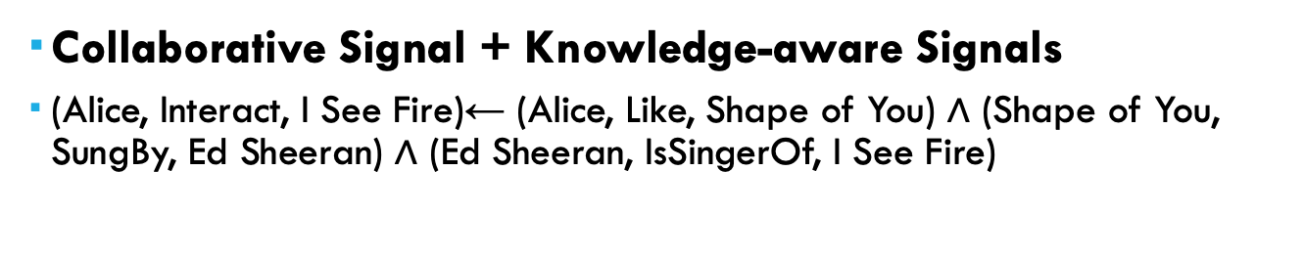
Graph-based Reasoning
Collaborative Signal + Knowledge-aware Signals
(Alice, Interact, I See Fire)← (Alice, Like, Shape of You) $∧$ (Shape of You, SungBy, Ed Sheeran) $∧$ (Ed Sheeran, IsSingerOf, I See Fire)
Notes:
Ranging from early matrix factorization to recently emerged deep learning methods

Slide 18
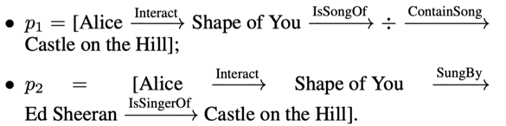


Preference Inference via Paths
Multiple Paths:
The triples describe direct or indirect (i.e., multiple-step) relational properties of items, which shall constitute one or several paths between the given user-item pair.
A set of paths connecting the user and item
How to model the sequential dependencies of entities & sophisticated relations of a path???
Wang et al, 2019, “Reasoning over Knowledge Graph for Recommendation”.
Notes:
Ranging from early matrix factorization to recently emerged deep learning methods

Slide 19
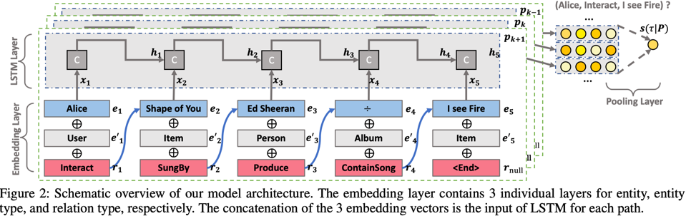
Preference Inference via Paths
Treat the head entity & relation as a whole
Different paths have varying contributions (importance) to model user preferences.
Notes:
Ranging from early matrix factorization to recently emerged deep learning methods

Slide 20
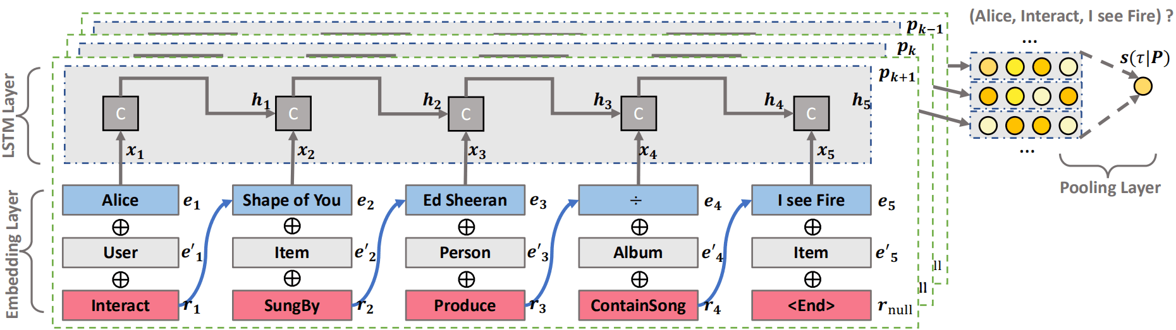
Preference Inference via Paths
three key components:
(1) embedding layer to project three types of IDs information: the entity, entity type, and the relation pointing to the next node into a latent space,
(2) LSTM layer that encodes the elements sequentially with the goal of capturing the compositional semantics of entities conditioned on relations,
(3) pooling layer to combine multiple paths and output the final score of the given user interacting the target item.
Notes:
KPRN takes a set of paths of each user-item pair as input, and outputs a score indicating how possible the user will interact the target item.

Slide 21
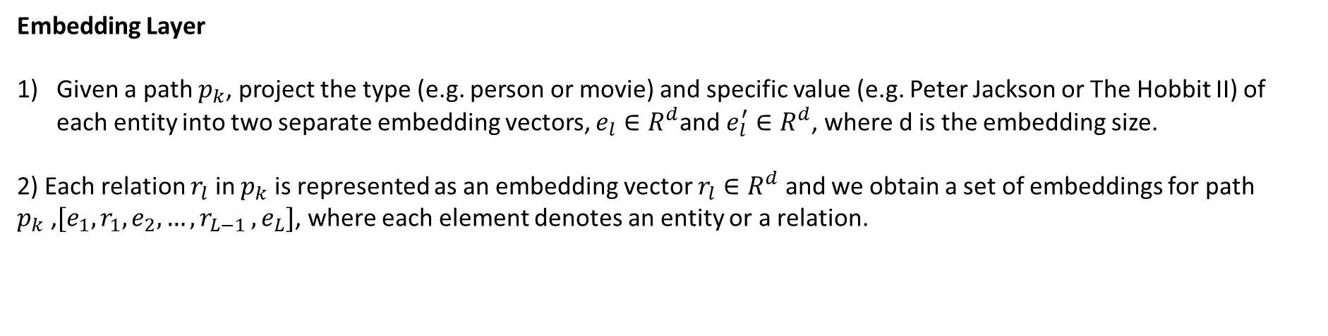
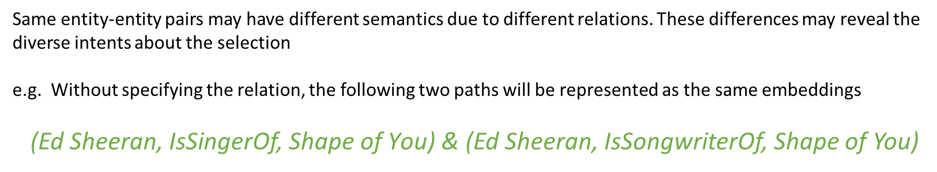
Modeling
Embedding Layer
Given a path $p_{k}$, project the type (e.g. person or movie) and specific value (e.g. Peter Jackson or The Hobbit II) of each entity into two separate embedding vectors, $e_{l}∈R^{d}$and $e_{l}^{′}∈R^{d}$, where d is the embedding size.
2) Each relation $r_{l}$ in $p_{k}$ is represented as an embedding vector $r_{l}∈R^{d}$ and we obtain a set of embeddings for path $p_{k}$ ,$[e_{1},r_{1},e_{2},{…,r}_{L−1},e_{L}]$, where each element denotes an entity or a relation.
Same entity-entity pairs may have different semantics due to different relations. These differences may reveal the diverse intents about the selection
e.g. Without specifying the relation, the following two paths will be represented as the same embeddings
$\text{(}\text{Ed} \text{Sheeran}\text{, }\text{IsSingerOf}\text{, }\text{Shape} \text{of} \text{You}\text{)}$ & (Ed Sheeran, IsSongwriterOf, Shape of You)

Slide 22

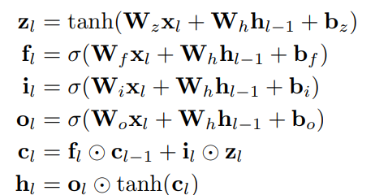
Modeling
LSTM Layer
Employ LSTM model to explore the sequential information
Generate a single representation for encoding holistic semantics based on embedding sequence of a path
The long-term sequential pattern is also used to estimate the confidence of the “interact” relation
input vector contains 1) sequential information, 2) the semantic information of the entity and its relation to the next entity.

Slide 23

Modeling
LSTM Layer
predict the plausibility of τ = (u, interact, i)
two fully-connected layers are adopted to project the final state into the predictive score for output

Slide 24
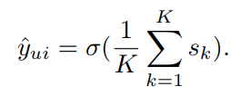
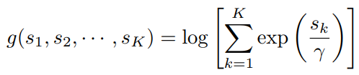

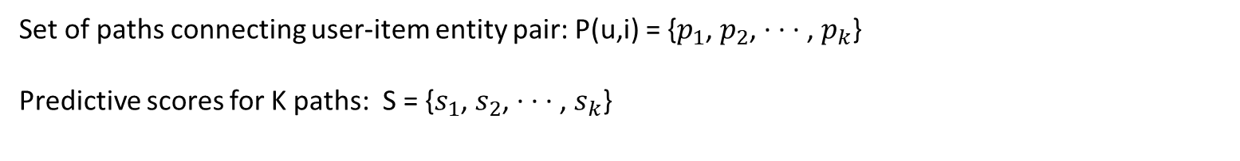
Modeling
Weighted Pooling Layer
Set of paths connecting user-item entity pair: P(u,i) = {$p_{1}$, $p_{2}$, · · · , $p_{k}$}
Predictive scores for K paths: S = {$s_{1}$, $s_{2}$, · · · , $s_{k}$}
final prediction could be the average of the scores of all paths
Fails to specify importance of each path
weighted pooling operation to aggregate scores of all paths
final prediction score
when setting γ → 0, the pooling function can degenerate to max-pooling; whereas, it can degrade to mean-pooling by setting γ → ∞.

Slide 25

Modeling
Learning
Treat the recommender learning task as a binary classification problem (observed user-item interaction is assigned a target value 1, otherwise 0 )
Use the pointwise learning methods to learn the parameters of our model.
objective function
Notes:
if a user rates a movie or has an interaction record with a song, we set the user-movie or user-song pair as the observed positive feedback with the target value of 1, and 0 otherwise.

Slide 26
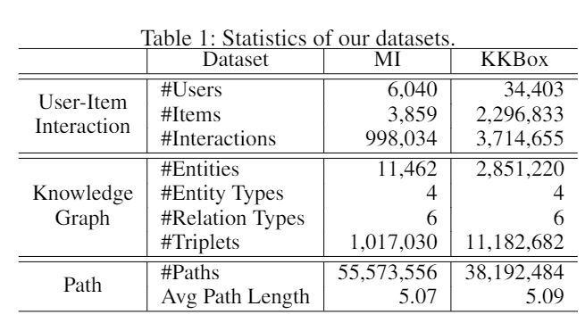
Experiments
Datasets:
Movie recommendation: MovieLens-1M (user-item interaction data) and IMDb (serves as the KG part contains movie information such as genre, actor, director and writer) datasets (linked by the titles and release dates of movies)
Music recommendation: KKBox (includes user-item interaction data and contains the description of music like singer songwriter and genre).

Slide 27
Experiments
Evaluation Metrics:
hit@K: considers whether the relevant items are retrieved within the top K positions of the recommendation list.
ndcg@K : measures the relative orders among positive and negative items within the top K of the ranking list.
Baselines:
MF: this is matrix factorization with Bayesian personalized ranking (BPR) loss, which solely utilizes user-item interaction.
NFM: The method is a state-of-the-art factorization model which treats historical items as the features of users.
CKE: Such embedding-based method is tailored for KG-enhanced recommendation, which integrates the representations from Matrix Factorization and TransR to enhance the recommendation.
FMG: This is a state-of-the-art meta-path based method, which predefines various types of meta-graphs and employs Matrix Factorization on each meta-graph similarity matrix to make recommendation.

Slide 28
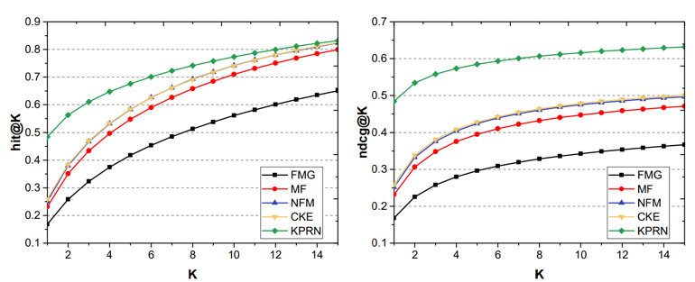
Experiments
Top-K recommendation performance between all the methods on MI datasets w.r.t. hit@K and ndcg@K, where K = {1, 2, · · · , 15}

Slide 29
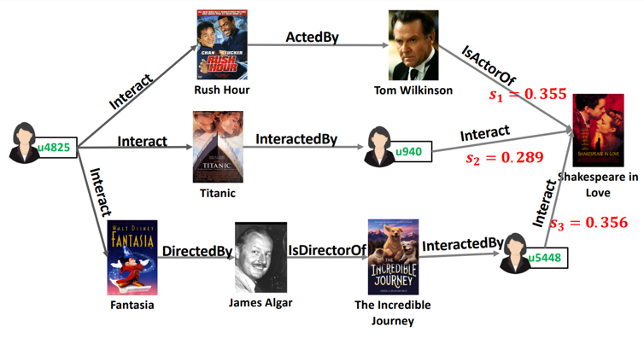
Experiments
KPRN’s property to reason on paths to infer the user preferences towards target items and generate reasonable explanations.
Collaborative filtering effect: interaction behaviors from other users (e.g., u940 and u5448) on Shakespeare in Love are involved in two paths.
KPRN is capable of extending user interests along KG paths (connection between the movies [Rush Hour], actor[ Tom Wilkinson] and movie [Shakespeare in Love]
Different paths describe the user-item connectivity from dissimilar angles
We Can offer path-wise explanations such as Shakespeare in Love is recommended since you have watched Rush Hour acted by the same actor Tom Wilkinson or since it is similar to Titanic that you watched before

Slide 30
Summary
Reasoning over Lined Data:
Exploit Connectivity between users & items
Explore how influence spread along the connectivity
Pros:
Explainability
Reasoning Ability
Cons:
Rely heavily on path quality
Path extraction is labor-tensive
Not a full version of knowledge graph learning

Slide 31

Thank you!

