Slide 1


Batch IS NOT Heavy: Learning Word Representations From All Samples
Xin Xin, Fajie Yuan, Xiangnan He, Joemon Jose
School of Computing Science, University of Glasgow
School of Computing, National University of Singapore
1
1
2
1
1
2
Presented by Xin Xin@ACL 2018, July 17, 2018
Notes:
Hello everyone, I’m Xin from university of Glasgow. I’m very glad to stand here and give the talk. This research is done by univiersity of glasgow and national university of sigor. The topic is about learning word embedding from all examples without any sampling.

Slide 2
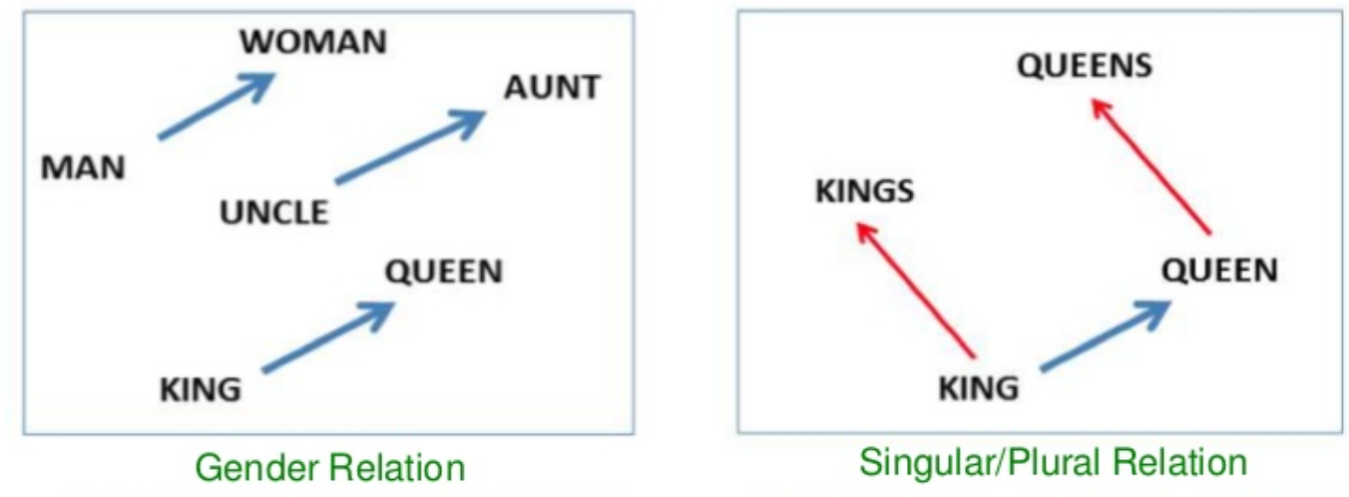
Word Representations
Representing words has become a basis for many NLP tasks.
One-hot encoding
Large dimensionality
Sparse representation (most zeros)
Dense word embedding
100~400 dims with real-valued vectors
Semantic and syntactic meaning in latent space
Notes:
With the development of DL, word representations has become a basis for many NLP tasks.
Generally, there are two kinds of word representations.
The 1st is one-hot encoding, which……
The 2nd is dense word embedding which…… Now it has become a very hot research point.

Slide 3
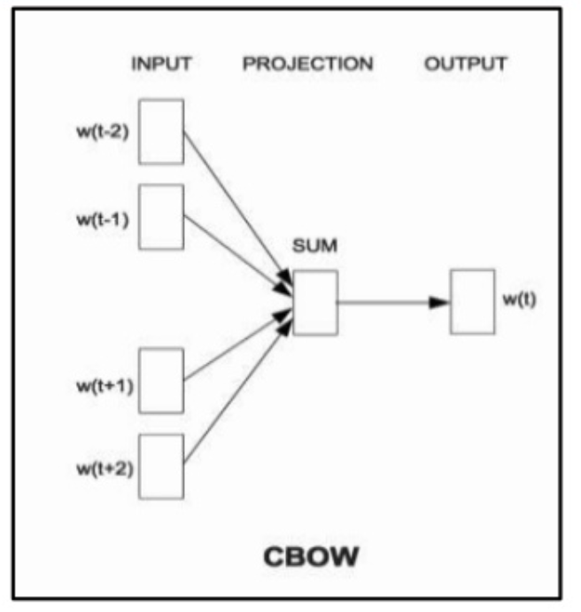
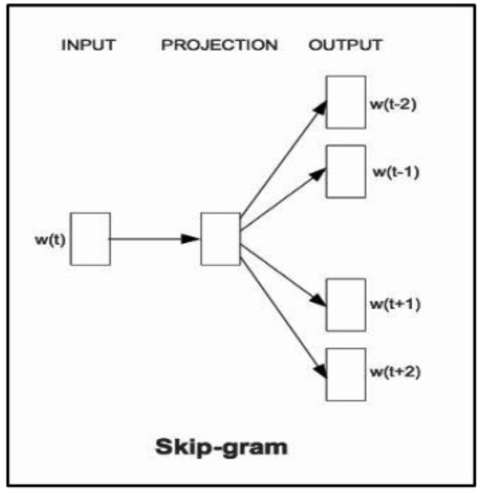
Learning word embedding
Predictive models:
Word2vec: CBOW & Skip-gram
Count-based models:
GloVe: Biased MF on word co-occurrence statistics
Notes:
Generally, there are two kinds of methods to generate word embedding
The 1st is the predictive models, such as the very famous CBOW and Skip-gram models. These models performance the embedding as a predictive task. For example, the CBOW model tries to predict the proper target word given a set of context word. Skip-gram is the same but or the exchange of word and context.
The other model is based on matrix factorization on the word co-occurrence statistics, such as GloVe.

Slide 4
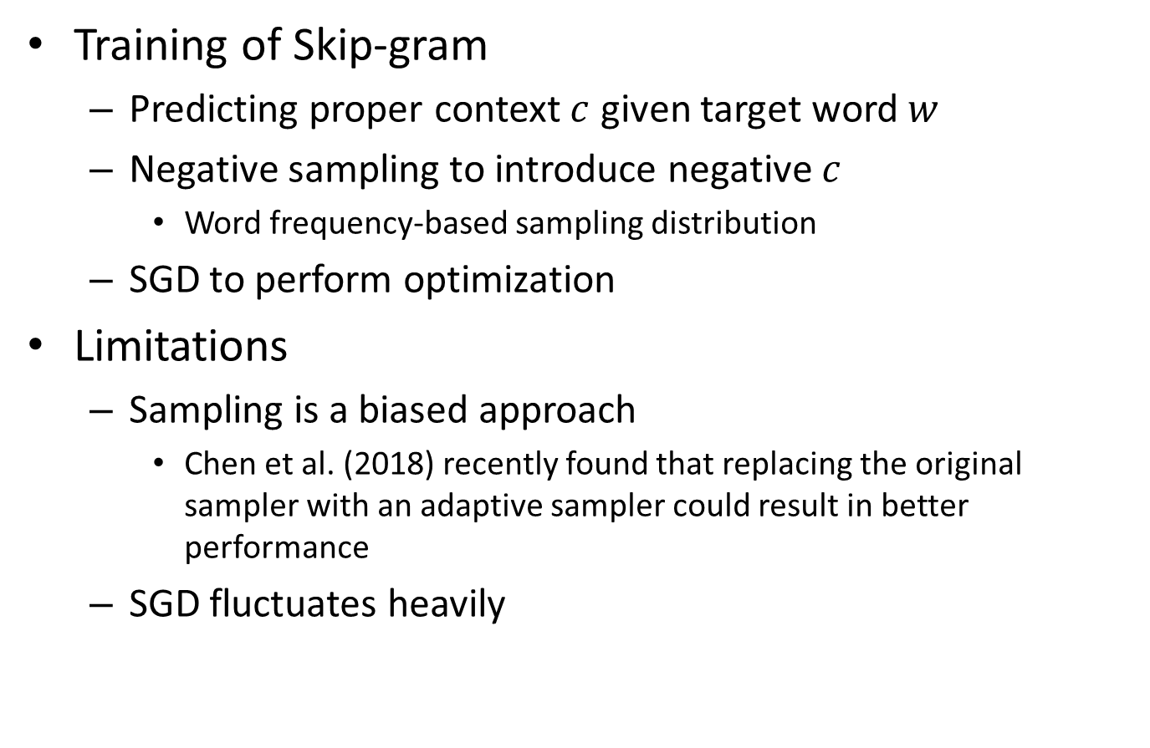
Learning word embedding
Training of Skip-gram
Predicting proper context $c$ given target word $w$
Negative sampling to introduce negative $c$
Word frequency-based sampling distribution
SGD to perform optimization
Limitations
Sampling is a biased approach
Chen et al. (2018) recently found that replacing the original sampler with an adaptive sampler could result in better performance
SGD fluctuates heavily
Notes:
Now, let’s focus on the very famous skip-gram models.
There are three key components in the training of skip-gram:
Relationship between word and context, which is captured by a local window
Negative sampling techniques which aims to introduce negative information.
Xxxxxx
However, we can see that there are some limitations about the training.
1.xxxxxx, while the original SG utilizes a word-frequency based sampling distribution. However, even an adaptive sampler can not reveal the whole data and there is always some information missed.
2.xxxxxxxx

Slide 5
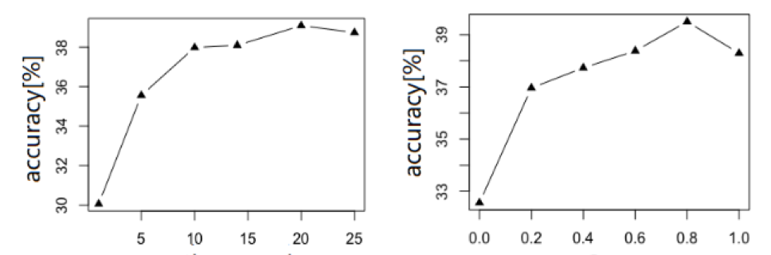
Limitations
Sampled negative instances have great influence
Sample size and sampling distribution have great impact
Smaller corpora tend to require a large sample size
Sample size
Sampling distribution (power)
Word analogy accuracy on text8 corpus
Notes:
Here, the two figures show the effect of negative sampling.
We can see that both the sample size and sampling distribution have a large impact on the embedding quality

Slide 6
Motivations
Can we drop out negative sampling and directly learn from whole data?
With whole data considered, can we design an efficient learning scheme to perform optimization?
Notes:
Given that situation, can we xxxxxxx so that we could break the limitation of sampling and consider a more diverse information.
However, if doing so, the size of whole data, especially the size of negative pairs would be very large. Can we design xxxxx

Slide 7
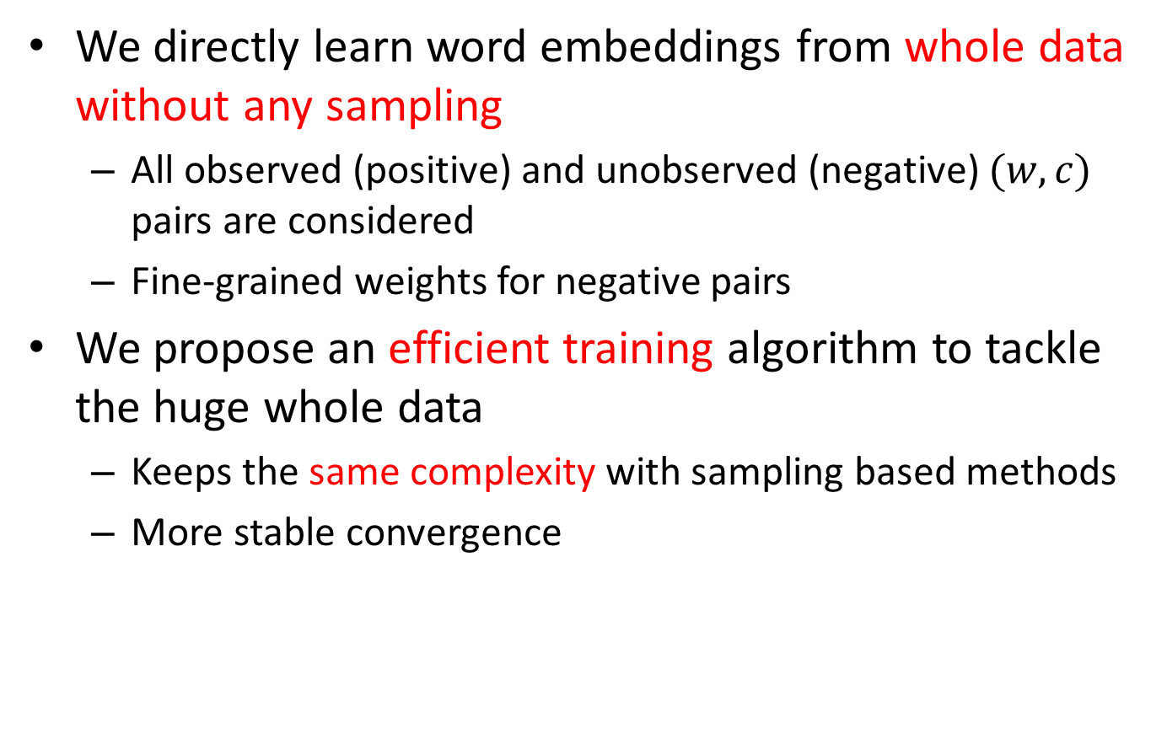
Contributions
We directly learn word embeddings from whole data without any sampling
All observed (positive) and unobserved (negative) $(w,c)$ pairs are considered
Fine-grained weights for negative pairs
We propose an efficient training algorithm to tackle the huge whole data
Keeps the same complexity with sampling based methods
More stable convergence
Notes:
In this work, we are addressing the above two problems. The main contribution of this paper is:
Firstly, we xxxxxxxx, which means that we will take all xxxxxxxxxxxxxxxx. Besides, we also designed a fine-rained weighting scheme for negative pairs.
Secondly, we propose xxxxxxxxxxxxxxxxxxxx. As a result, the training of whole data can keep xxxxxxxxxxxxxxxxxxxxxxxxxxx, which is only determined by the size of positive pairs. Besides, we could also achieve a more stable convergence because of the whole batch learning property.

Slide 8
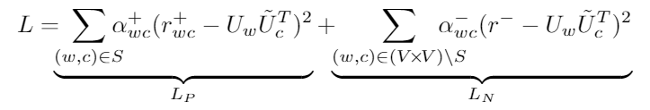
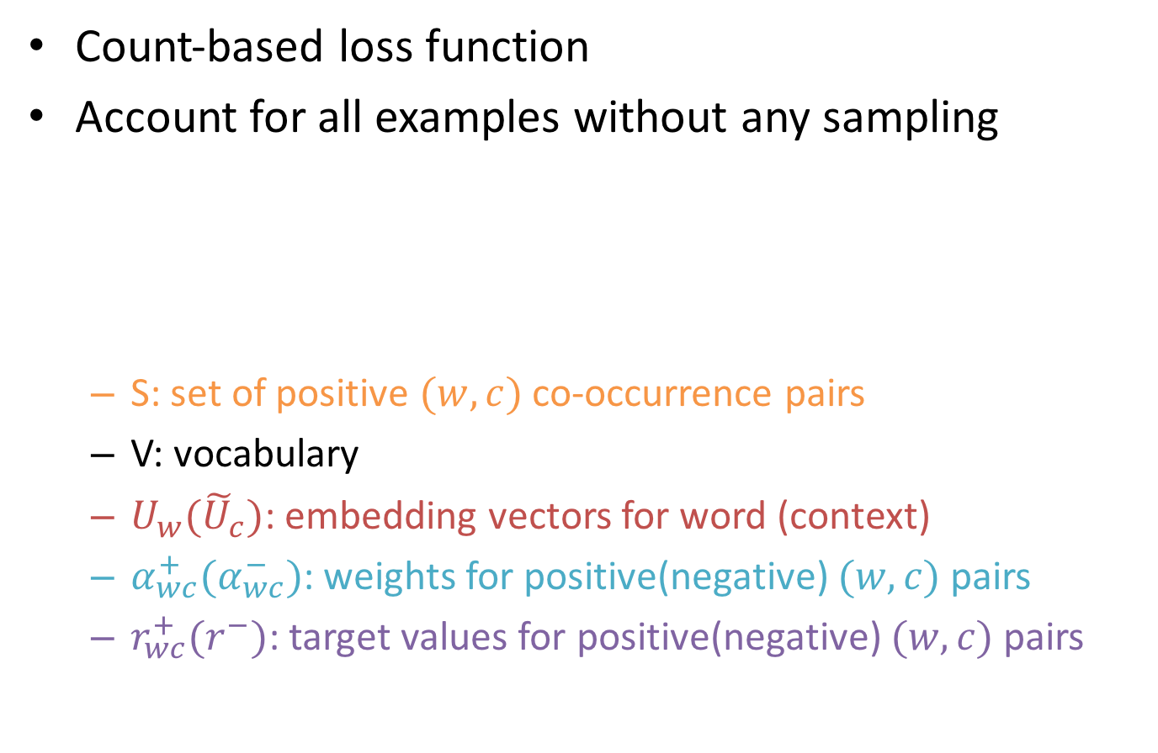
Loss function for all data
Count-based loss function
Account for all examples without any sampling
S: set of positive $(w,c)$ co-occurrence pairs
V: vocabulary
$U_{w}({\tilde{U}}_{c})$: embedding vectors for word (context)
$α_{wc}^{+}(α_{wc}^{−})$: weights for positive(negative) $(w,c)$ pairs
$r_{wc}^{+}(r^{−})$: target values for positive(negative) $(w,c)$ pairs
Notes:
Firstly, we show the loss function of our model. Here, we adopt the count-based loss function which aims to perform MF on the word co-occurrence statistics. However, unlike GloVe which only calculates the loss of positive word-context pairs, we take all positive and negative pairs into account. We can see from the equation that the loss is calculated on all positive pairs which is denoted by (Lp) and all negative pairs which is denoted by (Ln).

Slide 9
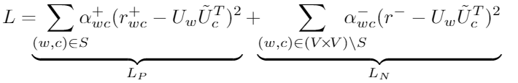
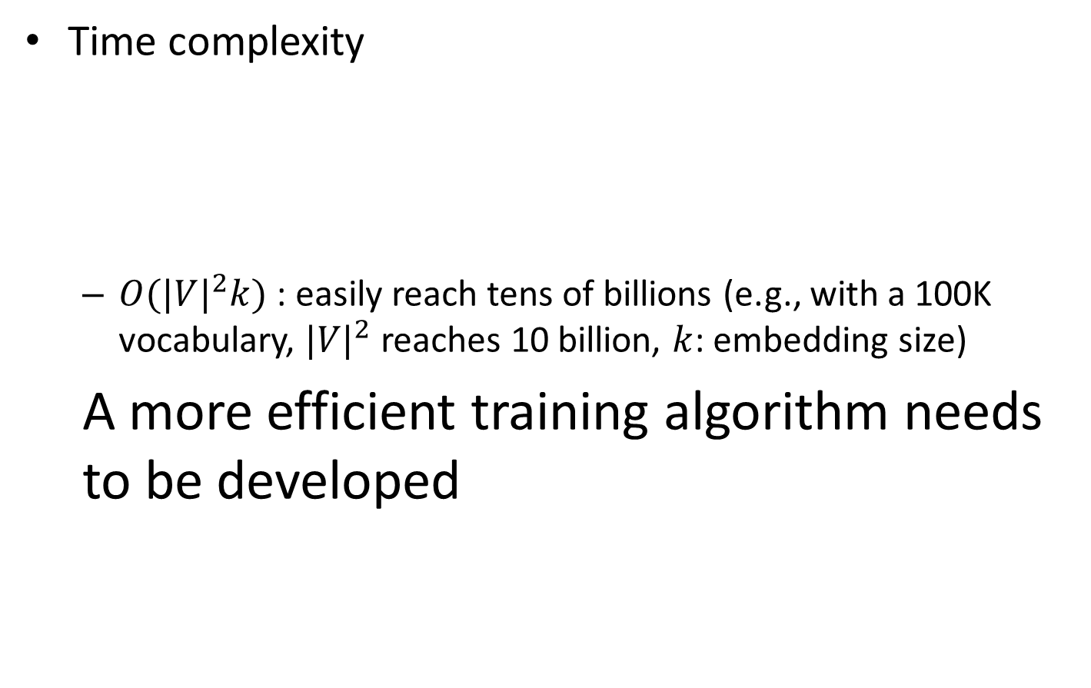
Difficulties to Optimize
Time complexity
$O({|V|}^{2}k)$ : easily reach tens of billions (e.g., with a 100K vocabulary, ${|V|}^{2}$ reaches 10 billion, $k$: embedding size)
A more efficient training algorithm needs to be developed
Notes:
However, it’s obvious that given the embedding size k ,the total time complexity is XXXX, because we account for the loss on the whole V*V space. For example, if the vocabulary size is xxxxxxxxxx which is inpracticeable for traditional SGD optimization.
As a result, XXXXXXXXXXXX

Slide 10

Difficulties to Optimize
$|V|×|V|$ interactions
breaking
. . . .
. . . .
. . . .
. . . .
Loss Partition
Product Decouple
word
context
word
context
Notes:
If we focus on the loss function, we can see that the source of the time complexity comes from the V*V interactions between word and context. If we can break these interactions, we may achieve a huge speed up. In the following parts, I will show how to break these interactions by two mathematical transformations. The first is loss partition and the second is inner product decouple.

Slide 11




Loss Partition
The major computation lies in $L_{N}$
Transfer $L_{N}$
Now, the major part falls in $L_{A}$
$$L_{A}$$
Merge with $L_{P}$
Notes:
It’s obvious that the major computational cost lies in Ln, because the size of negative pairs is much larger than the positive ones. So the first transformation aims to transfer Ln into the difference between the loss on all V*V pairs and the counter pater of positive pairs, as shown in the second equation. After that, we can see that the blue part of the second equation can be merged with Lp. Now, the major computation part falls into La. In the following sections, we will show how to compute La efficiently with inner product decouple.

Slide 12

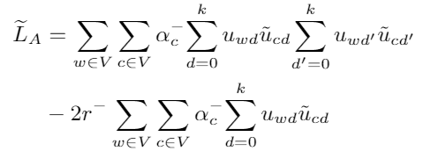


Product Decouple
Inner product Decouple
Rewrite $L_{A}$ into ${\tilde{L}}_{A}$ with the constant part omitted
$|V|×\left|V\right|$ interactions between $u_{w}$ and ${\tilde{u}}_{c}$
Notes:
To show the decouple more clearly, we first rewrite La into another form with the const part omitted. We can see the there are V*V interactions between u_w and u_c, which causes the difficulity of the computation.

Slide 13
Product Decouple
Inner product Decouple
Rewrite $L_{A}$ into ${\tilde{L}}_{A}$ with the constant part omitted
Commutative property
Notes:
However, if we use the commutative property and exchange the sequence of the sum, we can get another from of La

Slide 14
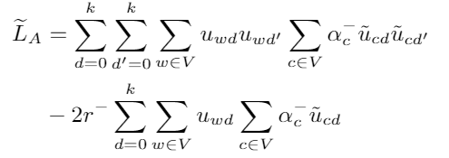
Product Decouple
Inner product Decouple
Rewrite $L_{A}$ into ${\tilde{L}}_{A}$ with the constant part omitted
Commutative property

Slide 15

Product Decouple
Inner product Decouple
Rewrite $L_{A}$ into ${\tilde{L}}_{A}$ with the constant part omitted
Commutative property
$u_{w}$ and ${\tilde{u}}_{c}$ are now independent
Notes:
And now, in the second equation, we can see that u_w and u_c has no interactions any more. They are independent with each other, which means that we can keep one fixed when calculating (updating) the other.

Slide 16
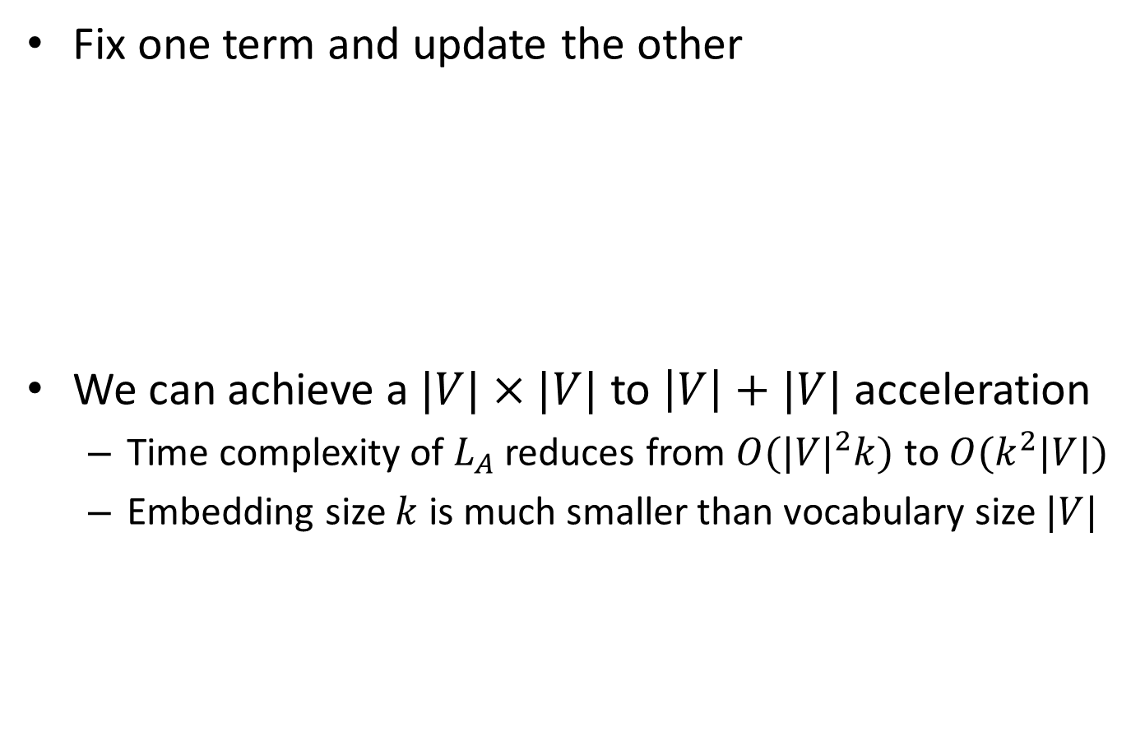
Product Decouple
Fix one term and update the other
We can achieve a $|V|×|V|$ to $\left|V\right|+|V|$ acceleration
Time complexity of $L_{A}$ reduces from $O({|V|}^{2}k)$ to $O(k^{2}|V|)$
Embedding size $k$ is much smaller than vocabulary size $|V|$
Notes:
For example, we can define the pre-computation terms as the green part. This part will be pre-computed before each iteration and keep fixed when updating u_w. Finally, with these form of La, we can achieve a XXXXXXXXX. The total complexity of La is transferred from XXXX to XXXXX. Given the situation that embedding size k is much smaller than vocabulary size V, we can achieve a huge speed up.

Slide 17
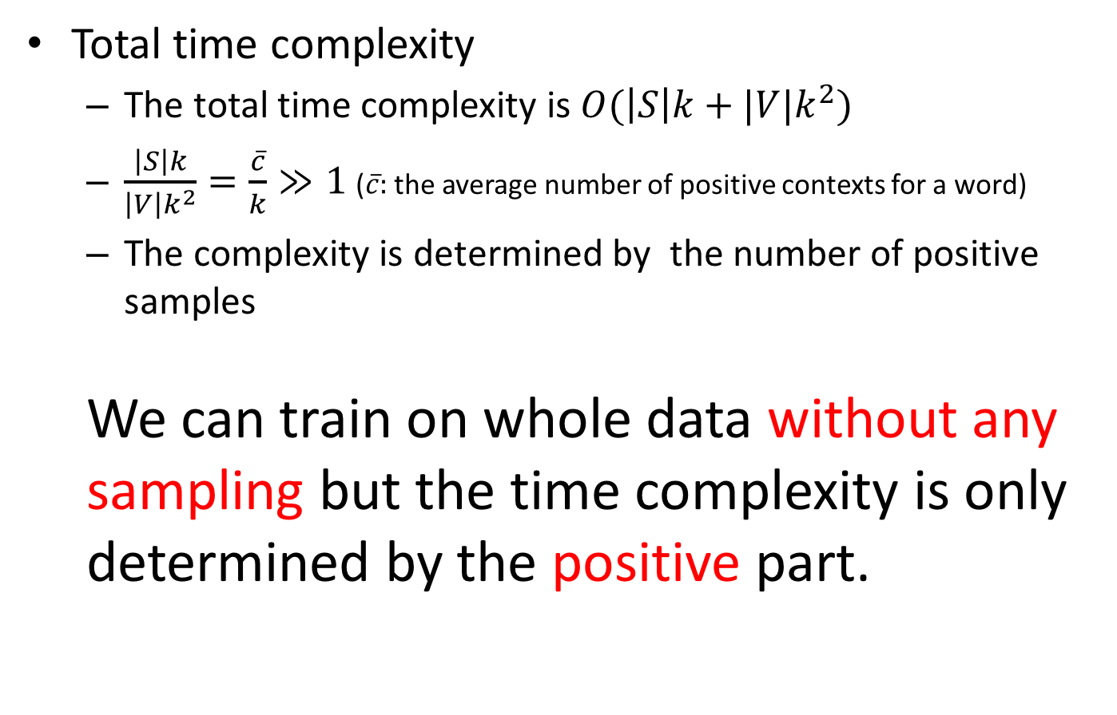
Efficient training
Total time complexity
The total time complexity is $O(\left|S\right|k+|V|k^{2})$
$\frac{\left|S\right|k}{{\left|V\right|k}^{2}}=\frac{\overline{c}}{k}≫1$ ($\overline{c}:$ the average number of positive contexts for a word)
The complexity is determined by the number of positive samples
We can train on whole data without any sampling but the time complexity is only determined by the positive part.
Notes:
Finally, with the positive part considered, the total time complexity is XXXXXXXXXXXXXXX.
Then, if we compare the two part of the complexity, we can see that XXX is much larger than XXXXX, which means that the total complexity is only determined by the number of positive pairs.
Which means that yy doing so, we can XXXXXXXXXXXXXXXXX

Slide 18
Experiments
Evaluation tasks
Word analogy (semantic&syntactic)
King is to man as queen is to ?
Word Similarity
MEN,MC,RW,RG,WSim,WRel
QVEC (Tsvetkov et al., 2015)
Intrinsic evaluation based on feature alignment
Training Corpora: Text8, NewsIR, Wiki
Baseline: Skip-gram, Skip-gram with adaptive sampler, GloVe, LexVec (Salle et al., 2016).
Notes:
To evaluate the performance of the proposed model, we conduct experiments on three evaluation tasks
The first is XXXX
The second is word sim tasks. Here we conduct the experiments on 6 word similarity datasets.
The last one is XXXX, which shows strong relationship with downstream tasks.
The training corpora is XXXX
For baselines, we use SG, SGA GloVe and LexVec.

Slide 19
Experiments
Word analogy accuracy (%) on Text8
Our model performs especially good
GloVe performs poorly (lack of negative information)
Syntactic performance is not so good as semantic performance
 | Semantic | Syntactic | Total
Skip-gram | 47.51 | 32.26 | 38.60
Skip-gram-a | 48.10 | 33.78 | 39.74
GloVe | 45.11 | 26.89 | 34.47
LexVec | 51.87 | 31.78 | 40.14
Our model | 56.66 | 32.42 | 42.50
Notes:
This table shows the word analogy accuracy on Text8 dataset.
We can see that our model performs especially good in the small dataset
However, GloVe XXXXXXXXXXX. We think this is because GLoVe do not consider the negative information ,which is especially important when the training set is small.
The other phenom is XXXXXXXXXXXX. We think this is because our model is based on the global word co-occurrence statistics, which is more effective to capture the semantic meaning. However, the skip-gram model is based on a small local window, which is more effective to capture the local syntactic structures.

Slide 20
Experiments
Word similarity & QVEC tasks on Text8
Similar results with word analogy tasks
GloVe performs poorly on these two tasks
 | MEN | MC | RW | RG | WSim | WRel | QVEC
Skip-gram | 0.6868 | 0.6776 | 0.3336 | 0.6904 | 0.7082 | 0.6539 | 0.3999
Skip-gram-a | 0.6885 | 0.6667 | 0.3399 | 0.7035 | 0.7291 | 0.6708 | 0.4062
GloVe | 0.4999 | 0.3349 | 0.2614 | 0.3367 | 0.5168 | 0.5115 | 0.3662
LexVec | 0.6660 | 0.6267 | 0.2935 | 0.6076 | 0.7005 | 0.6862 | 0.4211
Our model | 0.6966 | 0.6975 | 0.3424 | 0.6588 | 0.7484 | 0.7002 | 0.4211
Notes:
The similarity and QVEC tasks show the similar results with analogy tasks. However, we can see that GloVe’s performance is very poor on these two tasks. The reason may also be that GLOVe doesn’t consider negative information. Similar observations has also been seen by some other researchers.

Slide 21
Experiments
Word analogy accuracy (%) on NewsIR
GloVe’s performance is improved
The proposed model still over-performs GloVe
The importance of negative examples
 | Semantic | Syntactic | Total
Skip-gram | 70.81 | 47.48 | 58.10
Skip-gram-a | 71.74 | 48.71 | 59.20
GloVe | 78.79 | 41.58 | 58.52
LexVec | 76.11 | 39.09 | 55.95
Our model | 78.47 | 48.33 | 61.57
Notes:
Here is the result of word analogy on a larger NewsIR corpus. We can see that GloVe’s performance is improved. Because for a larger corpus, the information contained by positive pairs accounts for a larger part. But our model still achieves the best total accuracy, which also demonstrates the importance of considering all negative examples.

Slide 22
Experiments
Word similarity & QVEC tasks on NewsIR
GloVe still performs poorly on these two tasks
 | MEN | MC | RW | RG | WSim | WRel | QVEC
Skip-gram | 0.7293 | 0.7328 | 0.3705 | 0.7184 | 0.7176 | 0.6147 | 0.4182
Skip-gram-a | 0.7409 | 0.7513 | 0.3797 | 0.7508 | 0.7442 | 0.6398 | 0.4159
GloVe | 0.5839 | 0.5637 | 0.2487 | 0.6284 | 0.6029 | 0.5329 | 0.3948
LexVec | 0.7301 | 0.8403 | 0.3614 | 0.8341 | 0.7404 | 0.6545 | 0.4172
Our model | 0.7407 | 0.7642 | 0.4610 | 0.7753 | 0.7453 | 0.6322 | 0.4319
Notes:
This table shows the performance of word sim and Qvec tasks on NewsIR corpus.

Slide 23
Experiments
Word analogy accuracy (%) on Wiki
Models tend to have similar performance in large datasets
 | Semantic | Syntactic | Total
Skip-gram | 73.91 | 61.91 | 67.37
Skip-gram-a | 75.11 | 61.94 | 67.92
GloVe | 77.38 | 58.94 | 67.33
LexVec | 76.31 | 56.83 | 65.48
Our model | 77.64 | 60.96 | 68.52
Notes:
This table shows the results of word analogy tasks on the large wiki dataset. We can see that XXXXX

Slide 24
Experiments
Word similarity & QVEC tasks on Wiki
To conclude
Our model performs especially good in smaller datasets
GloVe performs poorly on word similarity and QVEC tasks
The difference between models tends to become smaller in large datasets
 | MEN | MC | RW | RG | WSim | WRel | QVEC
Skip-gram | 0.7564 | 0.8083 | 0.4311 | 0.7678 | 0.7662 | 0.6485 | 0.4306
Skip-gram-a | 0.7577 | 0.7940 | 0.4379 | 0.7683 | 0.7110 | 0.6488 | 0.4464
GloVe | 0.7370 | 0.7767 | 0.3197 | 0.7499 | 0.7359 | 0.6336 | 0.4206
LexVec | 0.7256 | 0.8219 | 0.4383 | 0.7797 | 0.7548 | 0.6091 | 0.4396
Our model | 0.7396 | 0.7840 | 0.4966 | 0.7800 | 0.7492 | 0.6518 | 0.4489
Notes:
And here is results of word similarity and Qvev.
To conclude, we can see that

Slide 25

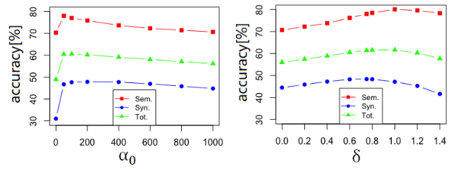

Experiments
Effect of weight parameters
Performance boosts when $α_{0}$ becomes non-zero
Negative information is of vital importance
Best performance achieves when $δ$ is around 0.75
Same with the power used in negative sampling

Slide 26
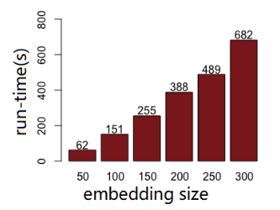

Experiments
Running time on NewsIR corpus
In a single iteration, our model has the same level of running time with skip-gram
The proposed model need to run more iteration, resulting in a little longer total time
Running time has almost a linear relationship with embedding size
$O(|S|k)$ (positive pairs) accounts for the main part in total $O(\left|S\right|k+|V|k^{2})$ complexity
 | Single iter | Iteration | Total
SG-3 | 259s | 15 | 65m
SG-7 | 521s | 15 | 131m
SG-10 | 715s | 15 | 179m
Ours | 388s | 50 | 322m
Notes:
We also conduct experiments to study the running time of our model. The left table shows the comparison of running time, where SG with a number denotes the sample size for skip-gram models.
We can see that XXXXX
The right graph shows the relationship between running time and embedding size. XXXX

Slide 27
Conclusion&Future works
Conclusion:
We proposed a new embedding method which can directly learn from whole data without any sampling
We developed a new learning scheme to perform efficient optimization
Complexity of learning from whole data is only determined by the positive part.
Future works:
Generalize the proposed learning scheme to other loss functions
Full example learning for deep models
Notes:
To conclude, in this paper, we XXX
And Then, we XXXXXX, in which the XXXXXXX
For future works, we are trying to XXXXXXX.
Besides, we are also trying to generalize the full example learning approach to deep models.

Slide 28
Thank you

