Slide 1









A Graph-Theoretic Fusion
Framework for Unsupervised
Entity Resolution
Presented by: Dongxiang Zhang

Slide 2
Entity Resolution
Text Records | Identical Entity
Les Celebrites 160 Central Park S New York French
Les Celebrites 155 W. 58th St. New York City French (Classic)
Palm 837 Second Ave. New York City Steakhouses
Palm Too 840 Second Ave. New York City Steakhouses
√
×
Two examples from the restaurant dataset.

Slide 3
Previous Work
Distance-based Methods
Edit Distance, TF-IDF
Simple and scalable, but not effective enough
Learning-based Methods
Learn a distance metric
Model ER as a classification task and apply SVM
Require considerable amount of training data
Crowd-based Methods
CrowdER, TransM, TransNode, GCER, ADC, Power+
Achieve state-of-the-art accuracy but require human intervention

Slide 4
Our Objective
Propose an unsupervised approach
More accurate when compared with distance-based methods
Require no training/labeling efforts when compared with learning-based methods
Require no human intervention and financial cost when compared with crowd-based methods

Slide 5
The General Idea
In the traditional unsupervised methods
Step 1: Craft a distance measure between two records
Step 2: Tune a threshold such that two records with similarity score higher than the threshold are considered as the same entity
We are motivated to improve these two steps by
Proposing ITER algorithm to learn record similarity
Proposing CliqueRank to estimate the likelihood of two records referring to the same entity
Iteratively Reinforcing these two components

Slide 6
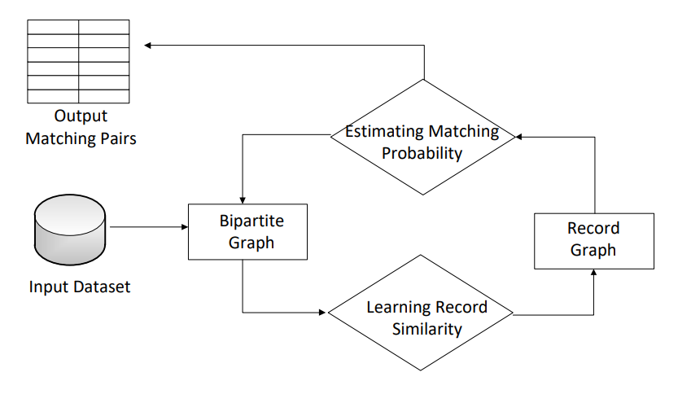
Unsupervised Fusion Framework
CliqueRank
ITER

Slide 7
ITER Algorithm
If a term only occurs in a group of matching records, then we consider the term as highly discriminative
Examples include product models for electronic devices or telephone numbers for restaurant.
These terms have low term frequency and may not be emphasized by TF-IDF
If a term is shared by many non-matching records, its weight will be punished

Slide 8
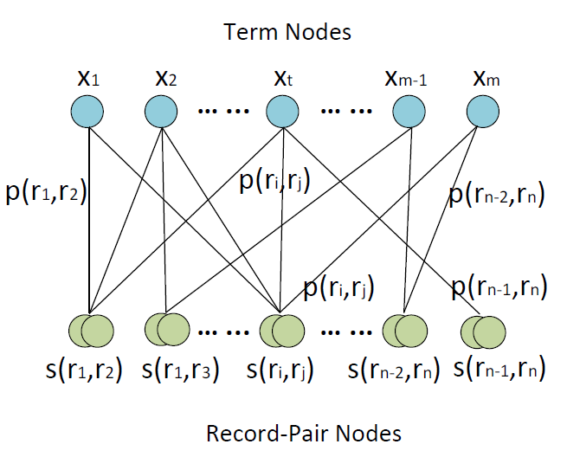
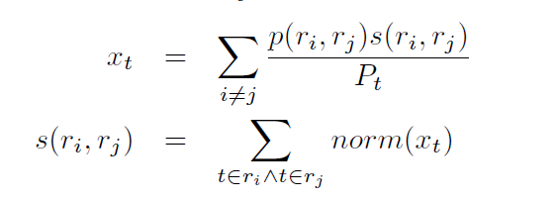
ITER Algorithm

Slide 9
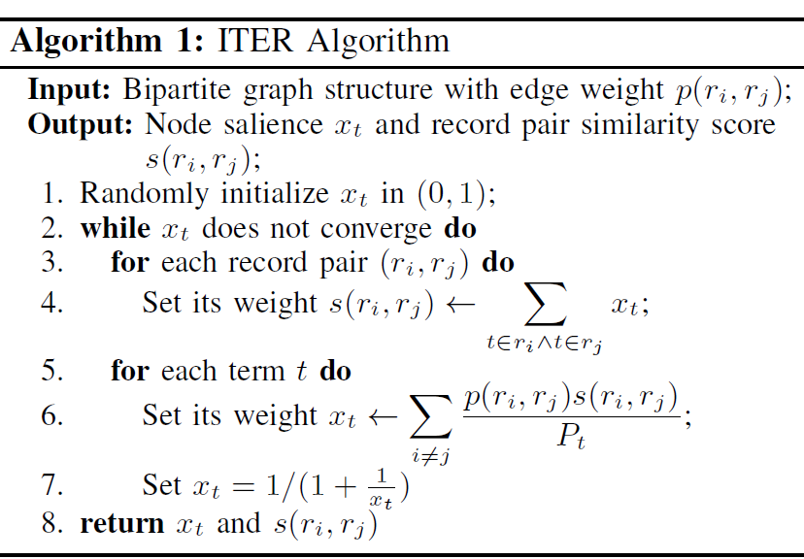
ITER Algorithm

Slide 10
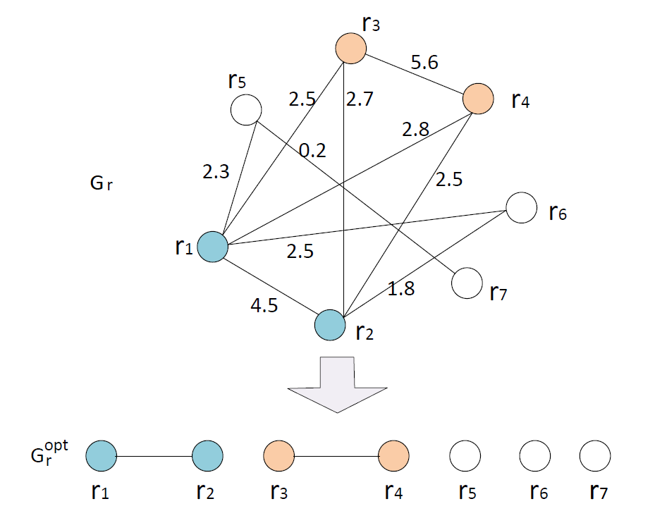
CliqueRank Algorithm
Given Gr, our goal is to identify matching probability.
Ideally, the probability should be 1 for matching pairs and 0 for non-matching pairs

Slide 11
CliqueRank Algorithm
Random-Walk based interpretation
Ideally, if r_{i} and r_{j} refer to different entities, they should be located in different cliques and not reachable from each other
Otherwise, if we start a random walk from one record r_{i}, it will be very likely to visit the other record r_{j} within certain number of steps

Slide 12
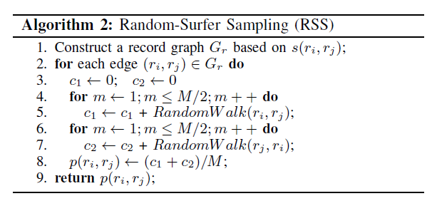
Random-Surfer Sampling

Slide 13
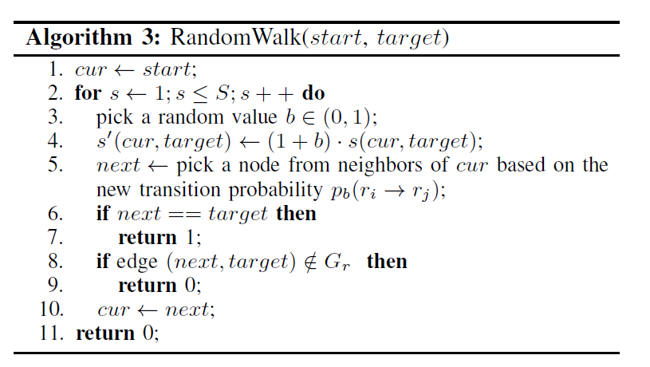
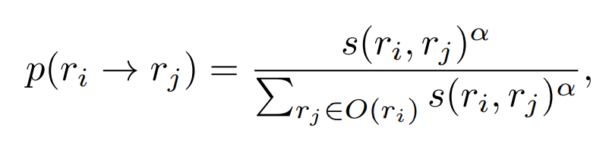
Random Walk Algorithm
To handle large cliques
To champion edge with high score
For early termination

Slide 14



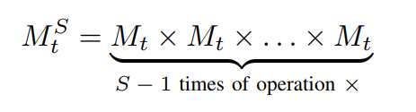
CliqueRank Algorithm
Iterative sampling is slow, and we switch to matrix operation
be the matrix with reaching probability from r_{i} to r_{j} with 1 step
be the matrix with reaching probability from r_{i} to r_{j} with S steps
The random surfer algorithm essentially estimates such probability

Slide 15



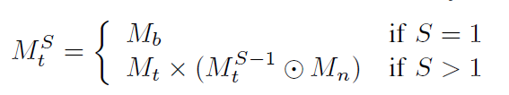
CliqueRank Algorithm
We make customizations to the RSS algorithm
be the initial transition probability matrix
is set to 1 if r_{i} to r_{j} are connected in Gr
Finally, we can define the reaching probability with S steps

Slide 16
Benchmark Datasets
Restaurant
858 non-identical restaurant records.
Each record contains the information of restaurant name and address.
Product
1081 records from the abt website and the other 1092 records from the buy website.
Each product record contains its name and descriptive information.
Paper
1865 non-identical publication records.
Each record has a cluster id and its textual information consists of authors, title, publication venue and year.

Slide 17
Experimental Setup
For the three datasets, we use the same setting of parameters
α=20
S=20
η=0.98
5 iterations between the reinforcement of ITER and CliqueRank
Eigen library is used to boost matrix multiplication
http://eigen.tuxfamily.org/index.php?title=Main Page

Slide 18
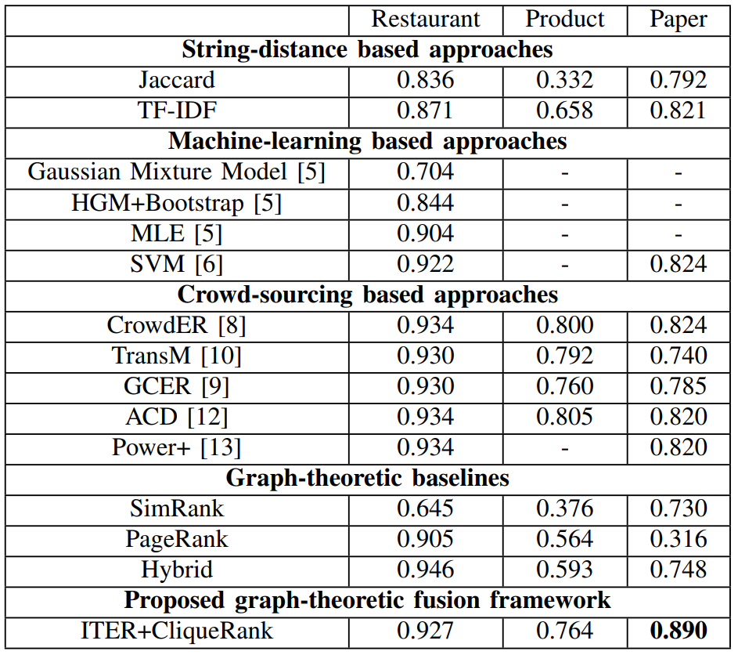
Experiment & Analysis
Accuracy

Slide 19
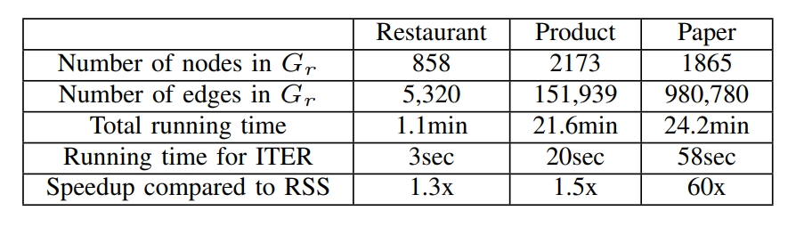
Experiment & Analysis
Efficiency

Slide 20
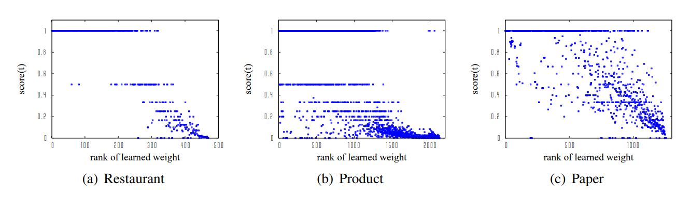

Experiment & Analysis
Effectiveness of Learned Term Weights
ground-truth score:

Slide 21
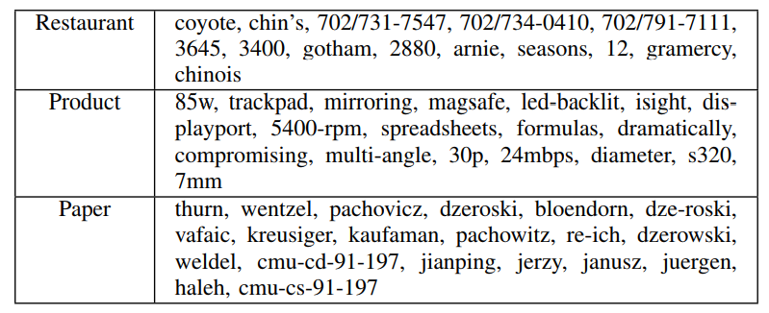
Experiment & Analysis
Top-Ranked Terms in the Benchmark Datasets

Slide 22
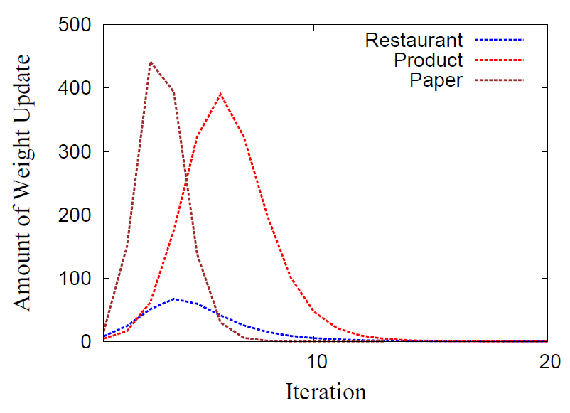
Experiment & Analysis
Convergence of ITER

Slide 23
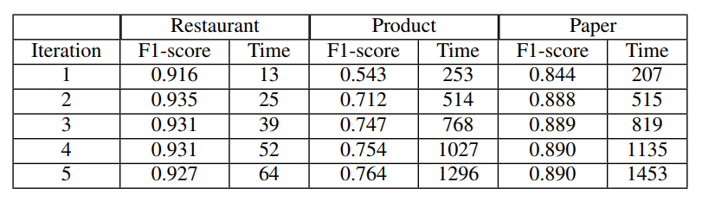
Experiment & Analysis
Effect of Reinforcement

Slide 24
Conclusion
We propose an unsupervised graph-theoretic framework for entity resolution.
Two novel algorithms ITER and CliqueRank are proposed, one for term-based similarity and the other for topological confidence. These two components can reinforce each other.
Experimental results on three benchmark datasets show that our algorithm is accurate
Codes are available at:
https://github.com/uestc-db/Unsupervised-Entity-Resolution

Slide 25

Thank you!
Q&A

