Slide 1

NUS-Tsinghua Centre for Extreme Search A Joint Research Collaboration Between NUS & Tsinghua University
Outer Product-based
Neural Collaborative Filtering
Xiangnan He¹, Xiaoyu Du², Xiang Wang¹,
Feng Tian³, Jinhui Tang⁴ and Tat-Seng Chua¹
1: National University of Singapore
2: Chengdu University of Information Technology
3: Northeast Petroleum University
4: Nanjing University of Science and Technology
© Copyright NExT++. All Right Reserved.
Notes:
Good morning everyone. Since the authors of the paper couldn’t come to the conference, I give this presentation on behalf of the authors. I’m Dingtao Ding, PhD student from Tsinghua university. I will try my best to explain the work. This work is about developing neural network models for the recommendation task.

Slide 2
Matrix Factorization (MF)
A prevalent model for collaborative filtering
Represent a user (or an item) as a vector of latent factors (also termed as embedding)
© Copyright NExT++. All Right Reserved.
Notes:
Recommender systems have now become a core service and a major monetization tool for many customer-oriented systems.
Matrix factorization is one of the most prevalent models for collaborative filtering, owing to its simpleness and effectivenss. Its basic idea is to represent a user (or an item) as a vector of latent factors. From the perspective of neural network modeling, it can be seen as using the ID feature in the input layer, and then projecting input to linear embedding layer.
[next page]

Slide 3
Matrix Factorization (MF)
A prevalent model for collaborative filtering
Represent a user (or an item) as a vector of latent factors (also termed as embedding)
Estimate an interaction as the inner product between the user embedding and item embedding
© Copyright NExT++. All Right Reserved.
Notes:
Then, a user-item interaction, that is the prediction score y_{ui}, is estimated as the inner product between user embedding and item embedding. [next page]

Slide 4
Matrix Factorization (MF)
A prevalent model for collaborative filtering
Represent a user (or an item) as a vector of latent factors (also termed as embedding)
Estimate an interaction as the inner product between the user embedding and item embedding
Many extensions on MF
Model perspective: NeuMF [He et al, WWW’17], Factorization Machine etc.
Learning perspective: BPR, Adversarial Personalized Ranking [He et al, SIGIR’18]
© Copyright NExT++. All Right Reserved.
Notes:
Since MF has been proposed, they are many variants being developed. For example, from the modeling perspective, there are Neural MF, which extends the interaction function modeling with deep neural nets. From the learning perspective, besides the traditional pairwise learning framework BPR, adversarial training has been recently applied to pairwise ranking. [next page]

Slide 5
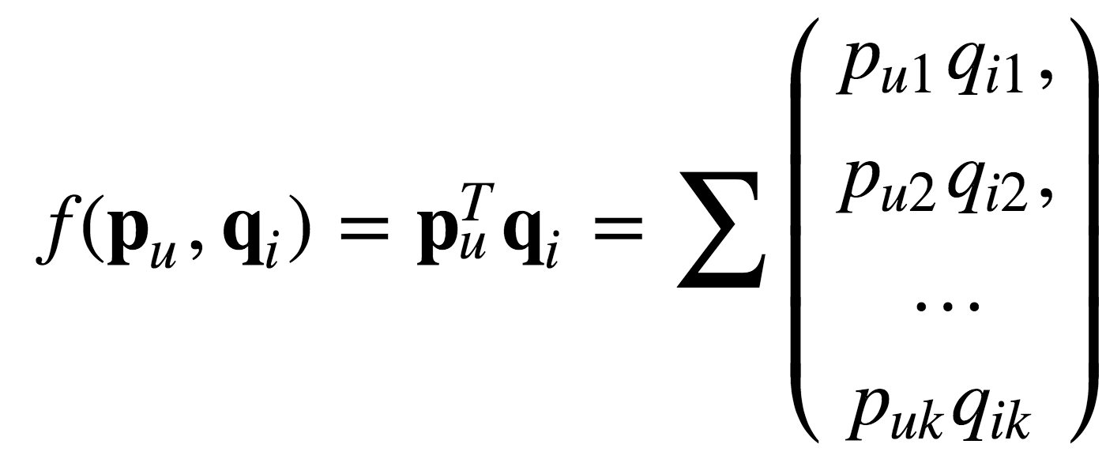
Interaction Function in MF
MF uses Inner Product as the interaction function
The implicit assumption in Inner Product:
The embedding dimensions are independent with each other
However, the implicit assumption is impractical.
The embedding dimensions could be interpreted as certain properties of items [Zhang et al., SIGIR’14], which are not necessarily to be independent
Recent DNN-based models either use element-wise product or concatenation.
E.g., NeuMF [He et al, WWW’17], NNCF [Bai et al, CIKM’17], JRL [Zhang et al, CIKM’17], Autoencoder-based CF Models [Wu et al, WSDM’16]
Still, the relations among embedding dimensions are not explicitly modeled.
© Copyright NExT++. All Right Reserved.
Notes:
Clearly, MF applies inner product to interact user embedding and item embedding to get the prediction score. From the operation of inner product as shown in the right figure, it implicitly assumes that the embedding dimensions are independent with each other. [Click]
However, this implicit assumption is impractical, since the embedding dimensions can be interpreted as certain properties of items, which are not necessarily to be independent. [Click]
Although DNN has been used to learn interaction function from data, however when merge user embedding and item embedding, they typically use element-wise product or concatenation. With this design, the relations, or correlations, among embedding dimensions are still not explicit modeled. For example, Neural MF model, Neighbor-based NCF, and these auto-eoncoder based CF models. [next page]

Slide 6
Research Questions
How to model the relations between embedding dimensions?
Next:our proposed method:
1. Outer product on user&item embedding for pairwise interaction modeling
2. CNN on the outer product matrix to extract and reweight prediction signals.
© Copyright NExT++. All Right Reserved.
Notes:
In this work, we aim to model the relations between embedding dimensions to achieve better performance for recommendation.
Next, I will show our proposed method, which has two key ideas:
Using outer production on user embedding and item embedding to explicitly model the pairwise relations between embedding dimensions.
Using Convolution Neural Nets above the outer product matrix to extract and reweight the signals for prediction.

Slide 7
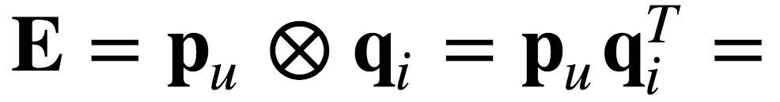
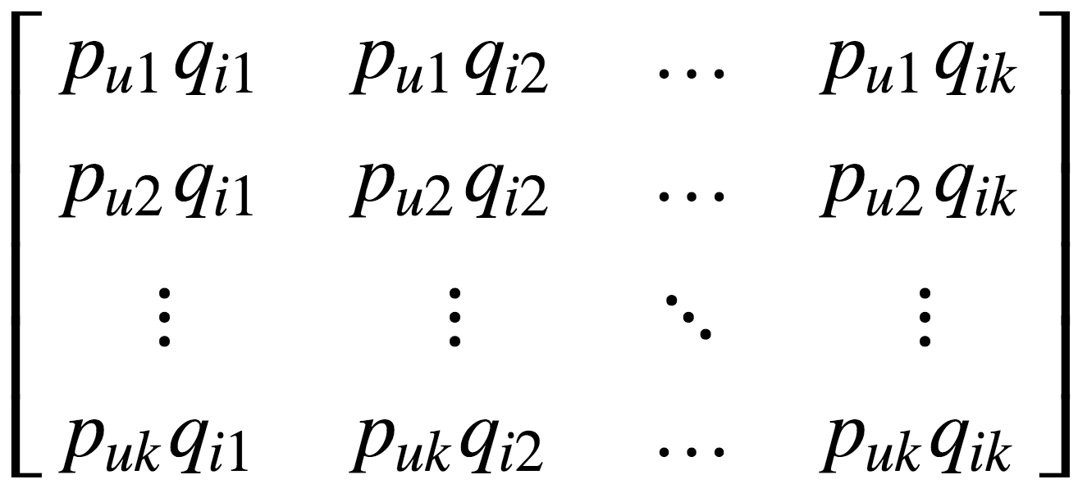
Outer Product-based
Neural Collaborative Filtering (ONCF)
Outer-product explicitly models the pairwise relations between embedding dimensions:
- Get a 2D matrix, named as interaction map:
Signals in Inner product
Indicating the interaction between the k-th dimension of p_{u} and the 2-nd dimension of q_{i}.
© Copyright NExT++. All Right Reserved.
Notes:
Our proposed ONCF is a variant of the Neural Collaborative Filtering framework. Instead of merge user embedding and item embedding into a vector, it applies outer product to get a 2-dimension matrix, which we call it interaction map. Outer product explicitly models the pairwise relations between embeddings.
[Click] For example the entry E_{k, 2} of the matrix denotes the interaction between the k-th dimension of user embedding and 2-nd dimension of item embedding.
[Click] Moreover, the diagonal elements aligns the embedding dimensions, which are the prediction signals in inner product. As such, the 2D interaction map enriches inner product with more prediction signals on embedding dimension interactions. [next page]

Slide 8
ONCF-MLP
Above the interaction map are hidden layers, which aim to extract useful signal from the 2D interaction map.
A straightforward solution is to use MLP, however it results in too many parameters:
Interaction map E has K×K neurons (K is embeddings size usually hundreds)
Require large memories to store the model
Require large training data to learn the model well
© Copyright NExT++. All Right Reserved.
Notes:
Above the interaction map are the hidden layers, which aim to extract useful signal from the 2D interaction map for the final prediction. A straightforward solution for hidden layers is to use multi-layer perception. However, it will result in too many parameters, because the interaction map E has K\times K neurons where K denotes the embedding size which is usually hundreds. As such, the neurons in the interaction map can easily reach tens of thousands. Building MLP above it will lead to a model having too many parameters, not only require large memories to store the model, but also large training data to learn the model well.

Slide 9
Convolutional NCF (ConvNCF)
ConvNCF uses locally connected CNN as hidden layers in ONCF:
CNN has much fewer parameters than MLP
Hierarchical tower structure: higher layer integrates more information from larger area.
Final prediction summarizes all information from interaction map.
2 Fully Connected Layers: > 10M parameters
6 Convolutional Layers: 20K parameters, but achieve better performance!
© Copyright NExT++. All Right Reserved.
Notes:
To address the drawback of MLP, we propose to employ locally connected CNN as the hidden layers to extract interaction features, which has much fewer model parameters.
We apply a 6-layer hierarchical tower structure, where higher layer integrates more information from larger area. For example, each element in layer 6 is composed of 4 elements in layer 5. Following such recursive relation, the final prediction aggregates all elements in the interaction map, and their importance are determined by the weights of convolution layers.
Moreover, we use 32 channels to increase the modeling capability.
With the setting on embedding size of 64 on our data, two fully connected layers over interaction map have over 10 million parameters, while 6 convolution layers only have 20 thousand parameters, which is three magnitudes fewer but achieves better performance. [next page]

Slide 10
Experimental Settings
Datasets
Yelp: 25,815 users, 25,677 items, and 730,791 interactions.
Gowalla: 54,156 users, 52,400 items, and 1,249,703 interactions.
Protocols
Leave-one-out: holdout the latest interaction of each user as the test
Pair 1 testing instance with 999 negative instances
Top-K evaluation: ranking 1 positive vs. 999 negatives.
Ranking lists are evaluated by Hit Ratio and NDCG (@10).
Loss Function
Bayesian Personalized Ranking
© Copyright NExT++. All Right Reserved.
Notes:
We perform experiments on two datasets, Yelp and Gowalla, here are the statistics after necessary filtering. Both datasets are casted to implicit feedback and we employ Bayesian personalized ranking objective function to optimize all models.
We employ leave-one-out protocol, holding out the latest interaction of each user as testing, and ranking each testing interaction among 999 negative instances. The ranking list is evaluated by HR and NDCG.

Slide 11
Baselines
MF-BPR [Rendle et al., UAI’09]
Learning MF with a pair-wise classification loss.
MLP [He et al., WWW’17]
3-layer multi-layer perceptron above user and item embeddings.
JRL [Zhang et al., CIKM’17]
Multi-layer perceptron above the element-wise product of embeddings.
NeuMF [He et al., WWW’17]
A neural network combining hidden layer of MF and MLP.
© Copyright NExT++. All Right Reserved.
Notes:
Here are the baselines we compared with. Note that MLP, JRL and NueMF are neural recommender models.

Slide 12
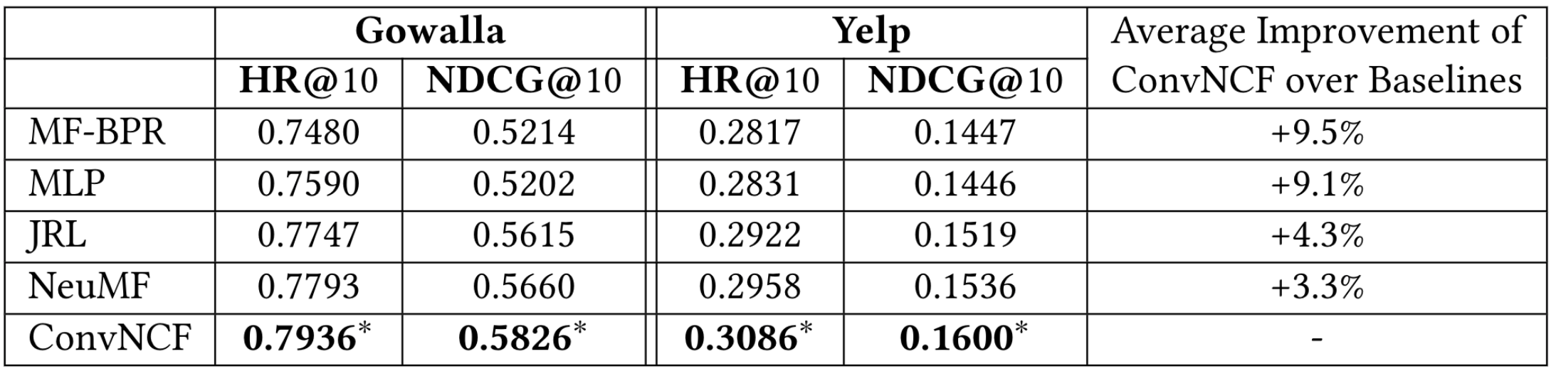
Performance Comparison
∗ indicates that the improvements over all other methods are statistically significant for p < 0.05.
Overall Performance: ConvNCF > NeuMF[He et al., 2017] > JRL[Zhang et al., 2017]
Usefulness of modeling the relations of embedding dimensions
Training MLP well is practically difficult.
© Copyright NExT++. All Right Reserved.
Notes:
Here shows the performance comparison results. The last column shows the average improvement of our ConvNCF over baselines. The overall trend is ConvNCF performs best, followed by NeuMF and JRL. The strong performance of ConvNCF demonstrates the usefulness of modeling embedding relations for collaborative filtering.
Moreover, although MLP has strong representation power in theory, it is practically difficult to train it well. So its performance is only in the same level as MF.

Slide 13
Efficacy of Outer Product
Training process of neural models that apply different operations above the embedding layer:
- ConvNCF: outer product; GMF: element-wise product; MLP: concatenation; JRL: element-wise product
Outer product is a simple but effective merge of user&item embeddings.
© Copyright NExT++. All Right Reserved.
Notes:
These results show the training process of neural models that apply different operations above the embedding layer. We can see that by ConvNCF applies outer product, which outperforms other models that use element-wise product and concatenation by a large margin.
Overall we draw the conclusion that outer product is a simple but effective merge of user&item embeddings.

Slide 14
Efficacy of CNN
NDCG@10 of using different hidden layers for ONCF:
ConvNCF uses a 6-layer CNN.
ONCF-mlp uses a 3-layer MLP above the interaction map.
ConvNCF outperforms ONCF-mlp.
ConvNCF is more stable than ONCF-mlp.
© Copyright NExT++. All Right Reserved.
Notes:
Lastly, we compare ConvNCF with a method that replaces the CNN with MLP. We call this method ONCF-mlp, which uses 3-layer MLP above the interaction map. This is to demonstrate the advantage of CNN over fully connected layers.
The figures show the training process of the two methods. We can see that ConvNCF not only outperforms ONCF-mlp significantly, but also is more stable to train, having smaller fluctuations. This shows that using CNN about the 2D interaction map is a better choice than MLP.

Slide 15
Conclusion & Future Work
Summary of contributions:
A new neural framework for CF --- ONCF, which explicitly captures pairwise correlations between embedding dimensions with outer product
A new model of ONCF framework --- ConvNCF, which uses CNN as hidden layers .
Extensive experiments show effectives of ONCF framework and ConvNCF method.
Future work:
We will explore more advanced CNN models to further explore the potentials of our ONCF framework.
We will extend ONCF to content-based recommendation scenarios, e.g., items have image and textual content.
© Copyright NExT++. All Right Reserved.
Notes:
To summarize, we propose a new neural framework for CF, which explicitly captures pairwise correlations between embedding dimensions with outer product. We propose a new model under the framework, named ConvNCF, which uses CNN as hidden layers. Extensive experiments show effectives of ONCF framework and ConvNCF method.
In future, we will explore more advanced CNN models to further explore the potentials of our ONCF framework. Also, we plan to extend ONCF to content-based recommendation scenarios, e.g., E-commerce products that have image and textual content.

Slide 16
References
[Xue et al., 2017] Hong-Jian Xue, Xinyu Dai, Jianbing Zhang, Shujian Huang, and Jiajun Chen. Deep matrix factorization models for recommender systems. In IJCAI, pages 3203–3209, 2017.
[Rendle et al., 2009] Steffen Rendle, Christoph Freudenthaler, Zeno Gantner, and Lars Schmidt-Thieme. Bpr: Bayesian personalized ranking from implicit feedback. In UAI, pages 452–461, 2009.
[He et al., 2018] Xiangnan He, Zhankui He, Xiaoyu Du, and Tat-Seng Chua. Adversarial personalized ranking for item recommendation. In SIGIR, 2018.
[Zhang et al., 2014] Yongfeng Zhang, Guokun Lai, Min Zhang, Yi Zhang, Yiqun Liu, and Shaoping Ma. Explicit factor models for explainable recommendation based on phrase-level sentiment analysis. In SIGIR, pages 83–92, 2014.
[Tay et al., 2018] Yi Tay, Luu Anh Tuan, and Siu Cheung Hui. Latent relational metric learning via memory-based attention for collaborative ranking. In WWW, pages 729– 739, 2018.
[Bai et al., 2017] Ting Bai, Ji-Rong Wen, Jun Zhang, and Wayne Xin Zhao. A neural collaborative filtering model with interaction-based neighborhood. In CIKM, pages 1979–1982, 2017.
[He et al., 2017] Xiangnan He, Lizi Liao, Hanwang Zhang, Liqiang Nie, Xia Hu, and Tat-Seng Chua. Neural collaborative filtering. In WWW, pages 173–182, 2017.
[Zhang et al., 2017] Yongfeng Zhang, Qingyao Ai, Xu Chen, and W Bruce Croft. Joint representation learning for top-n recommendation with heterogeneous information sources. In CIKM, pages 1449–1458, 2017.
© Copyright NExT++. All Right Reserved.
Notes:
The reference cited in this slides.

Slide 17
NUS-Tsinghua Centre for Extreme Search A Joint Research Collaboration Between NUS & Tsinghua University
THANK YOU!
Codes: https://github.com/duxy-me/ConvNCF
For questions: email to Dr. He Xiangnan xiangnanhe@gmail.com
© Copyright NExT++. All Right Reserved.
Notes:
Thank you all!

