Slide 1


Cross-Domain Depression Detection
via Harvesting Social Media
Tiancheng Shen¹, Jia Jia¹, Guangyao Shen¹, Fuli Feng², Xiangnan He², Huanbo
Luan¹, Jie Tang¹, Thanassis Tiropanis³, Tat-Seng Chua², Wendy Hall³
1. Department of Computer Science and Technology, Tsinghua University
2. School of Computing, National University of Singapore
3. Electronics and Computer Science, University of Southampton
17 July 2018 @ IJCAI 2018, Stockholm, Sweden

Slide 2

Why Cross-Domain Depression Detection?
Depression detection: a significant issue for human well-being
Traditional psychological diagnosis: reliable but reactive
Online detection via social media: success in Twitter, proactive
Labeling of depressed users: questionnaire vs self-reported sentence pattern matching (matching expressions like “I’m diagnosed with depression” in user-generated content)
In Twitter: a large well-labeled dataset [Shen et al., 2017]
Replication in other platforms: cultural differences, insufficient data for model training
Problem: can we utilize the multi-source datasets to enhance depression detection for a certain platform?

Slide 3
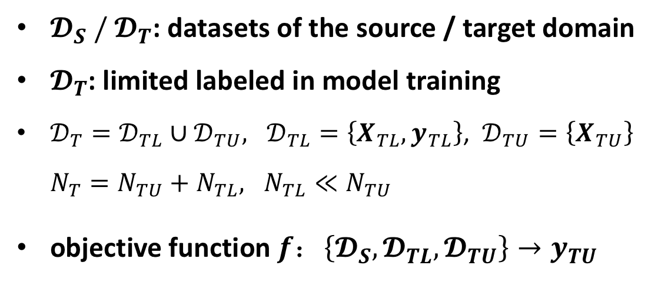
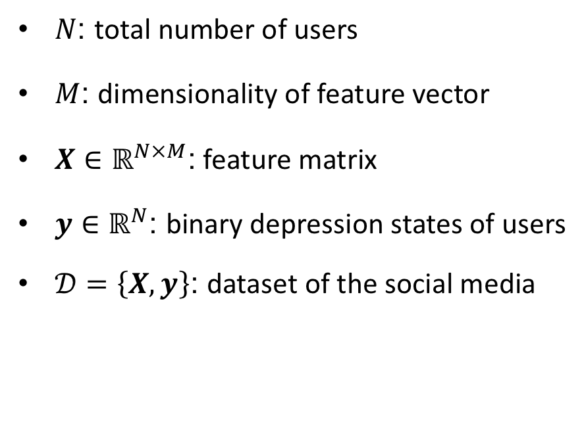
Problem Formulation
$N$: total number of users
$M$: dimensionality of feature vector
$X∈ℝ^{N×M}$: feature matrix
$y∈ℝ^{N}$: binary depression states of users
$𝒟=\left\{X, y\right\}$: dataset of the social media
$𝓓_{S} /{ 𝓓}_{T}$: datasets of the source / target domain
$𝓓_{T}$: limited labeled in model training
$𝒟_{T}=𝒟_{TL}∪𝒟_{TU}, 𝒟_{TL}=\left\{X_{TL}, y_{TL}\right\}$, $𝒟_{TU}=\left\{X_{TU}\right\}$
。 ${N_{T}=N}_{TU}+N_{TL}, N_{TL}≪N_{TU}$
objective function $f：\left\{𝓓_{S}, 𝓓_{TL},𝓓_{TU}\right\}→y_{TU}$

Slide 4
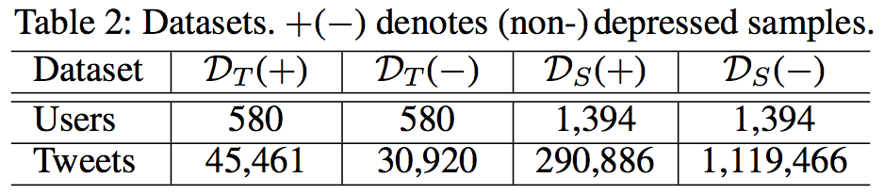
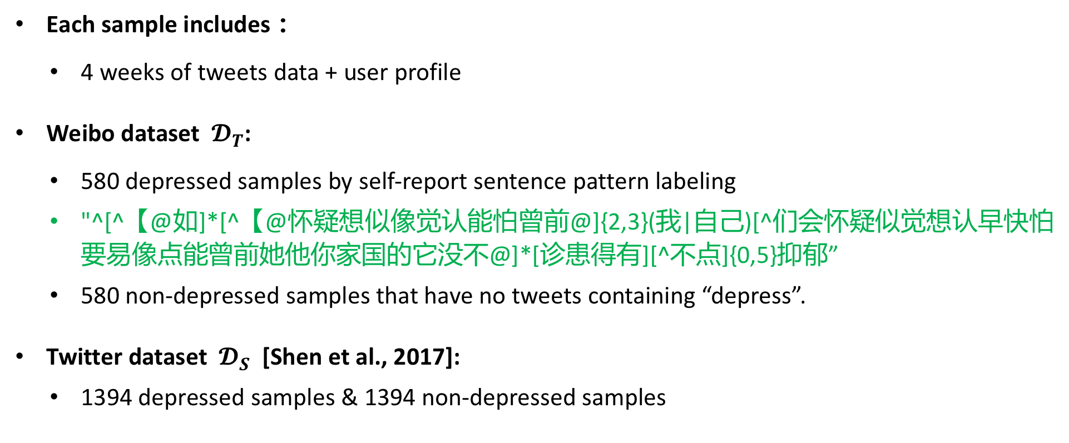
Dataset Construction
Each sample includes：
4 weeks of tweets data + user profile
Weibo dataset ${ 𝓓}_{T}$:
580 depressed samples by self-report sentence pattern labeling
"^[^【@如]*[^【@怀疑想似像觉认能怕曾前@]{2,3}(我|自己)[^们会怀疑似觉想认早快怕要易像点能曾前她他你家国的它没不@]*[诊患得有][^不点]{0,5}抑郁”
580 non-depressed samples that have no tweets containing “depress”.
Twitter dataset ${ 𝓓}_{S}$[Shen et al., 2017]:
1394 depressed samples & 1394 non-depressed samples

Slide 5
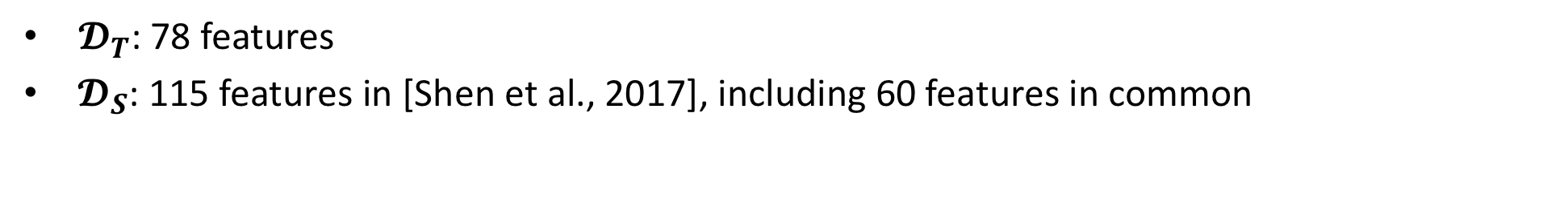
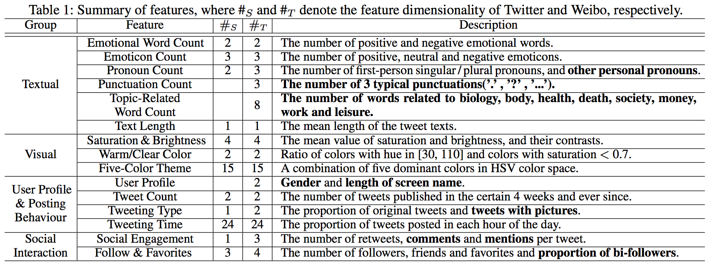
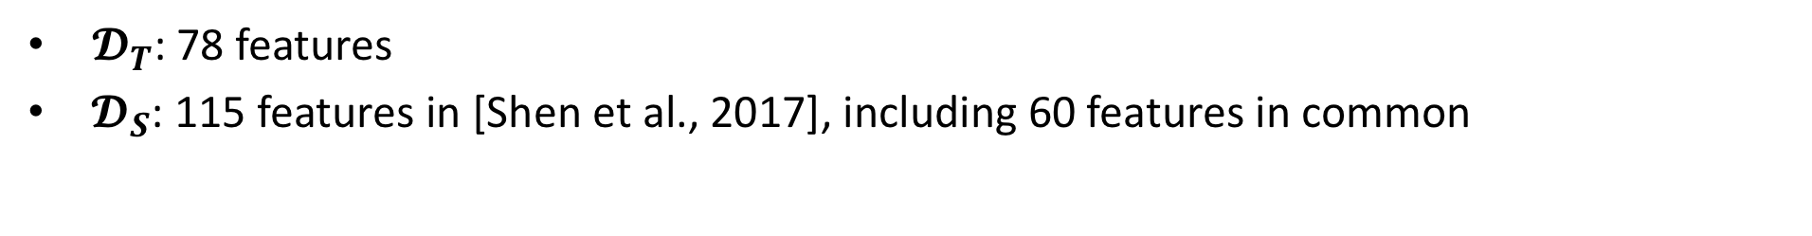
Feature Extraction
$𝓓_{T}$: 78 features (including 18 $𝒟_{T}$-exclusive features).
${ 𝓓}_{S}$: 60 features
$𝓓_{T}$: 78 features
${ 𝓓}_{S}$: 115 features in [Shen et al., 2017], including 60 features in common
© Copyright NExT++. All Right Reserved.

Slide 6
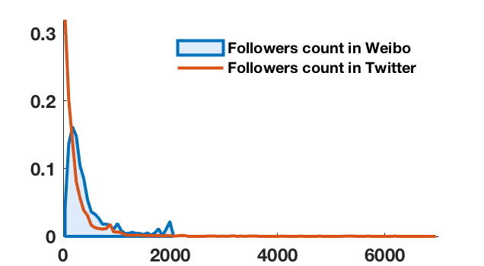
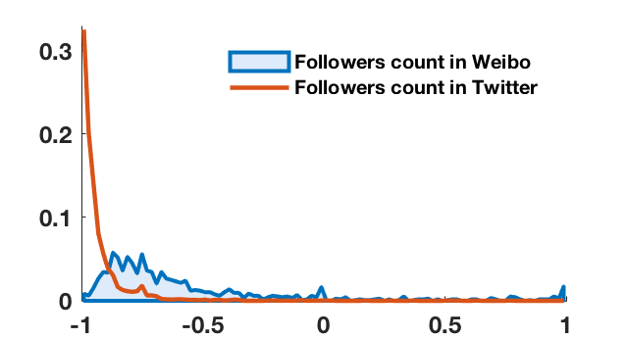
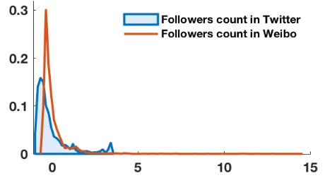
Data Analysis: Isomerism
One feature may follow distinctive integral distributions in different domains.
unrelated to specific user groups (de-pressed / non-depressed users).
Example: follower count
The same value of feature might have different implications across domains
Quite common in the dataset
Normalization methods: min-max & z-score, unsatisfactory
(Original)
(min-max normalization)
(z-score normalization)

Slide 7
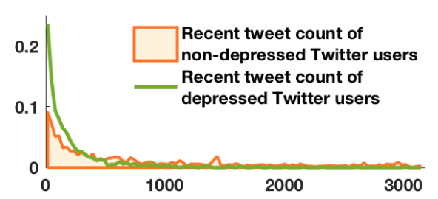
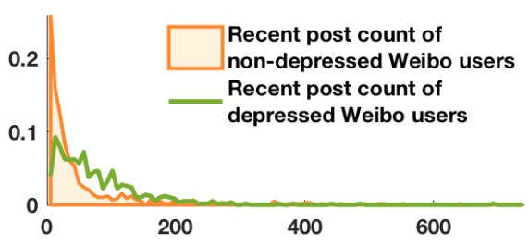
Data Analysis: Divergency
Due to cultural differences, the same feature may have distinctive, or even opposite implications on depression detection in different domains.
Such features: referred to as divergent features
Example: recent tweet count.
may tremendously impact the validity of transfer methods.

Slide 8
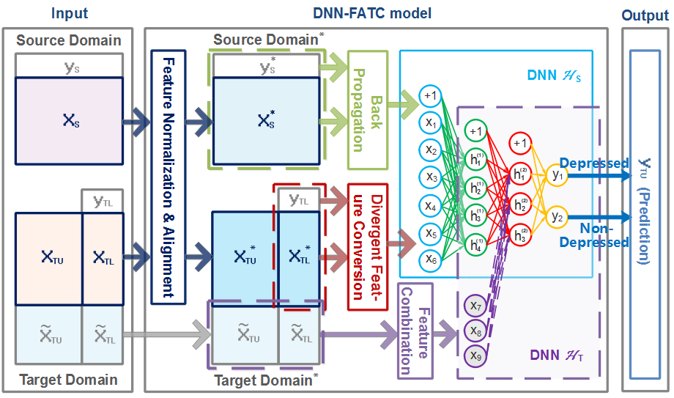

Methodology
DNN-FATC: A cross-domain Deep Neural Network model with Feature Adaptive Transformation & Combination strategy
Based mainly on$𝒟_{S}$
Shared features:
Against isomerism
Against divergency
$𝓓_{T}$-exclusive features :
Integrated in the end

Slide 9
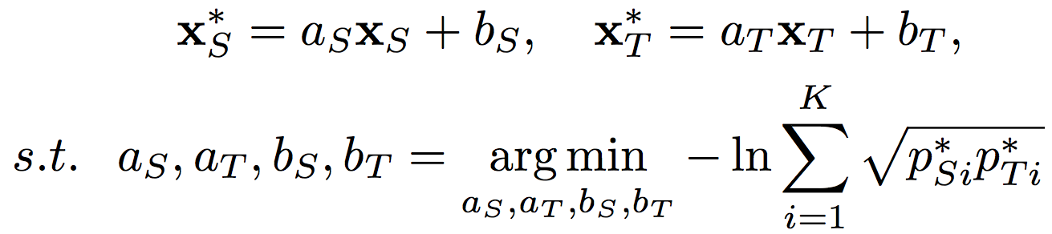
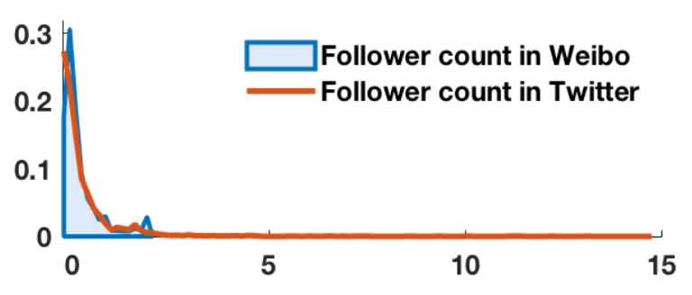
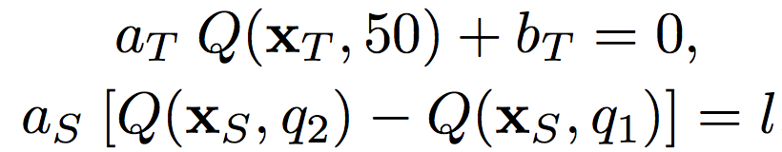

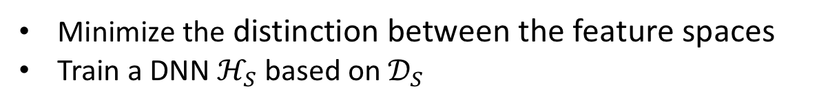
Feature Normalization & Alignment (FNA)
Targeted on isomerism
A linear transformation to fill the distributional gap by minimizing the Bhattacharyya distance.
Two more constraints:
Minimize the distinction between the feature spaces
Train a DNN $ℋ_{S}$ based on${ 𝒟}_{S}$

Slide 10




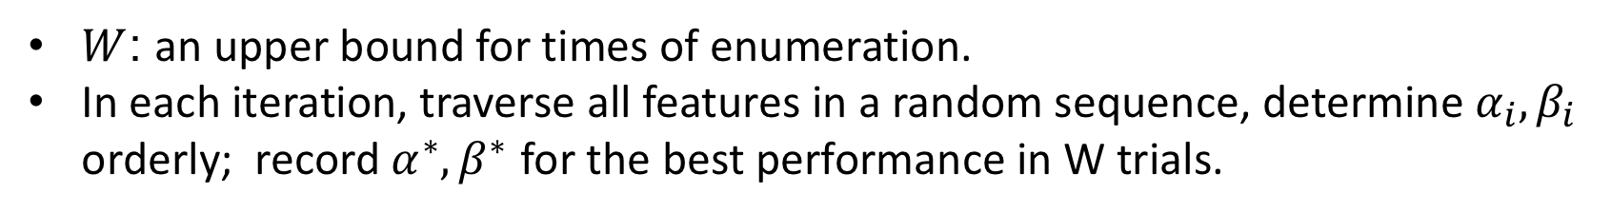
Divergent Feature Conversion (DFC)
Targeted on divergency
Identify singular features: better performance is achieved with $α_{i}<0$
Complexity of enumeration:
$W$: an upper bound for times of enumeration.
In each iteration, traverse all features in a random sequence, determine $α_{i},β_{i}$ orderly; record $α^{∗},β^{∗}$ for the best performance in W trials.
Extra constraint: $α_{i}∈\left\{−1,1\right\}, β_{i}=0$, centrosymmetric transformation
$σ$: a threshold of performance improvement to avoid overfitting.

Slide 11
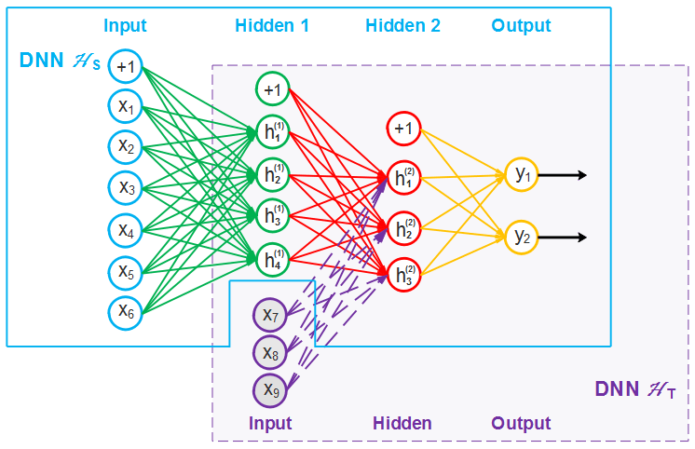
Feature Combination (FC)
$ℋ_{T}$: weights initialized to those of $ℋ_{s}$, trained on $𝒟_{TL} v$ia back propagation

Slide 12
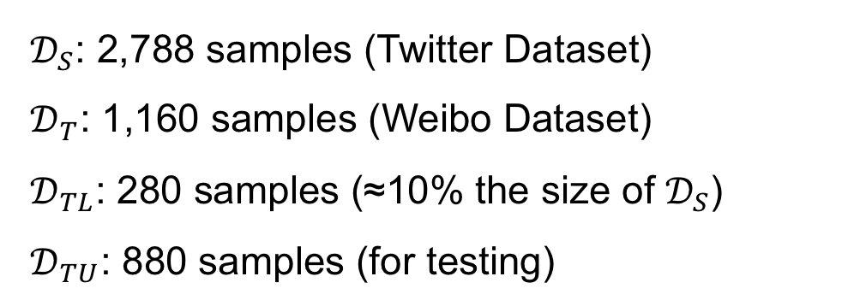
Experimental Setup: Dataset
${ 𝒟}_{S}$: 2,788 samples (Twitter Dataset)
${ 𝒟}_{T}$: 1,160 samples (Weibo Dataset)
${ 𝒟}_{TL}$: 280 samples (≈10% the size of $𝒟_{S}$)
${ 𝒟}_{TU}$: 880 samples (for testing)

Slide 13
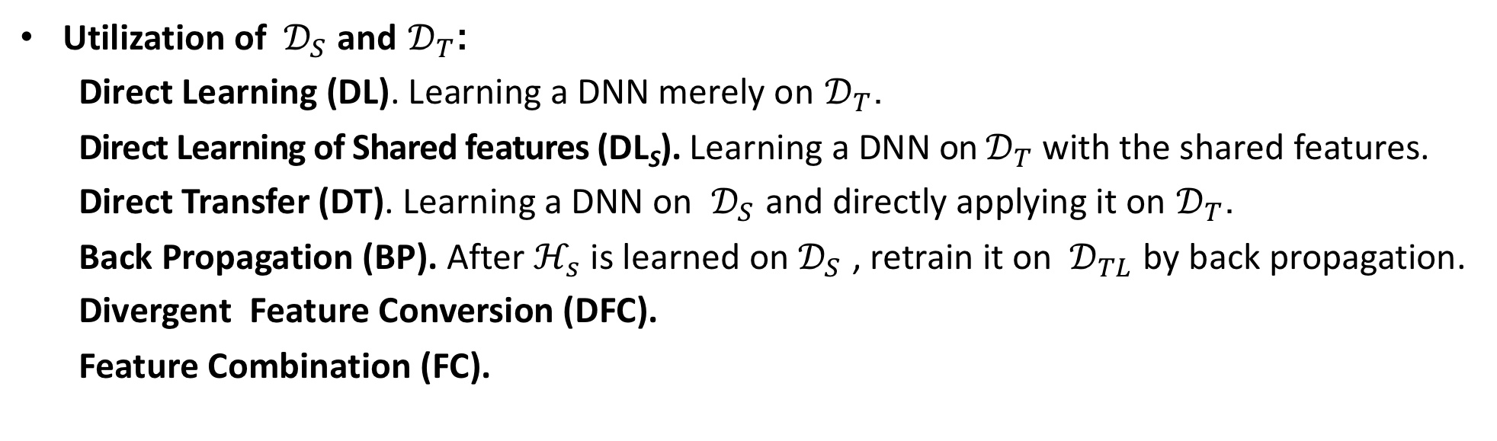
Experimental Setup: Compared Methods
Feature normalization methods:
MN: Min-Max Normalization
ZN: Zero-Mean Normalization
FNA: Feature Normalization & Alignment
Heterogeneous transfer learning methods:
ARC-t [Kulis, Saenko, and Darrell 2011]
MMDT [Hoffman et al., 2013]
HFA [Li et al., 2014]
Utilization of ${ 𝒟}_{S}$ and $𝒟_{T}$:
Direct Learning (DL). Learning a DNN merely on $𝒟_{T}$.
Direct Learning of Shared features (DL_{S}). Learning a DNN on $𝒟_{T}$ with the shared features.
Direct Transfer (DT). Learning a DNN on ${ 𝒟}_{S}$ and directly applying it on $𝒟_{T}$.
Back Propagation (BP). After $ℋ_{s}$ is learned on $𝒟_{S}$ , retrain it on ${ 𝒟}_{TL}$ by back propagation.
Divergent Feature Conversion (DFC).
Feature Combination (FC).

Slide 14
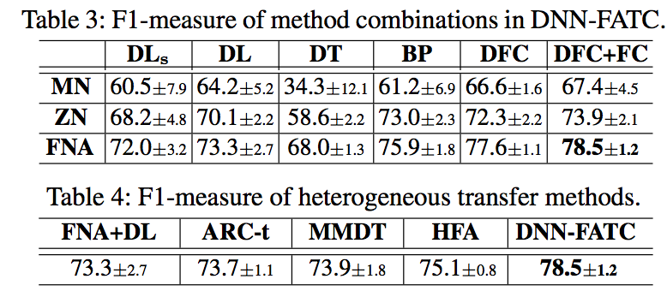
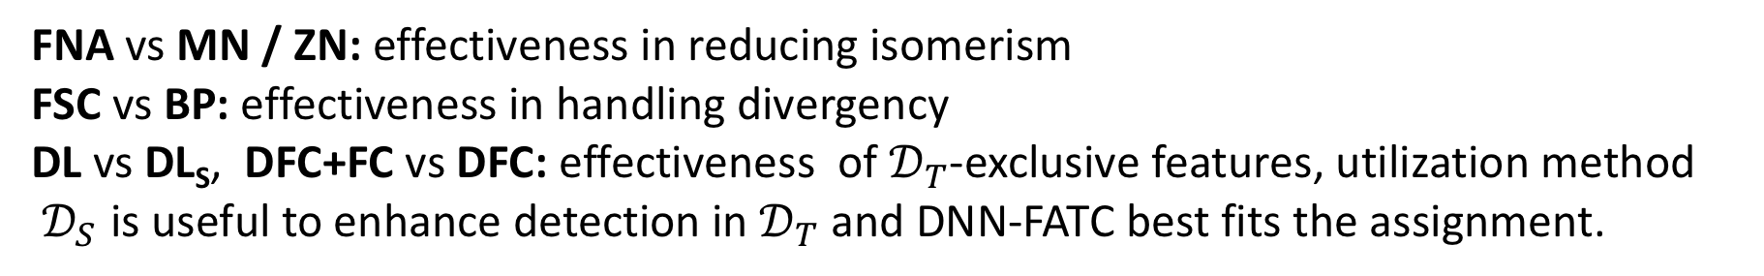
Experimental Results: Performance
FNA vs MN / ZN: effectiveness in reducing isomerism
FSC vs BP: effectiveness in handling divergency
DL vs DL_{S}, DFC+FC vs DFC: effectiveness of $𝒟_{T}$-exclusive features, utilization method
$𝒟_{S}$ is useful to enhance detection in $𝒟_{T}$ and DNN-FATC best fits the assignment.

Slide 15
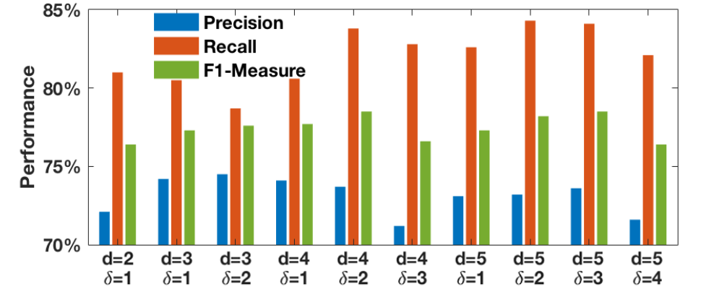
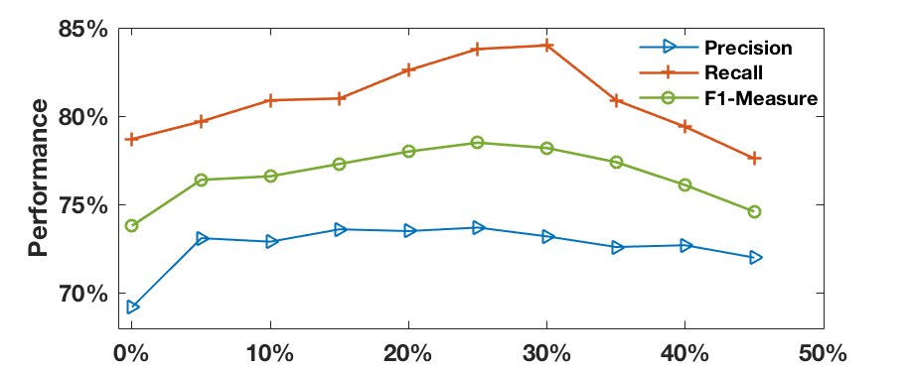
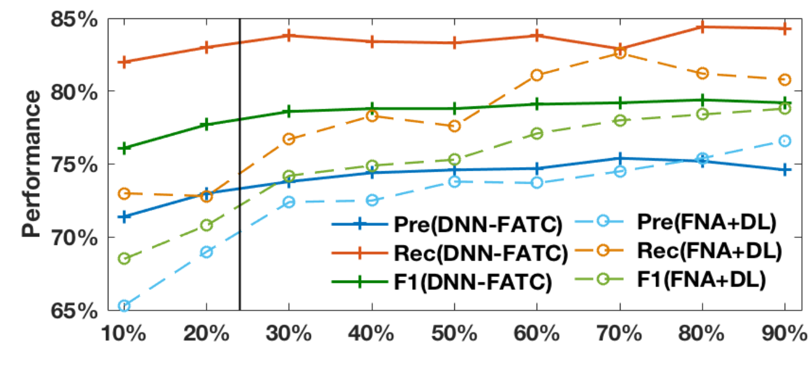
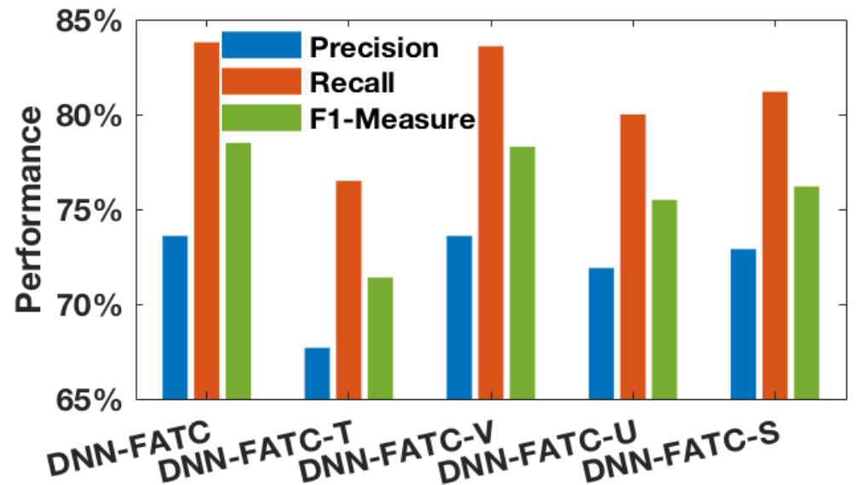
Experimental Results: Further Analysis
Aforesaid performance:
Parameter Analysis: limited Impact on performance
Data Scalability Analysis:
Feature Group Analysis:

Slide 16
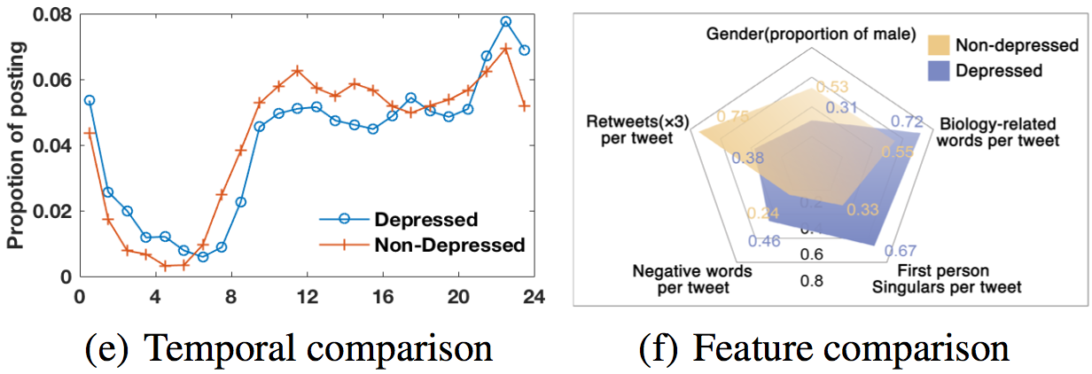
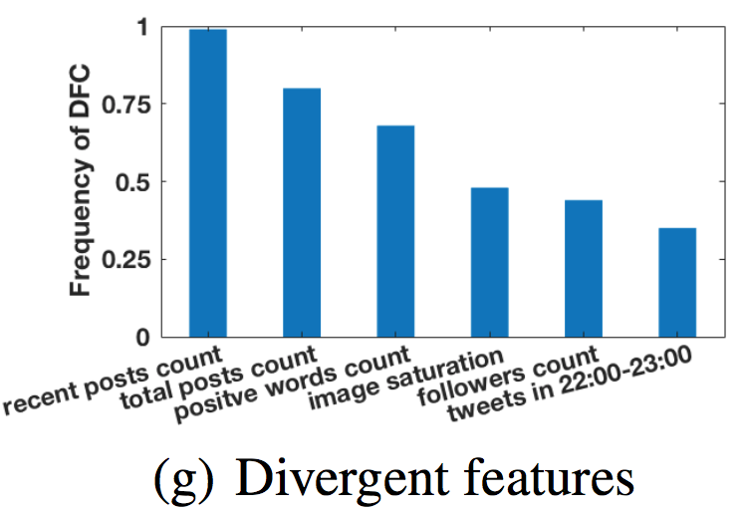
Case Study: Depressive Behavior Discovery
Depressive Behavior:
Tweet time
Gender
Linguistic pattern
Retweet count
Divergent Features:
Tweet count
Image saturation
follower count
positive word count

Slide 17
Conclusion
Raised the problem of enhancing depression detection via social media with multi-source datasets.
Proposed a cross-domain Deep Neural Network model with Feature Adaptive Transformation & Combination strategy (DNN-FATC) to transfer the relevant information across heterogeneous domains.
We expect the research to assist online depression detection for more countries, and contribute to the well-being of more people.
Future work:
Beyond binary classification: more fine-grained detection
Further improve online detection by combining offline researches

Slide 18
Thank you!

