Slide 1
Discrete Factorization Machines for Fast Feature-based Recommendation
Han Liu¹, Xiangnan He², Fuli Feng², Liqiang Nie¹,
Rui Liu³, Hanwang Zhang⁴
^{1.Shandong University}
2.National University of Singapore
3.University of Electronic Science and Technology of China
4.Nanyang Technological University
Notes:
Hello everyone, I am Han Liu, from School of Computer Science and Technology, Shandong University. The topic I speak on is Discrete Factorization Machines for Fast Feature-based Recommendation.

Slide 2





Motivation
Accurate Recommender System
Quality of Service & Profit of the Service Provider
side information
content-based : e.g., item descriptions
context-based : e.g., when and where a purchase is made
user
session-based : e.g., recent browsing history of users
item
Notes:
Recommendation is ubiquitous in today's cyber-world. An accurate recommender system should exploit the rich side information beyond user-item interactions, such as content-based, context-based, and session-based. However, existing collaborative filtering (CF) based systems merely rely on user and item features, which are far from sufficient to capture the complex decision psychology and the mood of a user behavior.

Slide 3
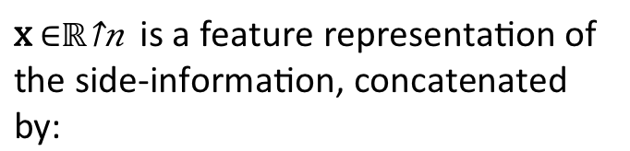
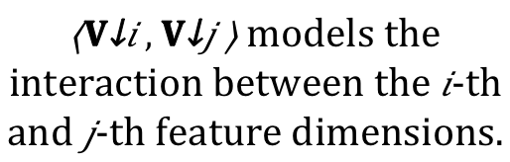
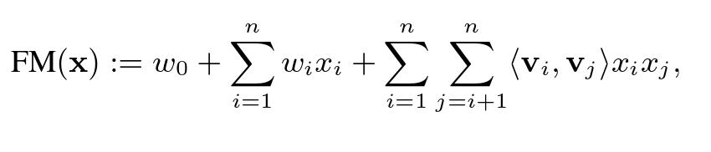


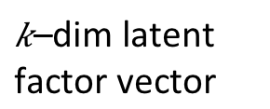
Factorization Machines (FM)
FM is a score prediction function for a (user, item) pair feature x.
one-hot user ID
one-hot item ID
side-information
FM models the interaction between each pair of nonzero features
Model bias parameter
Notes:
Factorization Machine is one of the prevalent feature-based recommendation model that leverages rich features for accurate recommendation. FM is essentially a user-item score prediction function, where x is a high-dimensional feature representation of the rich side-information, concatenated by one-hot user ID one-hot item ID and other features. w is the model bias parameter. V is the latent factor vector, and every inner product vi, vj models the interaction between the i-th and j-th feature dimensions. Therefore, V is the key reason why FM is an effective feature-based recommendation model, as it captures the rich side information interaction.

Slide 4



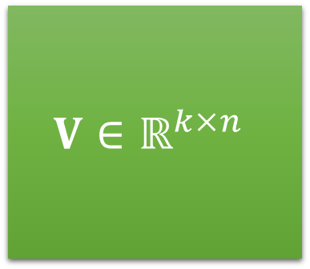
Motivation
one-hot user ID
one-hot item ID
side-information
1,300,000 users
174,000 business
1,200,000 attributes
here 𝑛 = 1,300,000+174,000+1,200,000 = 2,674,000
On-device storage?
Computation cost?
Existing FM framework is not suitable for fast recommendation, especially for mobile users.
Notes:
However, the dimension of x is large in practical recommender systems. It is impossible on-device storage of V. Moreover, large-scale float multiplications of the feature interaction is prohibitively slow. Therefore, existing FM framework is not suitable for fast recommendation, especially for mobile users.

Slide 5

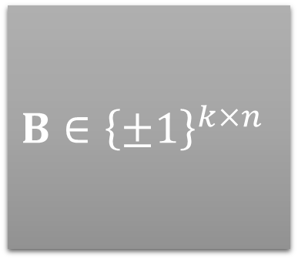


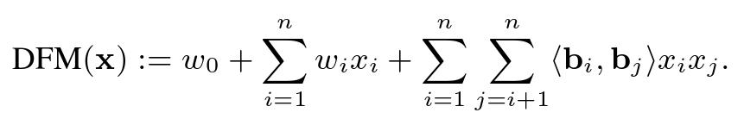
Discrete Factorization Machines


binary codes
real-valued vector
Storing:
Easily Store
XOR Bit Operations
Impossible
Float Multiplications
Computing:
Notes:
To this end, we want to use binary codes B instead of V, to formulate our proposed framework: Discrete Factorization Machines (DFM). In this way, we can easily store a bit matrix and perform XOR bit operations instead of float multiplications, making fast recommendation possible.

Slide 6
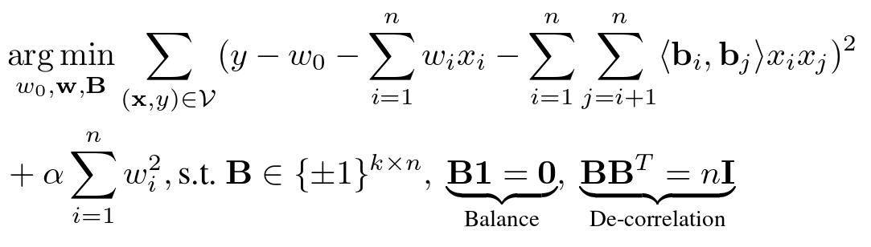
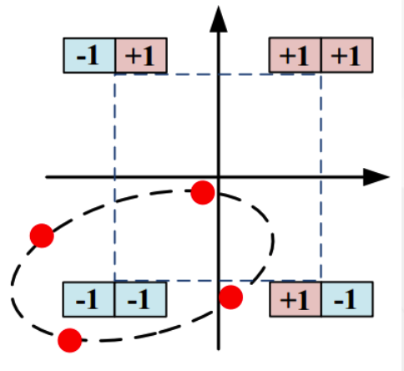
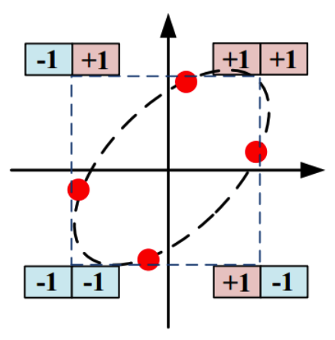
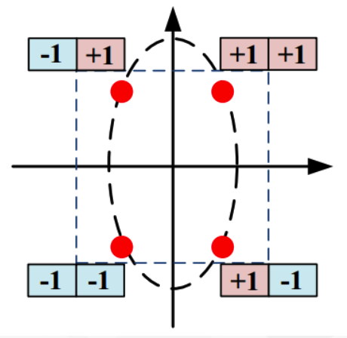
Solution with the Constraints
Observed score
Binary codes
Without any constraints
Balanced
De-correlated
Balance Constraint: each bit should split the dataset evenly
De-Correlation Constraint: each bit should be as independent as possible
However, the hard constraints of zero-mean and orthogonality may not be satisfied in Hamming space!
Notes:
The problem of DFM is formulated as this, where y is the ground truth score of feature vector x. Additionally, DFM imposes balanced and de-correlated constraints on the binary codes in order to maximize the information each bit carries and to make binary codes compact. However, optimizing the objective function above is a highly challenging task, since it is generally NP-hard.

Slide 7
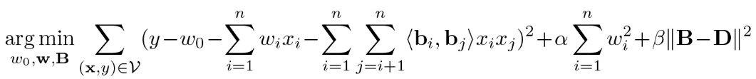


Our DFM Formulation
Objective Function:
Score Prediction
Constraint Trade-off
Binary Constraint:
Delegate Code Quality Constraint:
Balance
Constraint
De-correlation
Constraint
Notes:
Next, we introduce a new learning objective that allows DFM to be solved in a computationally tractable way. We introduce a delegate continuous variable D. Then the balanced and de-correlated constraints can be softened by this term. It is worth noting that we do not discard the discrete constraint and we still perform a direct optimization on discrete B. Furthermore, through joint optimization for the binary codes and the delegate real variables, we can obtain nearly balanced and uncorrelated binary codes.
Q&A: We process feature representation of side information by normalization, and slightly abuse the notation y as a scaled score according to the actual condition.

Slide 8

Our Solution: Alternating Optimization
Alternative Procedure
B-Subproblem
D-Subproblem
w-Subproblem
Notes:
We employ alternating optimization strategy to solve the problem. Specifically, we alternatively solve three sub-problems for DFM model, taking turns to update each of B, D, w, given others fixed. Next, we elaborate on how to solve each of the sub-problems.

Slide 9
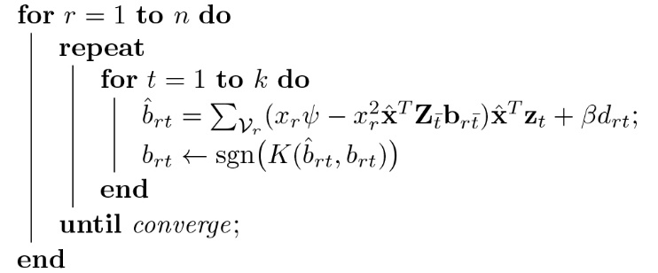
B-Subproblem for Binary Codes
Objective Function
for loop over n features
for loop over k bits
Notes:
In this subproblem, we aim to optimize B with fixed D and w. To achieve this, we can update B by updating each vector br. Due to the discrete constraint, we use Discrete Coordinate Descent (DCD) to take turn to update each bit of binary codes br.

Slide 10


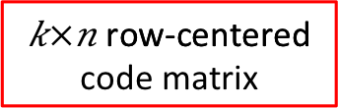


D-Subproblem for Code Delegate
Objective Function
Orthogonalization
Notes:
The D-subproblem can be solved with the aid of Singular Value Decomposition and Gram-Schmidt orthogonalization. Then we can get the closed-form update rule for D.
Q&A: By Singular Value Decomposition of row-centered B, P and Q are left and right singular vectors corresponding to the positive singular values. In order to satisfy the constraint, we further obtain additional Q hat by Gram-Schmidt orthogonalization. This update rule is employed by many state-of-the-art binarized methods.

Slide 11
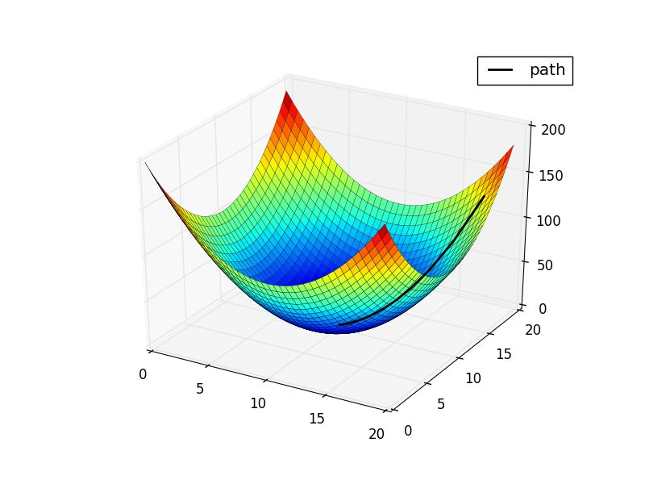
w-Subproblem for Bias
Objective Function
It is the standard multivariate linear regression problem, use Coordinate Descent algorithm
Notes:
When B and D are fixed, since w is a real-valued vector, it is the standard multivariate linear regression problem. Thus, we can use coordinate descent algorithm to find the optimal value of w.

Slide 12
Experiment Settings
Datasets:
Split: randomly split 50% training and 50% testing move items in the testing set that haven’t occurred in the training set to the training set.
Evaluation Protocol: rank the testing items of a user and evaluate the ranked list with NDCG@K
Datasets | #users | #items | #ratings | Density
Yelp | 13,679 | 12,922 | 640,143 | 0.36%
Amazon | 35,151 | 33,195 | 1,732,060 | 0.15%
Notes:
We experiment on two datasets with explicit feedbacks from different real-world websites: Yelp and Amazon. We rank the testing items of a user and evaluate the ranked list with Normalized Discounted Cumulative Gain (NDCG).
Q&A: For fair comparison with DCMF, we leave out the side information from the user field and represent an item with the bag-of-words encoding of its textual contents after aggregating all review contents of the item. Note that we remove stopping words and truncate the vocabulary by selecting the top 8000 words regarding their Term Frequency-Inverse Document Frequency. By concatenating the bag-of-words encoding (side information of the item) and one-hot encoding of user and item ID, we obtain a feature vector for the Yelp and Amazon dataset, respectively.

Slide 13
Compared to the state-of-the-art
libFM: Factorization Machines with libFM [Rendle et al.,TIST’12]
original implementation of FM
DCF: Discrete Collaborative Filtering [Zhang et al.,SIGIR’16]
CF+binarization+direct optimization
DCMF: Discrete Content-aware Matrix Factorization [Lian et al.,KDD’17]
CF+binarization+direct optimization+constraint
BCCF: Binary Code learning for Collaborative Filtering [Zhou&Zha,KDD’12]
MF+binarization+two-stage optimization
Notes:
We compare the DFM with following baseline methods.
1. libFM. This is the original implementation of FM, which has achieved great performance for feature-based recommendation with explicit feedbacks.
2. DCF. This is the first binarized CF method that can directly optimize the binary codes.
3. DCMF. This is the state-of-the-art binarized method for CF with side information. It extends DCF by encoding the side features as the constraints for user codes and item codes.
4. BCCF. This is a two-stage binarized CF method with a relaxation stage and a quantization stage.

Slide 14
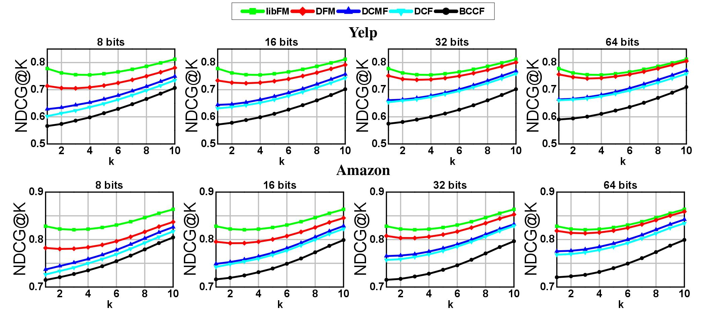
Performance Comparison
In figure, we show the recommendation performance (NDCG@1 to NDCG@10) of DFM and the baseline methods on the two datasets. The code length varies from 8 to 64.
Notes:
In Figure, we show the recommendation performance of DFM and the baseline methods on the two datasets. The code length varies from 8 to 64. From the figure, we have the following observations.
1. DFM demonstrates consistent improvements over state-of-the-art binarized recommendation methods. The performance improvements are attributed to the benefits of learning binary codes for features and modeling their interactions.
2. DFM shows very competitive performance compared to libFM, its real-valued version. By increasing the code length, the performance gap continuously shrinks. One possible reason is that libFM suffers from overfitting as the increase of its representative capability, whereas binarizing the parameters can alleviate the overfitting problem. This finding again verifies the effectiveness of the proposed DFM.

Slide 15
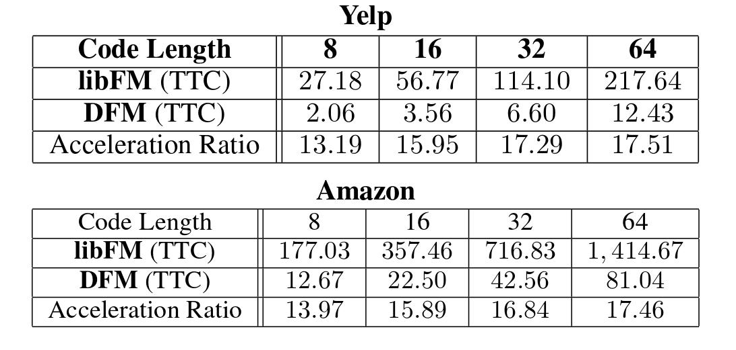
Efficiency Study
Efficiency comparison between DFM and libFM regarding Testing Time Cost (TTC) on the two datasets.
DFM is an operable solution for many large-scale Web service to reduce the computation cost of their recommender systems.
Notes:
Table shows the efficiency comparison between DFM and libFM regarding Testing Time Cost (TTC). The acceleration ratio of DFM based on libFM is stable around 16 times on both the datasets when the code length increases from 8 to 64. This demonstrates the great advantage of binarizing the real-valued parameters of FM.
Along with the comparable recommendation performance of DFM and libFM, the above findings indicate that DFM is an operable solution for many large-scale Web services to reduce the computation cost of their recommender systems.

Slide 16
Conclusion & Future Work
We propose DFM to enable fast feature-based recommendation.
We develop an efficient algorithm to address the challenging optimization problem of DFM.
We will extend binary technique to neural recommender models such as Neural FM.

Slide 17

Q&A
Thank you.
https://github.com/hanliu95/DFM
Notes:
Codes and datasets are available and here is the link. That is all, thank you.
Q&A: The convergence of the proposed DFM algorithm is not proved. We demonstrate the effectiveness of DFM base on experiments.

