Slide 1


Matching User with Item Set:
Collaborative Bundle Recommendation with Deep Attention Network
Liang Chen¹, Yang Liu¹, Xiangnan He², Lianli Gan³ and Zibin Zheng¹
1 Sun Yat-sen University
2 University of Science and Technology of China
3 The University of Electronic Science and Technology of China

Slide 2
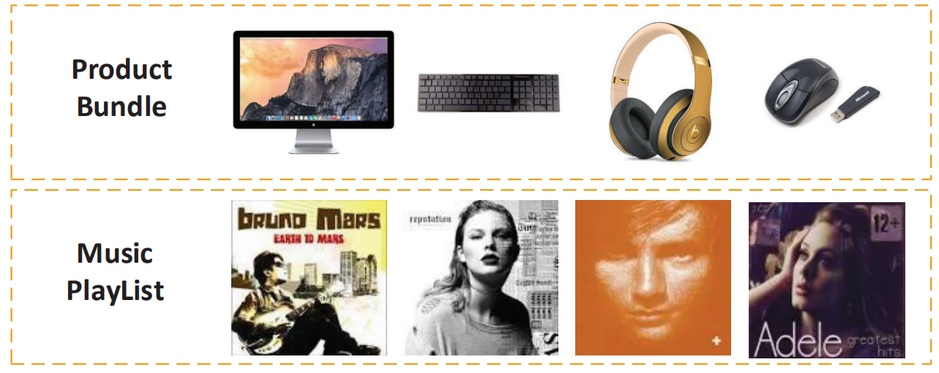
Bundle Recommendation
Many real-world applications need to recommend a set of items for users:
  music playlist
  product bundling
Challenges:
  Bundles are not atomic units.
  User-bundle interactions are more sparse.

Slide 3
Related Works
Bundle recomendation：
  Probabilistic models (BPM[TKDD 2017])
  Pairwise ranking (EFM[SIGIR 2017], LIRE[Recsys 2014])
Deep learning for recomendation：
  Deep neural network (NCF[WWW 2017], NGCF[SIGIR 2017])
  Attention mechanism (ACF[SIGIR 2017], AFM[IJCAI 2017])
  Deep multi-task Learning (AGREE[SIGIR 2018])

Slide 4
Problem Formulation
Input: users U , items V, bundles B, constituent items of bundels
{G₁, G₂, ..., G_{k}}, user-item interactions H, and user-bundle interactions R.
Output: A personalilzed scoring function that maps a bundle G to a real value for each user.

Slide 5
Methods
Bundle representation learning which aims to obtain the latent features to represent a bundle.
Multi-Task learning which jointly models user interactions on bundles and items.

Slide 6
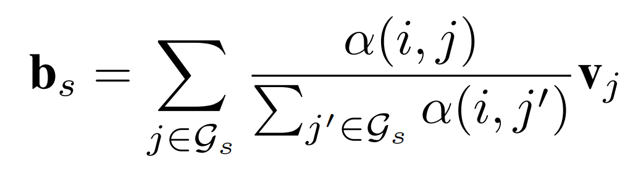
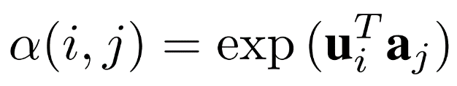
Bundle Representation Learning
Bundlle representaion:
Factorized attention network:

Slide 7
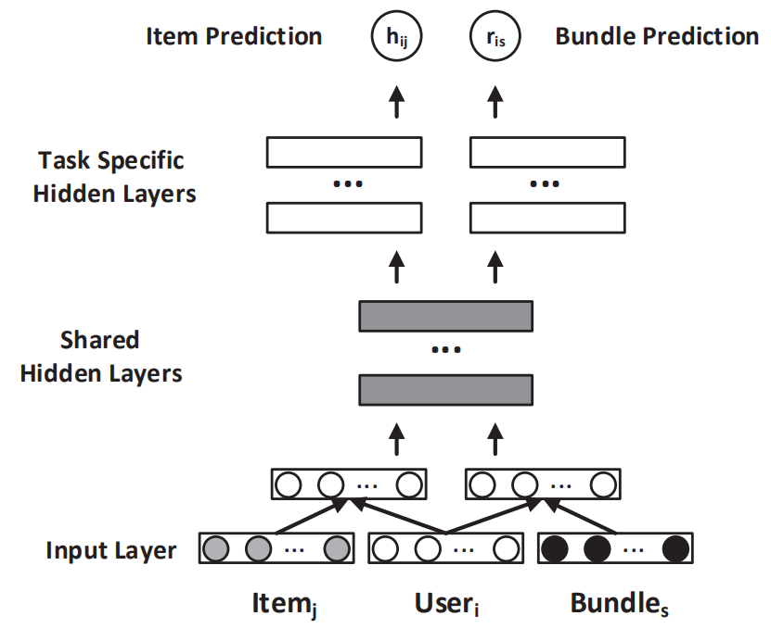
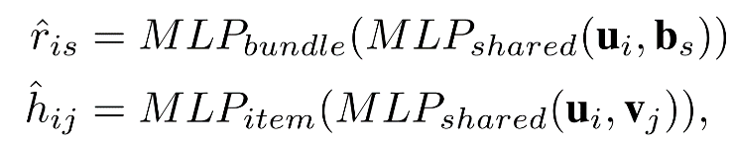
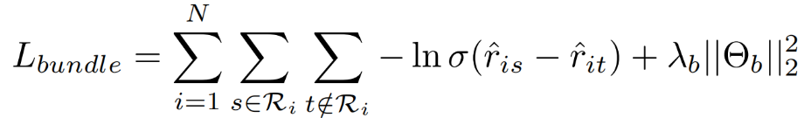
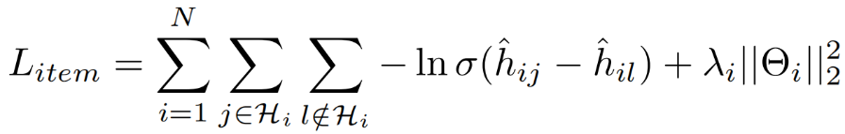

Multi-Task Learning
The architecture is formulated as:
Objective Function:

Slide 8
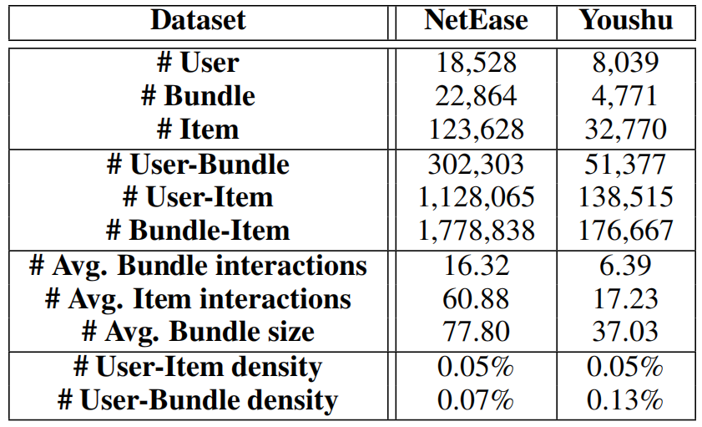
Expetimental Settings
Dataset
Two real-world datasets from NetEase clound music and Youshu book review site.
Evaluation metric
Leave-one-out: For each user, one of her interactions are randomly removed for testing and randomly select 99 bundles that are not interacted with users as negative samples.
The model performance are evaluated by Recall@K and MAP@K.

Slide 9
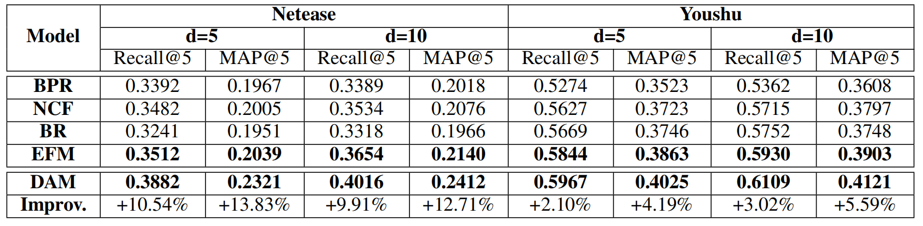
Performance Comparison
DAM achieves the best performance under all circumstances.
The results of BPR and NCF verify that the insufficient interaction data between user and bundle limits the model performance.
Co-training the user-item and user-bundle interactions achieve better performance.

Slide 10
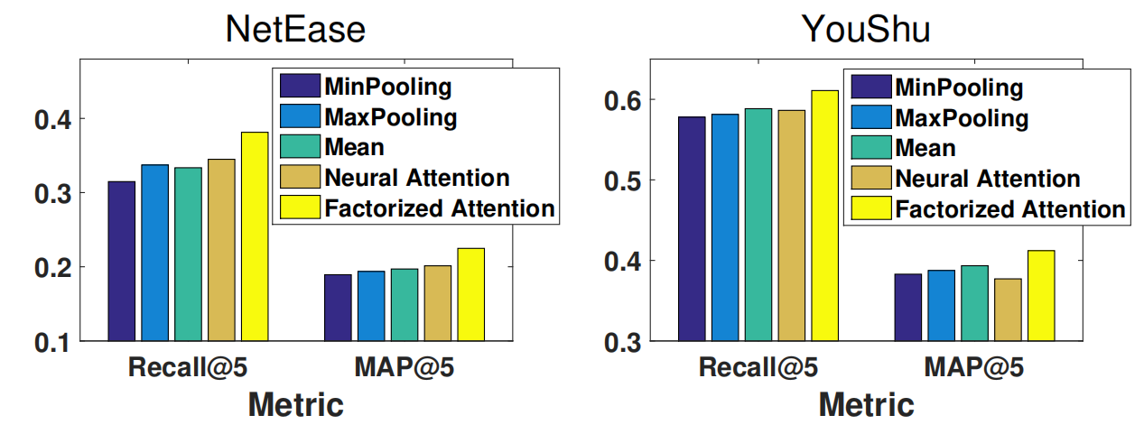
Effect of different fusing strategies
Factorized attention achieves the best performance in all cases.
MinPooling, maxPooling, and meanPooling achieve similar performance, indicating these methods are insufficient to capture the complex relations among the items.

Slide 11
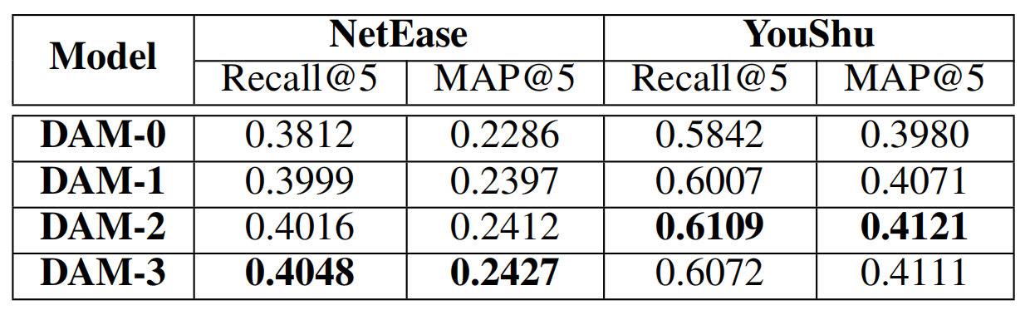
Effect of Shared Layer Number
Multi-task learning models perform better than single-task learning model.
Increasing the number of shared layers enhances the recommendation performance.

Slide 12
Conclusion and Future Work
Conclusion
A factorized attention network to aggregate the item information of each bundle.
A multi-task neural network to share the knowledge of user-item and user-bundle modeling.
Extensive experiments show that DAM outperforms the state-of-the-art solution.
Future Work
Consider other multi-task learning framework.
Utilize rating information.

Slide 13
Thanks！

