Slide 1




Model-Agnostic Counterfactual Reasoning for Eliminating Popularity Bias in Recommender System
Tianxin Wei¹ , Fuli Feng²∗ , Jiawei Chen¹ , Ziwei Wu¹ , Jinfeng Yi³ and Xiangnan He¹∗
¹University of Science and Technology of China
²National University of Singapore
³JD AI Research
* Corresponding Authors

Slide 2
Outline
Background
Preliminary
Methodology
Experiments

Slide 3





Feedback Loop
Recommender Data is observational rather than experimental (missing-not-at-random)
Affected by many factors:
The exposure mechanism
Display position
Public opinions
……
The collected data deviates from user true preference, resulting in “Matthew effect” issue: the rich gets richer
Data
System
User
Bias amplification
Feedback Loop

Slide 4
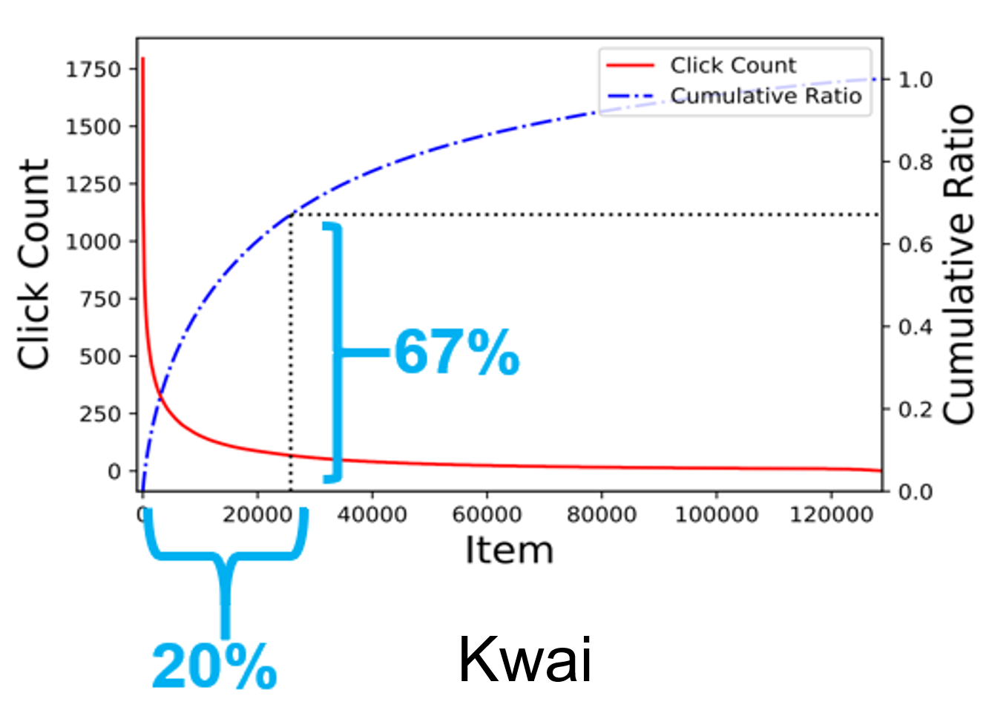
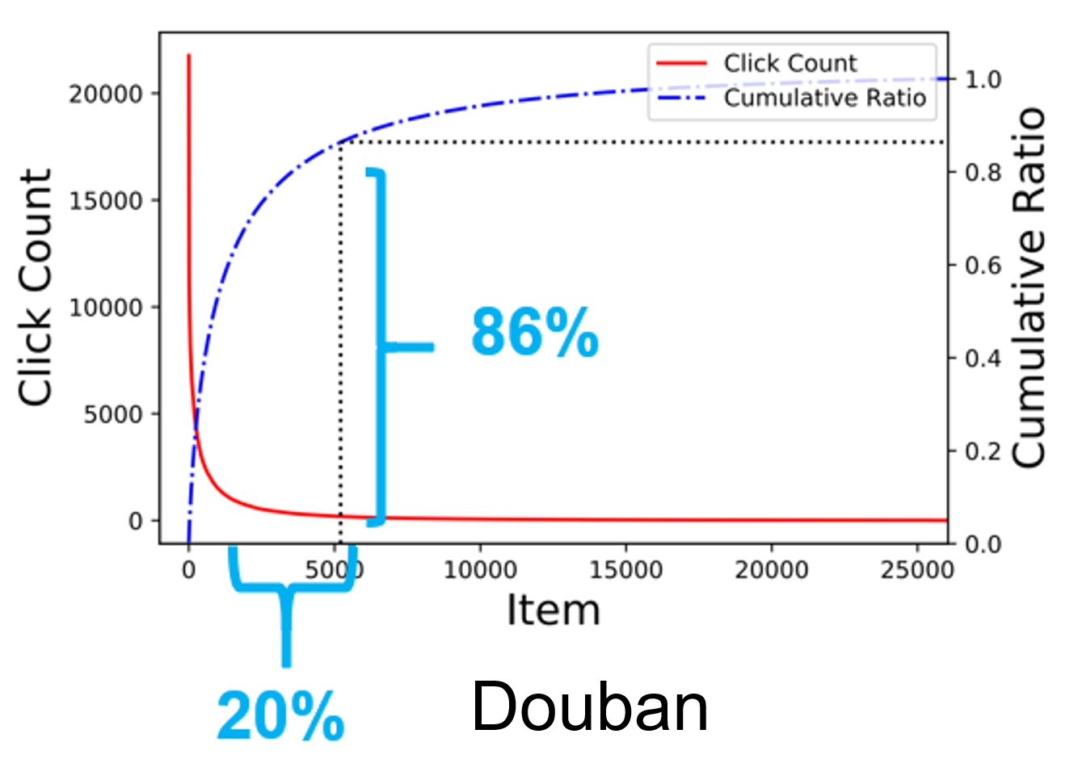
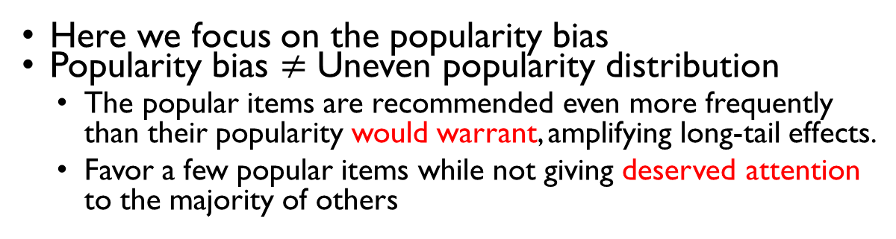
Popularity Bias in Recsys
Here we focus on the popularity bias
Popularity bias $≠$ Uneven popularity distribution
The popular items are recommended even more frequently than their popularity would warrant, amplifying long-tail effects.
Favor a few popular items while not giving deserved attention to the majority of others
From data perspective:
Long-tail distribution

Slide 5
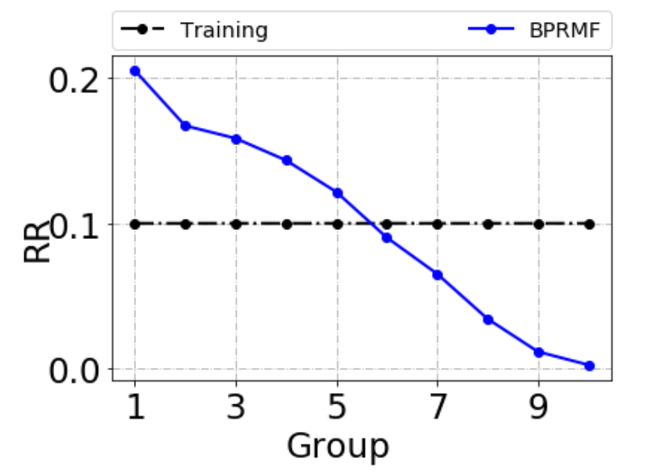
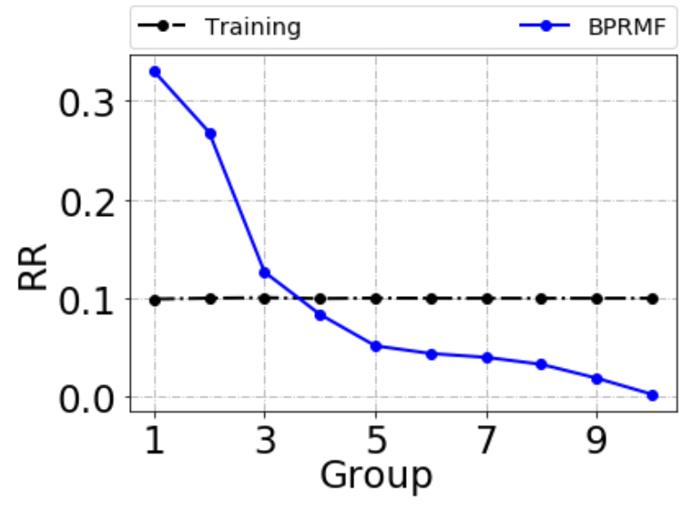
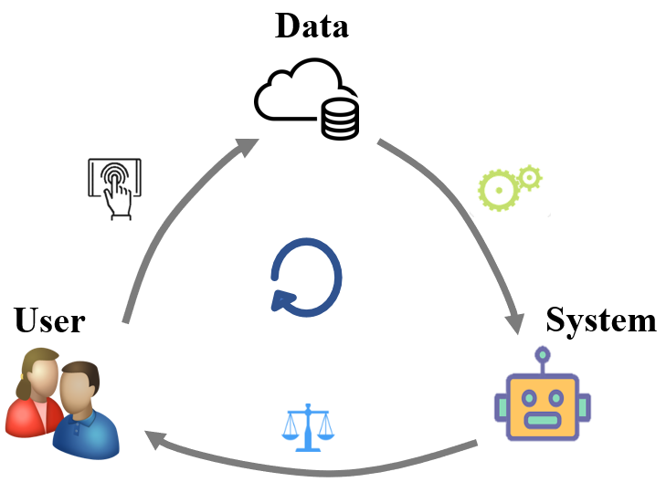
Popularity Bias in Recsys
From model perspective:
Note: Each group has the same number of interactions
Not only inherit bias from data, but also amplify the bias!
pop
unpop
pop
unpop
Kwai
Douban
Influence
Feedback-Loop ---- intensifies
Matthew effect, Unfairness

Slide 6
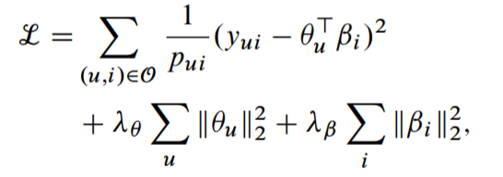
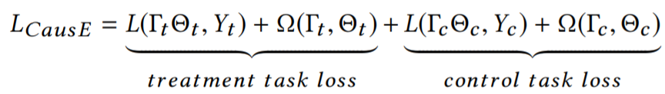
Existing Solutions
Inverse Propensity Score (IPS), etc.
Impose lower weight on popular items, and boost unpopular items
Causal Embeddings (CausE), etc.
Require unbiased data, perform two MF on biased and unbiased data, respectively
Propensity score, estimated by popularity
MF on biased data
MF on unbiased data

Slide 7
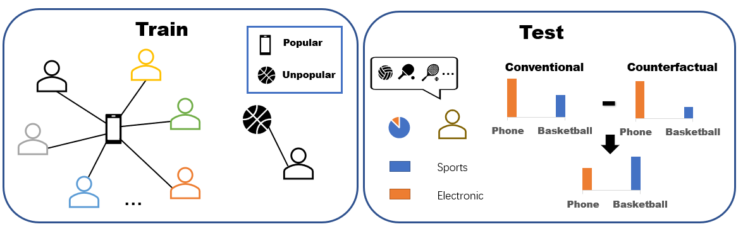
Intuitive Example
It shows a toy example where the training set is biased toward electronic products, making the model prefer iPhone than basketball largely ignore the user preference on sports products
Such bias is removed (higher score on basketball) by deducting the counterfactual prediction, which captures the direct popularity bias by blocking user-item matching

Slide 8
Outline
Background
Preliminary
Methodology
Experiments

Slide 9
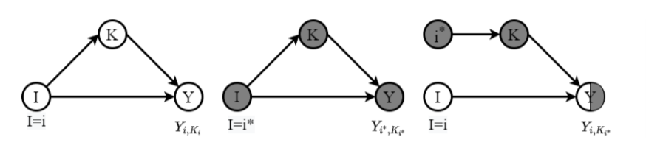
Causal Graph
Causal graph is a directed acyclic graph G, where V denotes the set of variables and E represents the cause-effect relationships among random variables
Causal graph describes how data is generated, gray nodes represent mean the variables are at reference status

Slide 10
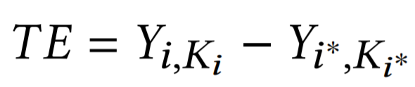
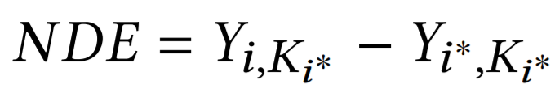
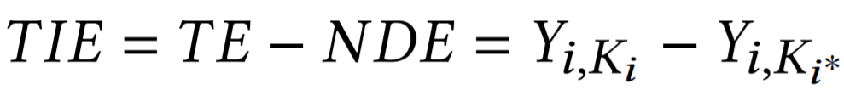
Causal Effect
x* is the counterfactual value of variable X where it refers to a hypothetical scenario that the value of X is muted from the reality

Slide 11
Outline
Background
Preliminary
Methodology
Experiments

Slide 12
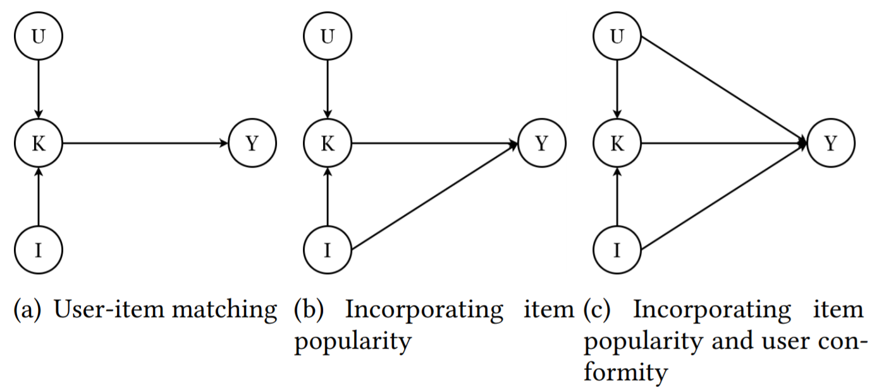
Our Solution
We present a causal view of the popularity bias in recommender and formulate the causal graph for recommendation
Trained a recommender model according to the causal graph via a multi-task training schema and performed counterfactual inference to eliminate the popularity bias

Slide 13
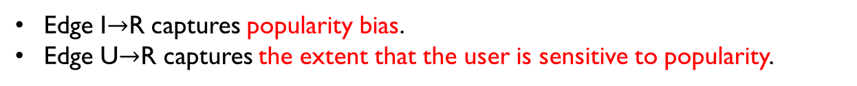
Causal View of Popularity Bias
Causal View
User
U
U
U
Matching
Ranking Score
K
R
K
R
K
R
Item
I
I
I
Common Recommender
User-Item Matching
Popularity bias modeling:
Incorporating item popularity
User-specific modeling:
Incorporating item popularity & user activity
Edge I$→$R captures popularity bias.
Edge U$→$R captures the extent that the user is sensitive to popularity.
Solution Idea:
Train a recommender based on the causal graph via a multi-task learning
Perform counterfactual inference to eliminate popularity bias (Question to anser: what would the prediction be if there is no bias? )

Slide 14
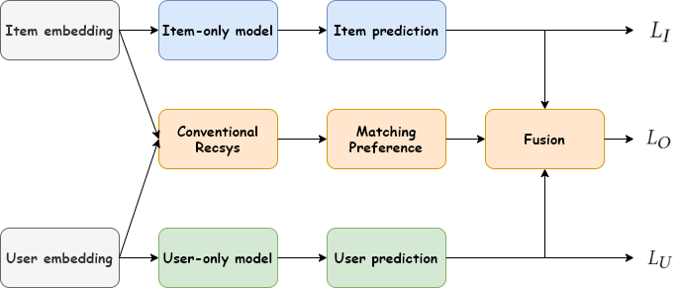


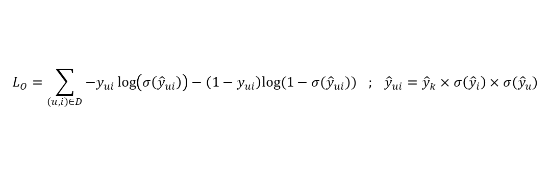
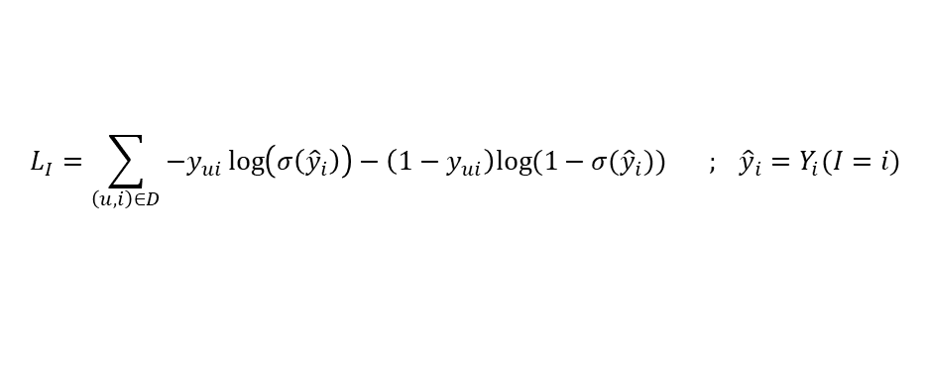
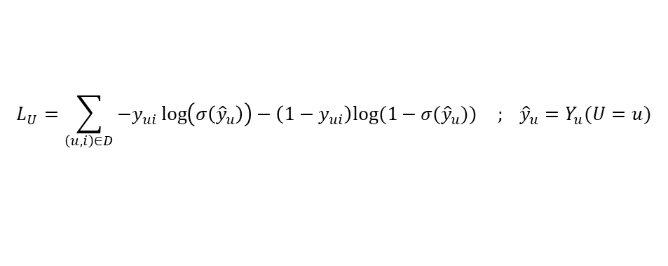


Multi-task Training on Causal Graph
Each branch (user/item/matching) capture the desired effect.
$${\hat{y}}_{i}=Y_{i}(I=i)$$
U
K
R
$${\hat{y}}_{ui}={\hat{y}}_{k}×σ\left({\hat{y}}_{i}\right)×σ({\hat{y}}_{u})$$
I
$${\hat{y}}_{u}=Y_{u}(U=u)$$
$$L_{I}=\sum_{\left(u,i\right)∈D}{−y_{ui}\log\left(σ\left({\hat{y}}_{i}\right)\right)−\left(1−y_{ui}\right)log⁡(1−σ({\hat{y}}_{i}))} ; {\hat{y}}_{i}=Y_{i}(I=i)$$
Item popularity
Adopting Simple NN
$$L_{U}=\sum_{\left(u,i\right)∈D}{−y_{ui}\log\left(σ\left({\hat{y}}_{u}\right)\right)−\left(1−y_{ui}\right)log⁡(1−σ({\hat{y}}_{u}))} ; {\hat{y}}_{u}=Y_{u}(U=u)$$
User conformity
$$L_{O}=\sum_{\left(u,i\right)∈D}{−y_{ui}\log\left(σ\left({\hat{y}}_{ui}\right)\right)−\left(1−y_{ui}\right)log⁡(1−σ({\hat{y}}_{ui}))} ; {\hat{y}}_{ui}={\hat{y}}_{k}×σ\left({\hat{y}}_{i}\right)×σ({\hat{y}}_{u})$$
Fusion/observed
Trade-off parameter

Slide 15
Counterfactual Inference to Remove Bias
Question: what the prediction would be if there is no bias?
U
U
K
R
$$U^{∗}$$
$${ K}^{∗}$$
R
$I^{∗}$
I
I
Factual World (original prediction)
Counterfactual World
(block matching to capture bias)
$$TIE=TE−NDE=Y\left(U=u,I=i,K=K_{u,i }\right) −Y\left(U=u,I=i,K=K_{u^{∗},i^{∗}}\right)$$
Factual world
Counterfactual world
Inference with TIE $={\hat{y}}_{k}×σ\left({\hat{y}}_{i}\right)×σ({\hat{y}}_{u})$ - $c×σ\left({\hat{y}}_{i}\right)×σ({\hat{y}}_{u})$

Slide 16
Outline
Background
Preliminary
Methodology
Experiments

Slide 17
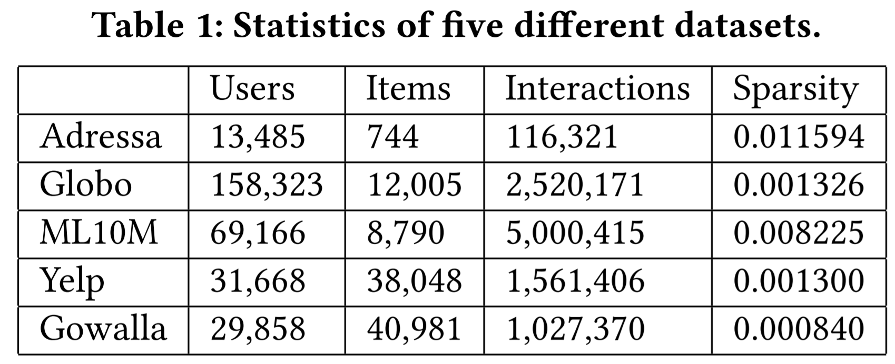
Experiment Setup
Simulate debiased recommendation where the testing interactions are sampled to be a uniform distribution over items
Test on five large-scale datasets

Slide 18
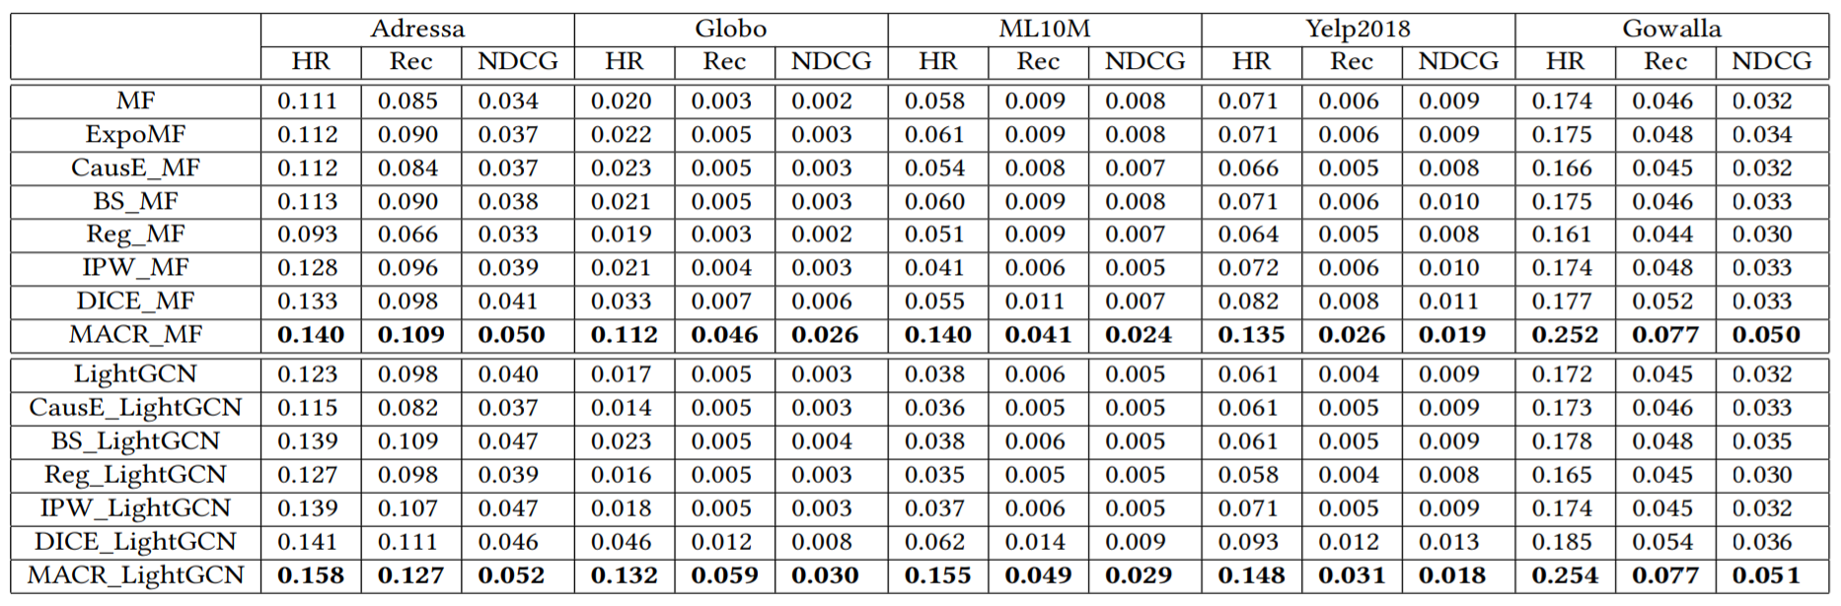
Experiment Results
Evaluate MACR framework on two base models: MF and LightGCN
Testing data is intervened to be uniform
Overall Performance: Leading to significant improvement in this setting

Slide 19
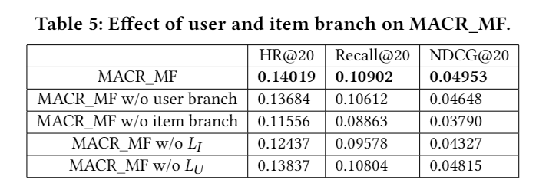
Ablation Study
Item branch is more important than user branch for removing popularity bias
Multi-task loss has a significant influence on modeling popularity bias for MACR

Slide 20
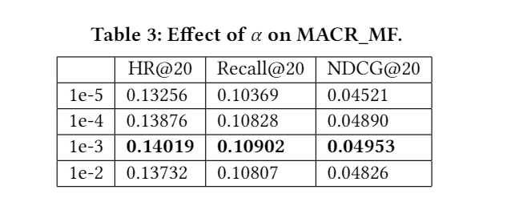
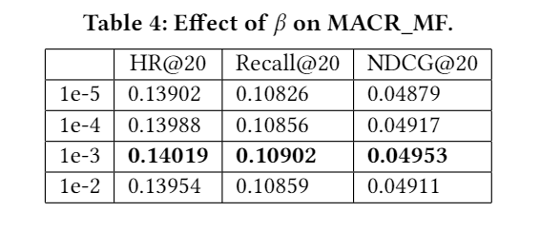
Hyper-parameter Study
As alpha and beta becomes larger from 1e-5 to 1e-3, the performance of MACR will become better
When alpha or beta surpasses a threshold (1e-3), the performance becomes worse with a further increase of the parameters due to the ignore of the main recommender model

Slide 21
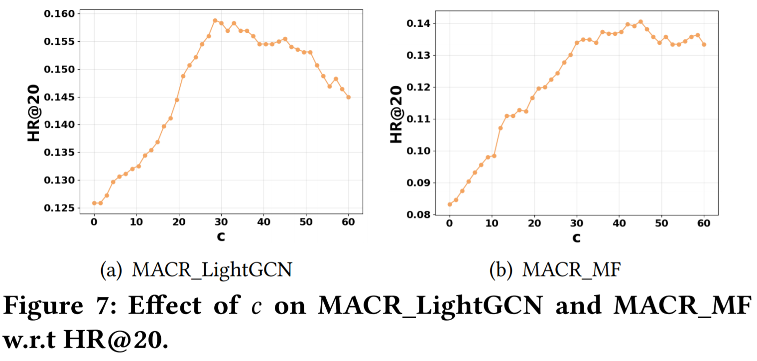
Hyper-parameter Study
As c varies from 0 to 29, the model performs increasingly better while further increasing c is counterproductive
Proper degree of blocking intermediate matching preference benefits the popularity debias and improves the recommendation performance

Slide 22
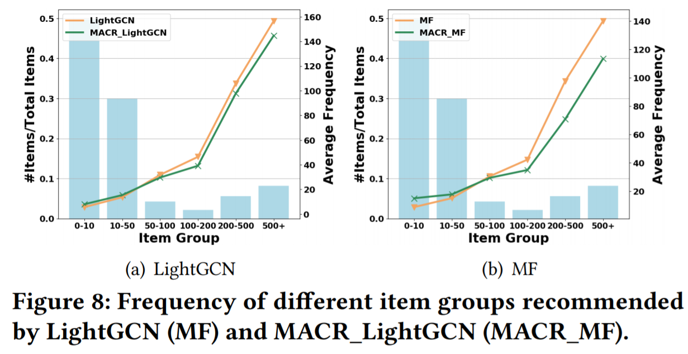
Debias Capacity
We can see that our methods indeed reduce the recommendations frequency of popular items and focus more on items that are less popular

Slide 23
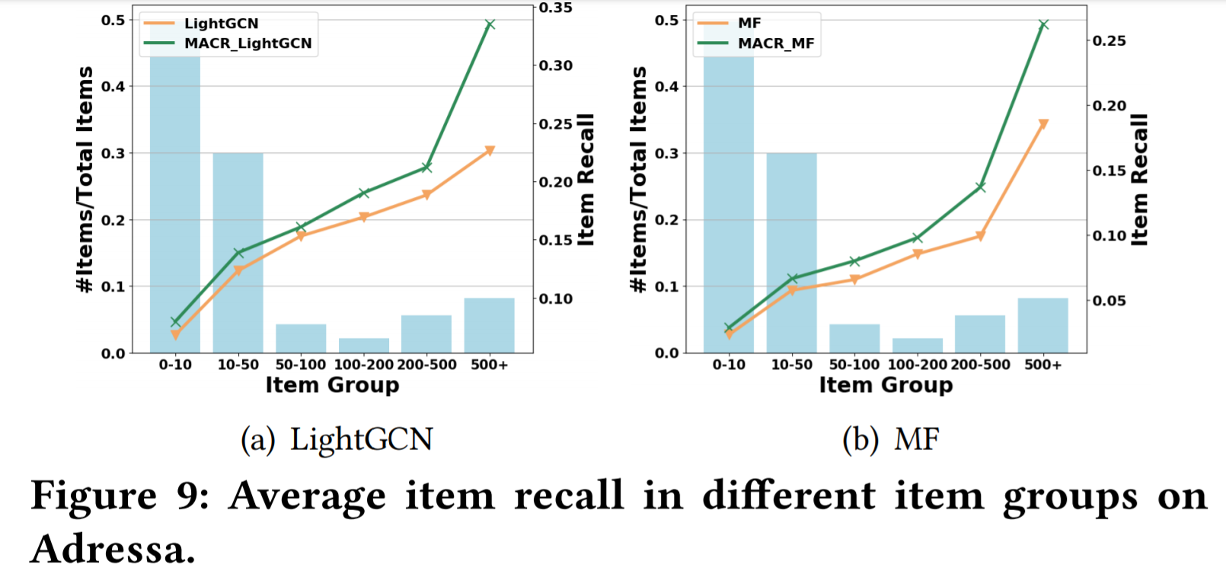
Debias Capacity
The most popular item group has the greatest recall increase, but our methods in the last Figure show the recommendations frequency of popular items actually reduced
It means traditional methods prone to recommend more popular items to unrelated users due to popularity bias, and our method improves this very well

Slide 24
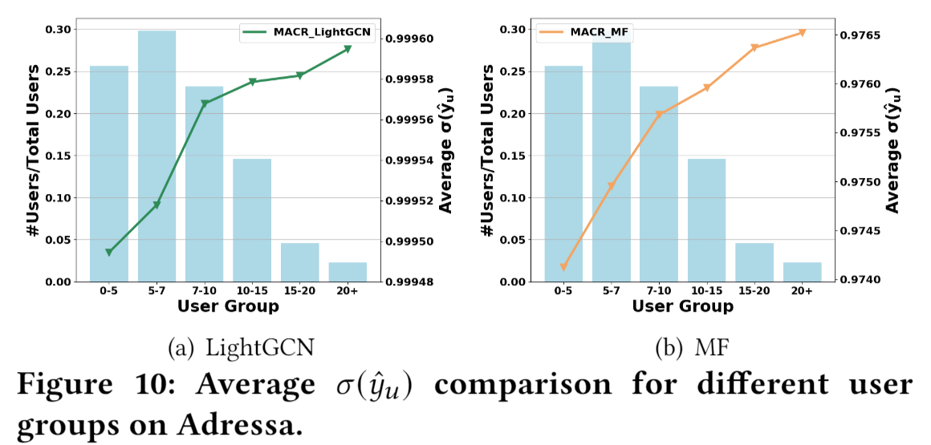
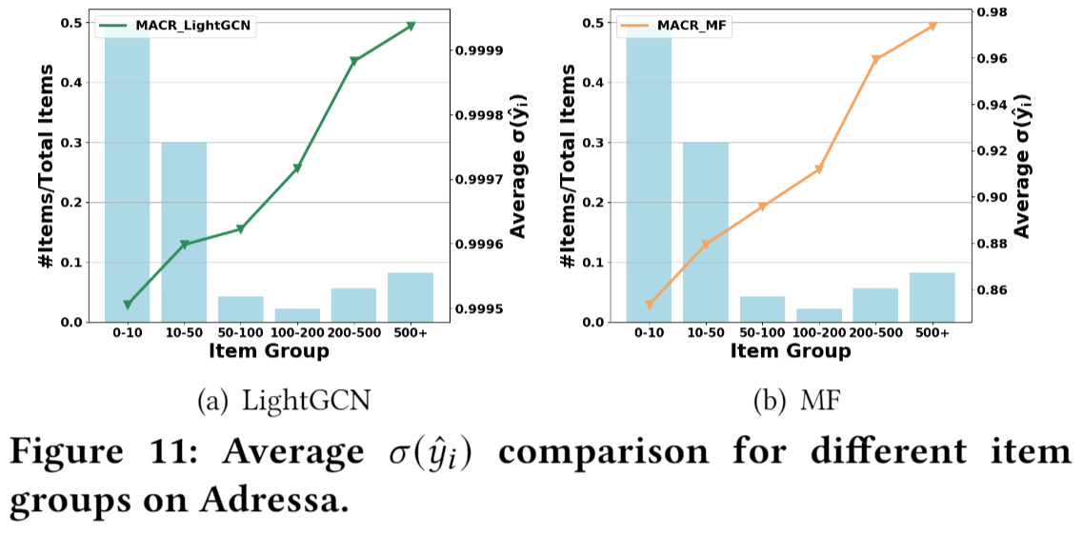
Debias Capacity
With the increase of the occurrence frequency of items and users in the dataset, the sigmoid scores of them also increase
These indicate that item and user branch can well capture item’s popularity level and user’s activity level

Slide 25
Conclusion
This work represents one of the initial attempts to exploit causal reasoning for recommendation and opens up new research possibilities
We presented the first cause-effect view for alleviating popularity bias issue in recommender systems
We proposed the model-agnostic framework MACR which performs multi-task training according to the causal graph to assess the contribution of different causes on the ranking score
The counterfactual inference is also performed to estimate the direct effect from item properties to the ranking score, which is removed to eliminate the popularity bias

Slide 26

Q&A
Thank you!

