Slide 1


Selective Dependency Aggregation for Action Classification
Yi Tan (Speaker), Yanbin Hao*, Xiangnan He, Yinwei Wei, Xun Yang
Notes:
My Name is Yi Tan, I am a phd candidate at University of Science and Technology of China, my supervisor is professor Xiangnan He. The paper I will be presenting today is Selective Dependency Aggregation for Action Classification.

Slide 2
Pipeline
1. Introduction
2. Selective Dependency Aggregation for Action Classification
2.1. Plug-and-play framework
2.2. Multi-dependency Modeling
2.3. Dependency Aggregation
3. Experiments on benchmarks
3.1. On something-something V1&V2
3.2. On Diving48 and EPIC-KITCHENS-55
3.3. Analysis and Interpretation
Notes:
Here is my pipeline.

Slide 3
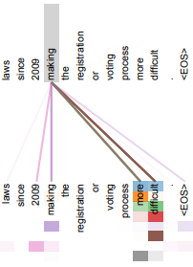

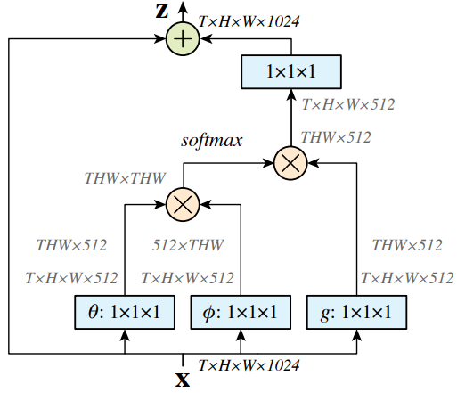
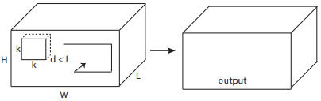
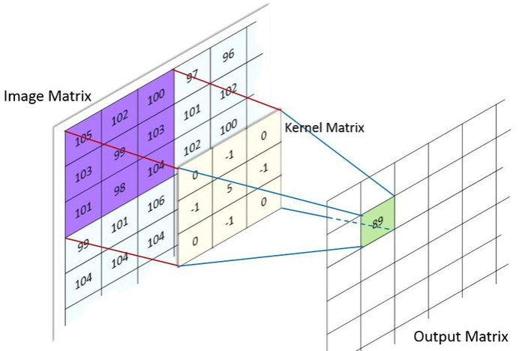
1. Introduction
-Widely used dependency
-Difficulty of dependency modeling for video media
W
H
T
Multi-spatial/temporal dependencies
Inefficiency of video model
High computational burden, hard to train
Long-range dependency
3D convolution [1]
Global view [2]
[1] Du Tran, Lubomir Bourdev, Rob Fergus, LorenzoTorresani, et al.
“Learning spatiotemporal features with 3d convolutional networks”. ICCV
Short-range dependency
[2] Xiaolong Wang, Ross Girshick, Abhinav Gupta, and KaimingHe
“Non-local neural networks.” CVPR
Notes:
Capturing content-related dependencies is of central importance in such as natural language processing (NLP), image processing, and the studied action classification. The difficulties of dependency modeling in video mainly lie in two aspects. First, the 3D dynamic nature inherently widens the sphere of actions with an order of magnitude larger than the 2D static vision, resulting in multiple dependencies across space and time dimensions. However, existing dependency modeling methods mainly leverage the dependency under a specific view, such as global view or temporal view. Second, 3D video models contain much more parameters and are hard to train. How to model multi-dependency in a efficient manner is our key consideration.

Slide 4
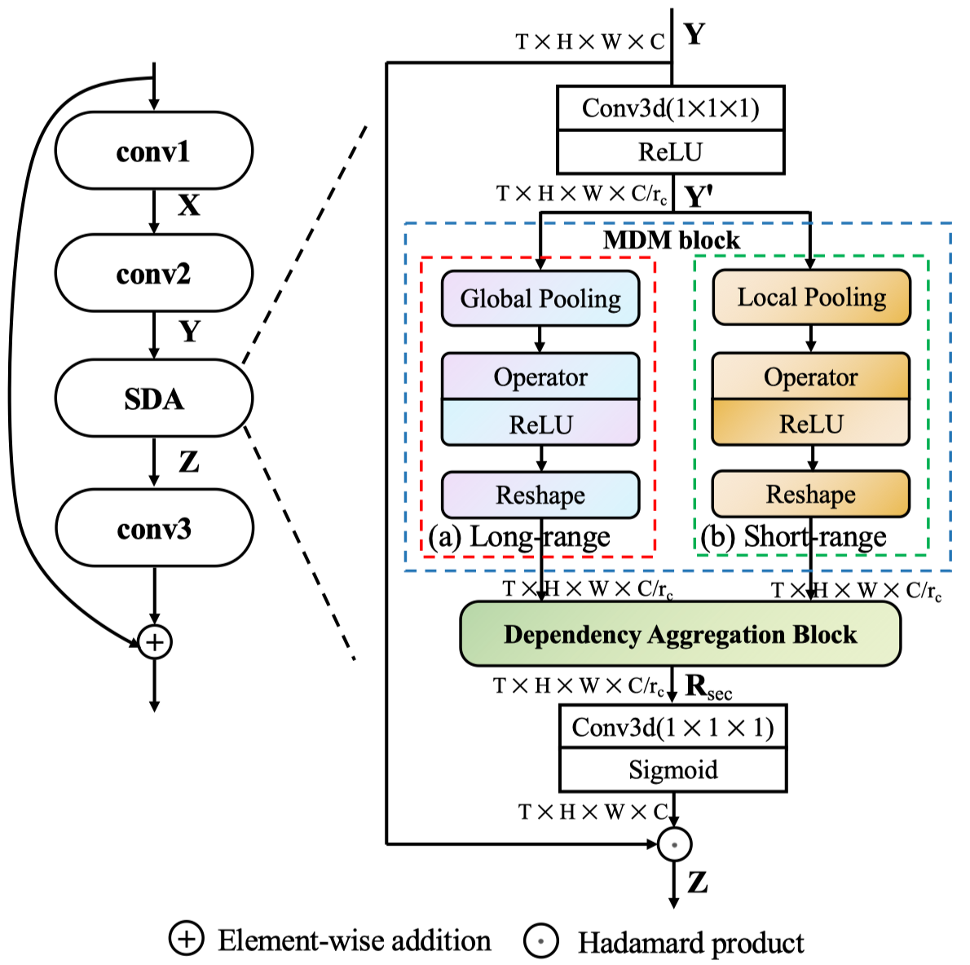
2. Selective Dependency Aggregation for Action Classification
2.1. Plug-and-play framework
Channel reduction
Multi-dependency
modeling
Easily plug-in
Selective aggregation
Channel recovery
Notes:
To tackle the mentioned problem, we construct a plug-and-play module for CNN-based video backbone. We plug the SDA module into the bottleneck for efficiency. Besides, we further adopt channel reduction and recovery for light-weight design, then multi-dependency modeling block extract the dependency representations from various perspectives. Finally, dependency aggregation block aggregate the dependency representations and the aggregated representation is used for video feature refinement by a dot-product.

Slide 5


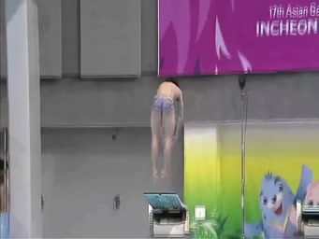
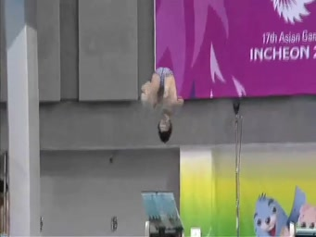
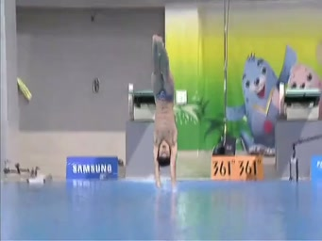


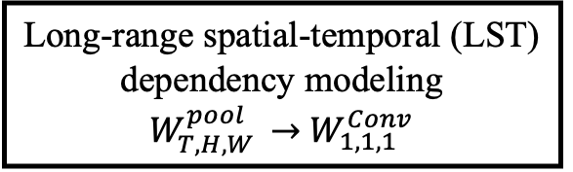
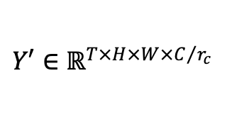
2. Selective Dependency Aggregation for Action Classification
2.2. Multi-dependency Modeling: feature squeeze$→$dependency excitation
Input: 3D video feature
Output: dependency representations
H
W
T
$W_{p_{t},p_{h},p_{w}}^{pool}=\left(p_{t} , p_{h} , p_{w}\right)$, $W_{p_{t},p_{h},p_{w}}^{Conv}=\left(c_{t} , c_{h} , c_{w}\right)$ is the size of pool/conv kernel
$$Y′∈ℝ^{T×H×W×C/{r_{c}}}$$
Long-range
Short-range
Feature
squeeze
Dependency
excitation
H
H
H/p_{h}
xM
T
W/p_{w}
W
T
W
T/p_{t}
Long-range spatial-temporal (LST) dependency modeling
$W_{T,H,W }^{pool}$ $→$ $W_{1,1,1 }^{Conv}$
LS: $W_{1,H,W }^{pool}$ $→$ $W_{3,1,1 }^{Conv}$
LT: $W_{T,1,1 }^{pool}$ $→$ $W_{1,3,3 }^{Conv}$
Notes:
We squeeze the 3D video feature by an average pooling, then 3d convolution is adopted to excite the pooled feature. Though controlling the size of pooling kernel and convolutional kernel, we can model the video dependencies from different view. For an example, If we use the global pooling along the spatial dimension and set the convolutional kernel size as 3x1x1, we can model the long-range spatial dependency. And if we use local pooling, short-range dependency is modeled.

Slide 6
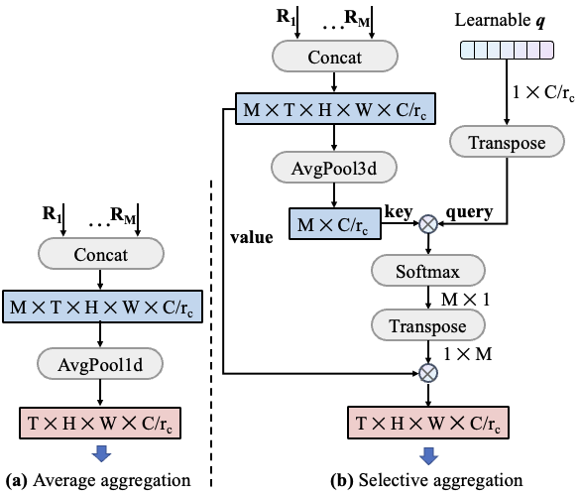
2. Selective Dependency Aggregation for Action Classification
2.3. Dependency Aggregation: as a weighted sum of dependency responses
Pros:
- Few-Parameters
- Low-FLOPS
- Enjoy the effectiveness of self-attention
Notes:
In order to aggregate the dependency representations according the to video-content, selective aggregation is designed. We initial it as a query structured attention, which introduce an external learnable query and omit the transform matrixes for efficiency. With such design, we only introduce ignorable parameters and FLOPs to enjoy the effectiveness of self-attention

Slide 7
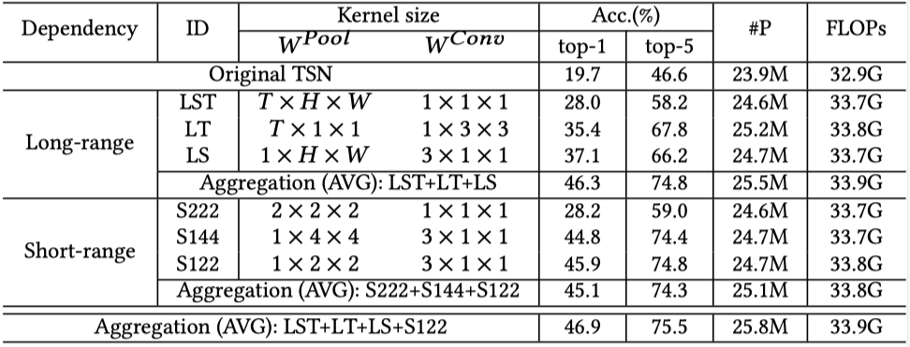
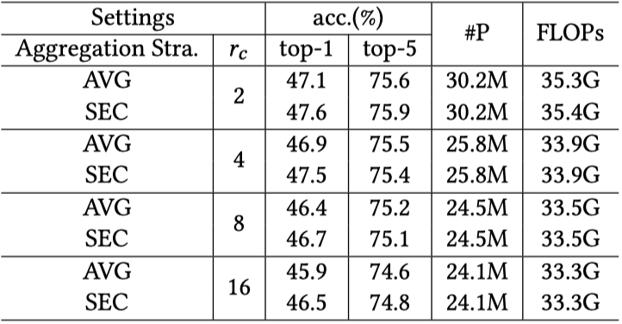
3. Experiment
3.1. On something-something V1&V2
- Sth-sth dataset: ~10² video categories, ~10⁵ samples, high Dynamics
(A). Ablation study (on V1)
Channel reduction ratio
Table 2: Performance comparison of different dependency aggregation strategies and r𝑐 on Something-Something V1
（+8%）
（+3%）
Table 1: Performance comparison of different kernel sizes of MDM block on the validation set of Something-Something V1.
Notes:
Let go to the experiment. Firstly, we compare different dependency modeling with various pooling kernels and convolutional kernels as shown in table 1, we use Temporal segment network as backbone. Overall, equipping the backbone network with the content dependencies can significantly improve the performance, and further averagely aggregating them achieves the higher accuracy. Secondly, we examine the results of different dependency aggregation. As shown in Table 2, the proposed selective aggregation method consistently outperforms the average counterpart with significant performance improvements among all the settings of channel reduction ratio.

Slide 8
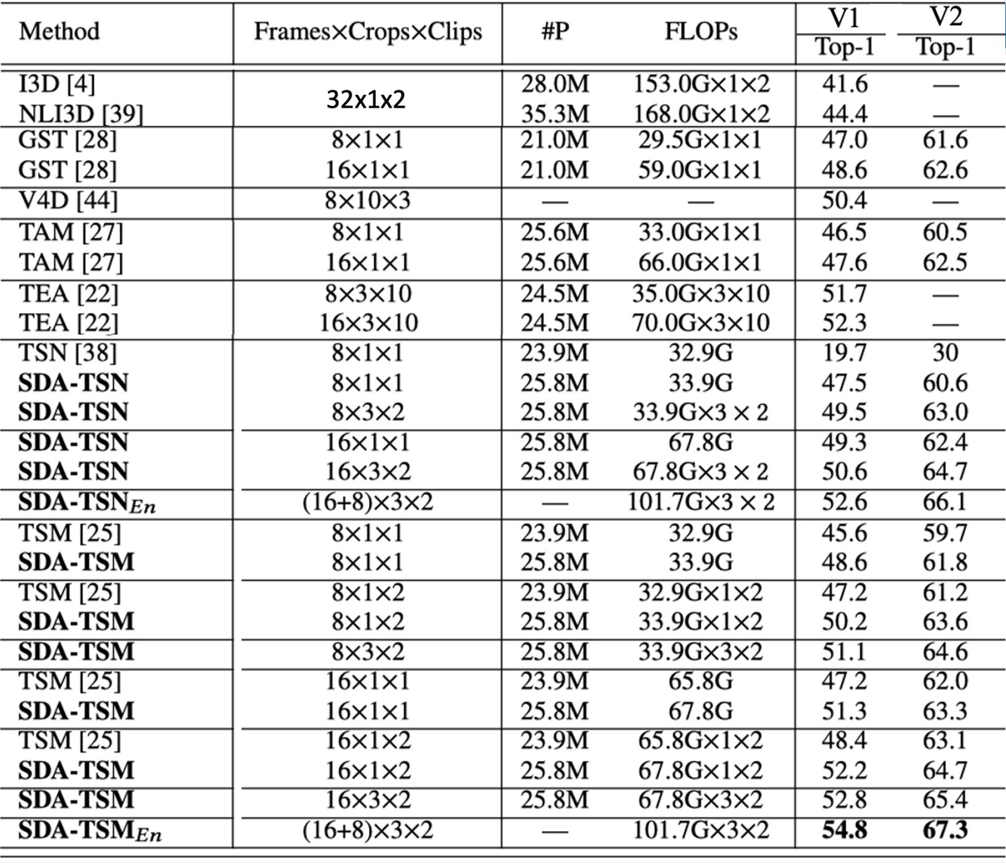
3. Experiment
3.1. On something-something V1&V2
- Sth-sth dataset: ~10² video categories, ~10⁵ samples, high Dynamics
(B). Comparison with SOTAs (partial)
Notes:
We report the performances of SDA-TSN and SDA-TSM by comparing them with the SOTAs in Table 3. In general, our proposed SDA module enhances the performance of TSN and TSM to be better or comparable among the competing methods. The computational cost, is also much lower than the most advanced TEA methods.

Slide 9
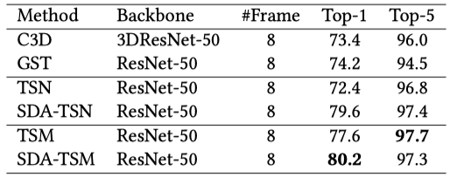
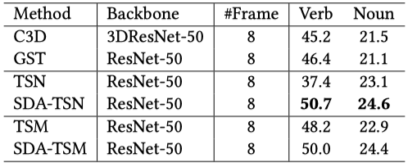
3. Experiment
3.2. On Diving48 and EPIC-KITCHENS-55
- Diving48 dataset: consists of ~18k trimmed video clips of 48 unambiguous dive sequences
- EPIC-KITCHENS-55 dataset: kitchen actions under first-person vision, two task: verb/noun classification
Table 4: Performance comparison on the updated Diving48 dataset using the official train/validation split V2.
Table 5: Performance comparison on EPIC-KITCHENS-55 dataset. All results are based on our train/validation split.
Notes:
Table 4 shows the performance comparison on the diving48 dataset. Enhanced by SDA, TSN and TSM get remarkable absolute improvements and outperforms all the SOTAs.
To show the generality of SDA for various video recognition tasks, we also compare SDA-Nets with SOTAs on the ego-motion video dataset EPIC-KITCHENS-55 in table 5. SDA-Nets perform better than their backbones, which, again, demonstrates the robustness of SDA under various requirements.

Slide 10
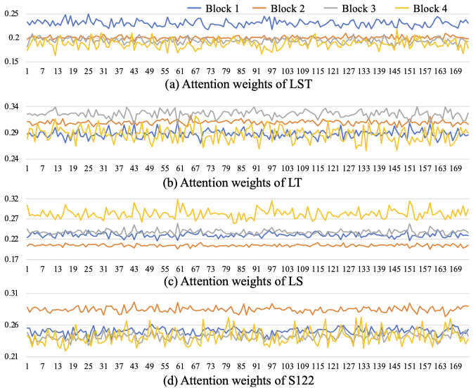
3. Experiment
3.3. Analysis and Interpretation
Average weights of dependency modeling units of SDA from Res1-4 of TSN.
Notes:
To more clearly understand how the dependency aggregation block (DAG) works on different residual blocks in the TSN backbone (i.e., ResNet-50), we report the averaged attention values of each dependency (e.g., LST, LT, LS, S122) on all action categories. we can find that different dependencies has its most salient stage of the learning process.

Slide 11




Thank you
Q & A

