Slide 1


BiNE: Bipartite Network Embedding
ACM SIGIR 2018, July 8, Ann Arbor Michigan, U.S.A.
MingGao*, Leihui Chen*, Xiangnan He⁺, Aoying Zhou*
*East China Normal University
⁺National University of Singapore

Slide 2










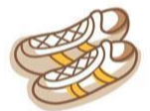

Background
Network
A ubiquitous data structure to model the relationships between entities
Network embedding
Crucial to obtain the representations for vertices
Helpful to many applications, such as vertex labeling, link prediction, recommendation, and clustering, etc.
Homogeneous Network
Heterogeneous Network
Social network
Collaboration
network
Transportation network
…
Item adoption
Web visiting
Question answering
…
Notes:
Network is a common data structure to model the relations between entities. For example, social network, collaborative network, and transportation network are networks where vertices are of the same type. In addition, many real-world tasks are dealing with heterogeneous neworks, such as item adoption, web visiting, and question answering.
To perform predictive analytics on network data, such as vertex labeling, link prediction, and clustering, it is crucial to first obtain the representations (i.e., features) for vertices.
Recent advances largely focus on embedding vertices into a low dimensional space, that is, latent feature learning.
Based on the learned embedding, standard machine learning techniques can be applied to address various tasks.

Slide 3
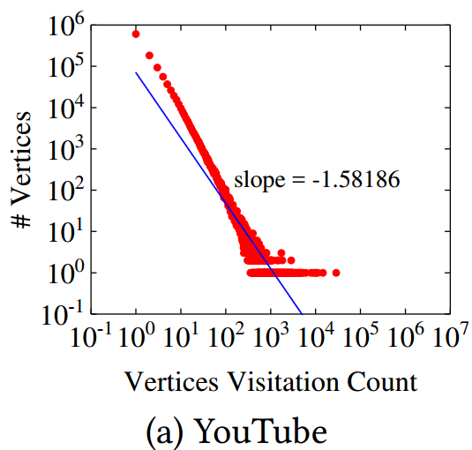
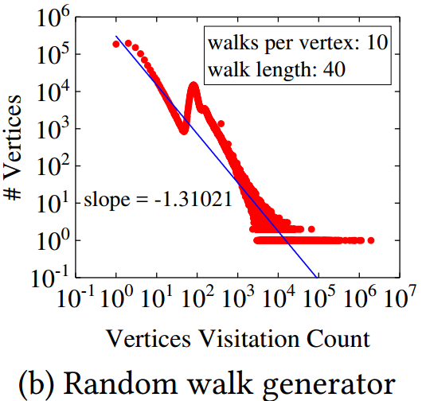
Drawbacks of Existing Works for Bipartite Networks
Homogeneous network embedding:
Ignore type information of vertices (e.g., Node2vec, DeepWalk, etc.)
Ignore key characteristic of bipartite network -- power-law distribution of vertex degrees
Heterogeneous network embedding:
MetaPath2vec [Dong et al, KDD’17] treats explicit and implicit relations as contributing equally
Notes:
This work focuses on embedding vertices of bipartite networks. To date, existing work have mainly focused on embedding homogeneous networks, where the vertices are of the same type. And very few work has considered bipartite networks. For these methods, like node2vec, and deepwalk, when applied to bipartite networks, they would be suboptimal for two reasons.
First, type information is ignored, which may lead to insufficient modeling of implicit relations, that is, the higher-order relations in the network. In bipartite network, edges only exist between vertices of different types. Although there is no observed edge between vertices of the same type, it doesn’t mean they don’t have relations. For example in recommendation, we deal with user-item bipartite graph, and the similarity relation between items are very important for collaborative filtering, and explicitly modeling them usually leads to better performance. As such, these homogeneous methods focus on modeling observed edges only and can easily be suboptimal for bipartite graph applications.
Second, these methods usually convert network to a corpus of vertex sequences to learn embeddings. And the corpus generation process ignores the key property of bipartite network – power-law distribution of vertex degrees. Here, the left figure shows the vertex degree distribution of a real-world youtube user-video network, and the right figure shows the distribution of the corpus generated by DeepWalk generator. We can see that real world data clearly shows a power-law distribution, but the generated one shows a different distribution. Since power-law distribution is a common property in bipartite network, it implies the necessity of designing a generator to properly capture that.
Recently in KDD last year, Dong proposed Metapath2Vec to embed heterogeneous network. However, when applying this state-of-the-art method to bipartite network, it has the drawback of treating explicit and implicit relations as contributing equally to learning.

Slide 4
Outline
Background & Motivations
Proposed Method
Experiments and Results
Conclusions

Slide 5

























BiNE: Bipartite Network Embedding
Two Characteristics of BiNE
Modeling the explicit and implicit relations simultaneously
A biased and self-adaptive random walk generator
$${ u}_{1}$$
$$w_{11}$$
$${ v}_{1}$$
$$f :U∪V →ℝ^{d}$$
$$w_{22}$$
$$w_{12}$$
$$|d|$$
$${ u}_{2}$$
$${ v}_{2}$$
$$w_{32}$$
$$w_{13}$$
.2 | .3 | .5 | 1 | .7
.4 | .3 | .5 | .1 | .2
.2 | .6 | .5 | .9 | .1
… | … | … | … | …
$${ u}_{3}$$
$$w_{33}$$
$${ v}_{3}$$
…
…
$$|U|$$
Capture explicit relations
$$G=(U ,V , W)$$
BiNE
Input
Jointly model explicit and implicit relations
$$|d|$$
$${ u}_{1}$$
$$w_{11}$$
$${ v}_{1}$$
$$w_{22}$$
$$w_{12}$$
Obtain implicit relations
.2 | .1 | .2 | 1 | .7
.3 | .4 | .5 | .5 | .7
.1 | .6 | .5 | .9 | .1
… | … | … | … | …
$${ u}_{2}$$
$${ v}_{2}$$
$$w_{32}$$
$$w_{13}$$
$$|V|$$
$${ u}_{3}$$
$$w_{33}$$
$${ v}_{3}$$
$${ u}_{1}$$
$${ u}_{1}$$
$${ v}_{1}$$
$${ v}_{1}$$
…
…
$${ u}_{2}$$
$${ u}_{2}$$
$${ v}_{2}$$
$${ v}_{2}$$
$${ u}_{3}$$
$${ u}_{3}$$
$${ v}_{3}$$
$${ v}_{3}$$
…
…
…
…
Notes:
Here shows the overall paradigm of our BiNE method. To overcome the drawbacks of existing methods, BiNE has two key properties: first, modeling both explicit and implicit relations simultaneously, and second, a biased and self-adaptive random walk generator.
The problem setting is that, given the input U, V, W, where U and V are the two types of vertices, and W is the weight matrix. We consider reconstructing the bipartite network from two perspectives, the explicit relations evidenced by the observed edges, and the implicit relations implied by the unobserved but transitive links. We then learn vertex embeddings by jointly optimizing both relations, and obtain a d-dimensional vector for each vertex.
Next, we introduce each component.

Slide 6
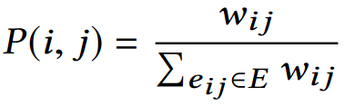
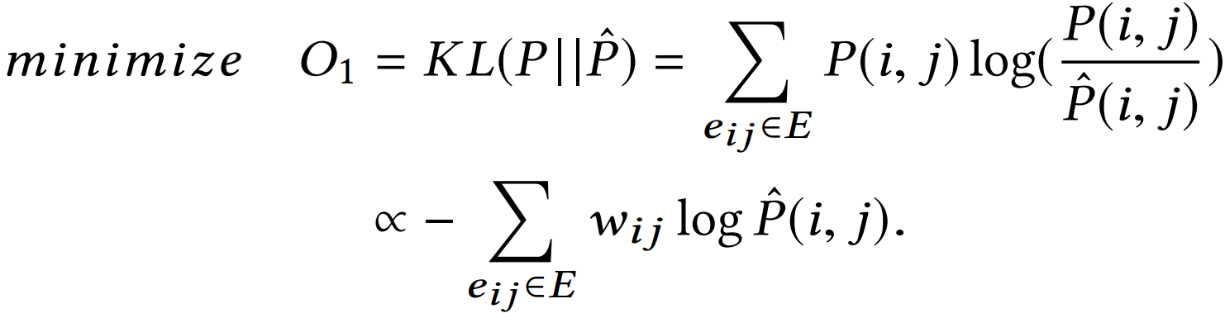
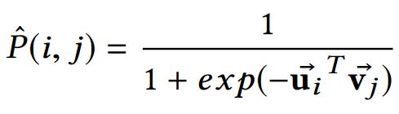

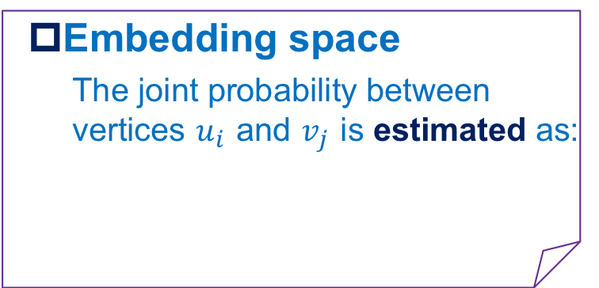
Modeling Explicit Relations (Observed links)
Original network space
The joint probability between vertices $u_{i}$ and $v_{j}$ is defined as:
Preserving the local proximity
Minimizing the difference (KL-divergence) between the two distributions:
Embedding space
The joint probability between vertices $u_{i}$ and $v_{j}$ is estimated as:
Notes:
For explicit relation modeling, BINE considers the local proximity between two connected vertices as the joint probability between then, which is defined based on the edge weights as here. In the embedding space, the probability can be estimated as the inner product of two vertices’ embeddings, followed by a sigmoid function to normalized the value.
To capture the explicit relation, BiNE minimize the distance between local proximity and the approximated one.
To achieve this, KL-divergence is applied to minimize the difference between two distributions.
By doing so, we make two vertices that are strongly connected in bipartite network also close with each other in the embedding space.

Slide 7

Modeling Implicit Relations (High-order relations)
Constructing Corpus of Vertex Sequences
Construct U-U and V-V networks
Run Self-adaptive random walker
# of walks starting from a vertex depends on its centrality score.
Length of a vertex sequence is controlled by a stop probability.
Optimizing a point-wise classification loss to capture the high-order correlations
$${ u}_{1}$$
$$w_{11}$$
$${ v}_{1}$$
$$w_{12}$$
$${ u}_{2}$$
$$w_{22}$$
$${ v}_{2}$$
$$w_{32}$$
$$w_{13}$$
$${ u}_{3}$$
$${ v}_{3}$$
$$w_{33}$$
…
…
$${ u}_{1}$$
$${ u}_{1}$$
$${ v}_{1}$$
$${ v}_{1}$$
$${ u}_{2}$$
$${ u}_{2}$$
$${ v}_{2}$$
$${ v}_{2}$$
$${ u}_{3}$$
$${ u}_{3}$$
$${ v}_{3}$$
$${ v}_{3}$$
…
…
…
…
Notes:
To capture the implicit relation, we convert the bipartite network to two homogeneous networks, which consist of vertices of the same type. The edge weight is defined based on the weights of shared neighbors of two vertices. Through this way, the second-order transitive relation between two vertices is captured. We then consider how to perform random walks on the two homogeneous networks to capture higher-order implicit relations. We develop a self-adaptive biased random walker, the idea is twofold: 1) we control the # of walks starting from each vertex to depend on its importance, as measured by its centrality. 2) we control the length of the vertex sequences by a stop probability. Details of the walker can be found in the paper so I didn’t show here.
Each walk gets a vertex sequence, and we run the walker many times to get a corpus of vertex sequences. Finally, we optimize a pointwise loss function, same as the one used in word2vec on the vertex corpus, to learn vertex embeddings. Next, I will show how to do parameter optimization.

Slide 8
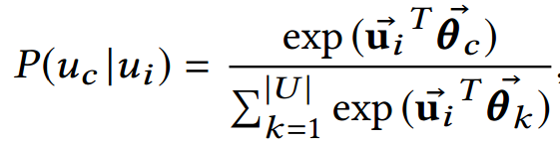
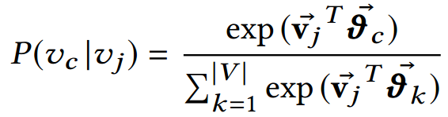










Capturing the High-order Relations
Assumption: vertices frequently co-occurred in the same context of a sequence should be assigned to similar embeddings.
Taking corpus of users $D^{U}$ as example , given a sequence $S$, $ws$(=2) and a vertex $u_{i}$:
$$u_{1}$$
$$u_{5}$$
$$u_{4}$$
$$u_{2}$$
$$S:$$
$$u_{7}$$
$$u_{i}$$
$$u_{3}$$
$$u_{9}$$
$$u_{8}$$
Sample High-quality and Diverse Negatives with Locality Sensitive Hashing (LSH)
Notes:
To capturing the high-order correlations, we can therefore preserve the implicit relations via maximizing the probability of observing all contexts of each center vertex in U or V, which can be formulized in equations B and C.
Note that the high-order proximity assumes that vertices that are easily reachable from each other are similar. In other words, vertices frequently co-occurred in the same context of a sequence should be embedded close to each other. Here P(u_c|u_i) denotes how likely u_c is observed in the contexts of u_i. However, directly optimizing the objective functions is non-trivial, since evaluating the softmax function needs to traverse over all vertices which is too time-consuming. We handle this by doing negative sampling, a common way in previous work. The novelty here is we apply Locality Sensitive Hashing to take the network structure into account. First LSH is applied to put vertices into different buckets – the vertices in the same bucket are topologically similar. Then, given a centered vertex, we sample negatives from different buckets to ensure the diversity of negative samples. More details on using LSH can be found in the paper.

Slide 9
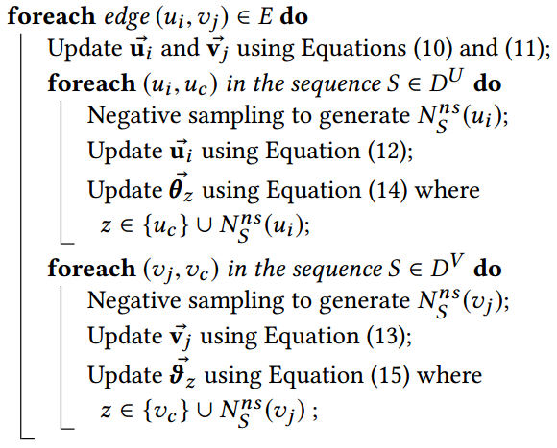

Joint Optimization
A joint optimization framework
Explicit relations
Implicit relations
Notes:
Lastly, joint optimization is performed to preserve both explicit and implicit relations simultaneously. Here O2 and O3 denote the objective for implicit relations, and O1 denotes the loss on explicit relations.
Note that the three components in the objective function have different definitions on a training instance.
To handle this issue, we propose a new training procedure based on SGD.
First, we sample an edge (u_i, v_j), and optimize their embedding vectors by minimizing the last component O1.
Then, for implicit relations, we separately treat vertices u_i and v_j as the center vertex, employing negative sampling on-the-fly and SGD to maximize objective O2 and O3, respectively.
Through this way, we can unify the both explicit & implicit relation modeling in learning vertex embeddings.

Slide 10
Outline
Background & Motivations
Proposed Method
Experiments and Results
Conclusions

Slide 11
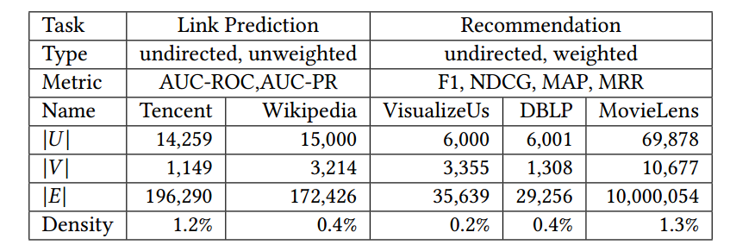
Experimental Setting-up
Tasks
Two tasks: link prediction (classification) & recommendation (ranking)
Datasets and Metrics
Research Questions
RQ1 Performance of BiNE compared to representative baselines
RQ2 Is the implicit relations helpful?
RQ3 Effect of random walk generator
Notes:
We perform empirical evaluation on two tasks, link prediction and recommendation, one is classification and one is ranking. For each task, we use different datasets and the statistics are shown here.
We aim to answer three research questions:
How does BiNE perform compared with state-of-the-art network embedding methods?
Is the modeling of implicit relations helpful to learn more better embeddings?
How is the effect of the random walk generator?

Slide 12
Baselines
Network embedding methods
DeepWalk [Perozzi et al KDD 2014]
LINE [Tang et al WWW 2015]
Node2vec [Grover et al KDD 2016]
Metapath2vec++ [Dong et al KDD 2017]
Link Prediction methods [Xia et al ASONAM 2012]
JC (Jaccard coefficient)
AA (Adamic/Adar)
Katz (Katz index)
PA (Preferential attachment)
Recommendation methods
BPR [Rendle et al UAI 2009]
RankALS [Takács et al Recsys 2012]
FISMauc [Kabbur et al KDD 2013]
Notes:
We consider the baselines of three types: developed for network embedding, link prediction and recommendation, respectively.
Here are the four methods for network embedding, three classic and one state-of-the-art, and we use the author released codes for each method.
Since this is not a recommendation paper, we don’t aim to outperform state-of-the-art recommendation methods like neural networks. Instead, we compare with BPR, RankALS and FISM which are quite competitive among traditional methods.
We also compare with some statistic measures for link prediction, as listed here.

Slide 13
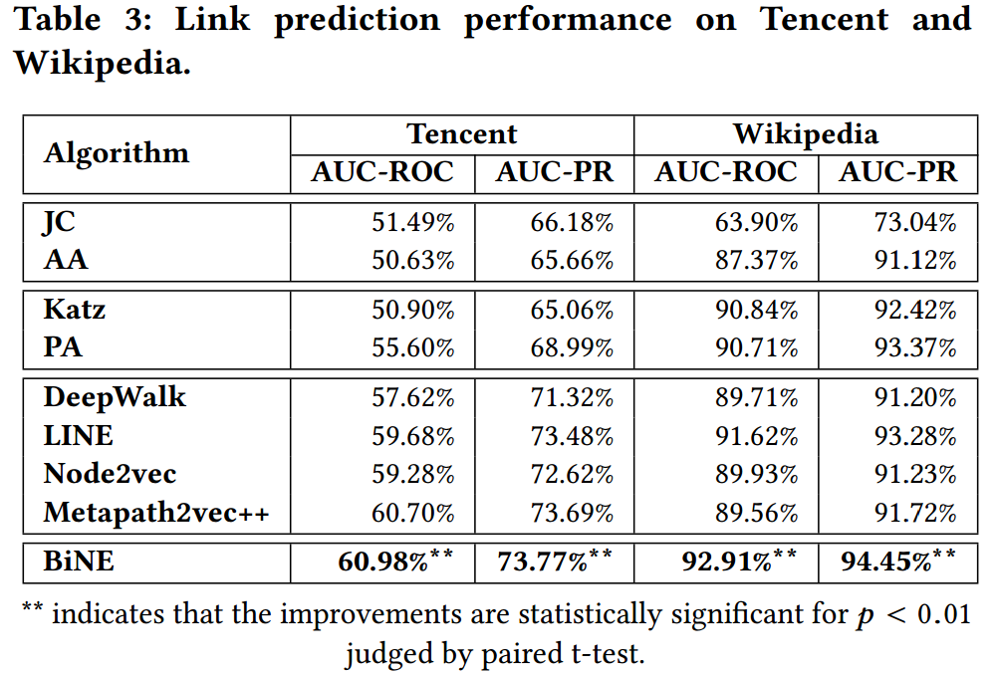
RQ1: Performance of Link Prediction
Observations:
Data-dependent supervised manner is more advantageous.
Positive eﬀect of modeling both explicit and implicit relations into the embedding process.
Eﬀectiveness of modeling the explicit and implicit relations in diﬀerent ways.
Notes:
For link prediction, we feed the embedding vectors of two vertices to logistic regression classifier.
Here show the results: [Click]
Comparing learning-based methods with statistic measure-based, we can see data-dependent learning based methods are more advantageous in general. [Click]
Comparing our method with the network embedding methods that are for homogeneous networks, we can see that our method is more effective in embedding bipartite network. [Click]
Our method outperforms the state-of-the-art method metapath2vec, which emphasizes the usefulness of treating explicit relation and implicit relation differently in the learning process.

Slide 14
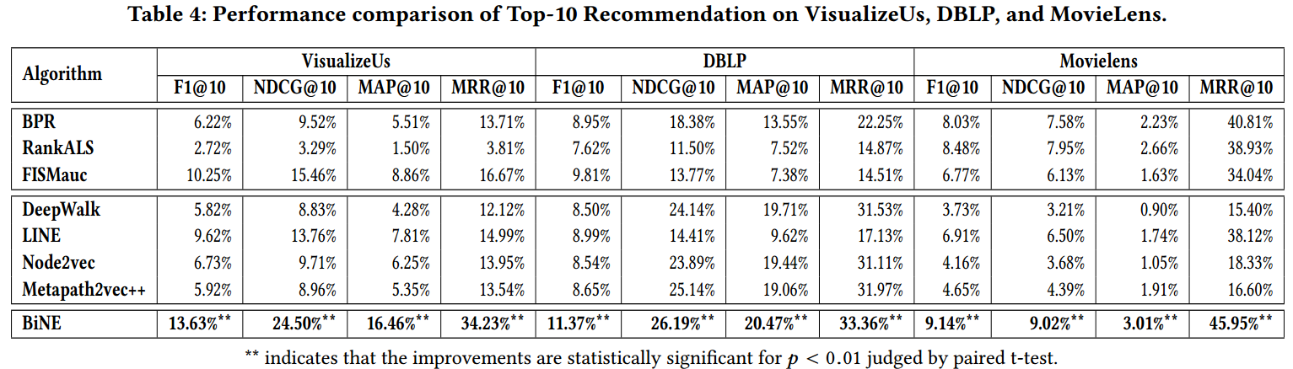
RQ2: Performance of Recommendation
Observations:
Positive effect of considering information of weight
Importance of focusing on the higher-order proximities among vertices
Jointly training is superior to separately training + post-processing
Notes:
In the recommendation task, the inner product of user embedding and item embedding is used as the ranking score.
We can find that:
BiNE outperforms all baselines on all datasets especially when the dataset is very sparse (the relative improvements over baselines on VisualizeUs are the highest).
(2) Network embedding methods underperform the best recommendation algorithm, which implies that applying these methods to bipartite network is suboptimal. [click]
(3) BiNE outperforms LINE which also models second-order implicit relation. This indicates simply 2-hop proximity is insufficient for learning from bipartite networks, and capturing higher-order relations is necessary. [click]
(4) Metapath2vec++ shows worse performances than expected, which might be affected by its uniform modeling of different relations.

Slide 15
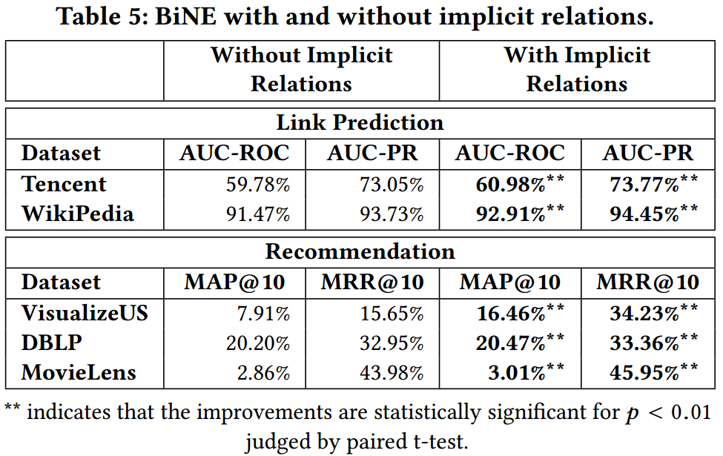
Utility of Implicit Relations (RQ2)
Observation:
Modeling high-order implicit relations is eﬀective to complement with explicit relation modeling.
Notes:
To demonstrate the utility of implicit relation modeling, we compare our method with a variant that removes implicit relation modeling.
We can see that in all cases, modeling implicit relation leads to improvement consistently. Especially for the recommendation task on VisualizeUS dataset, the improvement is more than double.
This indicates that modeling higher-order implicit relations can effectively complement with explicit relation modeling for some downstream applications.

Slide 16
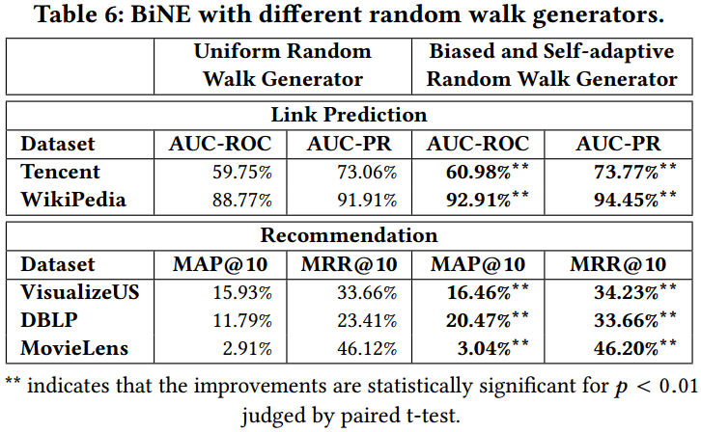
Random Walk Generator (RQ3)
Observation:
The biased and self-adaptive random walk generator contributes to learning better vertex embeddings.
Notes:
Next, we explore the effectiveness of random walk generator. The left table shows the result of BiNE with a uniform random walker and our designed self-adaptive walker. We can see that in all cases, using the self-adaptive random walker leads to significant improvements. On DBLP recommendation task the relative improvement is over 50%.

Slide 17
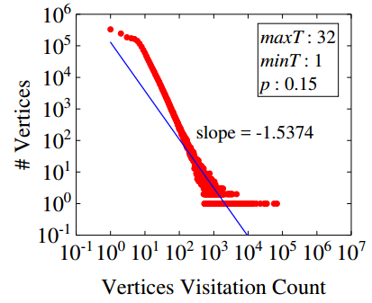
Random Walk Generator (RQ3)
Distribution of vertex degree：
DeepWalk Generator:
Our Generator:
(c) Self-Adaptive generator
Observation:
The biased and self-adaptive random walk generator contributes to learning better vertex embeddings.
Notes:
Here we recap the example in introduction on the vertex degree distribution generated by different walkers. The left figure is the distribution of real youtube data, the middle one is by the DeepWalk generator, and the right figure is by our self-adaptive walk generator. We can see that our generator leads to a long-tail distribution much closer to the original data distribution, and the discrepancy on the slope is much smaller.

Slide 18
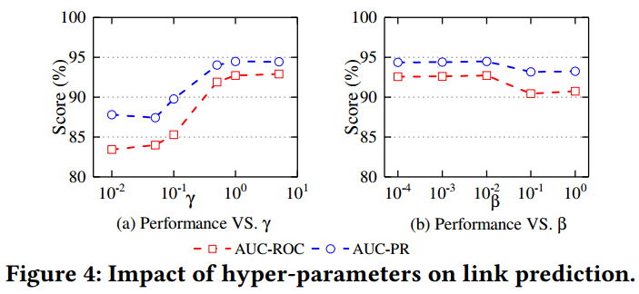
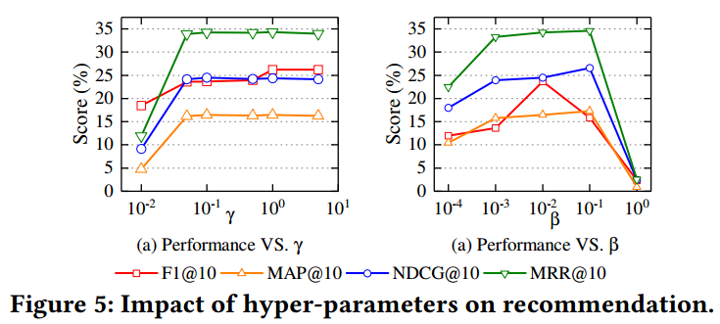

Hyper-parameter Studies (RQ4)
Observations:
Purely using explicit or implicit relations is insufficient.
explicit relations > implicit relations
Notes:
Furthermore，we address how the key hyper-parameters affect the performance of BiNE?
We only investigate the impact of the hyper parameters \beta and \gamma (fix \alpha = 0.01) with respect to the performance of link prediction and recommendation tasks. Except for the parameter being tested, other parameters assume default values. We chose two very sparsity networks used in the two tasks: VisualizeUs and Wikipedia.
As shown in the figures, the impact of the two parameters have a similar trend: the performance varies when a value of one parameter changes. It indicates that parameters \beta and \gamma play crucial roles in our model because they balance where the joint framework would focus on modeling the explicit relations or modeling implicit relations
In addition, the best value of \gamma is larger than that of \alpha and \beta, which indicates that explicit relations are more
important than implicit relations and we should not treat them equally when modeling bipartite networks.

Slide 19
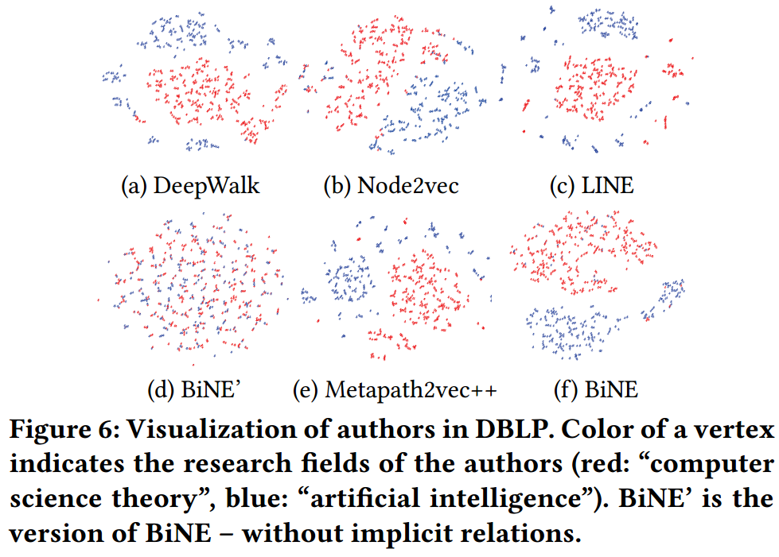
Case Study
Notes:
Lastly, we visualize the embeddings learned by different methods to demonstrate the difference. We visualize 700 DBLP authors from two research fields： computer science theory and artificial intelligence. We can see that the four embedding methods achieve reasonable embeddings, since vertices of the same cluster are distributed closer. But in our opinion, BiNE gives a better result since it further shows a large margin between vertices of different clusters. Moreover, if we remove implicit relation modeling in BINE, that is the subfigure (d), the results become quite messy. This further shows the importance of modeling implicit relations in bipartite network embedding.

Slide 20
Conclusions
Conclusions
Propose a dedicated approach for embedding bipartite networks
Jointly model both the explicit relations and higher-order implicit relations
Extensive experiments on several tasks of link prediction, recommendation, and visualization
Future work
Extend our BiNE method to model auxiliary side info
Investigate how to efficiently refresh embeddings for dynamic bipartite networks
Network embedding + adversarial training

Slide 21




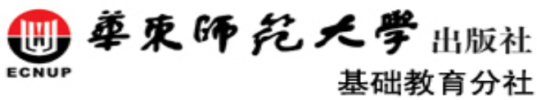
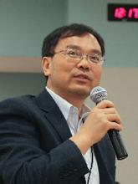

Acknowledgments
Ming Gao (高明)
(East China Normal University)
Leihui Chen (陈雷慧)
(East China Normal University)
Aoying Zhou (周傲英)
(East China Normal University)
National Natural Science Foundation of China
The Press of East China Normal University
National Research Foundation, Prime Minister’s Office, Singapore

Slide 22


Thank You
for Your Attention
Code available:

Slide 23

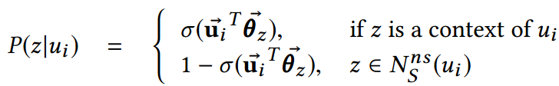

Negative Sampling
Optimizing a point-wise classification loss
$\text{p}\text{(}u_{c}\text{|}u_{i}\text{)}$can be approximate as:
Following the similar formulations, we can get the counterparts for the conditional probability $\text{p}\text{(}z\text{|}v_{i}\text{)}$
LSH-based
Notes:
To reduce the learning complexity, we employ the LSH-based negative sampling to approximate the conditional probability.
Since vertices in Neg() are far away from the center vertex comparing to vertices in context, i.e., the vertices in Neg() are
dissimilar to the center vertex considering the network topological structure. Thus, we employ locality sensitive hashing (LSH) to block vertices after shingling each vertex via its ws-hop neighbors in the network.
Given the center vertex, we can randomly choose the negative samples from the buckets which are different from the bucket contained the center vertex. This is due to the fact that LSH can probabilistically guarantee that dissimilar vertices are located in different buckets.

Slide 24

LSH-based Negative Sampling
LSH-based negative sampling method
For a center vertex $u_{i}$, high-quality negatives should be the vertices that are dissimilar from $u_{i}$
 | Frequency-based or popularity-based sampling | LSH-based negative sampling
Strategy | High frequency objects | Dissimilar objects
Word Embedding | Useless words
Network Embedding | Popular items or active users
Notes:
Compared to the frequency-base negative sampling, the reasons of employing LSH-based negative sampling approach are follows:
Frequency-based negative sampling method takes a large probability of choosing high frequency objects as negative samples, which is suitable for language model, because high frequency words are useless words, such as he, she, it, is, the, etc.
On the contrary, for a bipartite network, high frequency vertices are often the most import samples, such popular items or active users. As we all know, the tracing phenomenon widely exits in user buying and watching behaviors, that is users prefer popular items. Thus, we hold that LSH-based sampling method, which uses dissimilar information obtained from user behavior data, can generate more reasonable negative samples in modeling user behavior.

Slide 25
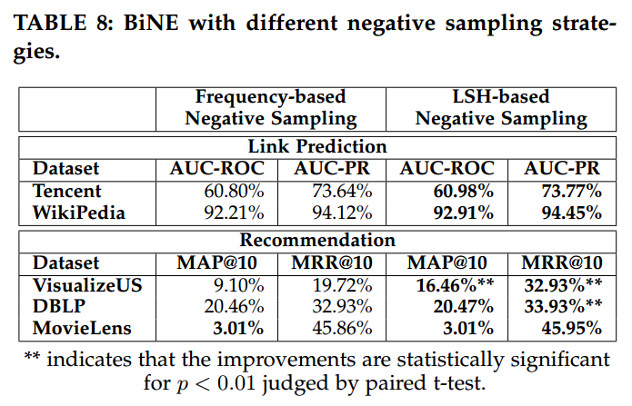
Experimental Results
Performance of BiNE with different negative sampling strategies.
Observations:
Two methods show roughly equivalent performance in most case.
However, there are situations (see VisualizeUS) in which LSH-based sampling method uses dissimilar information obtained from user behavior data can generate more reasonable negative samples
Notes:
We also conduct an additional experiment to address whether LSH-based negative sampling is reasonable or not.
As shown in the table, we can find that:
Two methods show roughly equivalent performance in most cases.
However, in the dataset VisualizeUS, LSH-based sampling method uses dissimilar information obtained from user behavior data can generate more reasonable negative samples.

