Slide 1

Adversarial Personalized Ranking for Recommendation
SIGIR 2018
Xiangnan He, Zhankui He, Xiaoyu Du, Tat-Seng Chua
School of Computing
National University of Singapore

Slide 2
Motivation
The core of IR tasks is ranking.
Search: Given a query, ranking documents
Recommendation: Given a user, ranking items
A personalized ranking task
Ranking is usually supported by the underlying scoring model.
Linear, Probabilistic, Neural network models etc.
Model parameters are learned by optimizing learning-to-rank loss
Question: is the learned model robust in ranking?
Will small change on inputs/parameters lead to big change on the ranking result?
This concerns model generalization ability.
Notes:
Because the model learns prediction function which can be seen as a curve in high-dimensional space. If the model is not robust, it means the curve is not smooth and has many spikes. This has the danger of overfitting.

Slide 3
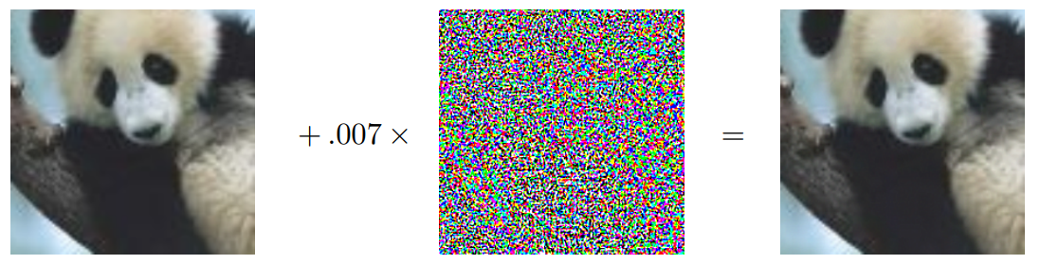
Adversarial Examples on Classification (Goodfellow et al, ICLR’15)
Recent efforts on adversarial machine learning show many well-trained classifiers suffer from adversarial examples:
This implies weak generalization ability of the classifier
Question: do such adversarial examples also exist for IR ranking methods?
Notes:
Recent efforts show that many well-trained classifers are vulnerable to adversarial examples. Here shows a quite famous example in Goodfellow’s ICLR paper. Given the testing image in left, originally the classifier can label it as panda correctly with middle confidence. However, after adding some perturbations, the classifier misclassifies it as a gibbon with very high confidence. Here the perturbations are very small and human can hardly perceive any change in the perturbed image.
This implies weak generalization ability of the classifer. [Click]
So the question here is, do such adversarial examples also exist for IR ranking methods?

Slide 4
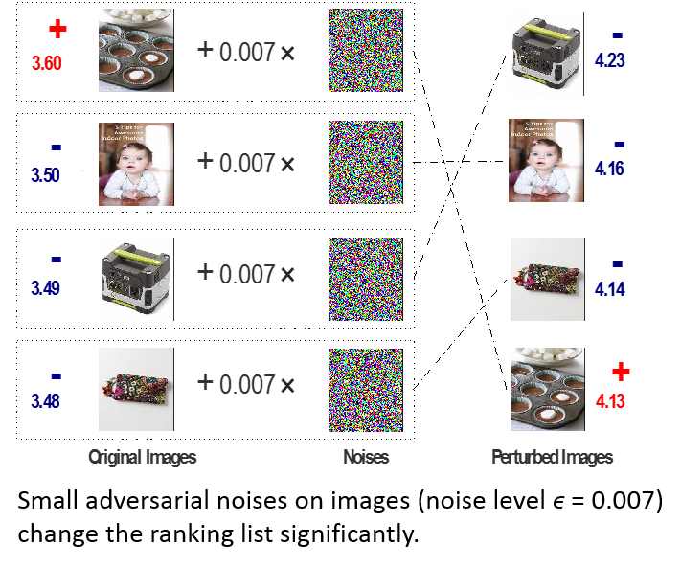
Adversarial Examples on Personalized Ranking
We train Visually-aware BPR (He et al, AAAI’16) on a user-image interaction dataset for visualization.
VBPR is a pairwise learning-to-rank method
Effect of adversarial examples on personalized ranking:
Top-4 image ranking of a sampled user.
before vs. after adversarial noise:
Ranking scores (before)
Ranking scores (after)
Small adversarial noises on images (noise level ϵ = 0.007) leads to big change on ranking.
Notes:
To answer the question, we train Visually-aware BPR method on a user-image interaction dataset for visualization. VBPR is a multimedia recommendation method which performs pairwise learning on MF model. We find that adversarial examples do exist for personalized ranking. [click]
To show this, we sample a user and shows the recommended image list for him in the left, and the right image list shows the ranking list after adding noises on the image pixels; the number beside each image is its ranking score. We can see that, in the left, originally the model ranks the positive image higher than other negative images, which is as expected. However, after we apply adversarial noises on images, even though the change on images can hardly be perceived by human, it results in a large change on the ranking result. The positive image is ranked in the bottom of the recommended list. In other words, the small noise makes big change on the ordering of model prediction scores.

Slide 5
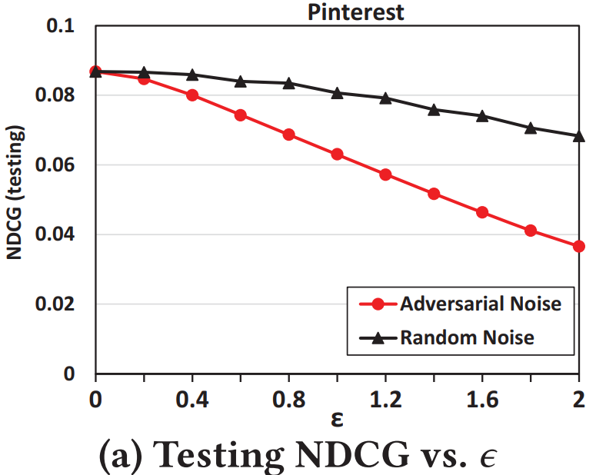
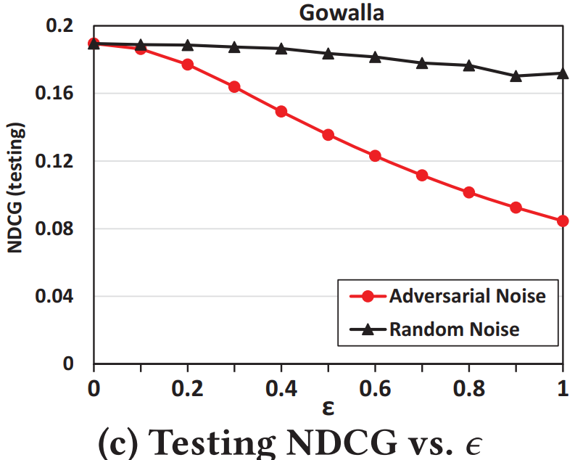
Quantitative Analysis on Adversarial Attacks
We train matrix factorization (MF) with BPR loss
MF is a widely used model in recommendation
BPR is a standard pairwise loss for personalized ranking
We add noises on model parameters of MF
Random noise vs. Adversarial noise
Performance change w.r.t. different noise levels ε (i.e., L₂ norm):
Conclusion:
MF-BPR is robust to random noise, but not for adversarial noise!
Notes:
To be more clear on the effect of adversarial attacks, we further perform some quantitative analysis. We train matrix factorization model with BPR loss on two standard recommendation benchmarks. Note that MF is a widely used model in recommendation, and BPR is a standard pairwse objective tailored for personalized ranking. The combination of them leads to a strong method in recommendation [Click]
We add noises on model parameters of MF, and compare the impact of random noise versus adversarial noise. The adversarial noise is designed to change the BPR loss on training set as much as possible. The figure shows the testing performance, measured by NDCG, w.r.t. the noise level \epsilon. The noise level is the L2 norm of noise vector. The black line is the random noise and the red line is for adversarial noise, and the starting point of \epsilon=0 means on noise is performed. [Click]
From the figure, we can see that adversarial noise leads to a much larger performance drop on the ranking performance. In contrast, random noise has very small impact on the performance. We can draw the conclusion that MF-BPR is rather robust to random noise, but is not robust to adversarial noise.

Slide 6
Outline
Introduction & Motivation
Method
Recap BPR (Bayesian Personalized Ranking)
APR: Adversarial Training for BPR
Experiments
Conclusion

Slide 7
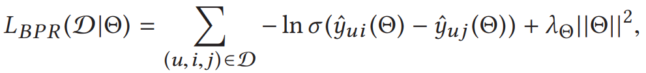
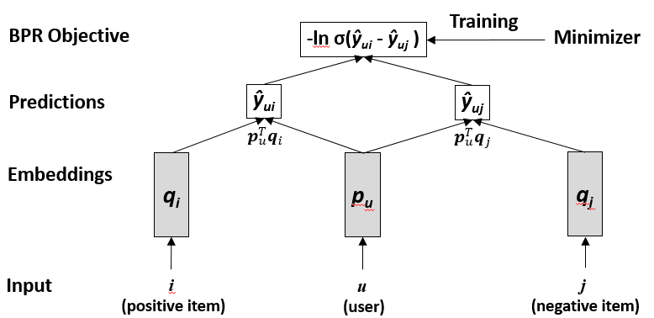

Recap BPR
BPR aims to maximize the margin between an ordered example pair.
An example of using BPR to optimize MF model:
sigmoid
Positive prediction
Negative prediction
Pairwise training examples: u prefers i over j
[Rendle et al, UAI’09]

Slide 8


Our Method APR: Adversarial Personalized Ranking
The aim is to improve the robustness of model trained for personalized ranking.
Idea:
Construct an adversary to generate noise on BPR during training
Train the model to make it perform well even under noise.
Original BPR Loss
Perturbed BPR Loss
+
Generate additive noise by maximizing BPR loss
Minimize
Learner
Adversary

Slide 9

APR Formulation
Learning objective of APR (to be minimized):
where the adversarial noise tries to maximize BPR loss:
Can be seen as adding an adaptive regularizer to BPR training
Dynamically change during training
λ controls strength of regularization
Adversarial noise
Original BPR Loss
Perturbed BPR Loss
Current model parameters
Control magnitude of noise (avoid trivial solution that simply increases value)

Slide 10
APR Formulation
Overall formulation is solving a mini-max problem:
Next: Iterative two-step solution for APR learning:
1. Generate Adversarial Noise (maximizing player)
2. Update Model Parameters (minimizing player)
Until a convergence state is reached
Model Learning
Minimize ranking loss + adversary loss
mini-max game
Adversary Learning
Maximize ranking loss

Slide 11
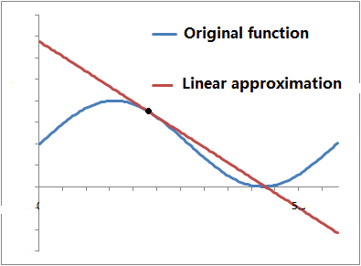
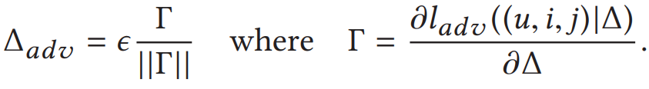

APR Solver
Randomly sample training instance (u, i, j):
Step 1: Generate Adversarial Noise by maximizing:
Difficulty: for many models of interest, it is difficult to get the exact optimal solution.
E.g., MF (bilinear model), Neural Networks (nonlinear models) etc.
Solution: approximate the objective function around ∆ as a linear function:
Constant set, denoting current model parameters
Optimal solution for the linear function is :
I.e., move ∆ towards the direction of gradient.
(fast gradient method [Goodfellow et al, ICLR’15])
Recall Taylor series:
Notes:
We apply stochastic gradient descent paradigm to solve APR, that is, randomly sample a training instance to update parameters. The first step is to generate adversarial noise by maximizing the objective w.r.t. the stochastic instance. Here the \hat{theta} denotes the current model parameters. [Click]
The difficulty is that for many models of interest, it is difficult to get the exact optimal solution. Such as the bilinear MF model and nonlinear neural networks, since objective function is nonconvex to all variables. [click]
The solution is to approximate the objective around \delta as a linear function. Here shows an example, the blue curve line is the original function, at the black point, the red line is the best linear function to approximate the original function. This can be obtained by the Taylor series, where the linear line is just the first two terms, and the slope of the line is the gradient at the black point. [click]
Based on this, we can get the optimal solution for the approximated linear function, which is essentially moving Delta towards its gradient direction, and normalized by the noise scale. This method is also known as the fast gradient method (Goodfellow et al, ICLR’15)

Slide 12
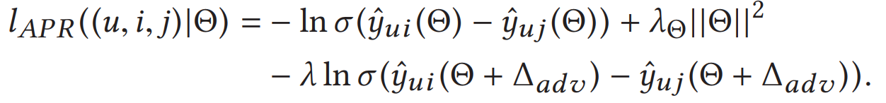
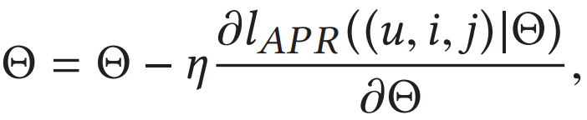
APR Solver
Randomly sample training instance (u, i, j):
Step 2: Learn model parameters by minimizing:
Standard SGD update rule:
Original BPR loss
Perturbed BPR loss

Slide 13

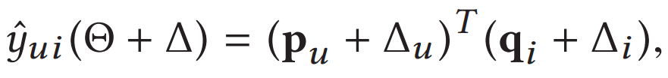
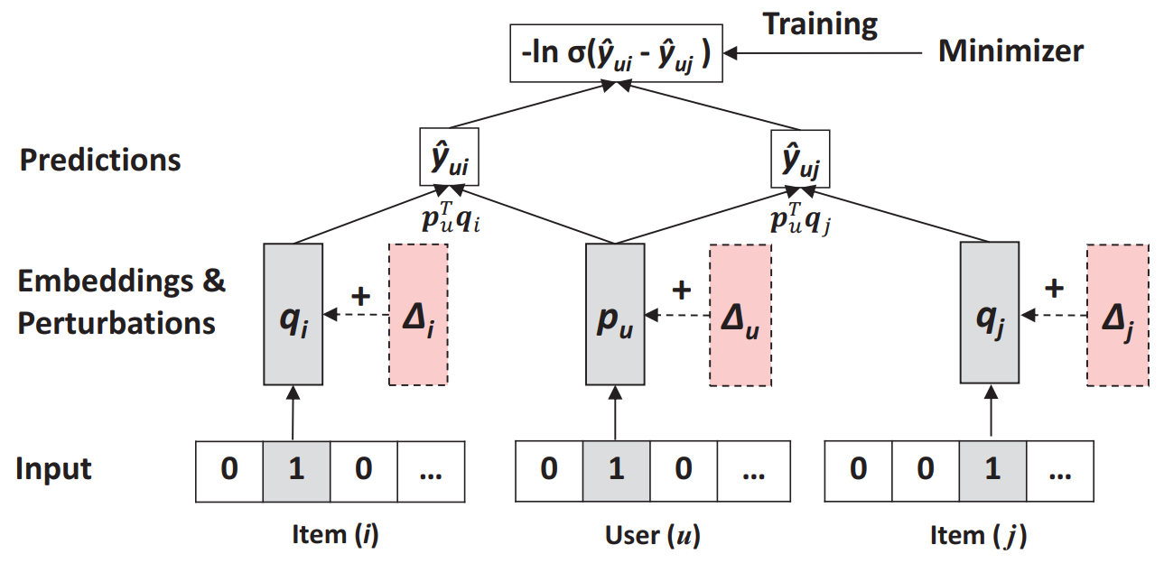
Apply APR on Matrix Factorization
Original MF model:
Perturbed MF model:
Last but not the least: initialize APR parameters by optimizing BPR, rather than random!
When model is underfitted, normal training is sufficient.
When model is overfitted, we should do adversarial training.
Illustration of adversarial matrix factorization (AMF):

Slide 14
Outline
Introduction & Motivation
Method
Recap BPR (Bayesian Personalized Ranking)
APR: Adversarial Training for BPR
Experiments
Conclusion

Slide 15
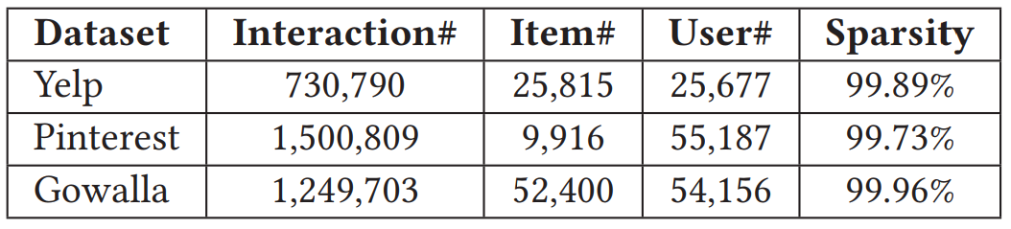
Settings
Three datasets:
Pre-processing: merge repetitive interactions to the earliest time (recommend novel items to user)
Leave-one-out All-ranking Protocol:
For each user, hold out the latest interaction as testing set.
Rank all items not interacted by the user in training.
Evaluate ranking list at position 100, by Hit Ratio and NDCG.
HR@100 is position non-sensitive (like recall)
NDCG@100 is positive-sensitive
Default settings: embedding size = 64, noise level ε = 0.5, adversarial regularizer λ = 1.

Slide 16
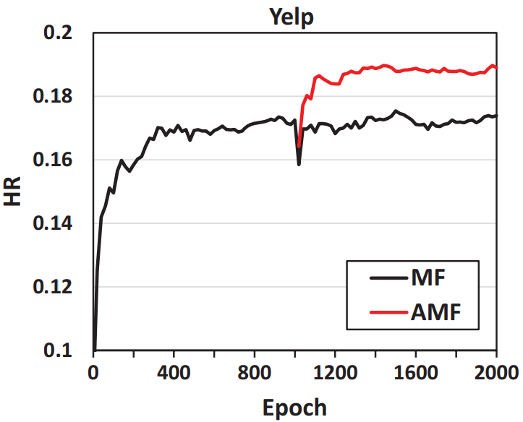
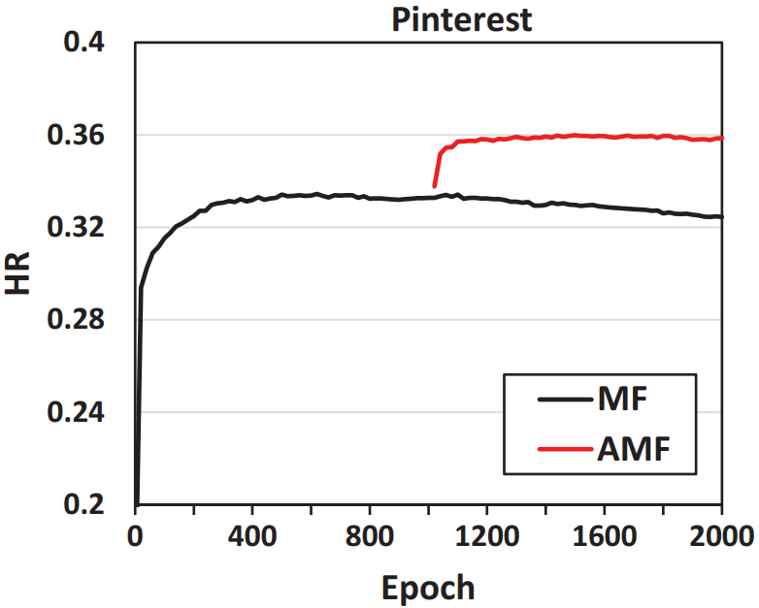
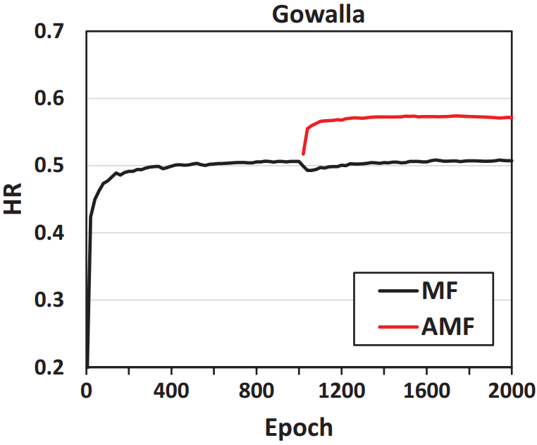
Result: Effect of Adversarial Training - Training Curve
Training curve of MF-BPR (black) vs. MF-APR (red)
First train MF-BPR for 1000 epochs (converged)
Continue training MF with APR for 1000 epochs
Adversarial training leads to over 10% relative improvement.
After convergence, normal training may degrade performance.
Note: L2 regularizer has been sufficiently tuned.

Slide 17
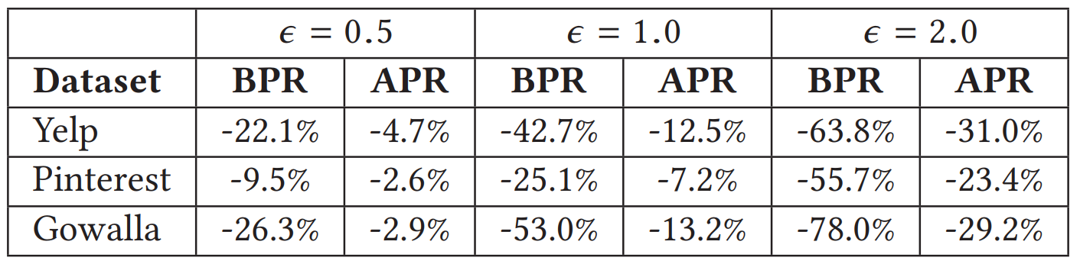
Result: Effect of Adversarial Training - Robustness
Add adversarial perturbations on MF model trained by BPR and APR, respectively.
Performance drop (NDCG in testing set) w.r.t. different noise levels (ε = 0.5, 1.0, 2.0)
APR learner makes the model to be rather robust to adversarial perturbations.

Slide 18
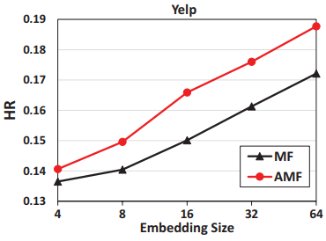
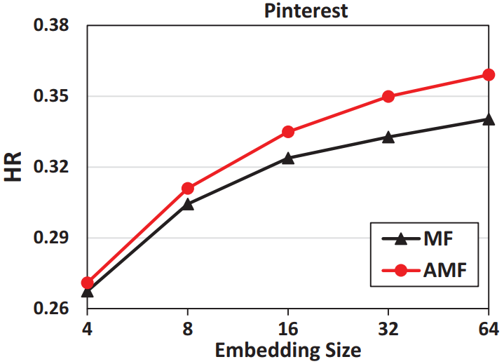
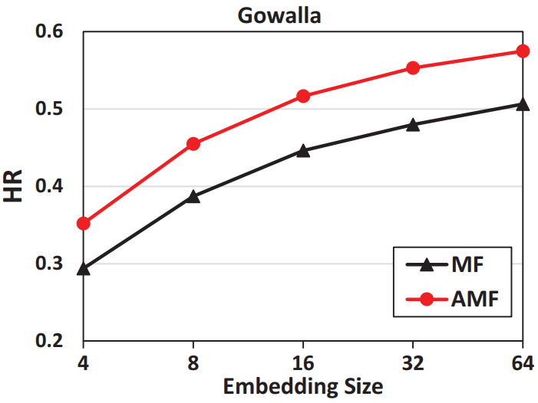
Result: Effect of Adversarial Training - On Models of Different Sizes
Embedding size controls model complexity of MF:
Performance of MF trained by BPR and APR w.r.t. different embedding sizes (4, 8, 16, 32, 64):
Improvements are consistent on models of different sizes.
Improvements on larger models are more significant.
The bottleneck of small models is model representation ability

Slide 19

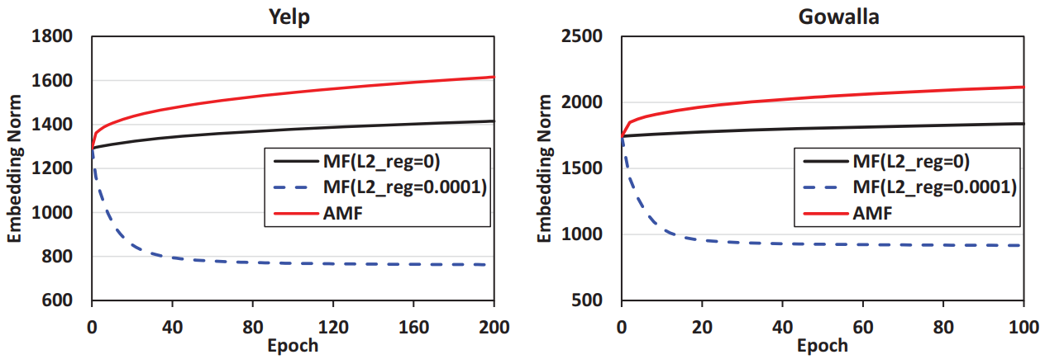
Result: Effect of Adversarial Training - Where the improvement comes from?
Adversarial regularization vs. L₂ regularization in improving model generalization
Training curve w.r.t. norm of embedding matrices
Adversarial regularization increases the value of model parameters, which is beneficial to model robustness.
In contrast, L₂ regularization decreases the value of model parameters.

Slide 20
Result: Performance Comparison
Average Improvement of AMF over the baseline.
 | Yelp |  | Pinterest |  | Gowalla
 | HR | NDCG | HR | NDCG | HR | NDCG | Avg Impro.
ItemPop | 0.0742 | 0.0169 | 0.0485 | 0.0116 | 0.1560 | 0.0428 | +394.2%
MF-BPR | 0.1721 | 0.0420 | 0.3403 | 0.0886 | 0.5072 | 0.1878 | +10.5%
CDAE | 0.1733 | 0.0405 | 0.3495 | 0.0873 | 0.5483 | 0.2007 | +8.2%
IRGAN | 0.1765 | 0.0465 | 0.3363 | 0.0904 | 0.518 | 0.2019 | +6.4%
NeuMF | 0.1817 | 0.0445 | 0.3526 | 0.0925 | 0.5642 | 0.2138 | +2.9%
AMF | 0.1885* | 0.0465 | 0.3595* | 0.0938* | 0.5763* | 0.2212*
* denotes the improvement is statistically significant for p<0.01
Overall: AMF > NeuMF (He et al, WWW’17) > IRGAN (Wang et al, SIGIR’17) > CDAE (Wu et al, WSDM’16) > MF-BPR
The importance of a good learning algorithm:
The improvement of NeuMF comes from DNN model, which is more expressive
AMF optimizes the simple MF model, achieving improvements by a better learning algorithm

Slide 21
Conclusion
We show that personalized ranking models optimized by standard pairwise L2R learner are not robust.
We propose a new learning method APR:
A generic method to improve pairwise L2R by using adversarial training.
Adversarial noises are enforced on model parameters
Acted as an adaptive regularizer to stabilize training
Experiments show APR improves model robustness & generalization
Future work:
Dynamically adjust noise level ε in APR (e.g., using RL on validation set)
Explore APR on complex models, e.g., neural recommenders and FM
Transfer the benefits of APR to other IR tasks, e.g., web search, QA etc.
Notes:
APR represents a generic methodology to improve pairwise learning by using adversarial training

Slide 22

Thanks!
Codes are available:
https://github.com/hexiangnan/adversarial_personalized_ranking

