Slide 1
Attentive Group Recommendation
Da Cao¹, Xiangnan He², Lianhai Miao¹,
Yahui An³, Chao Yang¹, Richang Hong⁴
July 11, 2018 @ SIGIR 2018
1 Hunan University
2 National University of Singapore
3 University of Electronic Science and Technology of China
4 Hefei University of Technology
SIGIR 2018

Slide 2
Group Recommendation
Examples:
A group of travelers work together to plan a trip on Mafengwo.
A group of teenagers organize a social party on Meetup.
A group of researchers discuss a paper on Mendeley.
Limitations:
Statistic aggregation strategies, such as average, least misery, maximum satisfaction, expertise, and so on.
Mainly optimize group-item interactions, ignore significant user-item interactions.

Slide 3
Related Work
Our work
Group Recommendation
Deep Learning

Slide 4
Related Work
Group Recommendation
Memory-based (e.g., preference aggregation, average, least misery, maximum satisfaction, expertise, and so on)
Model-based (e.g., COM [SIGKDD 2014], DLGR [AAAI 2014])
Deep Learning-Based Recommendation
Deep neural network (NCF [WWW 2017], NFM [SIGIR 2017])
Attention mechanism (ACF [SIGIR 2017], AFM [IJCAI 2017])

Slide 5
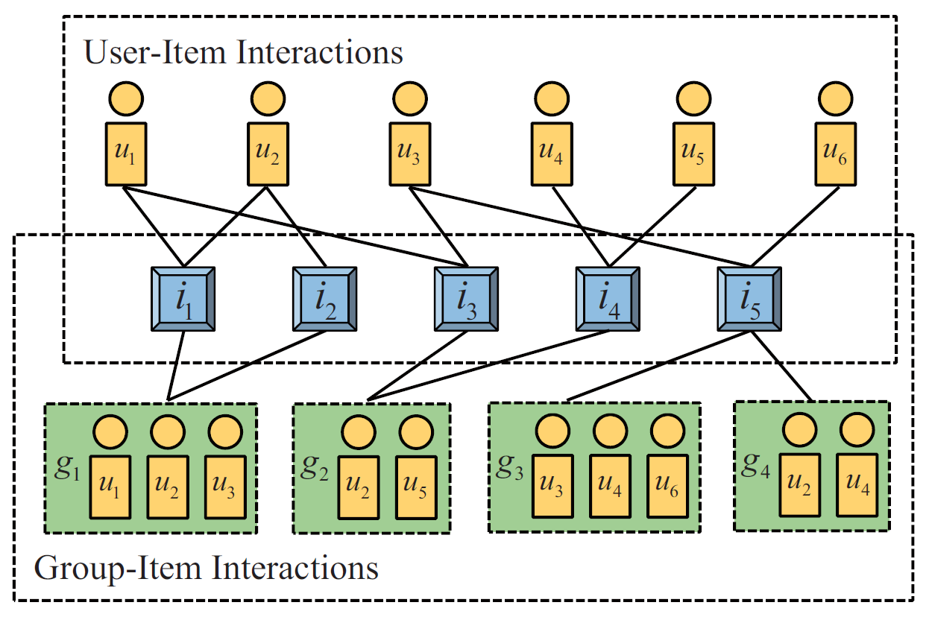
Problem formulation
Group-item interactions
User-item interactions
Group-user interactions

Slide 6
Proposed Methods
Group representation learning which represents a group based on its members aggregation and its general preference
Interaction learning with NCF which recommends items for both users and groups.

Slide 7
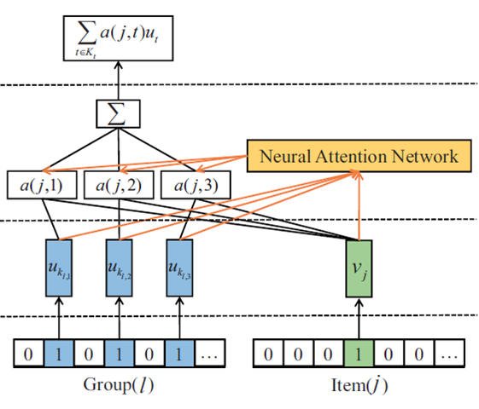
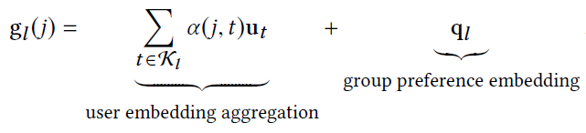
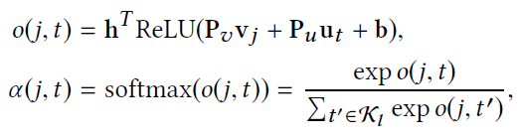
Group Representation Learning
Group representation:
Attention network:

Slide 8
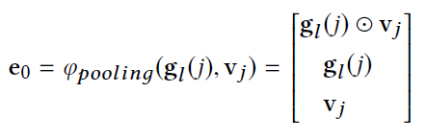
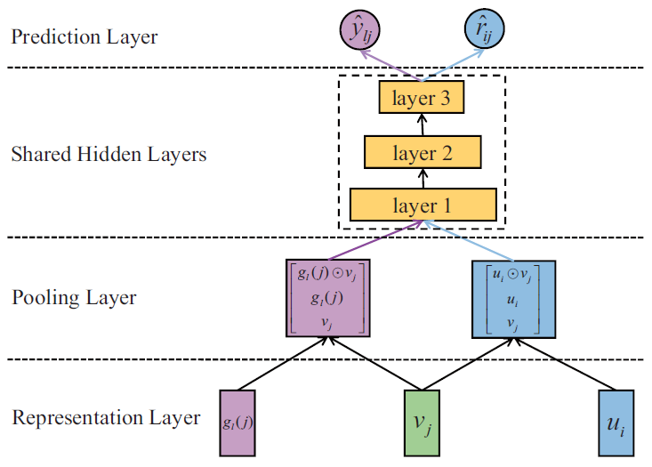
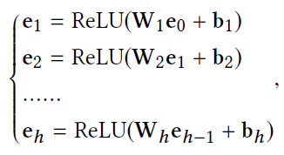
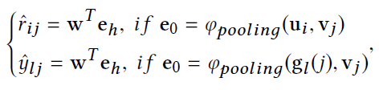


Interaction Learning with NCF
Pooling layer:
Shared hidden layer:
Prediction layer:
Optimization:

Slide 9
Experimental Setup
Two real-world datasets from Mafengwo and CAMRa2011:
Statistics of the evaluation datasets
Evaluation protocols:
Leave-one-out: randomly remove one interaction of each user for testing, and pair it with 100 negative samples.
Top-N evaluation
The ranked list are evaluated by Hit Ratio and NDCG.
Dataset | User# | Group# | Item# | User-Item Interactions | Group-Item Interactions
Mafengwo | 5,275 | 995 | 1,513 | 39,761 | 3,595
CAMRa2011 | 602 | 290 | 7,710 | 116,344 | 145,068

Slide 10
Baselines
State-of-the-art:
NCF [WWW 2017]
Popularity [RecSys 2010]
COM [SIGKDD 2014]
GREE [variance]
Aggregation strategies:
NCF+avg [average]
NCF+lm [least misery]
NCF+ms [maximum satisfaction]
NCF+exp [expertise]

Slide 11
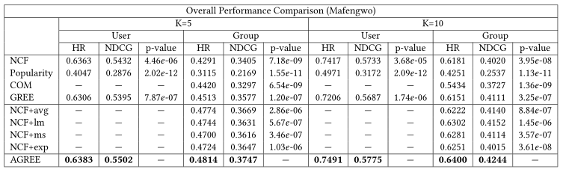
Overall Performance Comparison
AGREE achieves the best performance w.r.t. HR and NDCG when K=5 and K=10.
Neural network-based solutions (i.e., NCF, GREE, NCF+avg, NCF+lm, NCF+ms, NCF+exp, and AGREE) beat Popularity and COM.
There is no obvious winner among the score aggregation based solutions (i.e., NCF+avg, NCF+lm, NCF+ms, and NCF+exp).

Slide 12
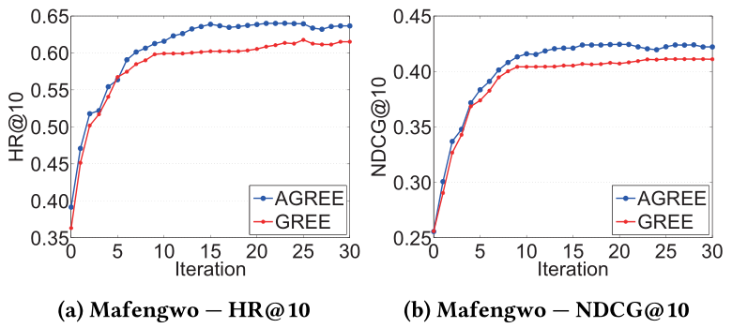
Effect of Attention
AGREE beats GREE w.r.t. both metrics.
AGREE and GREE converge rather fast, reach their stable performance around the 20th iteration.

Slide 13
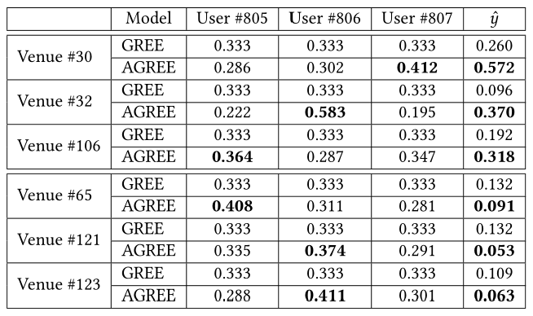
Effect of Attention
The attention weights of group members vary significantly in AGREE.
For positive venues (#30, #32, #106), the prediction scores of AGREE are larger than that of GREE and are closer to the target value of 1. For negative venues (#65, #121, #123), ….

Slide 14
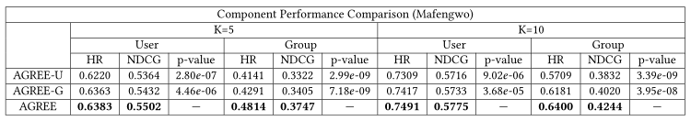
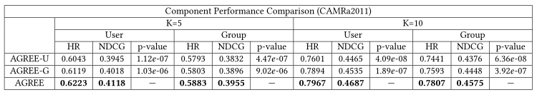
Importance of Components
AGREE consistently and significantly outperforms AGREE-U and AGREE-G on both datasets w.r.t. both metrics.
AGREE-G shows better performance that AGREE-U on both datasets w.r.t. both metrics.

Slide 15
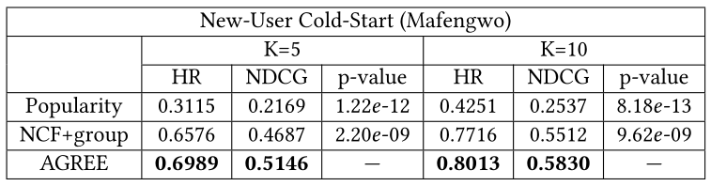
New-User Cold-Start
AGREE outperforms Popularity and NCF+group.
Personalized methods (AGREE and NCF+group) achieve preferable results as compared with non-personalized method (Popularity).

Slide 16
Conclusion and Future Work
We addressed the group recommendation problem under the neural network structure :
How to obtain a semantic representation for a group.
How to reinforce the recommendation performance of both group-item and user-item.
Experiments show promising results:
Overall performance comparison.
Effect of attention.
Importance of components.
New-user cold-start.
Future work:
The utility of social network.
Online learning.

Slide 17

Thanks!
Codes: https://github.com/LianHaiMiao/Attentive-Group-Recommendation

