Slide 1


STAR: croSs-plaTform App Recommendation
Da Cao, Xiangnan He, Liqiang Nie, Xiaochi Wei, Xia Hu, Shunxiang Wu, Tat-Seng Chua
This work was finished when Da Cao was a Ph.D. student in XMU and a visiting student in NUS.
Currently Da Cao is an assistant professor in HNU.
caoda0721@gmail.com
Submit: June 2016
Accepted: Nov 2016
Published: July 2017

Slide 2
Outline
Background
Proposed Method
Experiments and Results
Conclusion

Slide 3


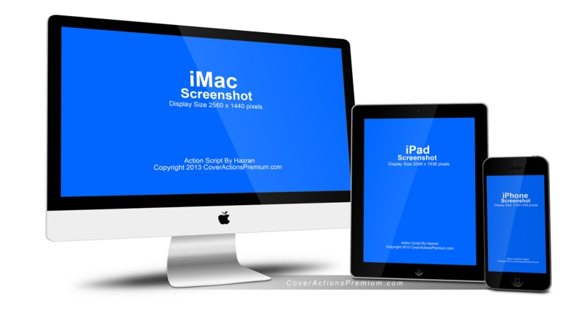

App Development
Mobile Network
App-Driven Life
Multi-Platform
Overwhelmed

Slide 4
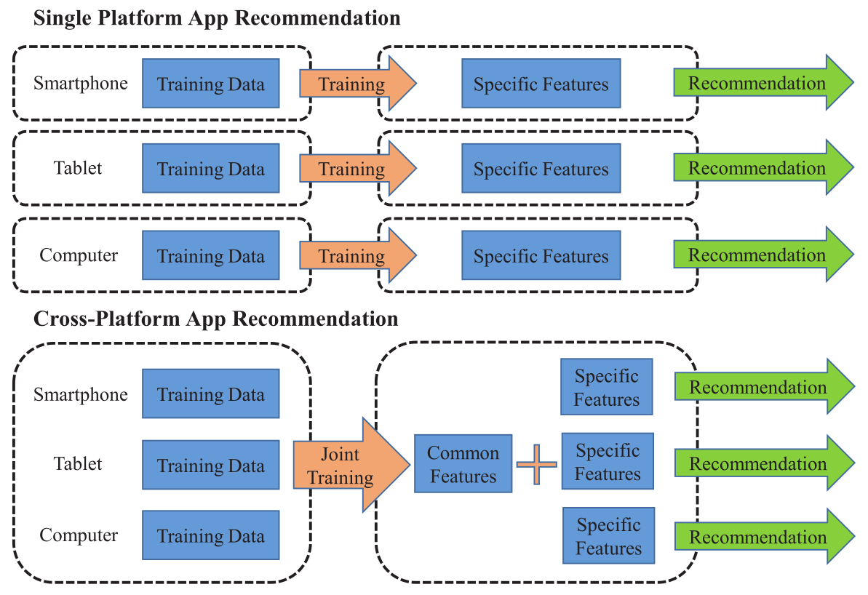


Two App Recommendation solutions
Who wins?
Single Platform
Cross-Platform
VS
Russia
Croatia

Slide 5
Challenges
Platform Variance
Data Heterogeneity
Data Sparsity
Cold-Start Problem

Slide 6
Outline
Background
Proposed Method
Experiments and Results
Conclusion

Slide 7


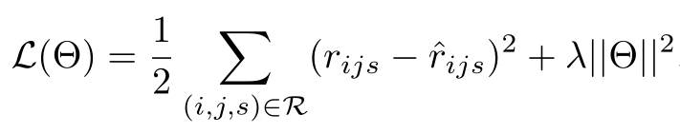
Proposed Method

Slide 8
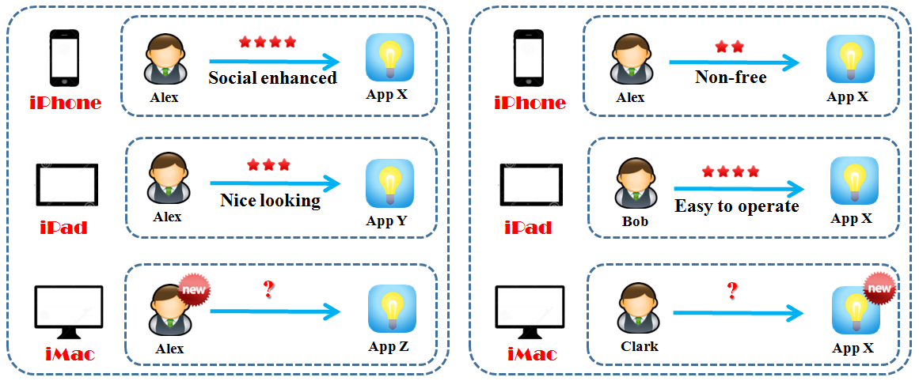
Cold-Start Problems
New-user cold-start
New-App cold-start
The question mark “?” stands for the ratings that we wish to predict, and the label “new” means the user or App is new to the platform and has no rating history on it.

Slide 9
Outline
Background
Proposed Method
Experiments and Results
Conclusion

Slide 10
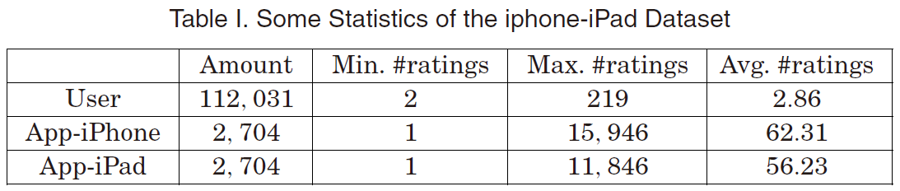
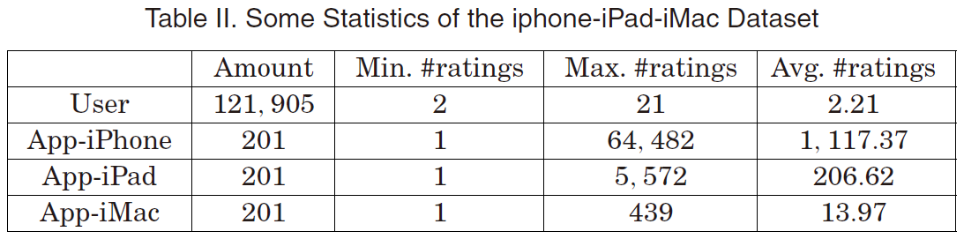
Dataset and Evaluation
Rating Prediction
MAE
RMSE
Top-N Recommendation
Recall
NDCG
We selected users who rated at least once on both of these platforms.
We selected users who had at least two ratings on all platforms.

Slide 11
Research Questions
(RQ1). How does STAR perform as compared to other state-of-the-art competitors?
(RQ2). How is the performance of STAR in handling the new-user and new-App cold-start problems?
(RQ3). Whether the rated App on current platform is the user's preferable one as compared to the same App on other unrated platforms?
(RQ4). How do the common features and specific features of Apps contribute to the overall effectiveness of STAR?
(RQ5). In addition to rating prediction that is prevalent to a recommendation algorithm, how does STAR perform in the more practical top-N recommendation?

Slide 12
Baseline Methods
SVD++ [Koren 2008] (Collaborative Filtering)
RMR [Ling et al. 2014] (Semantics Enhanced Recommendation)
CTR [Wang and Blei 2011] (Semantics Enhanced Recommendation)
FM [Rendle et al. 2011] (Context-Aware Recommender System)
CMF [Singh and Gordon 2008] (Cross-Domain Recommender System)
WMF [Hu et al. 2008] (Collaborative Filtering)
Popular (Non-personalized method)

Slide 13
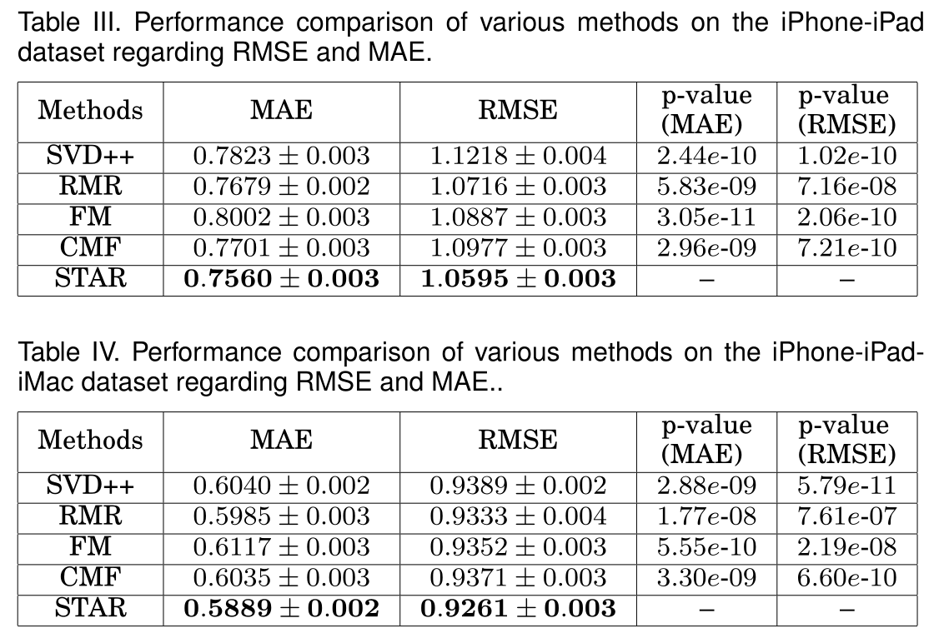
Overall Performance Comparisons (RQ1)

Slide 14
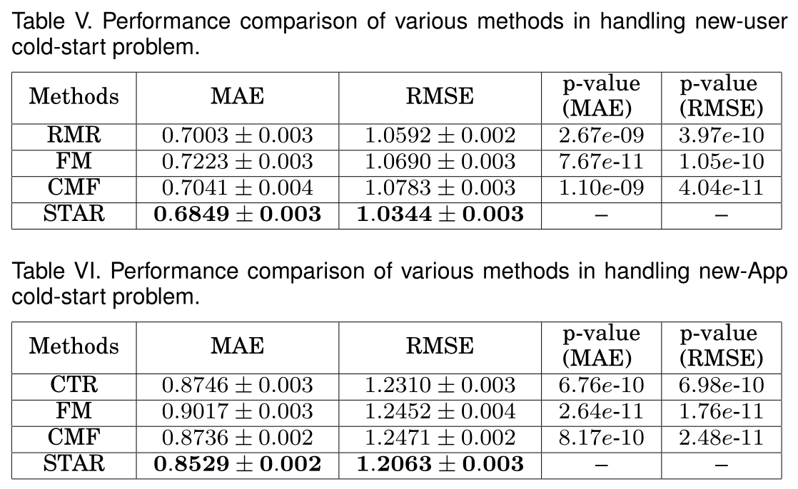
Handling Cold-Start Problems (RQ2)

Slide 15
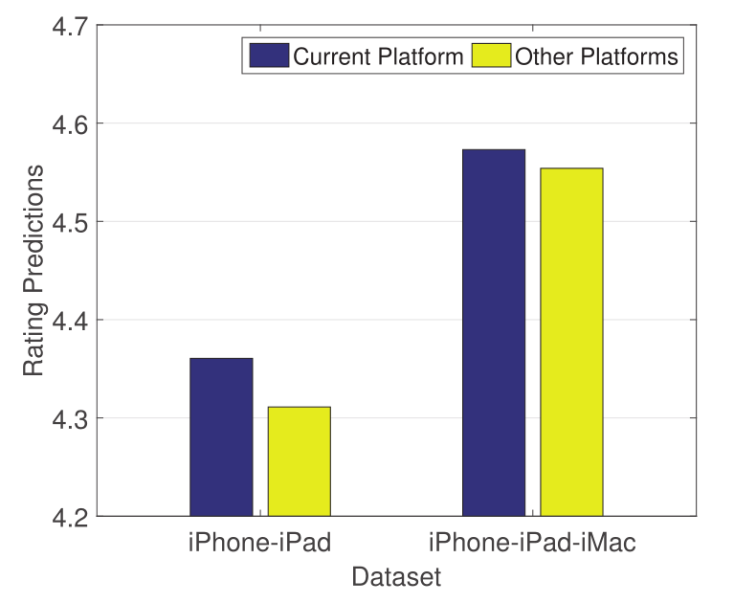
User Preference on App-Platform (RQ3)
Our method favors the current platform better.
The gap between rating predictions of current platform and other platforms on the iPhone-iPad dataset is larger than that of the iPhone-iPad-iMac dataset.

Slide 16
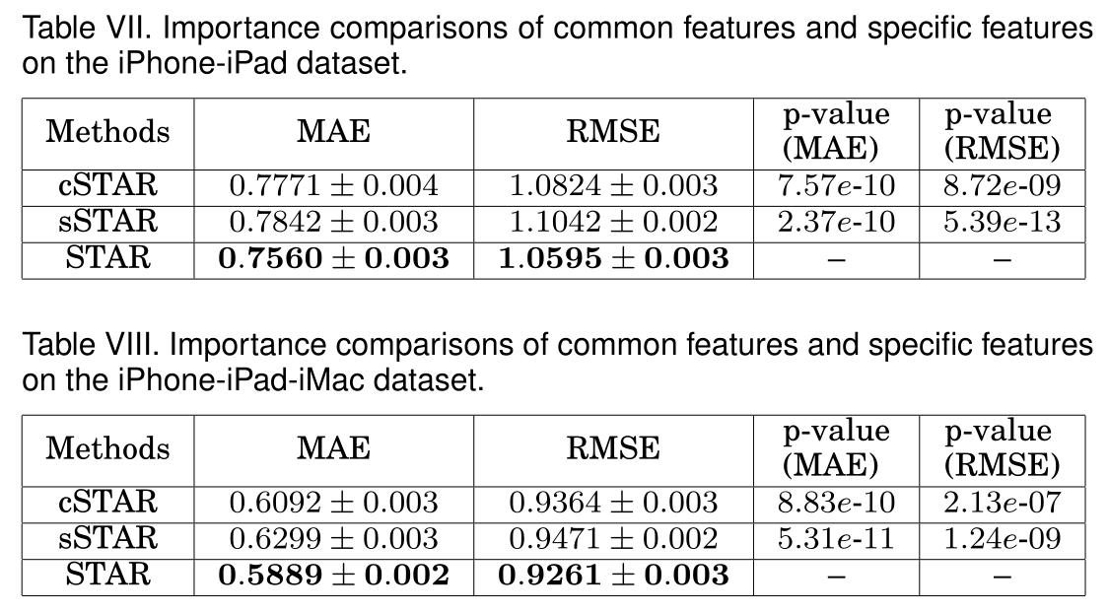
Justification of Common Features and Specific Features (RQ4)

Slide 17
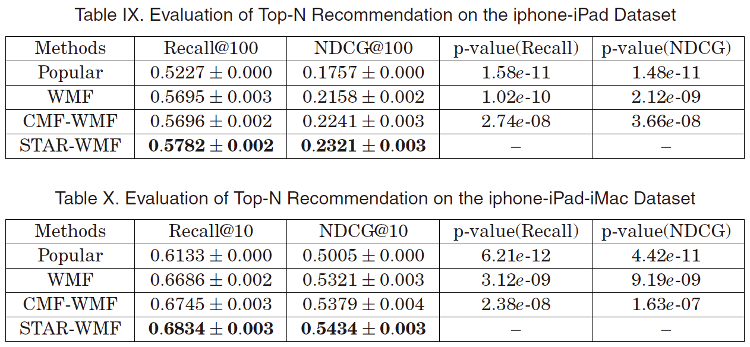
Evaluation of Top-N Recommendation (RQ5)

Slide 18
Outline
Background
Proposed Method
Experiments and Results
Conclusion

Slide 19
Challenges Solved
Platform Variance
Data Heterogeneity
Data Sparsity
Cold-Start Problem

Slide 20
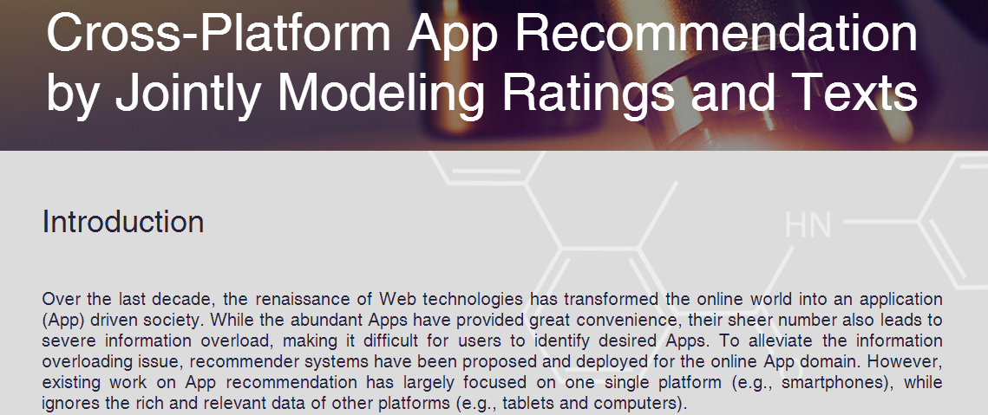
Website
Data & code are available at http://apprec.wixsite.com/star

Slide 21






Thanksgiving
Co-authors:
Xiangnan He
(NUS)
Liqiang Nie
(SDU)
Xiaochi Wei
(BIT)
Xia Hu
(Texax A&M)
Shunxiang Wu
(XMU)
Tat-Seng Chua
(NUS)
And all audiences…

