Slide 1




Estimation–Action–Reflection:
Towards Deep Interaction Between Conversational and Recommender Systems
Wenqiang Lei, Xiangnan He, Yisong Miao, Qingyun Wu, Richang Hong, Min-Yen Kan, Tat-Seng Chua
{wenqianglei, xiangnanhe}@gmail.com (they planned to be here)
WSDM’2020 Houston Feb’04 USA

Slide 2

The Position of Conversational Recommendation System(CRS)—Bridging Recommendation System and Search
Traditional methods for user to get an item:
Search or Recommendation
Search:
User's Intention is totally clear
Conversational Recommendation:
Try to induce user preference through conversation!
Recommendation:
User's Intention is totally unclear

Slide 3


What is Conversational Recommendation?
I want a new phone.
What operating system do you want?
iOS
What about the latest iPhone 11?
No, too expensive.
Do you want all screen design with FaceID?
Yes!
Do you want more color options? Red, blue?
Red is great option
iPhone XR Red with 128GB is a real bargain!
Nice! I will take it!
Asking attribute
Attempt to recommend
Reflect on why user reject recommended items?
Asking attribute
Asking attribute
Attempt to recommend
User accept, conversation terminates.

Slide 4
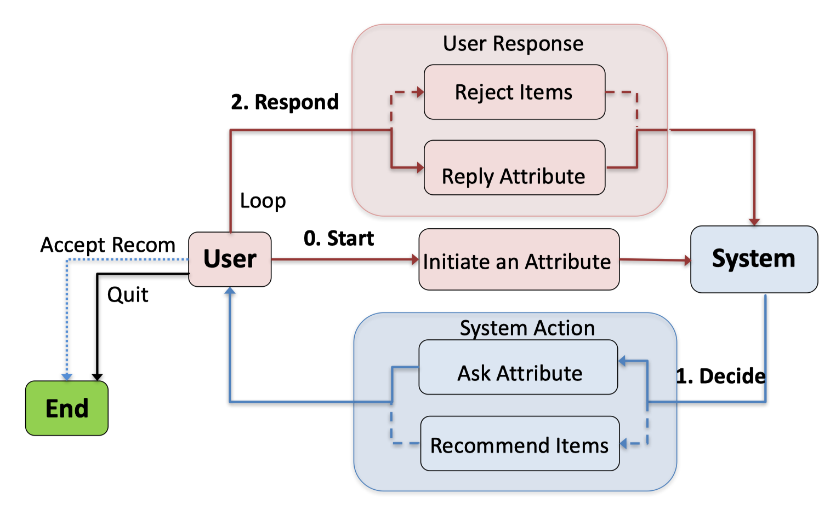
Workflow of Multi-round Conversational Recommendation Scenario
Objective:
Accurately recommend item to user in shortest turns

Slide 5
Overview: EAR- Estimation, Action, Reflection Deep interaction among CC(Conversation System) and RC (Recommendation System)
Ranked item and attributes
Rejected items
Estimation
Action
Reflection
Adjust the estimation for the user
Estimation:
What item to recommend, what attribute to ask?
Action:
What’s the good strategy to interact with user.
Reflection:
When user rejects list of recommendation, the RC adjusts its estimation for user.

Slide 6
Estimation Stage — Item Prediction
1000 candidates remains
I'd like some Italian food.
Got you, do you like some Pizza?
Yes!
Got you, do you also want some nightlife?
Yes!
250 candidates remains
95 candidates remains

Slide 7
Estimation Stage — Attribute Prediction
1000 candidates remains
I'd like some Italian food.
Got you, do you like some Chinese food?
No!
Got you, do you also want some ? ?
___?___
1000 candidates remains.
Waste a turn!
_?_ candidates remains

Slide 8
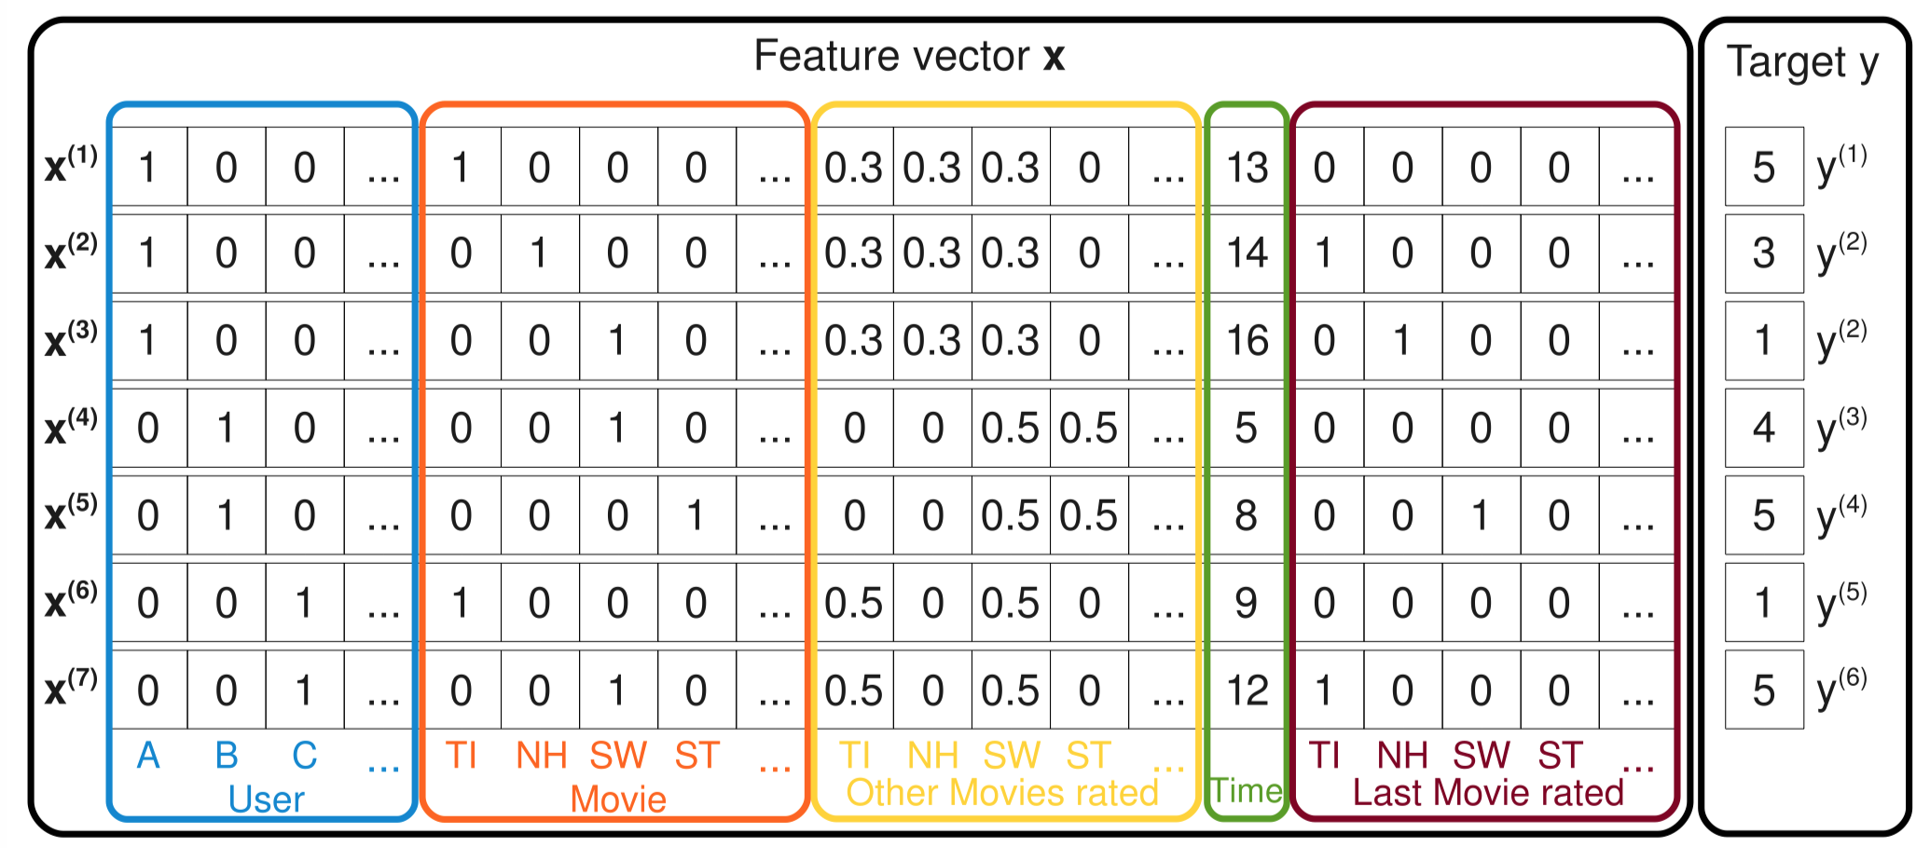
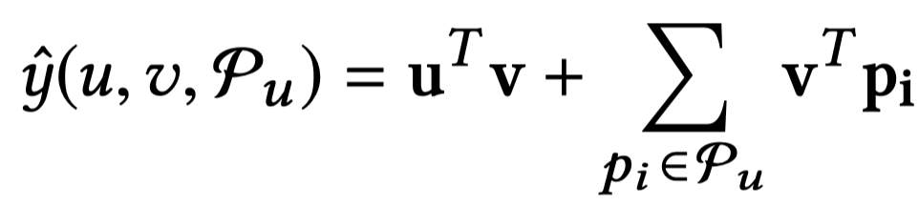
Preliminary - FM (Factorization Machine)
De Facto Choice for Recommender System
A framework to learn embedding in a same vector space.
Capture the interaction between vectors by their inner product.
Co-occur, similar.
Notation | Meaning
u | User embedding
v | Item embedding
P_u={p_1,p_2,…, p_n} | Known user preferred attributes in current conversation session.
Score Function to decide how likely user would like an item:

Slide 9
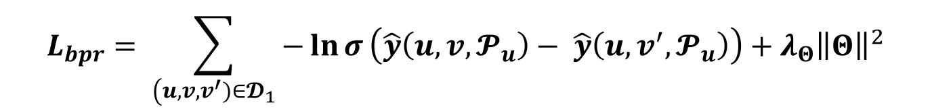
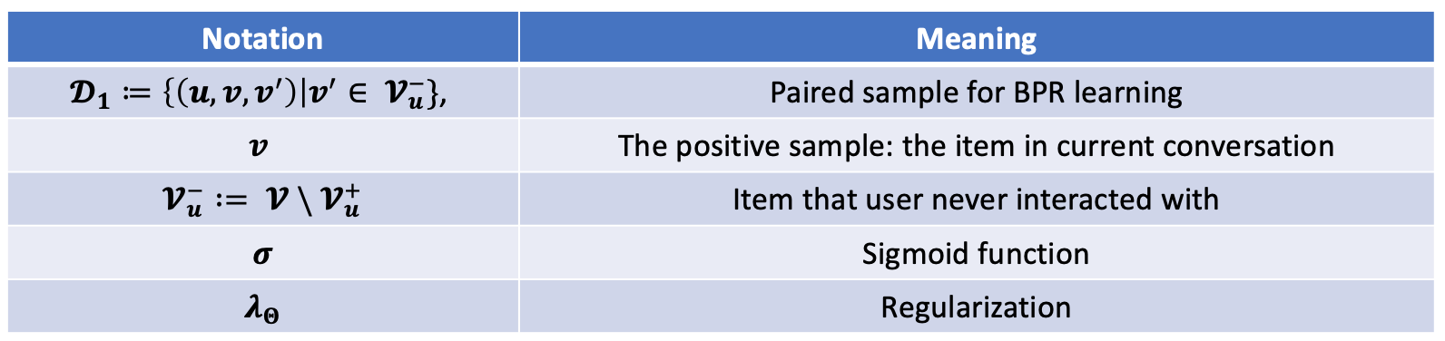
Method: Bayesian Personalized Ranking
Positive sample
Negative sample

Slide 10
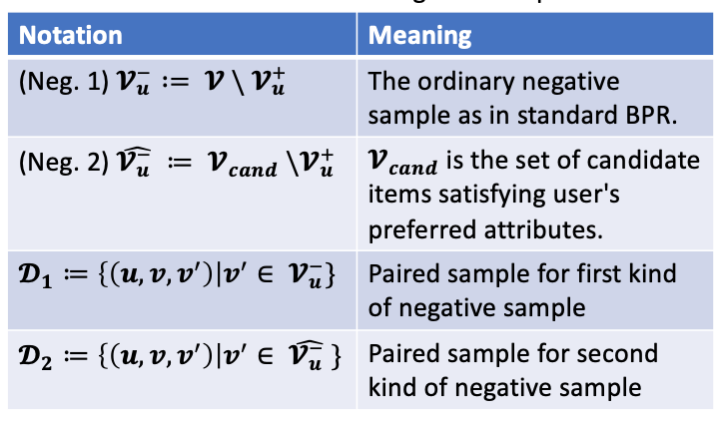
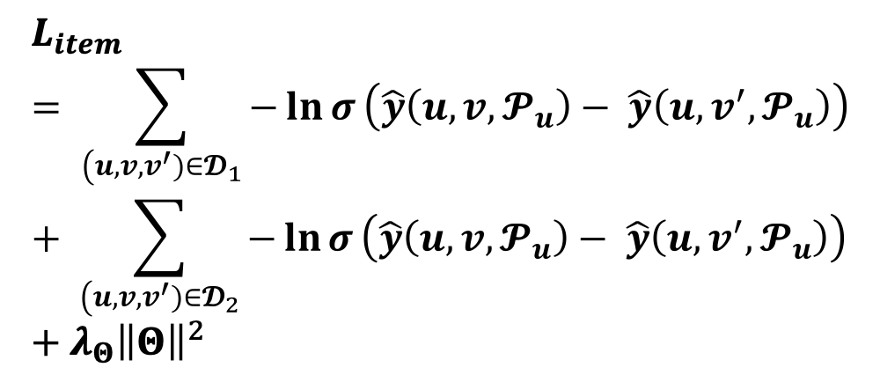
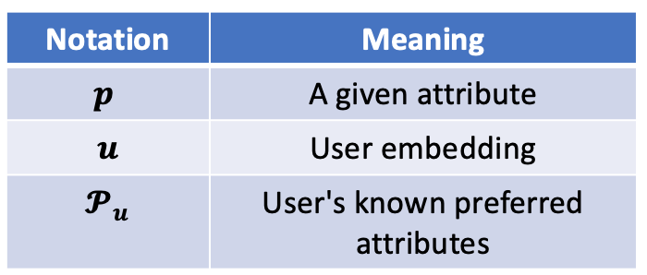
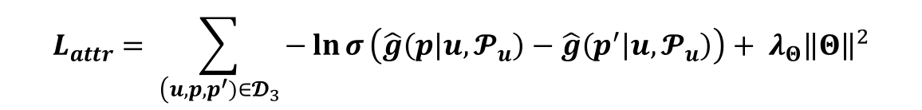
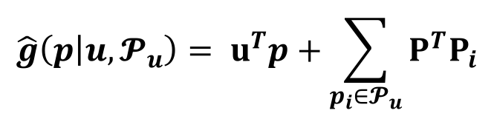
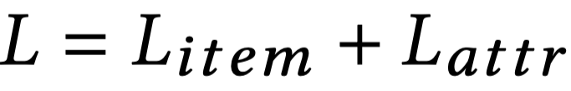
Method: Attribute-aware BRP for Item Prediction and Attribute Preference Prediction
Score function for
attribute preference prediction
Multi-task Learning
Note: We use information gathered by CC(conversation part) to enhance the RC!

Slide 11
Action stage: Strategy to Ask and Recommend?
This time, I try to recommend more earlier...
1000 candidates remains
I'd like some Italian food.
Got you, do you like some pizza?
Yes!
Got you, do you like some nightlife?
Yes!
Try to recommend 10 items!
Rejected!
Got you, do you like some Wine?
Yes!
Try to recommend 10 items!
Accepted!
800 candidates remains
600 candidates remains
Should recommend?
600candidates remains
70 candidates remains
Should recommend?
Target item rank 6 / 10

Slide 12
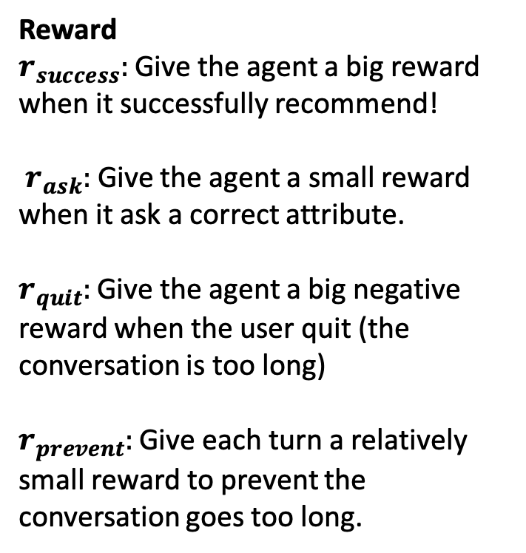
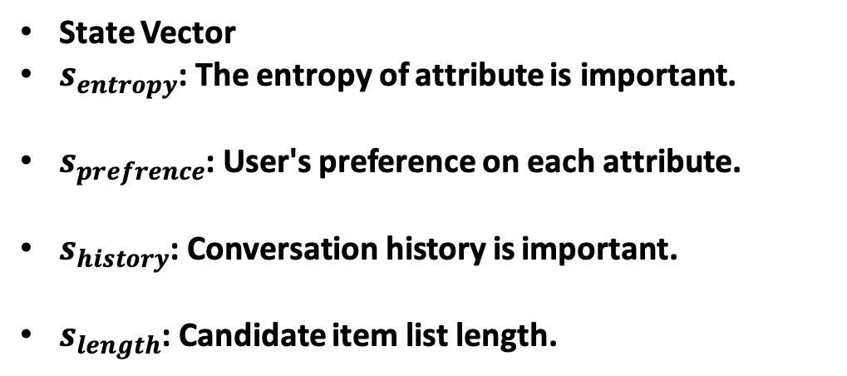

Method: Strategy to Ask and Recommend? (Action Stage)
We use reinforcement learning to find the best strategy.
policy gradient method
simple policy network of 2-layer feedforward network
Note: 3 of the 4 information come from Recommender Part
Action Space:

Slide 13
Reflection stage: How to Adapt to User's Online feedback?
This time, I try to recommend more earlier...
1000 candidates remains
I'd like some Italian food.
Got you, do you like some pizza?
Yes!
Got you, do you like some nightlife?
Yes!
Try to recommend 10 items!
Rejected!
250 candidates remains
95candidates remains
Should recommend?
Adjust estimation

Slide 14
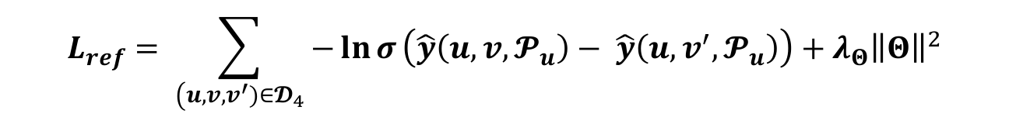
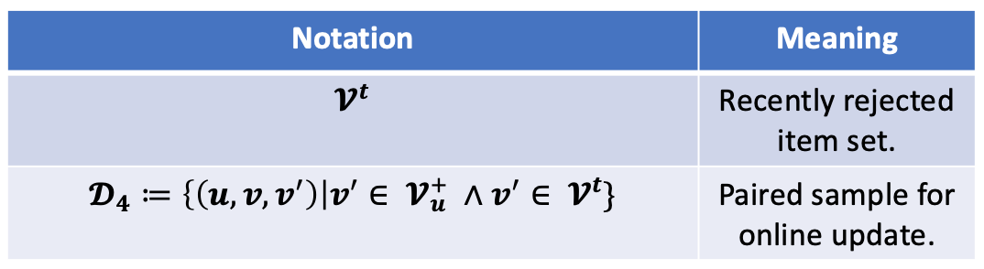
Method: How to Adapt to User's Online Feedback? (Reflection stage)
Solution: We treat the recently rejected 10 items as negative samples to re-train the recommender, to adjust the estimation of user preference.

Slide 15
Experiment setup (1) — User simulator

Slide 16
Experiment setup (2) - Dataset Collection
Dataset Description
Dataset | #user | #item | #interactions | #attributes
Yelp | 27,675 | 70,311 | 1,368,606 | 590
Last.FM | 1,801 | 7,432 | 76,693 | 33
Why we need to create our own dataset?
There’s no existing datasets specially for CRS.
Datasets of previous work has too few attributes for real-world applications.
How we create dataset?
Standard pruning operation (user / item has < 5 reviews)
For Last.FM, we build 33 binary attributes for Last.FM (e.g. Classic, Popular, Rock, etc…)
For Yelp, we build 29 enumerated attributes on a 2-level taxonomy over 590 original attributes.

Slide 17
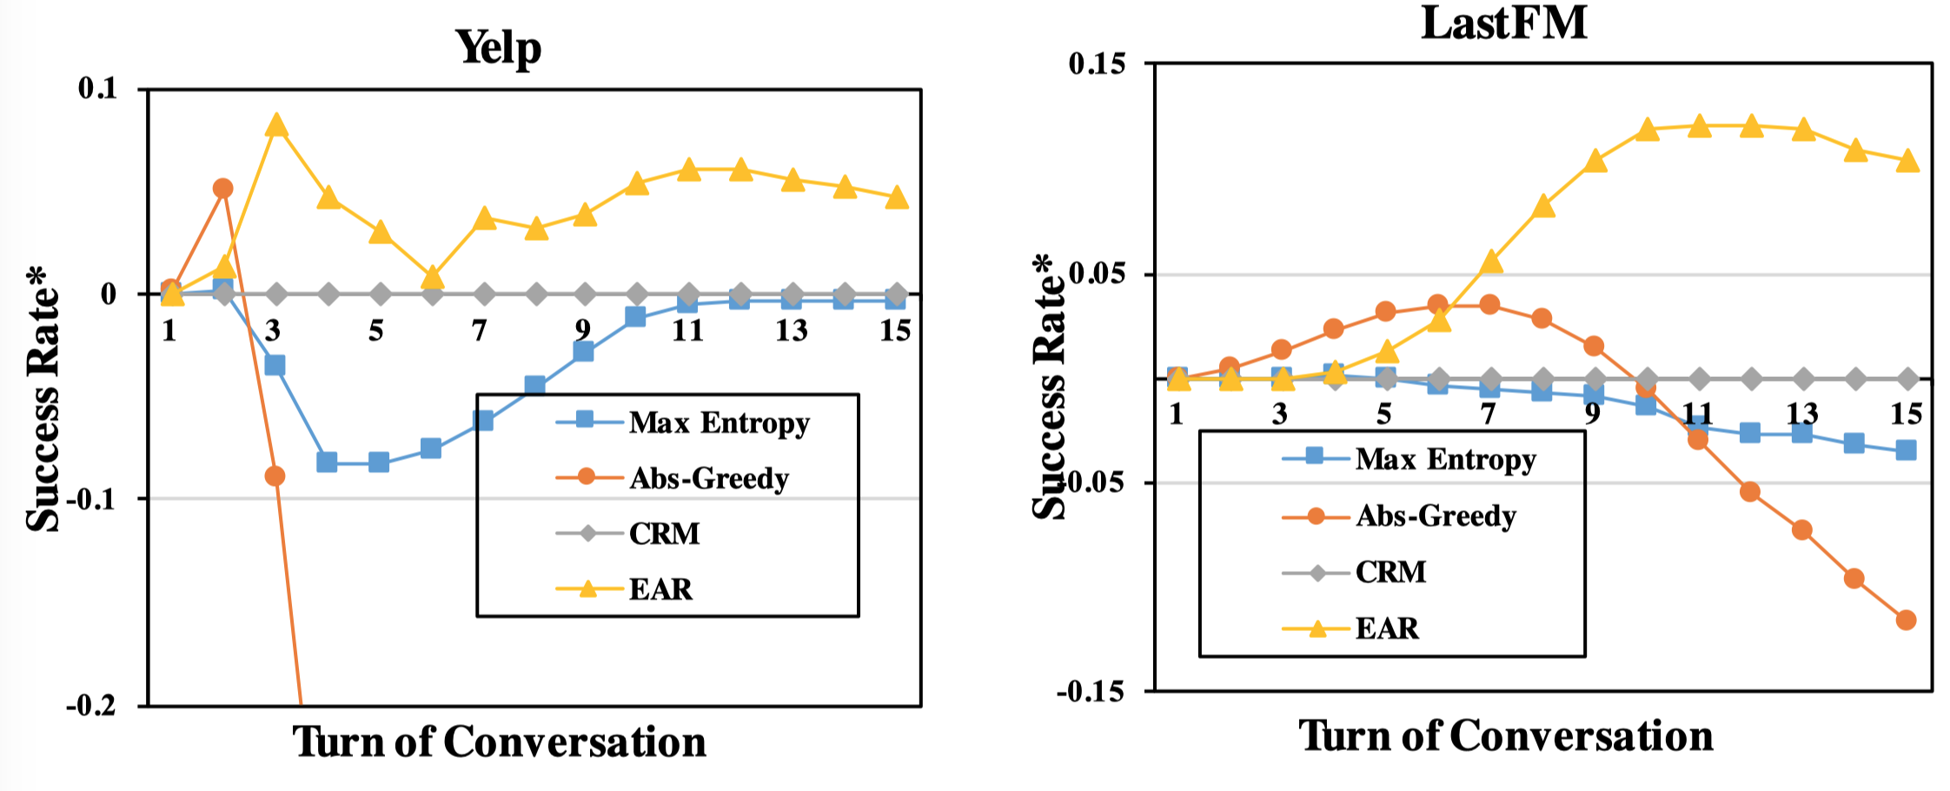
Main Experiment Results
Evaluation Matrices:
SR @ k (Success rate at k-th turn)
Enumerated Question
Binary Question

Slide 18
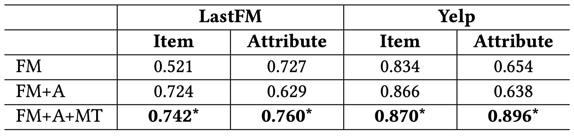
Experiment Results – Estimation Stage Item and Attribute Prediction
The offline AUC score of prediction of item and attributes
Standard FM model,
FM + A (attribute aware item BPR)
FM + A + MT (Multitask learning)

Slide 19
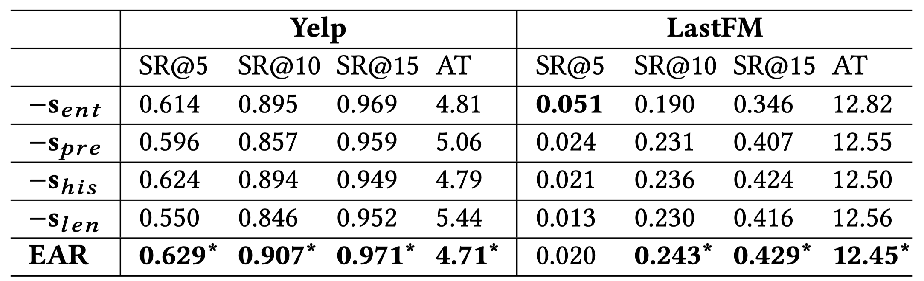
Experiment Results – Action stage
Strategy to Ask and Recommend?
entropy seems to be the most important component.

Slide 20
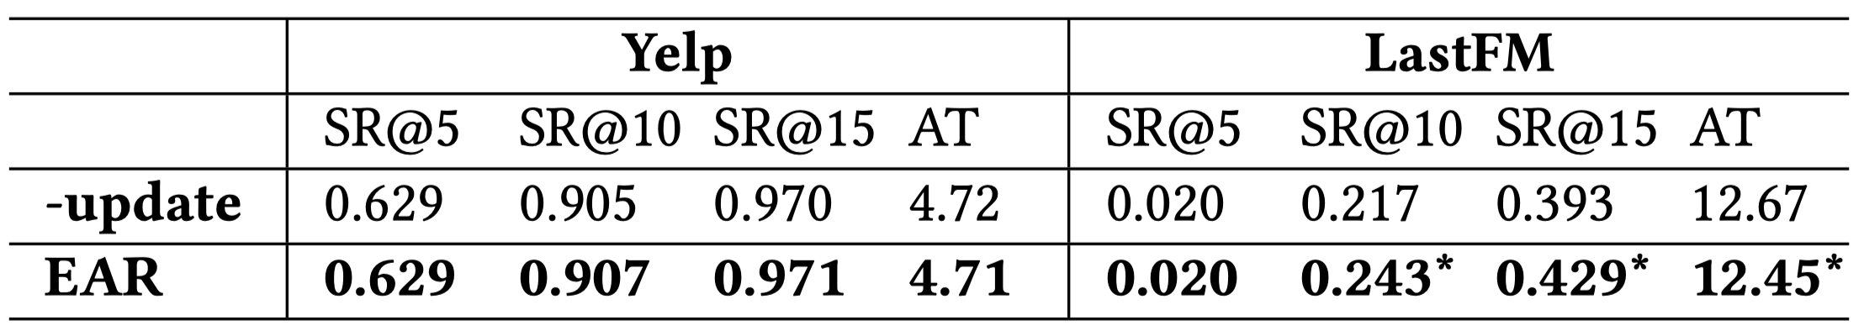
Experiment Result: Reflection Stage
How to Adapt to User's Online Feedback?

Slide 21
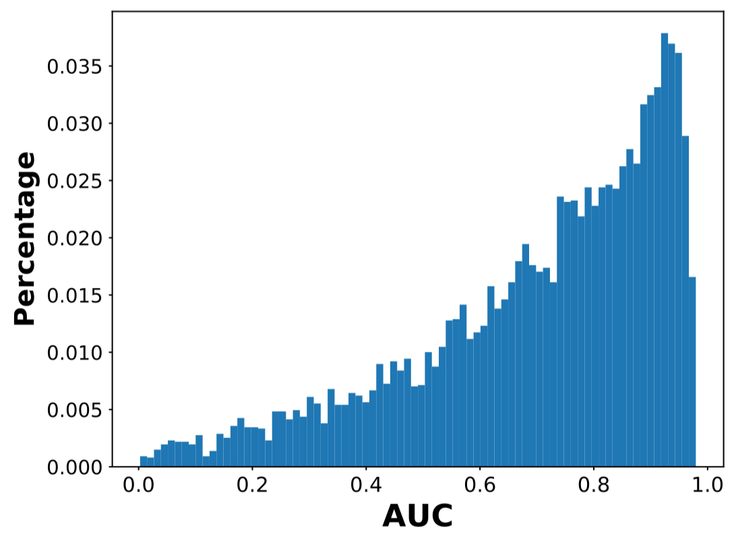
Experiment Result: Reflection Stage
How to Adapt to User's Online Feedback?
Yelp Dataset “Bad update” (target ranking drops)

Slide 22
Conclusion and Future Works
We formalize the task of multi-turn conversational recommendation system (CRS).
We refine the recommendation system in a conversational scenario for both item prediction and attribute prediction.
We proposes a three-stage solution EAR for CRS, outperforming state-of-the-art baselines.
We plan to do online evaluation and obtain real-world exposure data by collaborating with E-commerce companies.

Slide 23
Thank you!

Slide 24
Spare Slides

Slide 25
References
Towards Deep Conversational Recommendations. Raymond Li, Samira Ebrahimi Kahou, Hannes Schulz, Vincent Michalski, Laurent Charlin, and Chris Pal. NIPS. 2018
Knowledge-aware Multimodal Dialogue Systems. Lizi Liao, Yunshan Ma, Xiangnan He, Richang Hong, and Tat-Seng Chua. ACMMM 2018
Q&R: A Two-Stage Approach toward Interactive Recommendation. Konstantina Christakopoulou, Alex Beutel, Rui Li, Sagar Jain, and Ed H Chi.. SIGKDD 2018
Towards conversational search and recommendation: System ask, user respond. Yongfeng Zhang, Xu Chen, Qingyao Ai, Liu Yang, and W Bruce Croft. CIKM 2018
Conversational Recommender System. Yueming Sun and Yi Zhang. SIGIR 2018
An Visual Dialog Augmented Interactive Recommender System. Tong Yu, Yilin Shen, and Hongxia Jin. SIGKDD 2019

Slide 26
Importance of this research project
The Importance of CRS (Conversational Recommendation System):
Overcome the limitation of traditional static recommender systems, thus improve user’s satisfaction and bring revenue for business!
Embrace recent advances in conversation technology.
The Advances Brought By Our Work:
We’re the first to consider a realistic multi-round conversational recommendation scenario.
Unifying CC(Conversation Component) and RC(Recommender Component), and propose a novel three-staged solution EAR.
We build two datasets by simulating user conversations to make the task suitable for offline academic research.

Slide 27
Literature Review (1)
Static Traditional Recommendation Systems:
- Collaborative Filtering
- Matrix Factorization
- Factorization Machine
- etc...
Limitation 1:
- Offline: learn from user history data, so can only mimic user's history preference.
Limitation 2:
- User cannot explicit tell system her preference.
- System cannot leverage user's feedback.
Existing online recommendation methods (bandit):
epsilon-greedy
Thompson-Sampling
Upper Confidence Bound (UCB)
Linear-UCB
Collaborative UCB...
Limitation:
Can only attempt to recommend items, cannot ask attributes of item
The mathematics formulation of bandit restricts it to only recommend 1 item each turn.

Slide 28
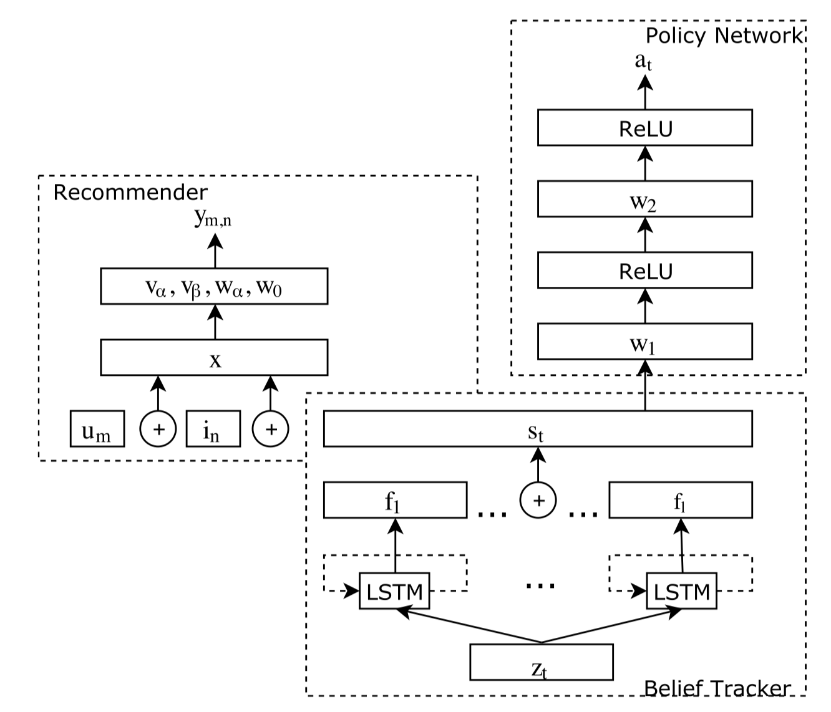
Literature Review (2)
Towards Conversational Recommendation — Sun et.al. SIGIR 2018
Limitation:
Can only recommend for 1 time. The session will end regardless of success or not.
Recommender Component and Conversation Component are isolated part.
Simply taking belief tacker as input for action decision.
Interaction?
Screenshot from SIGIR 2018, Towards Conversational Recommendation

