Slide 1

NUS-Tsinghua Centre for Extreme Search A Joint Research Collaboration Between NUS & Tsinghua University
TEM: Tree-enhanced Embedding Model for Explainable Recommendation
Dr. HE Xiangnan (何向南)
National University of Singapore
31 May 2018 @ Microsoft
Work appeared in WWW 2018.
© Copyright NExT++. All Right Reserved.
Notes:
Good afternoon everyone, welcome to my presentation --- TEM: tree-enhanced embedding model for explainable recommendation. I’m the presenter, Wang Xiang, from National University of Singapore.

Slide 2




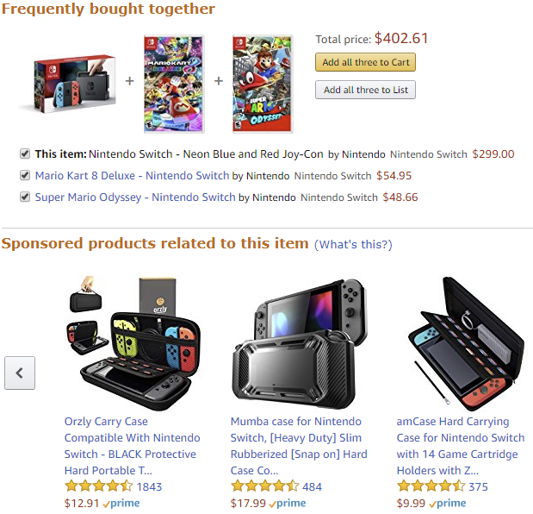

Value of Recommender Systems (RS)
Amazon: 35% sales from recommendations
Netflix: 80% TV shows discovered are recommended
Google News: RS generates 38% more click-through
Notes:
In the age of information explosion, recommender systems play a crucial role in alleviating information overload, and have been widely adopted in many online services, like online shopping, web content sharing, and social networking.

Slide 3
Trade-off of Accuracy & Explainability
Embedding-based Models
Our Goal:
Explainable: be transparent in generating a recommendation & can identify the key rules for a prediction
Accurate: achieve the same level or comparable performance as embedding-based methods
Notes:
However, one fundamental trade-off in RS is that of accuracy & explainability.
As we can see, the deep learning components used in RS boost the recommendation accuracy, but hurt the explainability adversely.
In this work, we aim to fill the research gap by developing a recommendation solution that is both accurate and explainable.
By explainable, we expect our system to be …
By accurate, we expect our system to …
Towards this end, we propose a novel solution named Tree-enhanced Embedding Method (TEM), which combines embedding-based methods with decision tree-based approaches.

Slide 4
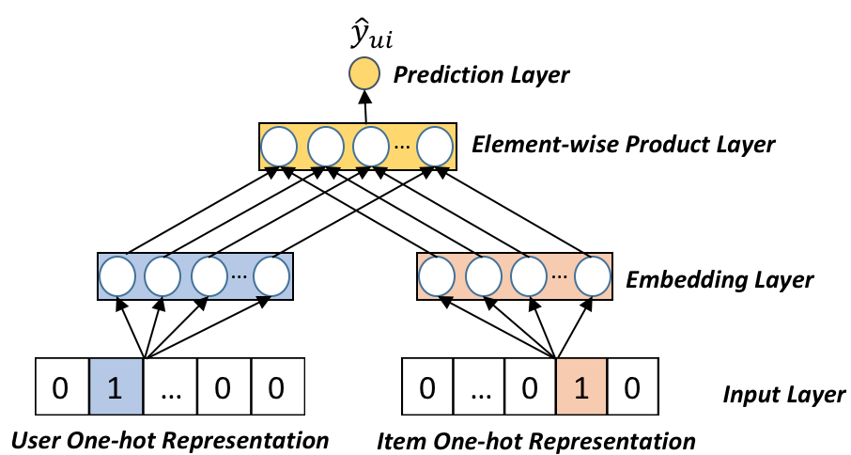

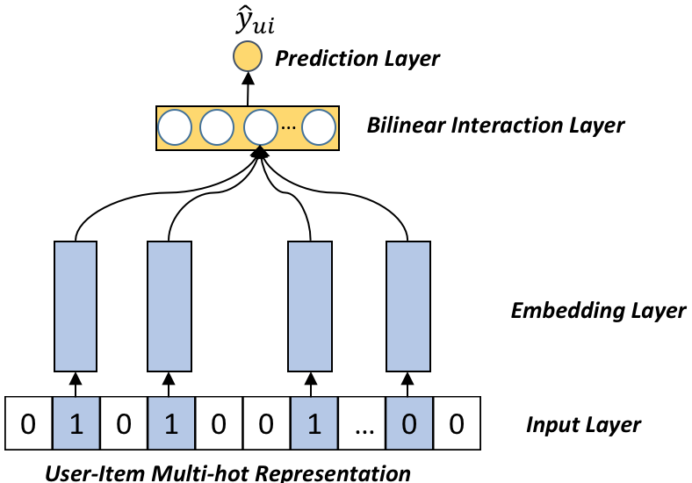

Embedding-based Models
Embedding-based Models: Learn latent factors for each feature (IDs & side Info)
Matrix Factorization (MF)
Input: user ID, item ID
Interaction: Inner Product
Items
1 | 0 | 0 | 1
0 | 1 | 0 | 0
1 | 1 | 0 | 0
1 | 0 | 0 | 1
Users
Factorization Machine (FM)
Input: user ID, item ID, side features ID
Interaction: Element-wise Product
User-Item Interactions
Neural Network Methods
NCF, Deep Crossing, Wide&Deep, DIN, NFM
Notes:
CF is the core component of existing RS, simply assuming similar users tend to have similar preferences on items.
Embedding-based CF predicts users’ interests by modeling latent factor for each features and learning interaction functions.
Matrix factorization and Factorization machine are the simplest but effective CF models.

Slide 5
Explainable Recommendation
Recommended List:
ŷ_{u3} = 0.9
ŷ_{u1} = 0.7
ŷ_{u5} = 0.3
ŷ_{u2} = 0.2
Why did RS recommend it?
Why not something else?
How do I correct an error?
Items
1 | 0 | 0 | 1
0 | 1 | 0 | 0
1 | 1 | 0 | 0
1 | 0 | 0 | 1
Users
Black-box Model
End User/ Data Scientist
Recommended Reason
Users of <City: SG, Age: 18-25, Style: Sci-Fi> like items of <Price: $$, Attribute: Science> …
I understand why
I understand why not
I know how to correct RS
User-Item Interactions
Explainable Model
End User/ Data Scientist
Transparency, Trust, Explainability, Scrutability
Notes:
While CF has achieved strong predictive performance, it works as a black-box that only can provide the predictive scores without any explanations about why the target item is suitable for the user.
The end users want to know: why …
Hence an explainable RS is desired, which can provide an explanation accompanying the recommendation.
Such explanations can serve one or more purposes, such as making the system transparent to the users, increasing users’ confidence in the system, persuading users to act on the recommendation, or correct the system to make predictions more accurately.

Slide 6
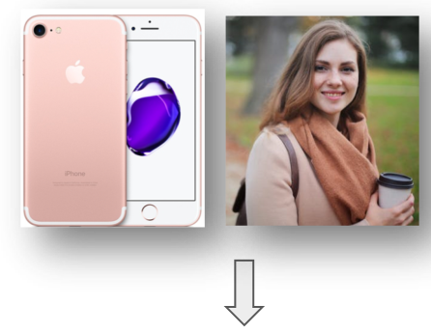
Cross Features
Cross Feature: combinatorial feature that crosses (or multiplies) multiple individual input features.
Why?
Higher-order feature interactions: e.g., [Age * Occupation *Gender]
Explicit decision rules
Users of <Gender=female & Age=20-25 & Income Level=$8,000> tend to adopt items of <Color=Pink & Product=Apple>.
Notes:
We first review the embedding-based CF methods.
Here we list several state-of-the-art approaches, such as Neural CF, wide&deep, and Neural FM.
As these methods embed each user and item into a latent factor, they have strong expressiveness, especially for neural network methods, capturing the higher-order feature interactions, and they can easily generalize to unseen user-item interactions.
However, due to the complex architecture of hidden layers, they lack necessary reasoning or explanations for a recommendation; their explanation mechanism is either … or …
We argue that such similarity-based explanations are too coarse-grained and insufficient to convince users on a rec.

Slide 7
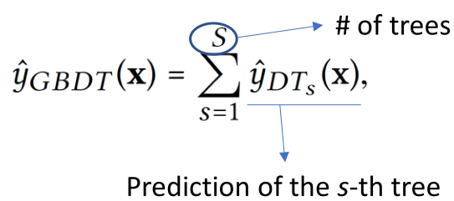
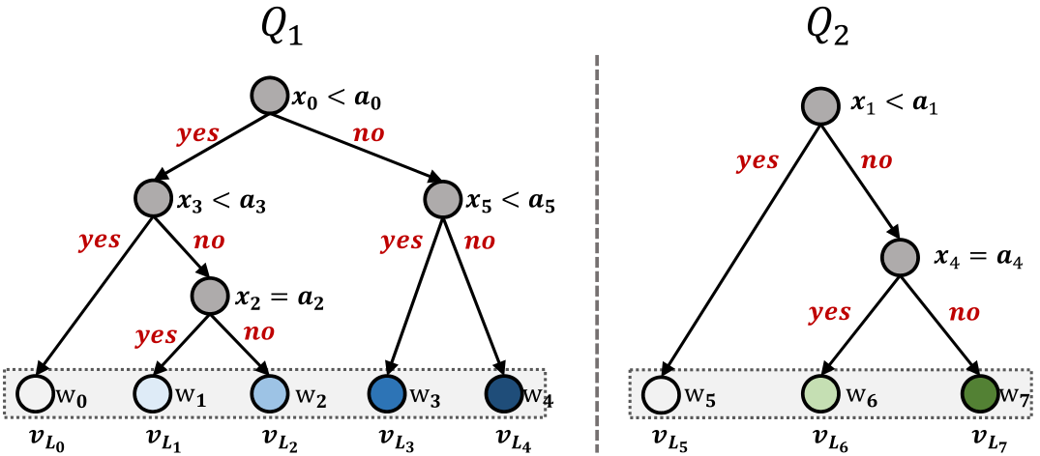
Tree-based Methods
Decision Tree (DT):
Each node splits a feature variable into two decision edges based on a value.
A path from the root to a leaf -> a decision rule (like a cross feature).
The leaf node -> the prediction value.
Forest (ensemble of trees)
Since a single tree may not be expressive enough, a typical way is to build a forest, i.e., an ensemble of additive trees
Notes:
On the other hand, tree-based methods, such as decision trees, do not learn latent features for a prediction. Instead, they perform prediction by learning decision rules from data.
We represent the structure of a tree model as the figure shows, where the nodes have three types: the root, the internal (known as decision), and the leaf nodes. Each decision node splits a feature variable into two decision edges.
A path from the root node to a leaf node forms a decision rule, which can also be seen as a cross feature.

Slide 8
Tree-based vs. Embedding-based Model
Tree-based Model (e.g., GBDT) | Embedding-based Model (e.g., DNN, FM)
+ Strong at continuous features | + Strong at categorical features
+ Explainable | - Blackbox
+ Low serving cost | - High serving cost
- Weak generalization ability to unseen feature combinations. | + Strong generalization ability to unseen feature combinations.
Why not combining the strengths of the two types of models?
Notes:
Recall that we propose to combine the strengths of embedding-based CF methods and tree-based methods.
To help you understanding the model, we introduce the framework from bottom to top.

Slide 9
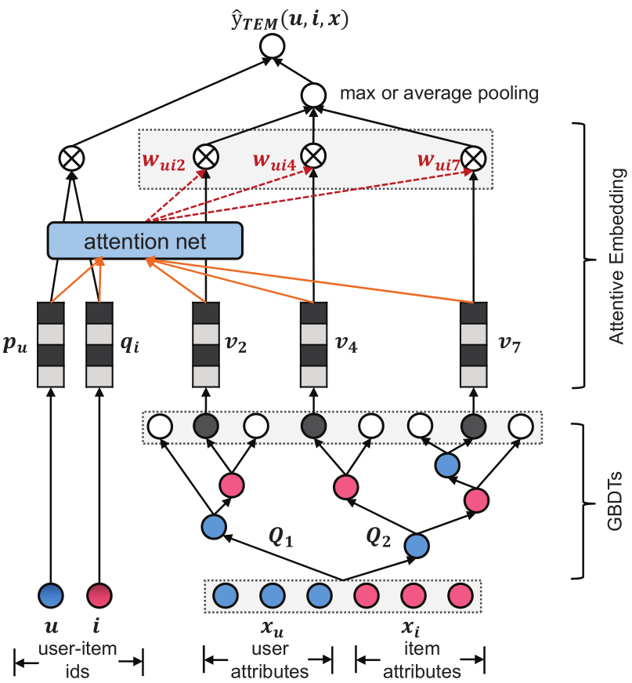
Tree-enhanced Embedding Model
Concrete Reasons: Explicitly discover effective cross features from rich side information of users & items
Explicit Decision Process: Estimate user-item matching score in an explainable way
Notes:
Recall that we propose to combine the strengths of embedding-based CF methods and tree-based methods.
To help you understanding the model, we introduce the framework from bottom to top.

Slide 10
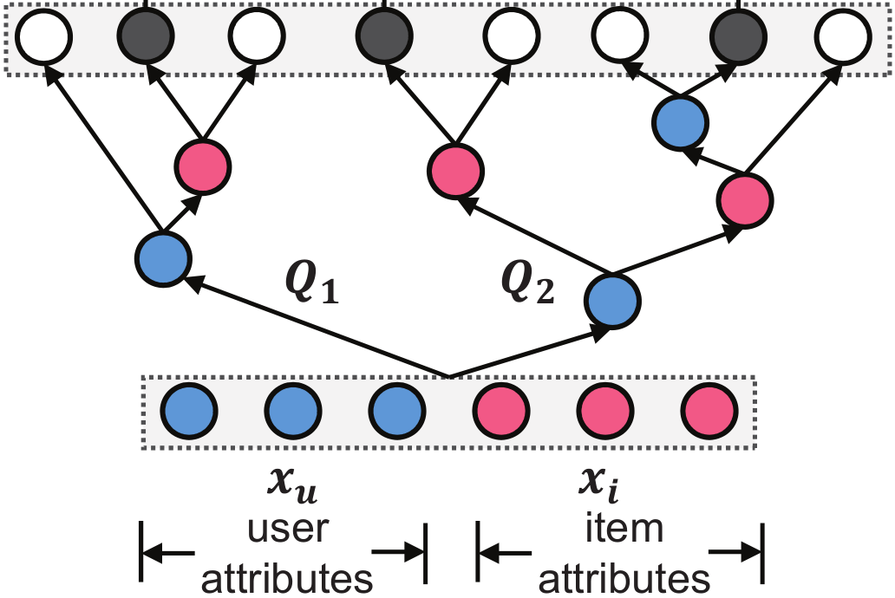
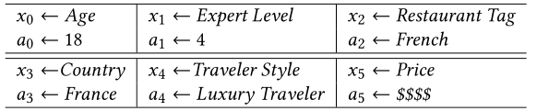
Constructing Cross Features
Traditional Solution: manually cross all values of feature variables
Our Solution: GBDT -> automatically identify useful cross features
We bulid GBDT on user attributes and item attributes.
Explicit Cross Features with easy-to-comprehend semantics!
Notes:
First, we extract the explicit cross features via tree-based model.
We can obtain a set of useful cross features, each of which has specific easy-to-comprehend semantics, such as …

Slide 11


Cross Features Embedding
Primary Consideration: seamlessly integrate cross features with embedding-based CF
Our Solution: embed them into user-item latent space
Multi-hot encoding of cross-feature ID
Embedding for each cross-feature ID
The correlations among cross features may be captured in the embedding space.
Notes:
Given the cross features, we project each cross feature into an embedding vector.
There are two advantages:
1. They capture correlations among feature

Slide 12
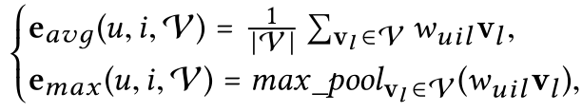
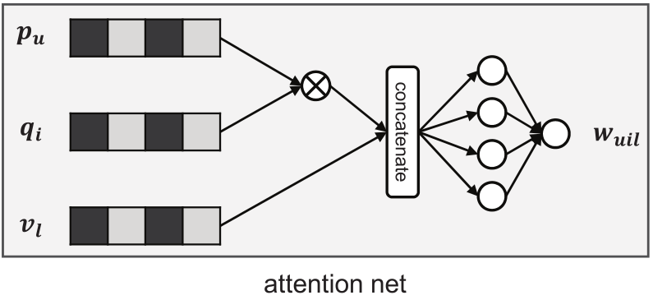

Attention Network
Primary Consideration: different cross features contribute differently for a prediction
Solution: Attention Network
Easy-to-comprehend cross features
Explicit contribution of each cross feature to the final prediction

Slide 13
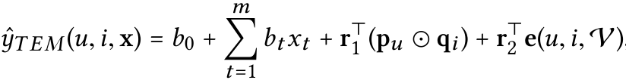

Final Prediction
Primary Consideration: explicit decision process & similarity-based + cross feature-based explanation mechanism
Solution: Simple linear regression
Similarity
Cross Feature
Pointwise logloss
Pointwise regression loss
Pairwise Ranking loss

Slide 14
OUTLINE
Introduction
Motivation
Tree-enhanced Embedding Model
Experimental Results
Conclusion
© Copyright NExT++. All Right Reserved.

Slide 15
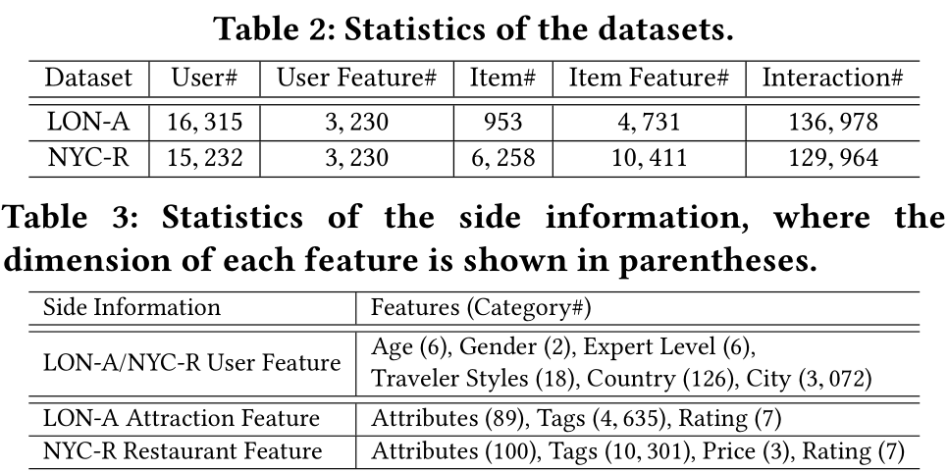

Experimental Settings
Research Questions:
RQ1: Compared with the state-of-the-art recsys methods, can TEM achieve comparable accuracy?
RQ2: Can TEM make the recsys results easy-to-interpret by using cross features and the attention network?
Tasks: Attraction Recommendation & Restaurant Recommendation
Dataset: TripAdvisor

Slide 16
Baselines
XGBoost: the state-of-the-art tree-based model
GBDT+LR [ADKDD’14]: feeding the cross features extracted from GBDT into the logistic regression
GB-CENT [WWW’17]: modeling categorical features with embedding-based model, numerical features with decision trees.
FM: a generic embedding model that implicitly models all the second-order cross features
NFM [SIGIR’17]: the state-of-the-art factorization model under the neural network framework
Evaluation Protocols:
logloss: indicate the generalization ability of each model
ndcg@k: reflect the top-k recommendation performance

Slide 17
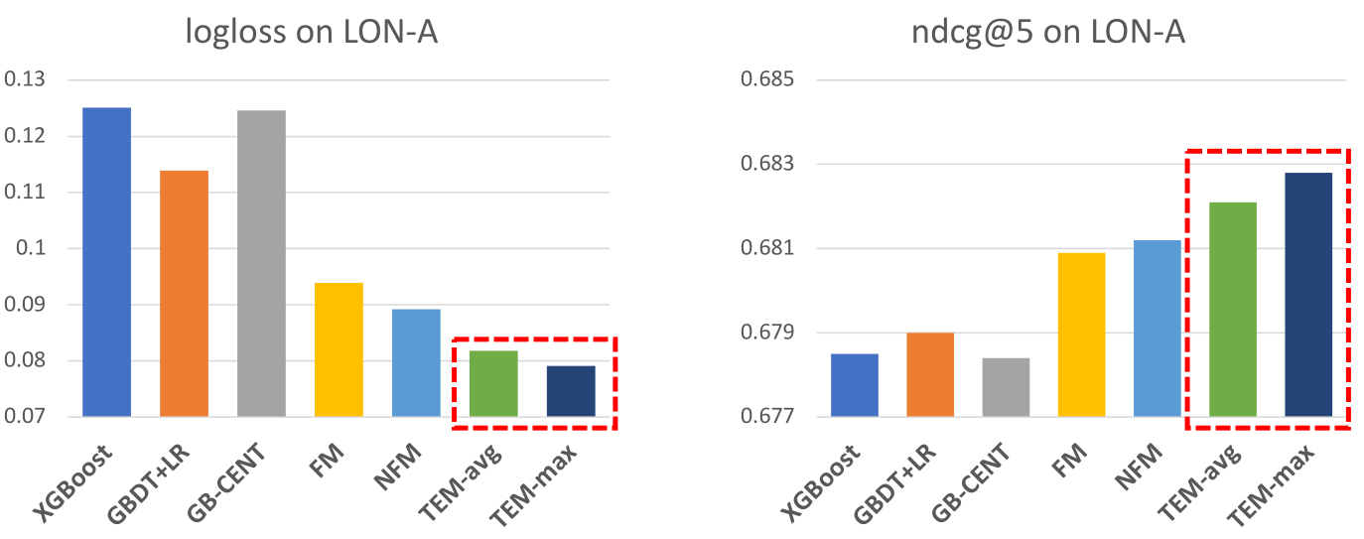
RQ1: Overall Performance Comparison
Comparable Expressiveness & Accuracy
Observations:
TEM achieves the best performance w.r.t. logloss.
TEM achieves comparable ndcg@5 to NFM.

Slide 18
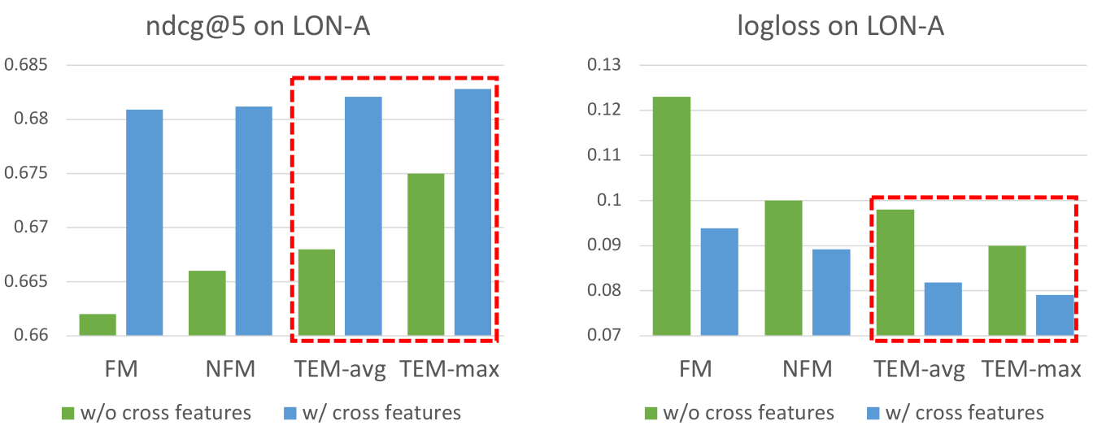
RQ1: Effect of Cross Feature Modeling
Without cross feature modeling:
All methods have worse performance
TEM is still better than others, due to the utility of attention network
(can learn which features are more important for a user-item prediction).

Slide 19
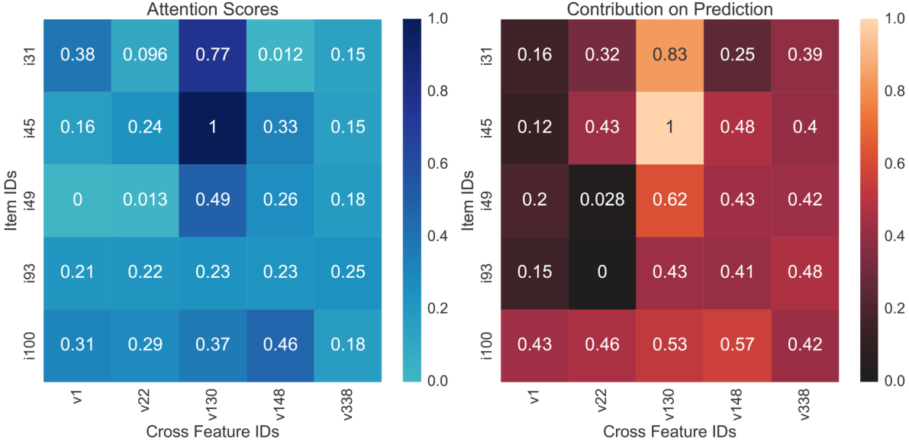
RQ2: Case Study of Explainability
Sampled a user and check her predictions.
• V130: User Gender=Female] & [User Style=Peace and Quiet Seeker] ⇒ [Item Attribute=Sights & Landmarks] & [Item Tag=Walk Around]
• V148: [User Age=30-40] & [User Country=USA] ⇒ [Item Tag=Top Deck &
Canary Wharf]
Attention Score
Contribution of
each cross feature
TEM can provide more informative explanations based on a user’s preferred cross features.
We attribute the user’s preferences on The View from the Shard to her special interests in the item aspects of Walk Around, Top Deck & Canary Wharf.

Slide 20
Conclusions
We proposed a tree-enhanced embedding method (TEM), which seamlessly combines the generalization ability of embedding-based models with the explainability of tree-based models.
Owing to the explicit cross features from tree-based part & the easy-to-interpret attention network, the whole prediction process of our solution is transparent & self-explainable.
Future Work:
Jointly learn the tree-based and embedding-based
Relational reasoning over KG (symbolic logics) + Deep Learning
How to evaluate the quality of explanations?

Slide 21
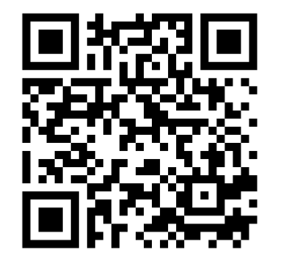
NUS-Tsinghua Centre for Extreme Search A Joint Research Collaboration Between NUS & Tsinghua University
THANK YOU
NExT research is supported by the National Research Foundation,
Prime Minister's Office, Singapore under its IRC@SG Funding Initiative.
© Copyright NExT++. All Right Reserved.

