Slide 1




On the Equivalence of Decoupled GCN and Label Propagation
Hande Dong, Jiawei Chen, Fuli Feng, Xiangnan He, Shuxian Bi, Zhaolin Ding, Peng Cui

Slide 2
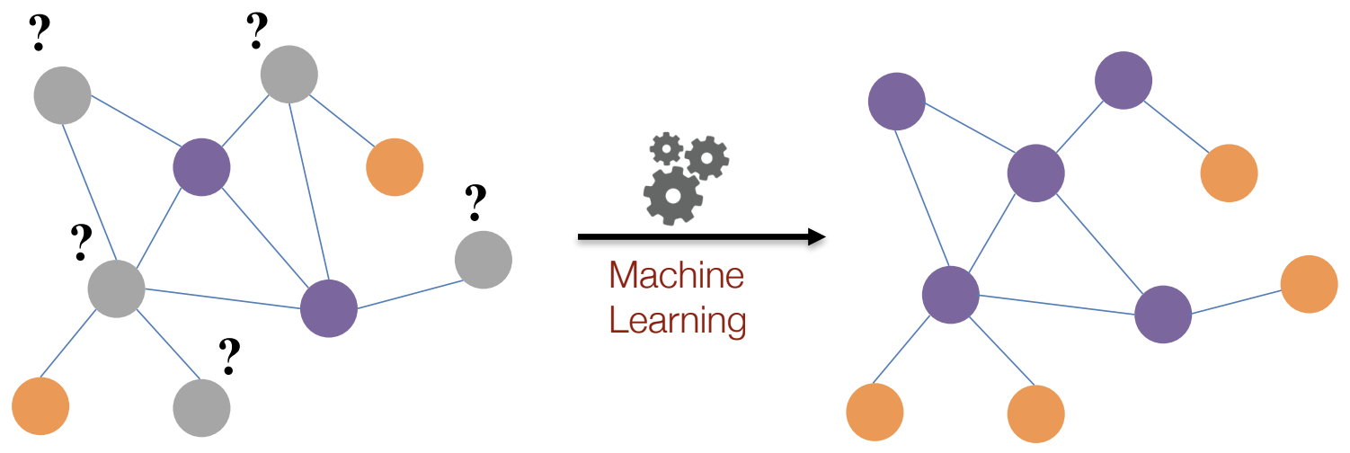

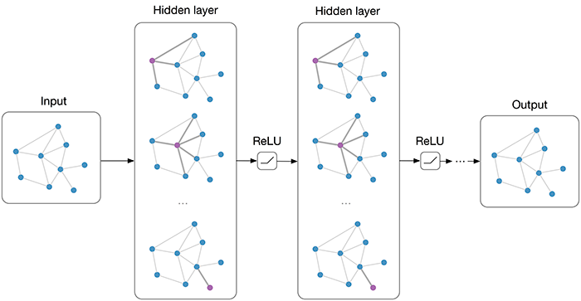

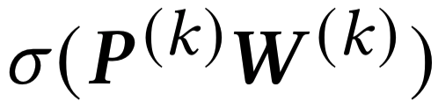
Background
Semi-supervised node classification task:
Graph convolution network (GCN):
Aggregation:
coupling
Transformation:

Slide 3
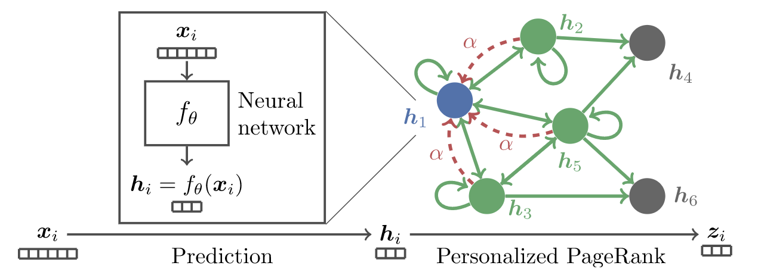
From GCN to decoupled GCN
Predict then propagate (APPNP):
APPNP decouples neighborhood aggregation and feature transformation: DECOUPLED GCN!
SOTA performance
High efficiency
APPNP (ICLR 2019), DAGNN (KDD 2020) SGCN (ICML 2019), lightGCN (SIGIR 2020)

Slide 4
Graph Information diffusion
Label propagation vs. representation aggregation:
Indirect diffusion vs. direct diffusion:
SOURCE NODE
TARGET NODE
Label Propagation
Representation Aggregation
Step 1
Step 2
Indirect diffusion ~ Multiple steps.
Direct diffusion ~ One step.
The effect of multiple indirect diffusion is the same as once direct diffusion.

Slide 5


LP vs. decoupled GCN
Label propagation
Decoupled GCN
2002
Label diffusion
Structure driven
Graph algorithm
Not learnable
Explainable
2019
Representation diffusion
Structure and feature driven
Representation learning
Learnable
Not explainable
Question:
Any intrinsic relationship between LP and decoupled GCN?

Slide 6
Outline
Motivation and background
Theoretical analysis
Propagation then Training Statically vs. decoupled GCN
The weight of decoupled GCN
Pros and cons of decoupled GCN
Method
Experiments
Conclusion

Slide 7
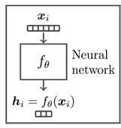
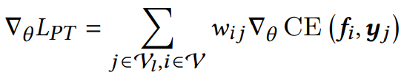


Propagation then Training vs. decoupled GCN
Two-step label propagation:
Reweight pseudo-label! Propagation then Training
Gradient analysis:
SOURCE NODE
Step 1: label propagation ~ pseudo-label
Step 2: Training

Slide 8
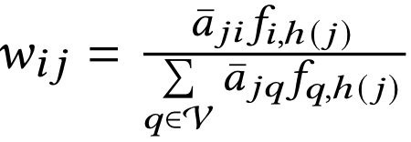
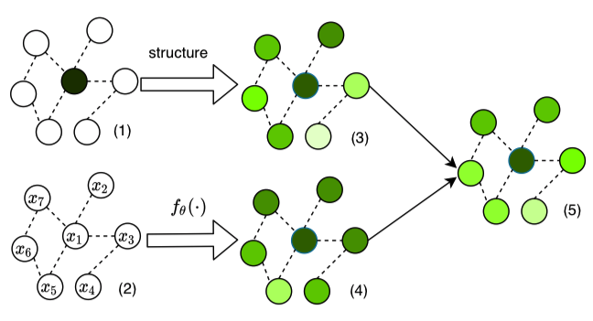
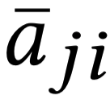
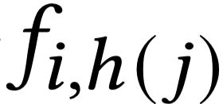
The weight of decoupled GCN
Weight of decoupled GCN:
Product
Normalize

Slide 9
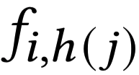
Strengths and weaknesses
The effects of our analysis:
Help us understand strengths and weaknesses of model
Provide intuition to improve decoupled GCN
Strengths:
Pseudo-label ~ data augmentation
Reasonable weight ~ reweight the pseudo labels
Ensemble ~ combine neighbors when inference
Weaknesses:
Unstable to initialization ~ is reliable?
Sensitive to label noise ~ equal weight?

Slide 10
Outline
Motivation and background
Theoretical analysis
Method
How to improve decoupled GCN?
PTA: Propagation then Training Adaptively
Experiments
Conclusion

Slide 11



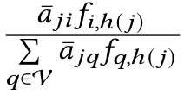


How to improve d-GCN?
Weight of decoupled GCN:
Design 1 - remove normalization:
Different label weight
Robust to label noise
Design 2 - add adaptive factor:
Factor:
The model becomes more and more reliable,
stable to initialization
Advantages: stable, robust to label noise.
remove
normalization
adaptive
factor

Slide 12

PTA: PT adaptively
Element form of loss function:
Matrix form of loss function:
No neighborhood aggregation. Much faster!
Decoupled GCN aggregates neighborhood
Neighborhood aggregation is hard to parallelly compute

Slide 13
Outline
Motivation and background
Theoretical analysis
Method
Experiments
About decoupled GCN
About PTA
Conclusion

Slide 14
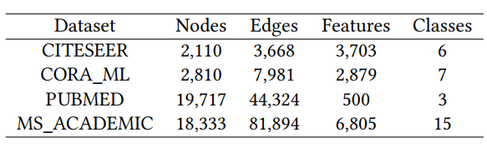
Setting
Datasets:
CITESEER, CORA_ML, PUBMED, MS_ACADEMIC
Evaluation metrics: accuracy
Data split:
Training set: 20*C
Early stopping set: 500
Test set: 1500/5000 - 20C - 500

Slide 15
Five questions to answer
Is our analysis for decoupled GCN are rational?
How does the proposed PTA perform as compared with state-of-the-art GCN methods?
Is PTA more stable to the initialization?
Is PTA more robust to label noise?
Is PTA more efficient?

Slide 16
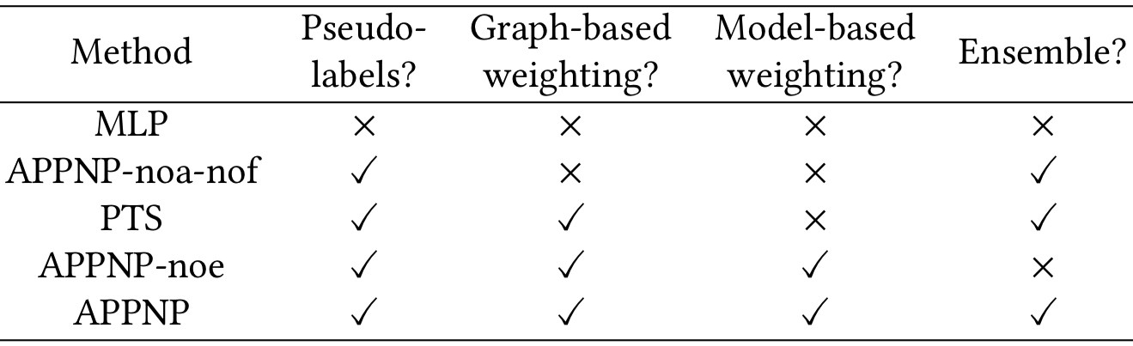
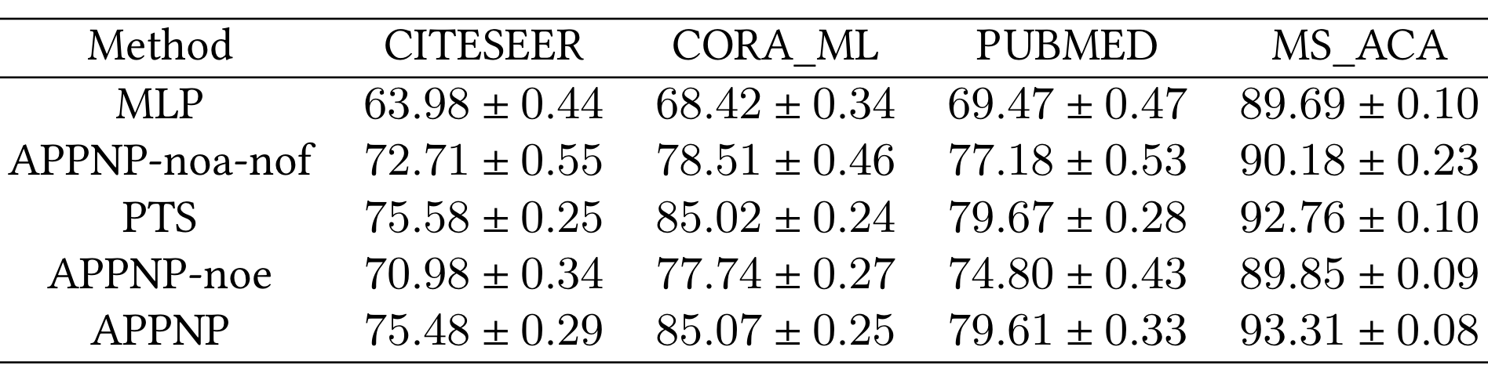
Effects of different components in decoupled GCN
Ablation study of APPNP:
The effect: Label propagation(+++), graph-based weighting(+++), model-based weighting(+), ensemble(++).

Slide 17
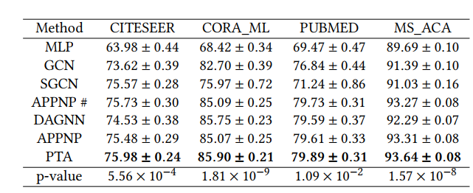
Performance comparison: PTA performs best
Accuracy comparison with SOTA methods:
PTA is better than APPNP with t-test. Statistically significant!

Slide 18
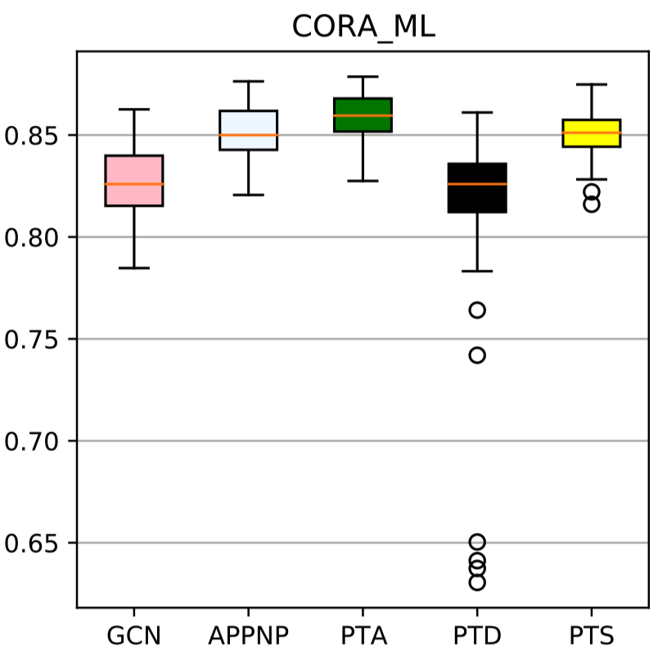
PTA is stable to initialization
Box plot of accuracy of different models:
PTS>APPNP: the effect of dynamic weight in APPNP is unstable, relying on the initialization
PTA>APPNP, PTD: adaptive strategy in PTA is useful
PTD is much unstable: merely removing normalization of APPNP will cause unstable. Removing normalization need co-occur with adaptive strategy.

Slide 19
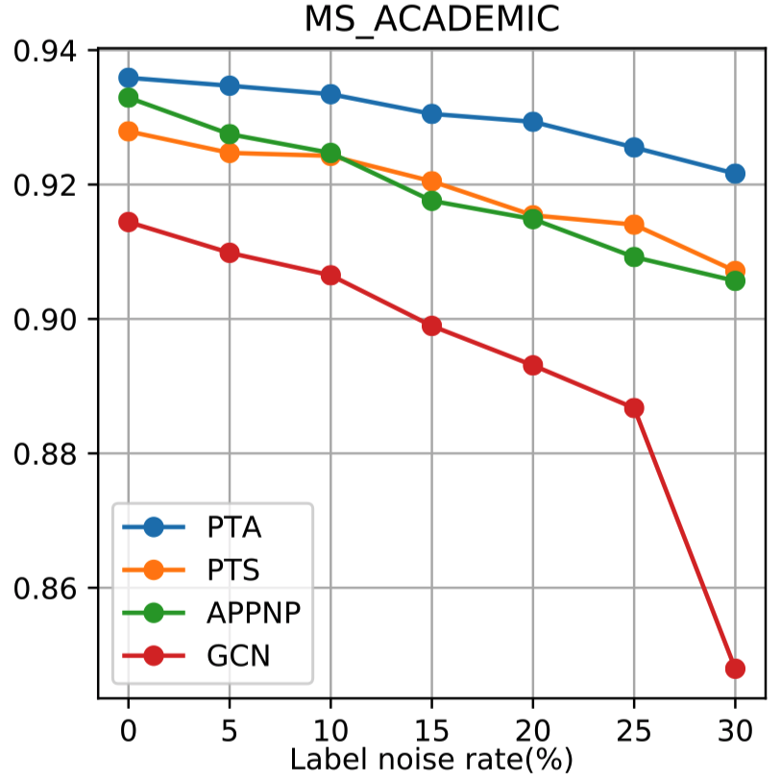
PTA is robust to label noise
Simulate label noise
Add noise to label in the training set
The margins of PTA and APPNP become larger with noise increasing: PTA is more robust to label noise.
PTA>others for all different label noise rate.
APPNP≈PTS: PTS is implicitly normalization.

Slide 20
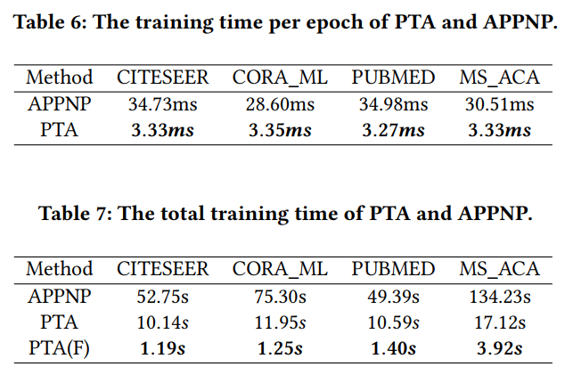
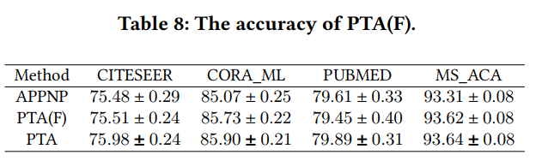
PTA is much faster
Compare the efficient of PTA and APPNP
10-times faster
PTA: 5 times faster
PTA(F): 50 times faster
PTA(F) still performs well.

Slide 21
Conclusion and future work
Conclusion:
Why decoupled GCN works well:
data augmentation, structure and model-aware weighting, ensemble
Proposed method -- PTA:
stable; robust to label noise; efficient
Future work:
Link prediction and graph classification tasks
Theoretical analysis for general GCN
Sophisticated weighting strategy

Slide 22
Reference
Zhu Xiaojin and Ghahramani Zoubin. 2002. Learning from labeled and unlabeled data with label propagation. Technical Report, Carnegie Mellon University (2002).
Thomas N. Kipf and Max Welling. Semi-Supervised Classification with Graph Convolutional Networks. In International Conference on Learning Representations, ICLR, 2017.
Felix Wu, Amauri H. Souza Jr., Tianyi Zhang, Christopher Fifty, Tao Yu, and Kilian Q. Weinberger. Simplifying Graph Convolutional Networks. In International Conference on Machine Learning, ICML, 2019.
Johannes Klicpera, Aleksandar Bojchevski, and Stephan Günnemann. Predict then Propagate: Graph Neural Networks meet Personalized PageRank. In International Conference on Learning Representations, ICLR, 2019.
Xiangnan He, Kuan Deng, Xiang Wang, Yan Li, Yong-Dong Zhang, and Meng Wang. LightGCN: Simplifying and Powering Graph Convolution Network for Recommendation. In International ACM SIGIR conference on research and development in Information Retrieval, SIGIR 2020.
Meng Liu, Hongyang Gao, and Shuiwang Ji. Towards Deeper Graph Neural Networks. In The ACM SIGKDD Conference on Knowledge Discovery and Data Mining, KDD, 2020.

Slide 23
Thanks & QA?
The code is available at https://github.com/DongHande/PT_propagation_then_training

