Slide 1





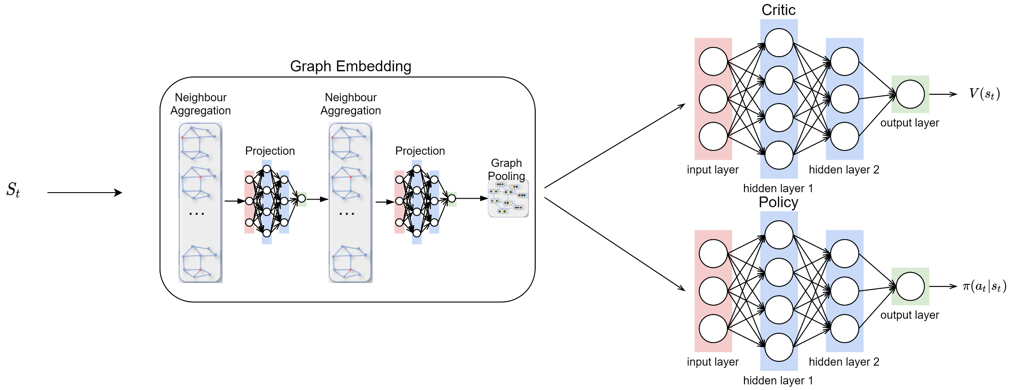
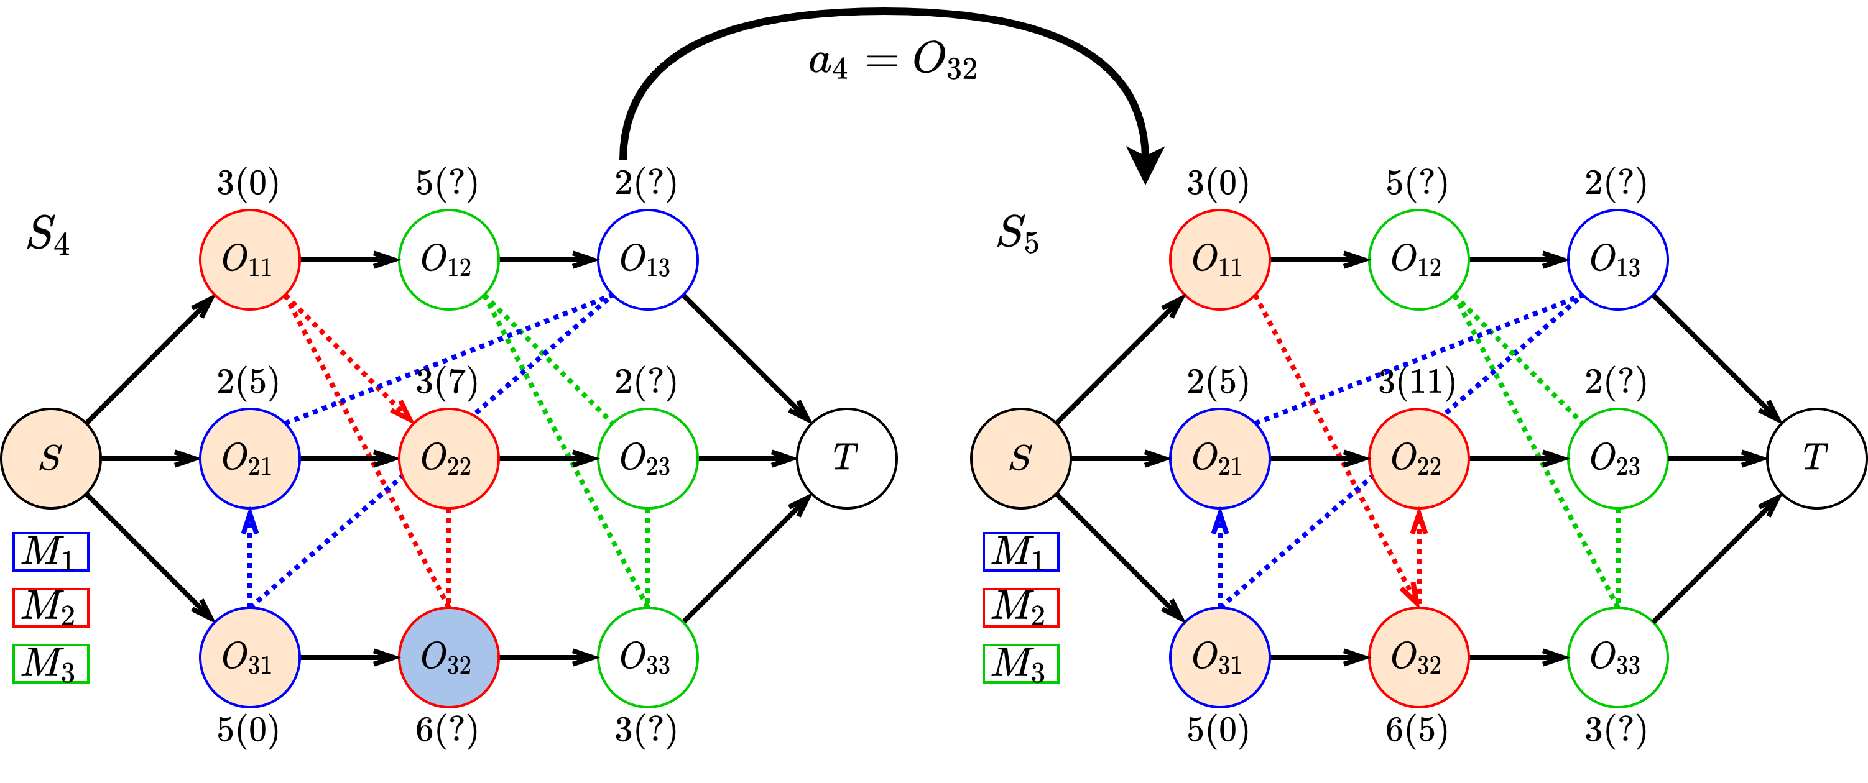
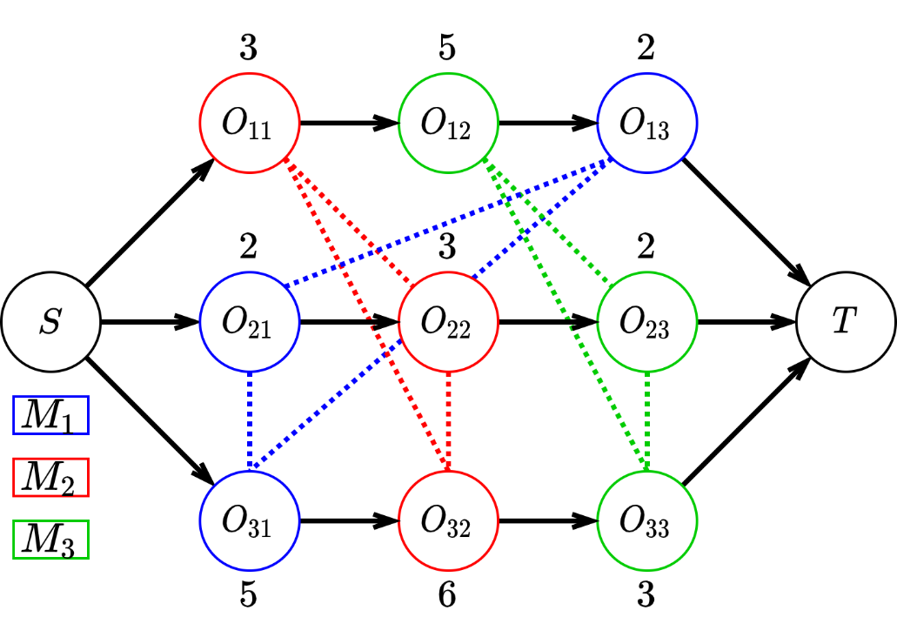
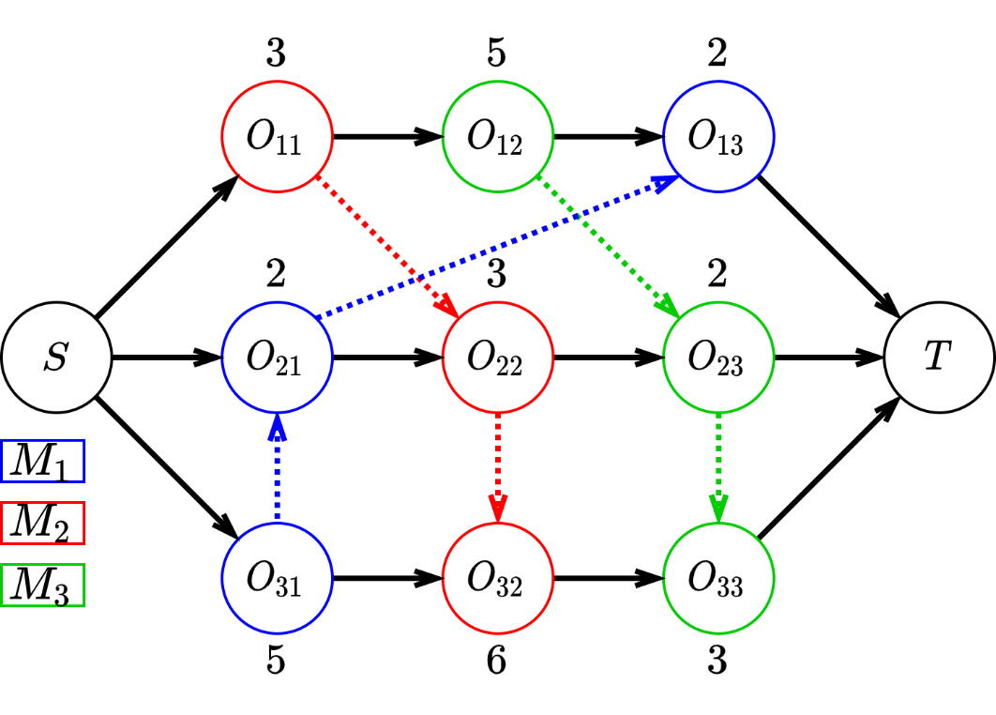
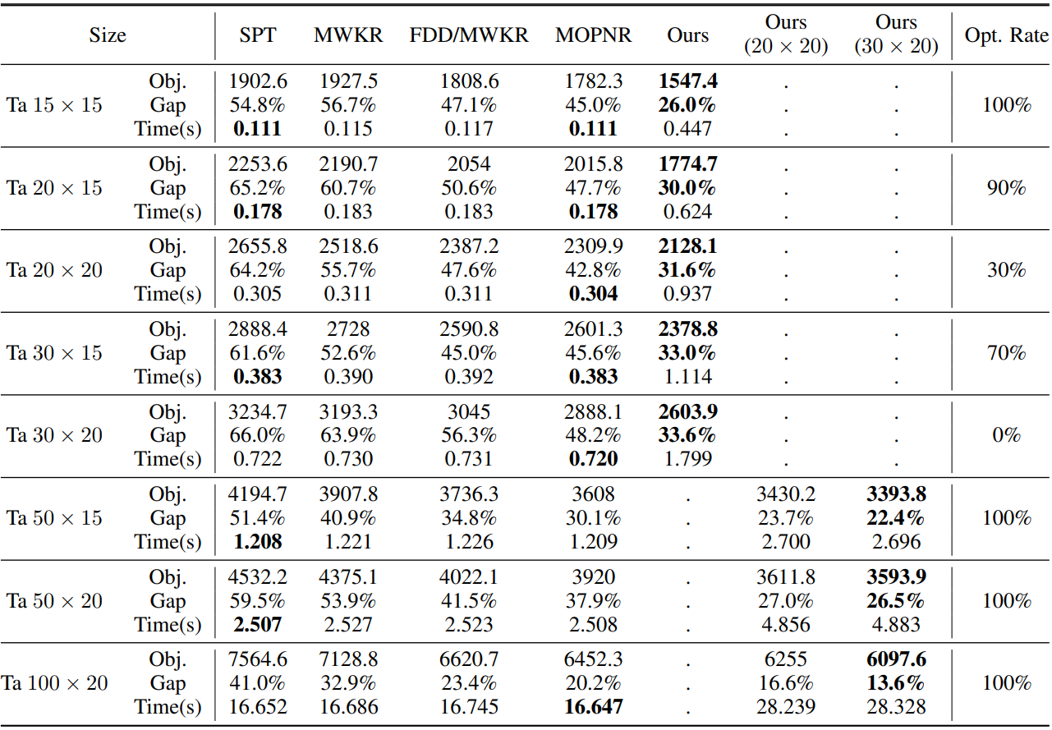
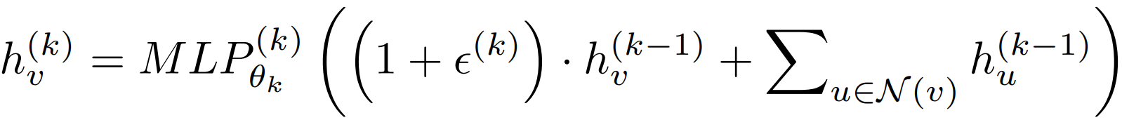
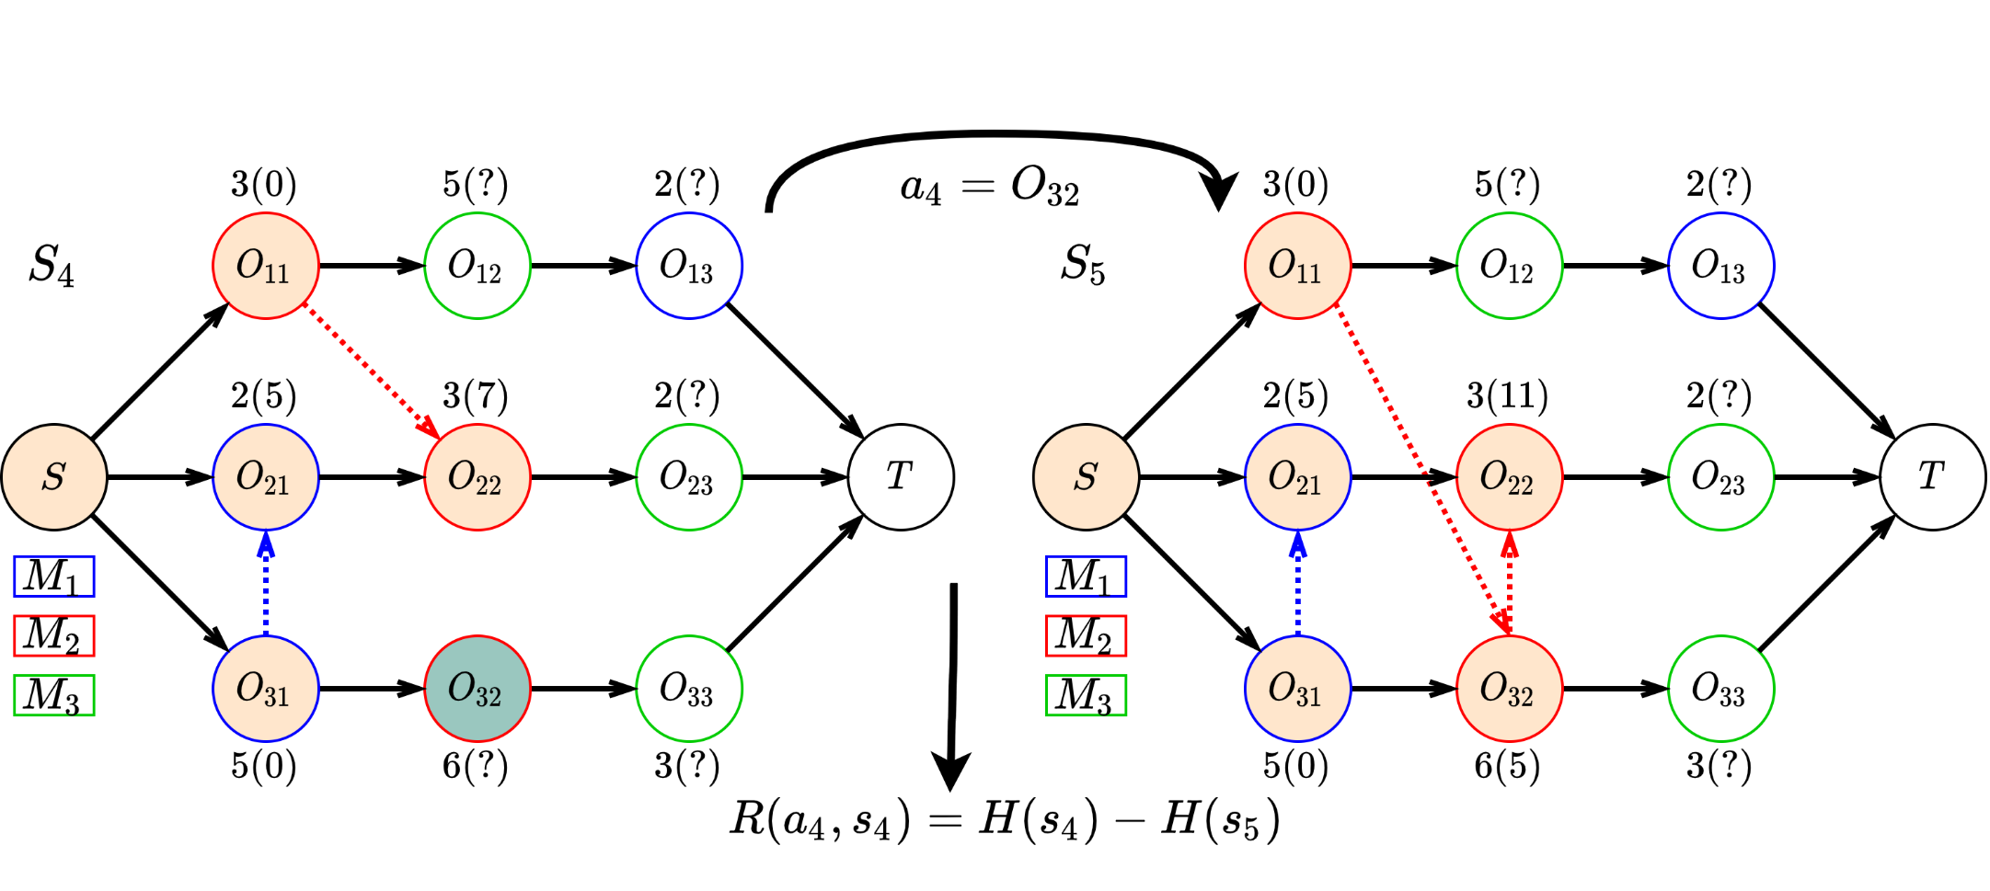
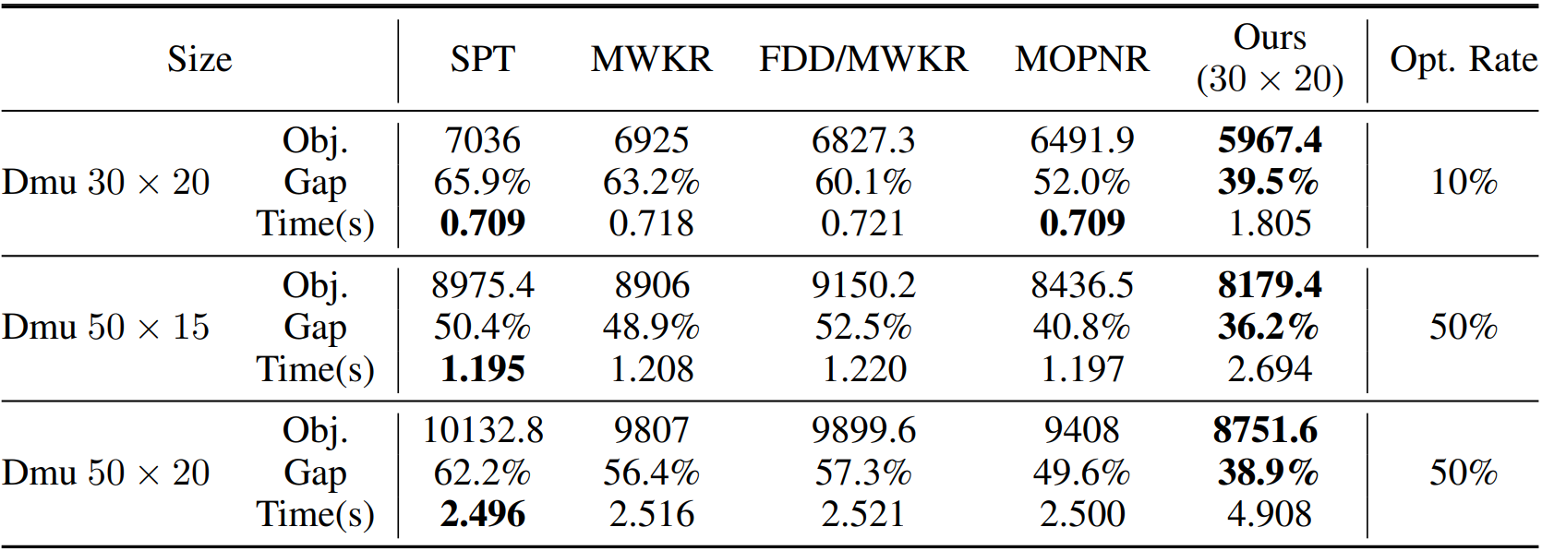
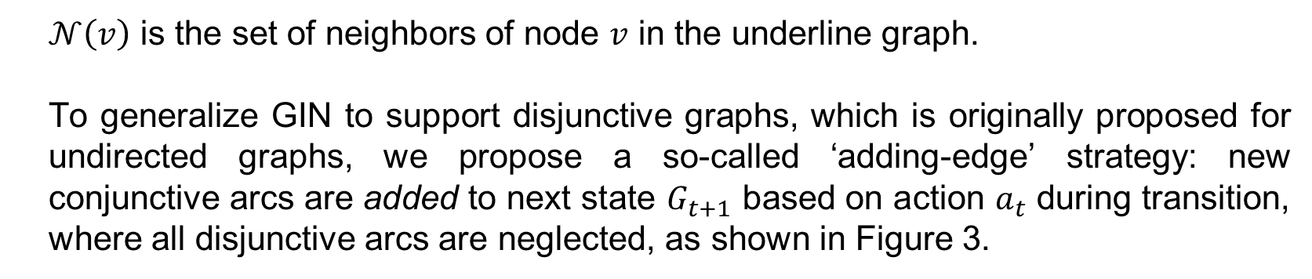
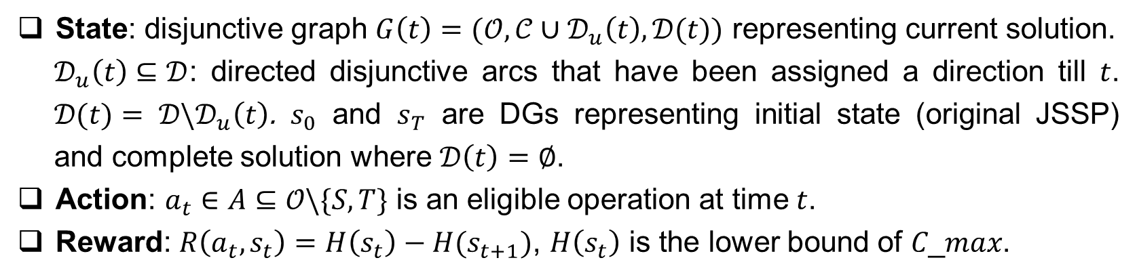
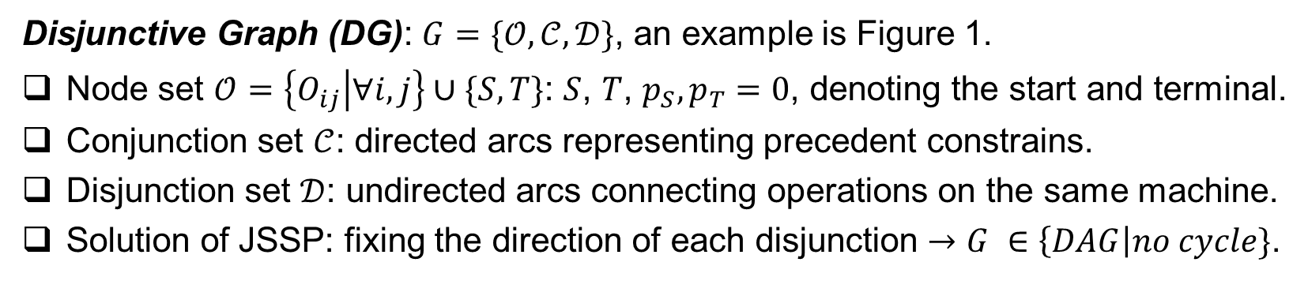
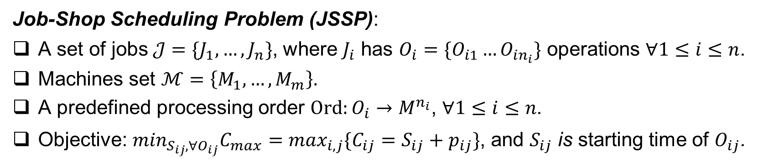
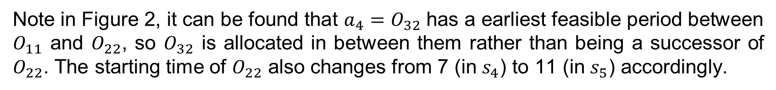
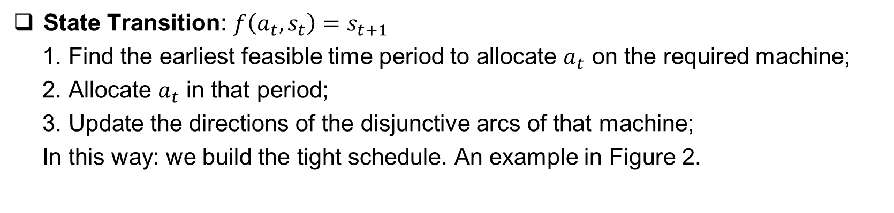
Learning to Dispatch for Job Shop Scheduling via Deep Reinforcement Learning
Cong Zhang¹, Wen Song², Zhiguang Cao³, Jie Zhang¹, Puay Siew Tan⁴, and Chi Xu⁴
¹Nanyang Technological University, ²Institute of Marine Science and Technology, Shandong University, China, ³National University of Singapore, ⁴Singapore Institute of Manufacturing Technology, A*STAR
paper
Contributions
State Transition: $f\left(a_{t}, s_{t}\right)=s_{t+1}$
1. Find the earliest feasible time period to allocate $a_{t}$ on the required machine;
2. Allocate $a_{t}$ in that period;
3. Update the directions of the disjunctive arcs of that machine;
In this way: we build the tight schedule. An example in Figure 2.
Policy network: A MLP
Critic network: A MLP
Policy and critic share the embedding network, and the whole architecture is depicted by Figure 4.
A novel reinforcement learning (RL) algorithm for learning priority dispatching rules (PDRs) for job-shop scheduling problem (JSSP).
We show how PDRs with strong performance and effective generalization can be learned by using a graph-based MDP formulation and a RL agent.
Background
Job-Shop Scheduling Problem (JSSP):
A set of jobs$𝒥=\{J_{1}, …, J_{n}\}$, where $J_{i}$ has $O_{i}=\{O_{i1}…O_{in_{i}}\}$ operations $∀1≤i≤n$.
Machines set $ℳ=\left\{M_{1}, …, M_{m}\right\}.$
A predefined processing order $Ord:O_{i}→M^{n_{i}}$, $∀1≤i≤n$.
Objective: $\min_{S_{ij}, ∀O_{ij}}C_{max}=\max_{i,j}\{C_{ij}=S_{ij}+p_{ij}\}$, and $S_{ij}$ is starting time of $O_{ij}$.
Figure 4. Actor-Critic Architecture
Experiments
Disjunctive Graph (DG): $G=\{𝒪, 𝒞, 𝒟\}$, an example is Figure 1.
Node set $𝒪=\left\{O_{ij} | ∀i,j\right\}∪\{S, T\}$: $S$, $T$, $p_{S},p_{T}=0$, denoting the start and terminal.
Conjunction set $𝒞$: directed arcs representing precedent constrains.
Disjunction set $𝒟$: undirected arcs connecting operations on the same machine.
Solution of JSSP: fixing the direction of each disjunction $→$ $G ∈\left\{DAG\right|no cycle\}$.
Training Algorithm: Proximal Policy Optimization (PPO) as training algorithm.
Dataset: Synthetic dataset, Taillard’s instances (open), DMU instances (open)
Baselines: 4 Strong hand-designed rules from literature
Result: only results for Taillard’s instances and DMU instances are showed here due to limited space.
Figure 2: Example of state transition. Orange nodes are operations already scheduled, and the grey node is operation selected to be scheduled at current state. Integers in bracket are starting time of scheduled operations, where unscheduled operations have unknown starting time (denoted as?).
Note in Figure 2, it can be found that $a_{4}=O_{32}$ has a earliest feasible period between $O_{11}$ and $O_{22}$, so $O_{32}$ is allocated in between them rather than being a successor of $O_{22}$. The starting time of $O_{22}$ also changes from 7 (in $s_{4}$) to 11 (in $s_{5}$) accordingly.
Parameterizing the Policy
Graph Embedding: We use Graph Isomorphism Network (GIN) as the embedding network, where at each layer $k$ the embedding can be formulated as:
(a): JSSP instance
(b): Complete solution
Figure 1:Disjunctive graph representation.
$𝒩\left(v\right)$ is the set of neighbors of node $v$ in the underline graph.
To generalize GIN to support disjunctive graphs, which is originally proposed for undirected graphs, we propose a so-called ‘adding-edge’ strategy: new conjunctive arcs are added to next state $G_{t+1}$ based on action $a_{t}$ during transition, where all disjunctive arcs are neglected, as shown in Figure 3.
Priority Dispatching Rules (PDRs): a class of heuristics that is widely used to solve real-world JSSP. Based on some calculated priority indices, it dispatches and schedules, within the current waiting list, the operation with highest priority index.
Motivation
However, the design of effective PDRs is a tedious task:
Requiring a myriad of specialized knowledge.
Delicate and limited performance for different JSSP.
Q:How to search the PDR space automatically to find PDRs that have robust generalization and strong performance?
Markov Decision Process (MDP) Formulation
State: disjunctive graph $G\left(t\right)=(𝒪, 𝒞∪𝒟_{u}\left(t\right), 𝒟(t))$ representing current solution.
$𝒟_{u}\left(t\right)⊆𝒟$: directed disjunctive arcs that have been assigned a direction till $t$. $𝒟(t)= 𝒟\backslash 𝒟_{u}\left(t\right)$. $s_{0}$ and $s_{T}$ are DGs representing initial state (original JSSP) and complete solution where $𝒟\left(t\right)=∅$.
Action: $a_{t}∈A⊆𝒪\backslash \{S, T\}$ is an eligible operation at time $t$.
Reward: $R\left(a_{t}, s_{t}\right)=H\left(s_{t}\right)−H(s_{t+1})$, $H\left(s_{t}\right)$ is the lower bound of 𝐶_𝑚𝑎𝑥.
Figure 3: Example of state transition with left-shifting and adding-edge strategy. Orange nodes are operations already scheduled, and the grey node is operation selected to be scheduled at current state. Integers in bracket are starting time of scheduled operations, where unscheduled operations have unknown starting time (denoted as?).
Table 1: Results on Taillard’s instances and DMU instances. ‘Gap’ is calculated against results obtained by OR-Tools with cut-off 3600 seconds. "Opt. Rate": rate of instances with optimal solution.

