Slide 1
Cover Glass Manufacturing Quality Analytics
Simulated MQE / Brittles portfolio project
Synthetic data only
Hexing Yin
Ph.D. in Materials Science and Engineering, UCLA
Synthetic data only | Portfolio project
Notes:
I'm walking through a simulated cover-glass yield excursion. All data is synthetic — this is not Apple or supplier confidential data.

Slide 2
Project Motivation
Why it matters: high-volume cover glass, brittle edge defects
What I saw: CNC edge chipping and chamfer width drift
MQE goal: find high-risk process windows and preventive controls
Synthetic data only | Portfolio project
Notes:
Start with the business problem — yield dropped after CNC contouring. My job as MQE is to localize the issue and recommend containment and fixes.

Slide 3
Manufacturing Problem
AOI yield drop after CNC contouring / chamfering
Edge-initiated defects can feed downstream reliability risk
Phase 1 focus: CNC-related Edge_Chipping
Synthetic data only | Portfolio project
Notes:
I'm not trying to solve every defect mode in v1. Edge chipping is the dominant signature, so that's where I focused.

Slide 4
Synthetic Data Design
What I built: 50,000 synthetic unit-level records
Traceability: machine, fixture, shift, tool life, coolant stability
CTQs, defect mode, defect location, final disposition
Embedded special cause: tool wear × coolant instability
Synthetic data only | Portfolio project
Notes:
I designed the dataset to mirror real traceability fields. There's a planted interaction — high tool life plus unstable coolant — so I can show whether analysis finds it without cheating.

Slide 5
End-to-End Workflow
Generate → validate → Pareto → stratification
SPC → capability → defect-location heatmap
ML risk screening (supporting, not controlling)
JMP interactive review → MQE containment / corrective / preventive actions
Synthetic data only | Portfolio project
Notes:
Python runs the reproducible pipeline. JMP is for live filtering and visual confirmation in a cross-functional review.

Slide 6
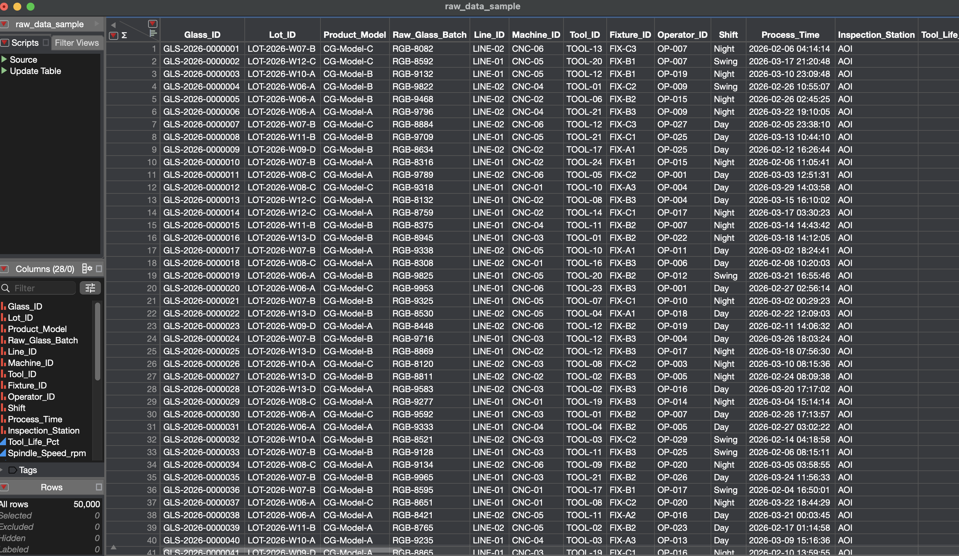
Implementation Evidence
What I built: reproducible Python pipeline (`main.py` + `src/`)
50,000-row synthetic dataset in `data/raw/`
JMP import table + project for interactive review
GitHub portfolio with reports, figures, and this deck
50k synthetic raw data
This is a working project — not just a slide outline.
Synthetic data only | Portfolio project

Slide 7
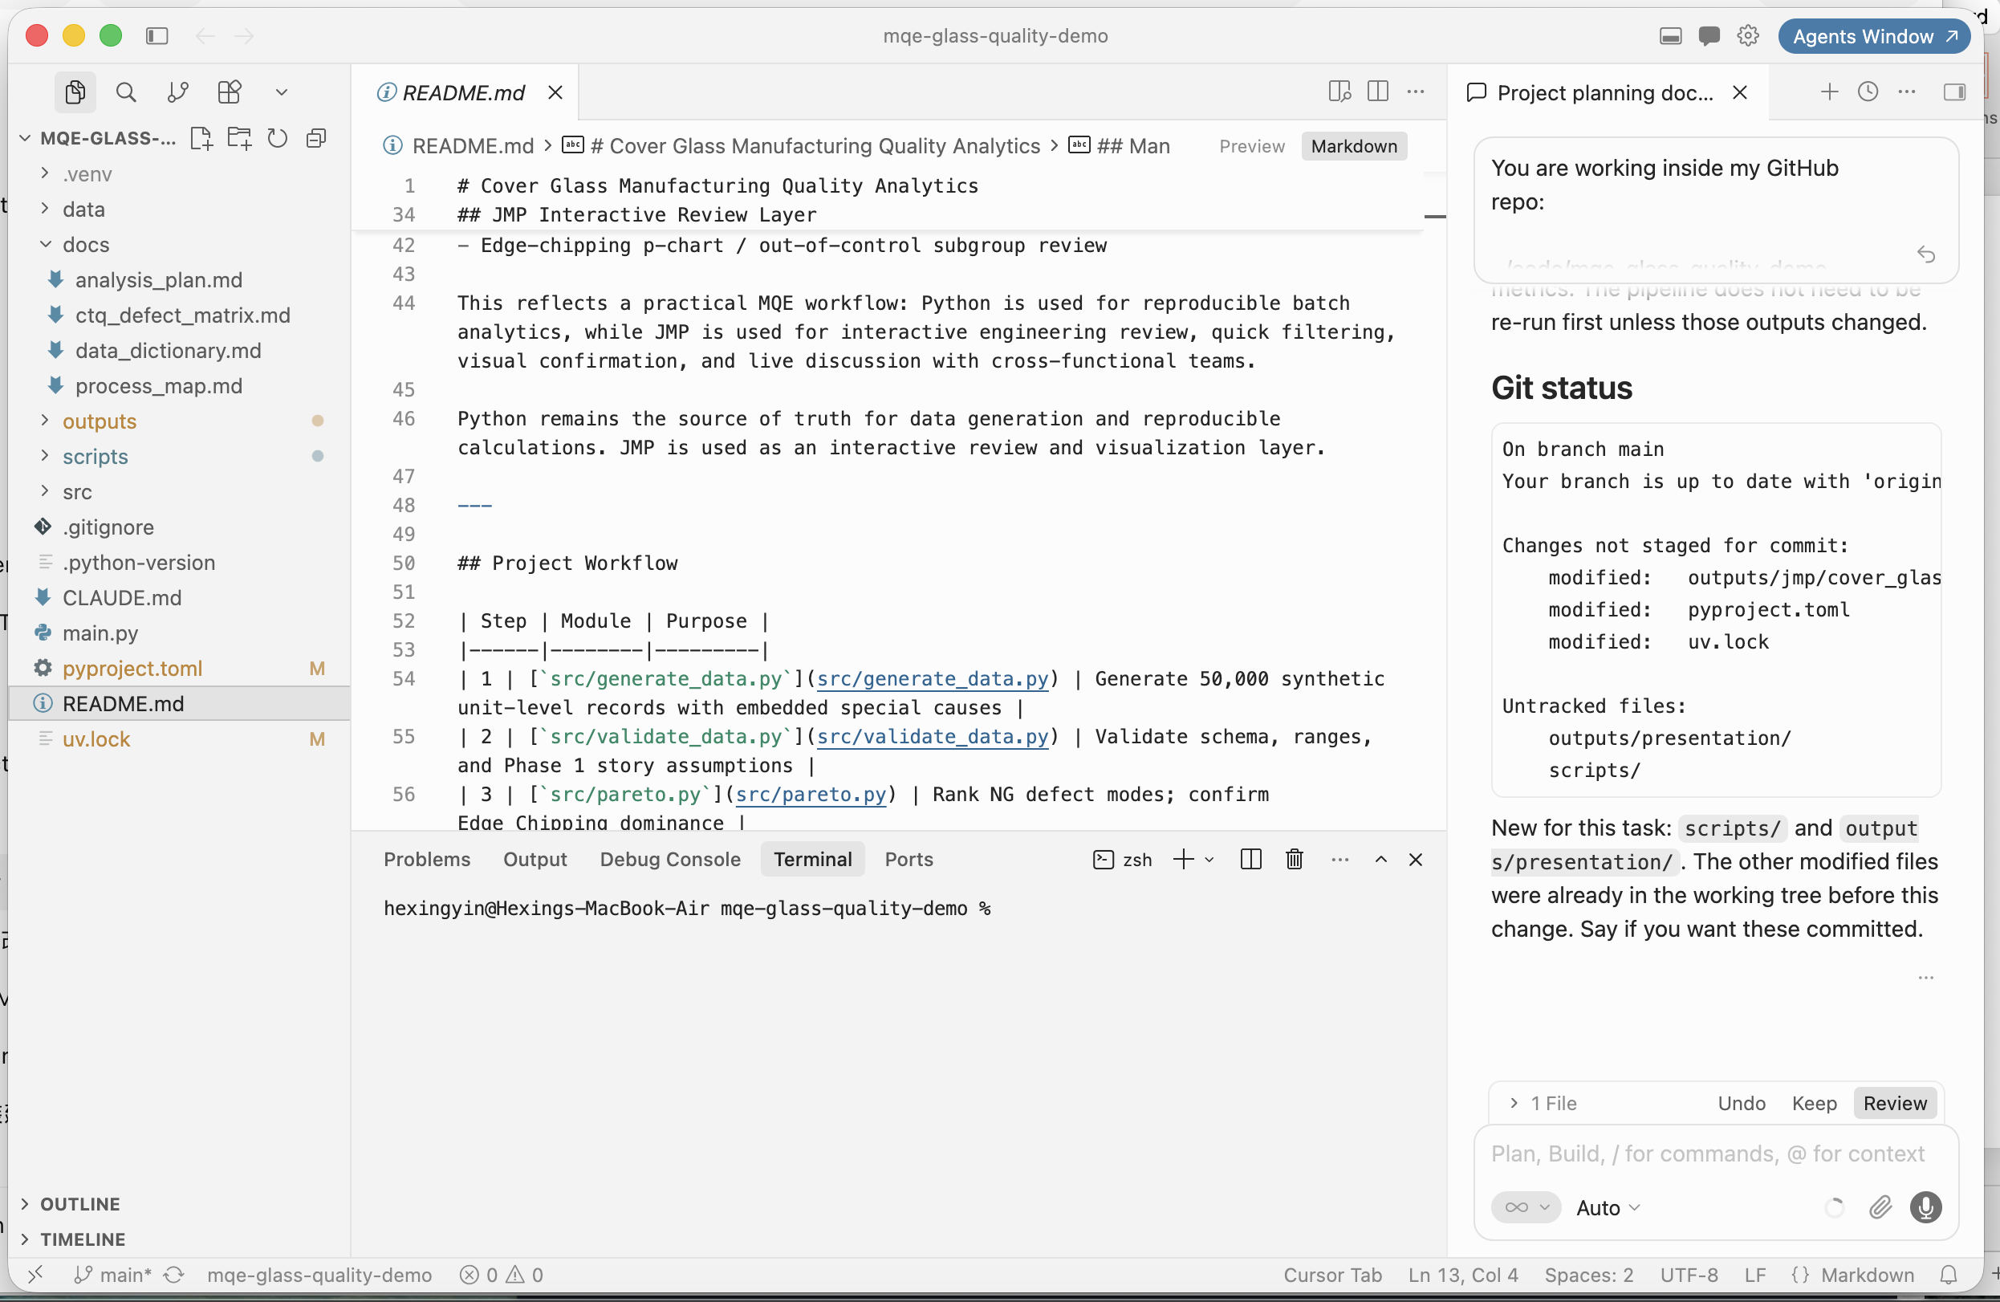
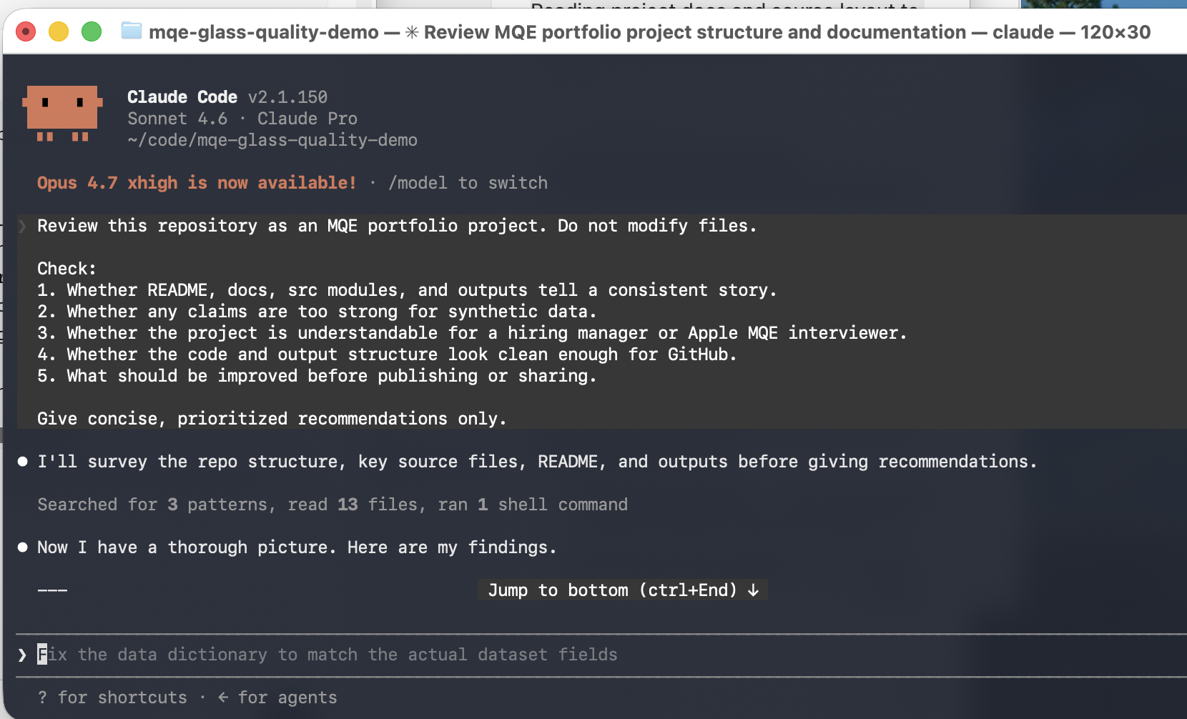
AI-Assisted Engineering Workflow
I used AI tools to move faster, but I still owned the MQE logic, validation, and conclusions.
Cursor: Python code, debugging, PPT script
Claude Code: Multi-file edits and docs
Python / JMP: Reproducible analytics + review
ChatGPT: planning, MQE storyline, stats review, interview prep | Cursor: implementation | Claude Code: larger refactors | Python + JMP: analytics source of truth + interactive review
AI tools accelerated implementation, but engineering assumptions, validation, leakage control, and MQE interpretation were manually reviewed.
Synthetic data only | Portfolio project
Notes:
I used AI to speed up coding and documentation. But I manually checked stats assumptions, ML leakage rules, and every MQE conclusion. Don't oversell AI — it's an accelerator, not the engineer.

Slide 8
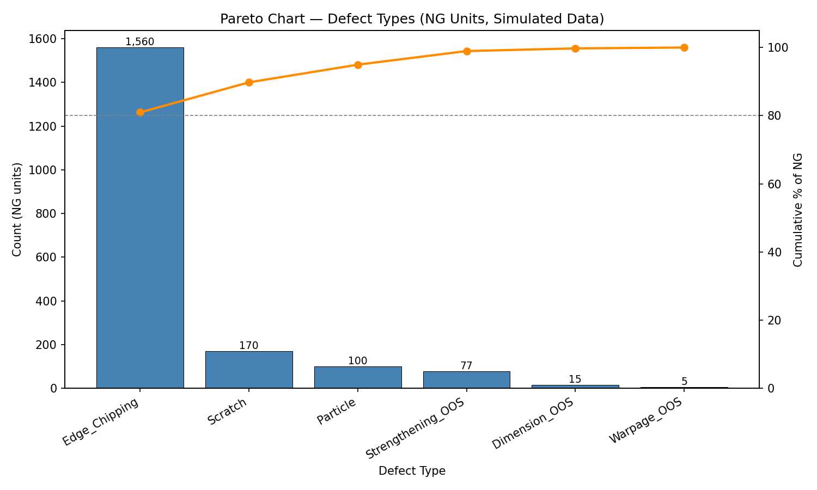
Defect Pareto
What I tested: overall NG defect mix
What the data showed: 3.85% NG rate
Edge_Chipping = 80.95% of NG parts
Why it matters: confirms where to spend root-cause time
Edge chipping dominates — start there before chasing minor modes.
NG defect Pareto (Python)
Synthetic data only | Portfolio project
Notes:
First step in any excursion: confirm the defect signature. Three-point-eight-five percent NG, and edge chipping is ~81% of that. That's my Phase 1 scope.

Slide 9
Traceability & Stratification
What I tested: machine, fixture, shift, tool life, coolant stability
What the data showed: concentration on CNC-04 / CNC-06, FIX-B2 / FIX-C1
Why it matters: narrows from fleet yield to suspect windows
Synthetic data only | Portfolio project
Notes:
This is classic traceability work — stratify before you jump to a root cause. A few machines and fixtures light up; that's where I drill deeper.

Slide 10
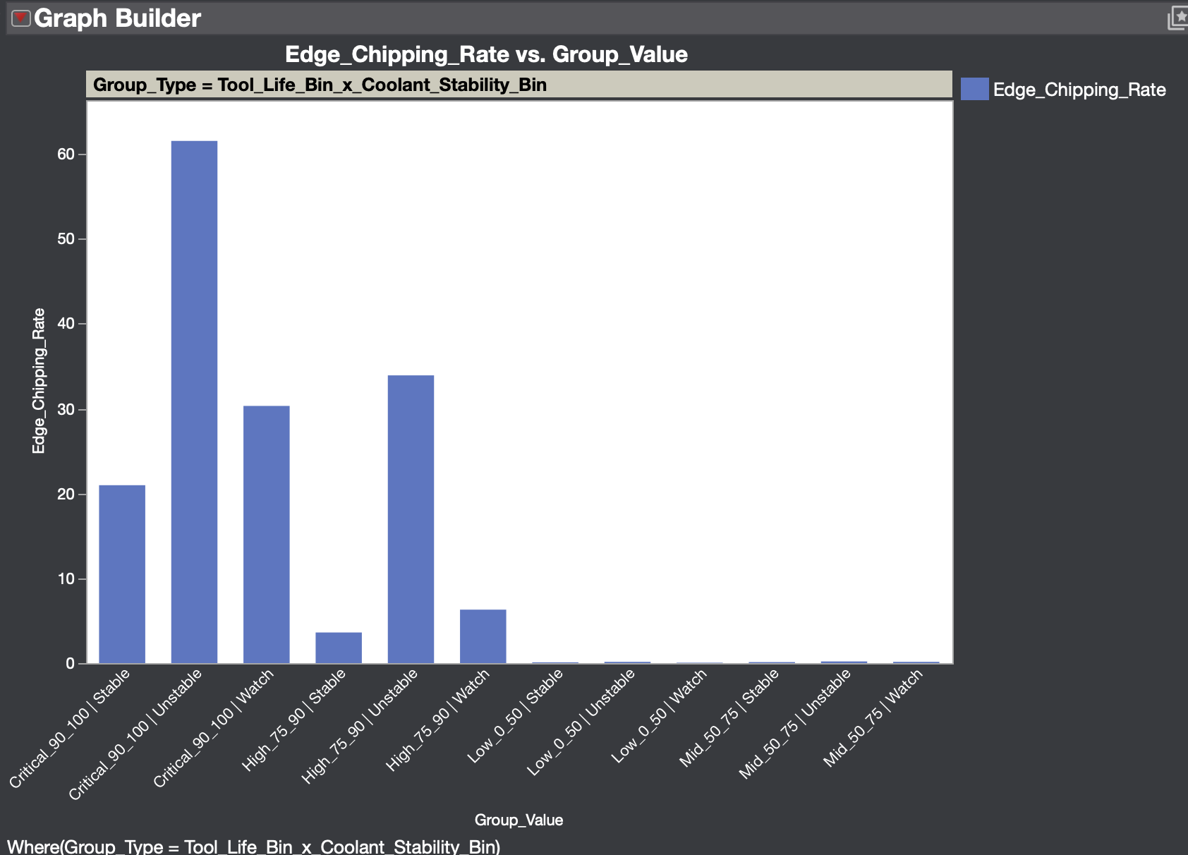
Key Finding: Tool Life × Coolant Stability
What I tested: tool-life band × coolant stability
Critical_90_100 + Unstable: 61.52% Edge_Chipping rate
Found through stratification — not assumed upfront
Why it matters: points to tooling + coolant interaction
Edge chipping is not random — it clusters in high tool-life and unstable coolant windows.
Tool life × coolant (JMP review)
Synthetic data only | Portfolio project
Notes:
When tool life is critical and coolant is unstable, chipping jumps to 61.5%. I didn't bake this into the headline — stratification rediscovered it.

Slide 11
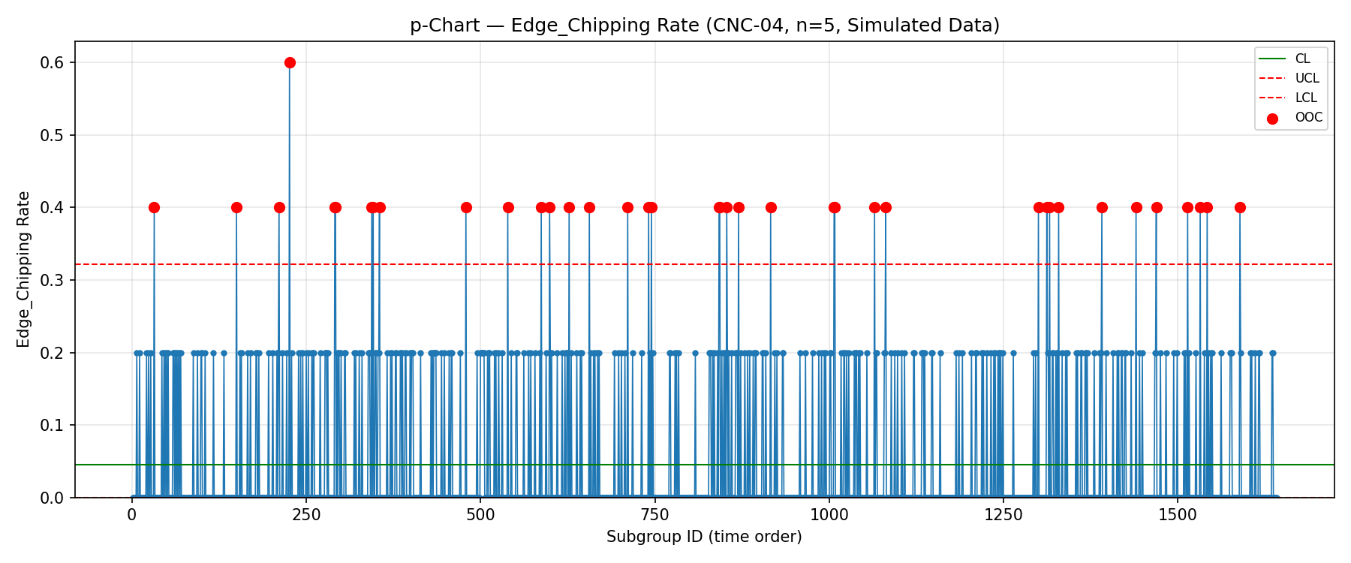
SPC Monitoring
What I tested: chamfer width (X-bar/R) and chipping rate (p-chart)
Chamfer is a continuous CTQ; chipping is an attribute rate
I-MR on chipping size kept exploratory (zero-inflated)
Why it matters: separates special cause from normal variation
Use p-chart for chipping rate; control limits are process-derived, not spec limits.
Edge chipping p-chart on CNC-04
Synthetic data only | Portfolio project
Notes:
For chipping I prefer the p-chart over I-MR on size because most units are zero.

Slide 12
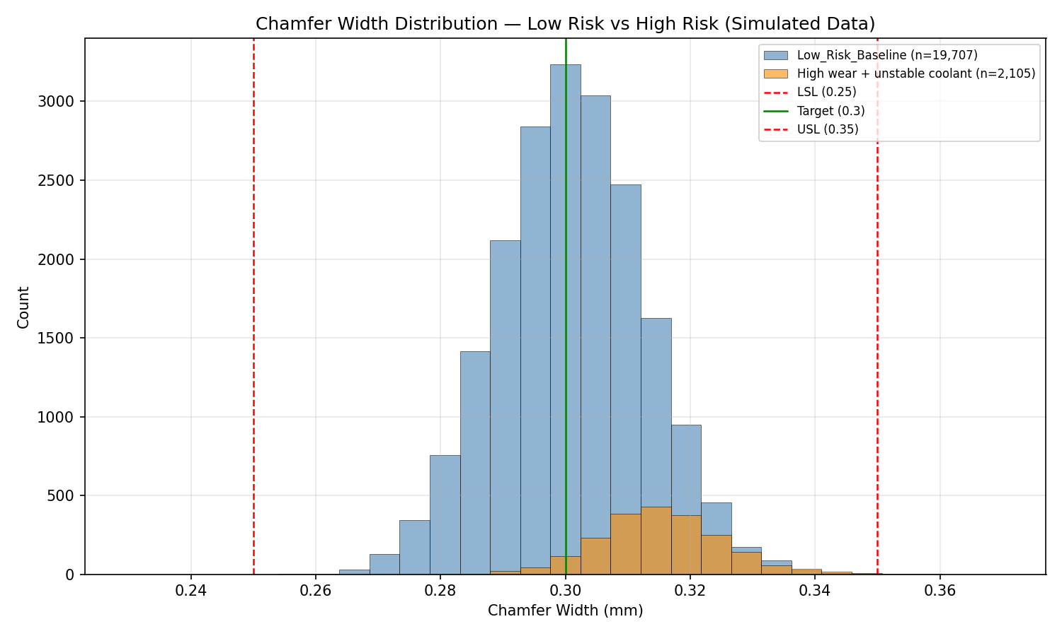
Process Capability
What I tested: chamfer width vs spec (LSL 0.25 / USL 0.35 mm)
Cp/Cpk: within-subgroup sigma (Rbar/d2)
Pp/Ppk: overall sigma
Low-risk Cpk ≈ 1.404 | High wear + unstable Cpk ≈ 1.181
High-risk window shifts mean toward USL — capability drops even if spread looks OK.
Chamfer capability by process window
Synthetic data only | Portfolio project
Notes:
Capability tells me spec margin, not just pass/fail. Baseline Cpk is ~1.4; the bad window drops to ~1.18 with a mean shift up.

Slide 13
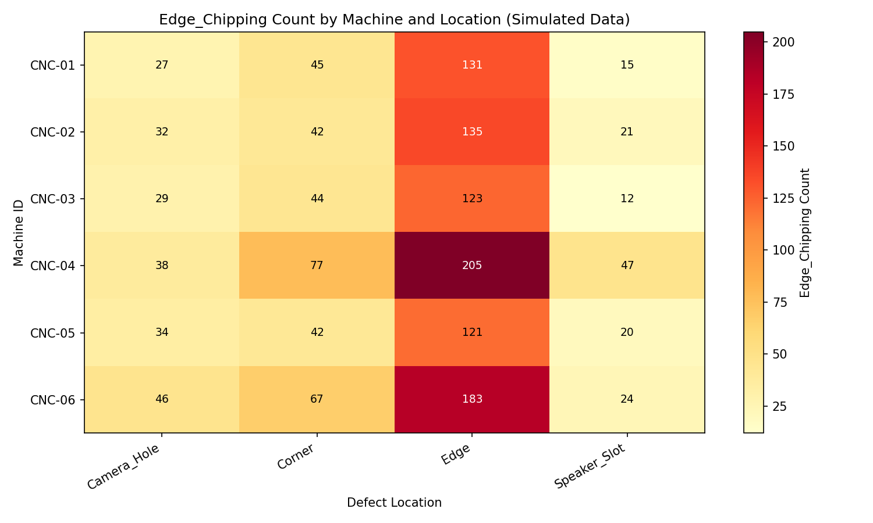
Defect Location Heatmap
What I tested: where Edge_Chipping shows up on the part
What the data showed: edge location dominates
Corners and feature cutouts are secondary clusters
Why it matters: supports CNC edge / contour root cause
Defects cluster on edges and corners — consistent with CNC contouring, not random handling.
Machine × defect location heatmap
Synthetic data only | Portfolio project
Notes:
Location pattern is another sanity check. If chipping were random contamination you'd expect a different map.

Slide 14
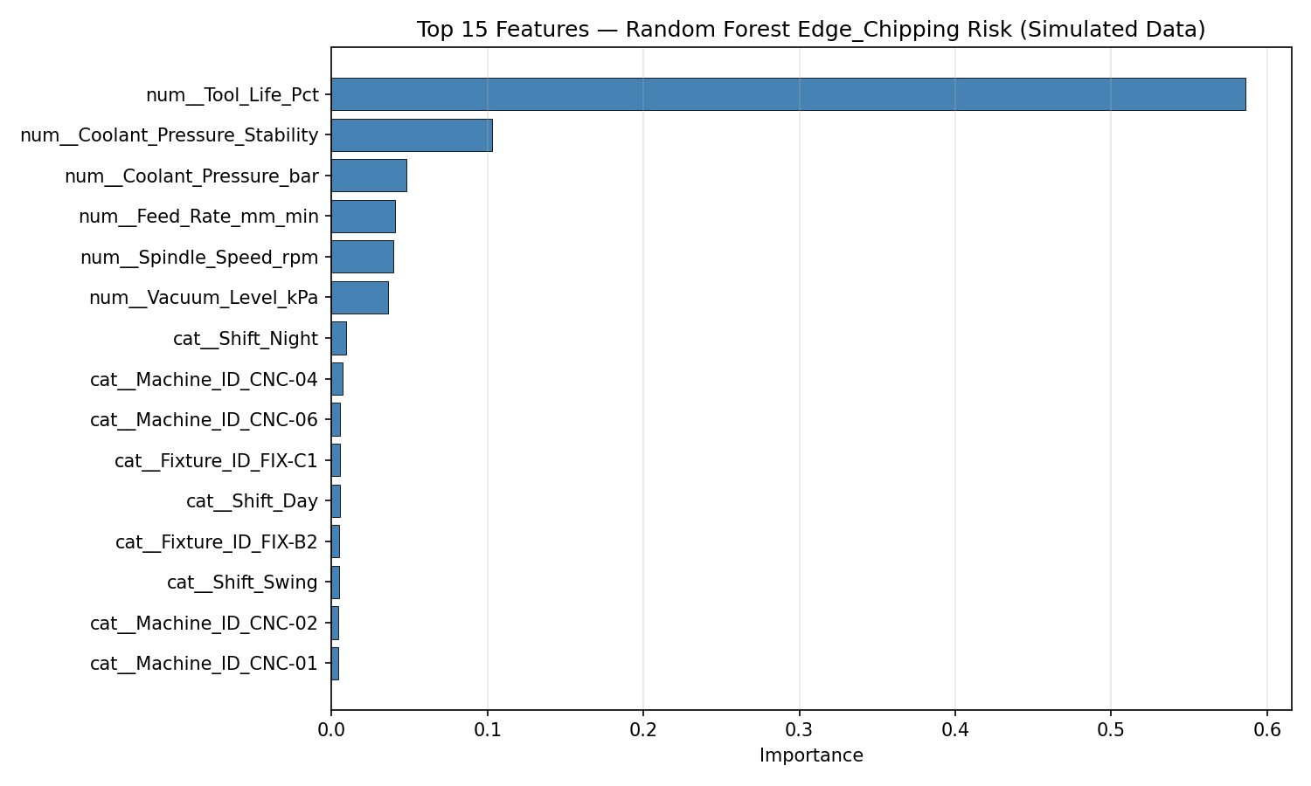
ML Risk Screening
What I tested: can process inputs rank chipping risk before inspection?
No CTQ leakage — process + traceability inputs only
ROC-AUC ~0.95 | PR-AUC ~0.40
Top features: Tool_Life_Pct, Coolant_Pressure_Stability, Coolant_Pressure_bar
ML is a screening aid — rank high-risk windows, not automatic process control.
Random Forest feature importance
Synthetic data only | Portfolio project
Notes:
ML supports the same story as stratification.

Slide 15
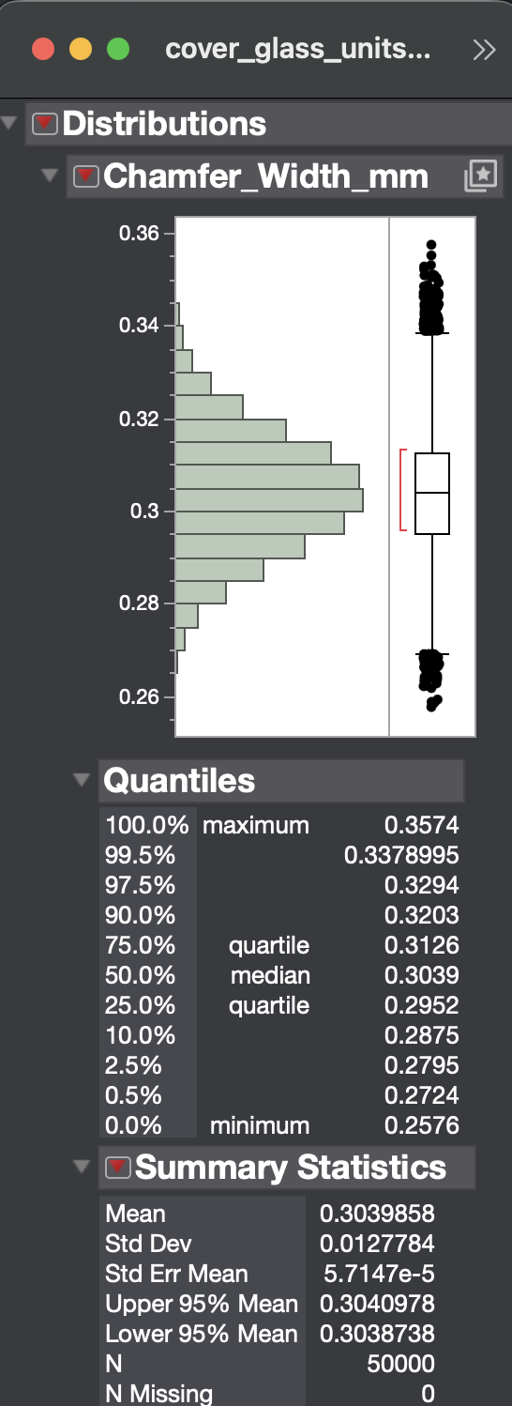
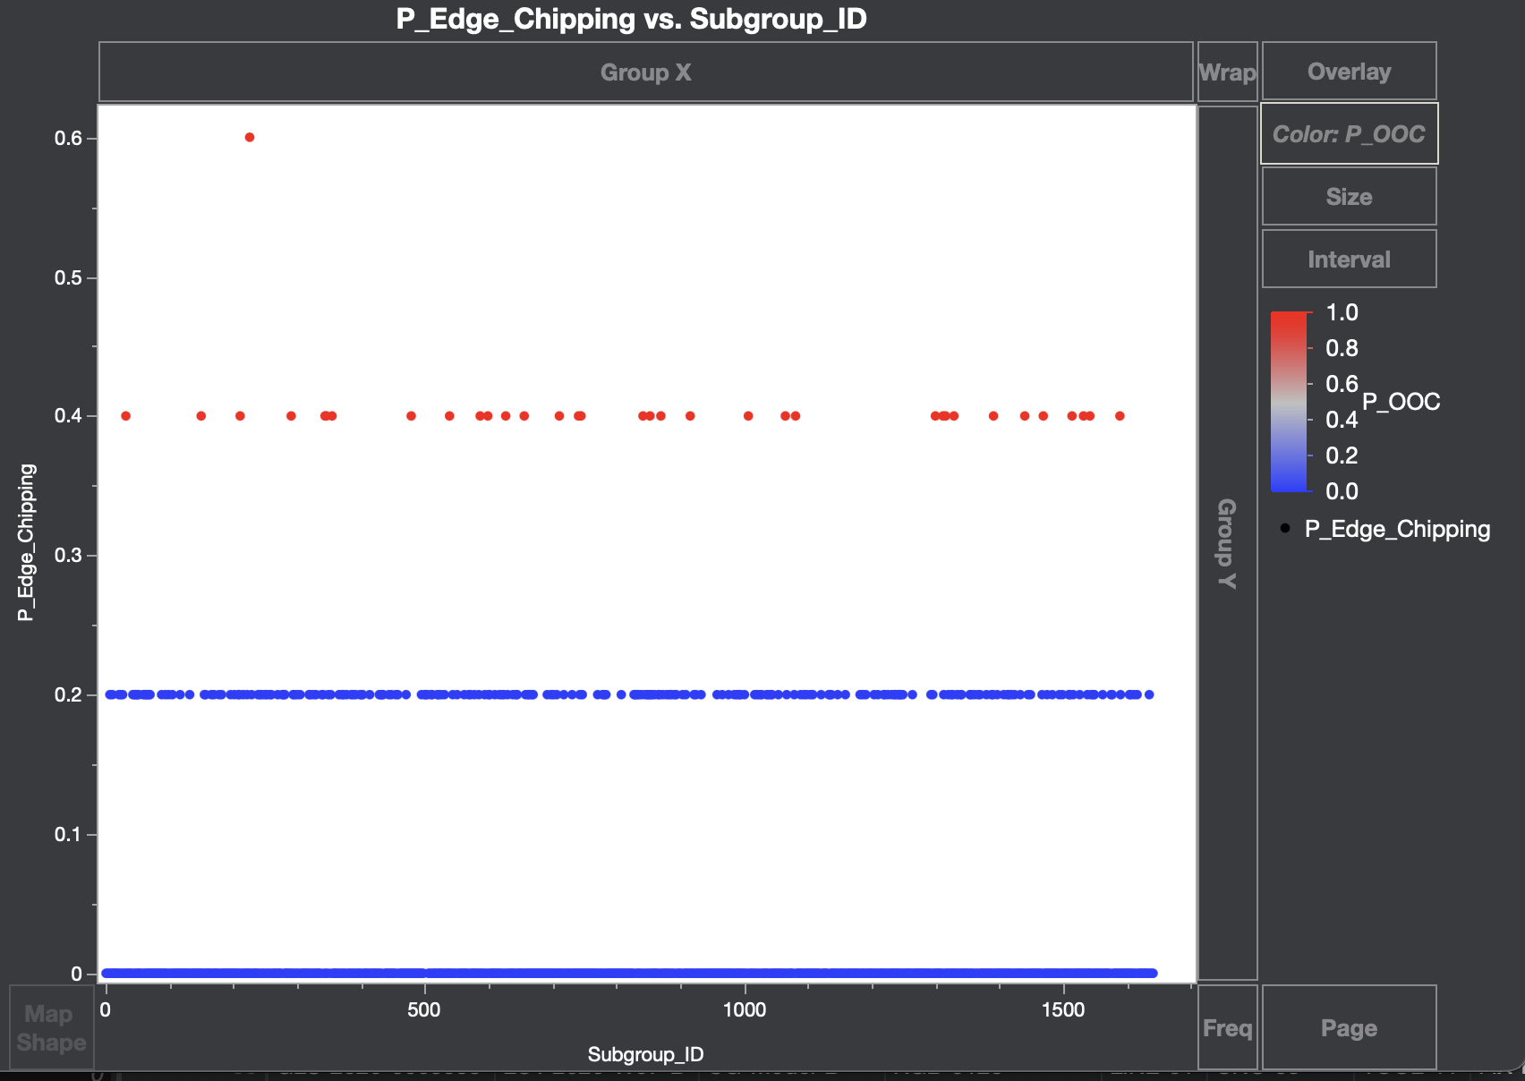
JMP Interactive Review Layer
Full 50,000-row dataset imported into JMP
Python = reproducible batch analytics
JMP = interactive filtering, CTQ review, OOC subgroup check
JMP supports live engineering review — Python stays the source of truth for calculations.
Chamfer CTQ distribution
OOC subgroup highlight
Synthetic data only | Portfolio project
Notes:
In a real review I'd open the JMP project and filter live. Python generated the numbers; JMP lets the team explore together.

Slide 16
MQE Recommendations
Containment: hold / sort high-risk lots on CNC-04, CNC-06
Corrective: inspect tooling, coolant system, FIX-B2 / FIX-C1
Preventive: tool-life stop (~75%), coolant interlock, SPC alerts, capability review
MQE action: contain now, fix tooling/coolant/fixtures, then lock in preventive controls.
Synthetic data only | Portfolio project
Notes:
Close the loop — containment first so bad material doesn't ship, then corrective on the machines and fixtures that stratified hot, then preventive so it doesn't come back.

Slide 17
Limitations & Future Work
Synthetic data only — no real AOI images or supplier data
No real DOE or line validation in Phase 1
Future: Streamlit dashboard, DOE simulation, reliability linkage, SHAP
Synthetic data only | Portfolio project
Notes:
This demonstrates MQE methodology on simulated data — next step would be real line validation.

Slide 18
Interview Takeaway
Structured MQE path: signature → traceability → SPC → capability → action
Connects materials / reliability background to manufacturing quality
Python for reproducible analytics; JMP for interactive review
AI-assisted workflow — with manual engineering review
Synthetic data only | Portfolio project
Notes:
I confirmed the defect, traced it to tool life and coolant, proved it with SPC and capability, and wrote containment plus preventive controls. All reproducible in Python, reviewable in JMP.

Slide 19
Thank You
Hexing Yin
GitHub: https://github.com/hexing-yin/mqe-glass-quality-demo
Synthetic data only | Portfolio project

