Slide 1
Hitchhiker
Login
Username:
Password:
Log in
Sign up
Copyright 2016 Web Application Development Team 10

Slide 2
Hitchhiker
Sign Up
First Name:
Last Name:
Email:
Username:
Age:
Bio:
Password:
Confirm Password:
Cancel
Sign up
Copyright 2016 Web Application Development Team 10

Slide 3
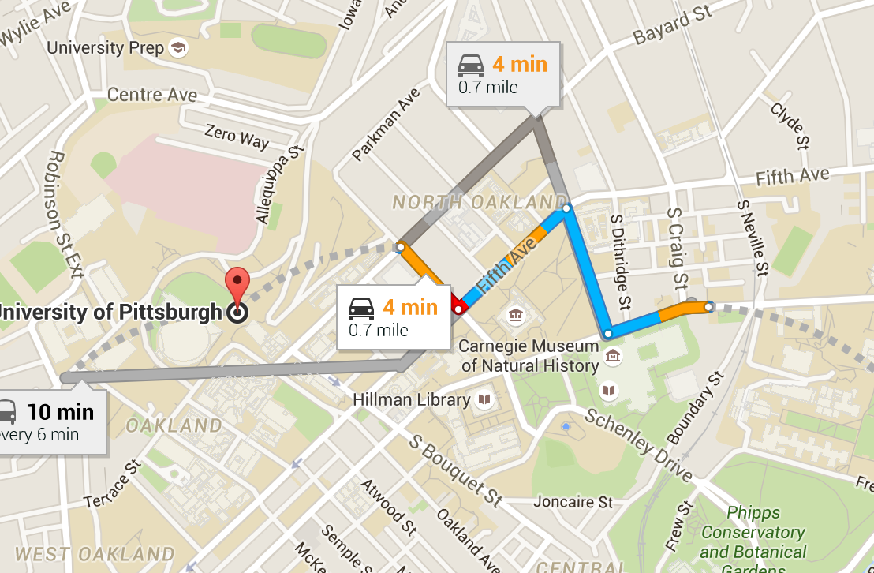
hitchhiker
hitchhiker
profile
log out
Choosing starting point or click on the map
Choosing destination or click on the map
post
driver
passenger
Copyright 2016 Web Application Development Team 10

Slide 4
hitchhiker
hitchhiker
profile
log out
Choosing starting point or click on the map
Choosing destination or click on the map
post
driver
passenger
Starting Point :
Carnegie Mellon University
Destination :
University of Pittsburgh
Departure Time :
Number of Passenger :
I am a driver
I am a passenger
Cancel
Confirm
Copyright 2016 Web Application Development Team 10

Slide 5

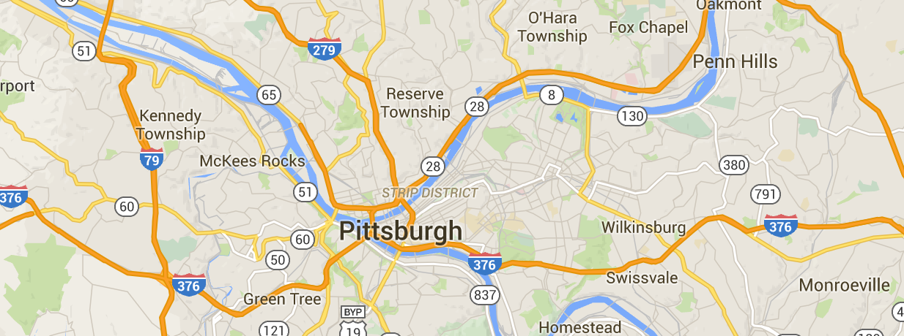
hitchhiker
profile
log out
Recently Visited Places
Friends List
Edit
Personal Information
People Sharing the Same Destination
Copyright 2016 Web Application Development Team 10

