Slide 1
Ch.5 Agile Development

Slide 2
The Manifesto for
Agile Software Development
“We are uncovering better ways of developing software by doing it and helping others do it. Through this work we have come to value:
  Individuals and interactions over processes and tools
  Working software over comprehensive documentation
  Customer collaboration over contract negotiation
  Responding to change over following a plan
That is, while there is value in the items on the right, we value the items on the left more.”
  Kent Beck et al

Slide 3
What is “Agility”?
Effective (rapid and adaptive) response to change
Effective communication among all stakeholders
Drawing the customer onto the team
Organizing a team so that it is in control of the work performed
Yielding …
Rapid, incremental delivery of software

Slide 4

Agility and the Cost of Change

Slide 5
An Agile Process
Is driven by customer descriptions of what is required (scenarios)
Recognizes that plans are short-lived
Develops software iteratively with a heavy emphasis on construction activities
Delivers multiple ‘software increments’
Adapts as changes occur

Slide 6
Agility Principles - I
Our highest priority is to satisfy the customer through early and continuous delivery of valuable software.
Welcome changing requirements, even late in development. Agile processes harness change for the customer's competitive advantage.
Deliver working software frequently, from a couple of weeks to a couple of months, with a preference to the shorter timescale.
Business people and developers must work together daily throughout the project.
Build projects around motivated individuals. Give them the environment and support they need, and trust them to get the job done.
The most efficient and effective method of conveying information to and within a development team is face–to–face conversation.

Slide 7
Agility Principles - II
Working software is the primary measure of progress.
Agile processes promote sustainable development. The sponsors, developers, and users should be able to maintain a constant pace indefinitely.
Continuous attention to technical excellence and good design enhances agility.
Simplicity – the art of maximizing the amount of work not done – is essential.
The best architectures, requirements, and designs emerge from self–organizing teams.
At regular intervals, the team reflects on how to become more effective, then tunes and adjusts its behavior accordingly.

Slide 8
Human Factors
the process molds to the needs of the people and team, not the other way around
key traits must exist among the people on an agile team and the team itself:
  Competence.
  Common focus.
  Collaboration.
  Decision-making ability.
  Fuzzy problem-solving ability.
  Mutual trust and respect.
  Self-organization.

Slide 9
Extreme Programming (XP)
The most widely used agile process, originally proposed by Kent Beck
XP Planning
  Begins with the creation of “user stories”
  Agile team assesses each story and assigns a cost
  Stories are grouped to for a deliverable increment
  A commitment is made on delivery date
  After the first increment “project velocity” is used to help define subsequent delivery dates for other increments

Slide 10
Extreme Programming (XP)
XP Design
  Follows the KIS principle
  Encourage the use of CRC cards (see Chapter 8)
  For difficult design problems, suggests the creation of “spike solutions”—a design prototype
  Encourages “refactoring”—an iterative refinement of the internal program design
XP Coding
  Recommends the construction of a unit test for a store before coding commences
  Encourages “pair programming”
XP Testing
  All unit tests are executed daily
  “Acceptance tests” are defined by the customer and executed to assess customer visible functionality

Slide 11
Extreme Programming (XP)
Spike solutions (For difficult problem)
prototypes
Simple design
CRC cards
User stories
values；
at most three weeks;
Acceptance test criteria
Iteration plan
Design
Coding
Planning
Refactoring
Pair programming
Test driven
Test
Release
Software increment
Project velocity computed
Unit test
continuous integration
Acceptance testing

Slide 12
Industrial XP (IXP)
IXP has greater inclusion od management, expanded customer roles, and upgraded technical practices
IXP incorporates six new practices:
  Readiness assessment
  Project community
  Project chartering
  Test driven management
  Retrospectives
  Continuous learning

Slide 13
Scrum
Originally proposed by Schwaber and Beedle
Scrum—distinguishing features
  Development work is partitioned into “packets”
  Testing and documentation are on-going as the product is constructed
  Work occurs in “sprints” and is derived from a “backlog” of existing requirements
  Meetings are very short and sometimes conducted without chairs
  “demos” are delivered to the customer with the time-box allocated

Slide 14
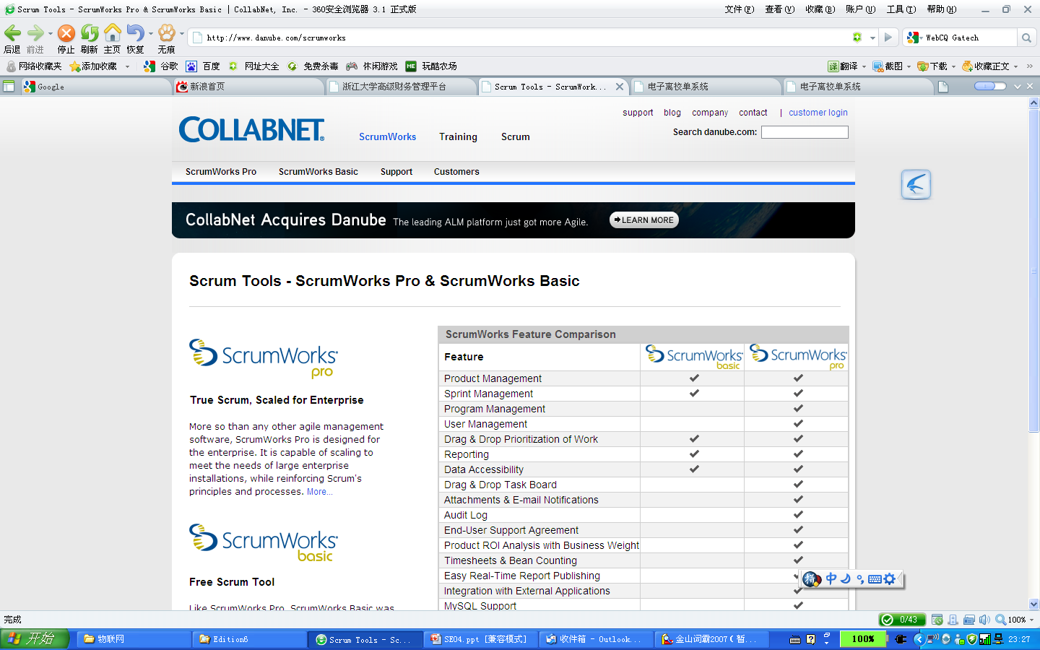

Scrum -- by Schwaber and Beedle
  http://www.danube.com/scrumworks
every 24 hours
Scrum: 15-minute daily meeting. Team members respond to basics:
1) What did you do since last Scrum meeting?
2) Do you have any obstacles?
3) What will you do before next meeting?
Backlog items expanded by team
Sprint Backlog:
Feature(s) assigned
to sprint
30 days
New functionality is demonstrated at end of sprint
Product Backlog:
Prioritized product features desired by the customer
8/11

Slide 15
Dynamic Systems Development Method
Promoted by the DSDM Consortium (www.dsdm.org)
DSDM—distinguishing features
  Similar in most respects to XP
  Nine guiding principles
        Active user involvement is imperative.
        DSDM teams must be empowered to make decisions.
        The focus is on frequent delivery of products.
        Fitness for business purpose is the essential criterion for acceptance of deliverables.
        Iterative and incremental development is necessary to converge on an accurate business solution.
        All changes during development are reversible.
        Requirements are baselined at a high level
        Testing is integrated throughout the life-cycle.

Slide 16
Dynamic Systems Development Method
80 percent rule
Feasibility
Business study
Agree plan
Implement
Create functional
prototype
Functional model iteration
Identify
functional
prototype
Review
business
Implemen-tation
Train
users
Review
prototype
User approval
& user guidelines
Agree plan
Create
design
prototype
Design & build iteration
Identify
design
prototype
Review
prototype

Slide 17
Agile Modeling
Originally proposed by Scott Ambler
Suggests a set of agile modeling principles
  Model with a purpose
  Use multiple models
  Travel light
  Content is more important than representation
  Know the models and the tools you use to create them
  Adapt locally

Slide 18
Agile Unified Process
Each AUP iteration addresses these activities:
  Modeling
  Implementation
  Testing
  Deployment
  Configuration and project management
  Environment management

