Slide 1
Ch.9 Requirements Modeling：
Scenario-Based Methods

Slide 2
Requirements Analysis
objectives
  Describe what the customer requires
  Establish a basis for the creation of a software design
  Define a set of requirements that can be validated
Requirements analysis allows the software engineer (called an analyst or modeler in this role) to:
  elaborate on basic requirements established during earlier requirement engineering tasks
  build models that depict user scenarios, functional activities, problem classes and their relationships, system and class behavior, the flow of data as it is transformed, constraints that software must meet.

Slide 3
A Bridge
system
description
analysis
model
design
model

Slide 4
Rules of Thumb
The model should focus on requirements that are visible within the problem or business domain. The level of abstraction should be relatively high.
Each element of the analysis model should add to an overall understanding of software requirements and provide insight into the information domain, function and behavior of the system.
Delay consideration of infrastructure and other non-functional models until design.
Minimize coupling throughout the system.
Be certain that the analysis model provides value to all stakeholders.
Keep the model as simple as it can be.

Slide 5

Domain Analysis
Goal: Software domain analysis is the identification, analysis, and specification of common requirements from a specific application domain, typically for reuse on multiple projects within that application domain . . .
technical literature
class taxononmies
SOURCES OF
DOMAIN
KNOWLEDGE
existing applications
reuse standards
DOMAIN
ANALYSIS
MODEL
customer surveys
DOMAIN
ANALYSIS
functional models
expert advice
current/future
requirements
domain languages

Slide 6
Scenario-based
models
Flow-oriented
models
Use-cases (text)
Use-case diagrams
Activity diagrams
Swim lane diagrams
Software
requirements
Data flow diagrams
control flow diagrams
Processing narratives
Class-based
models
Behavioral
models
Class diagrams
Analysis packages
CRC models
Collaboration diagrams
State diagrams
Sequence diagrams

Slide 7
Scenario-Based Modeling
Use-cases are simply an aid to defining what exists outside the system (actors) and what should be performed by the system
  (1) What should we write about?
  (2) How much should we write about it?
  (3) How detailed should we make our description?
  (4) How should we organize the description?

Slide 8
Use-Cases
a scenario that describes a “thread of usage” for a system
actors represent roles people or devices play as the system functions
users can play a number of different roles for a given scenario

Slide 9
Developing a Use-Case
What are the main tasks or functions that are performed by the actor?
What system information will the actor acquire, produce or change?
Will the actor have to inform the system about changes in the external environment?
What information does the actor desire from the system?
Does the actor wish to be informed about unexpected changes?

Slide 10
Reviewing a Use-Case
Use-cases are written first in narrative form and mapped to a template if formality is needed
Each primary scenario should be reviewed and refined to see if alternative interactions are possible
  Can the actor take some other action at this point?
  Is it possible that the actor will encounter an error condition at some point? If so, what?
  Is it possible that the actor will encounter some other behavior at some point? If so, what?

Slide 11
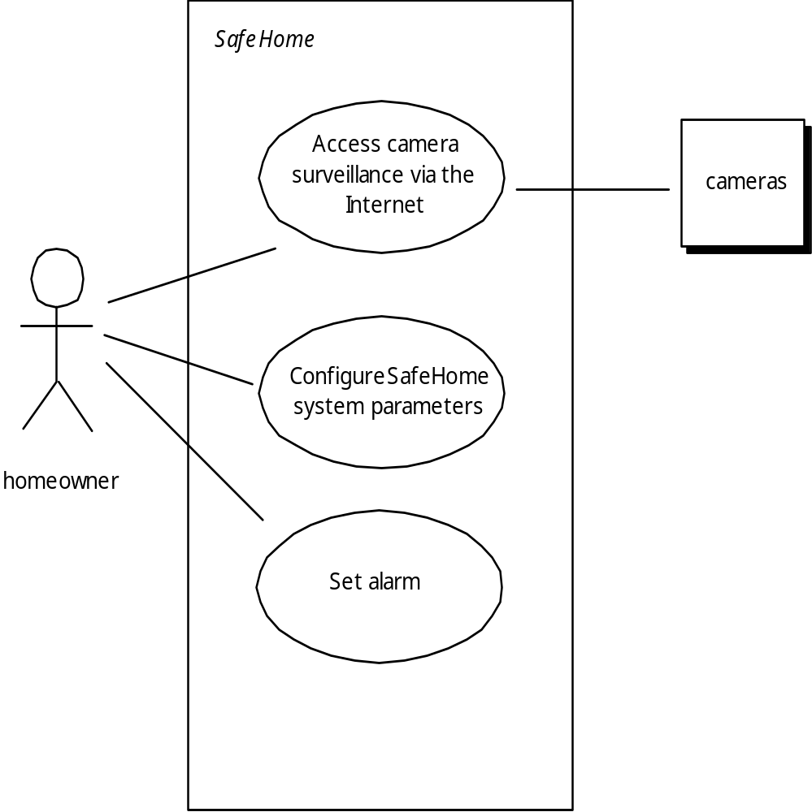
Use-Case Diagram

Slide 12
Activity and Swim Lane Diagrams
Activity diagram supplements the use-case by providing a diagrammatic representation of procedural flow
Swim lane diagram allows the modeler to represent the flow of activities described by the use-case and at the same time indicate which actor (if there are multiple actors involved in a specific use-case) or analysis class has responsibility for the action described by an activity rectangle

Slide 13
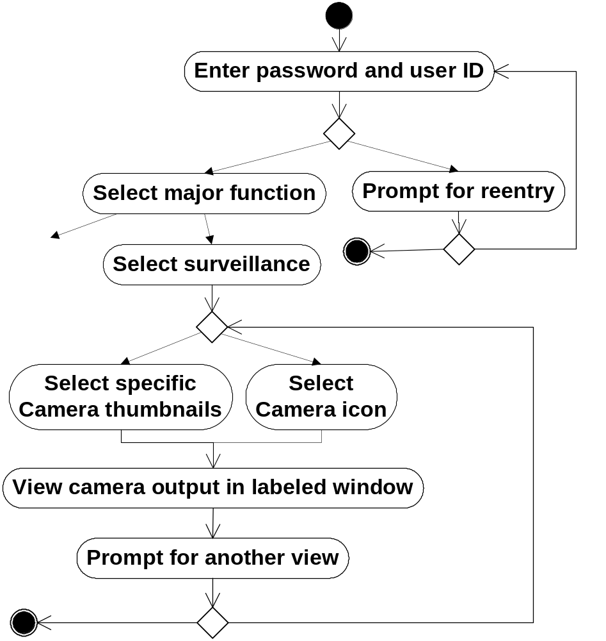
Activity diagram for
access camera
surveillance —
display camera
views function
Valid passwords/ID
Invalid passwords/ID
Other
functions
No input
Tries remain
Input tries
remain
Thumbnail views
Select a specific camera
Exit
See another camera

Slide 14
