Slide 1
Ch.22 Software Testing
Strategies

Slide 2
Software Testing
    Testing is the process of exercising a program with the specific intent of finding errors prior to delivery to the end user.

Slide 3

What Testing Shows
errors
requirements conformance
performance
an indication
of quality

Slide 4
Strategic Approach
To perform effective testing, you should conduct effective technical reviews. By doing this, many errors will be eliminated before testing commences.
Testing begins at the component level and works "outward" toward the integration of the entire computer-based system.
Different testing techniques are appropriate for different software engineering approaches and at different points in time.
Testing is conducted by the developer of the software and (for large projects) an independent test group.
Testing and debugging are different activities, but debugging must be accommodated in any testing strategy.

Slide 5
V & V
Verification refers to the set of tasks that ensure that software correctly implements a specific function.
Validation refers to a different set of tasks that ensure that the software that has been built is traceable to customer requirements. Boehm [Boe81] states this another way:
  Verification: "Are we building the product right?"
  Validation: "Are we building the right product?"

Slide 6


Who Tests the Software?
developer
independent tester
Understands the system
Must learn about the system,
but, will test "gently"
but, will attempt to break it
and, is driven by "delivery"
and, is driven by quality

Slide 7
Testing Strategy
System engineering
Analysis modeling
Design modeling
Code generation
Unit test
Integration test
Validation test
System test

Slide 8
Testing Strategy
We begin by ‘testing-in-the-small’ and move toward ‘testing-in-the-large’
For conventional software
  The module (component) is our initial focus
  Integration of modules follows
For OO software
  our focus when “testing in the small” changes from an individual module (the conventional view) to an OO class that encompasses attributes and operations and implies communication and collaboration

Slide 9
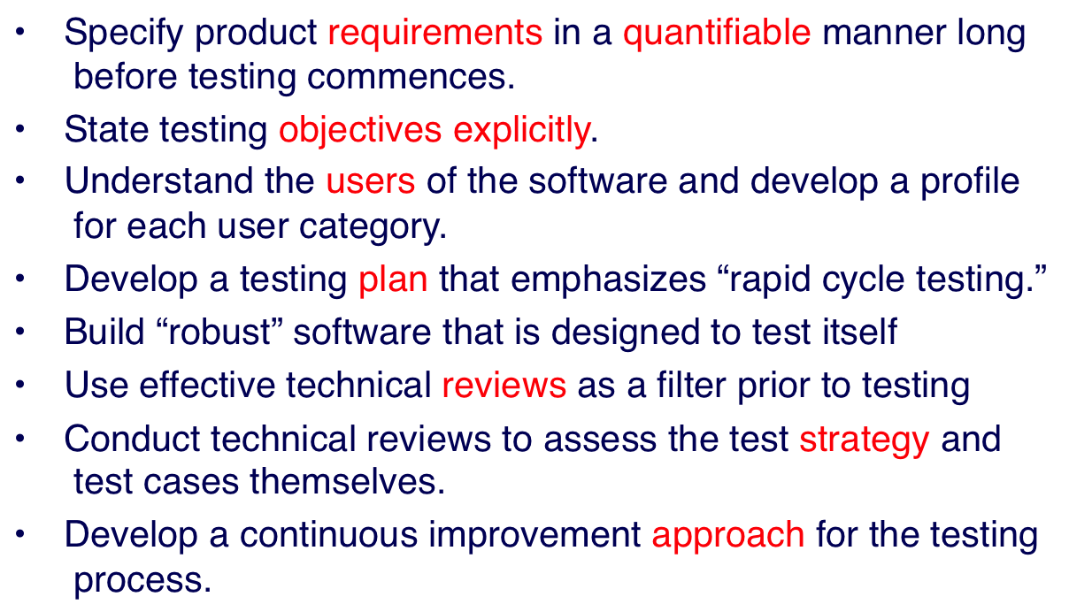
Strategic Issues

Slide 10


Unit Testing
module
to be
tested
results
software
engineer
test cases

Slide 11
Unit Testing
module
to be
tested
interface
local data structures
boundary conditions
independent paths
error handling paths
test cases

Slide 12
Unit Test Environment
driver
interface
local data structures
Module
boundary conditions
independent paths
error handling paths
stub
stub
test cases
RESULTS

Slide 13

Integration Testing Strategies
Options:
  the “big bang” approach
  an incremental construction strategy

Slide 14
Top Down Integration
A
top module is tested with
stubs
B
F
G
stubs are replaced one at
a time, "depth first"
C
as new modules are integrated,
some subset of tests is re-run
D
E

Slide 15
Bottom-Up Integration
A
B
F
G
drivers are replaced one at a
time, "depth first"
C
worker modules are grouped into
builds and integrated
D
E
cluster

Slide 16
Sandwich Testing
A
Top modules are
tested with stubs
B
F
G
C
Worker modules are grouped into
builds and integrated
D
E
cluster

Slide 17
Regression Testing
Regression testing is the re-execution of some subset of tests that have already been conducted to ensure that changes have not propagated unintended side effects
Whenever software is corrected, some aspect of the software configuration (the program, its documentation, or the data that support it) is changed.
Regression testing helps to ensure that changes (due to testing or for other reasons) do not introduce unintended behavior or additional errors.
Regression testing may be conducted manually, by re-executing a subset of all test cases or using automated capture/playback tools.

Slide 18
Smoke Testing
A common approach for creating “daily builds” for product software
Smoke testing steps:
  Software components that have been translated into code are integrated into a “build.”
        A build includes all data files, libraries, reusable modules, and engineered components that are required to implement one or more product functions.
  A series of tests is designed to expose errors that will keep the build from properly performing its function.
        The intent should be to uncover “show stopper” errors that have the highest likelihood of throwing the software project behind schedule.
  The build is integrated with other builds and the entire product (in its current form) is smoke tested daily.
        The integration approach may be top down or bottom up.

Slide 19
General Testing Criteria
Interface integrity – internal and external module interfaces are tested as each module or cluster is added to the software
Functional validity – test to uncover functional defects in the software
Information content – test for errors in local or global data structures
Performance – verify specified performance bounds are tested

Slide 20
Object-Oriented Testing
begins by evaluating the correctness and consistency of the analysis and design models
testing strategy changes
  the concept of the ‘unit’ broadens due to encapsulation
  integration focuses on classes and their execution across a ‘thread’ or in the context of a usage scenario
  validation uses conventional black box methods
test case design draws on conventional methods, but also encompasses special features

Slide 21
Testing the CRC Model
1. Revisit the CRC model and the object-relationship model.
2. Inspect the description of each CRC index card to determine if a delegated responsibility is part of the collaborator’s definition.
3. 68hnn m the connection to ensure that each collaborator that is asked for service is receiving requests from a reasonable source.
4. Using the inverted connections examined in step 3, determine whether other classes might be required or whether responsibilities are properly grouped among the classes.
5. Determine whether widely requested responsibilities might be combined into a single responsibility.
6. Steps 1 to 5 are applied iteratively to each class and through each evolution of the analysis model.

Slide 22
WebApp Testing - I
The content model for the WebApp is reviewed to uncover errors.
The interface model is reviewed to ensure that all use cases can be accommodated.
The navigation model for the WebApp is reviewed to uncover navigation errors.
The user interface is tested to uncover errors in presentation and/or navigation mechanics.
Each functional component is unit tested.

Slide 23
WebApp Testing - II
Navigation throughout the architecture is tested.
The WebApp is implemented in a variety of different environmental configurations and is tested for compatibility with each configuration.
Security tests are conducted in an attempt to exploit vulnerabilities in the WebApp or within its environment.
Performance tests are conducted.
The WebApp is tested by a controlled and monitored population of end-users. The results of their interaction with the system are evaluated for content and navigation errors, usability concerns, compatibility concerns, and WebApp reliability and performance.

Slide 24
MobileApp Testing
User experience testing – ensuring app meets stakeholder usability and accessibility expectations
Device compatibility testing – testing on multiple devices
Performance testing – testing non-functional requirements
Connectivity testing – testing ability of app to connect reliably
Security testing – ensuring app meets stakeholder security expectations
Testing-in-the-wild – testing app on user devices in actual user environments
Certification testing – app meets the distribution standards

Slide 25
High Order Testing
Validation testing
  Focus is on software requirements
System testing
  Focus is on system integration
Alpha/Beta testing
  Focus is on customer usage
Recovery testing
  forces the software to fail in a variety of ways and verifies that recovery is properly performed
Security testing
  verifies that protection mechanisms built into a system will, in fact, protect it from improper penetration
Stress testing
  executes a system in a manner that demands resources in abnormal quantity, frequency, or volume
Performance Testing
  test the run-time performance of software within the context of an integrated system

Slide 26

Debugging: A Diagnostic Process

Slide 27

The Debugging Process

Slide 28
Debugging Effort
time required
to diagnose the
symptom and
determine the
cause
time required
to correct the error
and conduct
regression tests

Slide 29
Symptoms & Causes
symptom and cause may be
geographically separated
symptom may disappear when
another problem is fixed
cause may be due to a
combination of non-errors
cause may be due to a system
or compiler error
symptom
cause may be due to
assumptions that everyone
cause
believes
symptom may be intermittent

Slide 30
Consequences of Bugs
infectious
damage
catastrophic
extreme
serious
disturbing
annoying
mild
Bug Type
Bug Categories:
function-related bugs,
system-related bugs, data bugs, coding bugs,
design bugs, documentation bugs, standards
violations, etc.

Slide 31
Debugging Techniques
brute force / testing
backtracking
induction
deduction

Slide 32
Correcting the Error
Is the cause of the bug reproduced in another part of the program? In many situations, a program defect is caused by an erroneous pattern of logic that may be reproduced elsewhere. （推演）
What “next bug” might be introduced by the fix I‘m about to make? Before the correction is made, the source code (or, better, the design) should be evaluated to assess coupling of logic and data structures. （带出泥）
What could we have done to prevent this bug in the first place? This question is the first step toward establishing a statistical software quality assurance approach. If you correct the process as well as the product, the bug will be removed from the current program and may be eliminated from all future programs.（溯源）

Slide 33
Final Thoughts
Think -- before you act to correct
Use tools to gain additional insight
If you’re at an impasse, get help from someone else
Once you correct the bug, use regression testing to uncover any side effects

