Slide 1
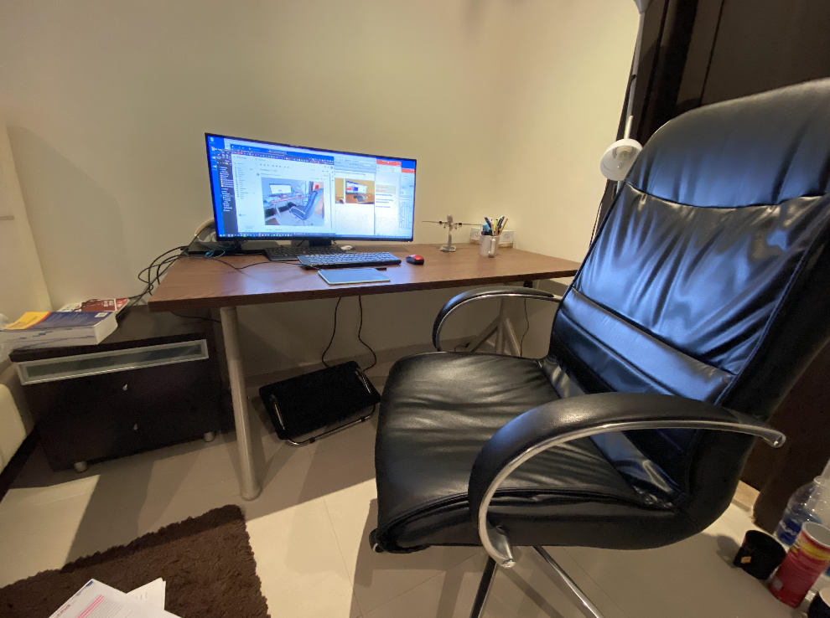
American University of the Middle East
IE386 (Work Analysis & Design I)
Example: Improving Ergonomic Problems in my room
IE386 (Your Section)
ID, Name
1. Background
5. Ergonomic Analysis
AUM started online classes from March, and I spend most of the time in my study room.
Sitting for more than 12 hours makes me very exhausted, and I need to identify and improve ergonomic problems.
Coronavirus pandemic may continue next 1-2 years (source)
I want to resolve my problems in my study room.
A. Used Ergonomics checklist (“Search”) for Item lost and messy desk problems
  Perhaps labels or color could be utilized?
  Will better layout of the workstation eliminate searching?
  Is proper lighting being used?
  Can tools and parts be prepositioned?
B. Used the Ergonomics checklist (“General posture evaluation, computer workstation, and general posture evaluation) for the neck-pain, tiresome, and bad posture problems.
  Are the joints maintained in a neutral position? (most are straight, elbow is at 90)
  Has the chair been adjusted first, then keyboard and mouse, finally the monitor?
  Is the monitor positioned 16 to 30 inches (roughly arm’s length) from the eyes?
  Is the document holder utilized for data transfer from papers?
  Are static postures avoided? i.e., are there changes in posture?
2. Current Problems
My desk is always messy.
I sit with bad posture for long hours.
I have a neck pain.
I get tired after sitting 2 hours.
Sometimes, iPhone, keys, wallet disappears.
6. Proposed Solutions
Solutions for the search/messy (I, V) problems
Change the layout of the workstation
Buy a light-stand, small containers, and bookshelf
Make preposition (home-position) for tools and put them back after using them.
Make a routine time for organizing and cleaning every day for 5 minutes
Solutions for the bad posture, neck pain and tiresome (II, III, and IV) problems.
Adjust the chair, then adjust the keyboard, mouse, and finally monitor so that joints maintain in a neutral position.
Position the monitor 16 30 inches (roughly arm’s length) from my eyes.
Buy a document holder
Avoid static postures, and make time for stretching and back-muscle exercising
Buy a 34-inch wide-monitor
Conduct stretch and exercise the back muscle
3. Goals
Resolve the above problems
Make a feasible implementation / deployment plan
4. Five-Whys Analysis (Basic IE Techniques)
Why-1
Why-2
Why-3
Why-4
Why-5
Items lost
Because it takes time to find
Desk is messy
Everything on desk
I do not have bookshelf
No money to buy it
Why-3
Why-4
7. Cost Analysis
We can evaluate the progress by measuring time to find iPhone, keys, wallet, and staples.
Not organized
No home-position for items
It is assumed to use items for 10 years to 30 years (my children can also use them)
Hours in a year = 4 hours/day x 7 days/week x 50 weeks/year = 1400 hours/year
The total cost per hour was 0.002KD/h, and it is acceptable for me.
If I spend one more year to graduate, it costs more than 418KD, this is acceptable.
Why-4
No habit to organize/clean
Why-5
Why-5
Did not make a routine time
No containers for small items
Neck pain
Why-1
Why-2
Why-3
Why-4
Bend my back
(kyphosis)
Because I want to see PC screen clearly
Text size is small
I did not change the PC settings
Why-1
Why-4
Why-5
Why-1
No stretch
My Note-PC’s screen is small
Because I did not know a Note-PC is not good for long-hours work.
Weak back muscle
Why-2
8. Timeline
Why-2
Don’t know how to stretch or exercise
Why-3
Why-3
Why-4
July | August | September | October | November | December
a, c, d, A, B,D | b, F |  | C |  | E
Did not make time
I was busy for work

