Slide 1
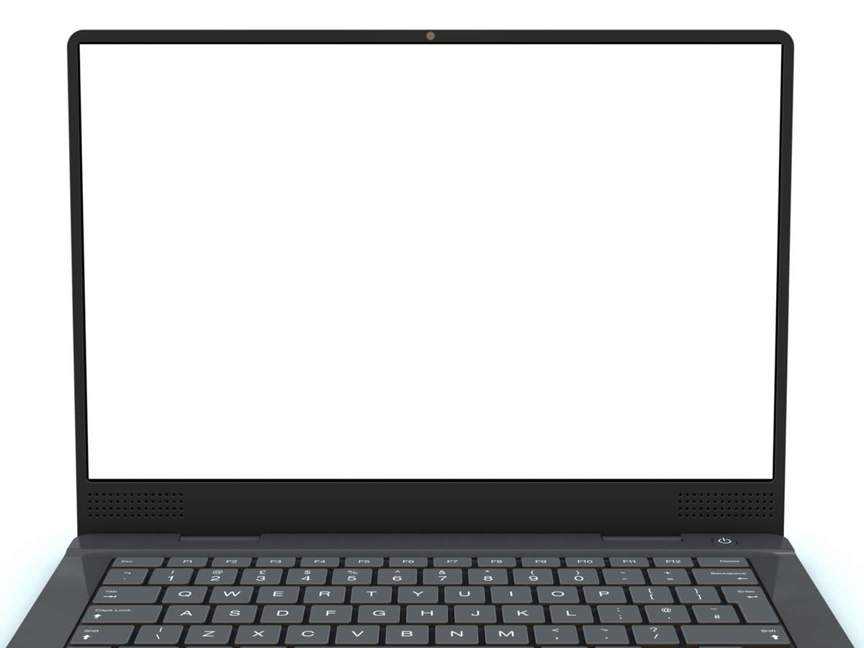
Def 2D Space Simulator
Programmers():
Harry(GUI designer) +
Tom (Engine creator)
Designer():
Adem (If it's colourful he made it
(more or less)(kinda)(not really))

Slide 2
        enjoy

