Slide 1
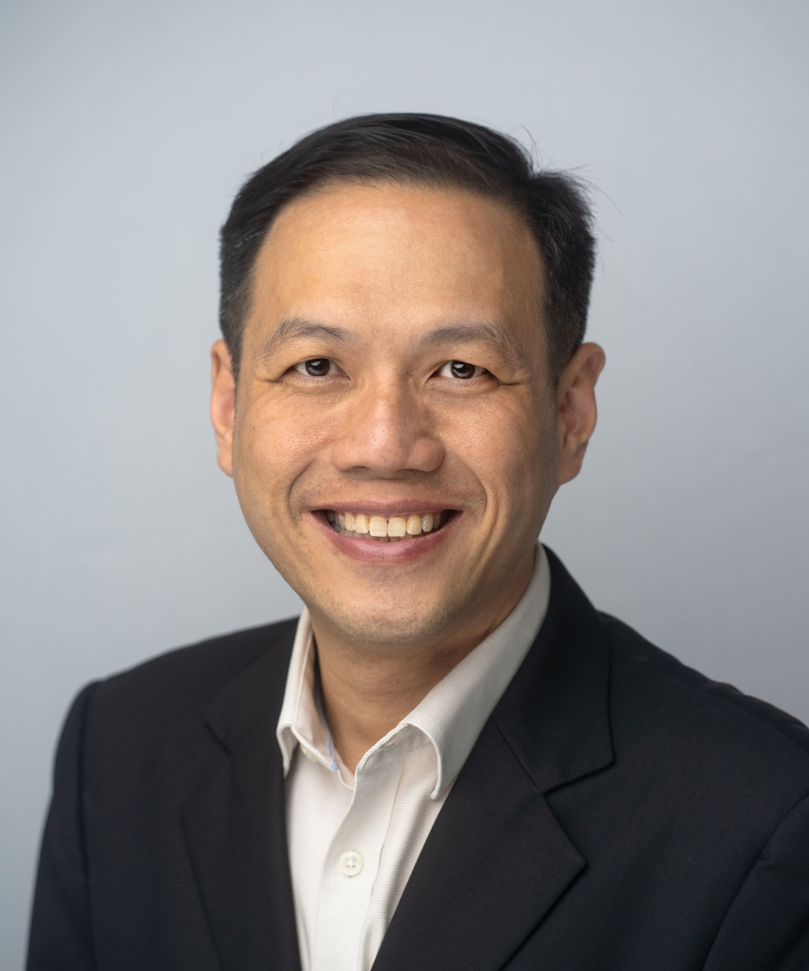

WELCOME SPEECH
General Chair, EPTC 2026
Prof. Yeow Kheng LIM
National University of Singapore
28th IEEE Electronics Packaging Technology Conference
1–4 December 2026 | Singapore
Notes:
Distinguished guests, industry leaders, colleagues, sponsors, and friends, good morning.

Slide 2



Welcome to EPTC 2026
Welcome to Singapore and to the 28th IEEE Electronics Packaging Technology Conference.
28th
edition of EPTC
Returning delegates
Welcome back.
4 days
1–4 December 2026
First-time participants
We are delighted to have you here.
A global meeting place
Singapore
IEEE EPS flagship conference in Asia Pacific
Your participation makes EPTC a valuable meeting place for the electronics packaging community.
Notes:
On behalf of the Organising Committee, it is my great pleasure to welcome you to Singapore and to the 28th IEEE Electronics Packaging Technology Conference, EPTC 2026.
To our returning delegates, welcome back. To those joining us for the first time, we are delighted to have you here. Your participation makes EPTC a valuable meeting place for the global electronics packaging community.

Slide 3
Thank You to Our Sponsors, Partners & Exhibitors
DIAMOND
PLATINUM
GOLD
SILVER
BRONZE
Notes:
Let me begin by expressing our sincere appreciation to all our sponsors.
To our Diamond, Platinum, Gold, Silver, and Bronze sponsors, and to all our supporting partners and exhibitors, thank you. Your generous contributions help us deliver a strong technical programme and create opportunities for researchers, engineers, and students to connect with industry. We deeply appreciate your continued confidence in EPTC.

Slide 4
Our Organising Committee
Thank you for the many months of planning and coordination, and to our Technical Programme Committee, reviewers and session chairs for upholding the quality of our programme.
Notes:
I would also like to recognise the people who have worked tirelessly to bring this conference together.
To our Organising Committee, thank you for the many months of planning and coordination. To our Technical Programme Committee, reviewers and session chairs, thank you for contributing your time and expertise to maintaining the quality of our programme.

Slide 5

The Team Behind EPTC 2026
IEEE EPS
IEEE RS/EPS/EDS Singapore Joint Chapter
InPrep
SparkPlanners
IEEE Electronics Packaging Society
IEEE RS/EPS/EDS Singapore Joint Chapter
Conference Secretariats
Student Helpers & Volunteers
For their leadership and continued support
For their leadership and continued support
For their dedication and hard work behind the scenes
For your energy, commitment and warm hospitality
Please join me in a warm round of applause
Notes:
We are grateful to the IEEE Electronics Packaging Society and the IEEE RS/EPS/EDS Singapore Joint Chapter for their leadership and continued support.
A special word of thanks goes to our conference secretariats, InPrep and SparkPlanners, for their dedication and hard work behind the scenes.
To our student helpers and volunteers, thank you for your energy, commitment, and warm hospitality. Please join me in giving the entire team a warm round of applause.
[Pause for applause]

Slide 6




Programme Highlights
AI & HPC are raising the bar. Our four-day programme tackles how we:
Connect dies
Deliver power
Remove heat
Ensure reliability
DAY 1
Tue 1 Dec
DAY 2
Wed 2 Dec
DAY 3
Thu 3 Dec
DAY 4
Fri 4 Dec
4
Keynote addresses
6
Professional Development Courses
Oral & poster presentations
Oral, poster & invited presentations
2
Panel discussions
Invited presentations
6
Fundamental Courses
Heterogeneous Integration Roadmap Workshop
Panel discussion
Poster session
Notes:
Ladies and gentlemen, artificial intelligence and high-performance computing are placing greater demands on electronics packaging. Meeting these demands requires advances in how we connect dies, deliver power, remove heat, and ensure reliability.
Our four-day programme brings together research findings and industry perspectives to address these challenges.
Today, we begin with four keynote addresses and two panel discussions, featuring leading voices on technology developments and industry priorities.
Day Two offers six Professional Development Courses and six Fundamental Courses, alongside a poster session, providing opportunities to deepen expertise and build new knowledge.
Day Three features oral and poster presentations, invited presentations and a panel discussion.
Day Four continues with oral, poster and invited presentations, together with the Heterogeneous Integration Roadmap Workshop, examining future technology needs and priorities.
I encourage everyone, especially our students and early-career participants, to ask questions and explore sessions beyond your own specialisation.

Slide 7
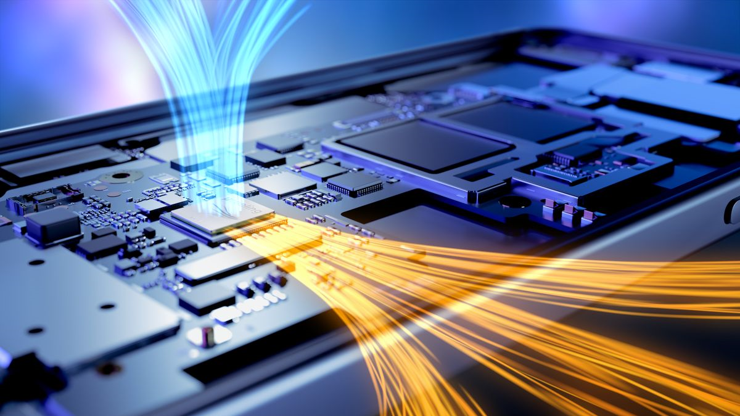






Introducing EPTEX
Electronics Packaging Technology EXPO, held alongside EPTC
Technology
Tools
Talents
Supporting Package Design, Prototyping and Production with live demonstrations and direct engagement with solution providers.
Sponsor & exhibitor presentations
Industry forum chaired by EDB
Expert insights & displays: robotics, emerging technologies, start-up innovation
Networking with potential collaborators
Notes:
This year, we are also pleased to introduce EPTEX, the Electronics Packaging Technology EXPO, held alongside EPTC.
EPTEX brings together Technology, Tools, and Talents to support Package Design, Prototyping and Production. Through live demonstrations and direct engagement with solution providers, it connects our technical discussions with practical applications.
Highlights include sponsor and exhibitor presentations, an industry forum chaired by EDB, and expert insights and displays spanning robotics, emerging technologies, and start-up innovation. Networking activities provide further opportunities to meet potential collaborators.

Slide 8




Art of Packaging with AI
CHALLENGE 1 OF 3
Bringing an artistic and creative dimension to electronics packaging
Create
Packaging technology reimagined as art, with AI as the creative tool
View the entries
See how participants interpret electronics packaging
Join the discussion
Support the participants and share your thoughts
Where engineering meets imagination
Notes:
A particular highlight is the three challenges that bring creativity and engineering problem-solving into the programme.
The first, Art of Packaging with AI, brings an artistic and creative dimension to electronics packaging.

Slide 9


Tech Challenge – Open Category
CHALLENGE 2 OF 3
Thermal management for advanced GPU and HBM packages in AI data centres
Heat spreader / cooling
The context
AI data-centre workloads push GPU and high-bandwidth memory (HBM) power ever higher
GPU
The problem
Removing heat from advanced GPU + HBM packages
HBM
HBM
Open to all
Interposer
Engineers and researchers demonstrate ideas on a real engineering problem
Package substrate
Notes:
The second, the Tech Challenge, Open Category, addresses thermal management for advanced GPU and high-bandwidth memory packages in AI data centres.

Slide 10


Student Innovation Challenge
CHALLENGE 3 OF 3
Optimising thermal interface materials for advanced packaging and reliability
Heat sink
TIM 2
Lid / heat spreader
For students
The next generation tackles a real packaging problem
TIM 1
Die
The focus
Thermal interface materials (TIM) that improve heat flow and reliability
Substrate
Support them
View the entries and join the discussions
TIM layers carry heat from die to lid and lid to heat sink — where performance and reliability are won or lost.
Notes:
The third, the Student Innovation Challenge, focuses on optimising thermal interface materials for advanced electronics packaging and reliability.
Together, these challenges give participants opportunities to demonstrate their ideas and engage with real engineering problems. I encourage you to view the entries, support the participants, and join the discussions.

Slide 11


Welcome to EPTC 2026 & EPTEX
Thank you to every speaker, author and delegate for contributing your time and ideas.
A rewarding conference
Productive discussions
An enjoyable stay in Singapore
THANK YOU
Notes:
Please also take time to visit our exhibitors. Share the challenges you face and explore the solutions on display. A conversation here could become your next research partnership or engineering breakthrough.
Finally, thank you to every speaker, author, and delegate for contributing your time and ideas.
On behalf of the Organising Committee, I officially welcome you to EPTC 2026 and EPTEX.
I wish you a rewarding conference, productive discussions, and an enjoyable stay in Singapore.
Thank you.

