Slide 1
Git and GitHub Primer
Hussaina Begum N.

Slide 2
Agenda
Version control systems
Intro to Git and GitHub
Creating a repo and committing some changes
Git branching and merging
Create a branch and merge changes to main branch

Slide 3

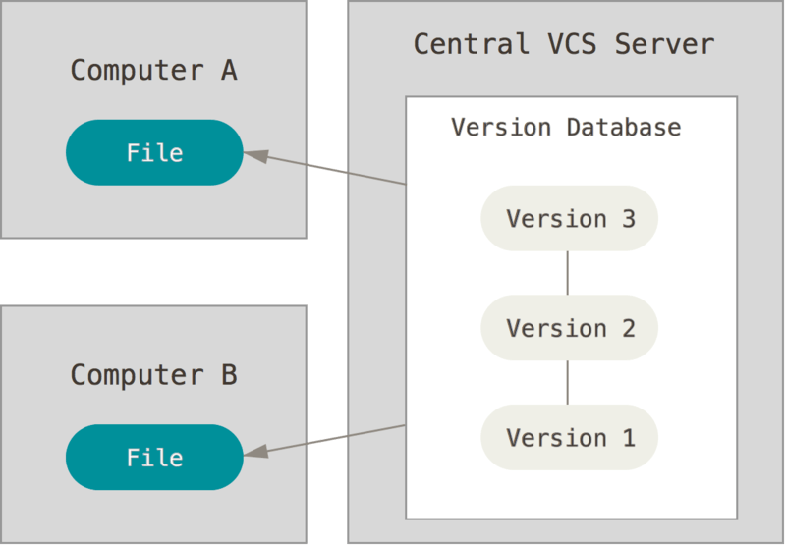
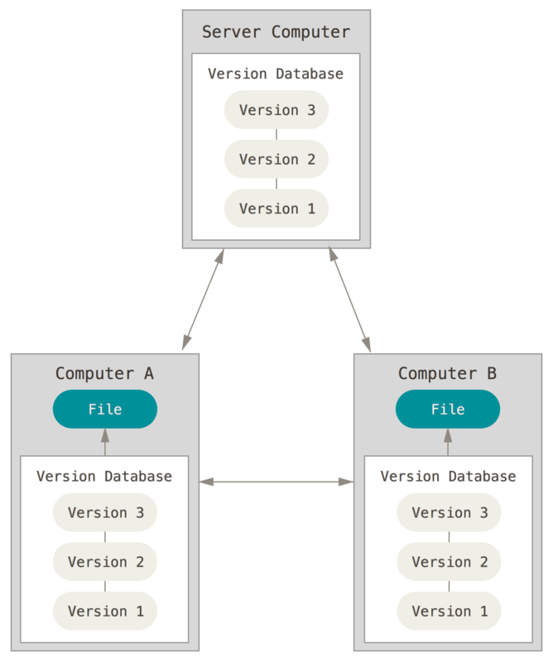
Version control systems
Local version control system
Centralized version control system
Distributed version control system
Img src: git-scm.com

Slide 4
Git – distributed version control tool
To keep track of changes
Synchronize code changes
Test any intermediate changes w/o affecting original code
Revert to earlier version of code

Slide 5
GitHub service
A cloud-based code hosting service
Space where the code (git) repositories are stored
Has a Graphical user interface
Built-in User management support
Code Browsing/Issue management/Pull Requests
Security features

Slide 6
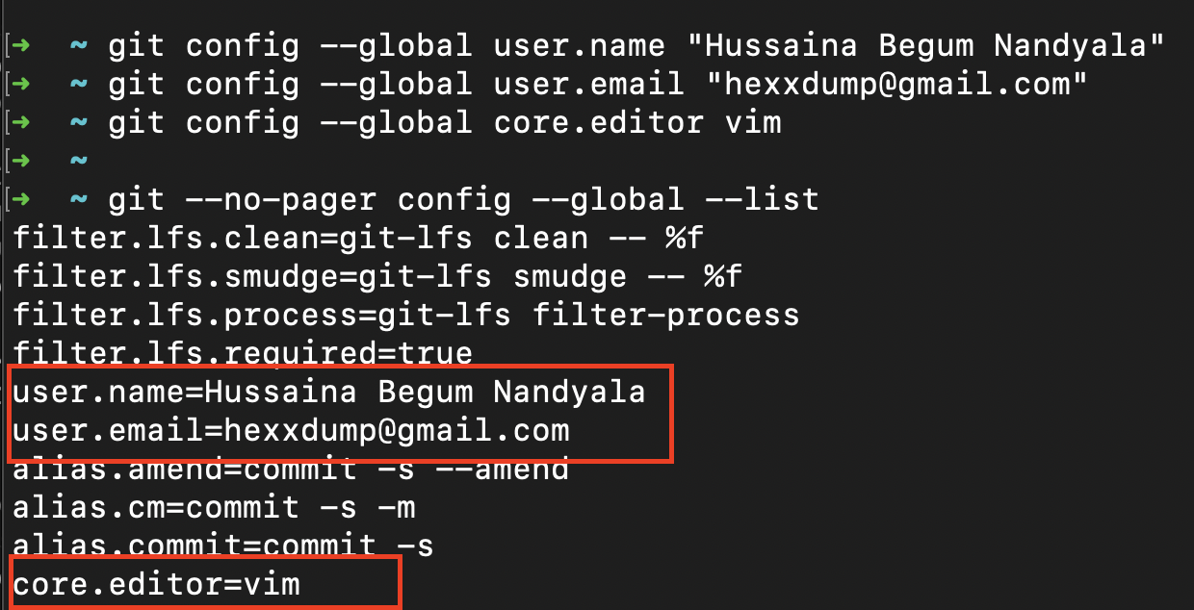
Getting started
git config --global user.name ”Firstname Lastname”
git config --global user.email ”user@abc.com”
git config --global core.editor vim
git config --global –list
Notes:
https://git-scm.com/book/en/v2/Getting-Started-Installing-Git

Slide 7
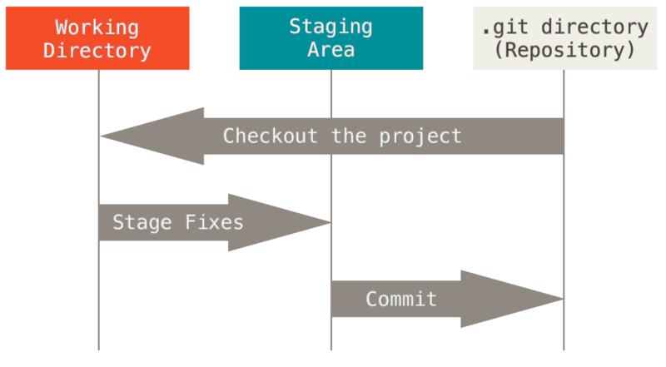
Git commit process
mkdir <codedir>; cd <codedir>
git init
Create the files
git add file1 file2 file3 …
git commit
git push
Img src: git-scm.com

Slide 8
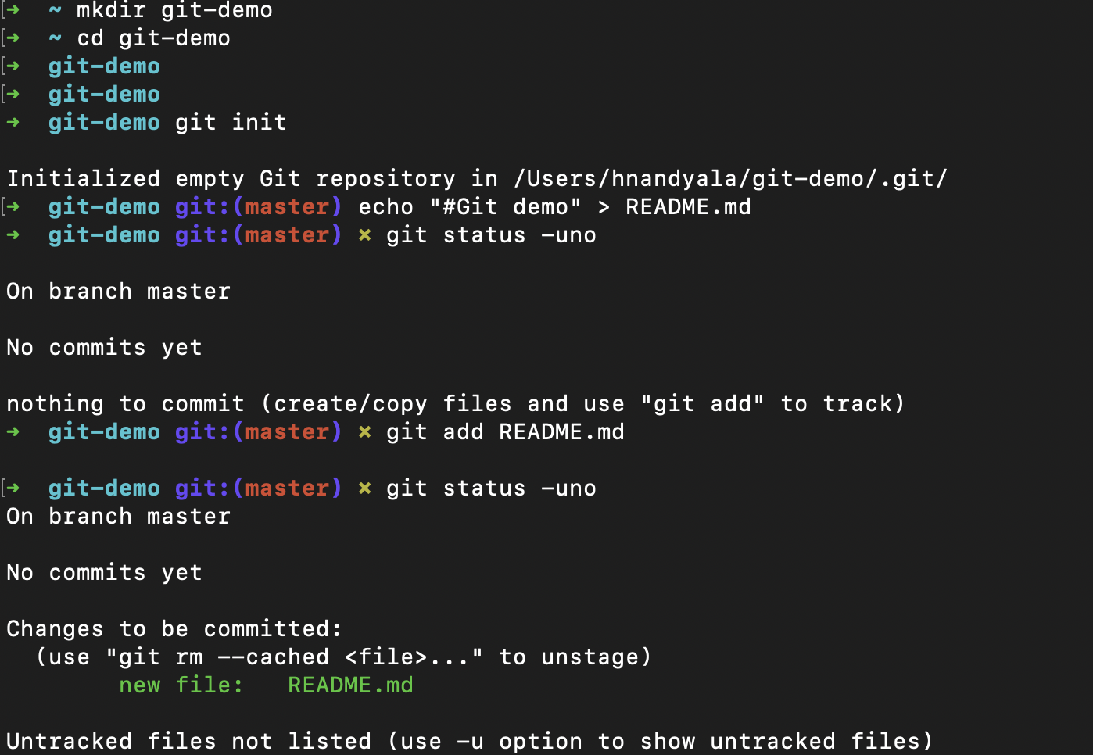
Hands on

Slide 9
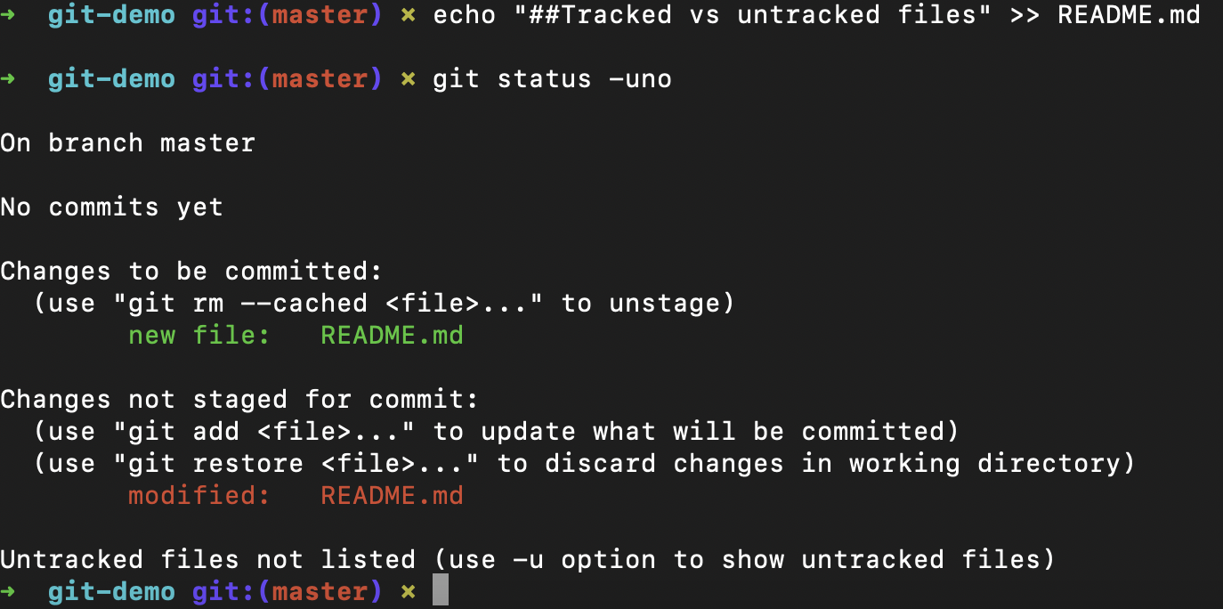
Hands on

Slide 10
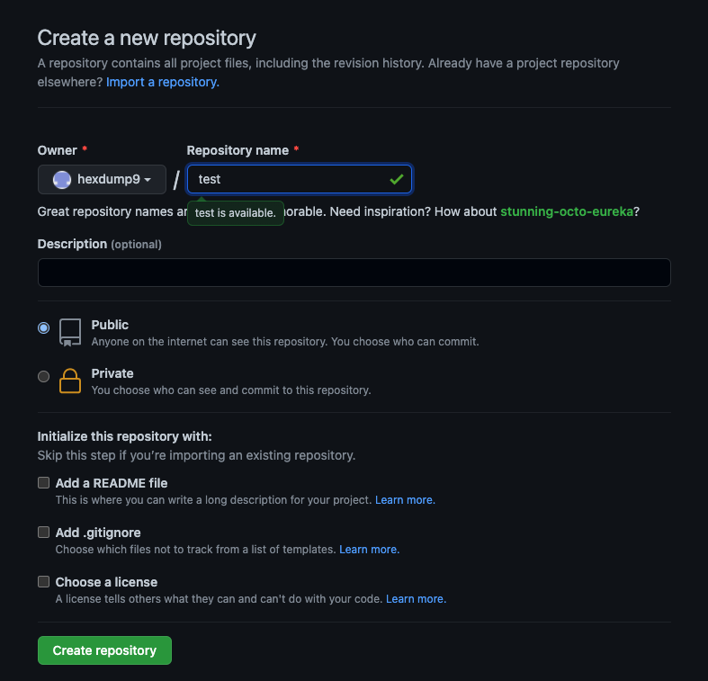
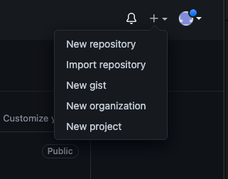
Hands on – Creating a repo on GitHub

Slide 11
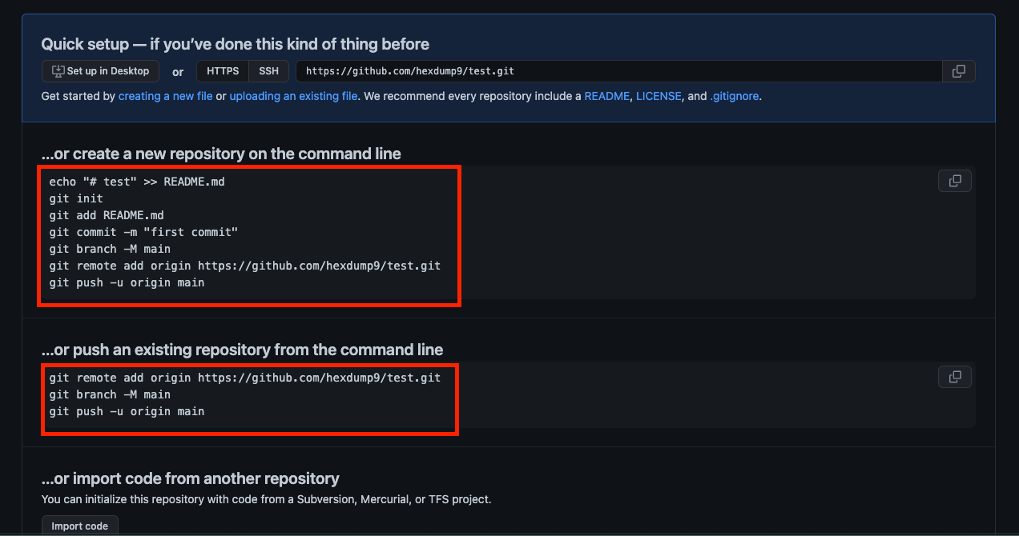
Hands on – Working on a GitHub repo
Notes:
Create a new repo on GitHub
===========================
echo "# test" >> README.md
git init
git add README.md
git commit -m "first commit"
git branch -M main
git remote add origin https://github.com/hexdump9/test.git
git push -u origin main
Push an existing repo to GitHub
===========================
git remote add origin https://github.com/hexdump9/test.git
git branch -M main
git push -u origin main

Slide 12
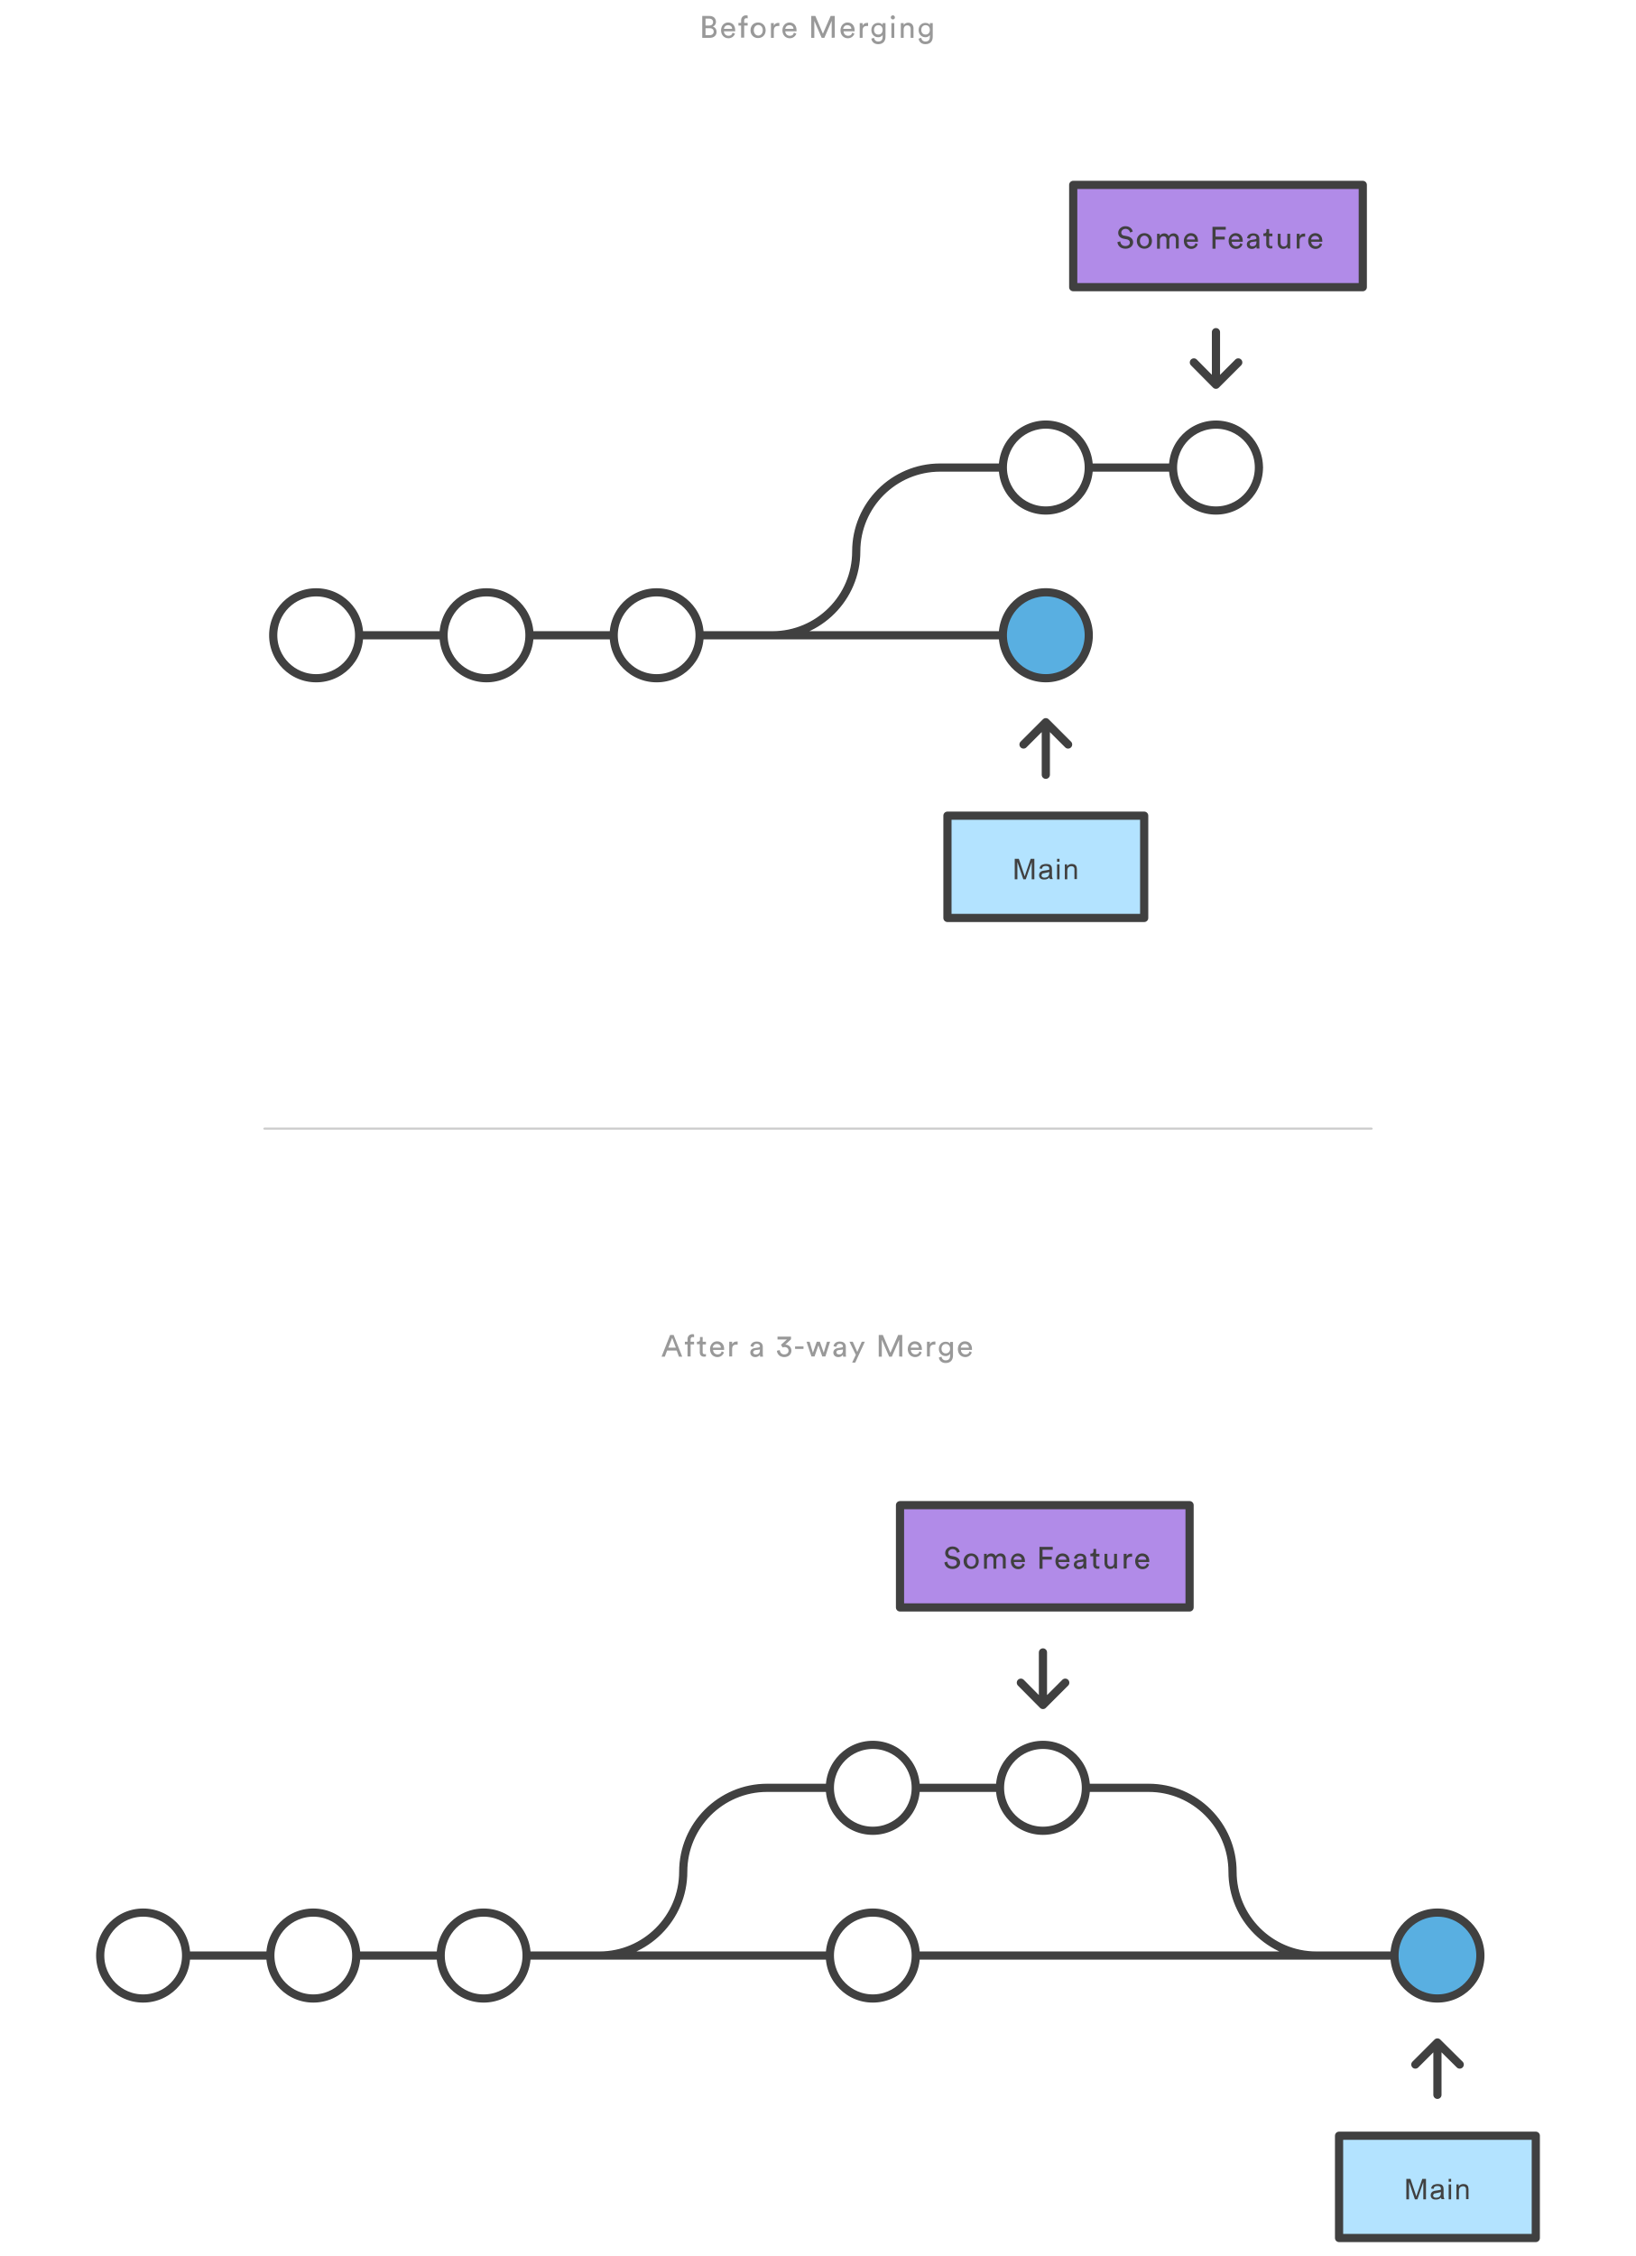
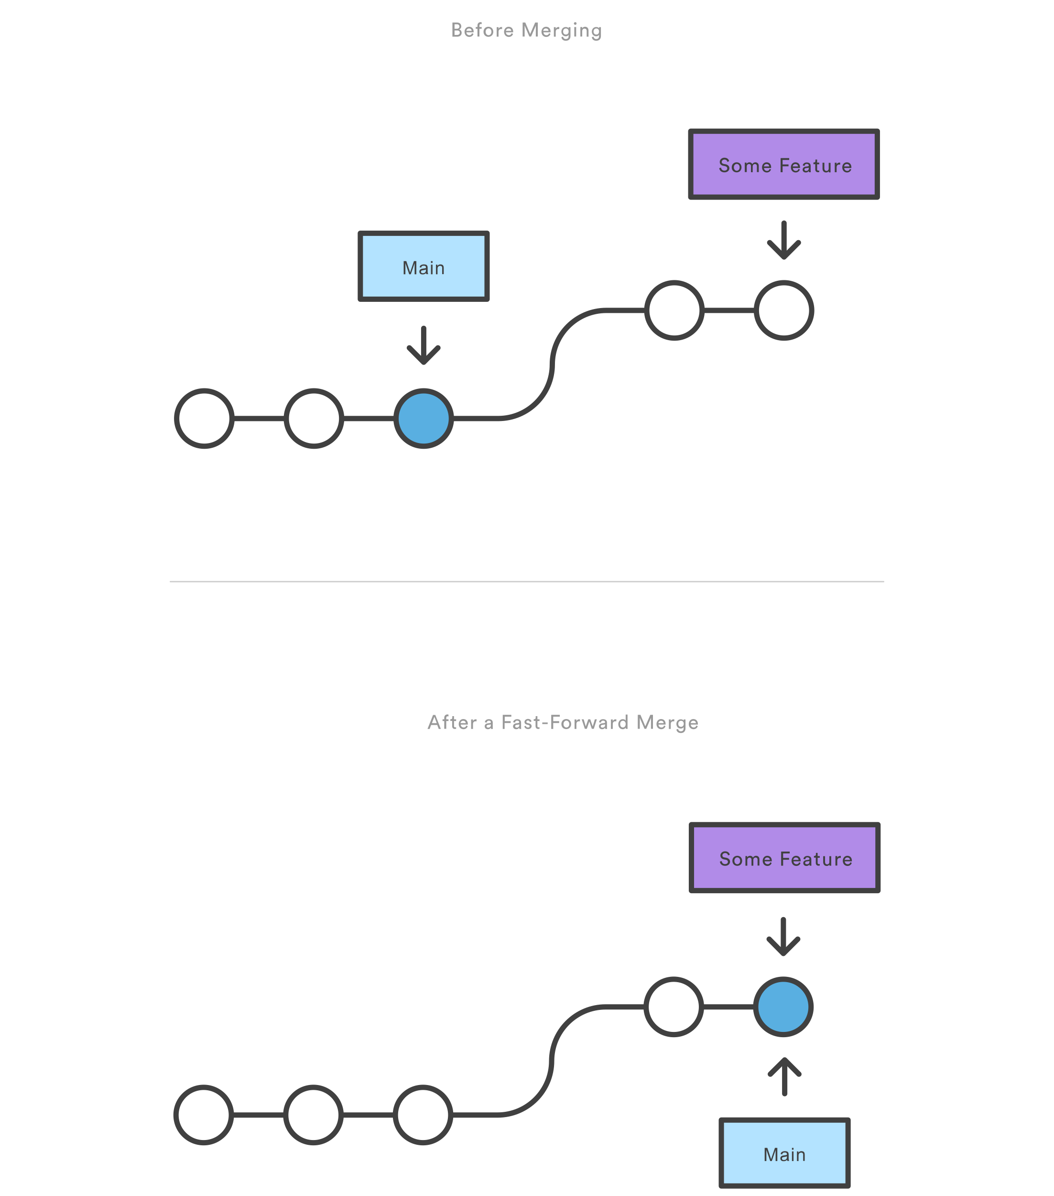
Git branching and merging
Fast forward merge
3-way merge
Img src: atlassian.com
Notes:
https://git-scm.com/book/en/v2/Git-Branching-Basic-Branching-and-Merging
https://www.atlassian.com/git/tutorials/using-branches/git-merge

Slide 13
Git branch and git merge
git branch <feature_branch>
git checkout <feature_branch>
git add <file>
git commit
git push
git push --set upstream origin <feature_branch>
git checkout main
git merge <feature_branch>

Slide 14
Questions?

