Slide 1
Full stack development
JULY 2025
Gateshead College
Amarjit

Slide 2
Assignments
Assignment 01 - Create a Record format in JavaScript.
Assignment 02 - Creating a working Database/Record System.
Github repo
https://github.com/hey-amo/SkillsBootcamp-GC/

Slide 3
Assignment 01 - Record format in JavaScript
Using a web-based technology: Express/Node/EJS create information relating to your favourite tv/movie/radio shows (you choose) or your own topic within a record format.
You will need to add some additional information like: Title, seasons, episodes, year, cast, type,rating, poster, and directors etc..
Display the data/record on web browser by using either node, express or EJS, remember you need to show an images & code listing to show it is working.

Slide 4
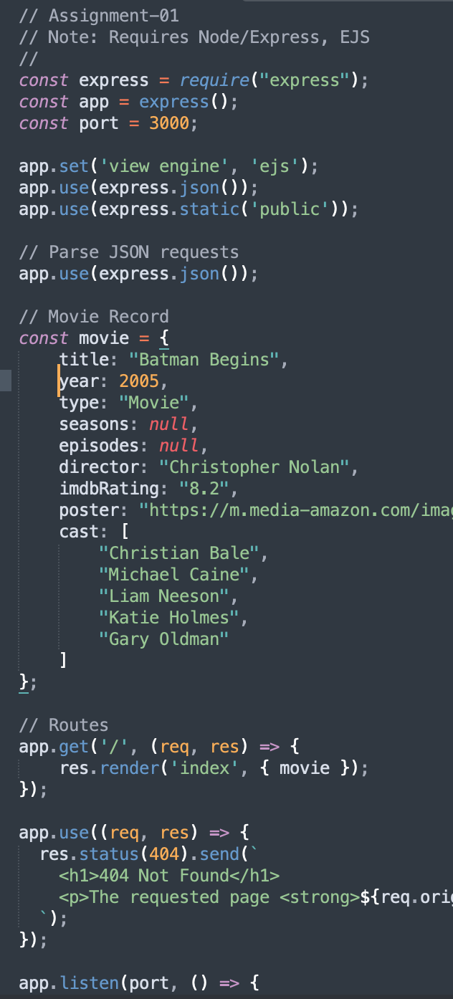
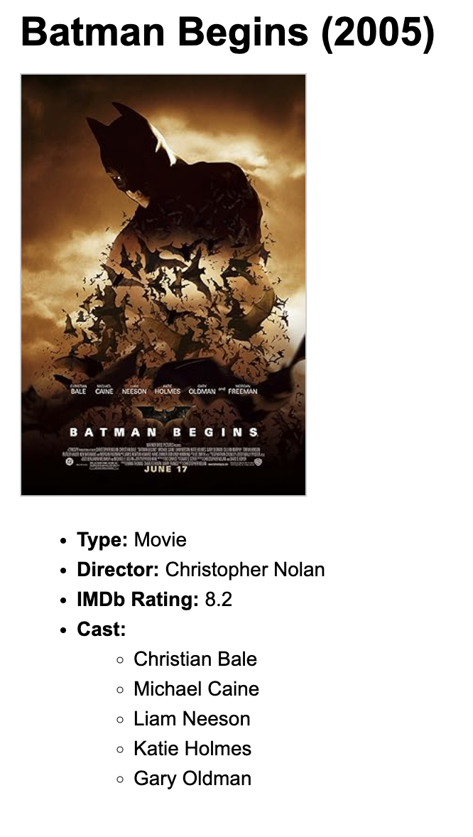
Assignment 01 - Record
Sample code
Record in JS
GET Routes in Express
Renders HTML via a ejs template
Github link:
https://github.com/hey-amo/SkillsBootcamp-GC/tree/main/assignment/assignment01

Slide 5
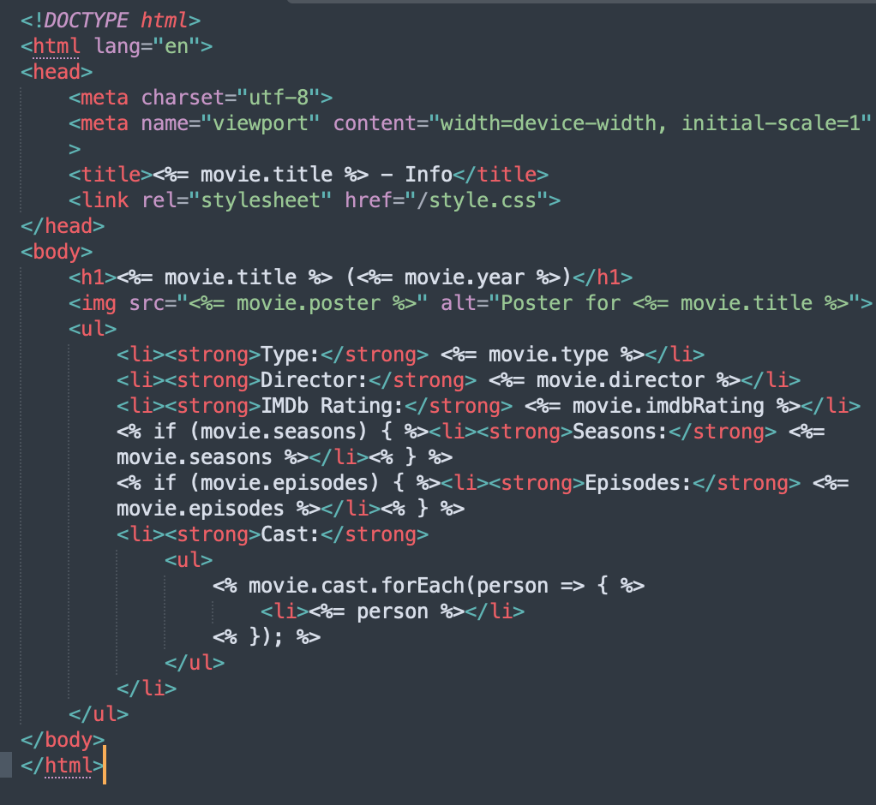
Assignment 01 - Route & View
app.get('/', (req, res) => {
res.render('index', { movie });
});
Above is 1 example of a GET request in Express
On the right is the EJS template used to output HTML

Slide 6
Assignment 02 - Database/Record System
On this Task, you must create a working database record system, using any web-
technology you feel comfortable with.
Main features, will include adding, removing, deleting, and searching (CRUD). The
main point of this task is to demonstrate your capabilities of being a Full Stack
Developer

Slide 7
Assignment 02 - My notes/goals
To create a simple CRUD app that adds, edits, deletes, lists movie records
To install mongodb locally via homebrew
Used mongosh mongodb://localhost:27017 to run mongo locally
To use EJS for templating HTML
Try to use a simple callbacks/promise to simplify syntax
Use a sample record structure for quick insertion testing
Github link:
https://github.com/hey-amo/SkillsBootcamp-GC/tree/main/assignment/assignment02

Slide 8
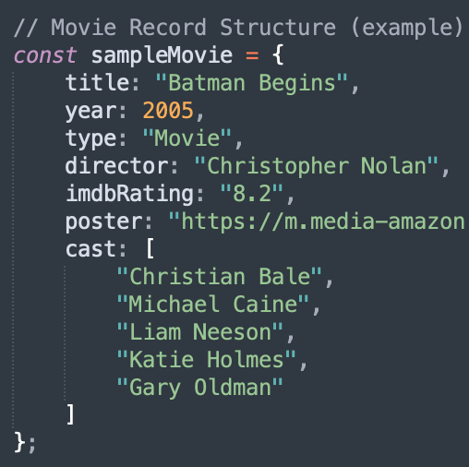
Assignment 02 - Sample record structure
This is a JSON object which holds a sample movie.
The app will allow the user to add, edit, delete, list movies using this structure

Slide 9
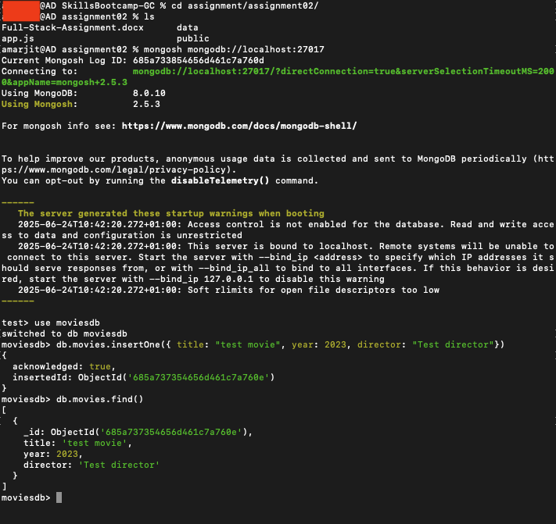
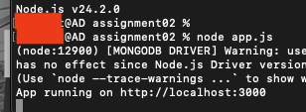
Assignment 02 - Screenshots /1
Node running
Mongodb running

Slide 10
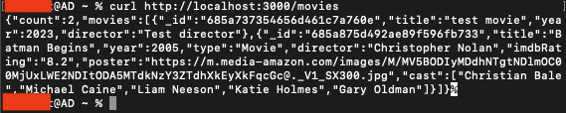
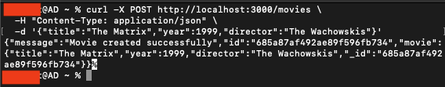
Assignment 02 - Screenshots /2
CURL - List all
CURL - Insert

Slide 11
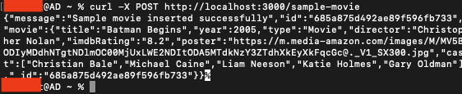
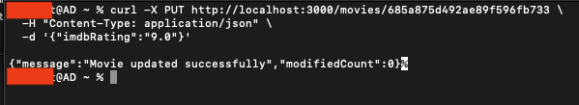
Assignment 02 - Screenshots /3
CURL - Insert sample movie
CURL - Update

Slide 12
Assignment 02 - Screenshots /4
CURL - Insert sample movie

Slide 13
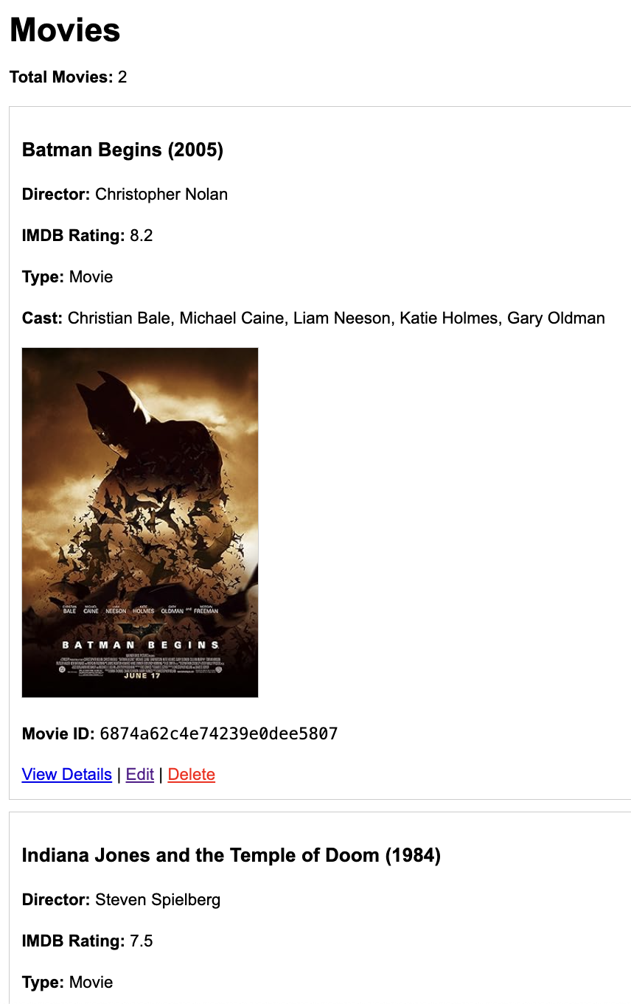
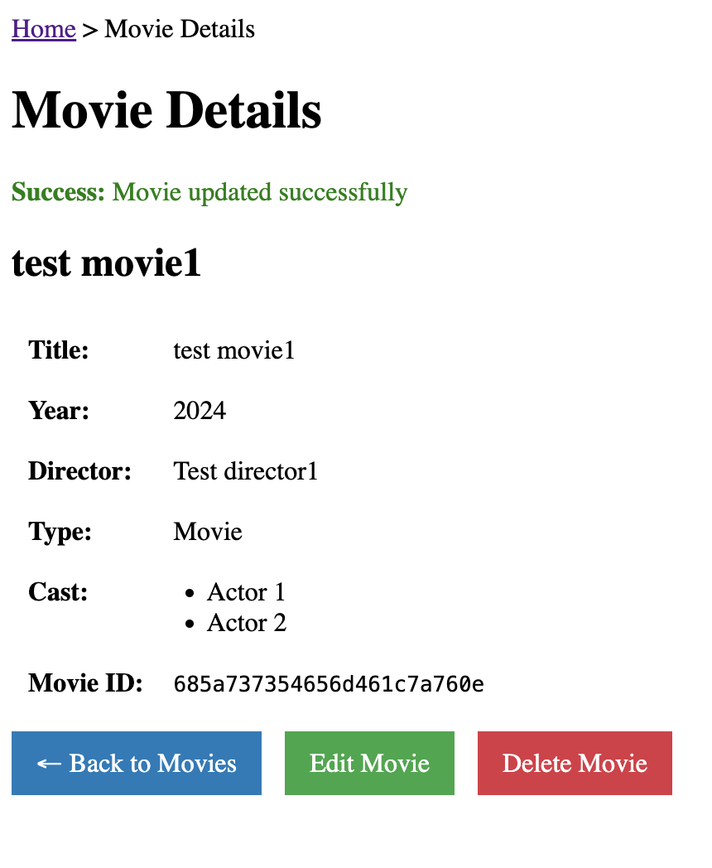
Assignment 02 - Screenshots /5
Listings page
Movie details page

Slide 14
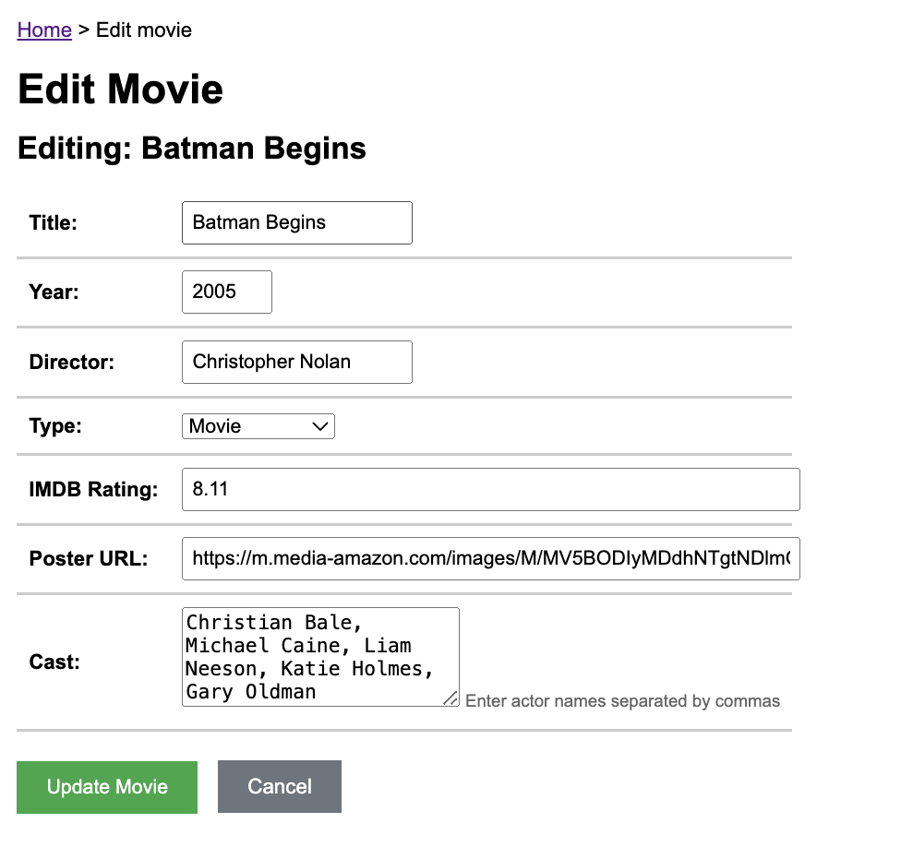
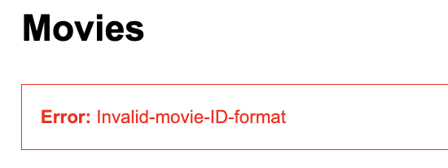
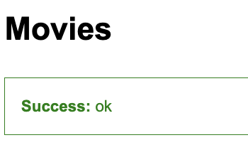
Assignment 02 - Screenshots /6
Edit page
Notification messages - Error
Notification messages - Success

Slide 15
Assignment 02 - Things that could be improved
UI: Visuals, Animations, notifications
Validation: On forms, movie poster URLs, etc
Security: Try to reduce possible XSS, injection attacks
Architecture: Cleaner code

