Slide 1


HUM412
360˚

Slide 2

Mastering the Art of Communication
(L9)

Slide 3

Reference Book
Employability 360 Degree
- Daffodil International University

Slide 4
Communication
Communication is the process of sending a meaningful message to a person. Proper communication is done when the receiver decodes the message exactly what the sender meant. Proper communication requires two parties and their effort.
Communication is sending or receiving ideas, thoughts or feelings from one person to one or more persons in such a way that, the person receiving it understands it in the same way the sender wants him/her to understand.

Slide 5






Communication
The person initiating the communication, or broadcasting the message.
The specific set of words, gestures and images that the sender uses to convey what he or she wants to say.
The channel through which the message moves.
Receivers (or the audience for the message) - from whom the receiver often expects a response.
MESSAGE
SENDER
CHANNEL
RECEIVER
FEEDBACK
The response from the receiver to the sender.

Slide 6
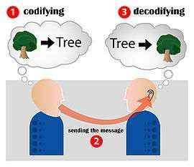
Communication

Slide 7

Communication
Effective Communication
R (receiver’s meaning)
--------------------------------- = 1
S (sender’s meaning)

Slide 8
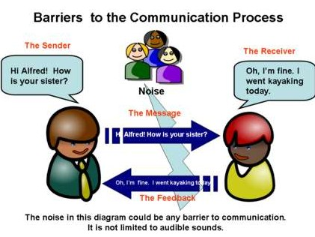
Communication

Slide 9

Types of Communication

Slide 10
Type of Communication
There are two types of communication.
Verbal communication
Non-verbal communication
According to a study done by “Professor Albert Mehrabian” effective communication 93% depends on non- verbal communication and only 7% depends on verbal communication.
Strangely, people mostly focus on words than their expressions hence, miscommunications occur

Slide 11



Type of Communication
Words 7%
Body Language 55%
Tone of Voice 38%

Slide 12
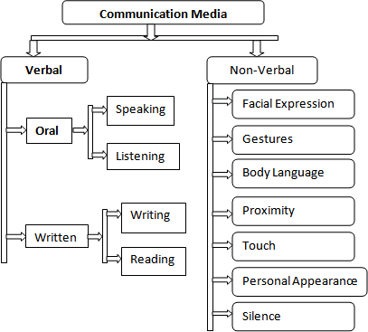
Type of Communication

Slide 13
Type of Communication
Verbal communication
Verbal communication is done using speech. It is more than just delivering the message. A good communicator also needs to receive and interpret messages clearly.
Employers highly value those people who can explain clearly and interpret messages accordingly. There are four verbal communication skill.

Slide 14
Type of Communication
Listening
Listening is a communication skill that we acquire naturally. We use our ears and brain to receive and process the information which is a passive or receptive skill. Listening is important because, if you fail to listen, you will not be able to interpret or reply properly.
An average adult person spends 70% of their time communicating with others of which, 45% is devoted to listening, 30% speaking, 16% reading, and 9% writing.
One of the most common listening barriers is that we listen to half of what the counter person is saying and think about what our reply will be in the other half. Thus, we lose a major portion of the meaning of what the person was saying. So, listen carefully till the end.

Slide 15
Type of Communication
II. Speaking
Speaking skill is one the most difficult skill to master in communication. The words we utter and the tone we use combines the skill of speaking.
Speaking can be interactive, partly interactive and non-interactive.
Talking to a person over phone or face to face is interactive, giving a speech in front of an audience is partly interactive and recording a speech on camera or radio is non-interactive speaking. Improving communication skill require lots of practice.

Slide 16
Type of Communication
III. Reading
While reading may sound easy, some people find it really difficult to read properly.
Reading skill is not about how fast one can read but it is about reading and understanding the message.
Practice and consistency can help a person improve reading skill.

Slide 17
Type of Communication
IV. Writing
Although for some people writing skills may not be as necessary as the first two were but the minimum level of proficiency in writing is required for every person regardless of their profession.
Writing skill is directly related to the speaking skill. Correct grammar, spelling, and punctuation are some of the elements that make your writing skill better.

Slide 18
Type of Communication
2. Non-verbal communication
Non-verbal communication is the most important part of communication. Words can have different meanings when different types of expressions are added to it. But, most people underestimate the necessity of non-verbal communication.
Non-verbal communication is a universal way of expressing one's feeling that can be mastered by practice. Every day we respond to thousands of non-verbal cues including gestures, postures and facial expressions.

Slide 19
Type of Communication
There are several more non-verbal communications-
I. Facial expressions
A smile or a frown can send a thousand words. Facial expression is responsible for the major part of non-verbal communication.
The first thing we notice about a person is the look on their face and try to judge what their mood is.
There are some expressions that may be different across countries but the most common ones like being sad, happy or angry are similar in other parts of the world.

Slide 20
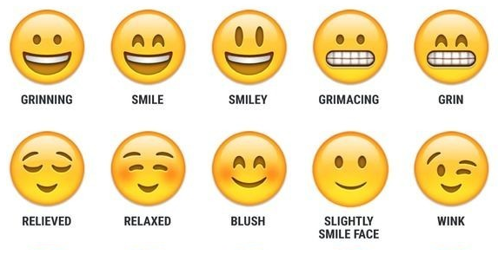
Type of Communication

Slide 21
Type of Communication
II. Body language and posture:
Body language is another most common form of non-verbal communication. Different postures carry a different kind of meaning and information that helps the communication to be more effective.
Arm-crossing or leg-crossing is known as the defensive posture whereas hands on the hip is an aggressive posture.

Slide 22
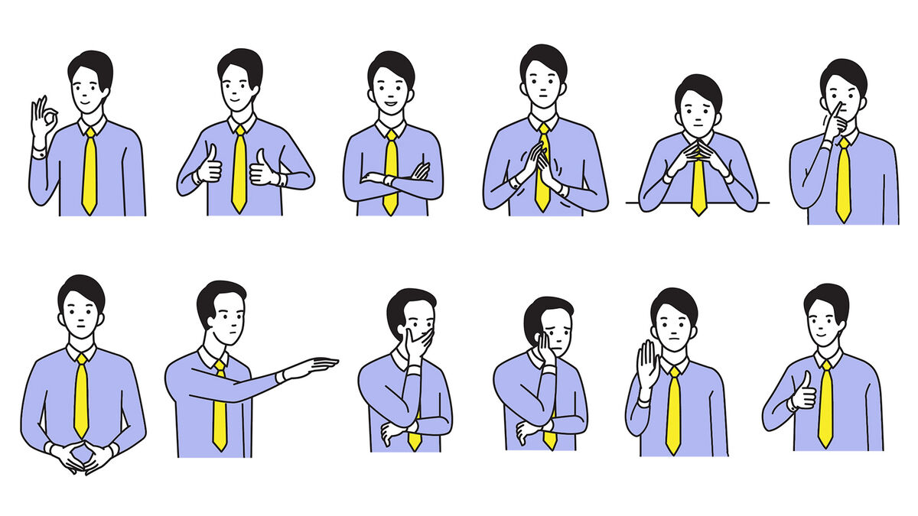
Type of Communication

Slide 23
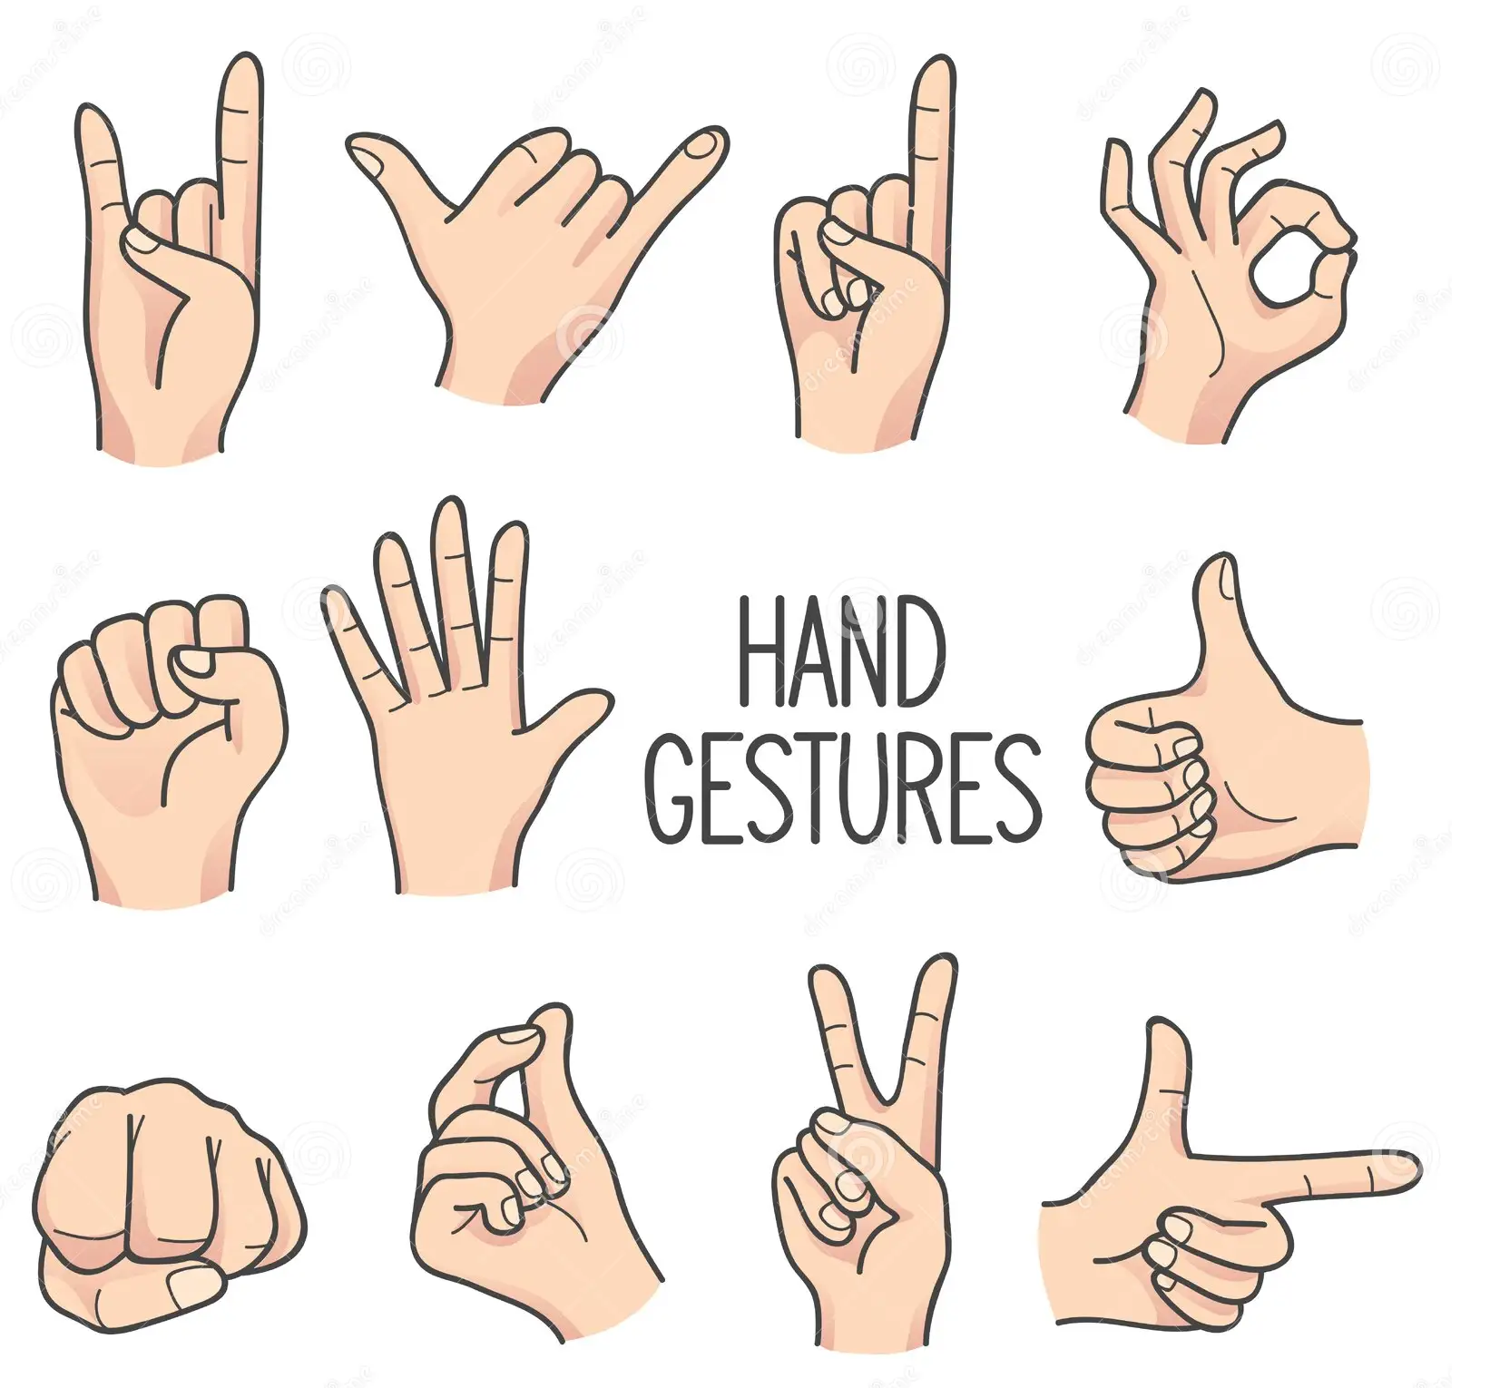
Type of Communication
III. Gestures: Signs are the mostly used non-verbal form of communication. Although, same sign can mean a different thing in a different region it is crucial to master the sign language as it carries a great deal of information

Slide 24
Type of Communication
IV. Eye contact:
Eye gaze is another most important element of nonverbal communication.
Looking, blinking, staring refers to different meanings and information.
Looking at others in different ways convey a different kind of behavior.
Eye contact is an important sign of confidence, respect, and social communication.

Slide 25
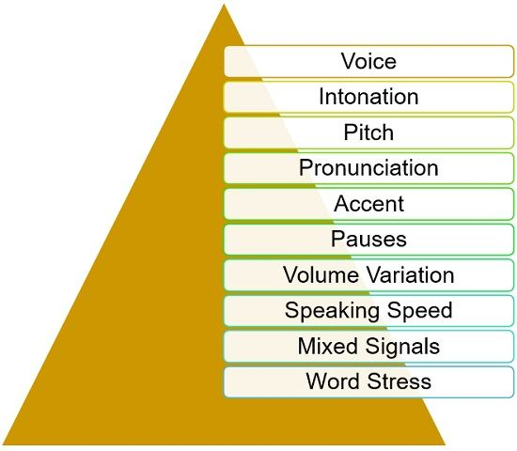
Type of Communication
There are few other types of non-verbal communications available. Paralinguistic, proxemics, appearances, haptic are few to mention.

Slide 26
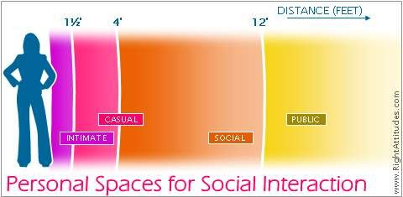
Type of Communication

Slide 27

Type of Communication

Slide 28
Type of Communication
Everything you do in your workplace is a result of communication. Communication is the heart and soul of an organization. Improper communication can cause a great deal of loss in business or personal life. Try to master communication skills. Never underestimate the need for non-verbal communication.

Slide 29

Presentation Skills

Slide 30
Presentation skills development
Presentation skill is not just speaking in front of a large audience. Talking to someone in person can also be a presentation.
For the majority of the people, the most fearful presentation is their job interview. Job interviews are a presentation as well.
Your day-to-day teamwork, showcasing your ideas to others, guiding or training someone requires good presentation skill.

Slide 31
Presentation skills development
Presentation skill is a communication skill. Mastering the presentation skill can reduce the amount of miscommunication.
Miscommunication is one of the major reasons for work-related stress. A proper presentation can reduce miscommunication thus work-related stress.

Slide 32
Presentation skills development
There are 7 magical tricks that will help one to nail any presentation that anyone conducts. So, they are:
Practice
One of the most important aspects of delivering a successful presentation is practice. Rehearsing your presentation multiple times allows you to become familiar with the content, timing, and flow.
It helps build confidence, reduces anxiety, and enables you to deliver a polished and well-structured presentation.

Slide 33
Presentation skills development
2. Be a Storyteller
Engage your audience by incorporating storytelling elements into your presentation. Stories have the power to captivate and connect with people on an emotional level.
Use anecdotes, examples, and narratives to illustrate your points and make your presentation more relatable and memorable.

Slide 34
Presentation skills development
3. Use Voice Modulation
Varying your tone, pitch, and pace of speech adds depth and emphasis to your presentation.
Utilize pauses for emphasis and to allow the audience to absorb important information.
Adjust your voice according to the content, highlighting key points, and creating a dynamic and engaging delivery.

Slide 35
Presentation skills development
4. Avoid Information Overdose
Keep your presentation focused and avoid overwhelming your audience with excessive information. Stick to the main points, use bullet points or visuals to convey key information, and provide supporting details when necessary.
A concise and well- organized presentation ensures that your message is clear and easily digestible.

Slide 36
Presentation skills development
5. Make it Interactive
Foster audience engagement by incorporating interactive elements into your presentation.
Encourage questions, conduct polls or surveys, or include activities that involve the audience.
Interaction creates a more dynamic and participatory environment, enhancing the overall impact and effectiveness of your presentation.

Slide 37
Presentation skills development
6. Smile and Eye Contact
Displaying a warm and friendly demeanor through a genuine smile helps establish a positive connection with your audience.
Maintain eye contact with individuals throughout your presentation, making them feel acknowledged and engaged. This builds trust, conveys confidence, and enhances your connection with the audience.

Slide 38
Presentation skills development
7. Remember the 10:20:30 Rule
This rule, popularized by Guy Kawasaki, suggests using no more than 10 slides, keeping the presentation within 20 minutes, and using a font size of at least 30 points.
This rule emphasizes brevity, focusing on essential information, and preventing information overload.
It ensures that your presentation is concise, impactful, and holds the audience's attention.

Slide 39
Presentation skills development
4Ts of Presentation
If you want to give your presentation to an audience. It is important that you know the formula for a proper presentation. There are 4 Ts of presentation that will help you render a quality presentation next time.
Tell them what you are going to tell them: At the beginning of your presentation, you need to brief the audience about what they will get from you. You can utter the topic of your presentation and describe what it is. Tell them why this topic is important. At this point, the audience will have a clear understanding of what to expect from the rest of the presentation.

Slide 40
Presentation skills development
Tell them Content: This is the main body of the presentation where you will talk about the detail of the topic.
Tell them what you have told them: This is the part where you conclude your presentation. Provide an overview of the presentation. Remind them what you have already told them.
Test them: At the end of your presentation, you should allow them to ask questions or you can ask them queries related to your presentation.

Slide 41
Summary
You are now better equipped with :
- Different type of Communication
Presentation Skill Development

Slide 42

Thank You

