Slide 1
Time-Varying Storage Announcement Effect in Natural Gas Market
Natural gas price volatility Level of inventory
The purpose of this project:
Effect of EIA’s natural gas inventory report Natural gas market
The sources of Data:
U.S natural gas inventory data (EIA) The actual price of gas inventory
Natural gas storage forecast (Bloomberg) The price prediction of gas inventory
Intraday natural gas futures prices (NYMEX) The price of gas inventory reported every

Slide 2
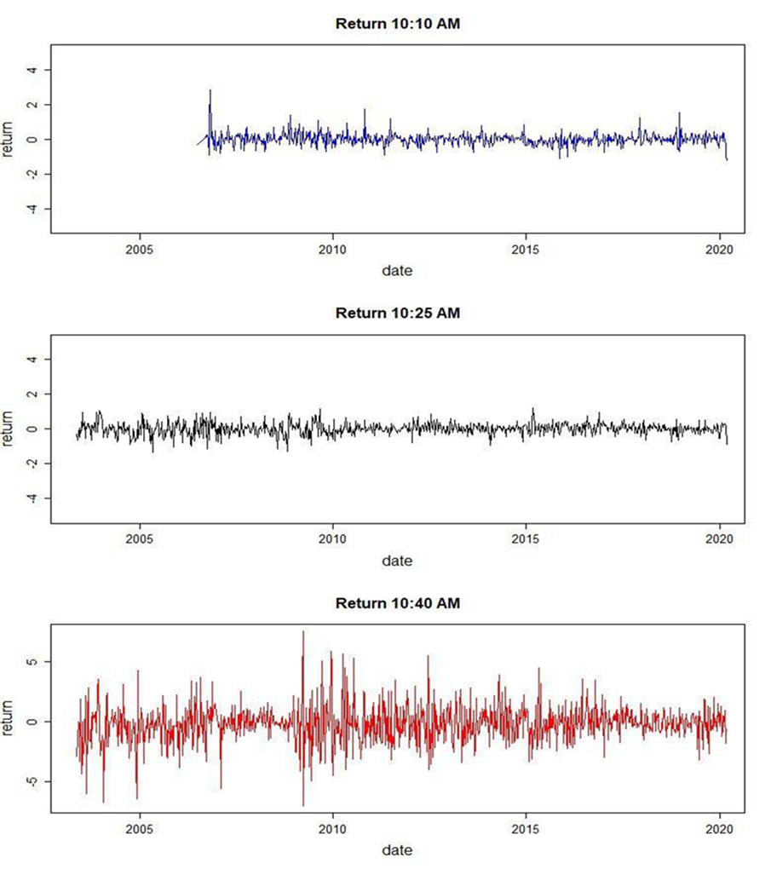

Price at time t
$$R_{t}=100 ×(\ln\left(P_{t}\right)−\ln\left(P_{t+}\right))$$
Return
Price at time t+Δt

Slide 3
Future Plan:
Calculating the surprise component and run regression model to see the impact of surprise on natural gas return
Analyzing whether the impact of EIA’s inventory report on natural gas futures prices has strengthened or weakened over time using several time-varying regression models.

