Slide 1
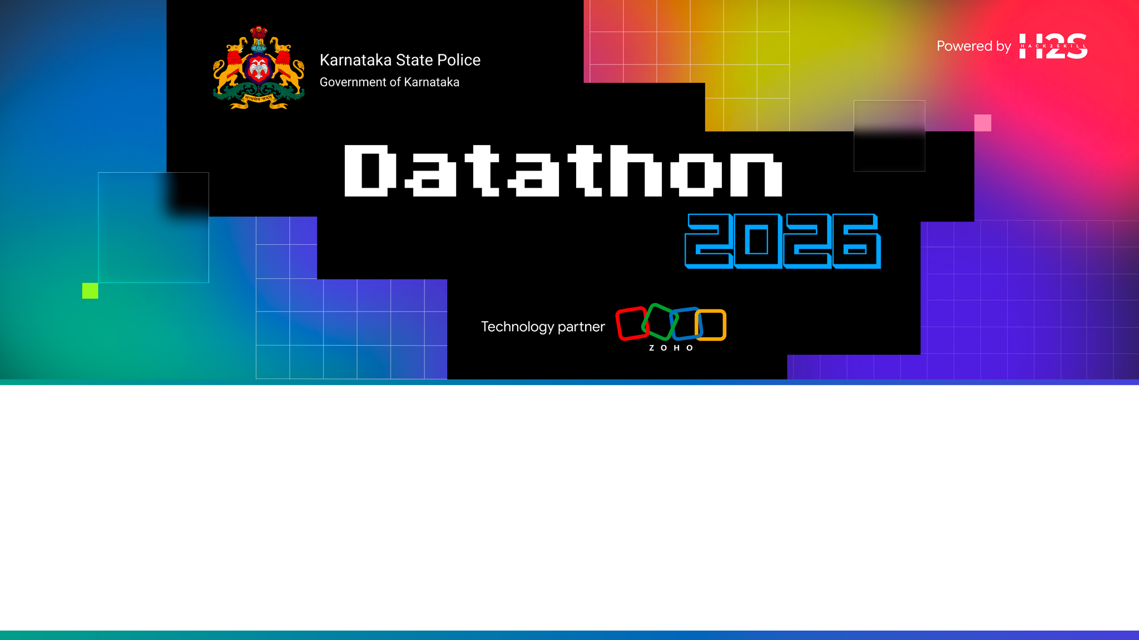
Team Details
  Team name: ULTRON
  Team leader name: HeyItsRocky
  Team size: 3
  Problem Statement:

Slide 2

Brief about the solution
ULTRON (Unified Law Enforcement Threat Response & Optimization Nexus) is an AI-driven crime analytics platform for the Karnataka State Police SCRB. It unifies crime, cyber, maps, network and intel modules behind one command center. 8 ML models (DBSCAN hotspots, Random Forest risk, Isolation Forest anomalies, Jaccard MO match, IP reputation, phishing LR, flow anomaly, attack-path BFS) run in Catalyst Functions and surface live KPIs, red-zone alerts and natural-language chat (English/Kannada). Frontend: React + Vite + Tailwind. Backend: Catalyst Advanced IO functions + Data Store (ZCQL). Works against local Flask/SQLite fallback when cloud login is unavailable.

Slide 3
Opportunities
  How different is it from any of the other existing ideas?
  How will it be able to solve the problem?
  USP of the proposed solution

Slide 4
List of features offered by the solution
• Login / JWT auth with role permissions (viewer/analyst/officer/admin)
• Command Center with live KPIs + 4-ring radial navigation
• Crime: cases, criminals, trends, hotspots, MO-match, predictive zones
• Cyber: incidents, IP/domain intel, evidence, network flows, fraud analytics
• Maps: DBSCAN hotspots, red zones, district drill-down, patrol/geofence
• Network & Link Analysis: crime/cyber/correlation graphs
• Intel Hub: briefs, emerging trends, socio-economic overlays, graph workspace
• Admin: users, roles, audit logs, data ingestion, system health
• Conversational AI (POST /chat/query) — EN + Kannada (backend ready)

Slide 5
Process flow diagram or Use-case diagram

Slide 6
Wireframes/Mock diagrams of the proposed solution (optional)

Slide 7
Architecture diagram of the proposed solution

Slide 8
Technologies to be used in the solution
Frontend: React 19, TypeScript, Vite, Tailwind CSS, TanStack Query, Recharts, Framer Motion, Zustand
Backend: Python 3.13 Catalyst Advanced IO, Flask request adapter, ZCQL, scikit-learn, numpy, scipy
Local fallback: Flask + SQLite (scripts/local_api.py) when Catalyst OAuth unavailable
Auth: HS256 JWT (stdlib hmac) locally; Catalyst Embedded Login in production
Data: 8 flat + 26 normalized Data Store tables; seed scripts + mock JSON for offline demo

Slide 9
List down Catalyst Services being used in the solution
• Catalyst Advanced IO Function (unified API router)
• Catalyst Data Store (ZCQL) — Crimes, Criminals, Threats, Users, AuditLogs, …
• Catalyst Authentication (Embedded Login / OAuth — blocked this session, see BLOCKERS.md)
• Catalyst Hosting (static SPA deploy) — after auth
• Catalyst AI / QuickML (LLM + RAG) — env-driven, optional offline mode
• Project: Hack2Skill (49084000000013049) · Gateway configured in catalyst-config.json

Slide 10
Estimated implementation cost (optional)

Slide 11
Snapshots of the prototype

Slide 12
Prototype Performance report/Benchmarking

Slide 13
Provide links to your:
GitHub Public Repository
Demo Video Link (3 Minutes)
Deployed Link
GitHub Public Repository: https://github.com/heyItsRocky/Datathon-2026-ULTRON
Demo Video Link (3 Minute): <pending — record after deploy>
Deployed Link (Catalyst/other): http://127.0.0.1:8787 (local API) · frontend http://localhost:5173
Cloud URL after OAuth: https://ultron.ksp.catalystapps.com (SLATE_DOMAIN in config)

Slide 14
Additional Details/Future Development (if any)

Slide 15
Blank slide

Slide 16


