Slide 1

Project Title- Seasonal Agriculture Performance Analysis
STU67a59764a6edf1738905444
KUSHAGRA SRIVASTAVA
BABU BANARASI DAS UNIVERSITY
AICTE STU ID : STU67a59764a6edf1738905444

Slide 2

PROBLEM STATEMENT
Agricultural activities are influenced by seasonal variations in environmental conditions, farming practices, resource availability and market conditions. As a result, agricultural performance may differ from one season to another. However, raw agricultural data does not clearly explain how agricultural performance changes across seasons or what patterns can be observed in different seasonal conditions.
The problem is to analyze the given agricultural dataset and investigate seasonal differences in agricultural performance by identifying meaningful patterns, trends, relationships and variations within the available data.

Slide 3
Project Description
This project uses data cleaning, statistical analysis, and visualization to identify seasonal patterns, trends, relationships and variations.
Analyzes agricultural data across different seasons, regions, and farming conditions.
Examines variations in crop production, environmental conditions, resource usage and economic performance.
Generates data driven insights and recommendations to support better understanding of seasonal agricultural performance

Slide 4

WHO ARE THE END USERS?
Potential End Users
👨‍🌾Farmers — Understand seasonal patterns and agricultural performance.
🏛️Agricultural Departments — Support evidence-based agricultural planning.
📊Agricultural Analysts & Researchers — Study trends and relationships in agricultural data.
🌾Agricultural Planners — Compare seasonal conditions and resource usage.
🎓Students & Academics — Use agricultural data for analysis and research.

Slide 5

Technology Used
Tools & Technologies
Python — Data analysis and processing
Pandas & NumPy — Data cleaning and manipulation
Matplotlib / Seaborn — Data visualization
Jupyter Notebook / Google Colab — Project development and analysis
Statistical Analysis — Identifying patterns, trends, relationships, and variations

Slide 6
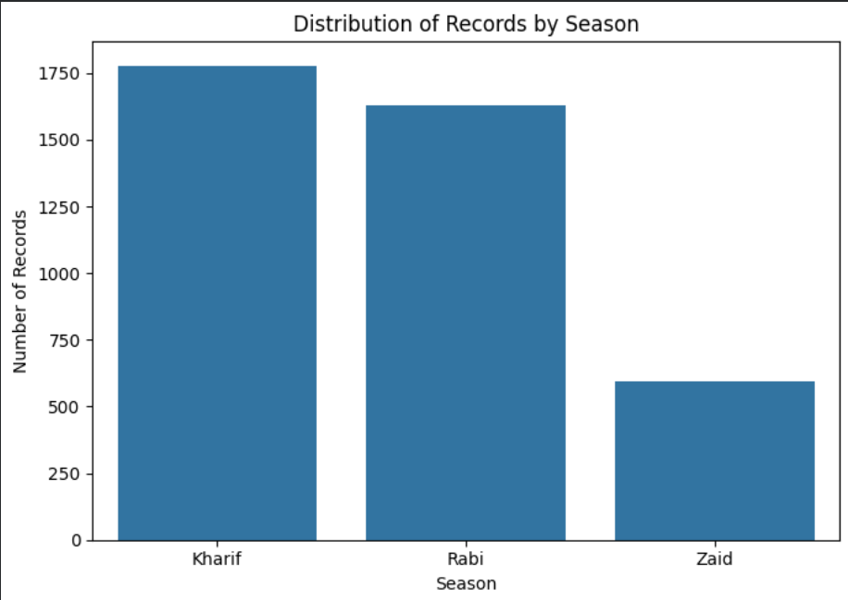
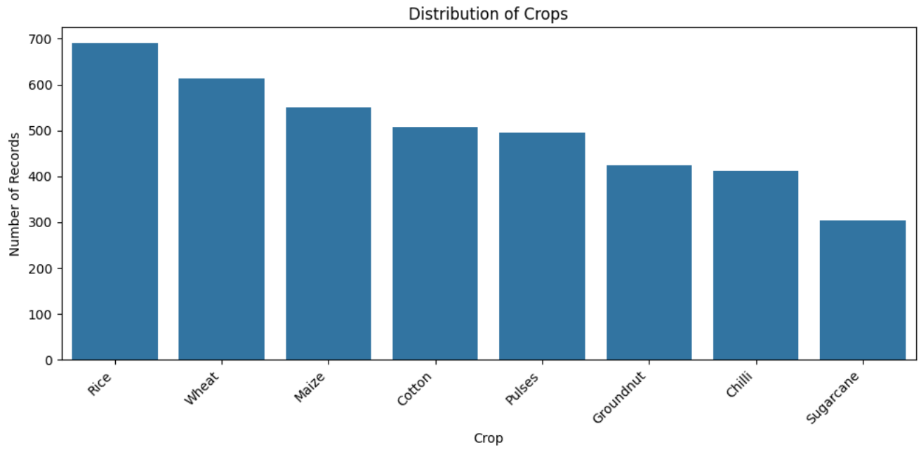
RESULTS

Slide 7
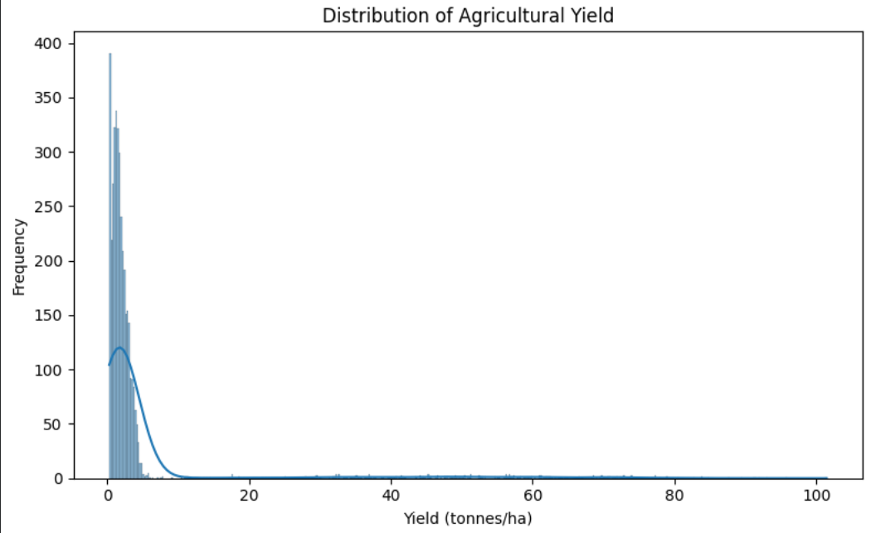
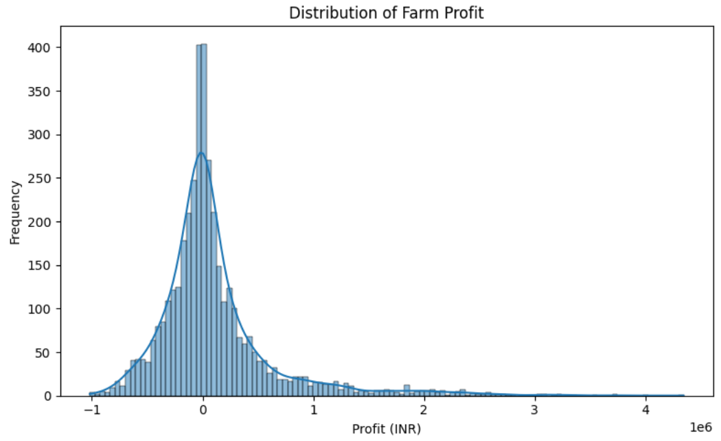
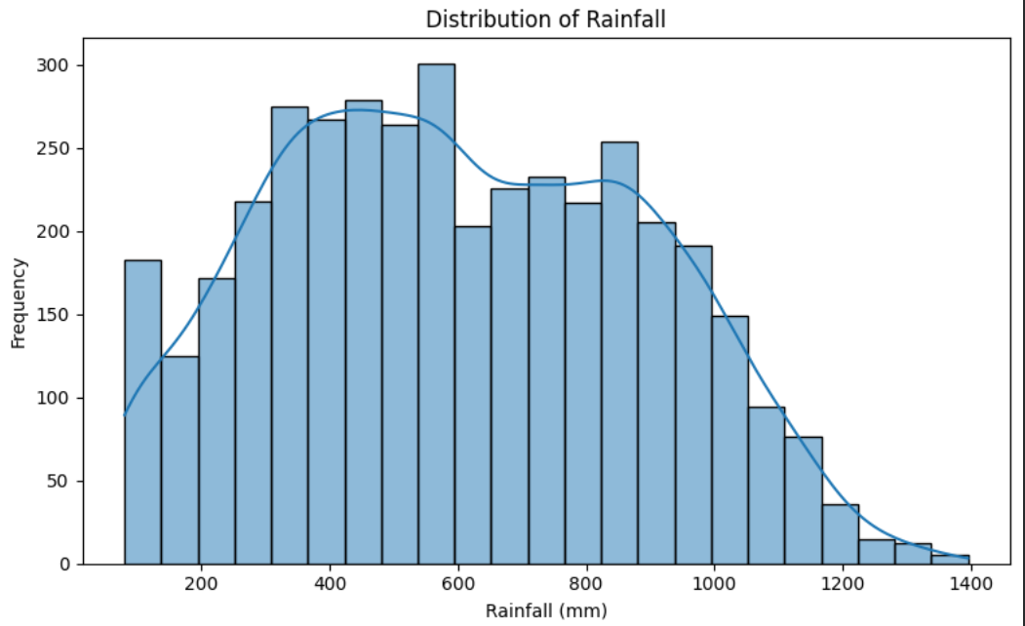
RESULTS
[Add screen shots of your code ]

Slide 8
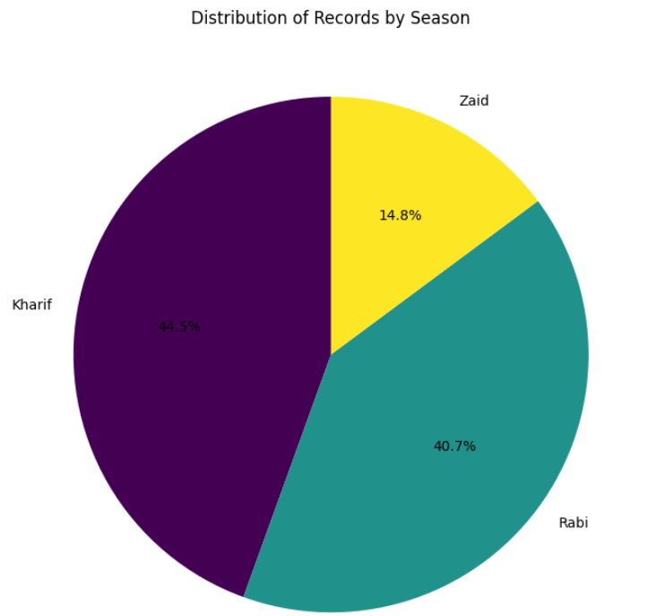
RESULTS
[Add screen shots of your code ]

Slide 9
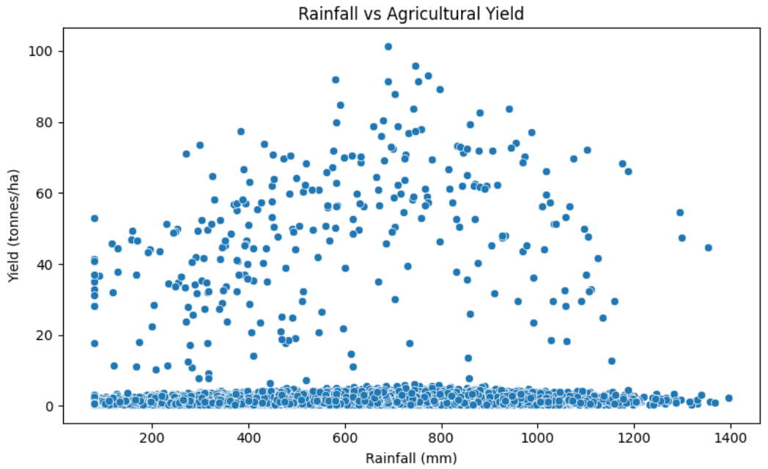
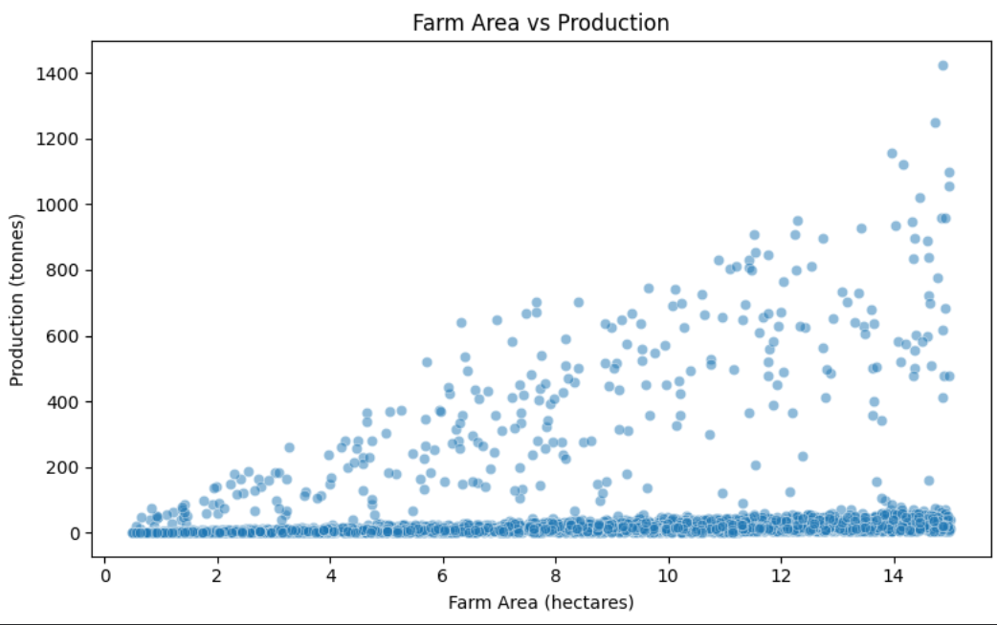
RESULTS
[Add screen shots of your code ]

Slide 10
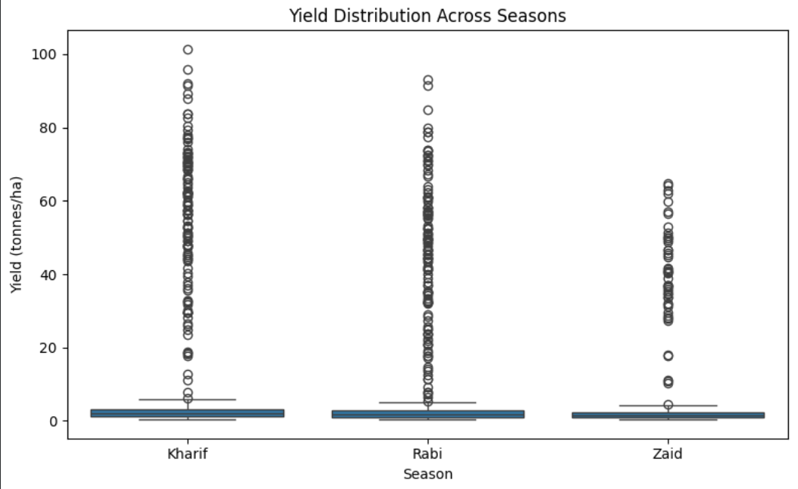
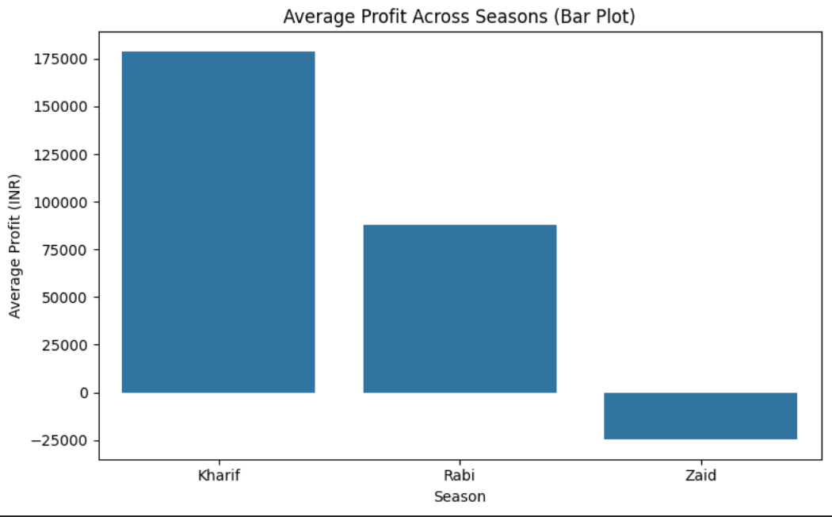
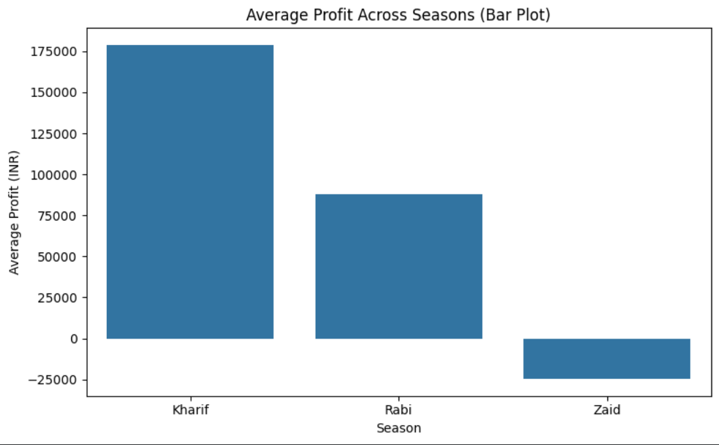
RESULTS
Bivariate Analysis

Slide 11
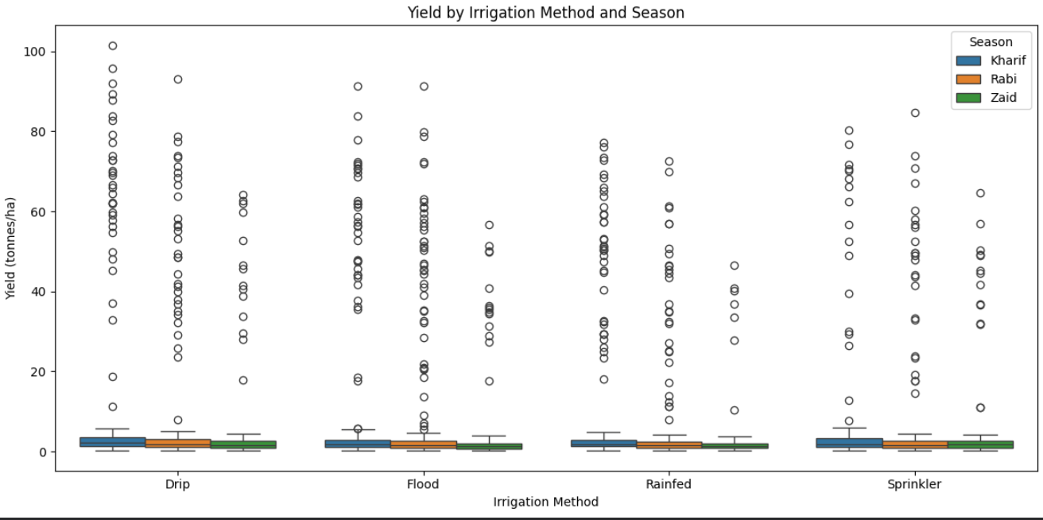
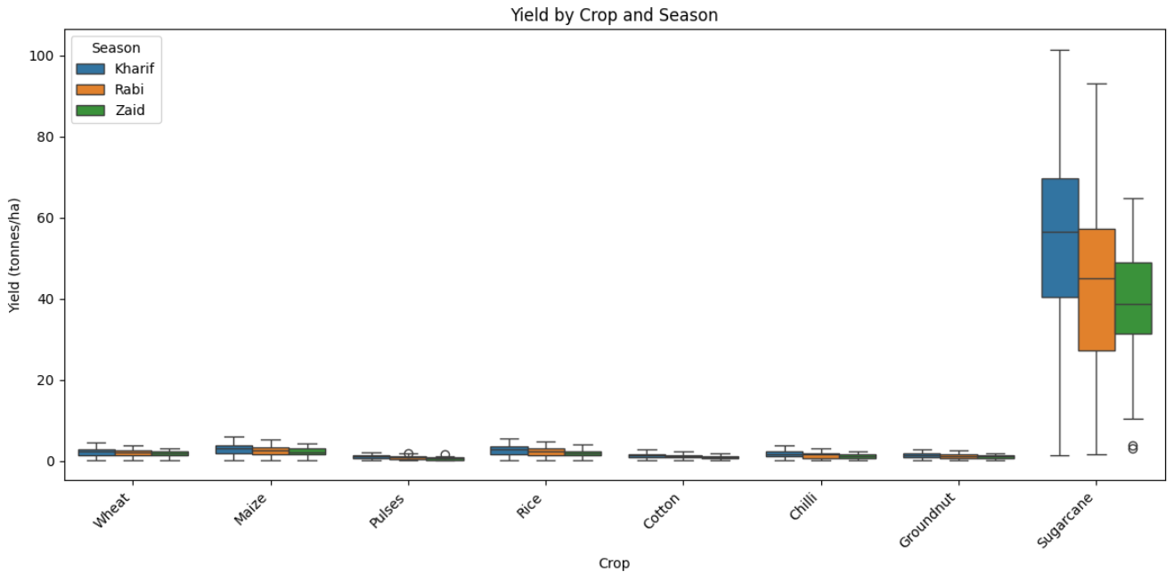
RESULTS
Univariate Analysis

Slide 12
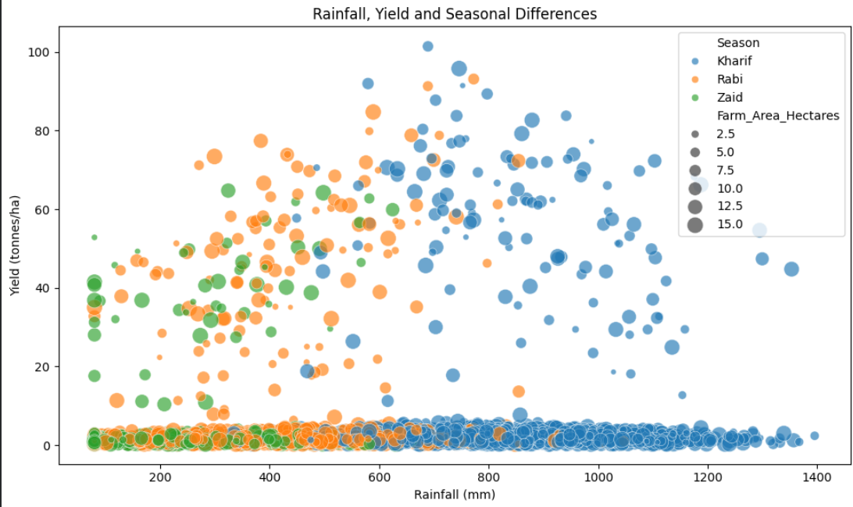
RESULTS

Slide 13
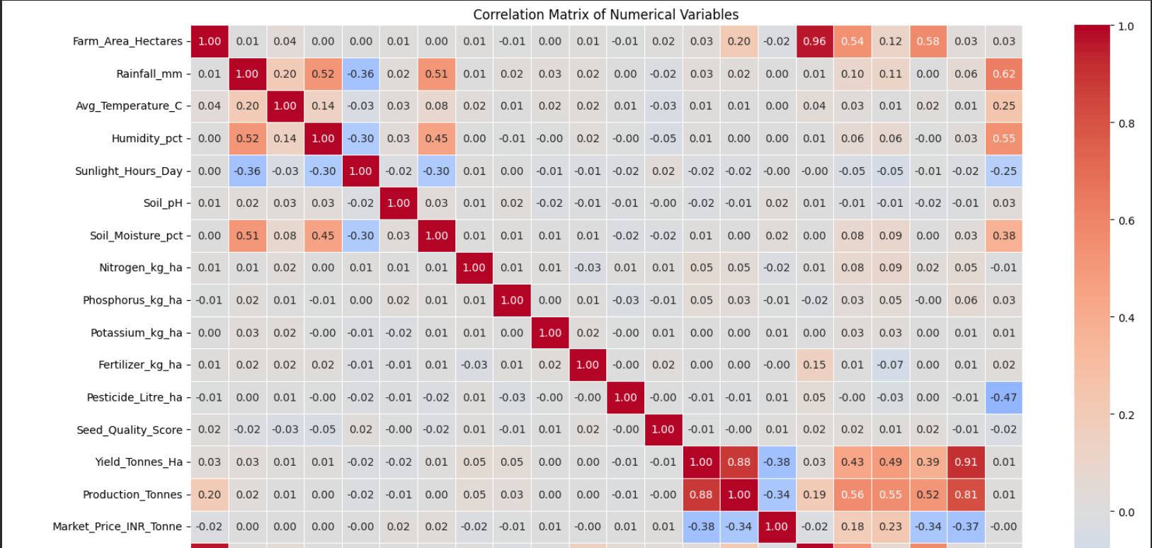
RESULTS
[Add screen shots of your code ]

Slide 14
Future scope
Future Enhancements
Integrate real-time weather and environmental data.
Expand analysis across more regions, crops, and seasons.
Apply machine learning models for agricultural performance and yield prediction.
Develop an interactive agricultural analytics dashboard.
Incorporate additional factors such as market prices and resource availability.
Use historical data for long-term seasonal forecasting and planning.

Slide 15
GitHub Link
https://github.com/heyKushagra/Seasonal-Agriculture-Performance-Analysis.git

Slide 16

VOIS Course completion certificate -
Course name- Data Visualization

Slide 17
Thank You
.
.

