Slide 1
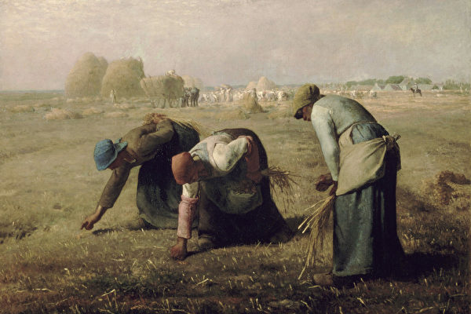
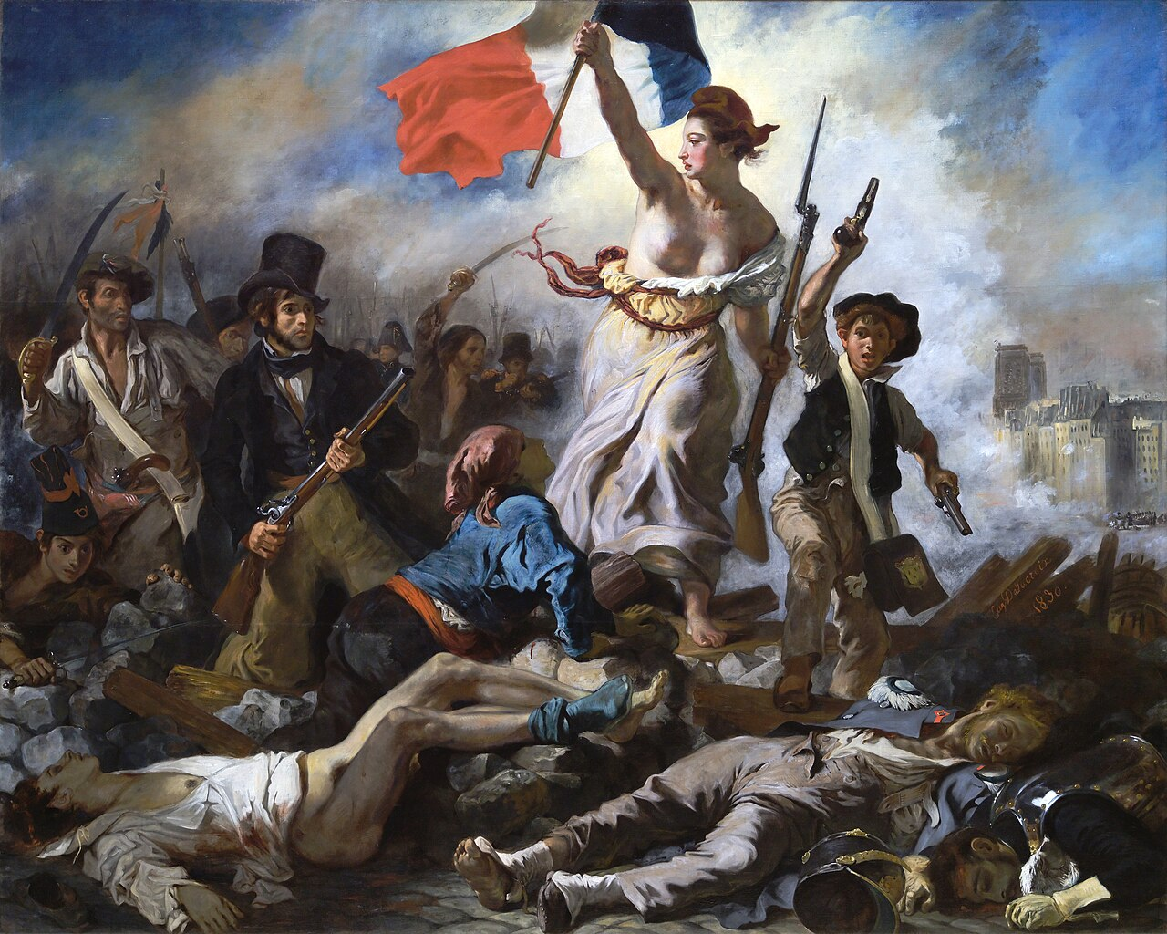
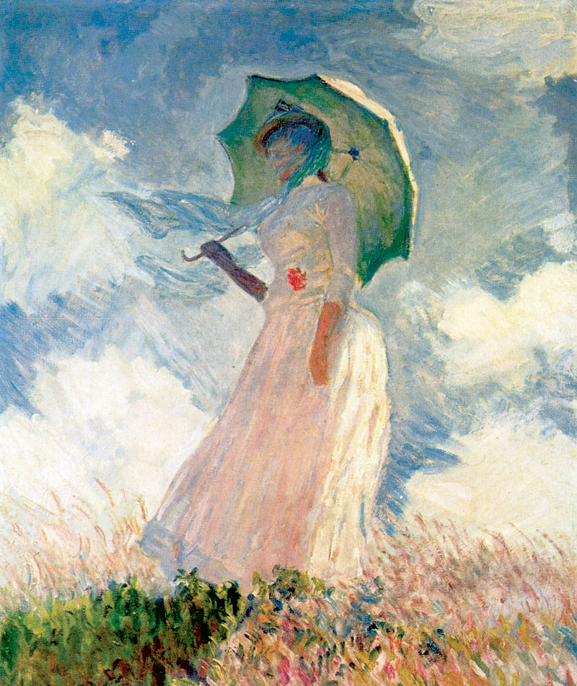
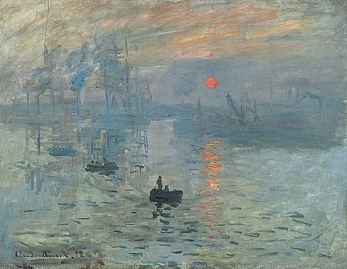
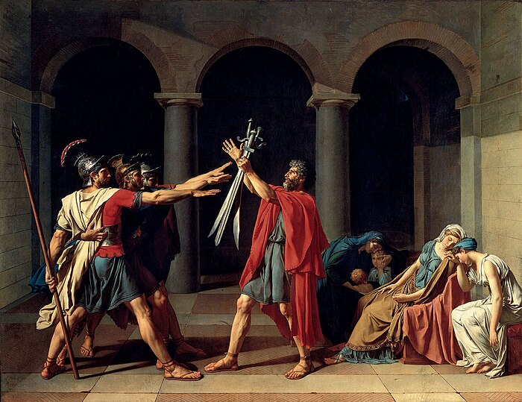
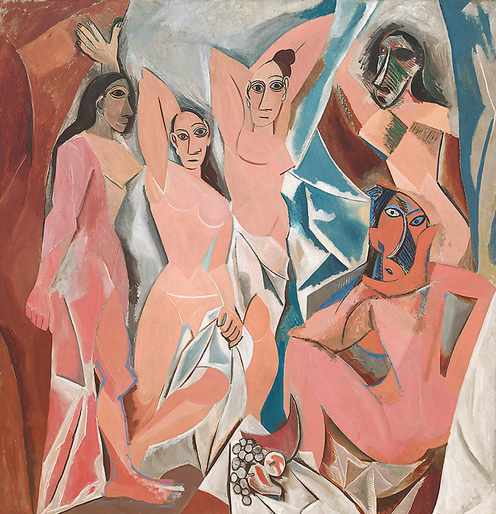
The Artistic Journey of French Paintings
- Classic Movements and Timeless Masterpieces
GUO Xiaofan
YIN Chenghao
04/10/2024

Slide 2
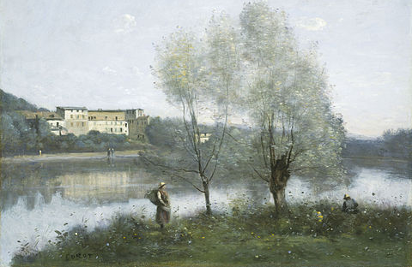
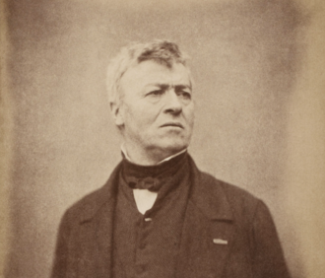
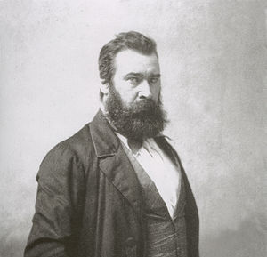
Barbizon School
Jean-Baptiste-Camille Corot
Ville d'Avray
Time:
Mid-19th century
Background:
Reaction against academic traditions, focused on natural landscapes and rural life.
Historical Context:
Response to industrialization and urbanization in France.
Main Features:
Natural landscapes and realistic peasant life
Soft lighting, simple, rural settings
Jean-Frandik Millet
The Gleaners

Slide 3
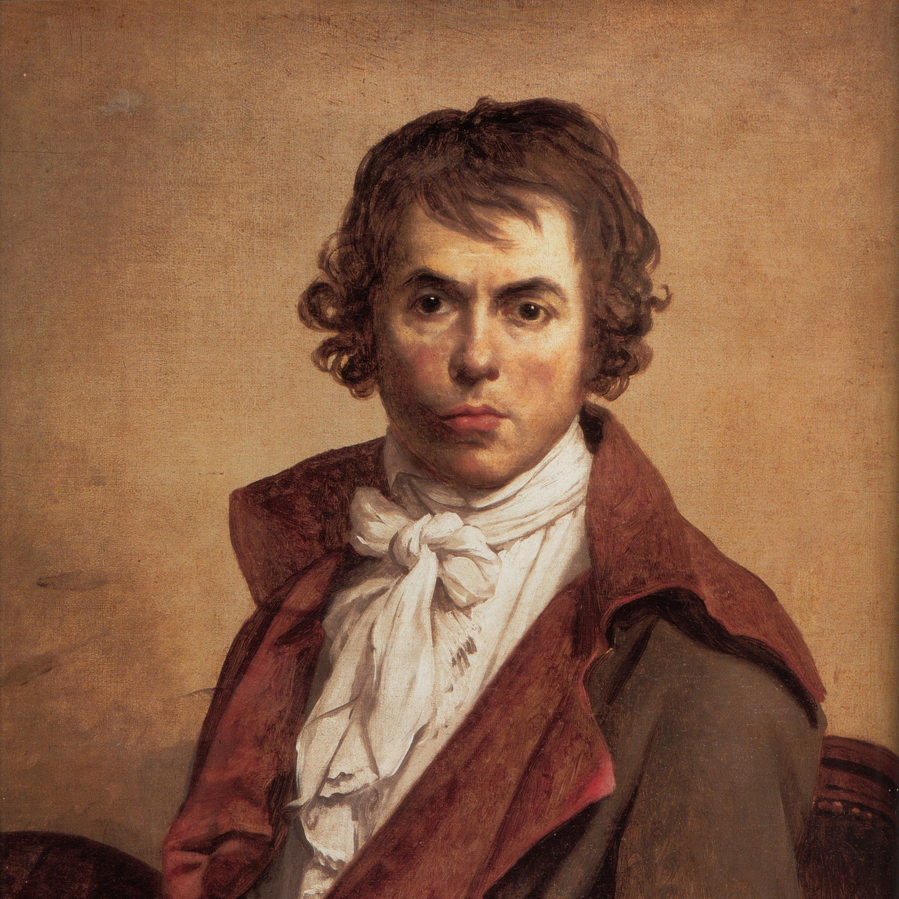
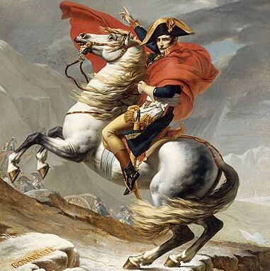
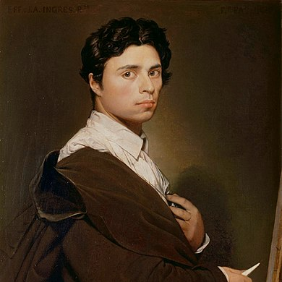
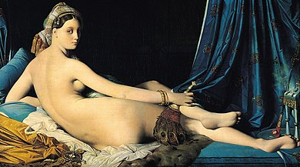
Neoclassicism
Napoleon
Crossing
the Alps
Time:
Late 18th century
Background:
Reaction against Baroque and Rococo, inspired by Ancient Greece and Rome.
Historical Context:
Linked to the Enlightenment and French Revolution.
Main Features:
Emphasis on reason, order, and classical tradition
Heroic and moral strength in characters
ymmetry and simplicity in composition
Jacques-Louis David
Grande Odalisque
Jean-Auguste-Dominique Ingres

