Slide 1



Wearable-based Fall Detection with Indoor Localization Context for Healthcare Environments
Indoor Localization System for Patient Behavior Analysis
in the Context of Connected Healthcare
Supervisors:
Dr. Wafa NJIMA | ISEP
Dr. Hedi YAZID | ISEP
Dr. Huaqiong LI | UCAS
PhD Researcher:
Xiaofan GUO

Slide 2
Global Agenda
Progress Update I

Slide 3
Update 1
Project Setup & System Design
Agenda
  Motivation and Problem Definition
  System-Level Design
  Functional Pipeline
  Sensing and Data Overview
  Expected Outcomes
Time Scope: 22 Dec 2025 – 5 Jan 2026

Slide 4
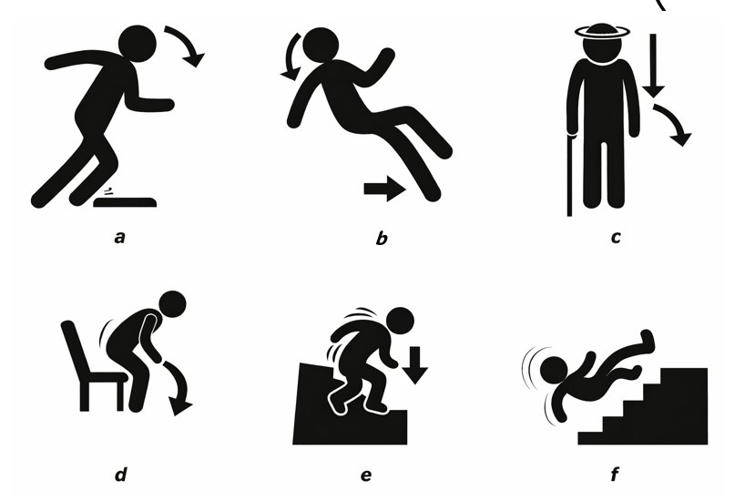
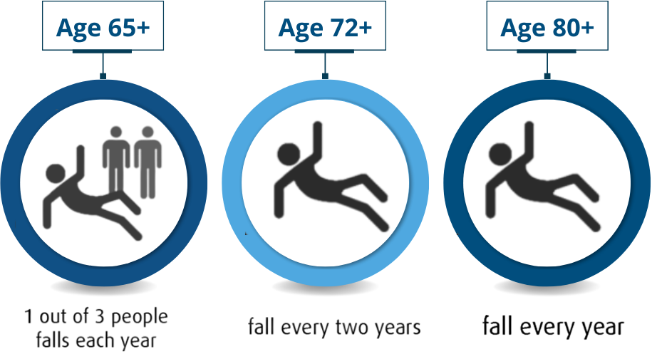
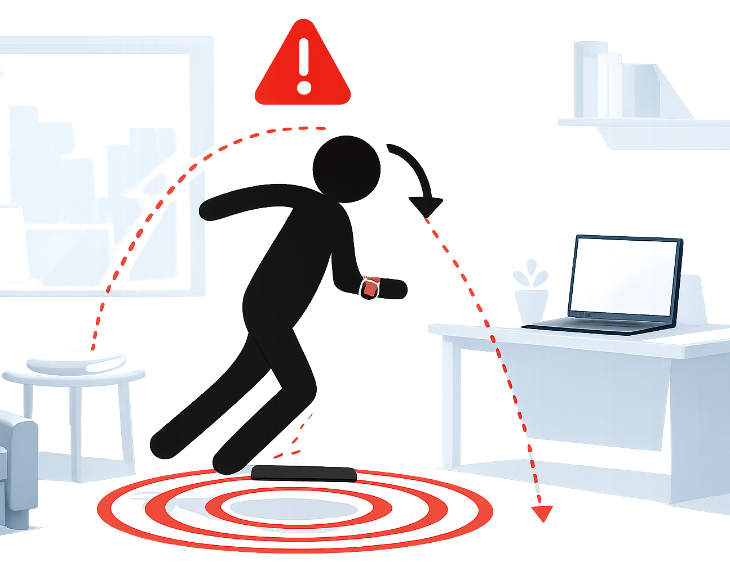
1.1 Motivation & Background
Motivation
  Reliable and timely interpretation of patient behavior and location
  are essential to enable rapid medical intervention and reduce risks.
  Background
  Falls are among the most critical and time-sensitive patient behaviors.
  IPS* are increasingly deployed in healthcare environments.
  Wearable devices (watch) are widely available and mature.
IPS : Indoor Positioning Systems (also referred to as Indoor Localization Systems)

Slide 5
1.2 Problem Statement
Problem 1 – Fall Interpretation
  Falls and daily activities may exhibit similar movement patterns.
  Real-time and reliable interpretation of movements in real environments.
  Alert triggering and alert severity prioritization (professional decision support).
  Problem 2 – Indoor Localization
  Difficulty in determining the exact indoor location of a fall (e.g., room-level).
  Timeliness and reliability of indoor location information.
  Consistent and accurate representation of location information for alerting.
Fall detection is studied as a concrete instance of patient behavior analysis,
with indoor localization used to determine the location of a fall event.

Slide 6
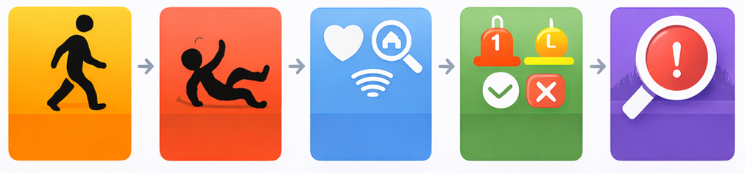
2 System-Level Design
Design Principles
  Wearable-first
  Low-intrusive & privacy-preserving
  Zone- / Room-level localization
  Modular and extensible system
System Level
  Wearable sensing layer
  Indoor localization layer
  Processing & decision layer
  Alert & analysis layer
  End-to-End Fall Management Workflow
Daily Activity
Fall Event
Assessment
Decision &
Alerting
Post-event
Analysis
Notes:
行为 → 事件 → 分析 → 决策 → 优化

Slide 7
3 Functional Design Overview
Functional Process Flow
F1
Fall Event Detection
F2
Post-fall Situation Assessment
F3
Indoor Fall Location Identification
F4
F5
Decision & Alerting
Post-event Analysis & Optimization
Event Understanding
Spatial Context
Operational Functionality
Long-term System Value

Slide 8



3.1 F1-Fall Event Detection
Purpose
Distinguish daily activities vs. fall-related motion.
Identify whether a fall event occurs and generate fall event candidates.
Role
Operates at the individual / event level.
Provides the foundational event signal for subsequent functions.
Devices & Data
Device: wrist-worn wearable (IMU)
Data: 3-axis acceleration, 3-axis angular velocity, timestamps
Output
Fall detection result (yes / no)
Confidence / reliability indication (event-level)

Slide 9

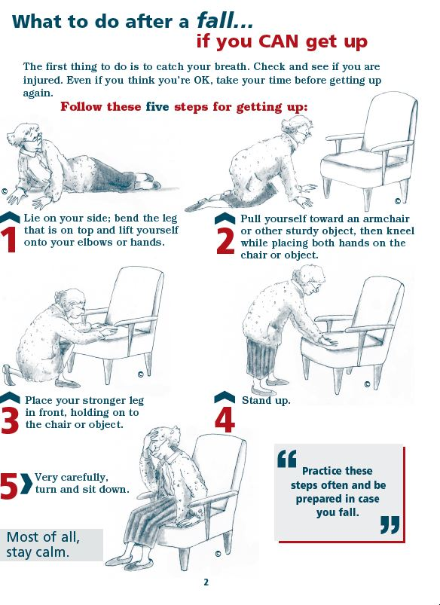
3.2 F2-Post-fall Situation Assessment
Purpose
Assess whether the user can recover after the fall.
Differentiate minor falls vs. critical / emergency falls.
Role
Refines risk and urgency level.
Supports alert prioritization.
Devices & Data
Device: wrist-worn wearable (IMU)
Data: 3-axis acceleration, 3-axis angular velocity, timestamps
Output
Post-fall motion status → recovery movements
Estimated severity level of the fall.

Slide 10
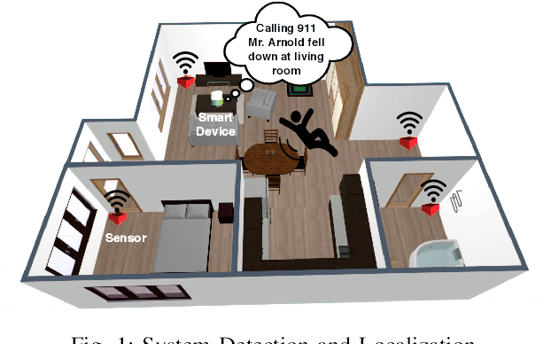
3.3 F3-Indoor Fall Location Identification
Purpose
Determine where the fall event occurred (event-time location).
Role
Provides accurate spatial feedback.
Embeds fall events into indoor spatial context.
Supports navigation and rescue response.
Devices & Data
Devices: BLE beacons / Wi-Fi APs
Data: RSSI signals, timestamps
Output
Predicted zone / room of the fall
Associated confidence level
Figure Source: Clemente et al., “Indoor Person Identification and Fall Detection through Non-Intrusive Floor Seismic Sensing.”

Slide 11


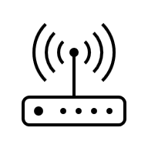






3.4 F4-Decision & Alerting
Purpose
Fuse information from F1, F2 and F3.
Generate alerts with different priority levels.
Data Sources
Role
Transforms the system from event detection
→ to decision support & operational response
Processing
Alert
Devices & Data
Devices: backend server / monitoring platform
Data: structured outputs from F1-F3
Output
Structured alert message
(event time, room / zone, severity)
Notification

Slide 12
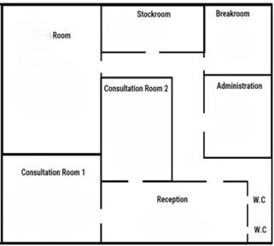
3.5 F5-Post-event Analysis & Optimization
Purpose
Long-term statistical analysis of fall frequency across locations / periods.
Identify high-risk areas & high-risk periods.
Role
Extends system value from event handling
→ to long-term knowledge and improvement
Spatial Risk
etc.
Temporal Risk
Devices & Data
Data source: accumulated event records from F1-F4
Data types: location / time / severity / alert logs
Output
Long-term risk analysis reports.
Spatial & temporal risk patterns.
Low Risk
Medium Risk
High Risk

Slide 13
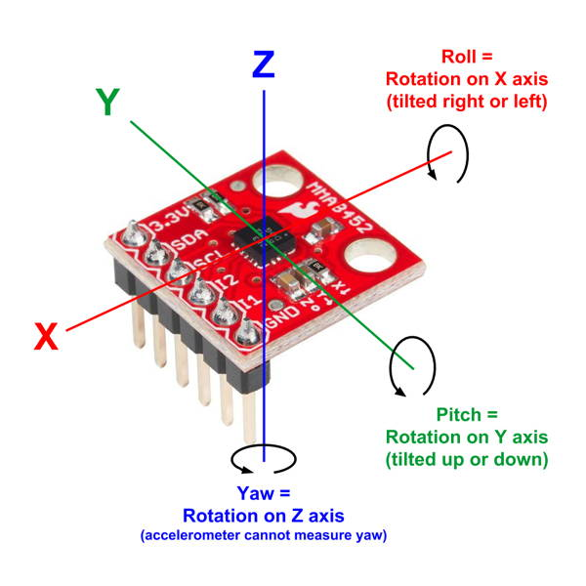
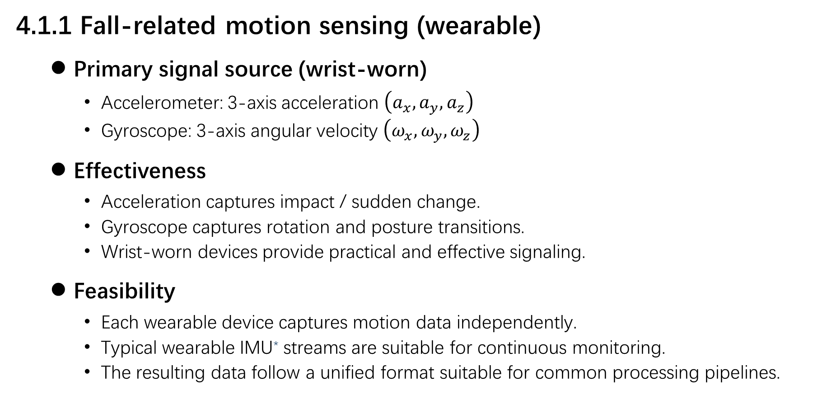
4.1 Sensing Overview
4.1.1 Fall-related motion sensing (wearable)
  Primary signal source (wrist-worn)
    Accelerometer: 3-axis acceleration $\left(a_{x}, a_{y}, a_{z}\right)$
    Gyroscope: 3-axis angular velocity $\left(ω_{x}, ω_{y}, ω_{z}\right)$
  Effectiveness
    Acceleration captures impact / sudden change.
    Gyroscope captures rotation and posture transitions.
    Wrist-worn devices provide practical and effective signaling.
  Feasibility
    Each wearable device captures motion data independently.
    Typical wearable IMU* streams are suitable for continuous monitoring.
    The resulting data follow a unified format suitable for common processing pipelines.
Fig. Sensor Coordinate System and Axes.
IMU : Inertial Measurement Unit 惯性测量单元
Figure Source: IDEW, Code: Internet of Things – Accelerometer

Slide 14
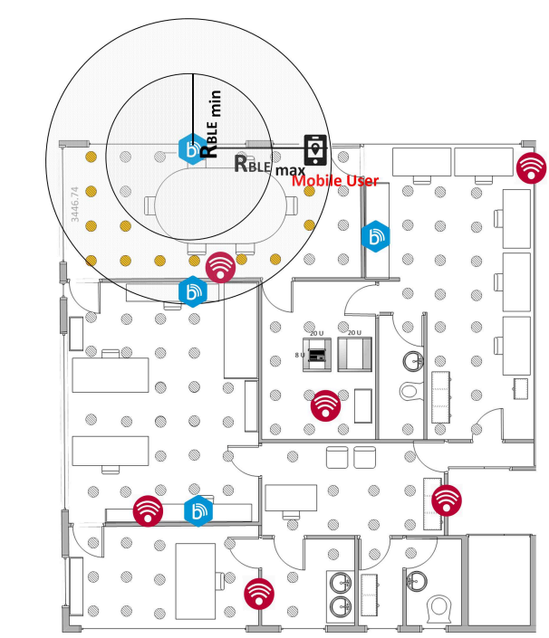
4.1 Sensing Overview
4.1.2 Indoor localization sensing (Event-driven)
  Primary signal source (environment-based)
    BLE-based signals: RSSI*
    Wi-Fi–based signals: RSSI from APs*
  Effectiveness
    BLE signals enable zone- / room-level localization (range 1-5 m).
    Wi-Fi signals support room-level localization (range 5-10 m).
    Event-driven sensing reduces unnecessary data acquisition.
  Feasibility
    BLE beacons and Wi-Fi infrastructure are widely available in indoor environments.
    Signal acquisition is lightweight and compatible with wearable devices.
    Room-level / Zone-level localization outputs can adopt a unified representation.
Fig. Combined BLE and Wi-Fi fingerprint
based indoor positioning.
RSSI : Received Signal Strength Indicator 接收信号强度指示
APs : Access Points
Figure Source: L. Kanaris et al., “Fusing Bluetooth Beacon Data with Wi-Fi Radio maps for Improved Indoor Localization,” Sensors, 2017 (CC BY 4.0).

Slide 15
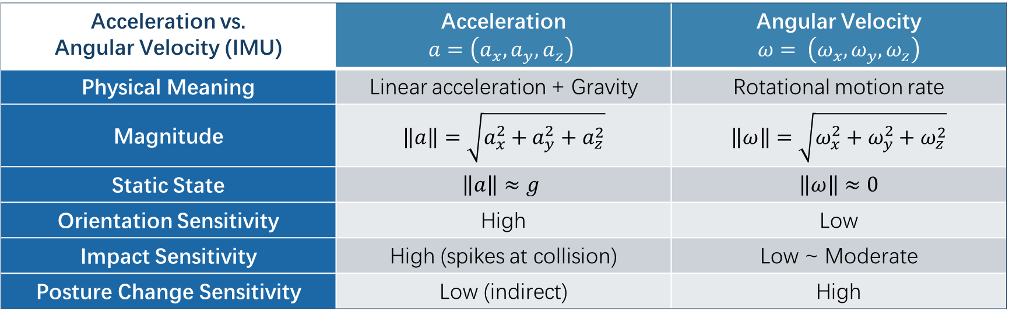
4.2 Data Overview
4.2.1 Motion Data for Fall Detection:
Acceleration vs. Angular Velocity (IMU) | Acceleration $$a=\left(a_{x}, a_{y}, a_{z}\right)$$ | Angular Velocity $$ω= \left(ω_{x}, ω_{y}, ω_{z}\right)$$
Physical Meaning | Linear acceleration + Gravity | Rotational motion rate
Magnitude | $$\left\|a\right\|=\sqrt{a_{x}^{2}+a_{y}^{2}+a_{z}^{2}}$$ | $$\left\|ω\right\|=\sqrt{ω_{x}^{2}+ω_{y}^{2}+ω_{z}^{2}}$$
Static State | $$\left\|a\right\|≈g$$ | $$\left\|ω\right\|≈0$$
Orientation Sensitivity | High | Low
Impact Sensitivity | High (spikes at collision) | Low ~ Moderate
Posture Change Sensitivity | Low (indirect) | High
  Complementarity for fall detection
    Acceleration → impact detection
    Angular velocity → posture change
    Combined patterns → robust fall characterization

Slide 16
4.2 Data Overview
4.2.2 Indoor Localization Signals:
BLE vs. Wi-Fi | BLE RSSI | Wi-Fi RSSI
Signal Meaning | Proximity to beacon | Signal strength from APs
Battery Lifetime | High | Moderate
Sensitivity to Body Blocking | Moderate | High
Sensitivity to Multipath | Low ~ Moderate | High
Event-time Behavior | Local RSSI dominance | RSSI vector pattern
Infrastructure Density | High (dense beacons) | Low (sparse APs)
  Complementarity for indoor localization
    BLE → fine-grained local proximity
    Wi-Fi → stable spatial context
    Combined patterns → improves robustness

Slide 17
5 Expected Outcomes
1. Fall Event Detection
  Activity vs. fall discrimination
  Fall-related motion patterns
  Impact event detection
2. Indoor Location
  Event-time indoor location
  Room-level localization
  Zone-level context (if available)
3. Integrated Alerts
  Fall severity indication
  Predicted room / zone
  With event timestamp
4. Long-term Analysis
  High-risk fall-prone areas
  High-risk time periods
  Optimization suggestions
A complete fall detection and indoor localization alerting system.

Slide 18
Thank You!

Slide 19
Update X
Title
Agenda
  …
Time Scope:

Slide 20
X TITLE
Title:
  …

