Slide 1

High-Performance Data Exchange in Microservices

Slide 2
BIRLA INSTITUTE OF TECHNOLOGY AND SCIENCE PILANI (RAJASTHAN) WILP Division
Name (s) and Designation (s) of your Supervisor and Additional Examiner:
Dharmesh Rana and Sujith Pratap
Organization: SAP Labs India Location: Bangalore Duration: 16 weeks Date of Start: 5th February 2024 Date of Submission: 1st June 2024

Slide 3
Goal
Contribution : New kind of serialization and deserialization technique/ flow chart. Which one to recommend? With given conditions, achieve minimum serialization and deserialization.

Slide 4
Secondary Goal
Optimized Performance
Cost Savings
Enhanced Scalability
Better Decision Making
Competitive Advantage

Slide 5

Results

Slide 6
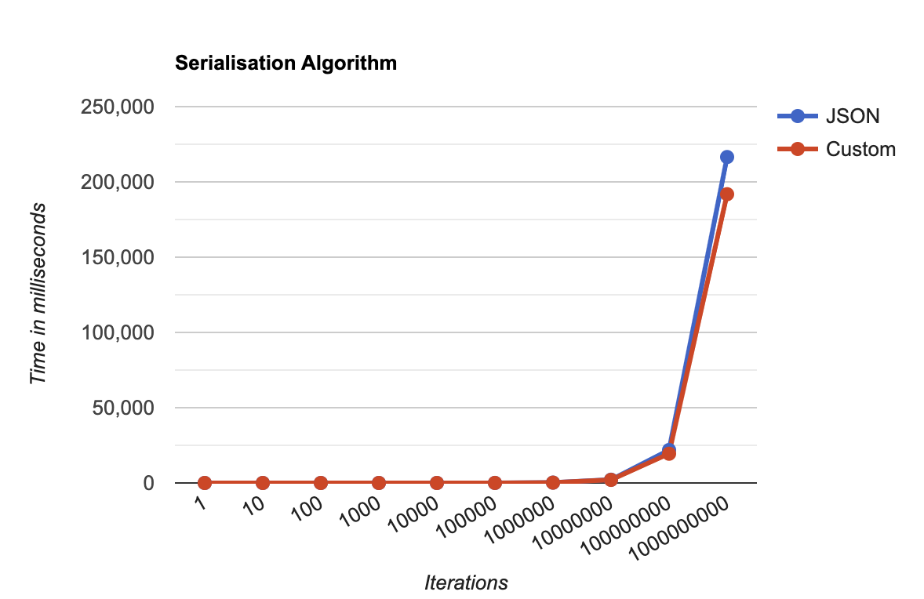
Serialization
 | JSON Serialization | Custom Serialization
Objects { }. In an Array | Time ( in milliseconds ) | Time ( in milliseconds )
1 | 0.01 | 0.03
10 | 0.01 | 0.05
100 | 0.13 | 0.13
1000 | 0.31 | 1.3
10000 | 2.74 | 5.34
100000 | 23.69 | 29.49
1000000 | 224.28 | 215.47
10000000 | 2168.73 | 2041.46
100000000 | 21891.67 | 19421.5
1000000000 | 216523.15 | 191821.11

Slide 7
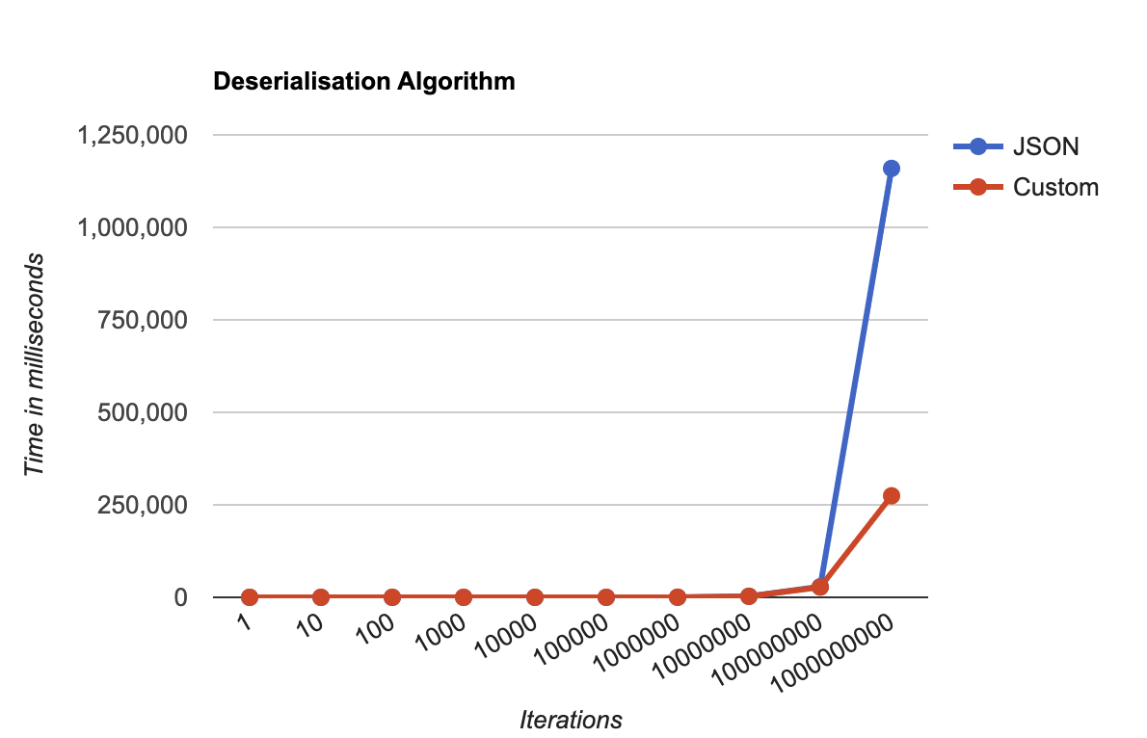
Deserialization
 | JSON Deserialization | Custom Deserialization
Objects { }. In an Array | Time ( in milliseconds ) | Time ( in milliseconds )
1 | 0.01 | 0.03
10 | 0.01 | 0.06
100 | 0.04 | 0.13
1000 | 0.38 | 1.22
10000 | 3.34 | 5.02
100000 | 29.94 | 33.63
1000000 | 300.08 | 291.25
10000000 | 2903.63 | 2759.26
100000000 | 28519.25 | 27669.63
1000000000 | 1159420.74 | 274499.51

Slide 8
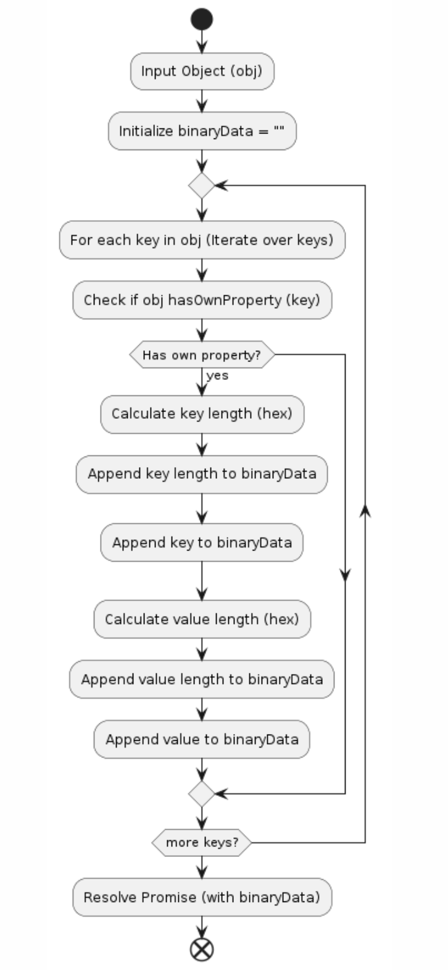
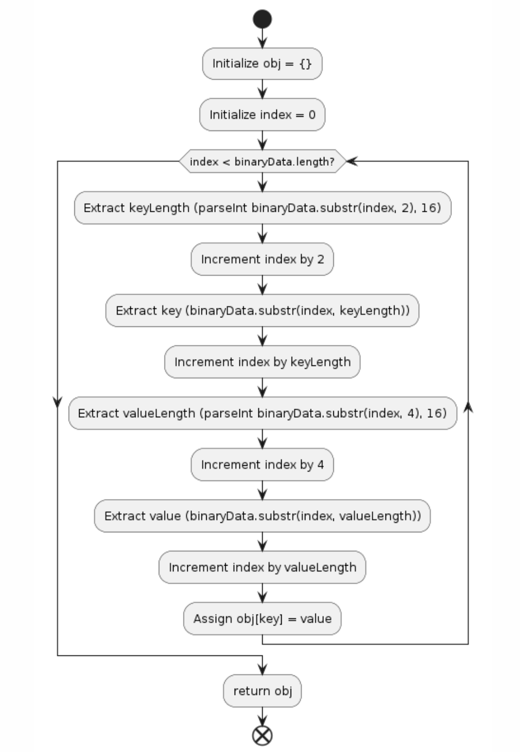
Custom Serialization
Custom Deserialization

Slide 9
Thank you : )

