Slide 1




PDFSENTRY
BCSE321L · MALWARE ANALYSIS
CONSOLIDATED REVIEW · R1 · R2 · R3
PDFSentry
Explainable, Drift-Resilient Static Detection of Malicious PDF Files
Reachability over recognition — reading what a PDF will do, not just what it contains.
Alok Singh 23BCI0158
Mrinali Charhate 23BCI0073
Aarya Ashish Nagvekar 23BCI0061
BCSE321L — Malware Analysis · Vellore Institute of Technology

Slide 2

PDFSENTRY
AGENDA
ROADMAP
What this deck covers
01
Review 1 — Proposal The problem, objectives, existing vs proposed system, samples, tools, datasets, methodology and expected outcome.
ONE LINE
We reproduce a state-of-the-art PDF detector, prove why it fails on evasive malware, and add a structural reachability signal that is explainable and obfuscation-invariant — without ever executing a file.
02
Review 2 — Implementation Finalised architecture, tools installed, datasets collected, static-analysis results, SHAP diagnosis, findings and blockers.
03
Review 3 — Final Final results across three pillars — Detection, Robustness, Assurance — malware characteristics, IoCs, comparison and demo.
04
The thesis A byte/string model sees what a file contains; PDFSentry parses the object graph and asks whether an automatic trigger can reach a dangerous action.
PDFSentry · Reachability over Recognition
02

Slide 3
PDFSENTRY
REVIEW 1 · PROPOSAL
R1
PROPOSAL
The problem we target, our proposed system, and the plan to build and evaluate it.
Title · Domain · Problem · Motivation · Objectives · Existing vs Proposed · Samples · Tools · Datasets · Methodology · Expected outcome

Slide 4
PDFSENTRY
REVIEW 1 · PROPOSAL
TITLE · DOMAIN
Project title & domain
A static, explainable detector for malicious PDFs, built around a structural idea rather than metrics alone.
Title PDFSentry — Explainable, Drift-Resilient Static Detection of Malicious PDF Files.
Domain Static malware analysis · machine-learning security · document-borne threat detection.
Why PDF One of the most common malware delivery vectors — portable, trusted by users, and rich in active-content features (JavaScript, launch actions, embedded files).
Positioning A built and defended research project with a genuinely novel structural idea — not a survey, and not just a benchmark score.
PDF
Static
Novel
a top malware delivery vector
zero execution, zero detonation
reachability over recognition
PDFSentry · Reachability over Recognition
04

Slide 5
PDFSENTRY
REVIEW 1 · PROPOSAL
PROBLEM
Problem statement
Strong benchmark numbers hide a dangerous blind spot on exactly the malware that matters most.
Looks solved State-of-the-art detectors report near-perfect scores on ordinary PDF malware.
Breaks on evasion On evasive malware — files that already slipped past antivirus — EMBER2024 drops from PR-AUC 0.9933 to 0.7841 on its own challenge set.
Root cause These detectors read byte and string statistics; they are structurally blind to a document’s object graph and its auto-execution behaviour.
Consequence 355 of 805 real evasive PDFs pass straight through — precisely the malware that reaches an inbox after a gateway.
0.9933 → 0.7841
355 / 805
44%
PR-AUC: ordinary → evasive
real evasive PDFs missed
of evasive malware slips through
PDFSentry · Reachability over Recognition
05

Slide 6

PDFSENTRY
REVIEW 1 · PROPOSAL
MOTIVATION
Motivation
Highest-value target Evasive PDFs are what remain after an AV gateway — detecting them has outsized security value.
Explainability Security analysts need a reason, not just a probability — a verdict they can verify and act on.
Drift resilience Byte statistics shift as attackers re-encode and re-compress; a structural signal should be stable by construction.
Behaviour over appearance The real question is not “does it look malicious?” but “can it act maliciously when opened?”
Academic brief The course rewards a genuinely new idea and real engineering over another high score on a known benchmark.
PDFSentry · Reachability over Recognition
06

Slide 7
PDFSENTRY
REVIEW 1 · PROPOSAL
OBJECTIVES
Objectives
01
O1 · Reproduce Re-establish the EMBER2024 PDF benchmark on the authors’ released model, as a verified baseline.
DESIGN PRINCIPLE
02
O2 · Diagnose Use SHAP to explain why evasive malware is systematically missed.
Every objective is falsifiable and traced to a stored artifact. We separate what is proven on real data from what is demonstrated in a controlled setting.
03
O3 · Build A trigger-reachability analyzer over the PDF object graph (engine TRA-1.0).
04
O4 · Fuse Show that reachability + EMBER recovers structural evasions a byte model cannot.
05
O5 · Harden Prove obfuscation-invariance — a verdict stable under lossless re-encoding (semantic stability).
06
O6 · Assure Deliver verifiable, explainable verdicts and an interactive dashboard.
PDFSentry · Reachability over Recognition
07

Slide 8
PDFSENTRY
REVIEW 1 · PROPOSAL
THREAT MODEL
Threat model & assumptions
A clear boundary for what PDFSentry defends against — and, honestly, what it does not.
Attacker goal Deliver a PDF that auto-executes a dangerous action (JavaScript, Launch, EmbeddedFile) on open, while reading as benign to an ML detector.
Attacker capability Full control of file structure — can compress, encrypt, reorder objects and hide payloads in object streams.
Defender constraint Static analysis only — no execution, no sandbox detonation (safety + reproducibility).
In scope Structural auto-execution threats reachable from a trigger; byte-level obfuscation of those threats.
Out of scope Pure social-engineering PDFs with no active content, and exploits in the viewer binary itself.
PDFSentry · Reachability over Recognition
08

Slide 9
PDFSENTRY
REVIEW 1 · PROPOSAL
EXISTING vs PROPOSED
Existing system vs proposed system
Where current approaches fall short, and what PDFSentry adds on top of them.
Property | AV signatures | EMBER2024 (byte ML) | PDFSentry (ours)
Reads what the file DOES | No | No (bytes/strings) | Yes — reachability
Explainable verdict | Match only | Post-hoc SHAP | Minimal witness path
Robust to re-encoding | No | No (SSI 0.22) | Yes (SSI 1.00)
Needs training data | Signatures | Yes | No (deterministic rule)
New / evasive malware | Weak | Weak on evasive | Targets the evasion mechanism
PDFSentry does not replace EMBER — it supplies the structural evidence a byte/string model structurally lacks.
PDFSentry · Reachability over Recognition
09

Slide 10
PDFSENTRY
REVIEW 1 · PROPOSAL
SAMPLES
Malware / samples to be analyzed
Real evasive malware for evidence; controlled, harmless twins for mechanism — never live execution.
EMBER2024 challenge 805 real evasive PDFs that first evaded antivirus — the authors release these as feature vectors.
CIC-Evasive-PDFMal2022 10,025 labelled PDFs (UNB) — used for evasion-cost mapping on a count-based feature set.
Controlled twins Benign PDFs carrying a harmless reachable payload (app.alert) across 4 trigger wirings — for mechanism and robustness studies.
Safety boundary Everything is static. No PDF is opened; no JavaScript, launch action or embedded file is ever executed.
805
10,025
0
real evasive PDFs
CIC labelled PDFs
files ever executed
PDFSentry · Reachability over Recognition
10

Slide 11
PDFSENTRY
REVIEW 1 · PROPOSAL
TOOLS · DATASETS
Tools required & dataset sources
Parsing pikepdf — static object-graph recovery; the file is parsed, never executed.
Detector LightGBM + thrember (EMBER v3 feature extractor, 2568 dimensions).
Explainability SHAP (TreeExplainer) for per-feature-family attribution of the model’s decisions.
Engineering Python 3.11 · FastAPI service · pytest · a self-contained ECharts dashboard.
Datasets EMBER2024 (FutureComputing4AI, KDD 2025) · CIC-Evasive-PDFMal2022 (University of New Brunswick).
PDFSentry · Reachability over Recognition
11

Slide 12
PDFSENTRY
REVIEW 1 · PROPOSAL
METHODOLOGY
Proposed methodology
01
Static parse Open with pikepdf — never executed — and recover the object-reference graph.
KEY IDEA
Recognition asks “does this look like malware?” Reachability asks “can an automatic trigger reach a dangerous action?” — the question that actually defines the threat.
02
Trigger surface Enumerate auto / interaction triggers: /OpenAction, /AA, /Names/JavaScript, action chains.
03
Reachability BFS Shortest-path search from each trigger to a dangerous capability.
04
Verdict taxonomy ABSENT · PRESENT_DORMANT · ACTIVE_ONINTERACT · ACTIVE_ONOPEN, each with a minimal witness.
05
Fusion Combine the 65-D reachability vector with the EMBER score for the final decision.
PDFSentry · Reachability over Recognition
12

Slide 13
PDFSENTRY
REVIEW 1 · PROPOSAL
EXPECTED OUTCOME
Expected outcome
What the project set out to deliver, stated as measurable goals.
Structural
Explainable
Drift-resilient
a detector that reads behaviour, supplying the signal byte-ML lacks
a verifiable witness path accompanying every verdict
stability under obfuscation, measured and not merely asserted
Reproducible
Honest
Usable
every reported number traced to a stored JSON artifact
a clear line between what is proven and what is projected
an interactive dashboard for the defence and live demonstration
PDFSentry · Reachability over Recognition
13

Slide 14
PDFSENTRY
REVIEW 2 · IMPLEMENTATION
R2
IMPLEMENTATION
What we built, the tools and data in place, and the first measured results.
Finalised methodology · Architecture · Tools installed · Datasets collected · Static & behavioural results · SHAP · Findings · Problems · Status

Slide 15
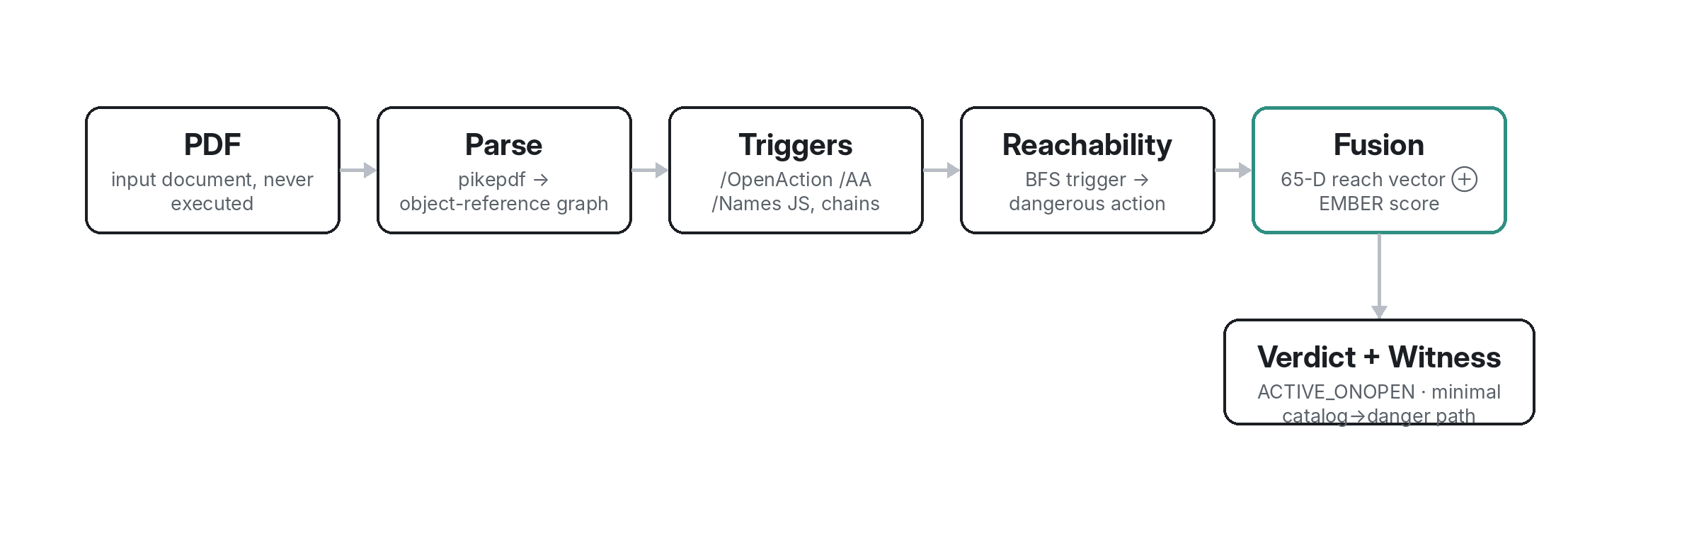
PDFSENTRY
REVIEW 2 · IMPLEMENTATION
ARCHITECTURE
Finalized methodology & system architecture
The PDFSentry pipeline — static throughout; the fusion node combines structural reachability with the EMBER score to produce a typed, witnessed verdict.
PDFSentry · Reachability over Recognition
15

Slide 16
PDFSENTRY
REVIEW 2 · IMPLEMENTATION
TOOLS INSTALLED
Tools installed & working
The full stack is built, tested and reproducible — not slideware.
Static parser pikepdf operational — object-graph recovery + reachability engine (TRA-1.0).
Detector EMBER2024 released PDF model loaded via LightGBM; thrember built from source (not on PyPI).
Explainability SHAP TreeExplainer over the full 2568-D EMBER vector, grouped by feature family.
Backend & tests FastAPI service; 23 pytest cases passing across parsing, reachability and fusion.
Dashboard Self-contained ECharts dashboard (library inlined) — 11 interactive views.
23
2568-D
11
pytest cases passing
EMBER feature vector
interactive dashboard views
PDFSentry · Reachability over Recognition
16

Slide 17
PDFSENTRY
REVIEW 2 · IMPLEMENTATION
DATA COLLECTED
Datasets & malware samples collected
EMBER2024 Authors’ PDF model + ordinary test set + the 805 evasive challenge PDFs (released as features).
Benign corpus 35 real PDF fixtures + 250 generated benign documents (links, forms, bookmarks) for false-positive testing.
Weaponized twins Benign bases × 4 trigger wirings × 8 lossless transforms, each carrying a harmless payload.
Provenance Every sample set is scripted and regenerable; all results fold into stored JSON artifacts.
285
4 × 8
100%
benign documents
wirings × transforms
results traced to artifacts
PDFSentry · Reachability over Recognition
17

Slide 18
PDFSENTRY
REVIEW 2 · IMPLEMENTATION
STATIC RESULTS · O1
Static analysis results — reproducing the gap
Same EMBER model, two regimes. Ordinary malware looks solved; evasive malware collapses precision.
0.7864
evasive PR-AUC (reproduced)
355/805
real evasive PDFs missed
0.9933
ordinary PR-AUC
PDFSentry · Reachability over Recognition
18

Slide 19
PDFSENTRY
REVIEW 2 · IMPLEMENTATION
SHAP · O2
SHAP diagnosis — the structural void
Where the EMBER model spends its attention on the evasive malware it misses (mean |SHAP| by feature family).
~0%
attention on structure
~60%
on string statistics
≈
missed looks like caught
PDFSentry · Reachability over Recognition
19

Slide 20
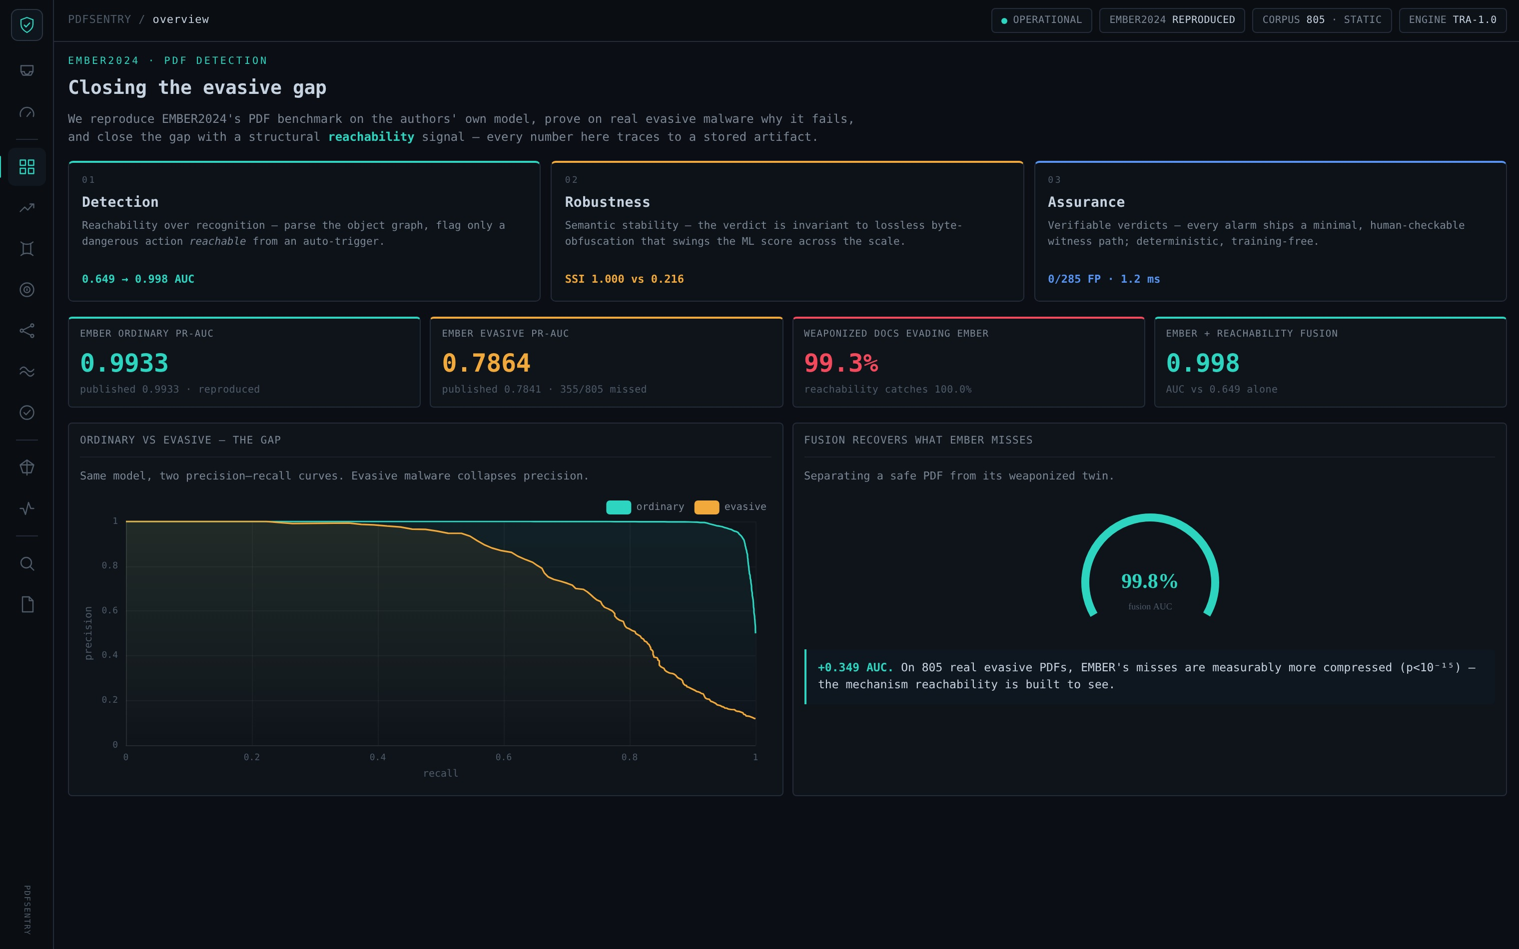
PDFSENTRY
REVIEW 2 · IMPLEMENTATION
BEHAVIOUR (STATIC)
Behavioural reasoning — without execution
The template’s “dynamic analysis” is answered by static behavioural reachability — safer, and reproducible.
By design, static No sandbox, no detonation — PDFs are never opened. This removes all execution risk and keeps results reproducible.
Reachability as proxy Instead of dynamic tracing, we statically prove whether an auto-trigger can reach a dangerous action.
The void confirmed SHAP shows the model acts on string/byte statistics and essentially nothing structural — so it cannot separate evasive malware from benign files.
Our fill Reachability supplies exactly that missing structural evidence, as a 65-D feature vector fused with the EMBER score.
Reproduction + SHAP in the dashboard
PDFSentry · Reachability over Recognition
20

Slide 21
PDFSENTRY
REVIEW 2 · IMPLEMENTATION
SCREENSHOTS
Screenshots — interactive dashboard
Traceable Every KPI links to a stored JSON artifact — nothing is hand-typed.
Three pillars Detection, Robustness and Assurance, each a clickable view.
Live PR curves Ordinary vs evasive, rendered from the real EMBER model.
Self-contained ECharts inlined — opens offline, shareable as a single file.
PDFSentry · Reachability over Recognition
21

Slide 22
PDFSENTRY
REVIEW 2 · IMPLEMENTATION
FINDINGS
Important findings
The collapse is real EMBER PR-AUC 0.9933 → 0.7864 on evasive malware; 355/805 missed.
Misses are structural Missed malware is measurably more compressed than caught malware — median /FlateDecode 12 vs 7 (p < 10⁻¹⁵), higher entropy, larger size.
Reachability recovers it On controlled structural evasions, EMBER + reachability fusion lifts ROC-AUC from 0.649 to 0.998.
Confound-free The real-malware evidence uses EMBER’s own released features — no new tooling, no execution, no circular labels.
p < 10⁻¹⁵
12 vs 7
0.649 → 0.998
compression gap on real misses
/FlateDecode: missed vs caught
fusion ROC-AUC (controlled)
PDFSentry · Reachability over Recognition
22

Slide 23
PDFSENTRY
REVIEW 2 · IMPLEMENTATION
PROBLEMS
Problems encountered
Raw malware unobtainable EMBER releases the 805 challenge as features only; CIC raw PDFs triggered AV quarantine and download limits.
Our workaround Used EMBER’s released features for confound-free real-malware evidence, and controlled twins for the mechanism.
Tooling friction thrember is not on PyPI (built from source); a signify import bug was stubbed around.
Safety boundary No safe way to execute live malware — so the whole pipeline stays static, which became a design strength.
PDFSentry · Reachability over Recognition
23

Slide 24
PDFSENTRY
REVIEW 2 · IMPLEMENTATION
STATUS
Work completed vs remaining (at Review 2)
01
Completed EMBER reproduction, SHAP diagnosis, reachability engine + 65-D features, fusion study, dashboard v1.
STATUS → R3
Every “remaining” item was completed for Review 3. The two new pillars — Robustness and Assurance — and the negative controls are the headline additions.
02
Remaining · robustness Quantify obfuscation-invariance (semantic stability).
03
Remaining · assurance Verifiable verdicts: witnesses, false-positive and determinism measurement.
04
Remaining · rigour Negative controls and honest-scope framing.
05
Remaining · delivery Final packaging, dashboard polish and write-up.
PDFSentry · Reachability over Recognition
24

Slide 25
PDFSENTRY
REVIEW 3 · FINAL
R3
FINAL
The complete system and its results across three pillars — Detection, Robustness, Assurance.
Final methodology · Taxonomy · Implementation · Three pillars · Characteristics · IoCs · Detection results · Comparison · Limits · Conclusion · Demo

Slide 26
PDFSENTRY
REVIEW 3 · FINAL
FINAL METHODOLOGY
Final methodology
01
Static parse pikepdf recovers the object-reference graph; the file is never executed.
UNCHANGED, PROVEN
The methodology promised at Review 1 is the one that shipped — now measured for accuracy, robustness and assurance.
02
Trigger surface Enumerate every auto / interaction trigger across the known PDF execution vectors.
03
Reachability BFS Shortest-path search from trigger to dangerous capability; record the minimal witness.
04
65-D reach vector Encode verdicts, hop counts, concealment signatures and trigger classes as features.
05
Fusion + verdict Combine with the EMBER score; emit a typed verdict with a human-checkable path.
PDFSentry · Reachability over Recognition
26

Slide 27
PDFSENTRY
REVIEW 3 · FINAL
TAXONOMY
Reachability verdict taxonomy
01
ABSENT No dangerous capability present in the document at all.
CAPABILITY ≠ INTENT
The four-state taxonomy is what lets PDFSentry separate a benign clickable link from a weaponised auto-run payload — and report exactly which it found.
02
PRESENT_DORMANT A dangerous capability exists but no trigger can reach it — inert.
03
ACTIVE_ONINTERACT Reachable only on user interaction (e.g. a clickable link) — a capability, not an auto-threat.
04
ACTIVE_ONOPEN A dangerous action auto-fires on open — the threat class PDFSentry is built to catch.
PDFSentry · Reachability over Recognition
27

Slide 28
PDFSENTRY
REVIEW 3 · FINAL
IMPLEMENTATION
Complete implementation
A built system, end to end — reproducible, tested and deployable.
TRA-1.0
65-D
23
trigger-reachability engine (static, deterministic)
reachability feature vector fused with EMBER
pytest cases passing (parse · reach · fusion)
11 views
285
704
interactive ECharts dashboard, self-contained
benign documents for false-positive testing
obfuscation variants in the stability study
PDFSentry · Reachability over Recognition
28

Slide 29
PDFSENTRY
REVIEW 3 · FINAL
RESULTS OVERVIEW
Three pillars of the final result
01
01 · Detection Reachability over recognition — fusion lifts controlled ROC-AUC 0.649 → 0.998.
THE ARC
Not one metric, but a complete argument: it works, it holds under attack, and you can verify it by hand.
02
02 · Robustness Semantic stability — verdict invariant to lossless obfuscation (SSI 1.000 vs 0.216).
03
03 · Assurance Verifiable verdicts — 0/285 false positives, 1-hop witnesses, deterministic, training-free.
PDFSentry · Reachability over Recognition
29

Slide 30
PDFSENTRY
REVIEW 3 · FINAL
DETECTION
Pillar 01 · Detection results
On controlled structural evasions, EMBER alone is near-blind; adding the reachability signal makes it near-perfect.
+0.349
ROC-AUC from the structural signal
100%
reachability recall on reachable threats
0
false positives on 285 benign
PDFSentry · Reachability over Recognition
30

Slide 31
PDFSENTRY
REVIEW 3 · FINAL
ROBUSTNESS
Pillar 02 · Robustness — semantic stability
Same malicious behaviour, eight lossless re-saves. EMBER’s score swings across the scale; reachability never moves.
78.4%
of docs get BOTH EMBER verdicts
1.000
reachability stability index
0.216
EMBER stability index
PDFSentry · Reachability over Recognition
31

Slide 32
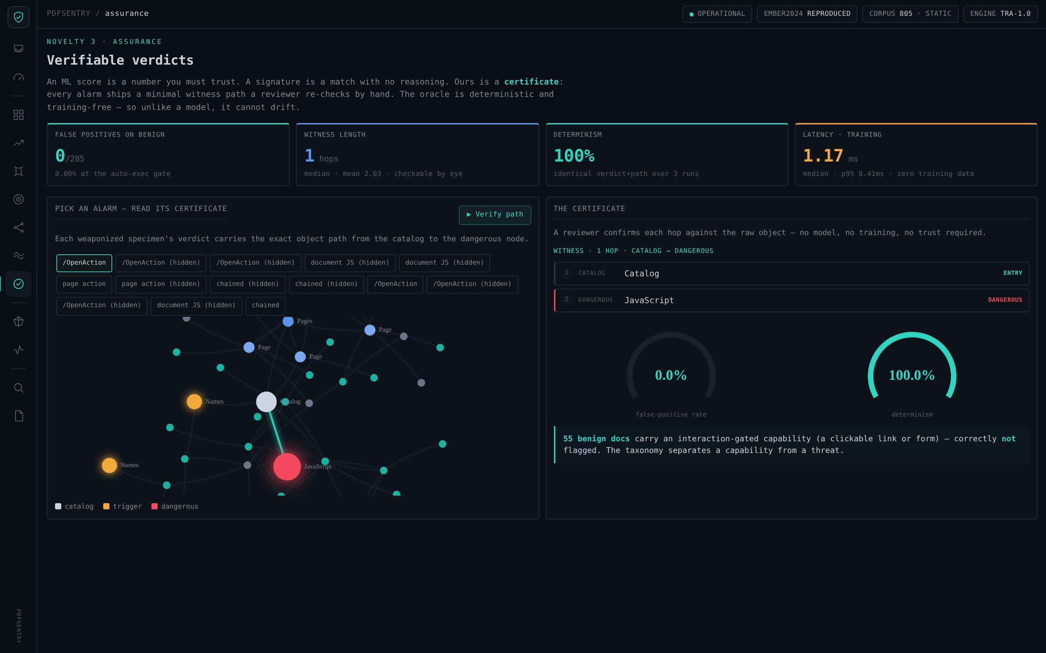
PDFSENTRY
REVIEW 3 · FINAL
ASSURANCE
Pillar 03 · Assurance — verifiable verdicts
Certificate Each alarm ships a minimal witness: catalog → trigger → dangerous node.
0 / 285 false positives on the benign corpus (auto-exec gate).
Deterministic identical verdict + path over repeated runs; no training data.
Fast ~1.2 ms median per document — gateway-deployable.
PDFSentry · Reachability over Recognition
32

Slide 33
PDFSENTRY
REVIEW 3 · FINAL
CHARACTERISTICS
Malware characteristics
What evasive PDFs do to survive: automate, conceal, and camouflage as ordinary compression.
Auto-execution A dangerous action (JavaScript, Launch, EmbeddedFile) wired to fire on open via /OpenAction, /AA or /Names.
Concealment The payload hidden inside a compressed object stream — present in behaviour, invisible to a token count.
Byte camouflage Elevated /FlateDecode and entropy make the file read as “just compressed” to a statistical model.
Indirection Action chains (GoTo → Next) reach the payload at depth, defeating shallow pattern checks.
entropy > 7.9
naive = 0
depth
byte camouflage
hidden auto-run payload
chained indirection
PDFSentry · Reachability over Recognition
33

Slide 34
PDFSENTRY
REVIEW 3 · FINAL
IOCs
Indicators of Compromise (IoCs)
Structural, checkable indicators — each maps to a reachability feature, not a fragile byte signature.
Reachable auto-trigger /OpenAction | /AA | /Names/JavaScript with a path to /JS, /Launch or /EmbeddedFile → ACTIVE_ONOPEN.
Hidden-gap signature An ACTIVE capability whose naive token count is 0 — a contradiction only concealment produces.
Object-stream hiding JavaScript wrapped in an ObjStm; /FlateDecode count far above the benign median (≈ 12 vs 7).
Statistical tells Byte entropy > 7.9 and file size well above benign, with a JS token count of 0.
Deep action chains GoTo → Next sequences terminating at a dangerous node.
PDFSentry · Reachability over Recognition
34

Slide 35
PDFSENTRY
REVIEW 3 · FINAL
COMPARISON
Comparison / results
PDFSentry against the byte-ML baseline and a classic structural-path detector.
Property | EMBER2024 | Hidost | PDFSentry
Reads what the file DOES | No (bytes/strings) | Partial (static paths) | Yes (reachability)
Explainable verdict | Post-hoc SHAP | No | Witness path
Obfuscation-invariant | No — SSI 0.22 | Not reported | Yes — SSI 1.00
Cost to evade | Free re-save | Low–medium | Must disarm payload
Training data needed | Yes | Yes | No (deterministic)
Honest scope: the 0.78 EMBER benchmark is NOT improved (no raw evasive files to retrain). The 0.998 is a controlled result that isolates the mechanism.
PDFSentry · Reachability over Recognition
35

Slide 36


PDFSENTRY
LIVE PORTAL
ENTERPRISE · SECURITY OPERATIONS
The Command Center
The research shipped as a working PDF-security portal — ingest, risk-score, triage, and prove every verdict.

Slide 37
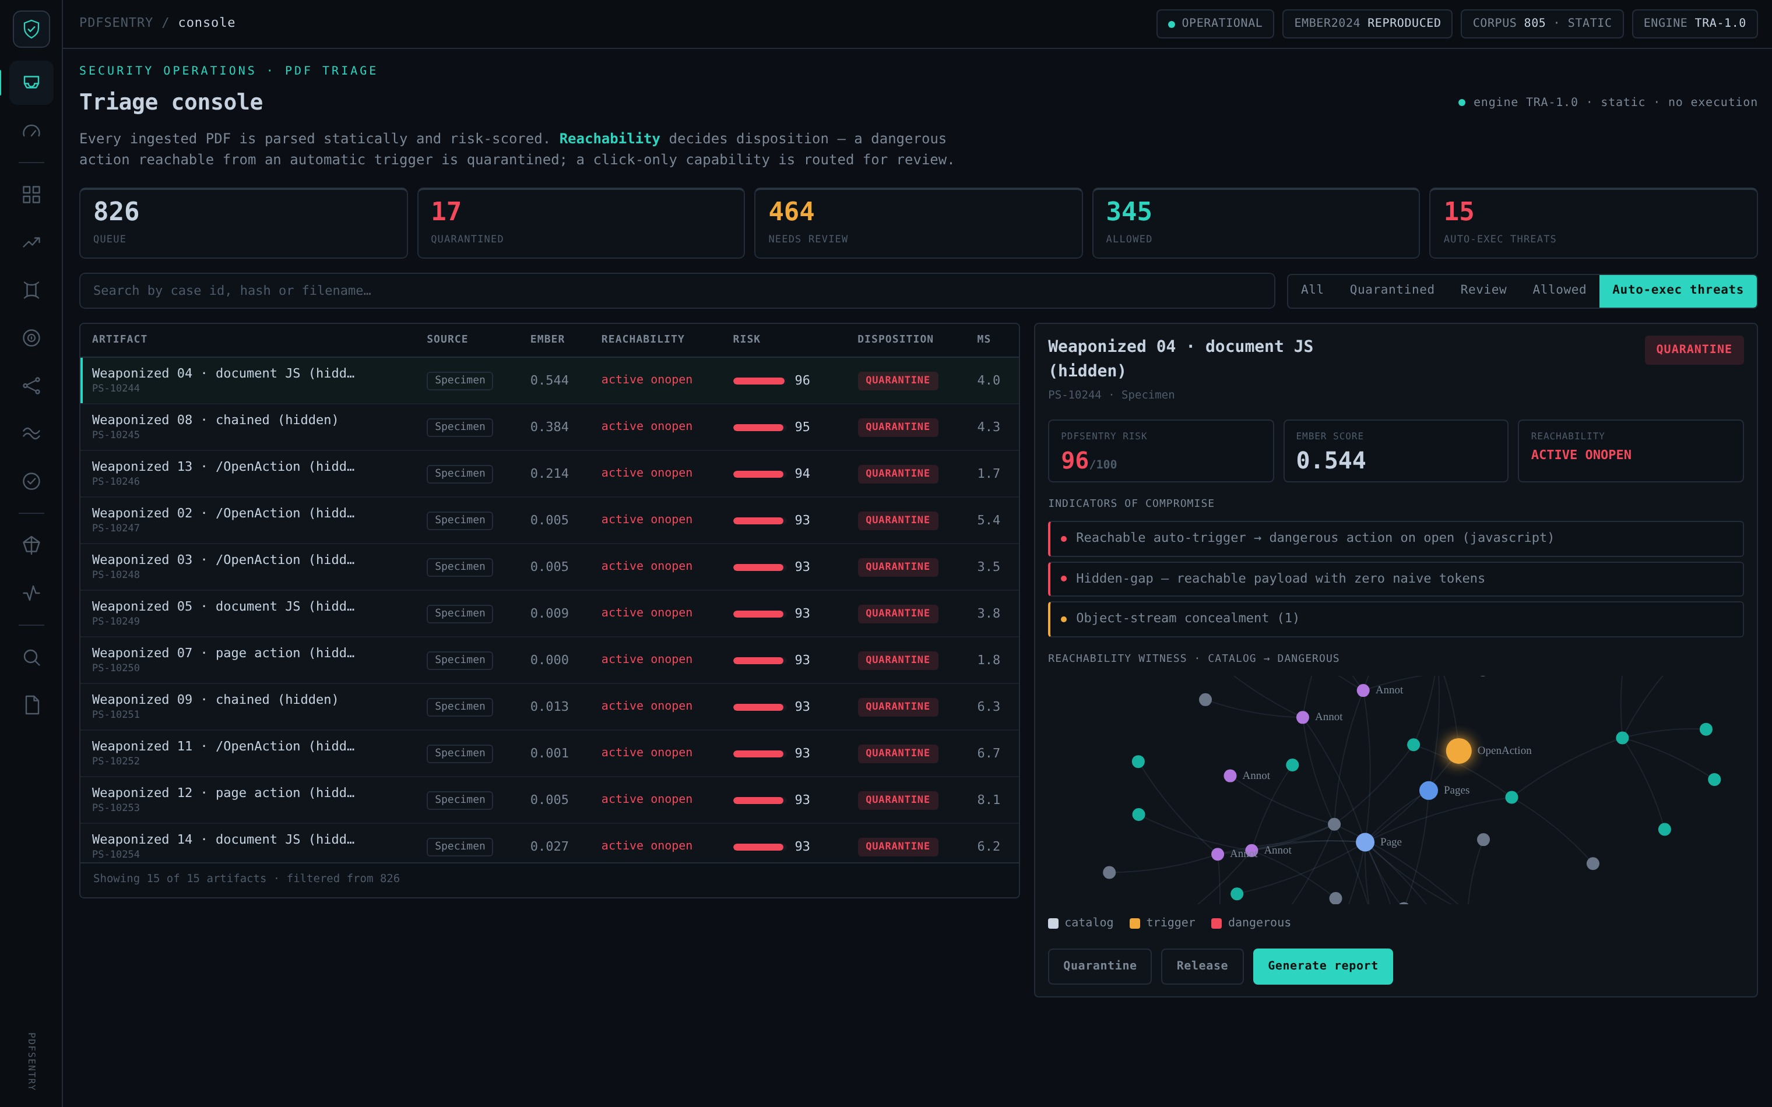
PDFSENTRY
LIVE PORTAL
TRIAGE CONSOLE
Every PDF, parsed and risk-scored
PDFSentry · Reachability over Recognition
37
826 artifacts triaged — an auto-exec threat open, with its indicators and the reachability witness that justifies quarantine.

Slide 38
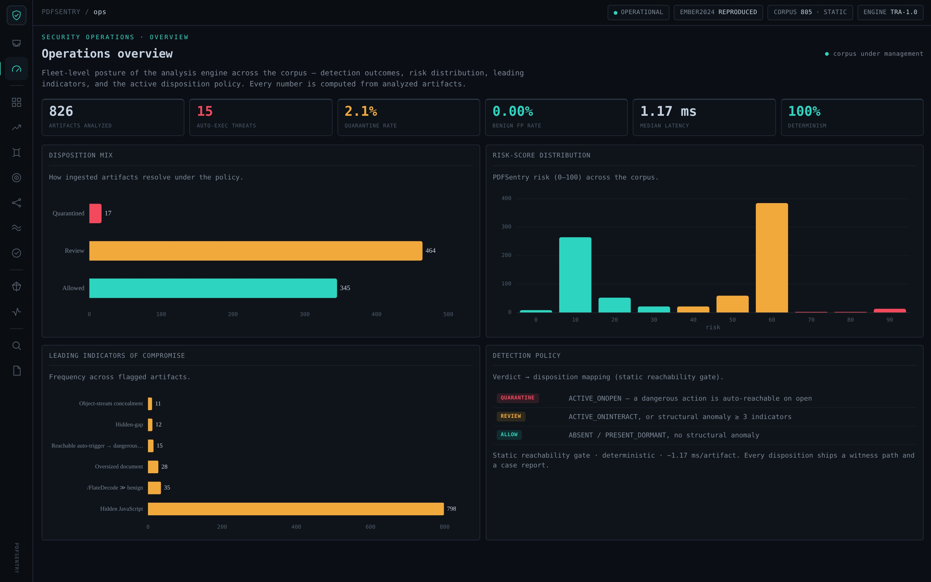
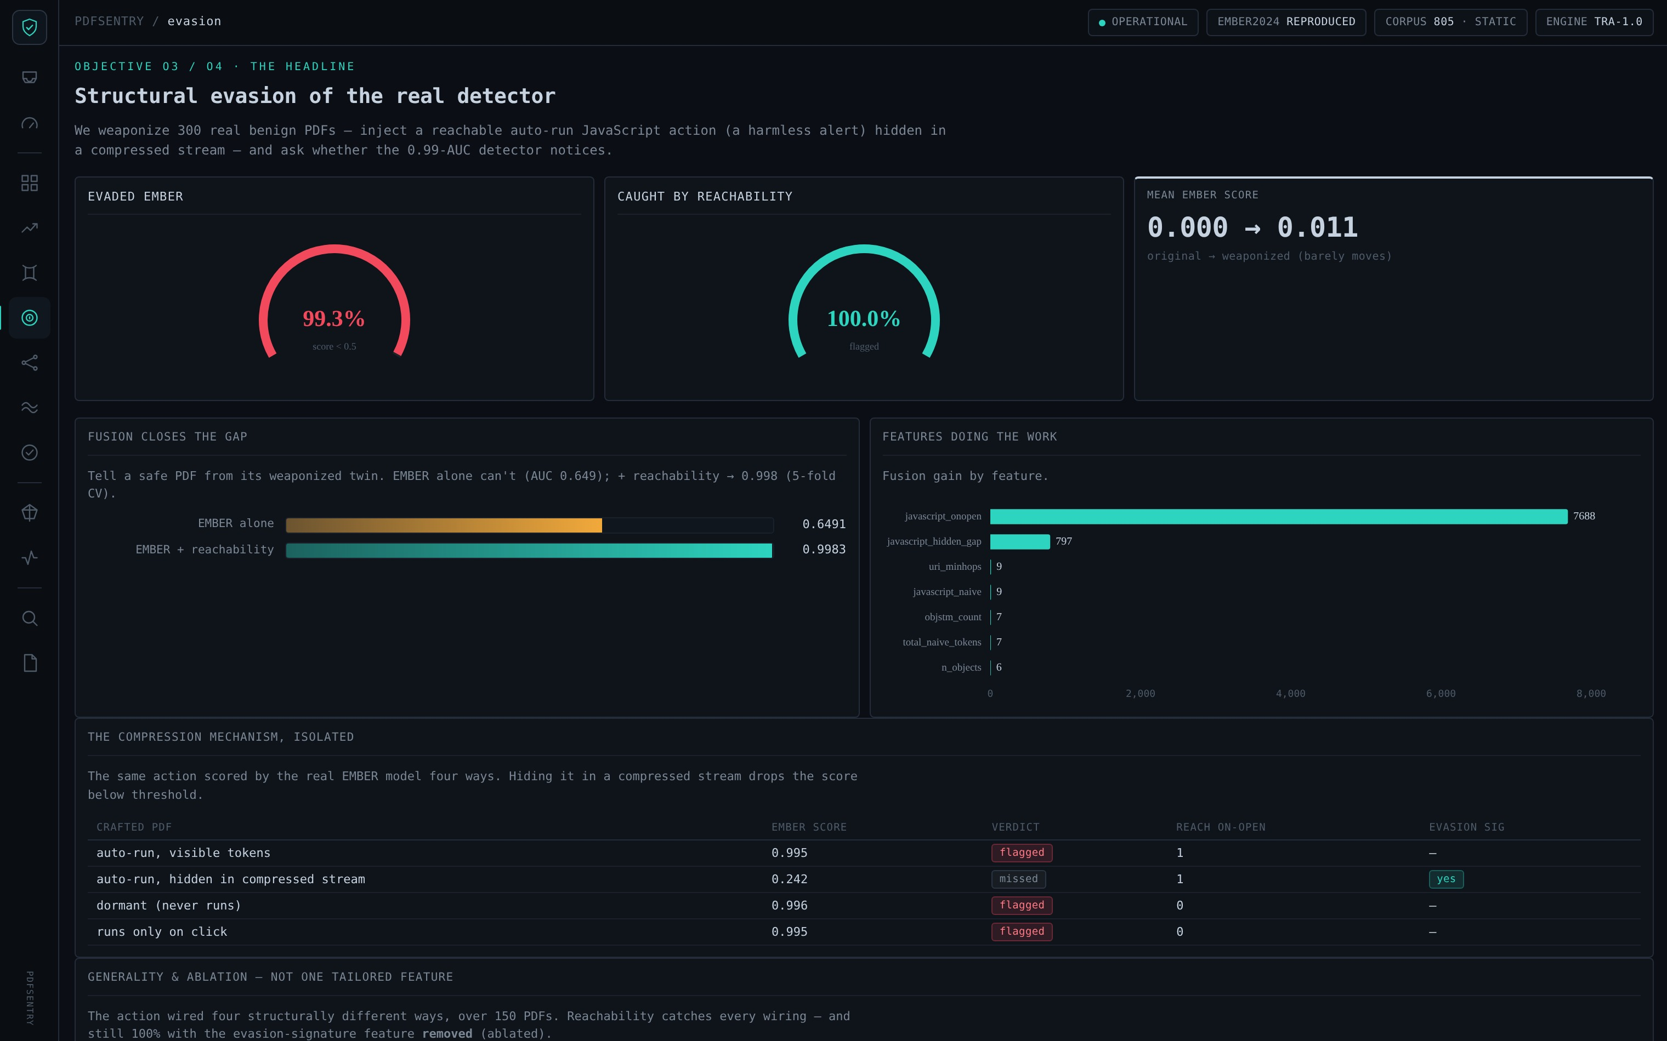
PDFSENTRY
LIVE PORTAL
OPERATIONS
Fleet posture at a glance
Operations — 0.00% false positives · 1.17 ms · 100% deterministic
Structural evasion — fusion lifts 0.649 → 0.998
PDFSentry · Reachability over Recognition
38

Slide 39
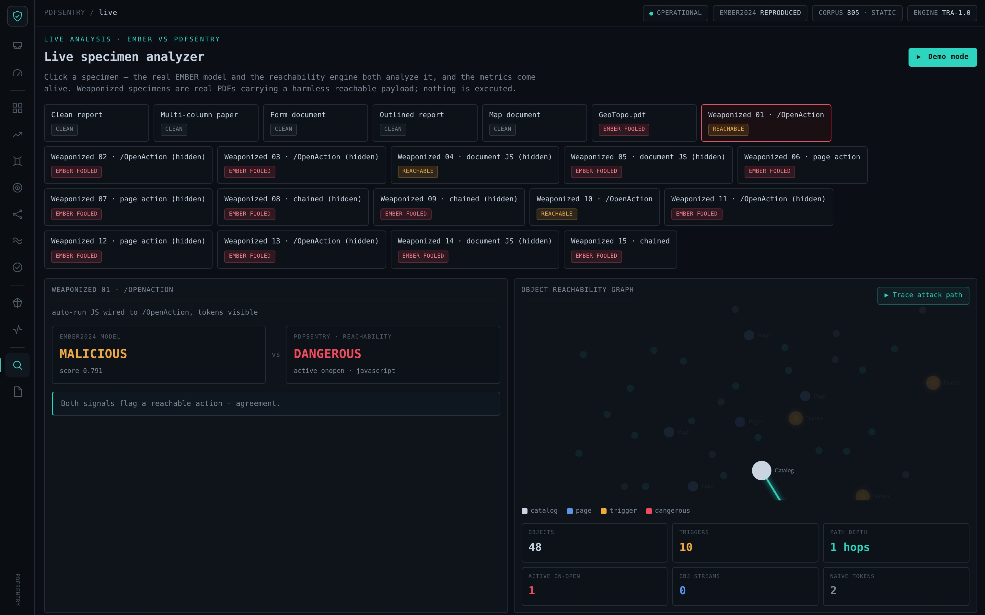
PDFSENTRY
LIVE PORTAL
LIVE ANALYSIS
The attack path, traced live
PDFSentry · Reachability over Recognition
39
EMBER says benign; PDFSentry says dangerous — and the object graph lights the catalog → trigger → JavaScript path.

Slide 40
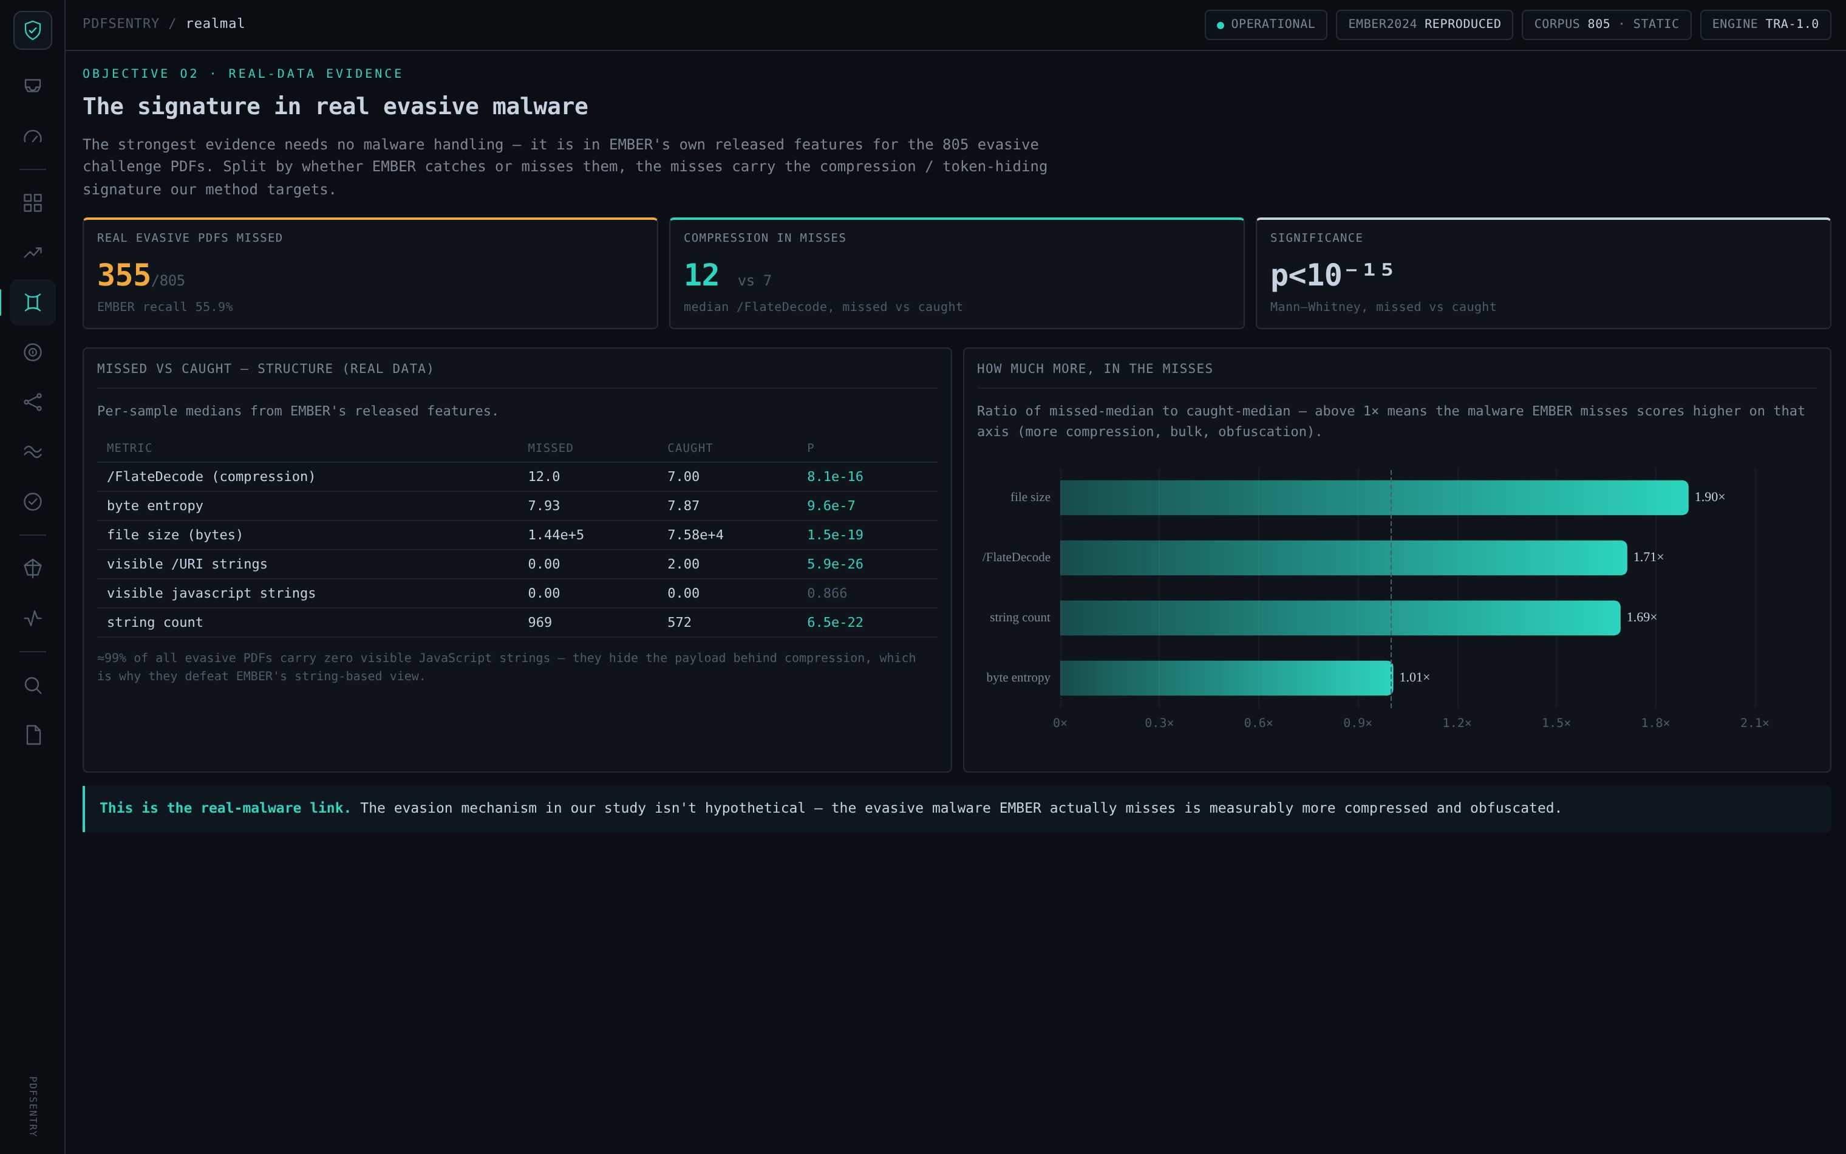
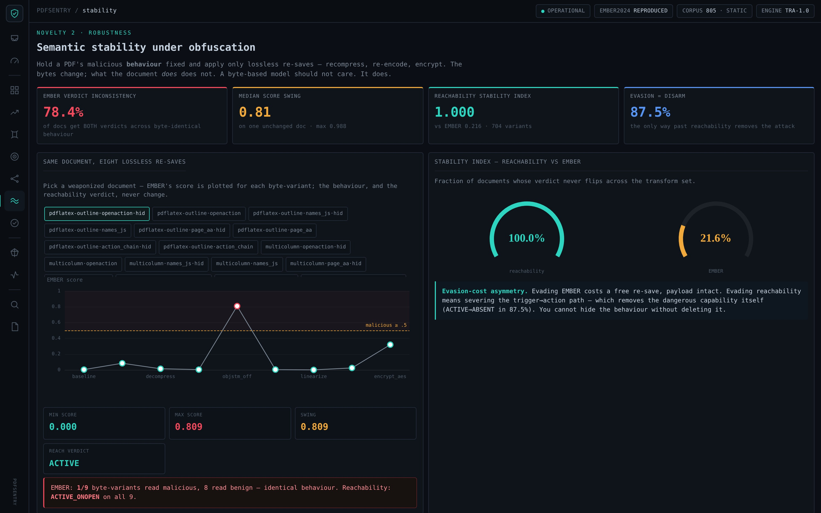
PDFSENTRY
LIVE PORTAL
EVIDENCE
The science behind the verdict
Real evasive malware — the compression signature (p < 10⁻¹⁵)
Semantic stability — SSI 1.000 vs EMBER 0.216
PDFSentry · Reachability over Recognition
40

Slide 41
PDFSENTRY
REVIEW 3 · FINAL
LIMITATIONS
Honest scope & limitations
Stated plainly so the contribution is credible: what is proven, and what is projected.
Benchmark not beaten We did NOT raise EMBER’s 0.78 evasive score — retraining needs raw evasive PDFs we could not obtain.
Controlled mechanism The 0.998 fusion is on controlled weaponized twins; it isolates the signal, it is not a benchmark claim.
Capability ≠ intent Reachability flags a reachable dangerous capability; a benign PDF that genuinely auto-runs JS would be flagged too.
Static only No dynamic cross-validation — by design, for safety and reproducibility.
PDFSentry · Reachability over Recognition
41

Slide 42
PDFSENTRY
REVIEW 3 · FINAL
CONCLUSION
Conclusion
New idea, built Reachability over recognition — a structural, static detector that reads what a PDF will do.
Three results Detection (0.649→0.998 controlled), Robustness (SSI 1.000 vs 0.216), Assurance (0/285 FP, verifiable).
Explains the gap Byte-ML spends ~0% on structure; evasive misses are measurably more compressed (p < 10⁻¹⁵).
Honest & reproducible Every number traces to an artifact; scope is stated without overclaim.
0.998
1.000
0 / 285
detection (controlled ROC-AUC)
robustness (stability index)
assurance (false positives)
PDFSentry · Reachability over Recognition
42

Slide 43
PDFSENTRY
REVIEW 3 · FINAL
FUTURE WORK
Future enhancement
Train on raw evasive Obtain raw evasive PDFs to retrain a reachability-augmented model and test the 0.78 benchmark directly.
Dynamic cross-check Sandbox a sample to validate reachability verdicts against observed behaviour.
Gateway deployment ~1.2 ms/file makes an email / browser gateway pre-filter realistic.
Beyond PDF Extend the reachability abstraction to Office OOXML and other active-content formats.
PDFSentry · Reachability over Recognition
43

Slide 44
PDFSENTRY
PDFSENTRY · R3
THANK YOU
Detection. Robustness.
Assurance.
Reachability over recognition — reading what a PDF will do, not what it looks like.
A working portal, 23 tests, and every number traced to an artifact.
Honest by design — static throughout, nothing ever executed.
Repository github.com/heyalokx/PDFSentry
Live dashboard self-contained interactive dashboard (link in repo README)

