Slide 1



PDFSENTRY
BCSE321L · MALWARE ANALYSIS
REVIEW 3 — FINAL DEFENCE
PDFSentry
Explainable, Drift-Resilient Static Detection of Malicious PDF Files
Reachability over recognition — reading what a PDF will do, not just what it contains.
Alok Singh 23BCI0158
Mrinali Charhate 23BCI0073
Aarya Ashish Nagvekar 23BCI0061
BCSE321L — Malware Analysis · Vellore Institute of Technology

Slide 2

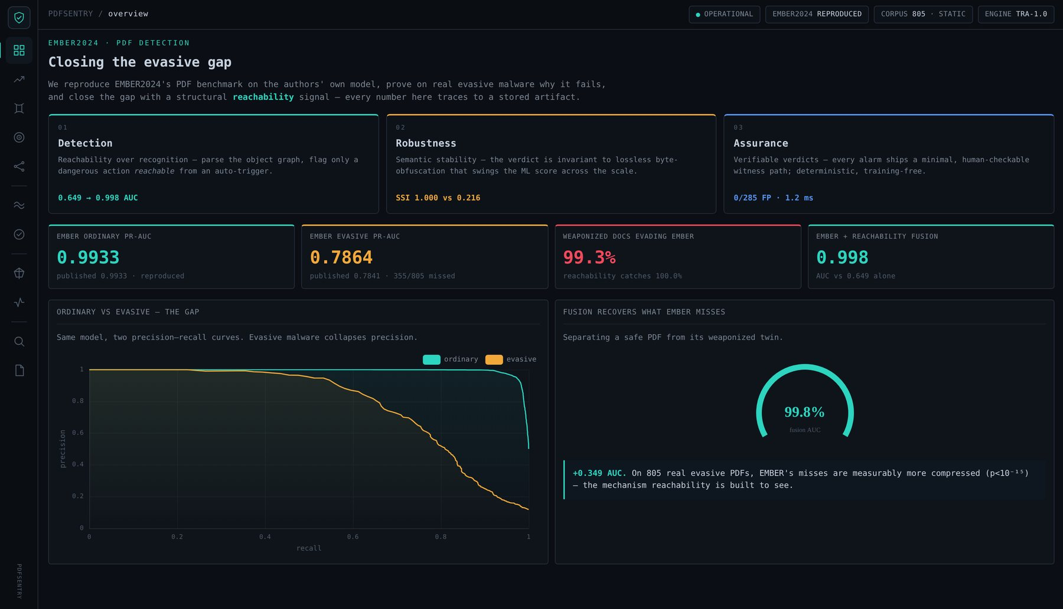
PDFSENTRY
REVIEW 3 · FINAL
MOTIVATION
The problem, in one slide
Great benchmark numbers hide a blind spot on the malware that matters most.
The gap EMBER2024, a state-of-the-art PDF detector, drops from PR-AUC 0.9933 (ordinary) to 0.7864 (evasive) on its own challenge set.
Why It reads byte and string statistics — it is structurally blind to auto-execution.
Cost 355 of 805 real evasive PDFs slip through — exactly the malware that already beat antivirus.
Our idea Recognition asks “does this look like malware?” Reachability asks “can an auto-trigger reach a dangerous action?”
Reproduced in the live dashboard
PDFSentry · Reachability over Recognition
02

Slide 3
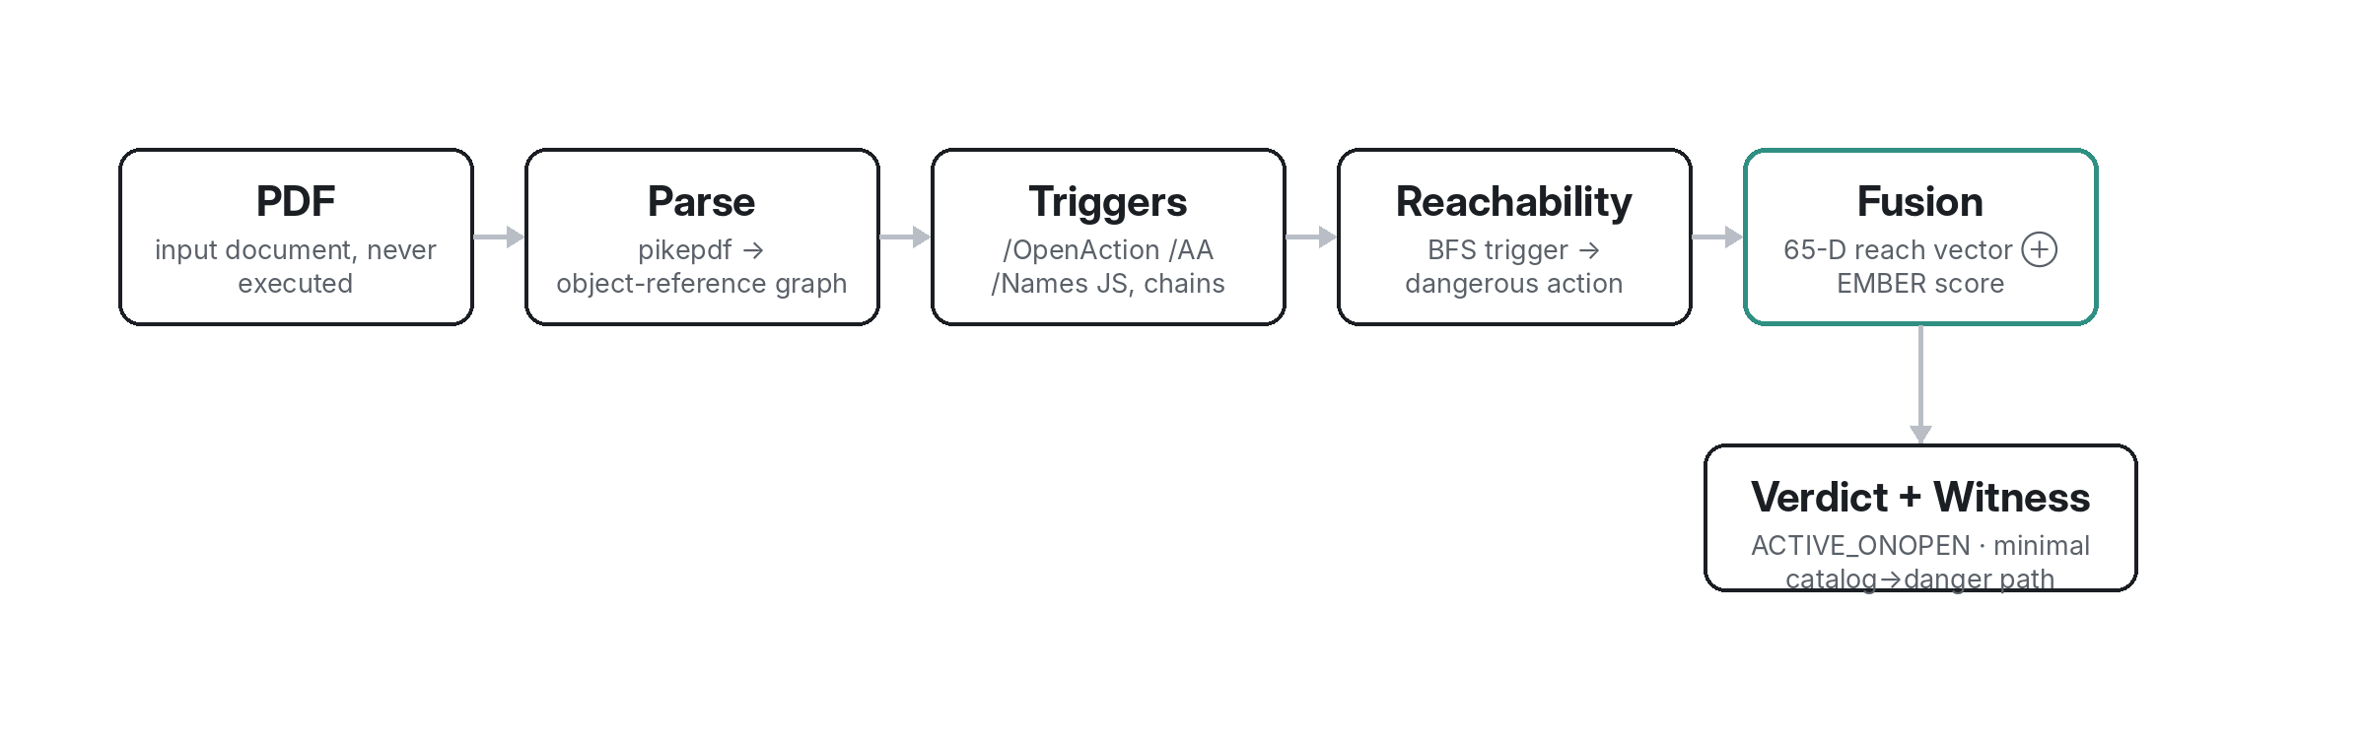
PDFSENTRY
REVIEW 3 · FINAL
METHODOLOGY
Final methodology
The PDFSentry pipeline — static throughout; the fusion node combines structural reachability with the EMBER score into a typed, witnessed verdict.
PDFSentry · Reachability over Recognition
03

Slide 4
PDFSENTRY
REVIEW 3 · FINAL
TAXONOMY
Reachability verdict taxonomy
01
ABSENT No dangerous capability present in the document at all.
CAPABILITY ≠ INTENT
The four states are what let PDFSentry separate a benign clickable link from a weaponised auto-run payload — and report exactly which it found.
02
PRESENT_DORMANT A dangerous capability exists but no trigger can reach it — inert.
03
ACTIVE_ONINTERACT Reachable only on user interaction (e.g. a clickable link) — a capability, not an auto-threat.
04
ACTIVE_ONOPEN A dangerous action auto-fires on open — the threat class we are built to catch.
PDFSentry · Reachability over Recognition
04

Slide 5
PDFSENTRY
REVIEW 3 · FINAL
RESULTS OVERVIEW
Three pillars of the result
01
01 · Detection Reachability over recognition — fusion lifts controlled ROC-AUC 0.649 → 0.998.
THE ARC
Not one metric, but a complete argument: it works, it holds under attack, and you can verify it by hand.
02
02 · Robustness Semantic stability — verdict invariant to lossless obfuscation (SSI 1.000 vs 0.216).
03
03 · Assurance Verifiable verdicts — 0/285 false positives, 1-hop witnesses, deterministic, training-free.
PDFSentry · Reachability over Recognition
05

Slide 6
PDFSENTRY
REVIEW 3 · FINAL
DETECTION
Pillar 01 · Detection
On controlled structural evasions, EMBER alone is near-blind; adding reachability makes it near-perfect.
+0.349
ROC-AUC from the structural signal
100%
reachability recall on reachable threats
0
false positives on 285 benign
PDFSentry · Reachability over Recognition
06

Slide 7
PDFSENTRY
REVIEW 3 · FINAL
ROBUSTNESS
Pillar 02 · Robustness
Same malicious behaviour, eight lossless re-saves. EMBER’s score swings across the scale; reachability never moves.
78.4%
of docs get BOTH EMBER verdicts
1.000
reachability stability index
0.216
EMBER stability index
PDFSentry · Reachability over Recognition
07

Slide 8
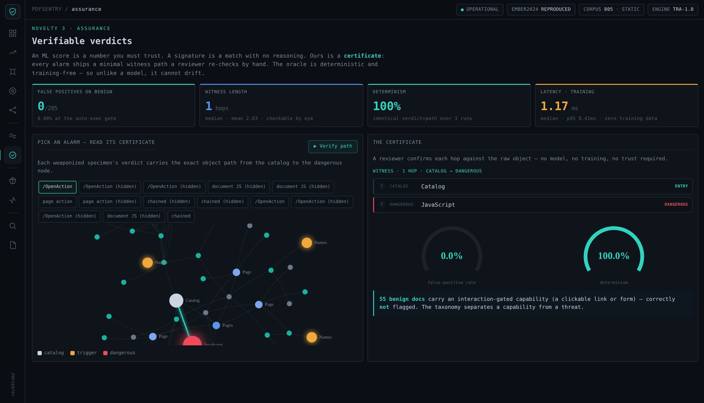
PDFSENTRY
REVIEW 3 · FINAL
ASSURANCE
Pillar 03 · Assurance
Certificate Every alarm ships a minimal witness: catalog → trigger → dangerous node.
0 / 285 false positives on the benign corpus (auto-exec gate).
Deterministic identical verdict + path over repeated runs; no training data.
Fast ~1.2 ms median per document — gateway-deployable.
PDFSentry · Reachability over Recognition
08

Slide 9
PDFSENTRY
REVIEW 3 · FINAL
CHARACTERISTICS
Malware characteristics
What evasive PDFs do to survive: automate, conceal, and camouflage as ordinary compression.
Auto-execution A dangerous action (JavaScript, Launch, EmbeddedFile) wired to fire on open via /OpenAction, /AA or /Names.
Concealment The payload hidden inside a compressed object stream — present in behaviour, invisible to a token count.
Byte camouflage Elevated /FlateDecode and entropy make the file read as “just compressed” to a statistical model.
Indirection Action chains (GoTo → Next) reach the payload at depth, defeating shallow pattern checks.
entropy > 7.9
naive = 0
depth
byte camouflage
hidden auto-run payload
chained indirection
PDFSentry · Reachability over Recognition
09

Slide 10

PDFSENTRY
REVIEW 3 · FINAL
IOCs
Indicators of Compromise (IoCs)
Structural, checkable indicators — each maps to a reachability feature, not a fragile byte signature.
Reachable auto-trigger /OpenAction | /AA | /Names/JavaScript with a path to /JS, /Launch or /EmbeddedFile → ACTIVE_ONOPEN.
Hidden-gap signature An ACTIVE capability whose naive token count is 0 — a contradiction only concealment produces.
Object-stream hiding JavaScript wrapped in an ObjStm; /FlateDecode count far above the benign median (≈ 12 vs 7).
Statistical tells Byte entropy > 7.9 and file size well above benign, with a JS token count of 0.
Deep action chains GoTo → Next sequences terminating at a dangerous node.
PDFSentry · Reachability over Recognition
10

Slide 11
PDFSENTRY
REVIEW 3 · FINAL
COMPARISON
Comparison / results
PDFSentry against the byte-ML baseline and a classic structural-path detector.
Property | EMBER2024 | Hidost | PDFSentry
Reads what the file DOES | No (bytes/strings) | Partial (static paths) | Yes (reachability)
Explainable verdict | Post-hoc SHAP | No | Witness path
Obfuscation-invariant | No — SSI 0.22 | Not reported | Yes — SSI 1.00
Cost to evade | Free re-save | Low–medium | Must disarm payload
Training data needed | Yes | Yes | No (deterministic)
Honest scope: the 0.78 EMBER benchmark is NOT improved (no raw evasive files to retrain). The 0.998 is a controlled result that isolates the mechanism.
PDFSentry · Reachability over Recognition
11

Slide 12
PDFSENTRY
REVIEW 3 · FINAL
LIMITATIONS
Honest scope & limitations
Stated plainly so the contribution is credible: what is proven, and what is projected.
Benchmark not beaten We did NOT raise EMBER’s 0.78 evasive score — retraining needs raw evasive PDFs we could not obtain.
Controlled mechanism The 0.998 fusion is on controlled weaponized twins; it isolates the signal, it is not a benchmark claim.
Capability ≠ intent Reachability flags a reachable dangerous capability; a benign PDF that genuinely auto-runs JS would be flagged too.
Static only No dynamic cross-validation — by design, for safety and reproducibility.
PDFSentry · Reachability over Recognition
12

Slide 13
PDFSENTRY
REVIEW 3 · FINAL
CONCLUSION
Conclusion & future work
New idea, built Reachability over recognition — a static detector that reads what a PDF will do, not just what it contains.
Three results Detection (0.649→0.998 controlled), Robustness (SSI 1.000 vs 0.216), Assurance (0/285 FP, verifiable).
Next · raw evasive Retrain a reachability-augmented model on raw evasive PDFs to test the 0.78 benchmark directly.
Next · deploy ~1.2 ms/file makes an email / browser gateway pre-filter realistic; extend to Office OOXML.
0.998
1.000
0 / 285
detection (controlled ROC-AUC)
robustness (stability index)
assurance (false positives)
PDFSentry · Reachability over Recognition
13

Slide 14
PDFSENTRY
REVIEW 3 · FINAL
PROJECT DEMONSTRATION
Detection. Robustness. Assurance.
Live dashboard — 11 interactive views, every number traceable.
GitHub — full code, scripts, tests and stored artifacts.
Static throughout — nothing is ever executed.
Repository github.com/heyalokx/PDFSentry
Live dashboard published interactive dashboard (link in repo README)

