Slide 1

Presentation Sequence:
a. Introduction and brief overview
b. Dashboard demonstration
c. Identifying the most influential columns in the dataset (650k):
Location & price
Distribution
Characteristics of average houses above 650k
d. Challenge and process:
Challenge while Building machine learning models
Process: Cleaning the data, using Tableau for categorical and numerical analysis
2. Identifying the most influential columns
3. Some interesting findings
4. Machine learning results
5. Conclusion

Slide 2
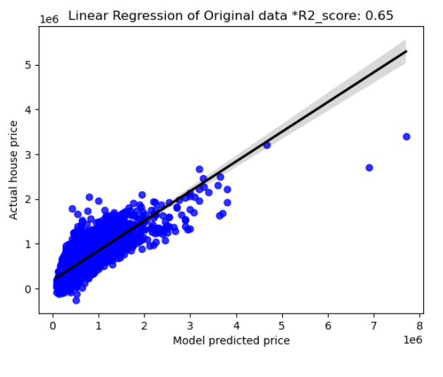
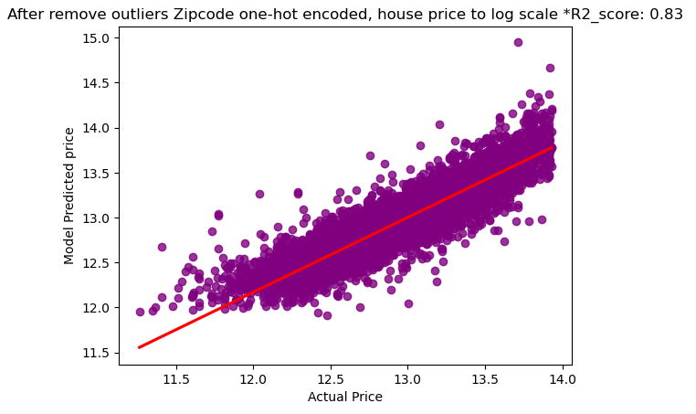
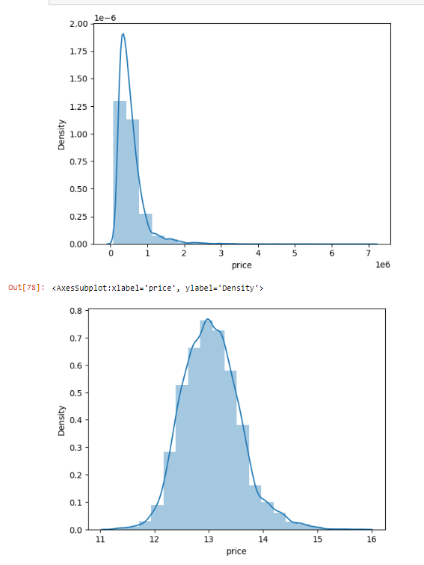
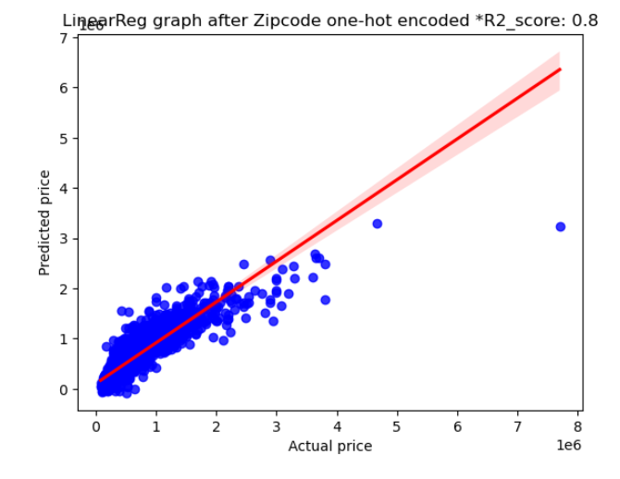
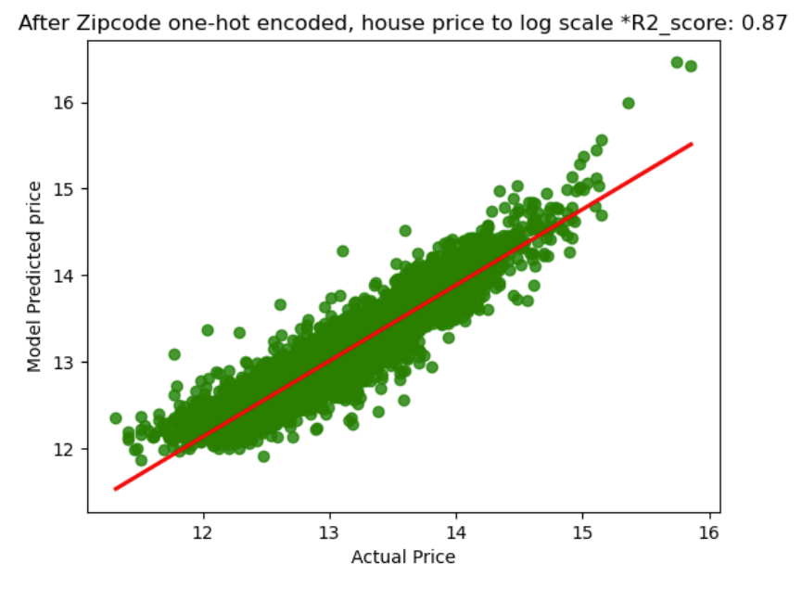

Slide 3
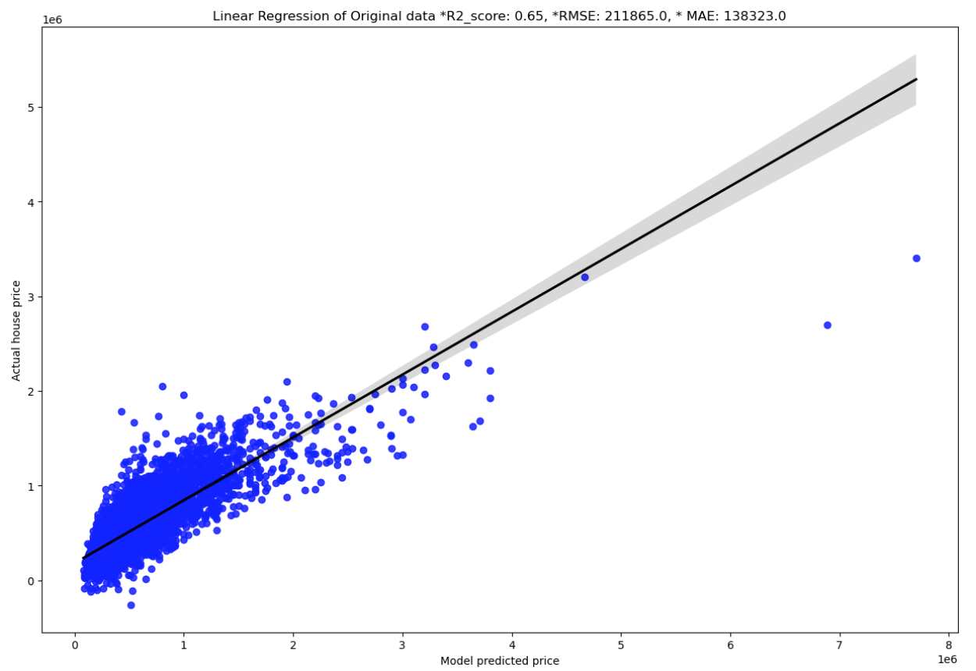
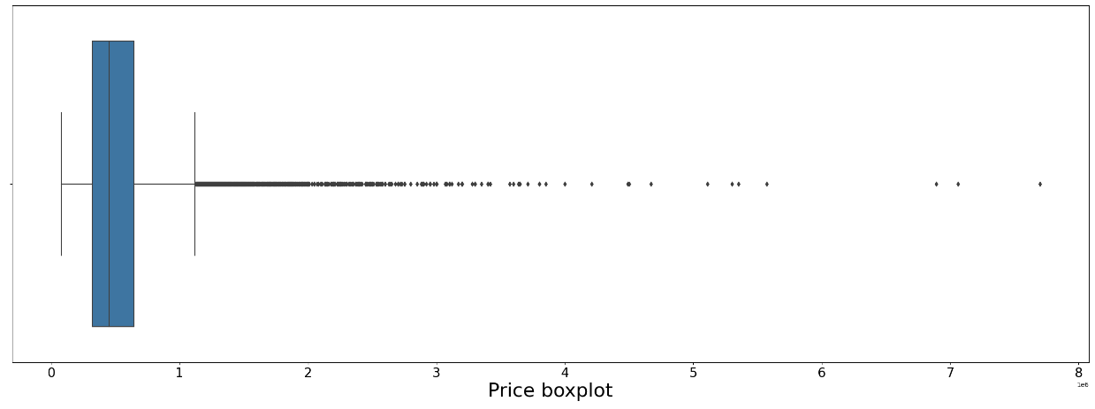
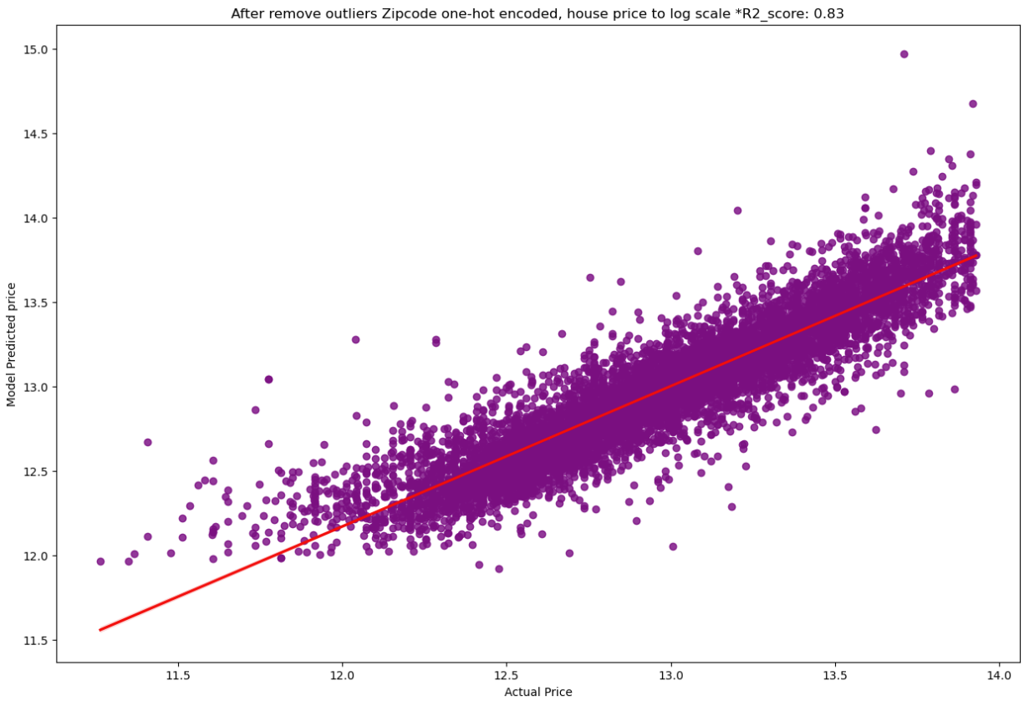
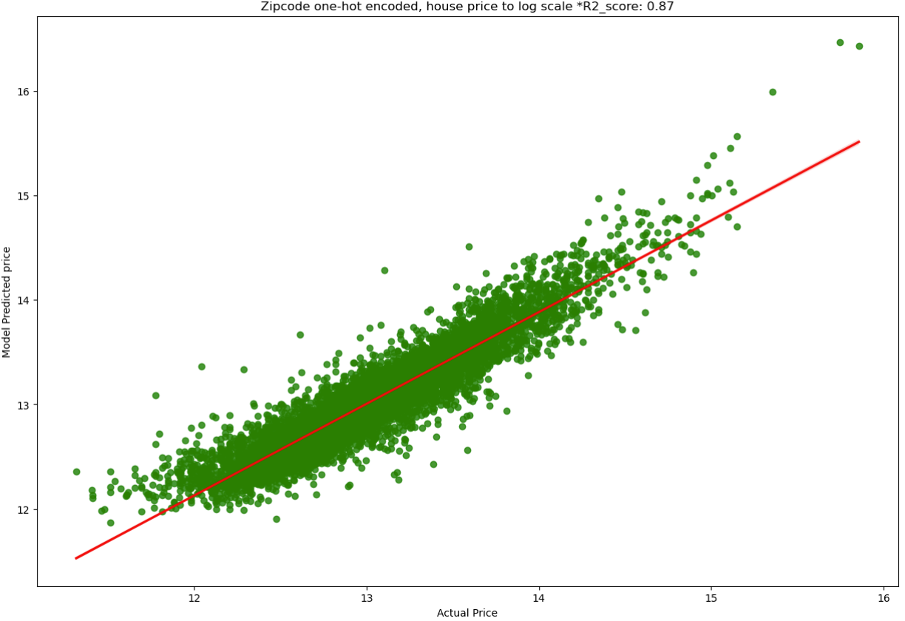
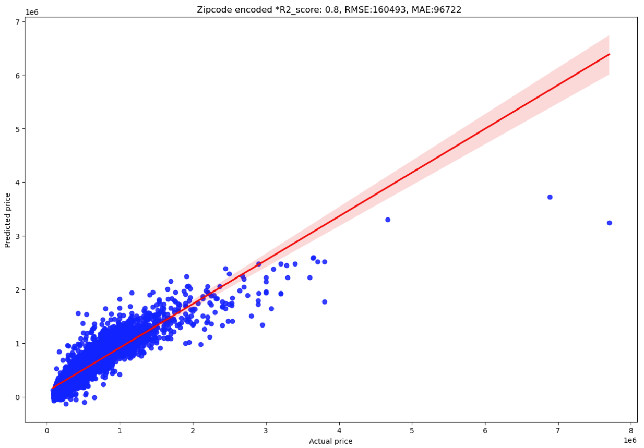

Slide 4
