Slide 1
Launch Plan
Prepared for the board
Notes:
Welcome everyone.

Slide 2
Timeline
Phase 1: Research & design
Milestone
Week | Goal
1 | Kickoff

Slide 3
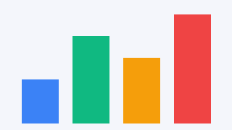
Results chart

