Slide 1
Re-tasking Wireless Sensor Networks
Michael Ruffing
ECE Master’s Project

Slide 2
Project Goals
Investigate and analyze Deluge architecture and framework
Design and implement architecture/framework for a selective re-tasking
Design and implement GUI for monitoring and re-tasking network

Slide 3
History (previous development)
Versioning project with Chris Thames using Deluge (Sensor Networks Fall 2010)
Problems with TinyOS 2.1.1
Very simple approach

Slide 4
TinyOS Overview
An event driven operating system designed for low-power wireless devices, specifically sensor networks
Language - nesC
Supports many platforms
Open source and actively developed (academia and industry)
Community working groups for documenting and defining new TinyOS standards (TEPs)
Notes:
nesC – extension of the C programming language (modules, configurations, interfaces, wiring)

Slide 5
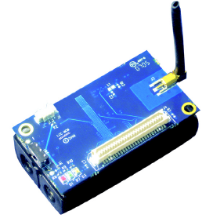
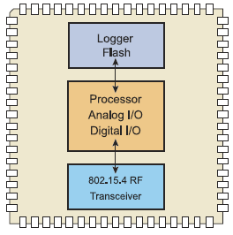
Iris Mote Overview
Hardware Specs
Radio Module – 2.4 Ghz IEEE 802.15.4
ATmega 1281 Microcontroller
Internal Flash Memory -128K bytes
8-bit RISC CPU
Flash Module – 512K Bytes
Operating System
TinyOS 2.1.2 (August 20, 2012)

Slide 6
Deluge – Timeline
“An efficient protocol for disseminating large data objects, such as program binaries, to many nodes within a wireless sensor network (Hui 2)”
Timeline
Paper– Adam Chilipala, Jonathan W. Hui, and Gilman Tolle (Fall 2003, Berkeley)
Beta Release (April 2004)
Initial release (Aug 2004)
Deluge 2.0 Beta (May 2005)
Deluge 2.0 Release (Jul 2005)
Current Version Deluge T2 (ported Deluge 2.0 to TinyOS 2.X)
Notes:
Hui, Jonathan. Deluge 2.0 – TinyOS Network Programming. July 28, 2005.

Slide 7
Deluge Overview
nesC reusable component for distributing program binaries
Allows up to four images to be distributed and installed on neighboring motes
Controlled, queried, and commanded using the tos-deluge python script (via serial communication)

Slide 8
Deluge Mote Configurations
Clients configured with the DelugeC component
Deluge Base station mote
Compiled as a DELUGE_BASESTATION
Responsible for forwarding serial messages (received from tos-deluge (python) to the neighboring sensor network (via Dissemination)

Slide 9
TOS-Deluge
TOS-Deluge (Python Script)
Injecting and erasing TinyOS applications within the Base station mote (4 slots external flash)
Initiating the dissemination and reprogram of nodes (network-wide)
Notes:
How does a user initiate a reprogram of the network? tos-deluge

Slide 10
Dissemination
Purpose: Reliably deliver a piece of data to every node (base station to motes)
TEP Standard 118
Drip implementation
Trickle timers
The process to push Deluge commands to the motes
Base station initiates (updates)Deluge command
Motes receive Deluge command value changed events
Notes:
TinyOS Enhancement Proposals (TEP)

Slide 11
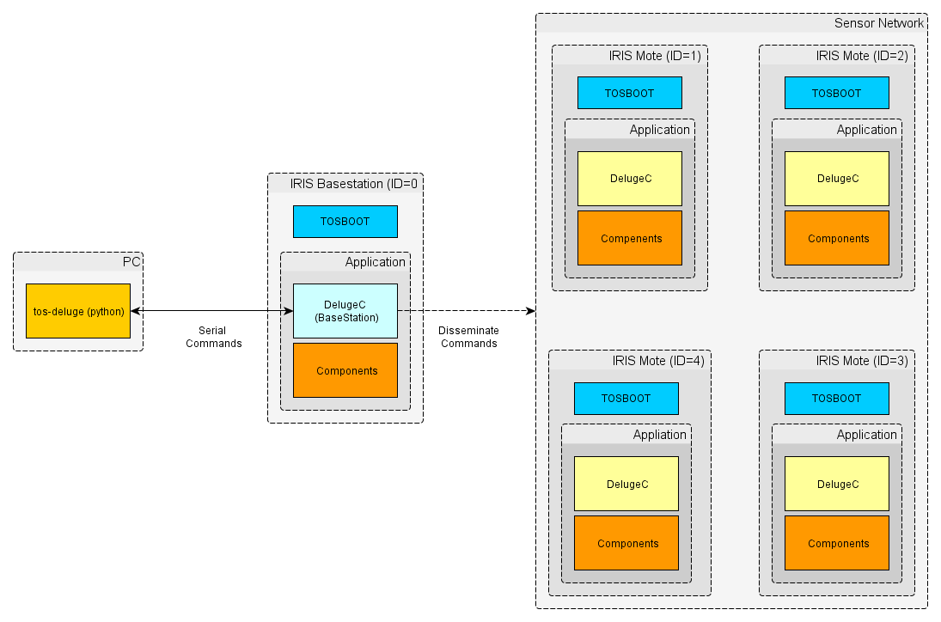
Deluge Overview

Slide 12
Deluge Architecture
TOSBoot Bootloader
High Level Components:
Dissemination
ObjectTransfer
NetProg
DelugeManager
DelugeMetadata
Notes:
Bootloader – TOSBOOT
DelugeC

Slide 13
Deluge Architecture: TOSBoot
Deluge bootloader responsible for the following:
Reading and writing program binaries between internal and external flash
Starting the application
Rollback gesture recognition for loading GoldenImage
Notes:
GoldenImage – regarding as a safe/reliable application

Slide 14
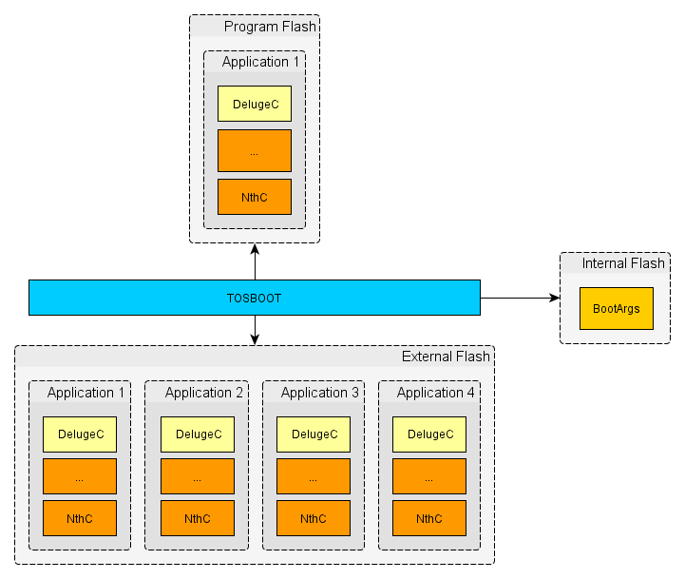
Deluge-TOSBoot Memory Model

Slide 15
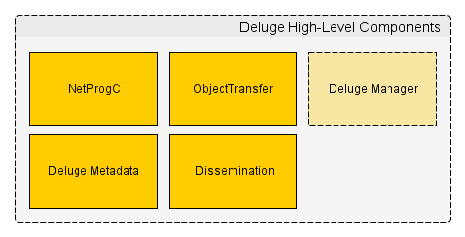
Deluge Architecture: High-Level Components
Notes:
Left out all flash/storage components for simplicity

Slide 16
DelugeC (Top Level)
Listens for Deluge command events (via dissemination)
States
IDLE
PUBLISHING
RECEIVING

Slide 17
Dissemination Component
Component used to update/receive Deluge commands
Base station: updates deluge command value
Clients: receive deluge command changed events

Slide 18
ObjectTransfer Component
ActiveMessage (AM) based service for sending/receiving program binaries
Each mote runs the ObjectTransfer service
IDLE
PUB – service is configured to send image to another mote
RECV – service is configured to receive image from another mote
Notes:
Motes share information – determine who needs an updated image
Images delivered in “Pages”

Slide 19
DelugeMetadata Component
Reads external flash for information regarding the stored images
Application Name
Unique ID
Timestamp
Size
Number of Pages
CRC (Validity)
Notes:
Used to determine if image already exists on mote

Slide 20
NetProg Component
Module to reprogram and reboot mote (specific to platforms i.e. IRIS)
Writes to internal flash to initiate reprogram (BootArgs)
Image Address (External Flash)
TOS_NODE_ID
DELUGE_GROUP_ID
Forces a hardware reset
Notes:
TOSBOOT reads from internal flash and writes the image from external flash to program flash

Slide 21
DelugeManager Component
Only available to motes that are compiled with the DELUGE_BASESTATION flag
Receives commands (serial) from TOS-deluge (python) and generates Deluge commands for network-wide dissemination

Slide 22
Current Deluge Limitations
Re-tasking is limited only to network-wide dissemination of program binaries.
Every mote stores and runs the same images
Feedback from the sensor network is limited to the motes’ LEDs

Slide 23
What did I add to Deluge to achieve the project goals?
Selective re-tasking (preserving current functionality)
Feedback from the sensor network (Collection)

Slide 24
Selective Re-tasking
Disseminate and reprogram specific motes based on TOS_NODE_ID
Disseminate and reprogram a group of motes based on DELUGE_GROUP_ID
Notes:
Backwards compatible

Slide 25
Re-tasking specific motes
Added node id hash to the Deluge command
Currently node id hash supports up to 32 devices
Each bit represents a node id. If the bit is set then that mote is signaled to be re-tasked
Motes check node id hash before executing command

Slide 26
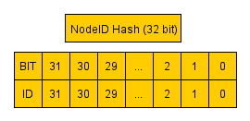
Node ID Hash Examples
Node IDs Set | Node ID Hash (32-Bit)
1,2,3,4,5 | 62
29,7,18 | 537133184
10 | 1024
31 | 2147483648

Slide 27
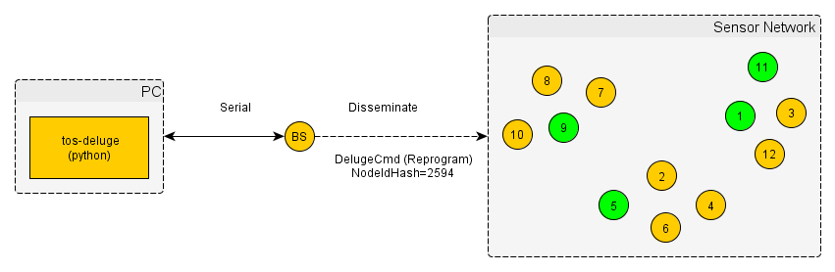
Re-tasking specific motes example

Slide 28
Re-tasking group of motes
Added the DELUGE_GROUP_ID preprocessor variable to Deluge
Added groupID variable to the Deluge command
Motes check groupID (originally compiled into image) before executing command
Notes:
DELUGE_GROUP_ID set using makefile flag (same process as TOS_NODE_ID)

Slide 29
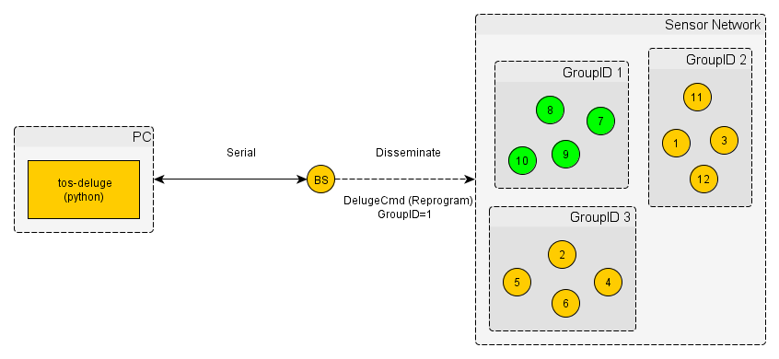
Grouping Sensors (via groupID)

Slide 30
Updating Groups
Added deluge command to update mote groups
Node id hash defines the motes to update and groupID specifies the new group

Slide 31
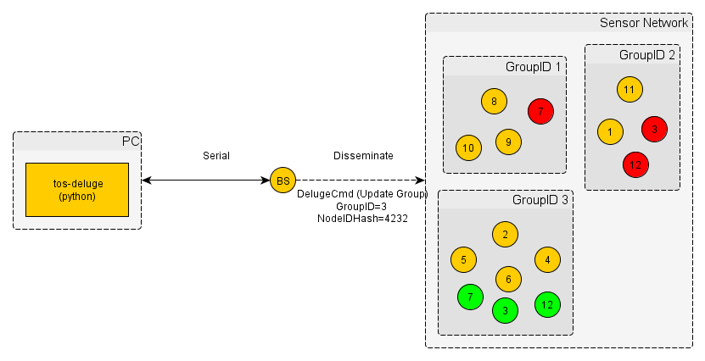
Update Group with new Motes

Slide 32
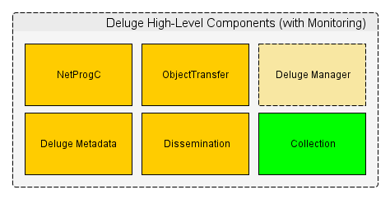
Deluge High-Level Components with Collection

Slide 33
Deluge Collection
Purpose: Gather information about the sensor network (motes to base station)
TEP Standard 119
Based on trees using a link estimator algorithm for building efficient/reliable routes between nodes and base station
Best-effort, multihop delivery of packets to the root of a tree
Notes:
TinyOS Enhancement Proposals (TEP)
Reverse of dissemination

Slide 34
Collection Message: NodeStatus
Fields
Node ID
Group ID
State
Current Running Application
Unique ID
Name
Time Stamp
Limited to 20 bytes per payload
Notes:
20 byte limit for collection payloads (took a while to figure this out)

Slide 35
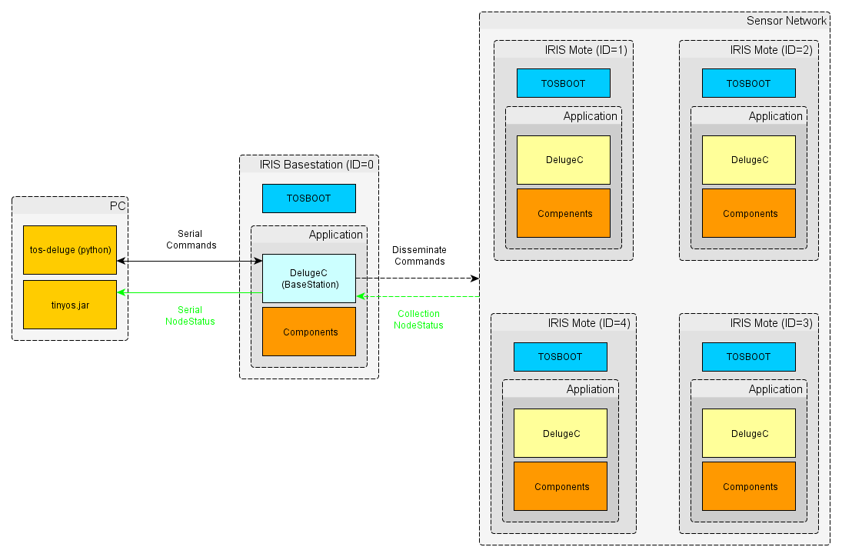
Deluge Overview with Monitoring

Slide 36
Deluge Code Size
Original Deluge (2.1.2)
Application | ROM (Bytes) | RAM (Bytes)
Blink (Deluge) | 26074 | 945
Base station (Deluge) | 32544 | 1300
Deluge w/o Collection (Monitoring)
Application | ROM (Bytes) | RAM (Bytes) | ROM Δ | RAM Δ
Blink (Deluge) | 26666 | 957 | +2.3% | +1.3%
Base station (Deluge) | 32840 | 1315 | +1.0% | +1.2%
Deluge with Collection (Monitoring)
Application | ROM (Bytes) | RAM (Bytes) | ROM Δ | RAM Δ
Blink (Deluge) | 33294 | 2127 | + 28% | 125%
Base station (Deluge) | 39614 | 2463 | + 22% | 89%

Slide 37
Deluge Visualizer
Purpose:
TOS-Deluge Frontend for issuing commands
Status window for displaying tos-deluge output
Dynamic table displaying information and state about the sensor devices
Cross platform: JAVA
Built using the TinyOS JAVA SDK and MIG tool
Notes:
MIG - used to auto-generate language specific serialization code
TinyOS SDK also includes C, C++, JAVA, and PYTHON

Slide 38
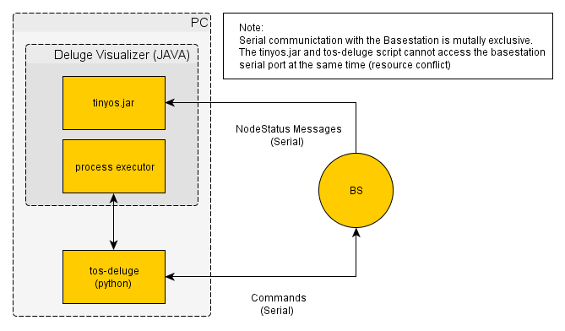
Deluge Visualizer Components

Slide 39
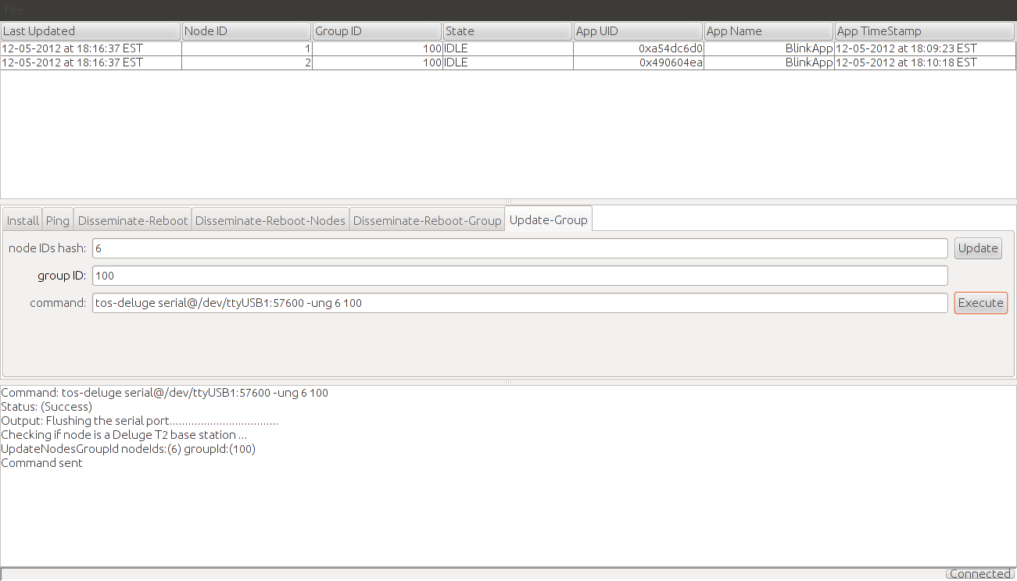
Deluge Visualizer Application
Notes:
3 sections – dynamic node status table, tos-deluge gui frontend, and status window

Slide 40
Development Tools/Process
Source Control: Mercurial
Wiki: Chiliproject
Ubuntu 12.04
Windows 7 running Ubuntu 12.04 VM (via VirtualBox)

Slide 41
IRIS Mote Debugging
PrintF
TOSSIM (python jig)
LEDS

Slide 42
Conclusion
Successfully completed project goals
Maintained current network-wide re-tasking features
Implemented selective re-tasking
Implemented monitoring framework and application

Slide 43
Future Work
Improve memory (ROM/RAM) footprint
Remove dependency on tos-deluge
Add support for Android TinyOS SDK

Slide 44
References
TinyOS Wiki: http://docs.tinyos.net/tinywiki/index.php/Main_Page
TEPs: http://docs.tinyos.net/tinywiki/index.php/TEPs
Deluge Documentation: http://www.cs.berkeley.edu/~jwhui/deluge/documentation.html
Notes:
TinyOS Enhancement Proposals (TEP

Slide 45
Live Demonstration

