Slide 1
Error Detection and Correction Scheme
Yuheng, Jiannan, Yang
Sep. 18th 2013

Slide 2
Motivation for error detection/correction
RAM memory contents can change due to electrical magnetic interference
Notes:
A network programming is a term to describe the technology that program the wireless sensor nodes without physically connect to each node.
Why do we use network programming?

Slide 3
Cyclic Redundancy Check
A technique for detecting error bits in digital storage medium
In write, add a certain number of check bits.
Store extra checksum bits for each data block.
Data block’s length is variant and customized by programmer
Divide the data you get by a Checking equation, check whether the remainder is 0
Notes:
Consider the case when we spend a lot of time and complete a deployment of
Tens of thousands of code.
After running the application for some time, we get sensor data readings, and we
Know the specific characters of a certain deplyment.
Know the network characteristics, the sensing environment.after deloyment
We want to change the program to adapt to the environment.
Adaptive reprogram which aware of the sensing environment.
An interaction.

Slide 4
Cyclic Redundancy Check
A technique for detecting error bits in digital storage medium
In write, add a certain number of check bits.
Division remainder is not 0 means data corruption
Reread
Report to software
Notes:
Consider the case when we spend a lot of time and complete a deployment of
Tens of thousands of code.
After running the application for some time, we get sensor data readings, and we
Know the specific characters of a certain deplyment.
Know the network characteristics, the sensing environment.after deloyment
We want to change the program to adapt to the environment.
Adaptive reprogram which aware of the sensing environment.
An interaction.

Slide 5
Cyclic Redundancy Check
Polynomial arithmetic
Transfer data bits to polynomial
1110 0110 is X⁷+ X⁶ + X⁵ + X² + X
Notes:
Consider the case when we spend a lot of time and complete a deployment of
Tens of thousands of code.
After running the application for some time, we get sensor data readings, and we
Know the specific characters of a certain deplyment.
Know the network characteristics, the sensing environment.after deloyment
We want to change the program to adapt to the environment.
Adaptive reprogram which aware of the sensing environment.
An interaction.

Slide 6
Cyclic Redundancy Check
Treat message as Polynomial
1110 0110 : M bits of data
R bit CRC
Given R degree polynomial G(X), do modulo-2 binary divide.
Original code word divides G, get remainder Q
Original code + Remainder code = CRC code
Notes:
Consider the case when we spend a lot of time and complete a deployment of
Tens of thousands of code.
After running the application for some time, we get sensor data readings, and we
Know the specific characters of a certain deplyment.
Know the network characteristics, the sensing environment.after deloyment
We want to change the program to adapt to the environment.
Adaptive reprogram which aware of the sensing environment.
An interaction.

Slide 7
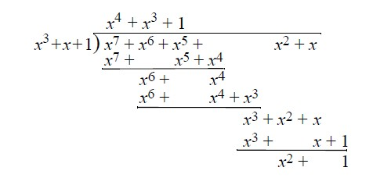
Cyclic Redundancy Check
Modula-2 division
Message 1110 0110
Generator 1010
Remainder 101
CRC code 1110 0110 101
It is easy to separate message code with parity code
Notes:
Consider the case when we spend a lot of time and complete a deployment of
Tens of thousands of code.
After running the application for some time, we get sensor data readings, and we
Know the specific characters of a certain deplyment.
Know the network characteristics, the sensing environment.after deloyment
We want to change the program to adapt to the environment.
Adaptive reprogram which aware of the sensing environment.
An interaction.

Slide 8
Cyclic Redundancy Check
Error Checking
In detecting phase, modulo-2 divide
M+Q / G == 0
No single bit error has been detected!
M+Q / G !=0
Data block has been corrupted
Notes:
Consider the case when we spend a lot of time and complete a deployment of
Tens of thousands of code.
After running the application for some time, we get sensor data readings, and we
Know the specific characters of a certain deplyment.
Know the network characteristics, the sensing environment.after deloyment
We want to change the program to adapt to the environment.
Adaptive reprogram which aware of the sensing environment.
An interaction.

Slide 9
Cyclic Redundancy Check
International standardized CRC code
CRC-12
X12 + X11 + X3+ X2 +X1 +1
CRC-16
X16+X15+X2+1
CRC-CCIT
X16+X12+X5+1
CRC-32
X32+X28+X27+…+X8+X6+1
Notes:
Consider the case when we spend a lot of time and complete a deployment of
Tens of thousands of code.
After running the application for some time, we get sensor data readings, and we
Know the specific characters of a certain deplyment.
Know the network characteristics, the sensing environment.after deloyment
We want to change the program to adapt to the environment.
Adaptive reprogram which aware of the sensing environment.
An interaction.

Slide 10
Cyclic Redundancy Check
CRC algorithm
Bit by bit
Low efficiency, consumes more time
Byte by byte look up table
CRC code of current byte = CRC of previous byte << 8 + CRC of sum(Current byte, CRC of previous byte>> 8 )
Notes:
Consider the case when we spend a lot of time and complete a deployment of
Tens of thousands of code.
After running the application for some time, we get sensor data readings, and we
Know the specific characters of a certain deplyment.
Know the network characteristics, the sensing environment.after deloyment
We want to change the program to adapt to the environment.
Adaptive reprogram which aware of the sensing environment.
An interaction.

Slide 11
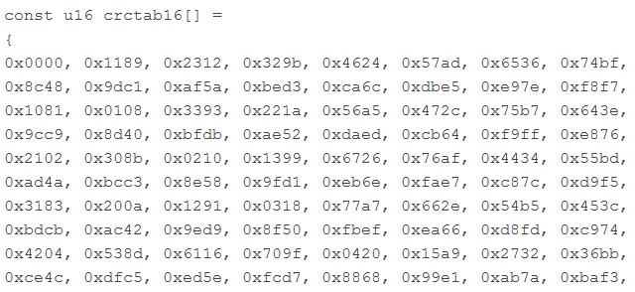
Cyclic Redundancy Check
CRC16 (CRC-ITU) Look up table
2 bytes * 256 = 512 bytes table size
Notes:
Consider the case when we spend a lot of time and complete a deployment of
Tens of thousands of code.
After running the application for some time, we get sensor data readings, and we
Know the specific characters of a certain deplyment.
Know the network characteristics, the sensing environment.after deloyment
We want to change the program to adapt to the environment.
Adaptive reprogram which aware of the sensing environment.
An interaction.

Slide 12
Cyclic Redundancy Check
CRC32 algorithm comparision
Data bytes | Bit by bit CRC 32 |  | Look up table CRC 32
 | Time us | Processor cycles | Time us | Processor cycles
10 | 319.58 | 3835 | 48.58 | 583
20 | 517.92 | 6215 | 76.08 | 913
80 | 1582.92 | 18995 | 241.08 | 2893
150 | 2957.08 | 35485 | 433.58 | 5203
250 | 4872.92 | 58475 | 708.58 | 8503
4 bytes * 256 = 1K table size
Simulation from Atmega128, 12Mhz clock rates
Notes:
Consider the case when we spend a lot of time and complete a deployment of
Tens of thousands of code.
After running the application for some time, we get sensor data readings, and we
Know the specific characters of a certain deplyment.
Know the network characteristics, the sensing environment.after deloyment
We want to change the program to adapt to the environment.
Adaptive reprogram which aware of the sensing environment.
An interaction.

Slide 13
Cyclic Redundancy Check
Deficiencies
Limited capability of error detection. Failure cause M+Q to become all 0s? M+Q/G will not detect this failure!
Can only be trusted to detect single bit error
SED
Notes:
Consider the case when we spend a lot of time and complete a deployment of
Tens of thousands of code.
After running the application for some time, we get sensor data readings, and we
Know the specific characters of a certain deplyment.
Know the network characteristics, the sensing environment.after deloyment
We want to change the program to adapt to the environment.
Adaptive reprogram which aware of the sensing environment.
An interaction.

Slide 14
Hamming Code
For error correction and detection
SEC and/or DED?
Min # of parity bits (P) for SEC with D data bits?
D+P+1 <= 2^{p}
Notes:
Consider the case when we spend a lot of time and complete a deployment of
Tens of thousands of code.
After running the application for some time, we get sensor data readings, and we
Know the specific characters of a certain deplyment.
Know the network characteristics, the sensing environment.after deloyment
We want to change the program to adapt to the environment.
Adaptive reprogram which aware of the sensing environment.
An interaction.

Slide 15
Pros and Cons b/w CRC & Hamming
CRC
Fast computation time if using look up table method
Simple implementation if using bit by bit method
Hamming
SEC
Quite complicate, more overhead. (7,4) (64, 57)
Notes:
What need to be considered for this dissemination protocol
If you are the designer??

